Slide 1
SEAC PF
Tahiti FIR
ISPACG 32

Slide 2
News from SEAC PF
ADS-B
DARP
CONNECTED AIRSPACE
NEW TRANS PACIFIC SERVICES
NO FIR ISSUE

Slide 3
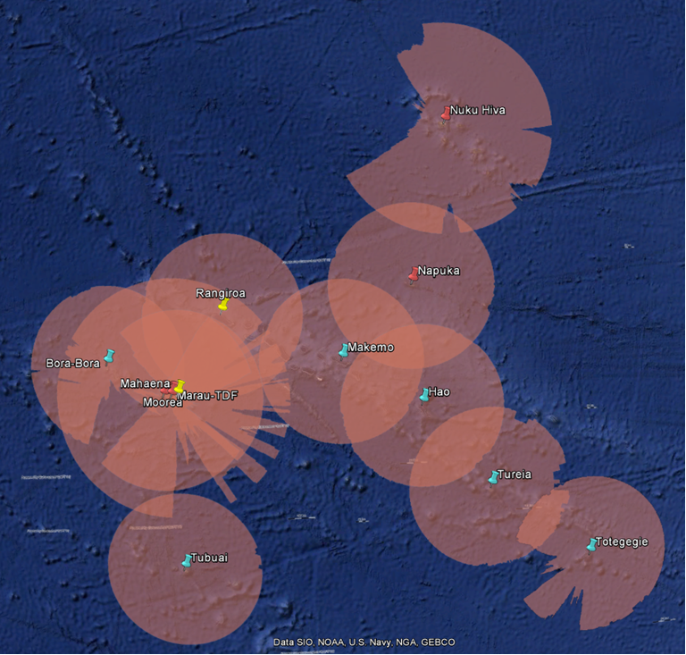
ADS-B Schedule
Oct 2017 : ADS-B stations installation 5 remote sites on phase 1
October 2018 : ADS-B data integration and validation in ATM system
November 2018 : Tier3 implementation
Phase 1

Slide 4
ADS-B Schedule : 2019 and later
July 2019 : Tier 1 implementation
Year 2019 : installation of 7 more ADS-B stations coupled with VHF extension on phase 2
End 2019 : implementation of Tier 3
Mid 2020 : Tier 1 everywhere
2024 : expected radar decommissioning

Slide 5
Tahiti FIR ADS-B regulation
ADS-B equipage mandate order published in the official journal of the French Republic in Oct 2017 :
1st January 2019: DO260 and above mandatory above FL195 – all aircraft
1st January 2022 : DO260 and above mandatory in Tahiti FIR – all aircraft – IFR- VFR – GA
Doc 7030 : no ADS-B certification = no ADS-B transmission:
Tahiti FIR asked to BKK regional office to be registered in §5.5 of PAC chapter – validated in 2017 (APANPIRG)
Integrated in the AIP PAC in December 2017

Slide 6
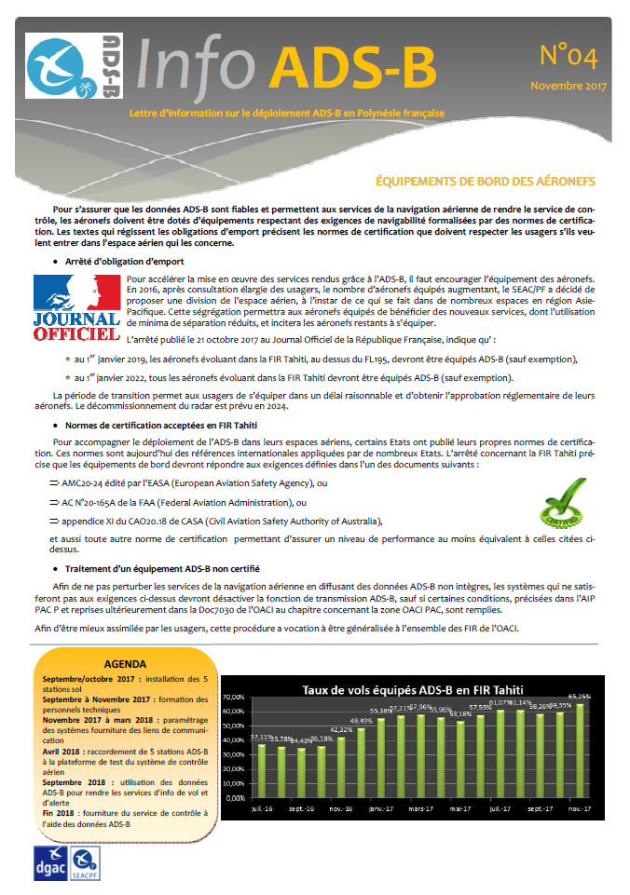
ADS- B Communication
Trimestrial newsletter in french/english
Target : airspace users
Notes:
Format A5
Sur toutes les positions

Slide 7
DARP Project
Experimental operational phase 1 from 1st of June to 31th August 2016
Malfunction identified and solved on March 2017 with a software upgrade
New experimental phase until June 2018 due to a too small sample size.
Option: expanding the sample?
Notes:
L’expérimentation étant terminée, pour chaque nouvelle demande de DARP, répondre UNABLE. Les compagnies QFA et ANZ sont informées.

Slide 8
Tahiti FIR = a connected airspace
As previously announced during ISPACG meetings, the TAHITI FIR is responding positively at the request made by major South Pacific airlines to stop "SELCAL CHECK" when entering TAHITI oceanic airspace on DATALINK environment.
Crossing FIR Boundary, TAHITI requests voice communication instructions as follows:
'MONITOR NTTT CENTER + FREQUENCY'
AND ONE CPDLC POSITION REPORT.
AIP PAC-P, PART ENR 1.8.3

Slide 9
Tahiti FIR = a connected airspace
According to AP010/18 State letter from ICAO Bangkok Office, the PBCS Implementation Strategy is clarified.
From 29 March 2018, SEAC PF in FIR TAHITI Oceanic Airspace provides reduced separations (50Nm longitudinal) for eligible aircrafts as:
1. PBCS information via AIP/AIC is edited
2. No PBCS-exclusionary airspace is implemented
3. 50Nm/50Nm existed before 10 November 2016 (in fact 03 May 2012)
4. PBCS monitoring is in place
5. The capability to apply performance base horizontal separation using PBCS designators in FPL is implemented as soon as practically possible.

Slide 10
New TRANS-PACIFIC services: seasonal or not…
QANTAS SYD/DFW, UNITED ACK/SFO(/PPT), AMERICAN AIRLINES ACK/LAX,
AIR NZ ACK/IAH and ORD
TOTAL TRANSIT | 2015 801 | 2016 1 434 | 2017 2 009

Slide 11
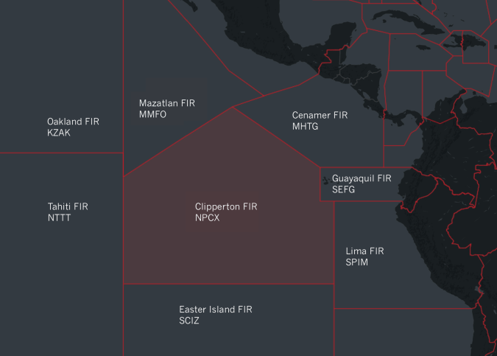
NO FIR ISSUE

