Slide 1



Agenda Item #2
NZZO Briefing
ISPACG FIT 25
Nadi, Fiji
9-10 April 2018

Slide 2
NZZO Feedback - Overview
Performance:
  Overall performance observed against both RSP180 and RCP240 specifications is acceptable.
  A small number of PR have been raised against aircraft not meeting PBCS specifications
  Availability affected by the number of outages in 2017/18.
  Work is needed to improve assessment of availability from an operational perspective
HFDL
  Concerns over poor performance when used as sole means may be mitigated by PBCS.
  HFDL does not meet RCP240/RSP180 when sole means
Iridium
  Makes up < 1% of traffic observed.
  Performance is poor and does not meet RSP180
PBCS monitoring in NZZO in 2017
  On-line analysis tool simplifies processing using less resource.
  Recommend FIT agree on standardised reporting templates for ISPACG FIT and regional use.
2
| ISPACG FIT 25 2018

Slide 3
NZZO Feedback
PBCS Implementation
  Implemented 29 March 2018.
  52% of FANS1A traffic in NZZO are indicating PBCS status. This percentage is based on an analysis of the number of ADS-C reports received, with ANZ aircraft making up 31% of this traffic. Currently, missing in action are the Australian carriers (12%), LAN (4.5%), SIA (2.5%), CPA (2%), THA (1%), and MAS (1%).
  No significant issues since cutover. Controllers
  are handling mixed mode operations well.
  Airline filing PBCS on 5 April were:
Company | Type
AAL | B789
ANZ | B772
ANZ | B77W
ANZ | B789
CES | A332
CHH | A333
DAL | B77L
HAL | A332
KAL | B772
THT | A343
UAE | A388
UAL | B789
3
| ISPACG FIT 25 2018

Slide 4
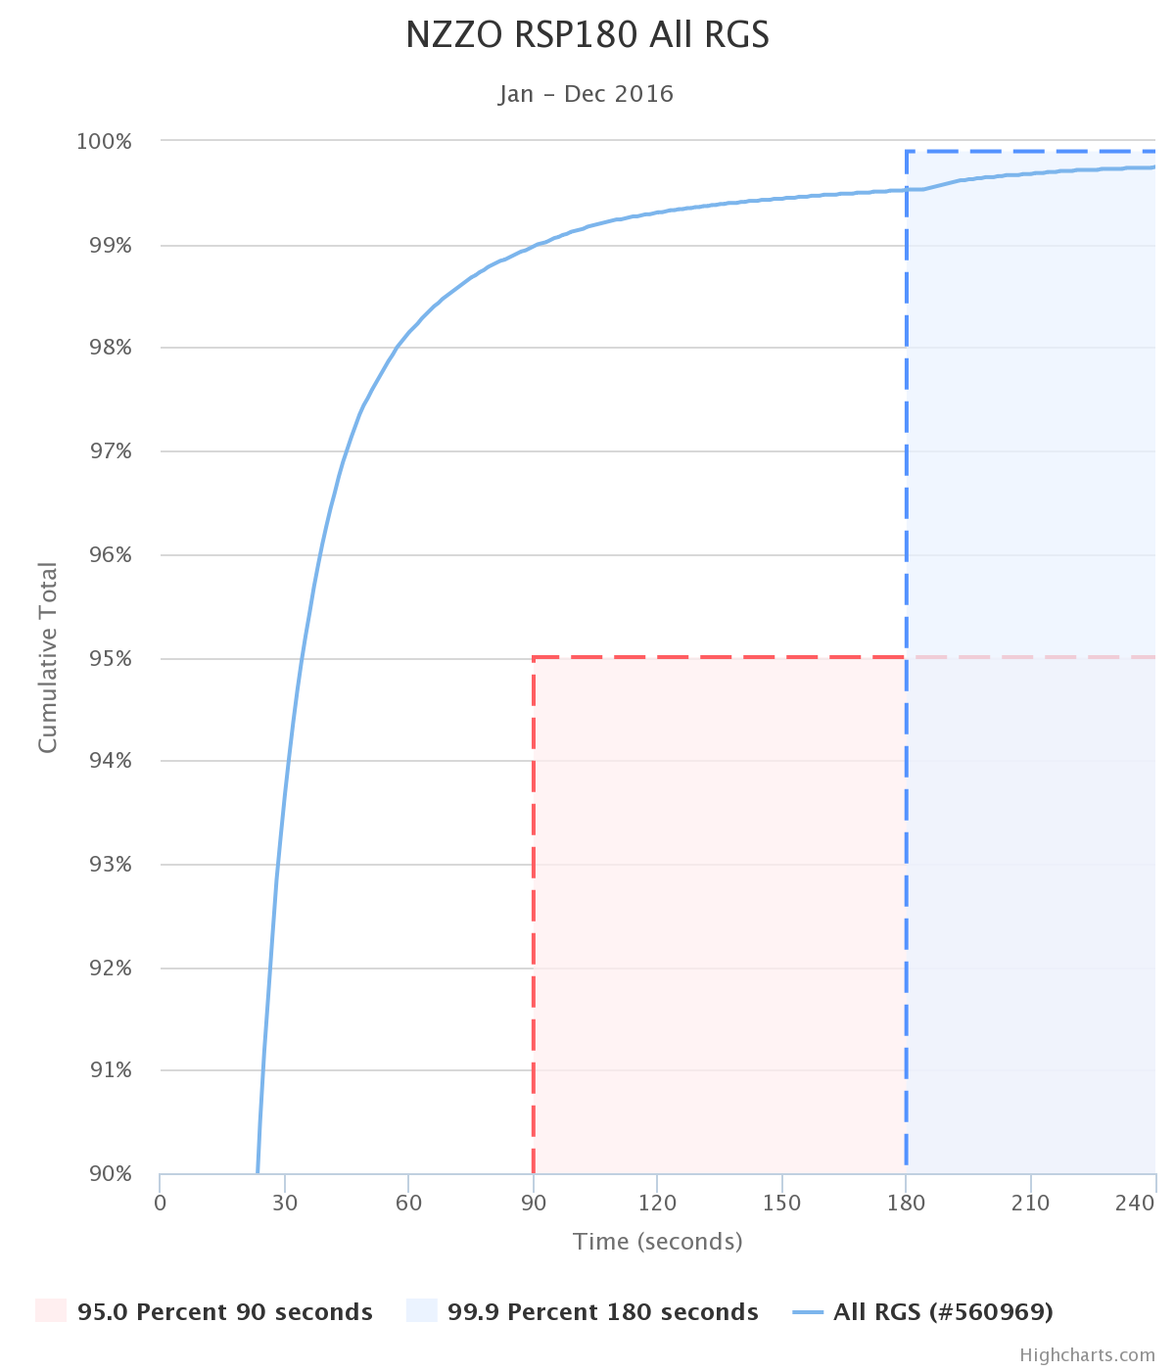
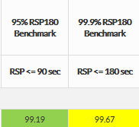
ADS-C RSP180 – All RGS 2017
No significant change observed from 2016 year.
4
| ISPACG FIT 25 2018

Slide 5
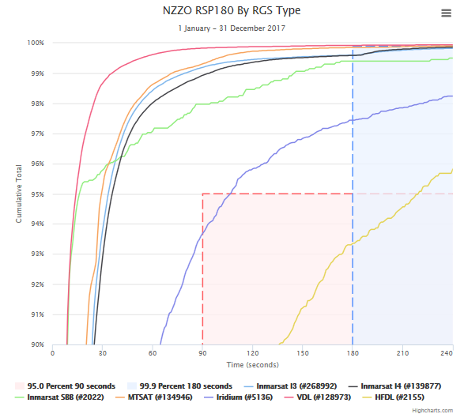
ADS-C RSP180 – By RGS Type
No significant change observed from 2016 year.
5
| ISPACG FIT 25 2018

Slide 6
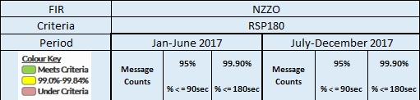
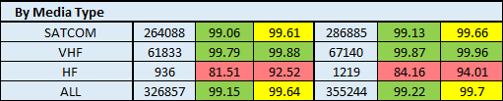
ADS-C RSP180 – By Media Type
6
| ISPACG FIT 25 2018

Slide 7
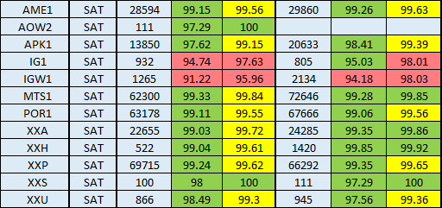
ADS-C RSP180 – By RGS/GES Satcom
7
| ISPACG FIT 25 2018

Slide 8
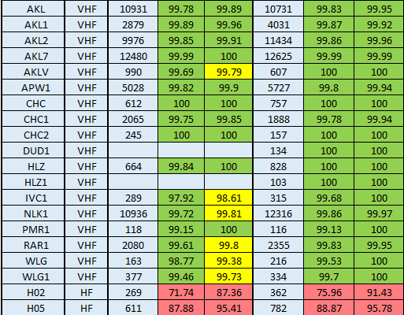
ADS-C RSP180 – By RGS/GES VDL HFDL
8
| ISPACG FIT 25 2018

Slide 9
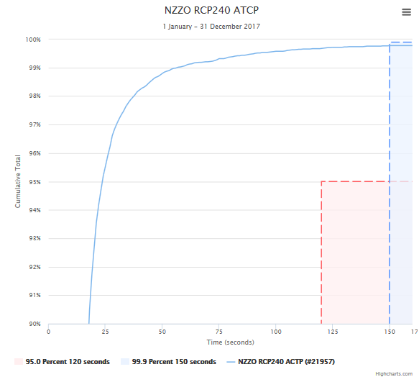
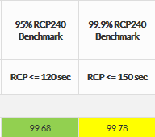
CPDLC RCP240 – Actual Communications Technical Performance (ACTP) – All RGS
No significant change observed from 2016 year.
9
| ISPACG FIT 25 2018

Slide 10
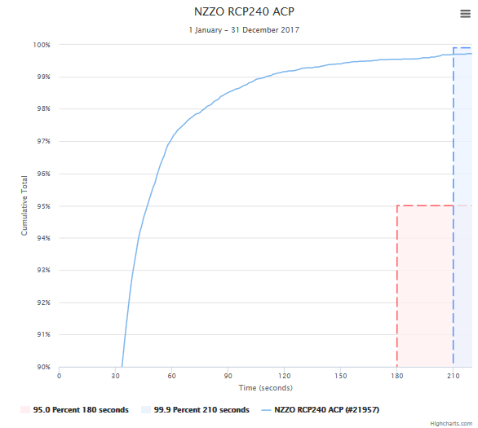
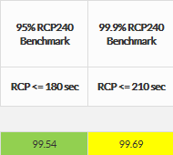
CPDLC RCP240 – Actual Communications Performance (ACP) – All RGS
No significant change observed from 2016 year.
10
| ISPACG FIT 25 2018

Slide 11
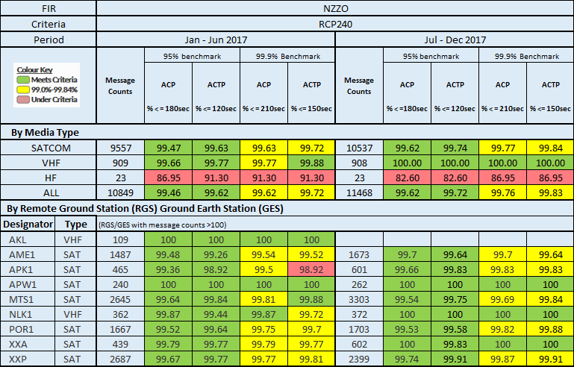
CPDLC RCP240 – Actual Communications Performance – by media type and RGS
11
| ISPACG FIT 25 2018

Slide 12
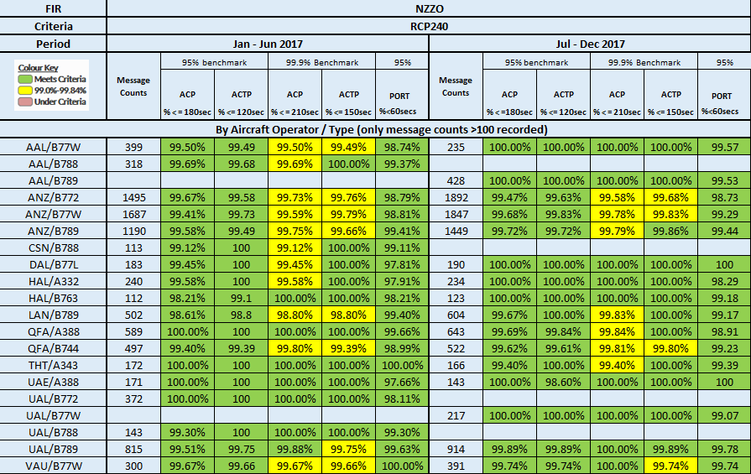
CPDLC RCP240 – Actual Communications Performance – By Operator and Type
By airline operating company and aircraft type (>100 data points) (2)
12
| ISPACG FIT 25 2018

Slide 13
Iridium Performance
13
| ISPACG FIT 25 2018

Slide 14
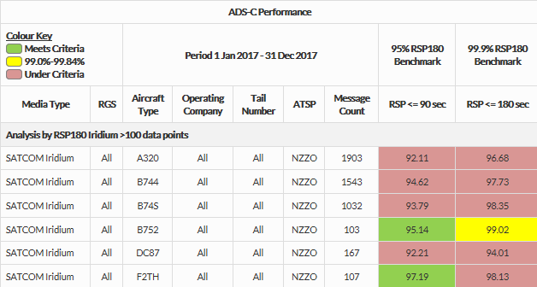
ADS-C RSP180 – Iridium Performance– All RGS
No significant change observed from 2016 year.
Still less than 1% of traffic using Iridium
14
| ISPACG FIT 25 2018

Slide 15
HFDL Performance
15
| ISPACG FIT 25 2018

Slide 16
ADS-C RSP180 – HFDL Performance– All RGS
Performance when used in “next on busy” mode does not cause significant performance deterioration.
Performance when used as primary media in event of SATCOM failure does NOT meet RSP180 performance requirements.
Dispatching with no SATCOM will not meet PBCS in oceanic
Still less than 1% of reports are using HFDL.
16
| ISPACG FIT 25 2018

Slide 17
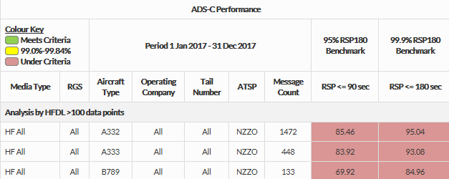
ADS-C RSP180 – HFDL Performance– All RGS
17
| ISPACG FIT 25 2018

Slide 18
ADS-C RSP180 – HFDL Performance– Operating as primary mode
A332
B77W
B748
08:32:13 | 1645 | HF
08:32:55 | 1110 | HF
08:33:15 | 555 | HF
08:33:46 | 519 | HF
08:34:17 | 97 | HF
08:34:53 | 77 | HF
09:14:16 | 1057 | HF
09:17:28 | 673 | HF
09:21:44 | 437 | HF
09:24:07 | 496 | HF
09:28:40 | 193 | HF
10:00:33 | 1530 | HF
10:02:09 | 1377 | HF
10:02:55 | 1409 | HF
10:08:33 | 1432 | HF
10:09:15 | 899 | HF
10:11:23 | 450 | HF
10:11:52 | 446 | HF
10:16:25 | 176 | HF
10:26:09 | 184 | HF
10:46:20 | 819 | HF
10:49:30 | 434 | HF
10:54:27 | 154 | HF
13:46:01 | 172 | HF
13:49:45 | 21 | HF
14:10:33 | 248 | HF
14:15:34 | 418 | HF
14:21:36 | 747 | HF
14:26:24 | 906 | HF
14:28:12 | 599 | HF
14:33:22 | 333 | HF
14:35:57 | 416 | HF
14:37:30 | 36 | HF
14:38:52 | 87 | HF
14:47:22 | 21 | HF
14:56:58 | 21 | HF
15:08:10 | 117 | HF
15:16:02 | 13 | HF
15:25:46 | 20 | HF
15:35:19 | 17 | HF
15:40:39 | 320 | HF
15:44:50 | 12 | HF
17:22:29 | 387 | HF
17:27:49 | 228 | HF
17:35:57 | 619 | HF
17:57:41 | 1346 | HF
18:01:57 | 1092 | HF
18:08:21 | 1411 | HF
18:11:01 | 1124 | HF
18:25:22 | 1469 | HF
18:48:33 | 557 | HF
18:55:26 | 521 | HF
18:57:35 | 522 | HF
19:02:27 | 238 | HF
19:13:35 | 331 | HF
19:20:33 | 173 | HF
19:37:59 | 643 | HF
19:44:01 | 687 | HF
20:14:10 | 1691 | HF
20:15:46 | 1468 | HF
18
| ISPACG FIT 25 2018

Slide 19

Thank you

