Slide 1


IP #12
FANS1/A PBCS Analysis Tool
ISPACG FIT-23
Gold Coast, Australia
15 March 2016

Slide 2
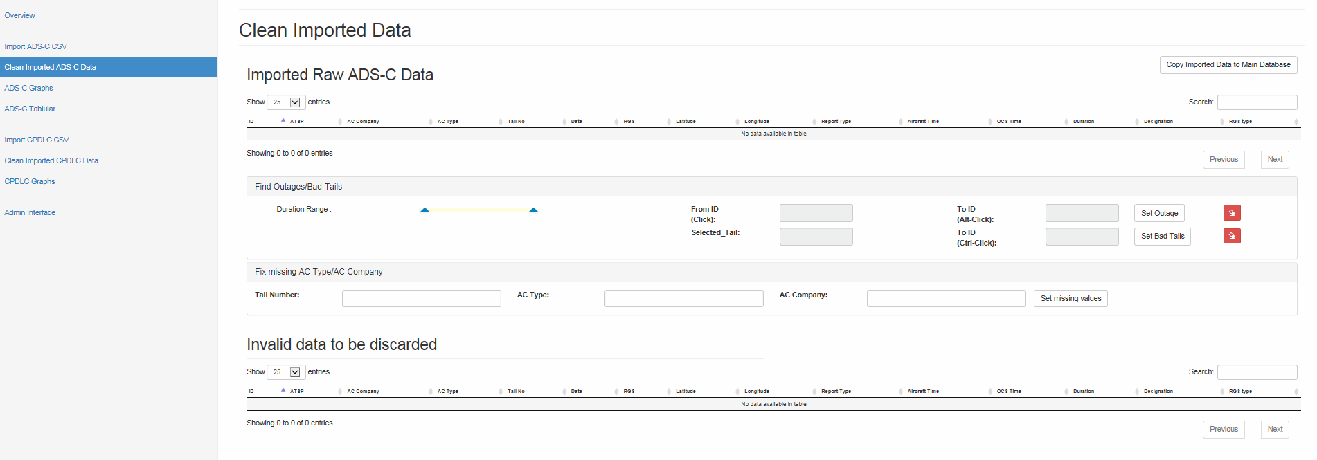
Import .csv files then this page enables review of imported data.
  Still in development.
  Shows all imported data , sort, review .
  Displays invalid records.
  Fix missing type/company for tail number.
  Find and designate bad tails and outages.
  Once imported data has been reviewed then copied to main database
2
| ISPACG FIT-23

Slide 3
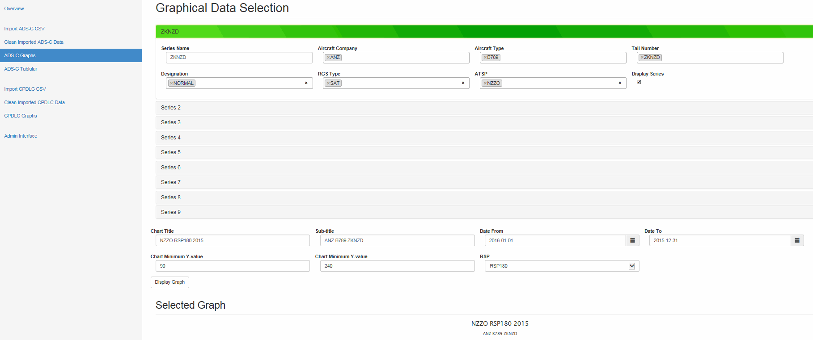
ADS-C Graphical data page:
In development
Select RSP180 or RSP400.
Select display of 9 series to graph by company, type, tail, RGS type, ATSP
Name title/subtitle
Select date range and X/Y ranges
3
| ISPACG FIT-23

Slide 4
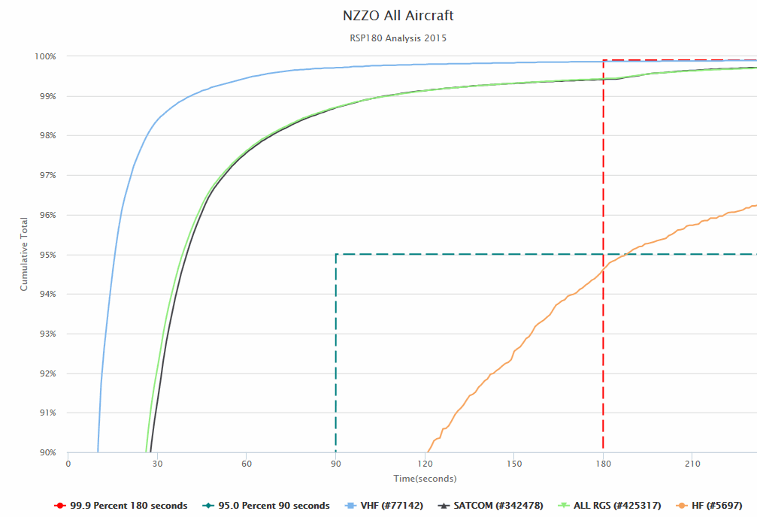
4
| ISPACG FIT-23

Slide 5
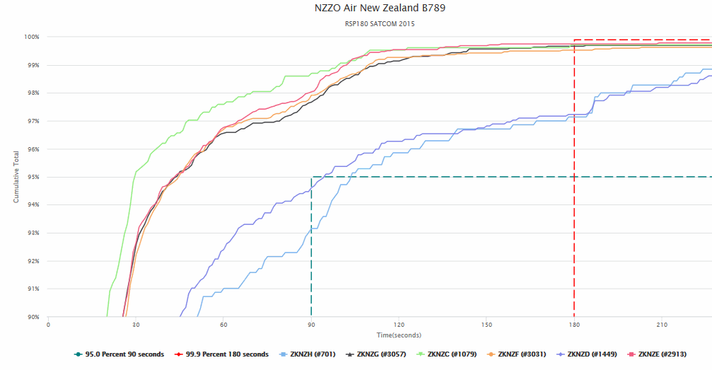
5
| ISPACG FIT-23

Slide 6
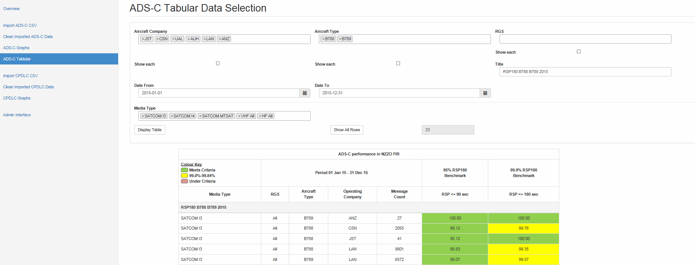
ADS-C Tabular data page
Select company, type, RGS, media type.
Date range
Title
Filter displayed table to remove rows of less than specified number of messages.
6
| ISPACG FIT-23

Slide 7
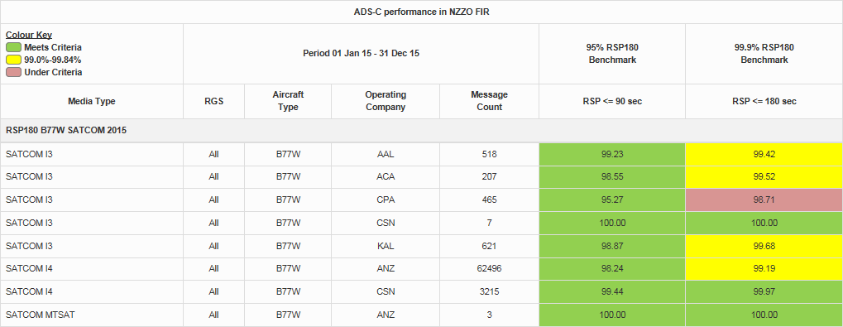
7
| ISPACG FIT-23

Slide 8
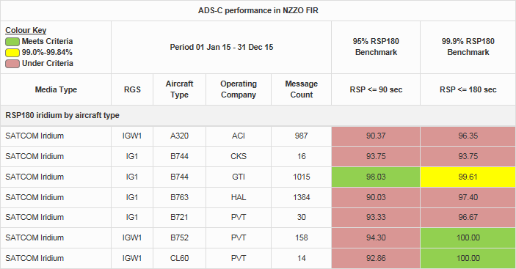
8
| ISPACG FIT-23

