Slide 1
ISPACG/30 FIT/23
PBCS Monitoring in US Oceanic Airspace
Prepared by:
Theresa Brewer-Dougherty
FAA Technical Center
Separation Standards Analysis Branch
theresa.brewer@faa.gov
Surfers Paradise, Australia
15 March 2016

Slide 2
Overview
Overview of FANS Data Link Usage in US Oceanic FIRs
Summary of Reported Outages and Measured Availability
PBCS Performance Criteria
How to Read PBCS Monitoring Charts
Aggregate FANS Data Link Performance
ASP for SATCOM Station Identifiers by FIR
Aggregate FANS Data Link Performance by Operator
Aggregate FANS Data Link Performance for Business Jet Aircraft Types

Slide 3
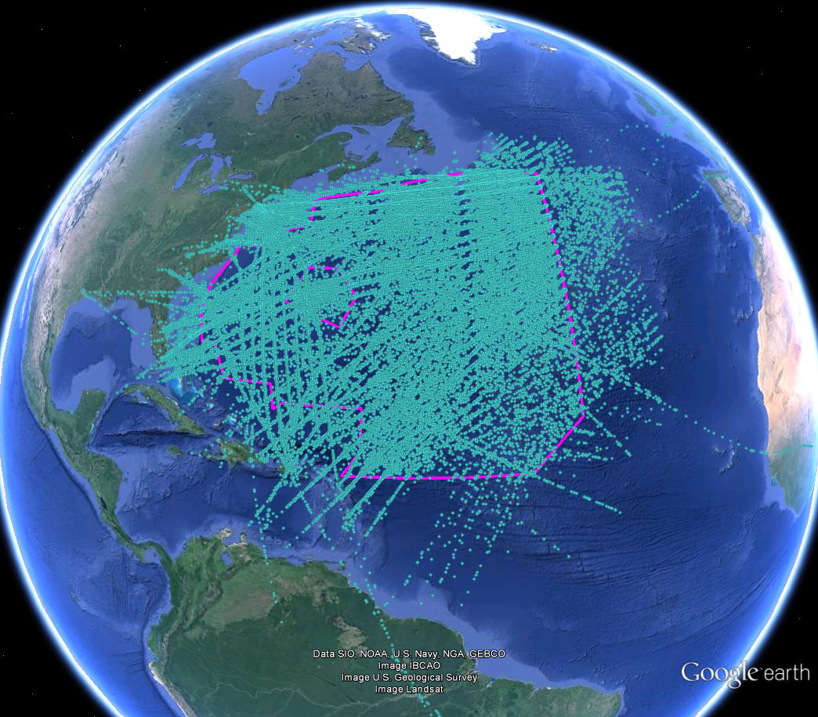
New York FIR
KZNY

Slide 4
KZNY – FANS Data Link Usage
July – December 2015
 | All ZNY | NAT | WATRS
Total flights | 109,374 | 56,624 | 92,387
% flights using FANS data link | 53% | 88% | 49%
% RNP4 | 38% | 54% | 37%
Average FANS data link flights per day | 314
% using Iridium | 7%
% using Inmarsat I-4 | 28%
Total FANS data link airframes | 2,966
% using Iridium | 9%
% using Inmarsat I-4 | 33%

Slide 5
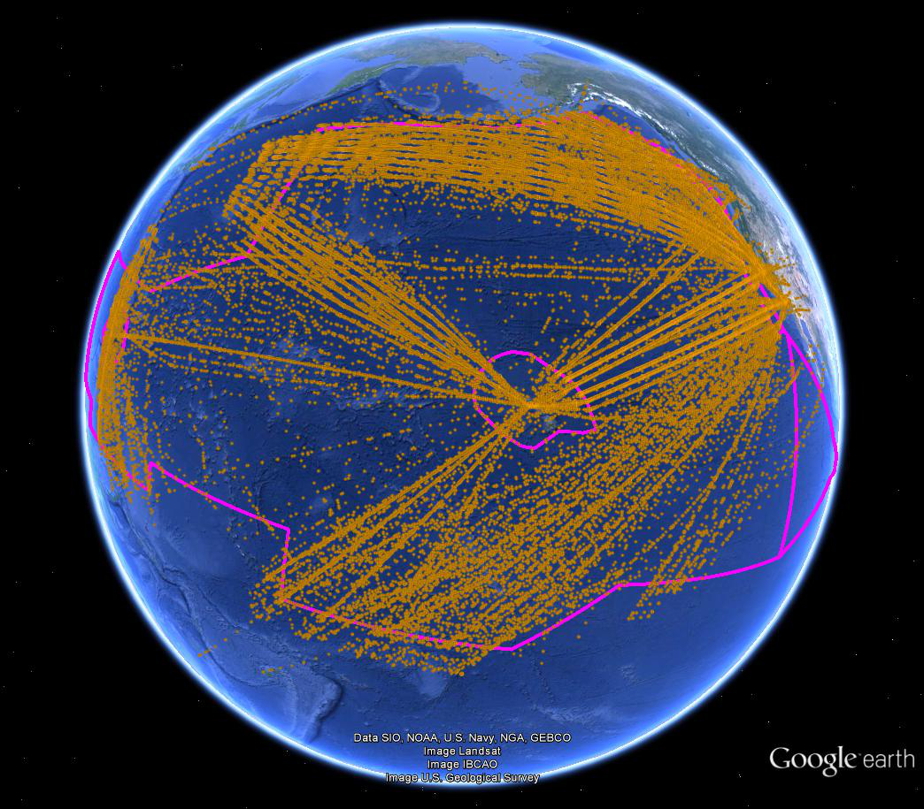
Oakland FIR
KZAK

Slide 6
KZAK – FANS Data Link Usage
July – December 2015
Total flights | 132,607
% flights using FANS data link | 65%
% RNP4 | 71%
Average FANS data link flights per day | 452
% using Iridium | 6%
% using Inmarsat I-4 | 23%
Total FANS data link airframes | 2,508
% using Iridium | 10%
% using Inmarsat I-4 | 28%

Slide 7
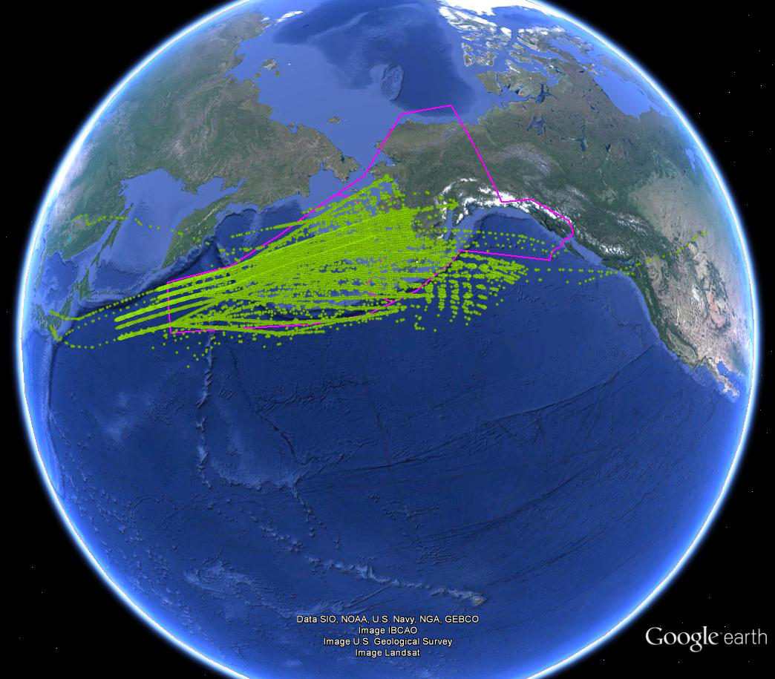
Anchorage FIR
PAZA

Slide 8
PAZA – FANS Data Link Usage
July – December 2015
Total flights | 36,371
% flights using FANS data link | 94%
% RNP4 | 82%
Average FANS data link flights per day | 187
% using Iridium | 9%
% using Inmarsat I-4 | 31%
Total FANS data link airframes | 1,650
% using Iridium | 10%
% using Inmarsat I-4 | 27%

Slide 9
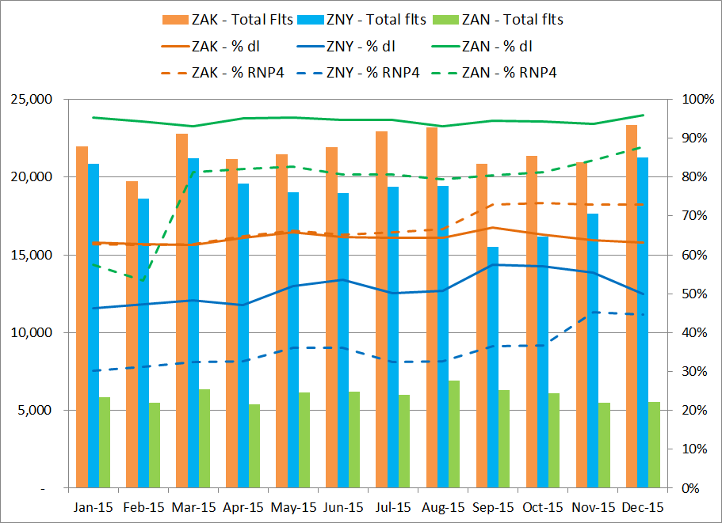

Slide 10
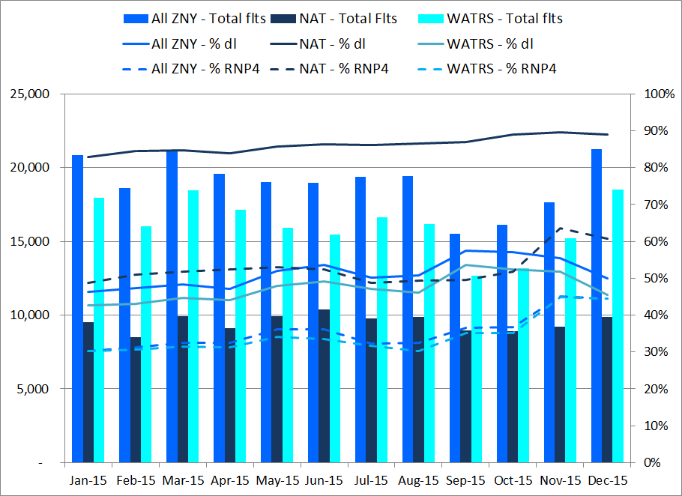

Slide 11
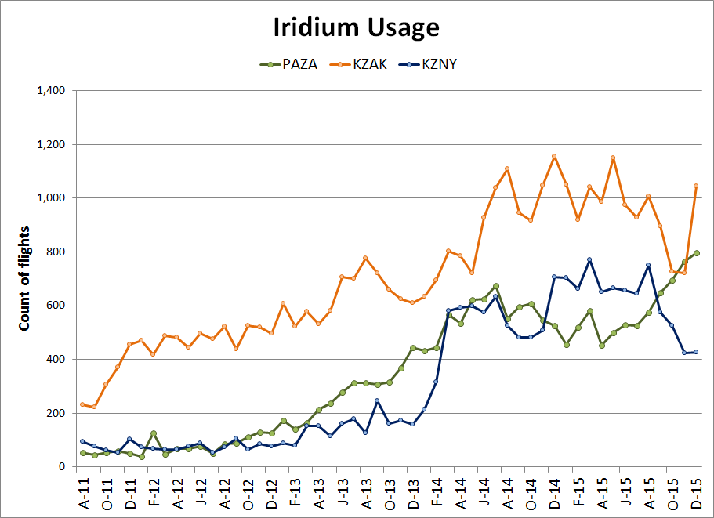

Slide 12
Outages Reported since PARC CWG/34 (1 of 2)
Last outage reported – 1 July 2015
START DATE | START TIME (UTC) | DURATION (HH:MM:SS) | SERVICE IMPACTED | SATELLITE REGION IMPACTED | NOTIFICATION SOURCE | NOTES
5-Sep-15 | 01:53 | 02:00:00 | ARINC I-3 | POR, IOR | ARINC | Inmarsat Global Ltd has resolved I-3 Pacific Ocean Region for Classic Aero over 13 and the I-3 India Ocean Region for Classic Aero over 13 region
5-Sep-15 | 03:21 | 00:41:00 | SITA Iridium | Global | SITA | Iridium customers may have experienced intermittent Short Burst Data service delay during the above timeframe
6-Sep-15 | 03:21 | 01:00:00 | I-4 | EMEA | ARINC | Degradation has been rectified - no cause was provided.
6-Sep-15 | 03:03 | 00:59:00 | I-4 | EMEA | SITA | There was a degradation over EUA1 Ocean region on I4 Ground Earth Station in Fucino due to Inmarsat network issue. Aircrafts switched to Atlantic and Indian Ocean region during this period.
20-Sep-15 | 12:52 | 04:12:00 | I-3 | POR | ARINC | Issue on the 3F3 satellite was resolved on the return direction
20-Sep-15 | 12:45 | 04:18:00 | I-3 | POR | SITA | Unscheduled loss of Classic Aero Services in Pacific Ocean Region (POR) has been resolved
25-Sep-15 | 16:31 | 02:03:00 | ARINC Iridium | Global | ARINC | one of Iridium's terrestrial Internet Service Providers experienced an issue with routing traffic through their network backbone. As a result, users may have experienced failed data transmissions if their traffic utilized the failing route. Iridium was able to correct this issue by forcing all traffic to another ISP and have opened a ticket with the affected provider. Please note that as a result of the traffic rerouting, some users may have experienced additional delays lasting until at least 20:34 or longer as these changes fully propagated across the internet.
9-Jan-16 | 16:36 | 00:14:00 | SITA | Global | SITA | A network interruption occured in our SIN Data center and the services were switched to our Montreal Center
21-Jan-16 | 21:37 | 00:55:00 | Inmarsat I-4 | EMEA | ARINC | Inmarsat network service degradation in I-4 EMEA for SwiftBroadband

Slide 13
Outages Reported since PARC CWG/34 (2 of 2)
Last outage reported – 1 July 2015
START DATE | START TIME (UTC) | DURATION (HH:MM:SS) | SERVICE IMPACTED | SATELLITE REGION IMPACTED | NOTIFICATION SOURCE | NOTES
25-Sep-15 | 16:31 | 02:45:00 | SITA Iridium | Global | SITA | Customers may experience issues with Iridium Datalink ACARS service
30-Sep-15 | 19:19 | 00:54:00 | ARINC I-3 | IOR | ARINC
30-Sep-15 | 18:45 | 00:20:00 | SITA I-3 | IOR | SITA
23-Oct-15 | 11:24 | 00:12:00 | SITA I-4 | EMEA | SITA | Inmarsat I-4 Ground Earth Station in Fucino experienced an unplanned interruption of service
26-Oct-15 | 02:20 | 00:21:00 | Inmarsat SBB | APAC | ARINC | Inmarsat reports they performed an AGGW server switch in Hawaii. Issue resolved. (XXU).
27-Oct-15 | 14:32 | 00:39:00 | Inmarsat I-4 | EMEA | SITA | Fucino GES Inmarsat Voice and Data Services
27-Oct-15 | 14:56 | 00:15:00 | Inmarsat I-4 | EMEA | ARINC | No update on cause
30-Oct-15 | 01:05 | 00:50:00 | Inmarsat I-3 | POR | SITA
30-Oct-15 | 01:56 | 00:07:00 | Inmarsat I-3 | POR | ARINC | Inmarsat experienced a network service degradation
19-Nov-15 | 04:30 | 00:05:00 | MTSAT | MTSAT | SITA | SATELLITE Voice and Data Services via MTSAT were affected due to a maintenance issue at MTSAT
5-Dec-15 | 18:25 | 00:26:00 | Inmarsat I-4 | EMEA | ARINC | Inmarsat experienced a network service degradation
17-Dec-15 | 12:46 | 00:30:00 | Inmarsat I-4 | EMEA | ARINC | Inmarsat experienced a network service degradation
7-Jan-16 | 17:27 | 01:44:00 | Inmarsat I-3 | IOR | ARINC | Inmarsat for Classic Aero over I3 outage
9-Jan-16 | 16:36 | 00:14:00 | SITA | Global | SITA | A network interruption occured in our SIN Data center and the services were switched to our Montreal Center
21-Jan-16 | 21:37 | 00:55:00 | Inmarsat I-4 | EMEA | ARINC | Inmarsat network service degradation in I-4 EMEA for SwiftBroadband

Slide 14
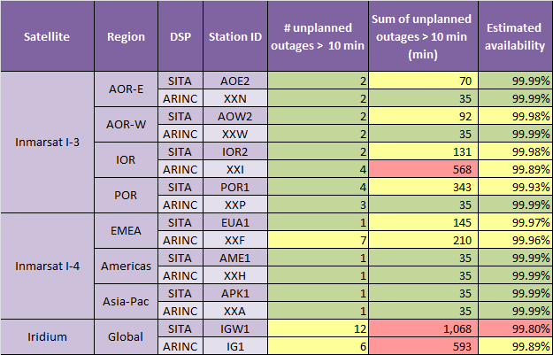
Measured Availability
Using Reported Outages from Jan to Dec 2015
 | Meets safety and reliability criteria
 | Meets safety criteria only
 | Does not meet safety or reliability criteria

Slide 15
PBCS Performance Criteria
Time/Continuity
Performance Measure | Percentage of Messages Required to Meet Criteria | ADS-C |  | CPDLC
 |  | RSP180 Criteria (sec) | RSP400 Criteria (sec) | RCP240 Criteria (sec) | RCP400 Criteria (sec)
ASP Actual Surveillance Performance | 95% | 90 | 300
 | 99.9% | 180 | 400
ACTP Actual Communication Technical Performance | 95% |  |  | 120 | 260
 | 99.9% |  |  | 150 | 310
ACP Actual Communication Performance | 95% |  |  | 180 | 320
 | 99.9% |  |  | 210 | 370
PORT Pilot Operational Response Time | 95% |  |  | 60 | 60

Slide 16
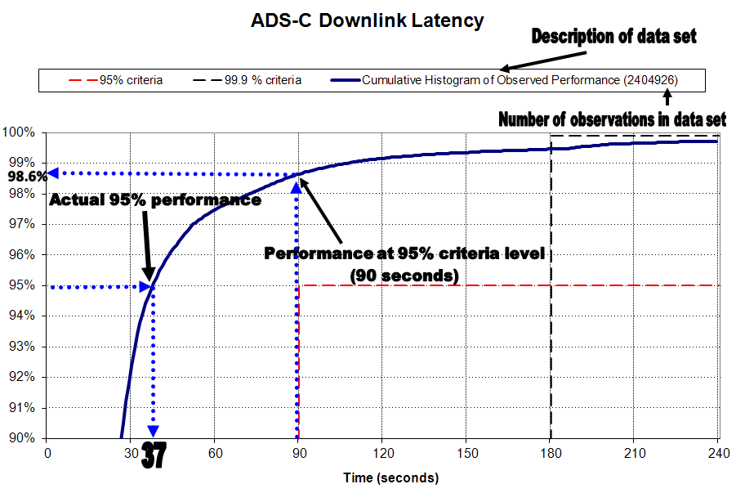
How to Read PBCS Monitoring Charts

Slide 17
data link performance by media type
July – December 2015

Slide 18
Performance by Media Type
57,697
flights
July – December 2015
New York
Media Type | ADS-C |  |  | CPDLC
 | Count of ADS-C Downlink Messages | ASP 95% | ASP 99.9% | Count of CPDLC Transactions | ACTP 95% | ACTP 99.9% | ACP 95% | ACP 99.9% | PORT 95%
Performance Criteria |  | RSP 180 |  |  | RCP 240
Aggregate | 1,530,259 | 98.3% | 99.4% | 51,273 | 99.6% | 99.7% | 99.1% | 99.4% | 96.9%
SAT | 1,182,082 | 98.1% | 99.4% | 46,965 | 99.6% | 99.7% | 99.1% | 99.4% | 96.9%
VHF | 344,060 | 99.2% | 99.6% | 3,612 | 99.9% | 99.9% | 99.6% | 99.7% | 97.3%
HF | 4,101 | 65.9% | 81.7% | 1 | -- | -- | -- | -- | --
SAT-VHF |  |  |  | 346 | 97.7% | 98.8% | 96.8% | 97.7% | 89.9%
VHF-SAT |  |  |  | 308 | 95.5% | 97.1% | 94.5% | 96.1% | 94.2%
SAT-HF |  |  |  | 33 | -- | -- | -- | -- | --
HF-SAT |  |  |  | 8 | -- | -- | -- | -- | --

Slide 19
Performance by Media Type
84,272
flights
July – December 2015
Oakland
Media Type | ADS-C |  |  | CPDLC
 | Count of ADS-C Downlink Messages | ADS-C 95% | ADS-C 99.9% | Count of CPDLC Transactions | ACTP 95% | ACTP 99.9% | ACP 95% | ACP 99.9% | PORT 95%
Performance Criteria |  | RSP 180 |  |  | RCP 240
Aggregate | 2,631,360 | 98.6% | 99.4% | 109,709 | 99.7% | 99.7% | 99.5% | 99.7% | 98.5%
SAT | 2,330,955 | 98.7% | 99.5% | 106,944 | 99.7% | 99.8% | 99.5% | 99.7% | 98.5%
VHF | 288,100 | 98.7% | 99.2% | 2,022 | 99.7% | 99.7% | 99.5% | 99.8% | 98.4%
HF | 12,290 | 69.2% | 82.4% | 31 | -- | -- | -- | -- | --
VHF-SAT |  |  |  | 229 | 91.7% | 94.8% | 94.3% | 96.5% | 96.1%
SAT-VHF |  |  |  | 192 | 100.0% | 100.0% | 99.0% | 99.5% | 96.4%
SAT-HF |  |  |  | 165 | 90.3% | 93.3% | 95.2% | 95.8% | 97.6%
HF - SAT |  |  |  | 121 | 99.2% | 99.2% | 94.2% | 97.5% | 86.8%
HF-VHF |  |  |  | 4 | -- | -- | -- | -- | --
VHF-HF |  |  |  | 1 | -- | -- | -- | -- | --

Slide 20
Performance by Media Type
34,497
flights
July – December 2015
Anchorage
Media Type | ADS-C |  |  | CPDLC
 | Count of ADS-C Downlink Messages | ADS-C 95% | ADS-C 99.9% | Count of CPDLC Transactions | ACTP 95% | ACTP 99.9% | ACP 95% | ACP 99.9% | PORT 95%
Performance Criteria |  | RSP 180 |  |  | RCP 240
Aggregate | 1,226,721 | 97.9% | 99.1% | 23,817 | 99.5% | 99.6% | 99.3% | 99.5% | 97.9%
SAT | 828,453 | 97.7% | 99.2% | 16,045 | 99.5% | 99.6% | 99.3% | 99.6% | 97.7%
VHF | 390,810 | 99.0% | 99.3% | 7,268 | 99.7% | 99.7% | 99.6% | 99.7% | 98.6%
HF | 7,418 | 63.4% | 77.5% | 8 | -- | -- | -- | -- | --
SAT-VHF |  |  |  | 261 | 99.6% | 100.0% | 98.1% | 99.2% | 90.4%
VHF-SAT |  |  |  | 159 | 92.5% | 96.9% | 93.1% | 94.3% | 95.0%
SAT-HF |  |  |  | 39 | -- | -- | -- | -- | --
HF-SAT |  |  |  | 27 | -- | -- | -- | -- | --
VHF-HF |  |  |  | 7 | -- | -- | -- | -- | --
HF-VHF |  |  |  | 3 | -- | -- | -- | -- | --

Slide 21
ANNUAL AGGREGATE fir performance
2010 - 2015

Slide 22
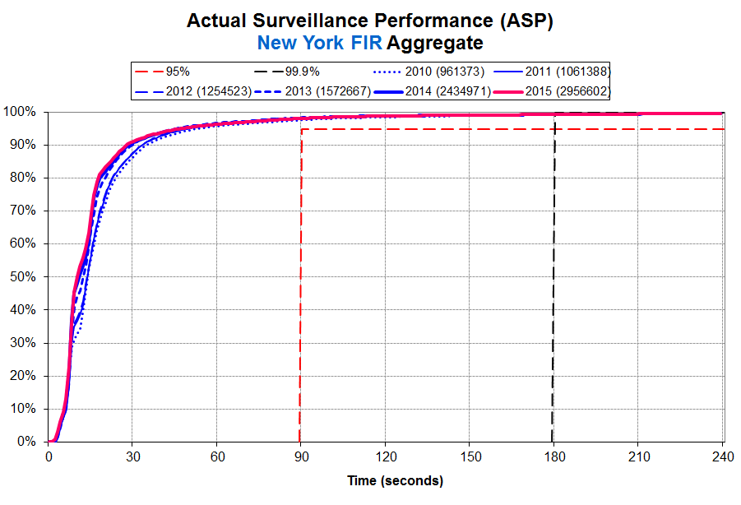
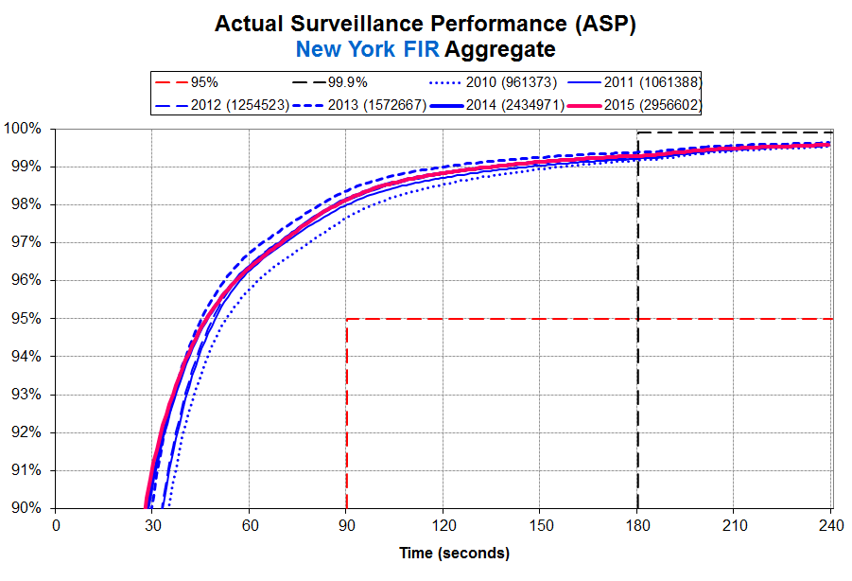

Slide 23
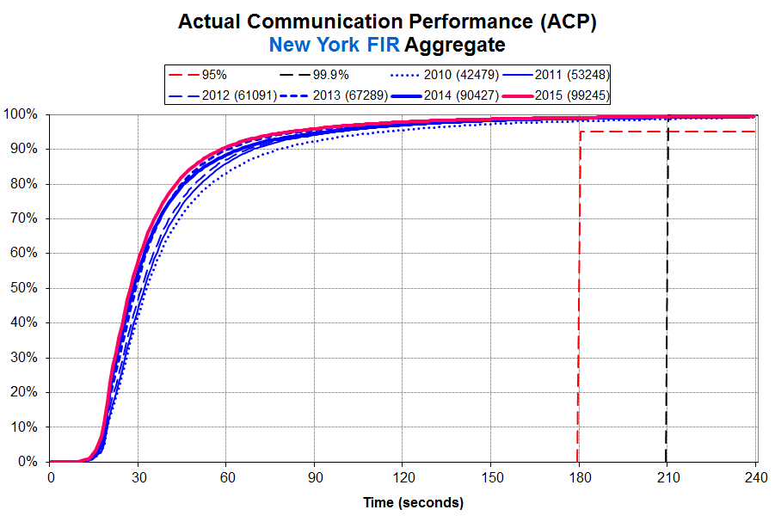
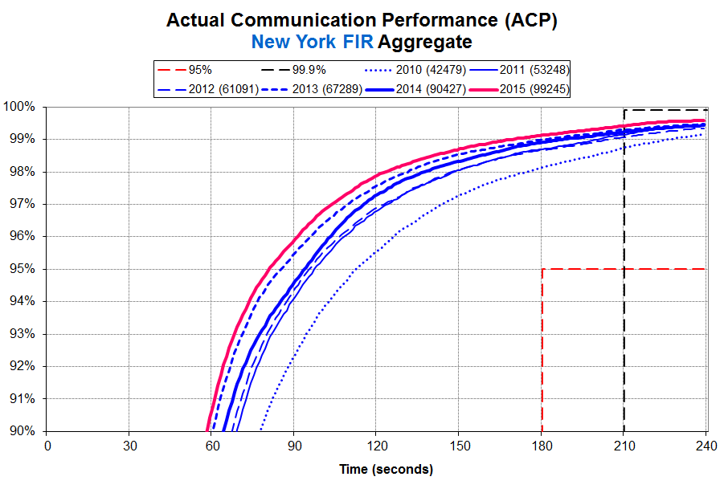

Slide 24
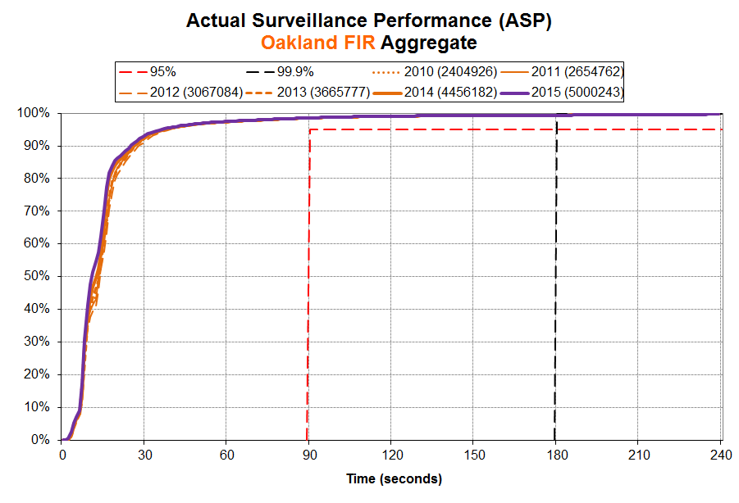
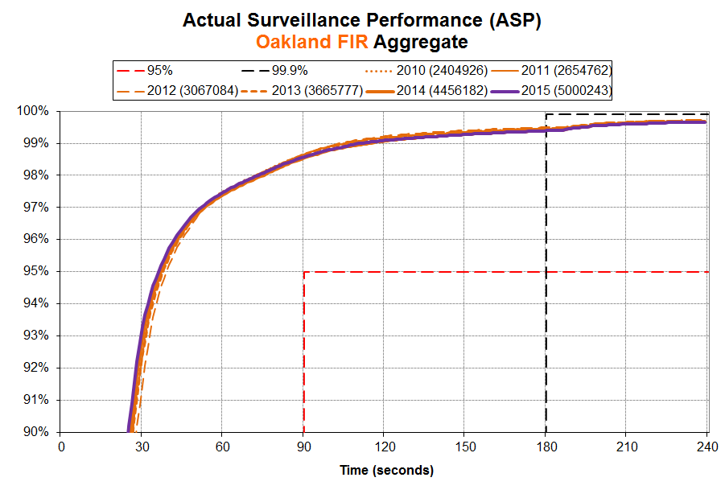

Slide 25
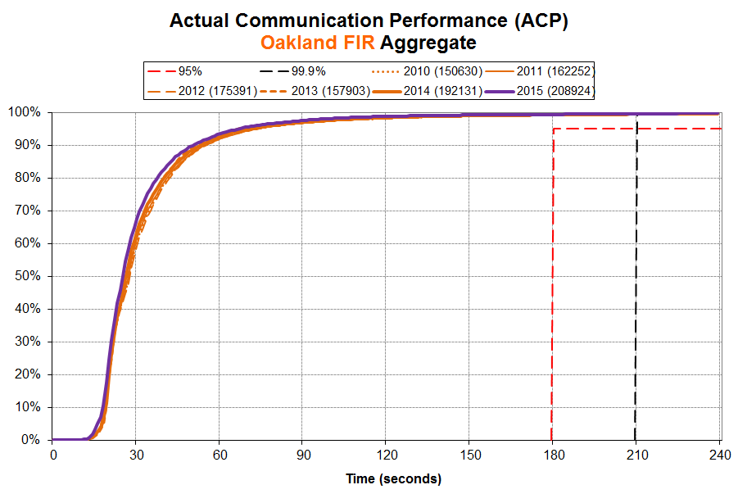
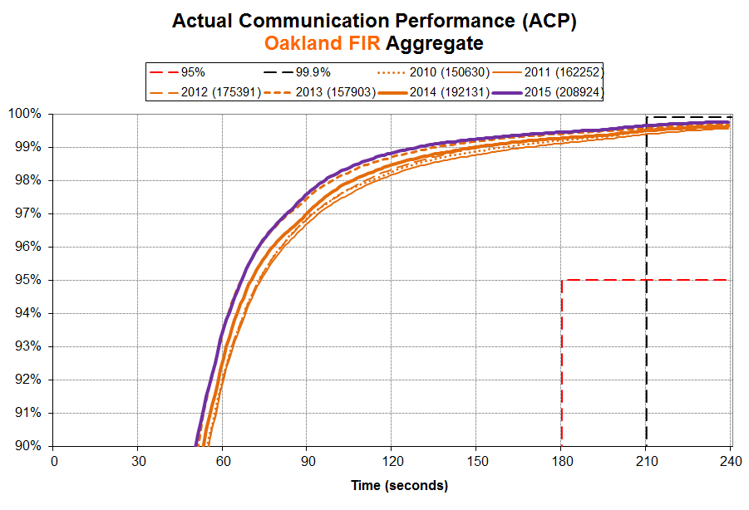

Slide 26
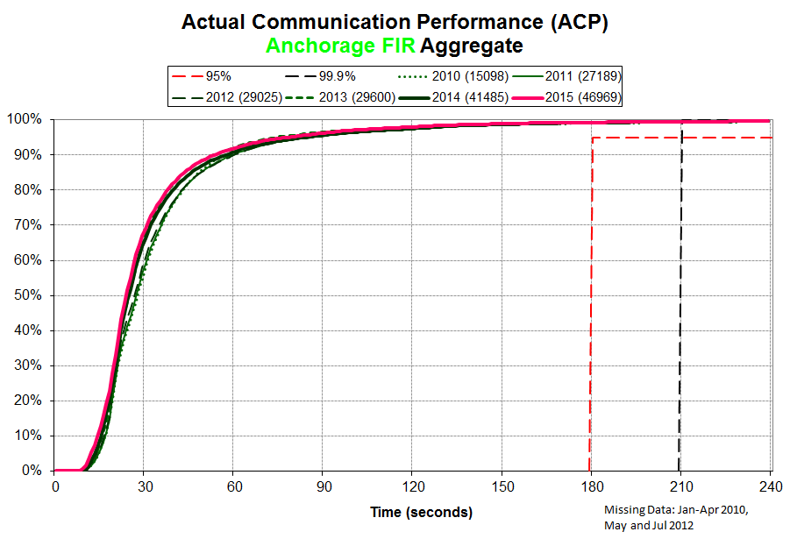
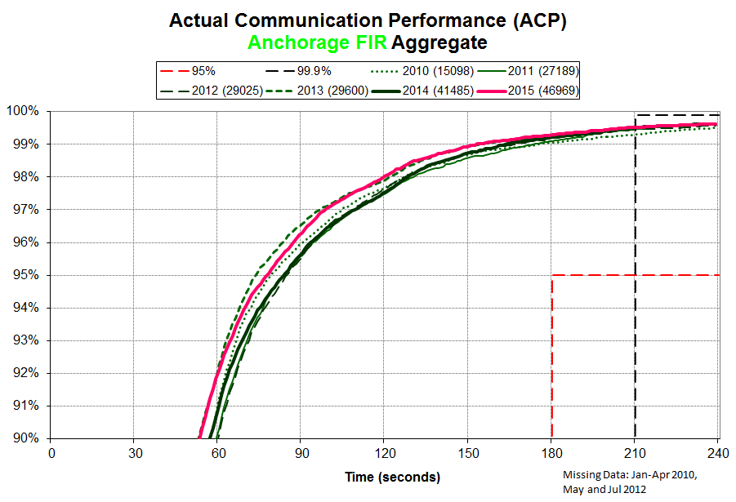

Slide 27
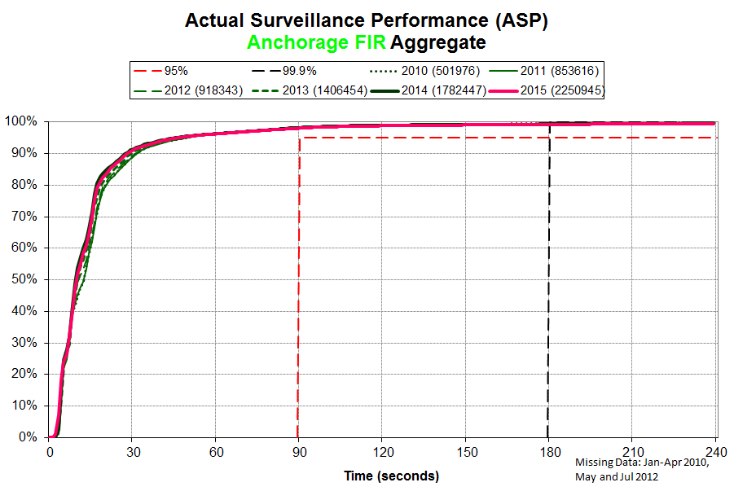
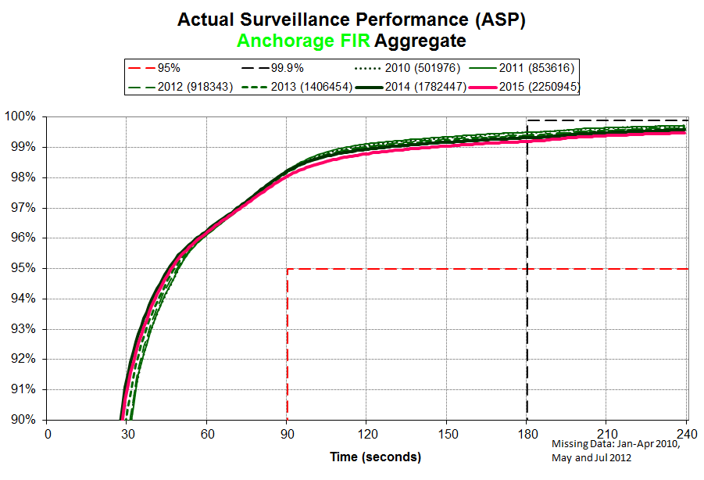

Slide 28
ASP by station identifier
Overview
Analysis period: June and December 2015
Analysis by FIR: Oakland, Anchorage, New York
ASP → RSP180 criteria
Station identifiers designate “path” taken by data link messages between aircraft and ATC
“Paths” vary between the four constellations of satellites and between the two data link service providers
June and December 2015

Slide 29
GES LOCATION(S) | SATELLITE/ REGION | SITA | ARINC
Burum, Netherlands | Inmarsat I‑3 AOR-E | AOE2 | XXN
 | Inmarsat I‑3 AOR-W | AOW2 | XXW
Perth, Australia | Inmarsat I‑3 IOR | IOR2 | XXI
 | Inmarsat I‑3 POR | POR1 | XXP
Fucino, Italy | Inmarsat I‑4 EMEA | EUA1 | XXF
 | Inmarsat I‑4 EMEA SBB | EME9 | XXB
Paumalu, Hawaii, US | Inmarsat I‑4 Americas | AME1 | XXH
 | Inmarsat I‑4 Asia-Pacific | APK1 | XXA
 | Inmarsat I‑4 Americas SBB | AMR9 | XXU
 | Inmarsat I‑4 Asia-Pacific SBB | PAC9 | XXS
Kobe and Hitachiota, Japan | MTSAT Japan | MTS1 | --
Phoenix, Arizona, US | Iridium Global | IGW1 | IG1

Slide 30
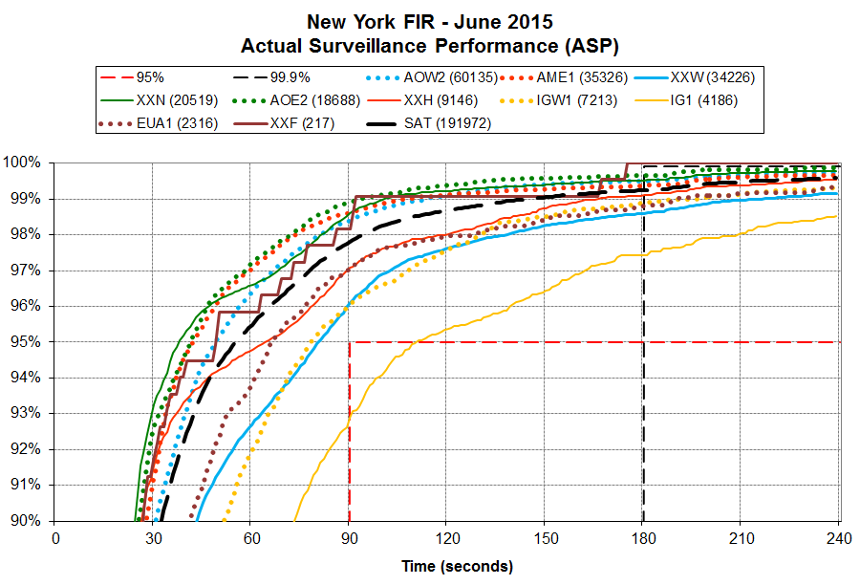
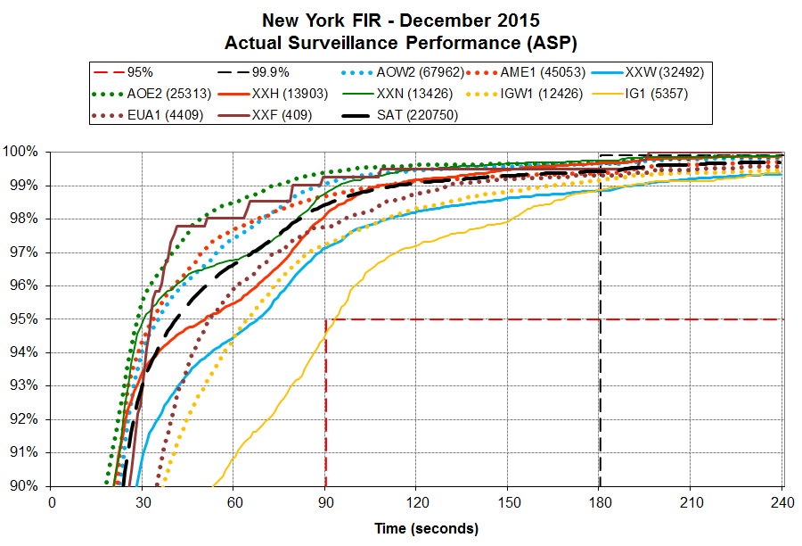

Slide 31
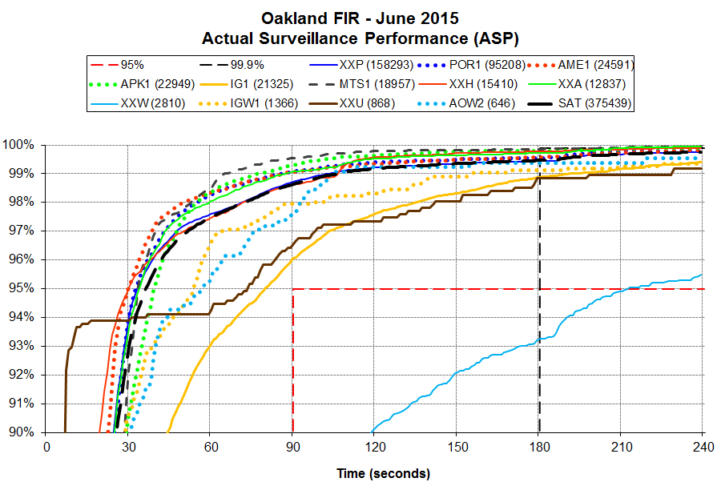
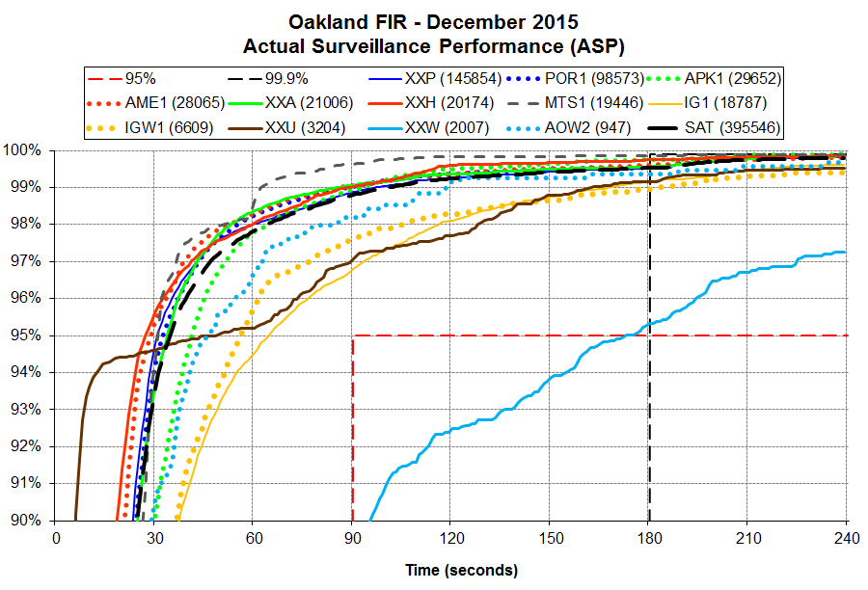

Slide 32
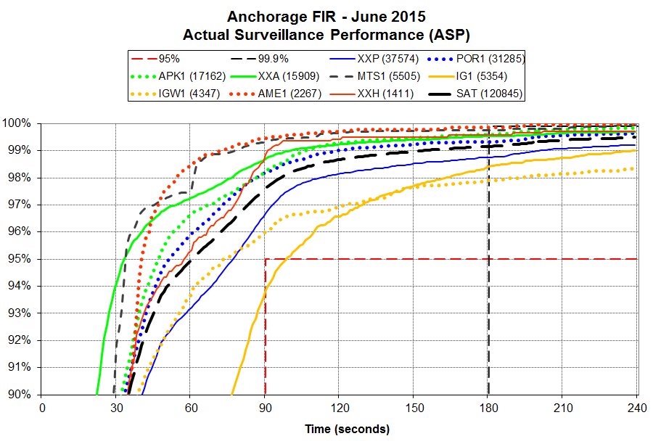
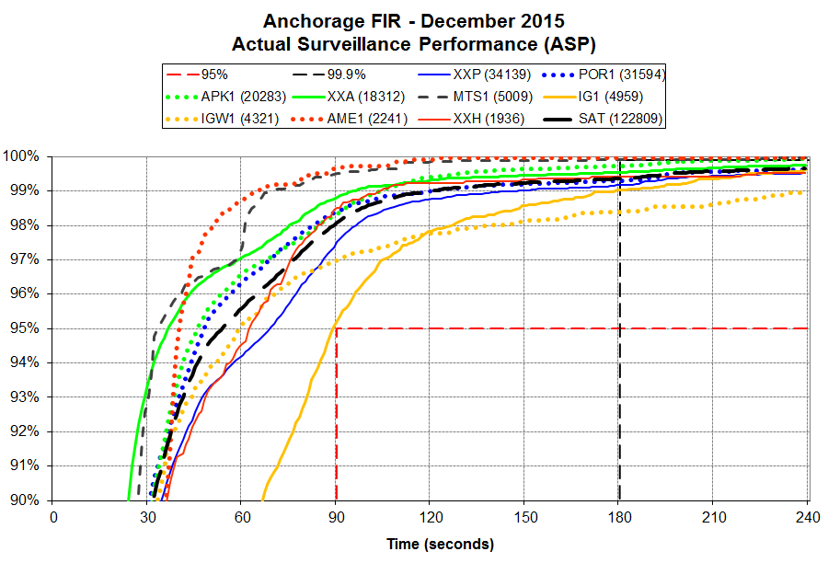

Slide 33
PR 1411: Poor performance for AOR-W over I-3
Submitted PR to DLMA for performance over XXW – 11/8/2013
Inmarsat investigation revealed it is not an Inmarsat issue
Investigated as an issue with certain operator/aircraft
CLOSED – operator/aircraft type performance issues will be dealt with individually through full PBCS implementation

Slide 34
PR 1508: Poor performance for AOR-E over I-4
Submitted PR to DLMA for performance over XXH – 2/5/2014
Variation in performance by operator/aircraft type
VIR B744 performance has continued to degrade
Data from Shanwick FIR showed notably better performance
ASP for New York FIR split between east of 57W and west of 57W
  57W chosen as point beyond which SAT/VHF transitions would occur
SAT/VHF transitions identified as having significant effect on data link performance
CLOSED – VIR B744 will continue to be monitored
Improvement noted for December 2015

Slide 35
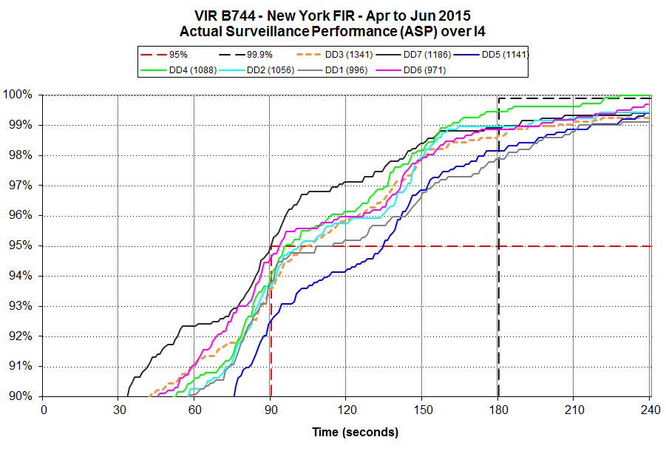
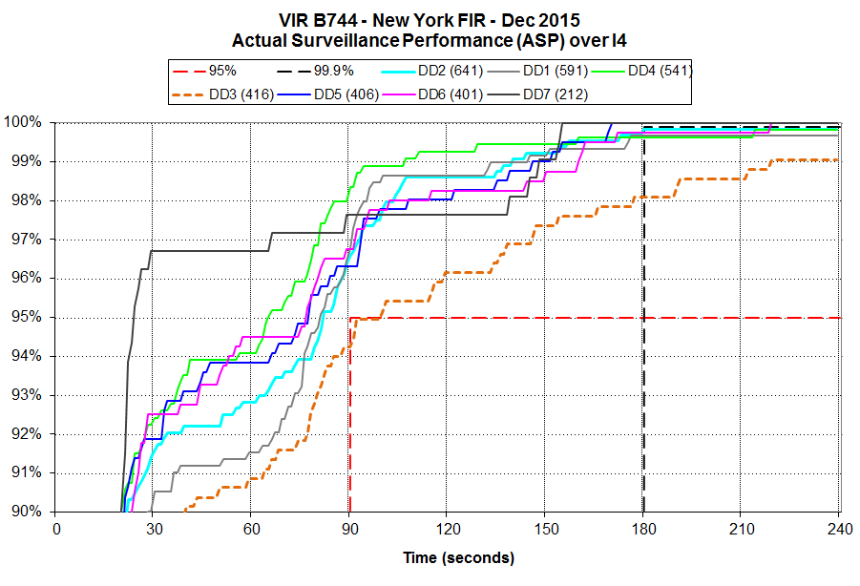

Slide 36
Data link Performance by operator/aircraft type
July – December 2015

Slide 37
Summary of Performance by Operator/Aircraft Type
New York FIR
224 operator/aircraft type pairs with at least 100 ADS-C messages
88 operator/aircraft type pairs with at least 100 RCP transactions during this 6-month period
Criteria | RSP180 ASP | RCP240 ACTP | RCP240 ACP | RCP240 PORT
Meets 95% | 212 | 88 | 88 | 73
Meets 99.9% | 70 | 43 | 29
Below 99.9% but above 99.0% | 127 | 45 | 50
Below 99.0% | 27 | 0 | 9
Total pairs | 224 | 88

Slide 38
Operator/Aircraft Types Not Meeting RSP180/RCP240 New York FIR
July – December 2015
Operator/ Aircraft Type | ADS-C |  |  |  | CPDLC
 | Count of ADS-C | % of Total ADS-C | ADS-C 95% | ADS-C 99.9% | Count of CPDLC | % of Total CPDLC | ACTP 95% | ACTP 99.9% | ACP 95% | ACP 99.9% | PORT 95%
A/B752 | 11,367 | 0.7% | 93.4% | 97.2% | 274 | 0.5% | 98.9% | 99.3% | 98.5% | 98.5% | 94.5%
DL/A332 | 5,313 | <0.1% | 94.5% | 97.7% | 177 | 0.3% | 99.4% | 99.4% | 98.9% | 99.4% | 96.1%
P/B77L | 3,169 | <0.1% | 94.1% | 98.9% | 53 | 0.1% | 100.0% | 100.0% | 100.0% | 100.0% | 100.0%
BW/B763 | 2,345 | <0.1% | 93.1% | 98.5% | 39 | 0.1% | 100.0% | 100.0% | 100.0% | 100.0% | 97.4%
BC/A332 | 2,013 | <0.1% | 94.0% | 99.8% | 116 | 0.2% | 100.0% | 100.0% | 99.1% | 99.1% | 98.3%
CG/B748 | 1,139 | <0.1% | 93.1% | 97.1% | 22 | <0.1% | 100.0% | 100.0% | 95.5% | 95.5% | 86.4%
IGA/CL35 | 429 | <0.1% | 94.4% | 98.4%
CZ/G280 | 218 | <0.1% | 92.7% | 95.9% | 8 | <0.1% | 100.0% | 100.0% | 100.0% | 100.0% | 100.0%
P/A333 | 197 | <0.1% | 92.4% | 99.5%
IGA/FA50 | 181 | <0.1% | 94.5% | 98.3%
A/B744 | 127 | <0.1% | 90.6% | 93.7%
AQ/B752 | 115 | <0.1% | 93.0% | 100.0%

Slide 39
PR 1502: Poor performance Operator DL
Submitted PR to DLMA for performance of DL (ARA) - 1/29/14
Assigned to Airbus
Airbus suggested change in particular part
1 aircraft stored, the other not observed as of December 2015
Left open pending observation of improvement

Slide 40
Summary of Performance by Operator/Aircraft Type
Oakland FIR
161 operator/aircraft type pairs with at least 100 ADS-C messages
99 operator/aircraft type pairs with at least 100 RCP transactions during this 6-month period
Criteria | RSP180 ASP | RCP240 ACTP | RCP240 ACP | RCP240 PORT
Meets 95% | 155 | 99 | 99 | 90
Meets 99.9% | 29 | 43 | 38
Below 99.9% but above 99.0% | 114 | 53 | 52
Below 99.0% | 18 | 3 | 9
Total pairs | 161 | 99

Slide 41
Operator/Aircraft Types Not Meeting RSP180/RCP240 Oakland FIR
July – December 2015
Operator/ Aircraft Type | ADS-C |  |  |  | CPDLC
 | Count of ADS-C | % of Total ADS-C | ADS-C 95% | ADS-C 99.9% | Count of CPDLC | % of Total CPDLC | ACTP 95% | ACTP 99.9% | ACP 95% | ACP 99.9% | PORT 95%
P/B788 | 11,794 | <0.1% | 94.1% | 94.7% | 363 | 0.3% | 99.5% | 99.5% | 99.5% | 99.5% | 99.5%
A/B752 | 7,701 | <0.1% | 94.0% | 97.6% | 235 | 0.2% | 97.5% | 97.9% | 96.6% | 97.5% | 94.0%
MIL/DC10 | 3,321 | <0.1% | 91.4% | 95.2% | 86 | 0.1% | 98.8% | 100.0% | 95.4% | 96.5% | 88.4%
IGA/CL35 | 1,256 | <0.1% | 93.6% | 96.7% | 17 | <0.1% | 100.0% | 100.0% | 100.0% | 100.0% | 88.2%
A/B753 | 260 | <0.1% | 92.3% | 92.7%
AQ/B752 | 116 | <0.1% | 93.1% | 100.0% | 6 | <0.1% | 100.0% | 100.0% | 100.0% | 100.0% | 100.0%

Slide 42
Summary of Performance by Operator/Aircraft Type
Anchorage FIR
114 operator/aircraft type pairs with at least 100 ADS-C messages
51 operator/aircraft type pairs with at least 100 RCP transactions during this 6-month period
Criteria | RSP180 ASP | RCP240 ACTP | RCP240 ACP | RCP240 PORT
Meets 95% | 107 | 51 | 50 | 46
Meets 99.9% | 26 | 26 | 19
Below 99.9% but above 99.0% | 65 | 19 | 26
Below 99.0% | 23 | 6 | 6
Total pairs | 114 | 51

Slide 43
Operator/Aircraft Types Not Meeting RSP180/RCP240 Anchorage FIR
July – December 2015
Operator/ Aircraft Type | ADS-C |  |  |  | CPDLC
 | Count of ADS-C | % of Total ADS-C | ADS-C 95% | ADS-C 99.9% | Count of CPDLC | % of Total CPDLC | ACTP 95% | ACTP 99.9% | ACP 95% | ACP 99.9% | PORT 95%
P/B788 | 27,287 | 1.7% | 94.4% | 95.8% | 431 | 1.8% | 96.3% | 96.5% | 96.3% | 97.0% | 97.7%
Y/B763 | 21,440 | 1.3% | 94.5% | 97.1% | 137 | 0.6% | 97.8% | 98.5% | 95.6% | 97.1% | 94.2%
R/B788 | 11,269 | 0.7% | 94.1% | 95.5% | 142 | 0.6% | 95.8% | 95.8% | 93.7% | 95.1% | 95.8%
CY/B788 | 4,163 | 0.3% | 92.2% | 94.0% | 63 | 0.3% | 96.8% | 96.8% | 96.8% | 96.8% | 100.0%
DW/K35R | 359 | <0.1% | 80.5% | 81.6% | 4 | <0.1% | 100.0% | 100.0% | 100.0% | 100.0% | 100.0%
MIL/C135 | 227 | <0.1% | 71.4% | 74.9% | 1 | <0.1% | 100.0% | 100.0% | 100.0% | 100.0% | 100.0%
S/B763 | 102 | <0.1% | 77.5% | 79.4%

Slide 44
Aggregated Data link Performance for business jet aircraft types
July – December 2015

Slide 45
Performance for IGA Aircraft Types
New York FIR
July – December 2015
Operator/ Aircraft Type | ADS-C |  |  |  | CPDLC
 | Count of ADS-C | % of Total ADS-C | ADS-C 95% | ADS-C 99.9% | Count of CPDLC | % of Total CPDLC | ACTP 95% | ACTP 99.9% | ACP 95% | ACP 99.9% | PORT 95%
CL30 | 58 | <0.1% | 98.3% | 100.0%
CL60 | 31 | <0.1% | 100.0% | 100.0%
GL5T | 3,409 | <0.1% | 97.4% | 99.6% | 86 | 0.2% | 98.8% | 98.8% | 97.7% | 98.8% | 88.4%
GLEX | 9,420 | 0.5% | 97.7% | 99.6% | 248 | 0.5% | 99.6% | 100.0% | 97.6% | 98.4% | 93.2%
F2TH | 1,806 | <0.1% | 96.0% | 98.1% | 38 | 0.1% | 100.0% | 100.0% | 97.4% | 97.4% | 89.5%
F900 | 1,615 | <0.1% | 97.3% | 98.8% | 39 | 0.1% | 97.4% | 97.4% | 89.7% | 89.7% | 74.4%
FA7X | 7,009 | 0.4% | 98.1% | 99.3% | 189 | 0.4% | 99.5% | 99.5% | 96.8% | 96.8% | 92.1%
G280 | 218 | <0.1% | 92.7% | 95.9% | 8 | <0.1% | 100.0% | 100.0% | 100.0% | 100.0% | 100.0%
GLF4 | 2,915 | <0.1% | 96.8% | 98.5% | 63 | 0.1% | 98.4% | 98.4% | 92.1% | 95.2% | 76.2%
GLF5 | 11,434 | 0.7% | 96.4% | 98.7% | 281 | 0.5% | 99.3% | 99.6% | 96.4% | 96.4% | 86.8%
GLF6 | 3,181 | <0.1% | 97.4% | 99.3% | 86 | 0.2% | 98.8% | 98.8% | 95.4% | 95.4% | 91.9%

Slide 46
Performance for IGA Aircraft Types
Oakland FIR
July – December 2015
Operator/ Aircraft Type | ADS-C |  |  |  | CPDLC
 | Count of ADS-C | % of Total ADS-C | ADS-C 95% | ADS-C 99.9% | Count of CPDLC | % of Total CPDLC | ACTP 95% | ACTP 99.9% | ACP 95% | ACP 99.9% | PORT 95%
CL30 | 46 | <0.1% | 100.0% | 100.0% | 4 | <0.1% | 100.0% | 100.0% | 100.0% | 100.0% | 100.0%
CL60 | 143 | <0.1% | 98.6% | 100.0% | 4 | <0.1% | 100.0% | 100.0% | 100.0% | 100.0% | 100.0%
GL5T | 3,039 | <0.1% | 97.5% | 99.4% | 41 | <0.1% | 100.0% | 100.0% | 100.0% | 100.0% | 97.6%
GLEX | 10,310 | <0.1% | 98.3% | 99.6% | 296 | 0.3% | 100.0% | 100.0% | 97.3% | 97.6% | 94.9%
F2TH | 343 | <0.1% | 96.8% | 98.3% | 8 | <0.1% | 100.0% | 100.0% | 100.0% | 100.0% | 75.0%
F900 | 634 | <0.1% | 99.4% | 99.5% | 31 | <0.1% | 100.0% | 100.0% | 100.0% | 100.0% | 87.1%
FA7X | 2,945 | <0.1% | 97.7% | 99.1% | 70 | 0.1% | 100.0% | 100.0% | 94.3% | 95.7% | 85.7%
G280 | 301 | <0.1% | 98.3% | 99.7% | 6 | <0.1% | 100.0% | 100.0% | 100.0% | 100.0% | 100.0%
GLF4 | 4,724 | <0.1% | 97.6% | 99.1% | 85 | 0.1% | 100.0% | 100.0% | 98.8% | 100.0% | 83.5%
GLF5 | 11,562 | <0.1% | 97.6% | 98.9% | 319 | 0.3% | 99.4% | 99.4% | 97.8% | 98.4% | 89.3%
GLF6 | 6,499 | <0.1% | 98.2% | 99.4% | 228 | 0.2% | 98.3% | 98.3% | 97.8% | 98.3% | 93.0%

Slide 47
Performance for IGA Aircraft Types
Anchorage FIR
July – December 2015
Operator/ Aircraft Type | ADS-C |  |  |  | CPDLC
 | Count of ADS-C | % of Total ADS-C | ADS-C 95% | ADS-C 99.9% | Count of CPDLC | % of Total CPDLC | ACTP 95% | ACTP 99.9% | ACP 95% | ACP 99.9% | PORT 95%
GL5T | 751 | <0.1% | 98.1% | 99.5% | 5 | <0.1% | 100.0% | 100.0% | 100.0% | 100.0% | 100.0%
GLEX | 2,704 | <0.1% | 98.2% | 99.9% | 30 | 0.1% | 100.0% | 100.0% | 100.0% | 100.0% | 96.7%
F2TH | 81 | <0.1% | 100.0% | 100.0% | 1 | <0.1% | 100.0% | 100.0% | 100.0% | 100.0% | 100.0%
F900 | 402 | <0.1% | 99.5% | 100.0% | 7 | <0.1% | 100.0% | 100.0% | 100.0% | 100.0% | 100.0%
FA7X | 1,063 | <0.1% | 97.0% | 98.6% | 12 | 0.1% | 100.0% | 100.0% | 91.7% | 91.7% | 83.3%
G280 | 114 | <0.1% | 100.0% | 100.0% | 1 | <0.1% | 100.0% | 100.0% | 100.0% | 100.0% | 100.0%
GLF4 | 998 | <0.1% | 98.4% | 98.9% | 10 | <0.1% | 100.0% | 100.0% | 100.0% | 100.0% | 90.0%
GLF5 | 5,227 | 0.3% | 97.7% | 98.7% | 55 | 0.2% | 100.0% | 100.0% | 96.4% | 96.4% | 96.4%
GLF6 | 2,909 | <0.1% | 97.8% | 99.1% | 32 | 0.1% | 93.8% | 93.8% | 90.6% | 93.8% | 96.9%

Slide 48
PR 1867: Poor performance for GLF6
Submitted PR to ISPACG CRA/NAT DLMA for performance of GLF6 not meeting 95% criteria for RSP180 ASP – 11/3/2014
Issue assigned to be worked by Gulfstream
Notable improvement in March 2015
GLF6 aggregate performance met in 3 US oceanic FIRs since March 2015
FAA analysis showing performance improvement supports closing PR at this time

Slide 49
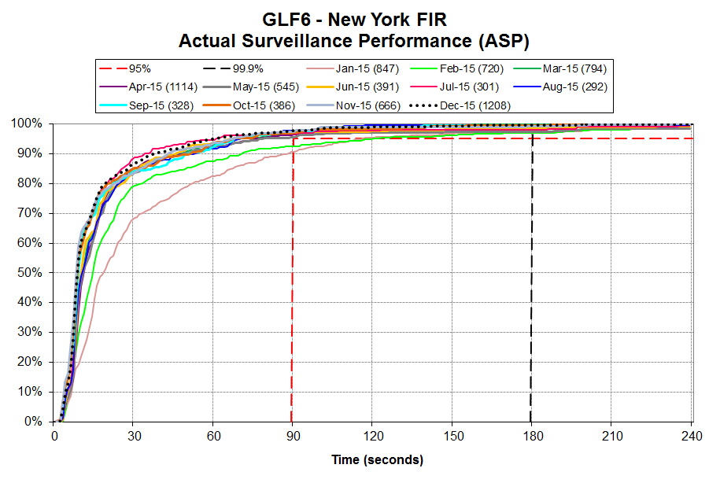
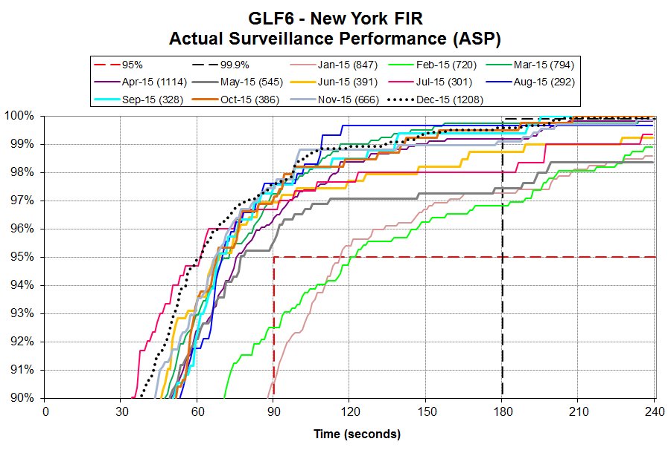

Slide 50
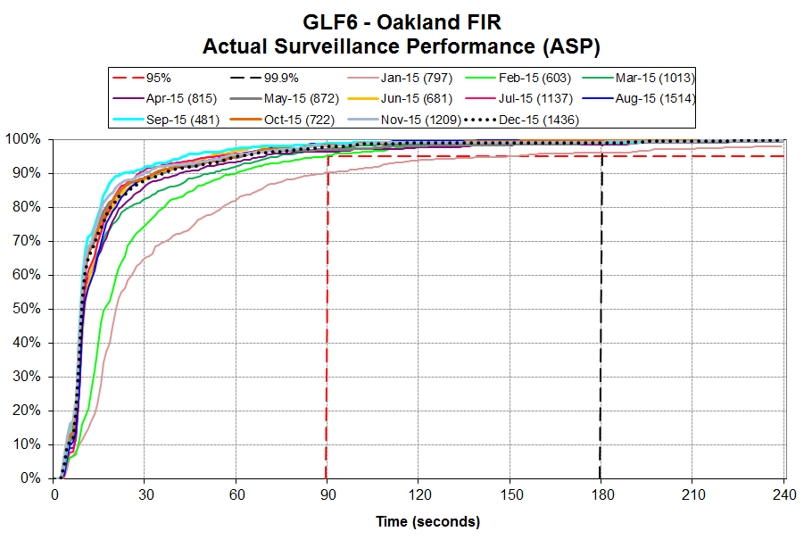
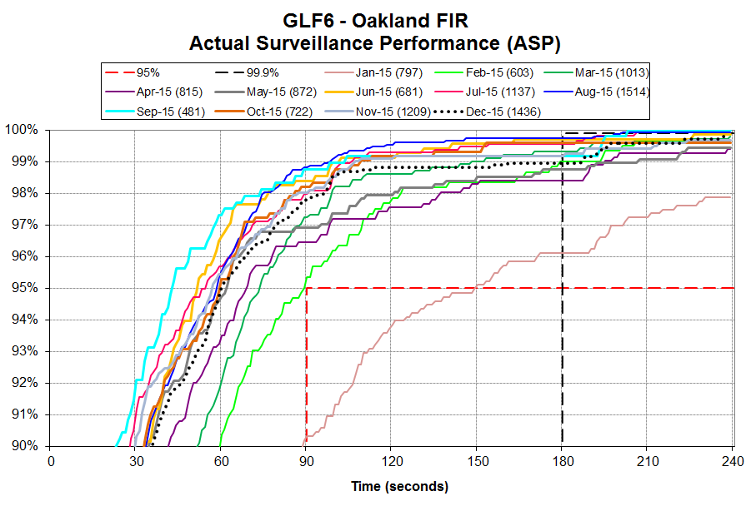

Slide 51
