Slide 1



PBCS Monitoring in NZZO
ISPACG FIT 23
Gold Coast, Australia
15 March 2015

Slide 2
ADS-C Performance - RSP180
2
| ISPACG FIT 23

Slide 3
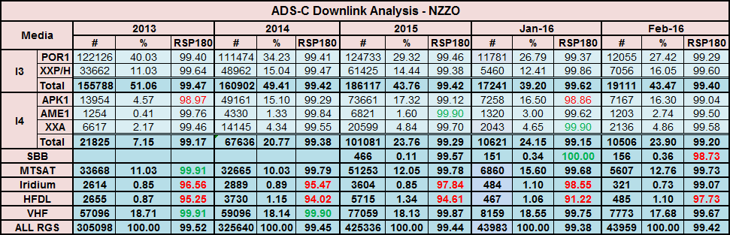
No major changes in overall performance in 2015
Gradual transition from Inmarsat I3 to I4 continues
Satellite performance generally good - but:
  I4 APK1 – 99.12% at 180” is lower than expected. Further analysis later.
  Iridium – 98.55% below 99.0% at 180” . Further analysis later
HFDL – 94.61% at 180” is below standard. Further analysis later.
In 2015 we recorded 425336 downlinks an 85% increase on 2009 when this analysis started.
3
| ISPACG FIT 23

Slide 4
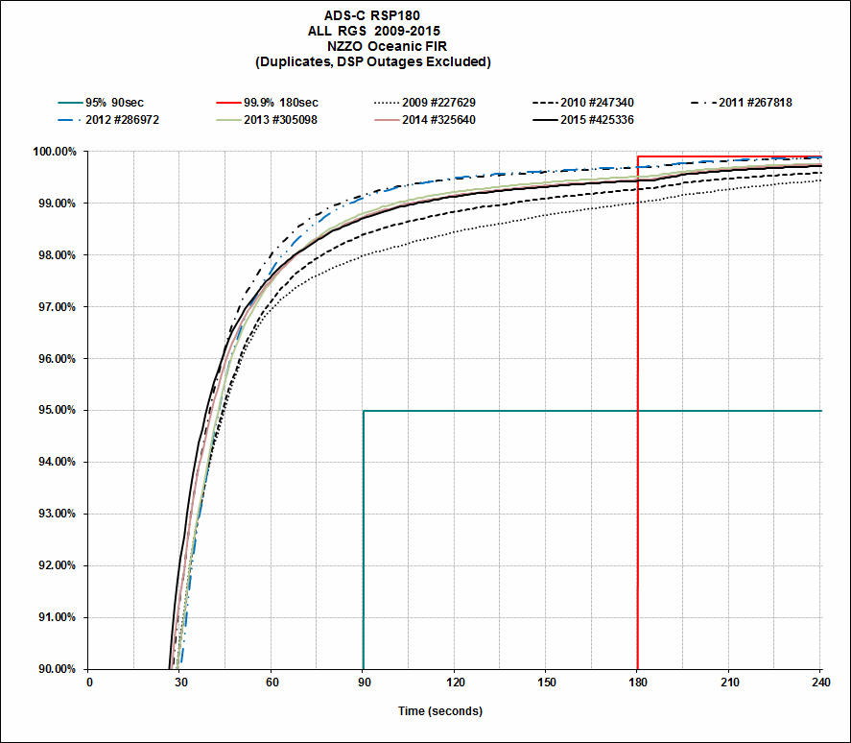
4
| ISPACG FIT 23
Notes:
Resolution of VHF transition issues see performance peak in 2012. Consistent performance in 2013-2015 slightly down on 2012. Coincides with introduction of Inmarsat I4.

Slide 5
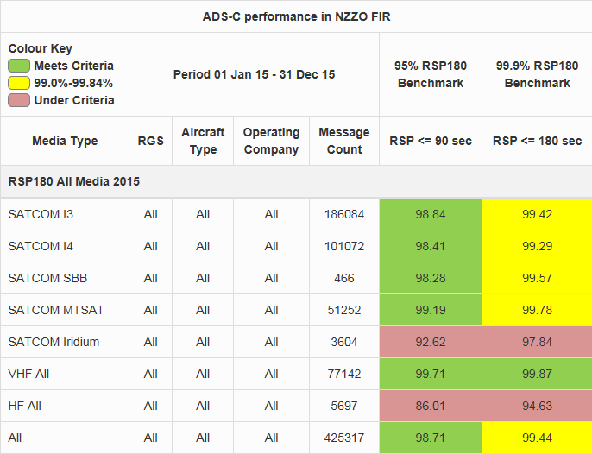
5
| ISPACG FIT 23
Notes:
Continuing poor performance from HFDL and Iridium Satcom.

Slide 6
PBCS RSP180 Certification
How can we help?
6
| ISPACG FIT 23

Slide 7
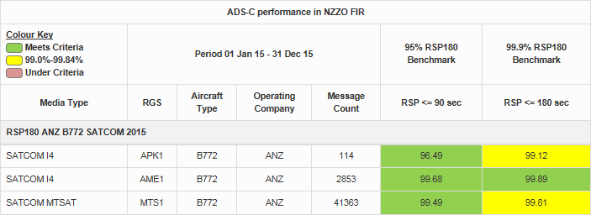
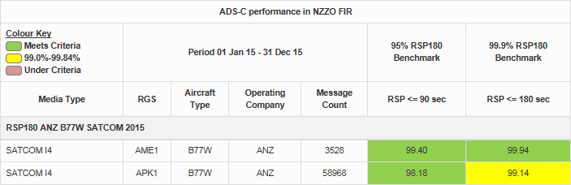
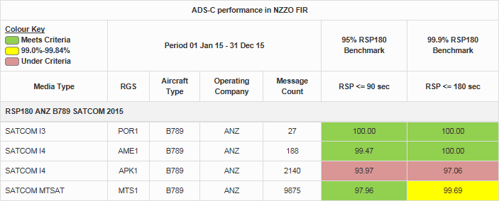
7
| ISPACG FIT 23
Notes:
PBCS In Service Monitoring – PBCS certification. Possible performance data that can be provided to Airlines.

Slide 8
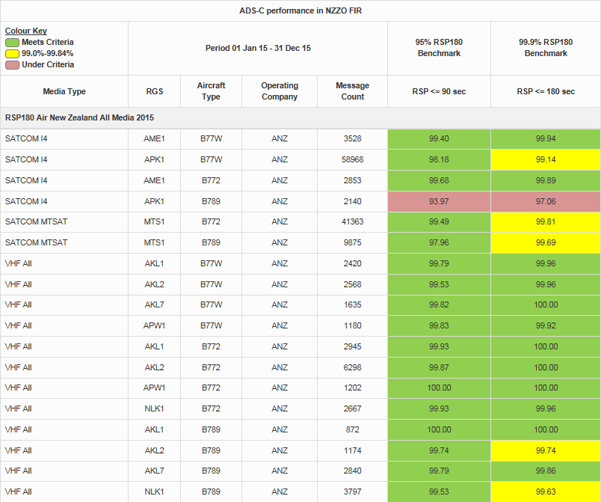
8
| ISPACG FIT 23
Notes:
PBCS In Service Monitoring – PBCS certification

Slide 9
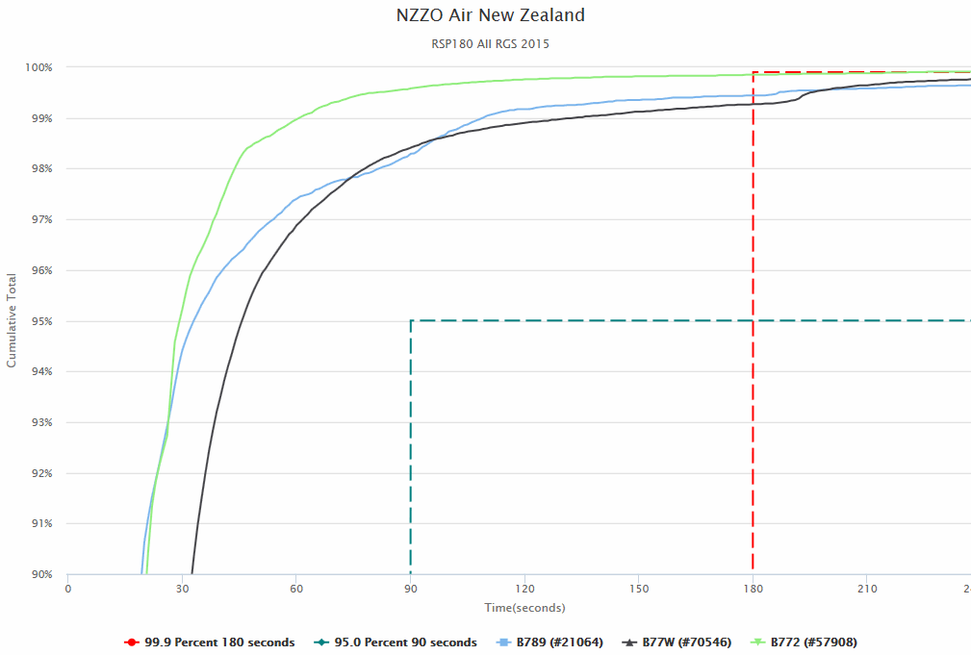
9
| ISPACG FIT 23
Notes:
PBCS in service monitoring – PBCS certification documentation

Slide 10
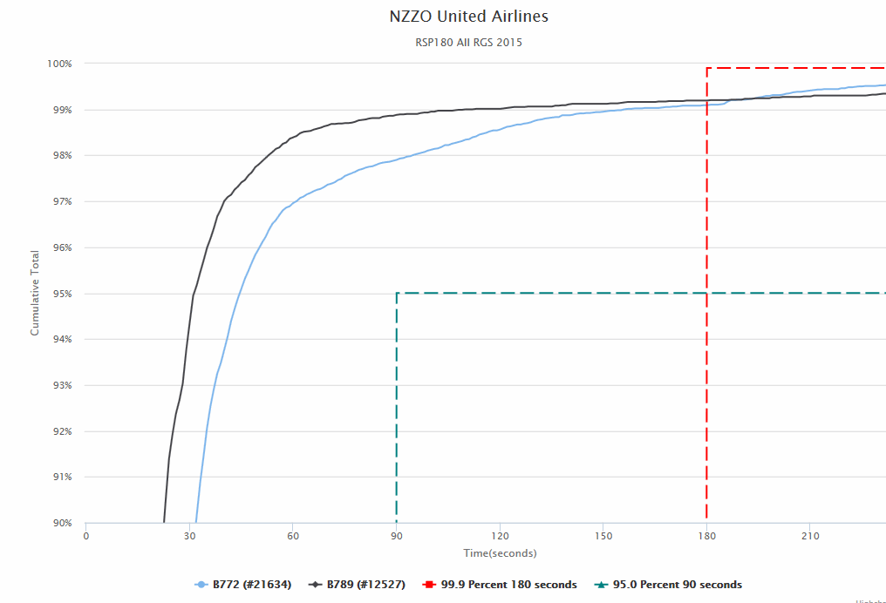
10
| ISPACG FIT 23
Notes:
PBCS in service monitoring – PBCS certification documentation

Slide 11
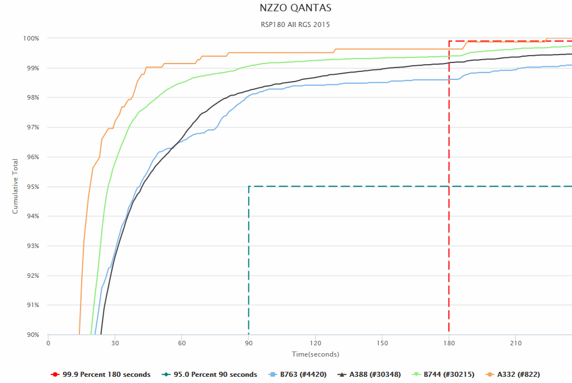
11
| ISPACG FIT 23
Notes:
PBCS in service monitoring – PBCS certification documentation

Slide 12
CPDLC Performance – RCP240
12
| ISPACG FIT 23

Slide 13
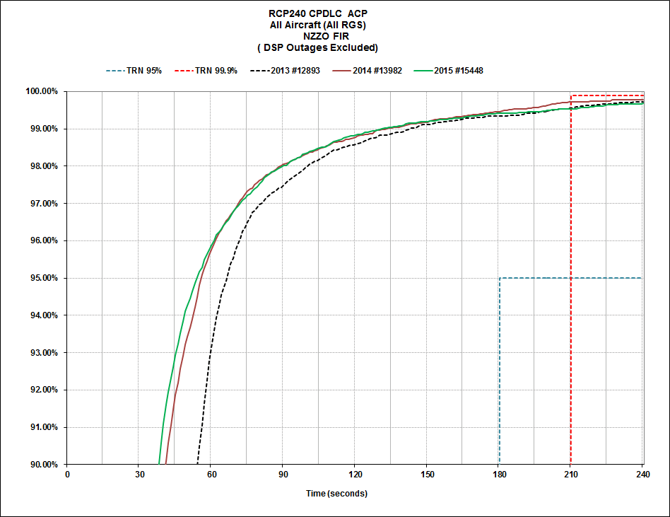
13
| ISPACG FIT 23
Notes:
Filtered data per GOLD/PBCS Manual with only “pure” intervention messages included.

Slide 14
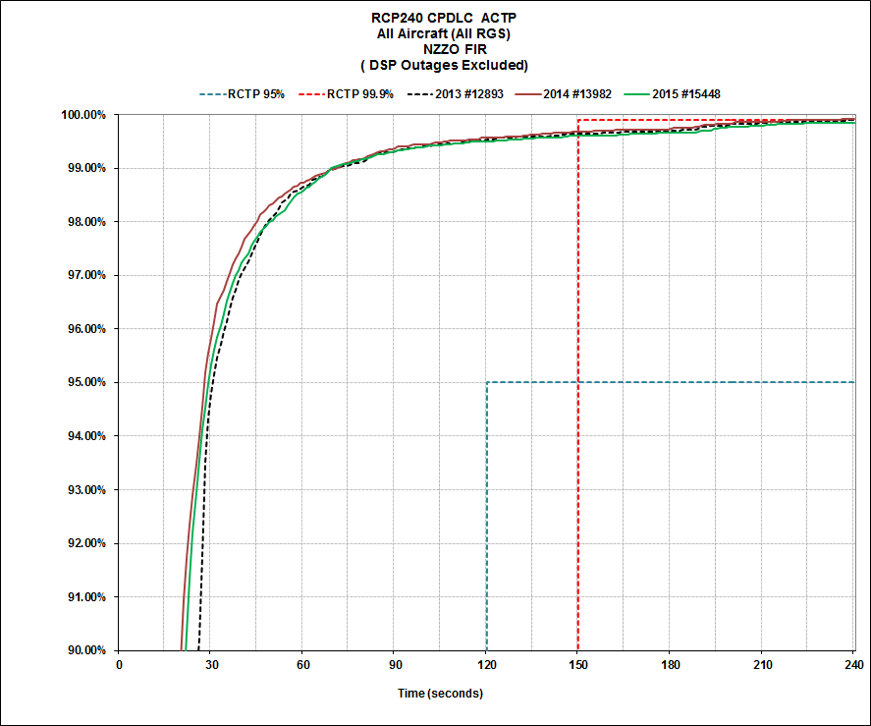
14
| ISPACG FIT 23

Slide 15
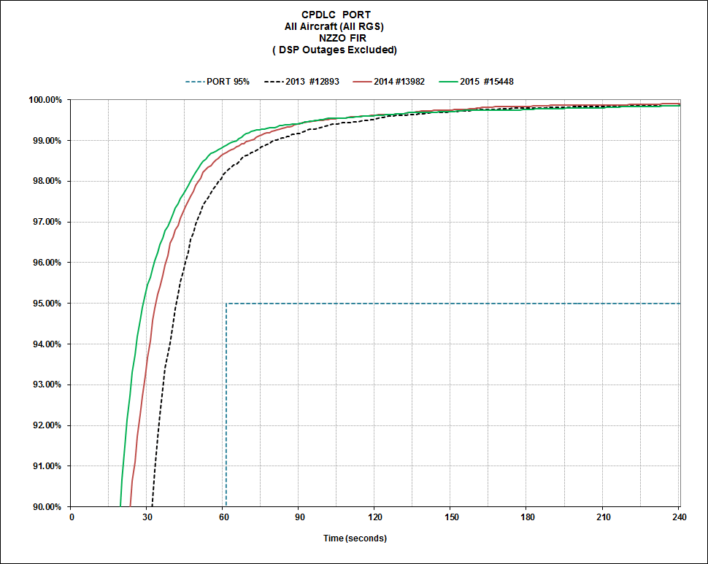
15
| ISPACG FIT 23

Slide 16

NZZO CPDLC Performance - All Aircraft – All RGS - 2015
16
| ISPACG FIT 23

Slide 17
Iridium Performance
17
| ISPACG FIT 23

Slide 18
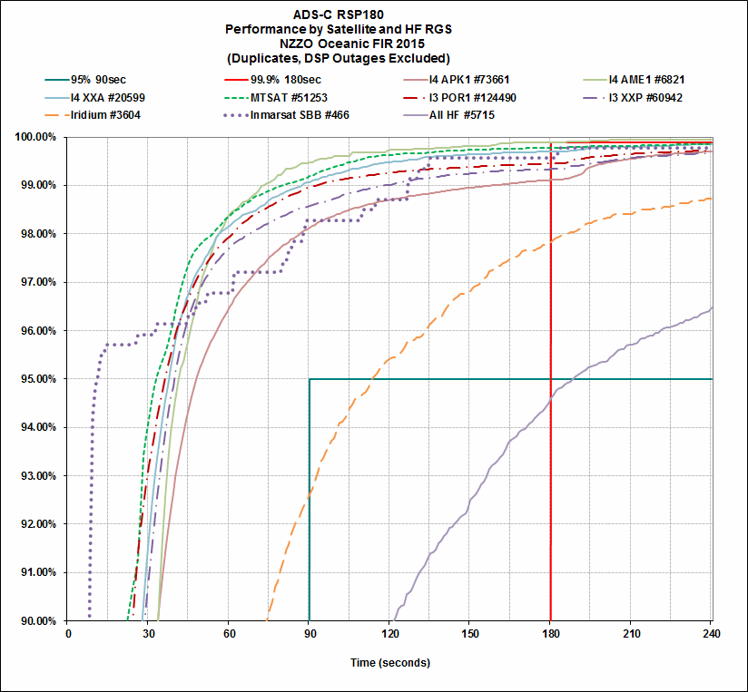
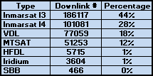
18
| ISPACG FIT 23

Slide 19
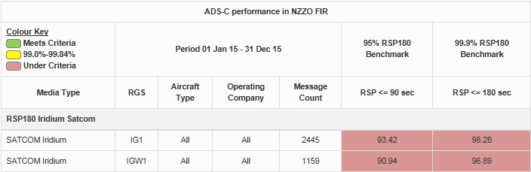
19
| ISPACG FIT 23
Notes:
No performance difference between SITA and Rockwell Collins/ARINC

Slide 20
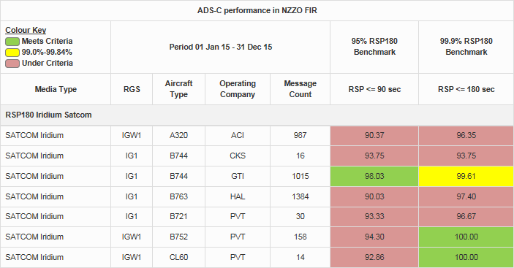
20
| ISPACG FIT 23
Notes:
By company and type. GTI B744 is meeting the specification ACI A320 is not. Some improvement with ACI when VDL added but still below requirements. Aircraft operated Norfolk Island – Auckland and we may be seeing VHF transition issues. Same issue previously noted with HAL B763 operating short sector into Samoa from Oakland.

Slide 21
HFDL Performance
21
| ISPACG FIT 23

Slide 22
22
| ISPACG FIT 23

Slide 23
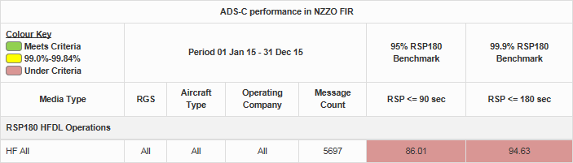
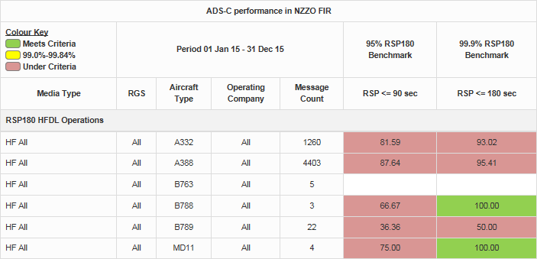
23
| ISPACG FIT 23
Notes:
Combined all types/operating company well below 180” at 94.63%. Similar for the main types A332 93.02% and A388 95.41%.

Slide 24
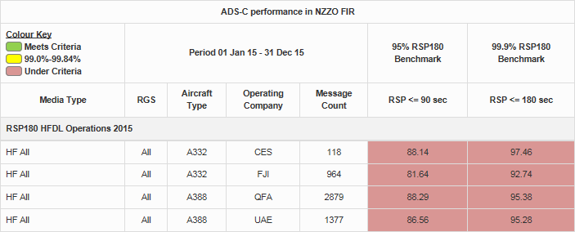
24
| ISPACG FIT 23
Notes:
Breaking down to each company – little variation seen main A388 users.

Slide 25
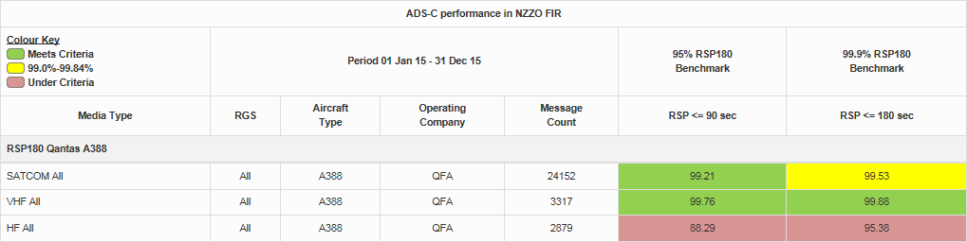

25
| ISPACG FIT 23
Notes:
The A388 have good SATCOM and VDL performance and HFDL use does not impact greatly on overall performance.

Slide 26
During the period 24 November 2015 – 14 December 2015 Qantas A388 VH-OQF operated with
no SATCOM using HFDL and VDL only. This was correctly indicated in the FPL - files HF and VDL.
(FPL-QFA94-IS
-A388/H-SADE2E3FGHIJ2J4RWYZ/LB1
On 18 December 2015 Air China A332 B6113 operated no SATCOM and operated HFDL and VDL only. This was not correctly indicated in the FPL – files HF, VDL , and SATCOM.
(FPL-CCA783-IS
-A332/H-SDE3FGHIJ3J4J5RWYZ/LB1D1
A review of FPL indicates some inconsistency in filing the J codes. For example:
(FPL-CCA784-IS (This flight operates SAT/VHF/HFDL – files OK)
-A332/H-SDE3FGHIJ2J3J4J5RWYZ/LB1D1
(FPL-CES779-IS (This flight operates SAT/VHF/HFDL – files only SATCOM)
-A332/H-SDE2E3FGHIJ5M1RWY/LB1
(FPL-FJI811-IS (This flight operates SAT/VHF/HFDL – files only HF and SATCOM)
-A332/H-SDE3FGHIJ2J5LRWXY/LB1D1
(FPL-KAL129-IS (This flight operates SAT/VHF/HFDL – files only VDL and SATCOM)
-B748/H-SDE2E3FGHIJ3J5M1RWXY/LB1D1
26
| ISPACG FIT 23

Slide 27
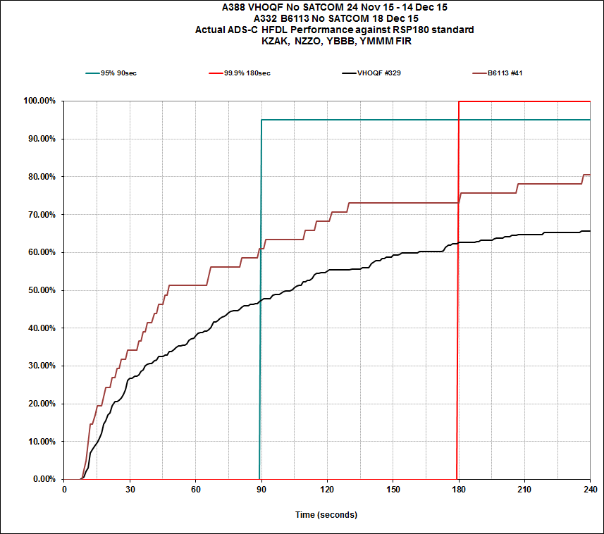
27
| ISPACG FIT 23
Notes:
RSP180 using pure HF – significant drop off from that seen in next-on-busy

Slide 28
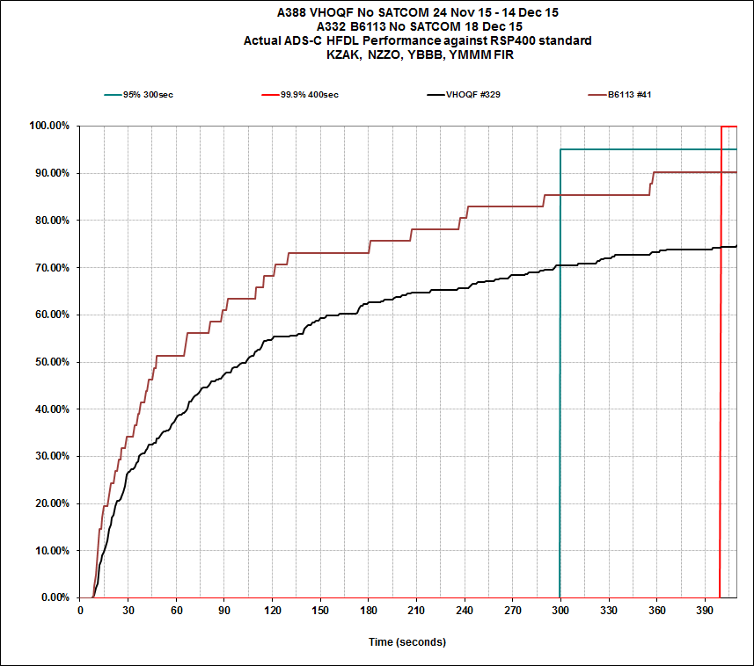
28
| ISPACG FIT 23
Notes:
RSP400 analysis – well below 95% requirements – unusable !!!

Slide 29
Individual HFDL performance for each QFA A388 - NZZO 2015
Tail # | # Message | 95% 90sec | 99.9% 180sec
OQC | 288 | 95.13 | 98.26
OQH | 286 | 89.51 | 98.25
OQD | 191 | 91.62 | 97.9
OQB | 282 | 90.42 | 97.51
OQL | 202 | 89.6 | 97.02
OQE | 214 | 91.58 | 96.26
OQI | 310 | 87.74 | 95.48
OQG | 278 | 91.36 | 95.32
OQA | 233 | 73.58 | 94.84
OQJ | 186 | 87.09 | 94.62
0QK | 144 | 82.63 | 93.05
OQF | 265 | 73.58 | 85.28
Individual HFDL performance for OQF operating no SATCOM
Tail # | # Message | 95% 90sec | 99.9% 180sec
OQF | 107 | 48.59 | 69.15
29
| ISPACG FIT 23
Notes:
See quite some variation in individual tail numbers – variability of the media and small data sets. Note significant drop in OQF when operating no SATCOM

Slide 30
With implementation of PBCS and ICAO FPL “P “ codes:
  Operating with no SATCOM on HFDL will mean that aircraft is not meeting RSP180 or RSP400.
  ATSP automation systems will place increasing reliance on the accuracy of FPL information.
  PBCS AOC and crew training will need to capture that operating with HFDL and no SATCOM aircraft will not meet RCP or RSP standards.
30
| ISPACG FIT 23

Slide 31
B787 Performance
31
| ISPACG FIT 23

Slide 32
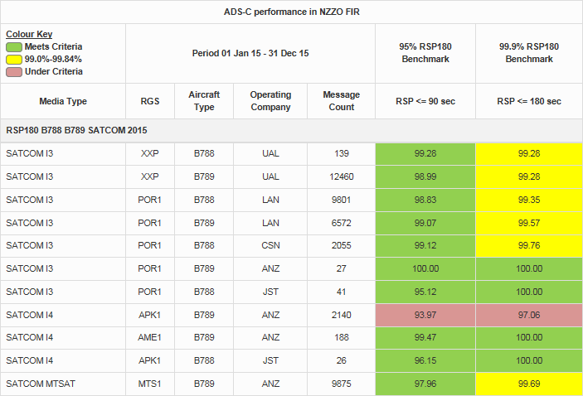
32
| ISPACG FIT 23
Notes:
Noticed significant drop off in ANZ B789 at end of 2015.

Slide 33
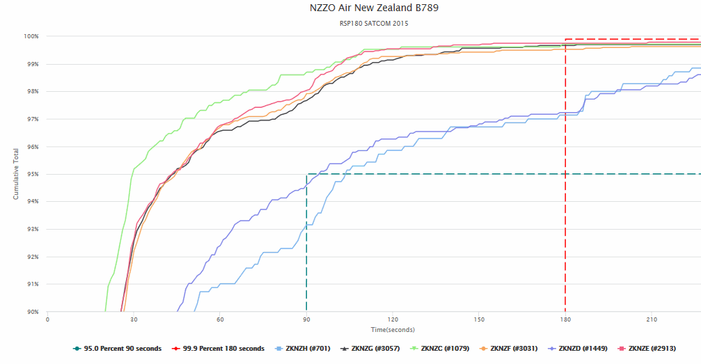
33
| ISPACG FIT 23
Notes:
Two tails affected.

Slide 34
Reviewing I4 performance shows a significant deterioration in overall performance for Air New Zealand B789 :
  Investigation shows performance deterioration is caused by two tails ZQ-NZF and ZQ-NZD.
  These were the last two aircraft delivered to ANZ and commenced operations in late 2015.
  Analysis shows both aircraft operating on the Inmarsat I4 while the rest of the fleet were operating on MTSAT as per aircraft software setup.
  ANZ advised that all the fleet had identical software loads.
  After checking with SITA , ANZ advised us that the aircraft had not been setup for operations on MTSAT although they had received positive confirmation of this when the aircraft entered service.
  This oversight has now been corrected and we expect performance on these two tails to return to normal.
  Performance impact is shown on following slide.
  We now have a new example of why monitoring is needed.
  Note for Suzie: The PR is on the website for action when you return :>)
34
| ISPACG FIT 23

Slide 35
B77W on Inmarsat I4 Performance
35
| ISPACG FIT 23

Slide 36
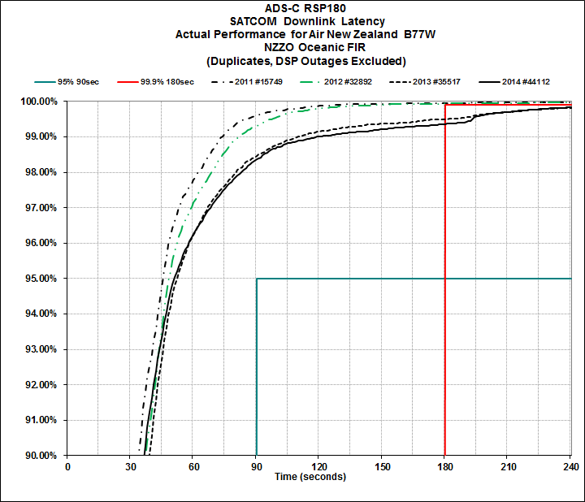
36
| ISPACG FIT 23
Notes:
Started transition to the I4 in 2013 – significant deterioration from 99.9% meeting spec to around 99.3%.

Slide 37
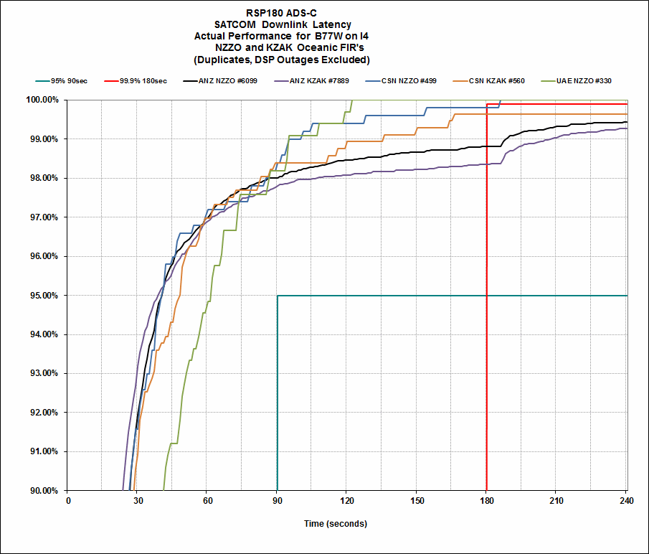
Notes:
In January KZAK and NZZO both show ANZ B77W performance below 99% 180”.
UAE B77W performance in NZZO operating on Tasman Sea routes meets the spec 99.9% 180”
CSN B77W operating on Northern Tasman Sea routes in NZZO nearly meets spec and is well above 99% 180”
CSN B77W operating in KZAK slightly down on performance seen in NZZO.
37
| ISPACG FIT 23

Slide 38
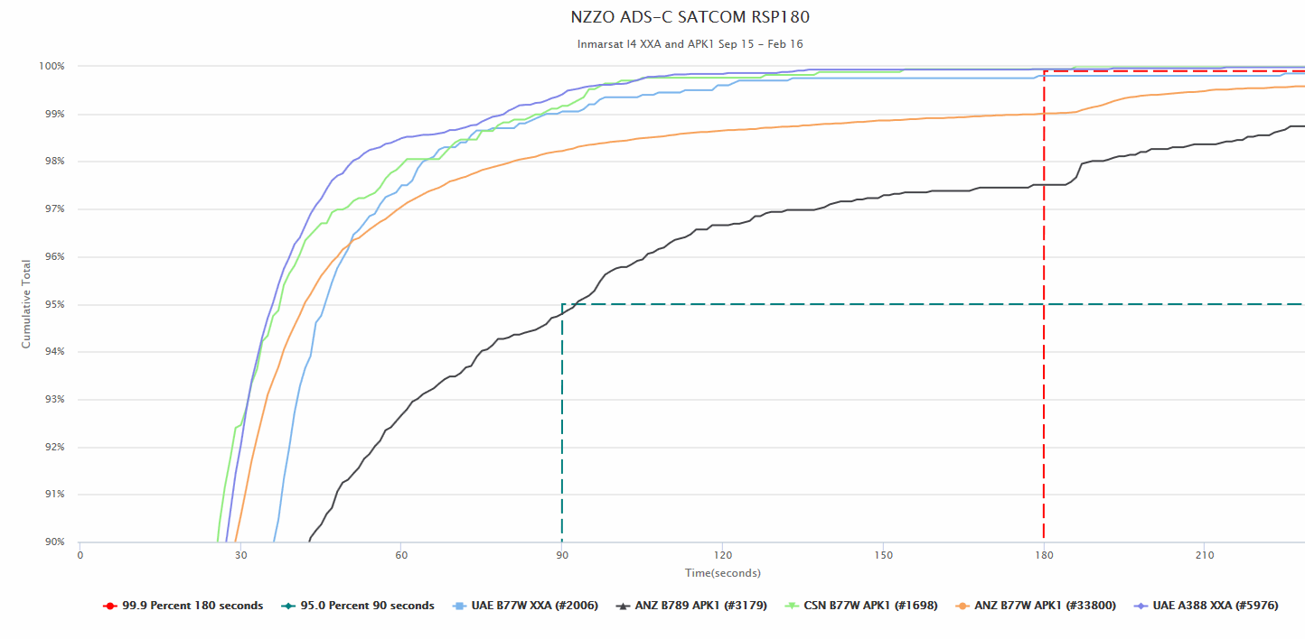
Airline | Type | RGS | RSP 180
CSN | B77W | APK1 | 99.9
UAE | B77W | XXA | 99.8
UAE | A388 | XXA | 99.9
ANZ | B77W | APK1 | 99.0
ANZ | B789 | APK1 | 97.5
This graph illustrates the difference between three fleets (CSN B77W on SITA APK1, UAE A388 and B77W on Rockwell Collins/ARINC XXA ) which meet the RSP180 requirement and the two ANZ fleets operating SITA APK1.
The CSN and UAE fleets operate on Tasman Sea routes while the ANZ fleets operate mainly on Pacific routes
38
| ISPACG FIT 23

Slide 39
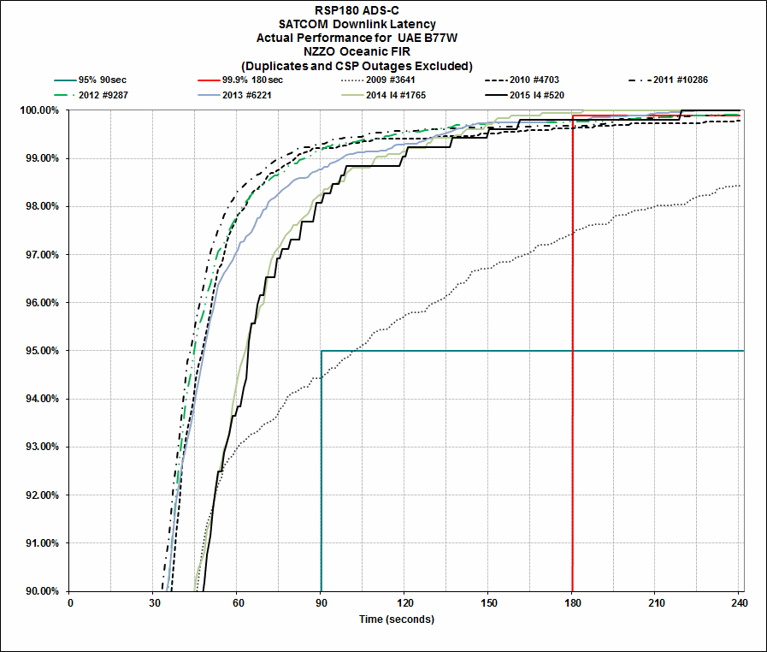
39
| ISPACG FIT 23

Slide 40
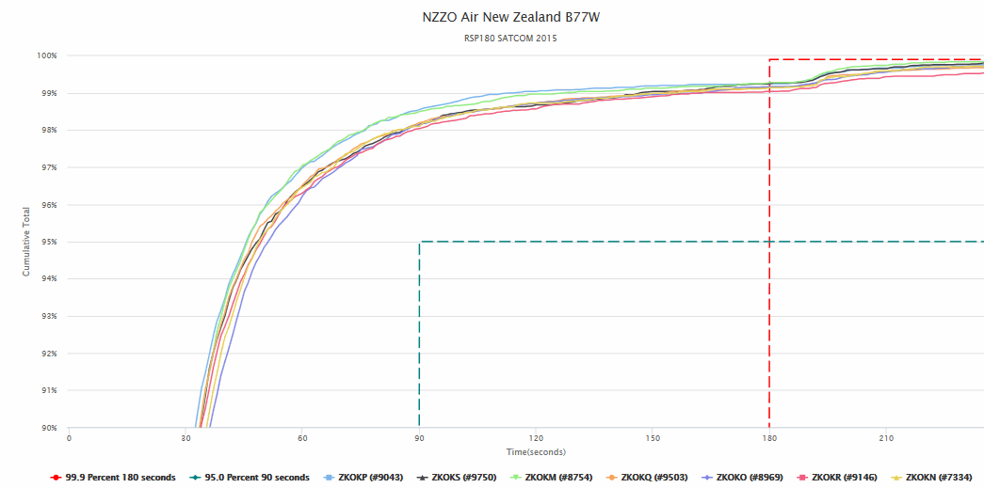
40
| ISPACG FIT 23

Slide 41
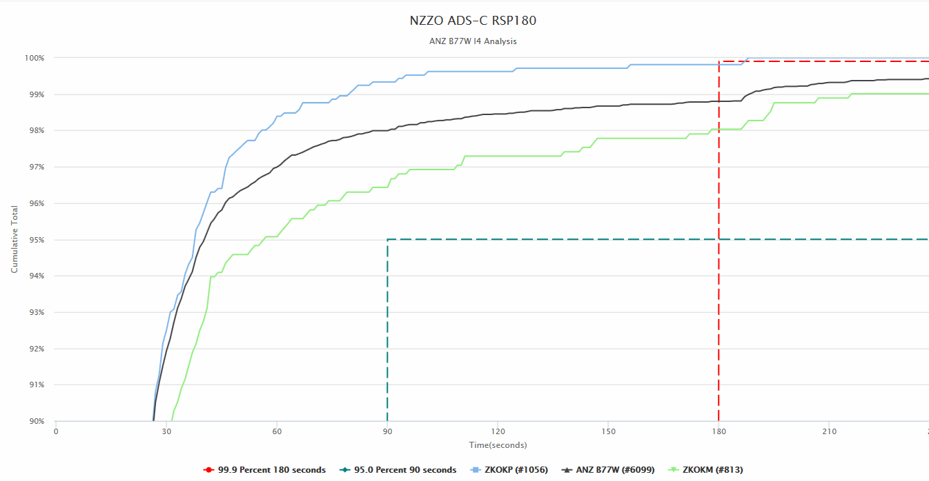
Notes: Analysis for January 2016. Smaller data-set shows wide r variability.
Note: Fleet average is below 99% 180 seconds. Best performing tail (ZKOKP) nearly meets the specification while the lowest performing tail (ZKOKM) just meets 98% 180 seconds .
41
| ISPACG FIT 23

Slide 42
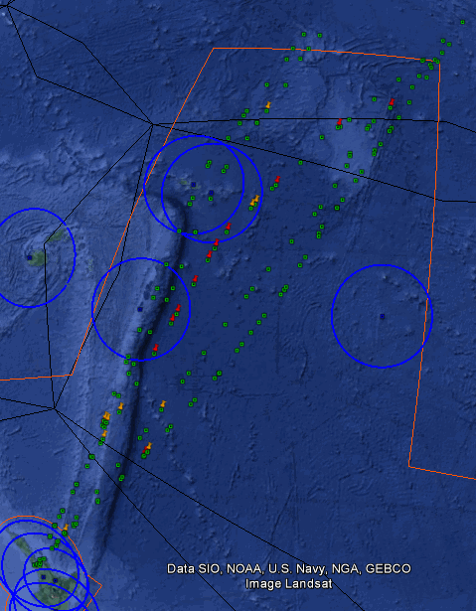
This shows the six pacific flights flown by ZKOKM that experienced ADS-C latency delays in January. These are all UPR routes between NZAA and NAM.
Delays 90-180 seconds in orange.
Delays 180+ seconds in red.
The blue circles are 180NM around VGS
The black lines depict approximate I4 spot beams and the transition areas between the spot beams
On the 19th January southbound from NAM we see 9 delays exceeding 180” and 4 delays between 90-180”
42
| ISPACG FIT 23

Slide 43
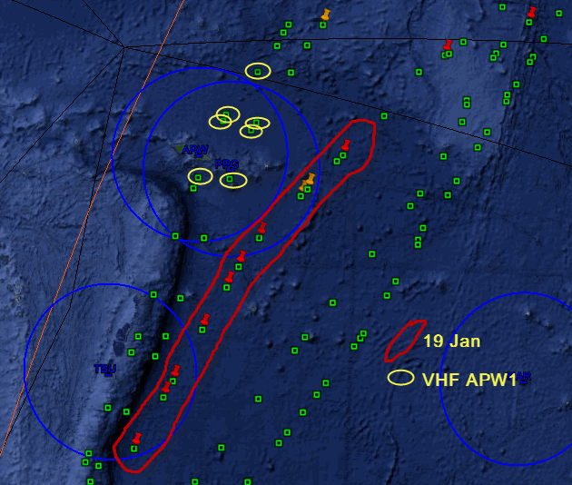
ZKOKM January routes with delays showing those reports using VHF and the flight on 19 January with multiple delays through APK1
43
| ISPACG FIT 23

Slide 44
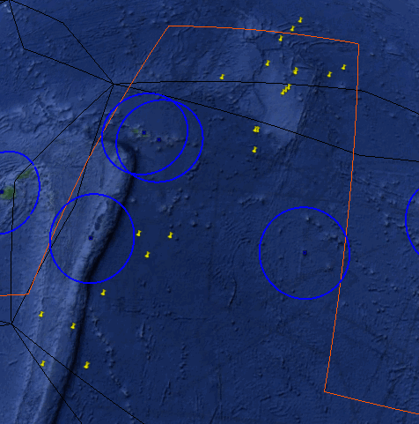
February delays 180”+
NZZO Pacific Area
ANZ B77W operating on I4 APK1
Spot beam transition???
44
| ISPACG FIT 23

Slide 45
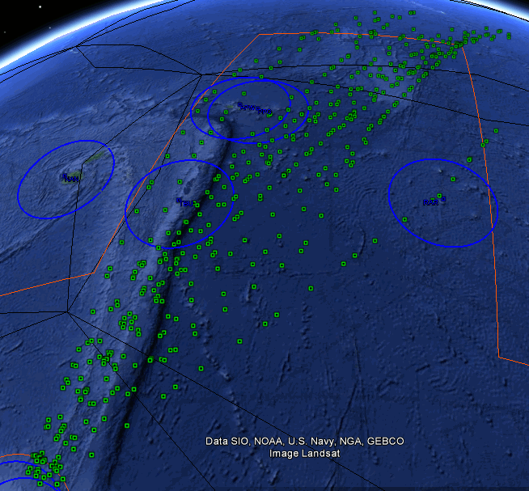
This shows the remaining pacific flights flown by ZKOKM that experienced no ADS-C latency delays in January. These are all UPR routes between NZAA and NAM.
45
| ISPACG FIT 23

Slide 46
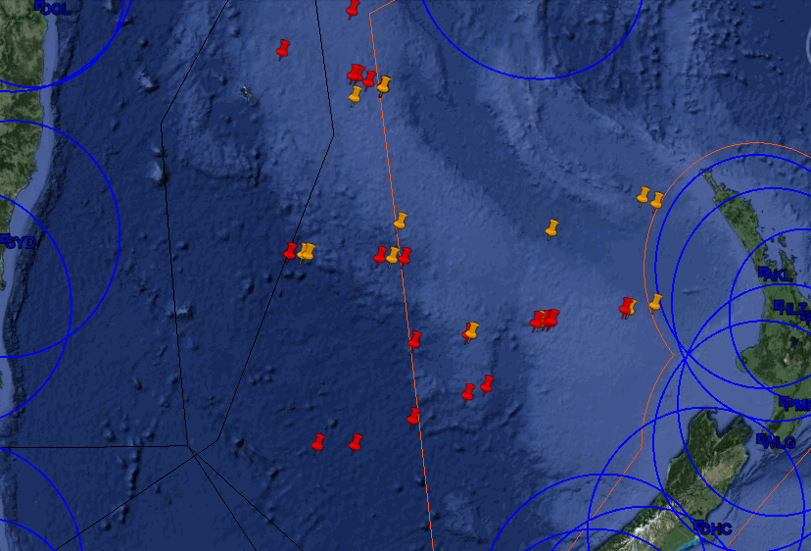
Spot beam transition ?
Delays from all B77W operating on Tasman Sea routes in January.
Some observed delays on 163E boundary between NZZO and YBBB may relate to multiple contracts.
Some delays around VHF-SATCOM transition around NZ
ZKOKO 20 January YMML-NZAA
46
| ISPACG FIT 23

Slide 47
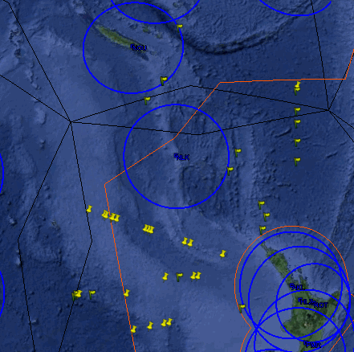
February delays 180+
NZZO Tasman Sea
ANZ B77W on APK1 (Yellow Pin)
ANZ B789 on APK1 (Yellow Flag)
47
| ISPACG FIT 23

Slide 48
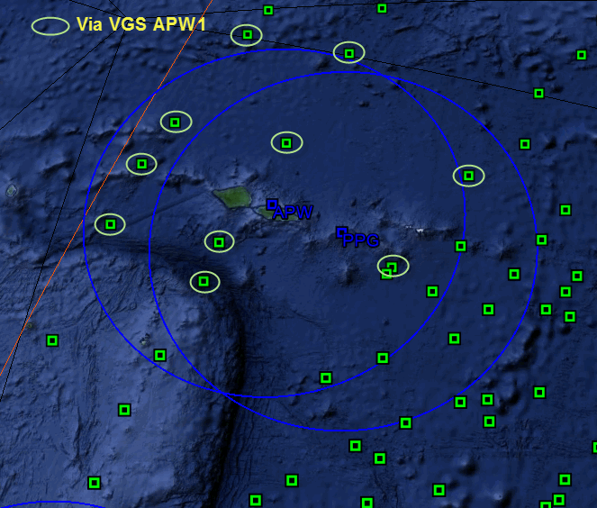
Flights by ZKOKM with no delays through the APW/PPG VHF RGS areas.
No downlinks seen through PPG in January?
48
| ISPACG FIT 23

Slide 49
To date no resolution on reason for performance drop when the fleet switched to the I4 from the I3 Some ideas that have been postulated include:
  Spot beam transition issues?
  VHF transition issues?
  Aircraft software?
  RGS software?
Seems to be occasional flights where we see numerous consecutive delays. For example 19 January with ZK-OKM through Samoa/Tonga and 20 January YMML-NZAA mid Tasman.
Investigation continues……….
49
| ISPACG FIT 23

Slide 50
Thank you

