Slide 1

Space Weather and Its Impacts on Aviation
Joe Kunches
Director, Space Weather Services
ASTRA
Boulder, Colorado
USA
ISPACG/29
March 4-6, 2015
Santiago, Chile

Slide 2
A Brief History of Northern Polar Flights and Space Weather
Background
North Polar flying matured and prospered in the decade starting in late ‘90s (Cameron, CPWG 10)
In parallel, solar activity also grew in the maximum phase of Solar Cycle 23, i.e., 2001-2006
  Motivated the definition of procedures and actions based on level of activity
Solar Cycle 24 began January 2009

Slide 3
Brief History…. (Part 2)
Compared to Cycle 23, the current Cycle 24 has been very weak
  Flares and CMEs are about 1/3 as frequent
  Geomagnetic storm activity affected similarly
There are suggestions that the next Cycle – Cycle 25 – will be even less eruptive
Mostly good news for the airlines, but not completely
  Weak solar activity means more galactic radiation at aircraft altitudes

Slide 4
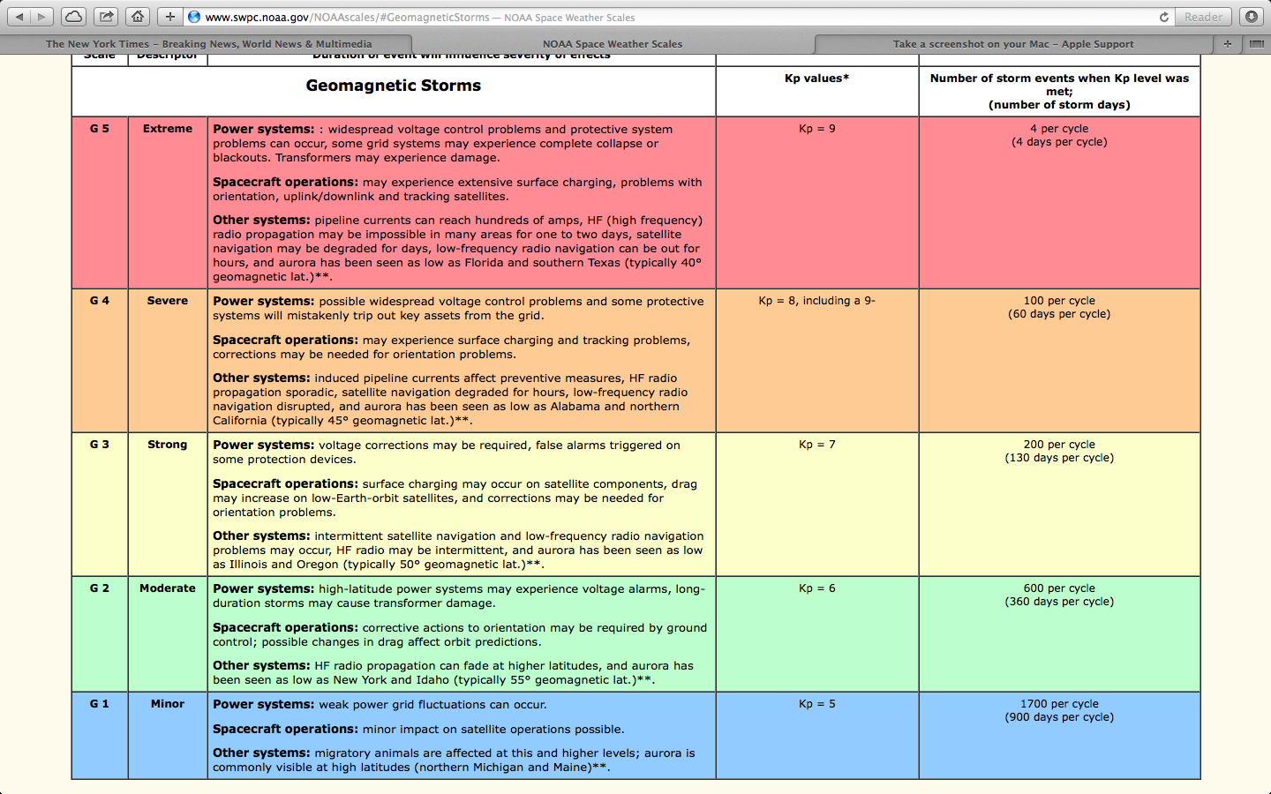
Example – NOAA Sp Wx Scales

Slide 5
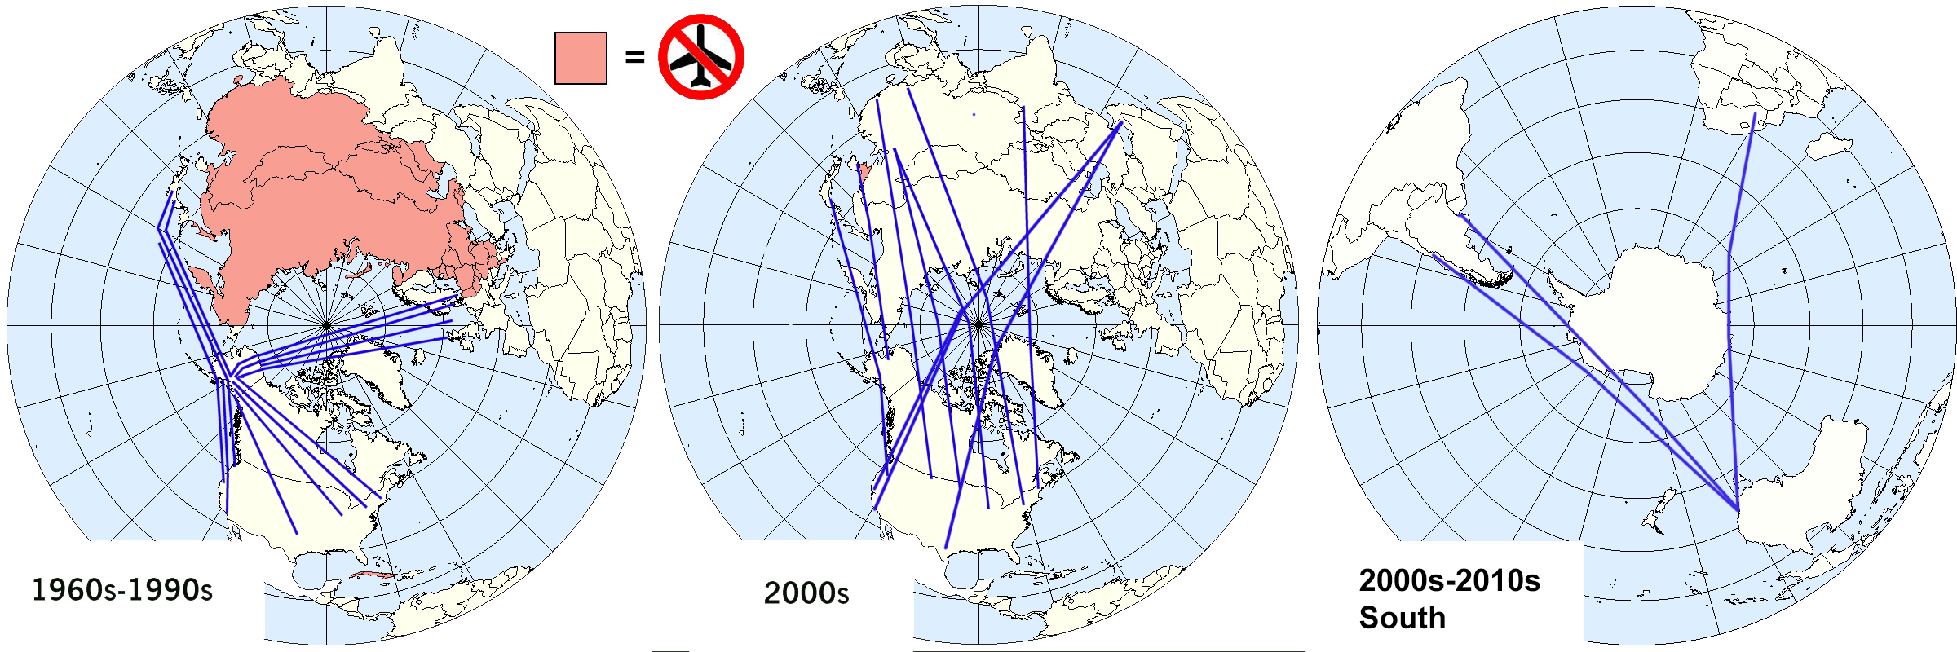
Global Polar Aviation

Slide 6
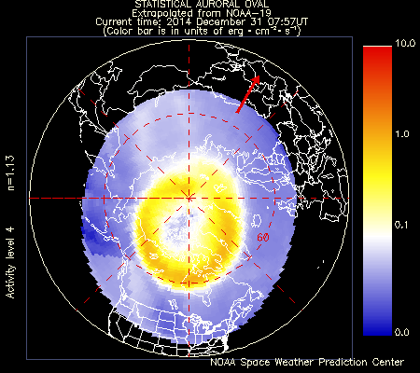
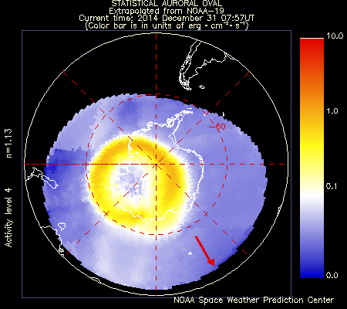
High Latitudes Have Same Sp Wx Access

Slide 7
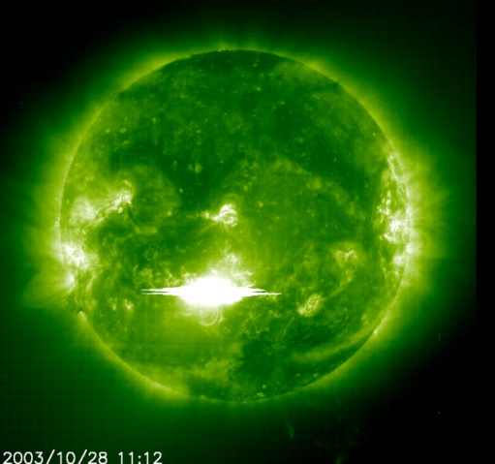
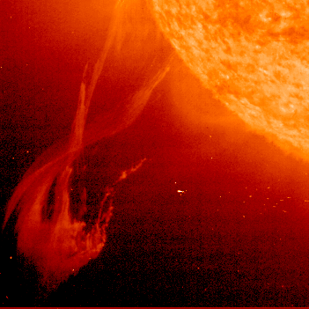
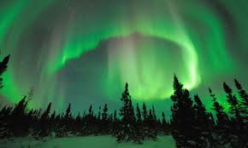
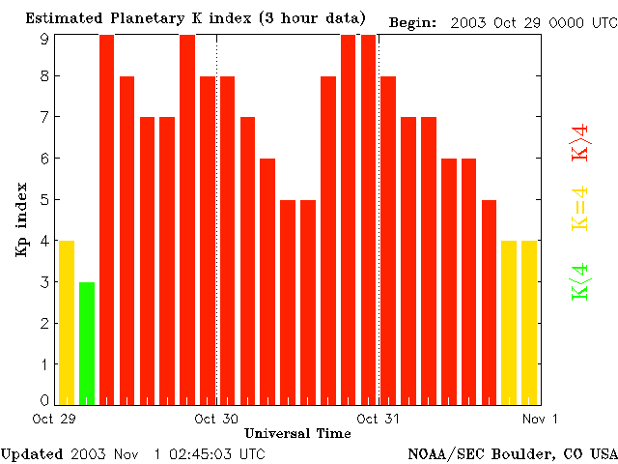
Geomag Storms = Degraded Comm
Ionospheric disturbances often occur in concert with geomagnetic disturbances.
The reflection of VHF signals will occur on occasion during strong geomagnetic storms.
Notes:
NOTAMs are occasionally issued for geomagnetic storms and communication problems. Below is an excerpt from a NOTAM issued in October 2003.
CZEG EDMONTON CENTRE (ACC)
A8577/03 - ROUTE AND LEVEL RESTRICTIONS DUE TO GEO-MAGNETIC STORM IMPACT ON COMM IN EDMONTON ACC ALL FLT TRANSITING CZEG FIR N OF 5700N AT FL290 OR ABOVE: 1. NORTHBOUND POLAR FLT PROCEEDING OVER DEVID, ORVIT…
6. OPR ARE ADVISED THAT VHF AND HF COMM RELAYED FROM THE TRANS SITE TO ATC VIA SATELLITE MAY FAIL DUE TO THE EFFECTS OF THE CURRENT INTENSE MAGNETIC STORM. CZEG WILL UPDATE THESE MEASURES AS THE STORM IMPACTS BECOMES BETTER KNOWN.
CZEG SHIFT MANAGER

Slide 8

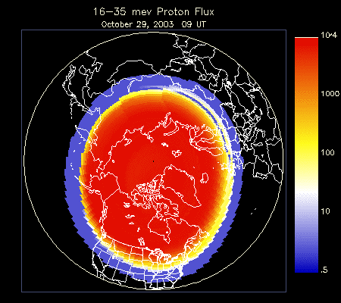
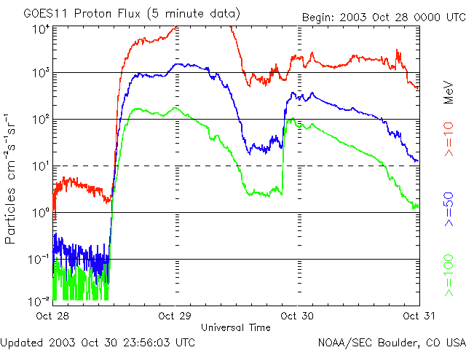
Radiation Storms = Blacked-Out Comm
Radiation storms (proton events) can cause extended
periods of HF blackout at higher latitudes.
Over 100 hours of HF blackout in the Antarctic
during the “Halloween Storms” of 2003.
The onset of these storms is difficult to predict, but
once they begin, forecasters can predict the duration
with some accuracy.
Notes:
Solar radiation storms create the biggest and most prolonged communications problems in the polar regions. Degradation of HF communications typically begins at the S2 (Moderate) level, and becomes serious at S3 (Strong) and above levels.

Slide 9
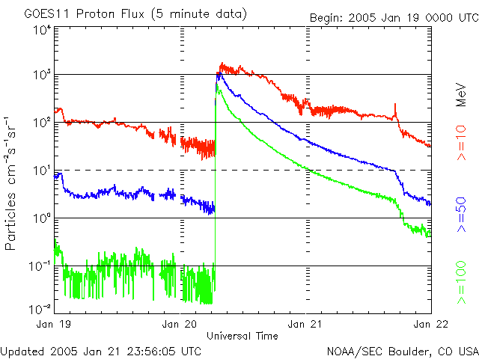
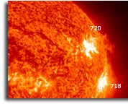
Radiation Storms and the Biological Threat
Radiation storms can quickly follow the onset of a large solar flare. Highest energy protons (>100 MeV) travel fastest (up to a third the speed of light!).
Jan 2005: X7 flare began at 20/0636 UT and peaked at 20/0701 UT. The Intense >100 MeV radiation storm peaked at 20/0710 UT. This storm was short-lived, but did exceed the FAA Solar Radiation Alert at Flight Altitudes for about 1.5 hours.
Notes:
There is growing concern about solar radiation exposure, especially over polar routes. The FAA Circular Advisory AC No: 120-61A on in-flight radiation references the article – “In-flight Radiation Exposure during Pregnancy” published by the American College of Obstetricians and Gynecologists (Barish, 2004). The article refers to the International Commission on Radiological Protection which recommends a dose limit of 1 mSv (100 mrem) to the conceptus. In July 2000, there was a solar radiation storm that raised the dose rates to 200 μSv (20 mrem) per hour. Based on FAA estimates, “a pregnant flyer’s radiation dose in the weeks and months before and after the event were added to the dose received during the event itself, the total dose could easily have been greater than 1 mSv.” Pilot and Flight Attendant union groups are especially concerned about this threat because of the amount of flight hours typically accumulated by flight crews.
Airlines will fly at lower altitudes and different routes to avoid this exposure.

Slide 10
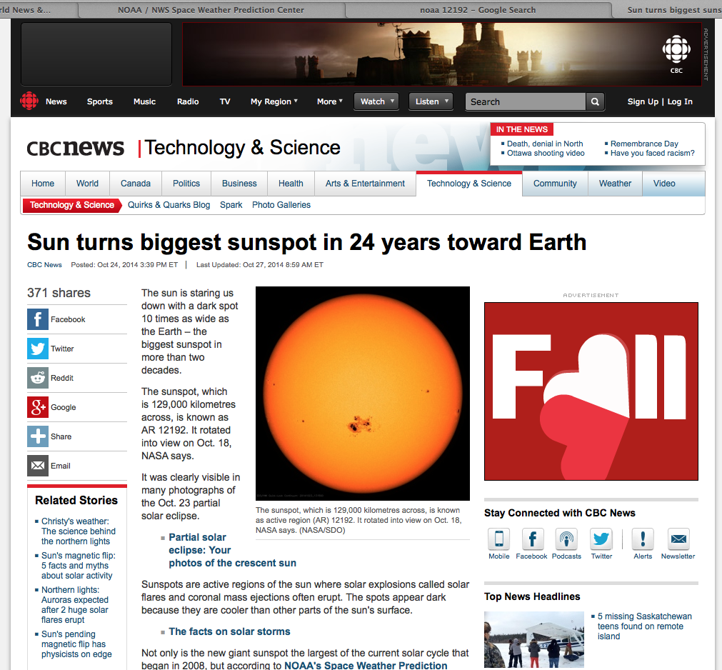
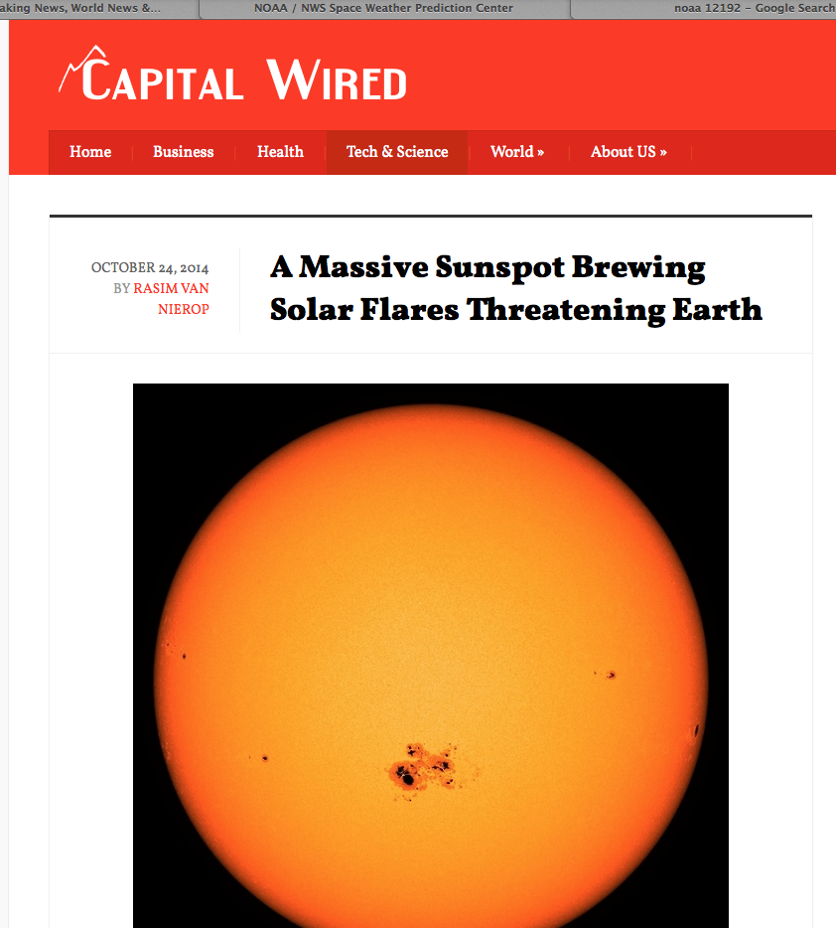
Recent Space Weather News

Slide 11
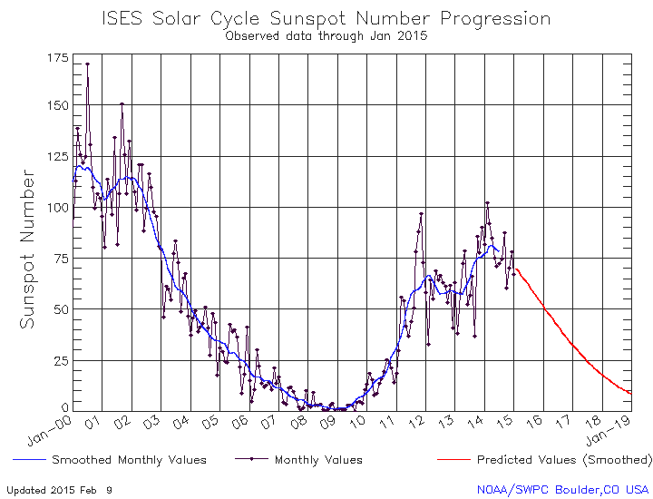
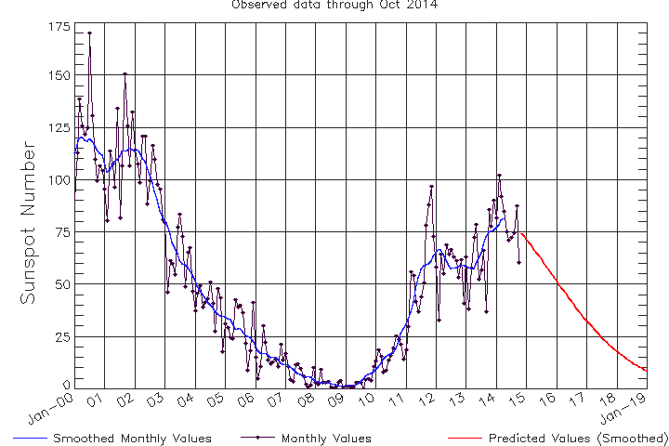
Solar Cycle Trend

Slide 12

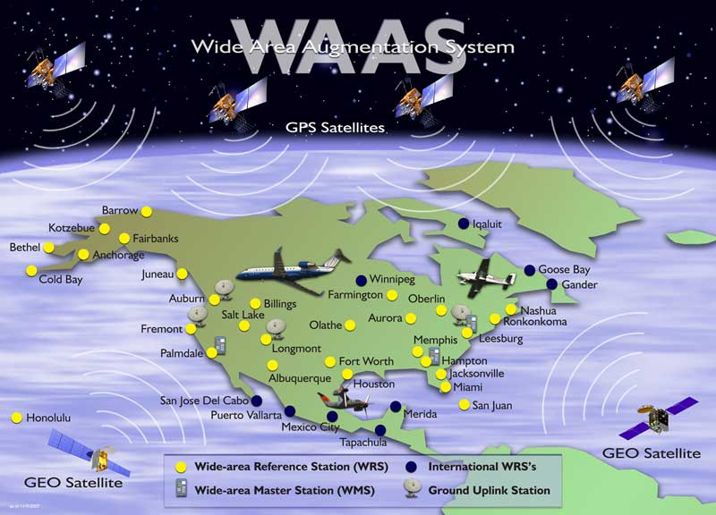
SBAS (WAAS) Infrastructure
©Copyright 2011

Slide 13
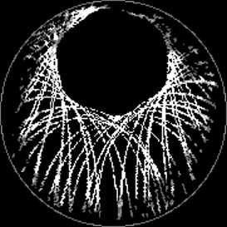
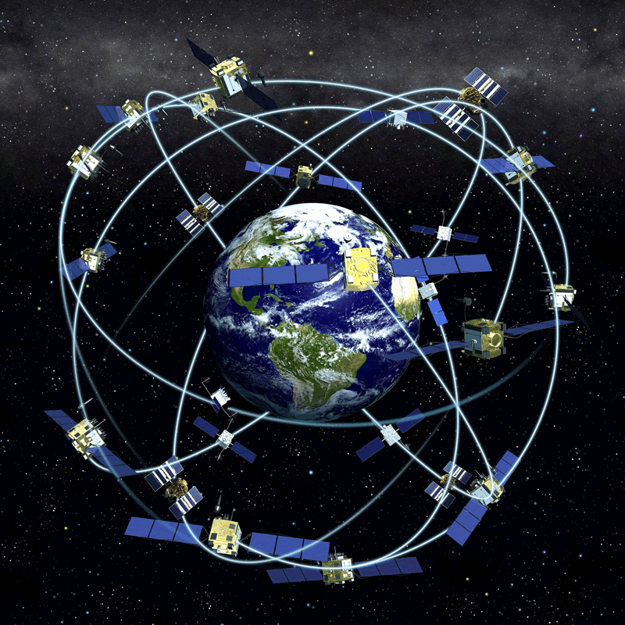
GPS: Consequences of a 55˚ Inclination
From high latitudes, all satellites relatively low on the horizon
Must look through “thick” ionosphere

Slide 14
Recent Impact to WAAS
“An Ionospheric Storm began on 2/27/14. The Satellite Operations Specialists were alerted at the WAAS O&M by a Significant Event 757 at 2120 Zulu. So far, LPV and LPV200 service has not been available in Eastern Alaska and Northeastern CONUS. At times, North Central CONUS and all of Alaska have lost LPV and LPV200 Service.” FAA
Moderate Kp = 6 Storm

Slide 15
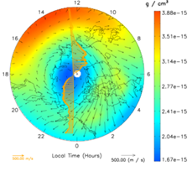
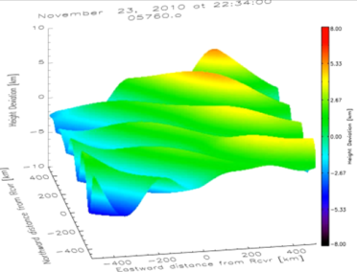
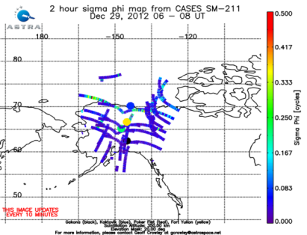
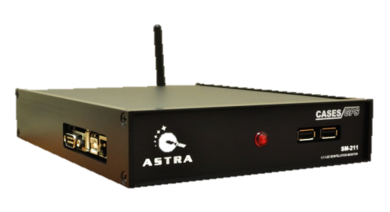
ASTRA: Overview
Modeling
Data Assimilation
Data
Services
Ground-based Instrument Development
Space Systems
Physics-Based Modeling
(TIMEGCM)
High-latitude Electrodynamics
(AMIE)
Space Based Data
GPS-based Space Weather Monitor
CubeSat Missions
NSF DICE Cubesat
Ground Based Data
Low Power Ionospheric Sounder
SMC SENSE
Global Ionosphere
(IDA4D)
Real-Time Specification of Ionosphere/ Thermosphere
AF DIME Cubesat
Forensic Space Weather Analysis
Plug-N-Play Avionics
Thermospheric Neutral Density (ADAM)
HF TID Mapper
CubeSat Instruments
Scanning
UV Photometer
Space weather Phone Apps
Laser Bathymetry
E-field Double Probe
Satellite Drag & Ballistic Coefficients
Topside Sounder
Lidar Systems
Wind Profiler
GPS-based Space Weather Monitor
Satellite Aerodynamics

Slide 16
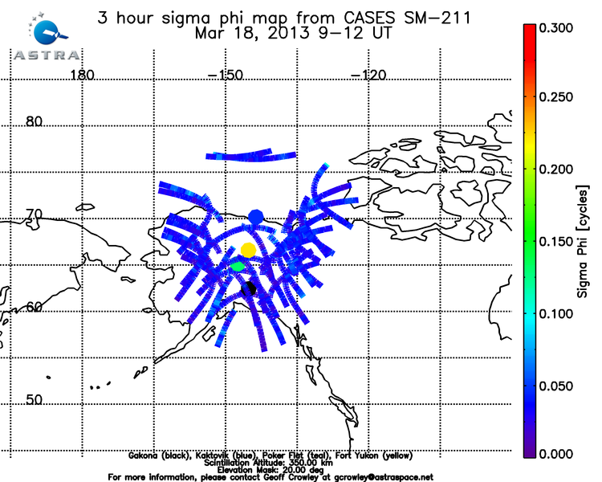
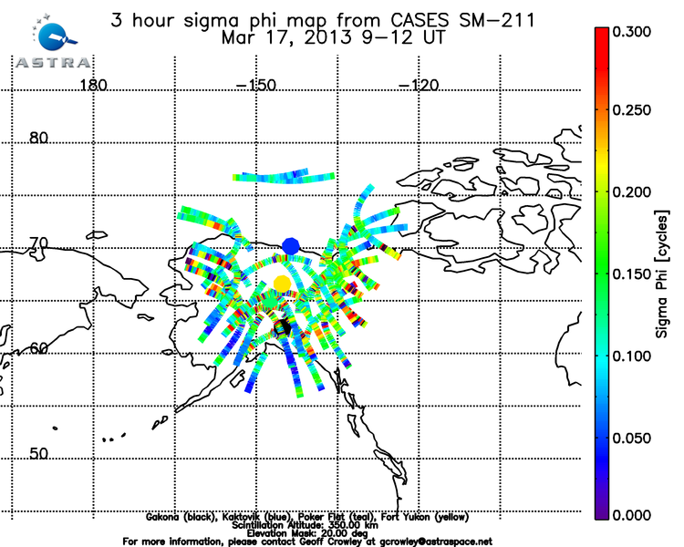
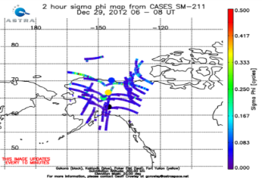
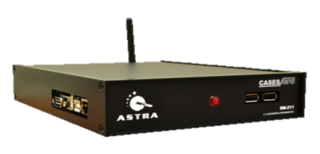
Real Time Alaska GPS Data
Quiet Conditions
Active Conditions

Slide 17
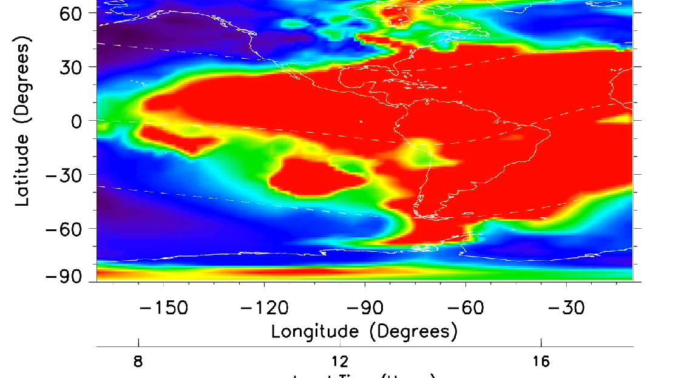
ASTRA Real Time Ionospheric Data Assimilation

Slide 18
Summary
Summary
Communications and navigation performance prime issues
Space weather benign lately ,i.e., SWPC alerts, but disruptive activity still occurring
ASTRA offers forward-looking, tailored products and services for ANSPs and airlines

