Slide 1



FIT22 Agenda Item 2
NZZO Feedback
ISPACG FIT 22
Santiago, Chile
3-4 March 2015

Slide 2
NZZO Feedback
Performance:
  Will be covered in more detail in FIT WP6 -NZZO Performance.
  Overall performance observed in monitoring against both RSP180 and RCP240 specifications is acceptable.
  Availability affected by two significant Inmarsat outages in 2014.
HFDL
  Observing low level of HFDL use on Airbus A380/A330 and now observed on some Boeing B787.
Iridium
  Low level of Iridium use in NZZO.
  Observed Performance of HAL B763 still poor, but issue may have been identified.
Monitoring in NZZO in 2014
  Again impacted by resource availability. Manual spreadsheet analysis is time consuming and while automation capability is on the software development work plan delivery schedule is unknown.
  One issue of interest detected affecting B787. Another good example of the importance of monitoring and of PBCS.
2
| ISPACG FIT 21 2014

Slide 3
NZZO Feedback
NZZO FANS1/A Media Mix in 2014
      SATCOM - 81%
          Inmarsat I3 – 49%
          Inmarsat I4- 21%
          Iridium-1%
          MTSAT-10%
      VHF – 18%
      HFDL – 1%
Gradual transition from Inmarsat I3 to Inmarsat I4 observed.
3
| ISPACG FIT 21 2014

Slide 4
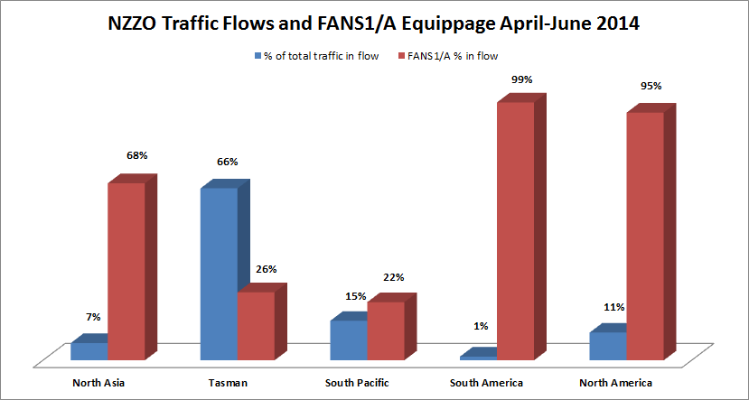
NZZO Feedback
Percentage of FANS1/A Equipage overall in NZZO is around 40%
4
| ISPACG FIT 21 2014

Slide 5
NZZO Feedback
CRA website Upgrade:
  Staff resources have impacted significantly on planned delivery.
  Progress has been slowed mainly because of staff turnover
  Latest indication is that the new problem reporting database may be available for testing end of March 2015.
  One issue to be addressed with the new database is that only one email address is permitted per username/logon.
Takeup
  Noticeable uptake by Biz-Jet operators in 2014/15
5
| ISPACG FIT 21 2014

