Slide 1



NZZO FANS1/A Performance 2014
ISPACG FIT 22
Santiago, Chile
2-3 March 2015

Slide 2
ADS-C Performance - RSP180
2
| ISPACG FIT 22 2015

Slide 3
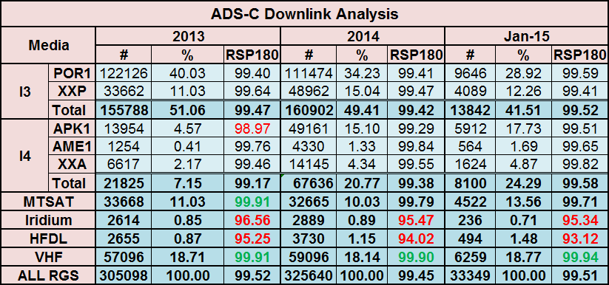
3
| ISPACG FIT 22 2015

Slide 4
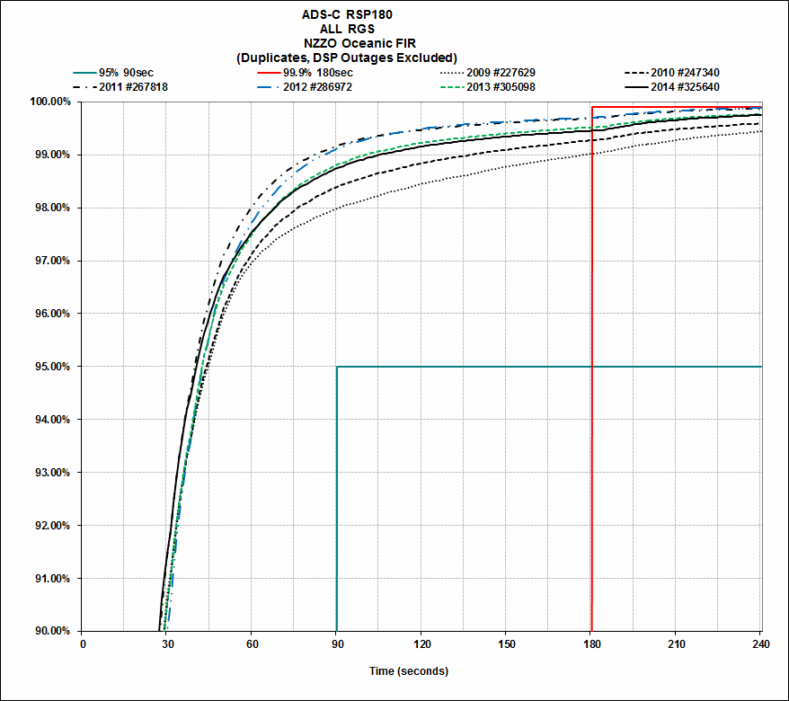
4
| ISPACG FIT 22 2015

Slide 5
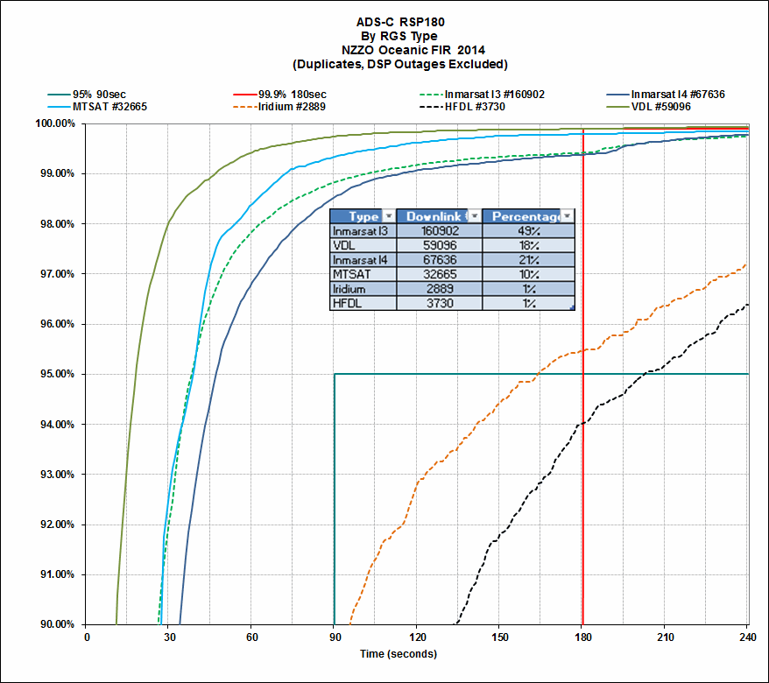
5
| ISPACG FIT 22 2015

Slide 6
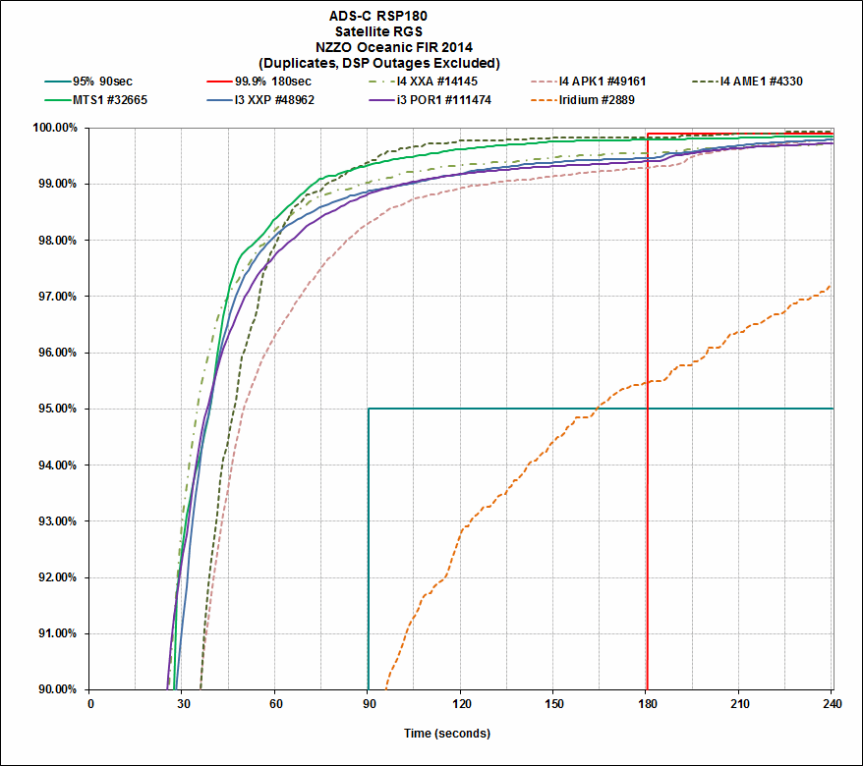
?
6
| ISPACG FIT 22 2015

Slide 7
CPDLC Performance – RCP240
7
| ISPACG FIT 22 2015

Slide 8
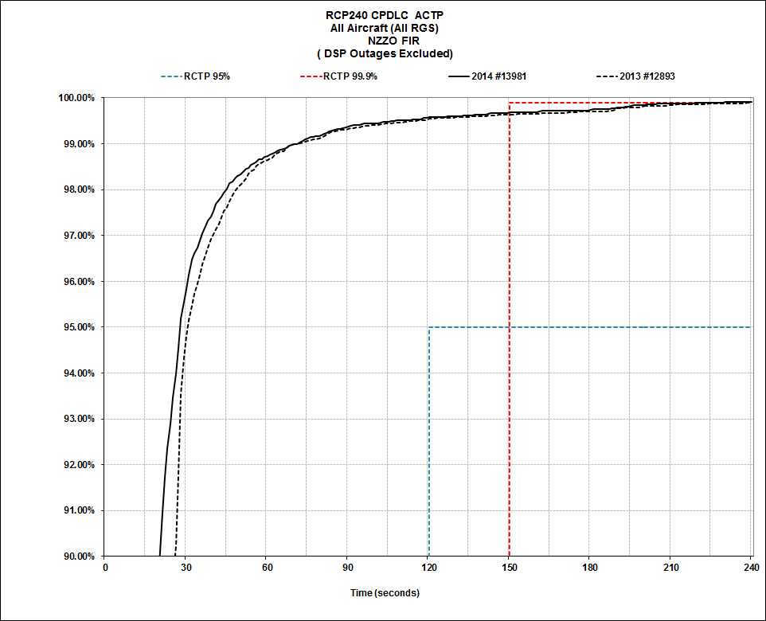
8
| ISPACG FIT 22 2015

Slide 9
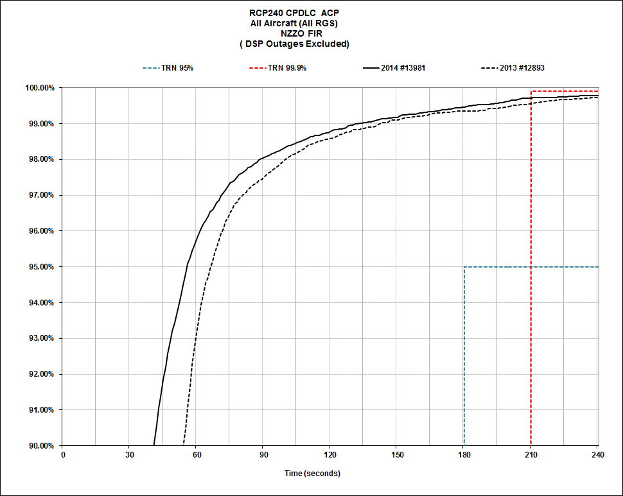
9
| ISPACG FIT 22 2015

Slide 10
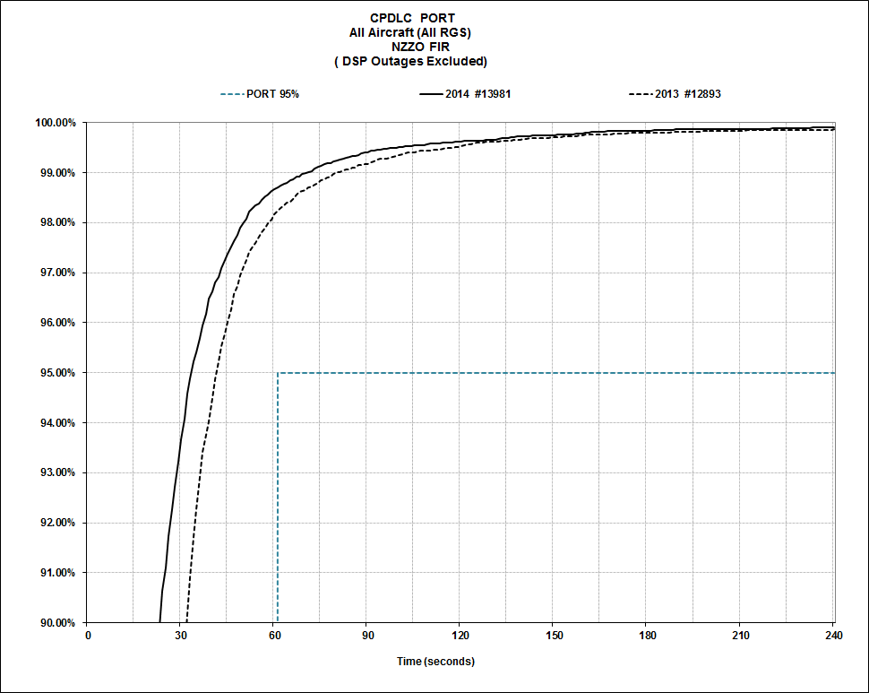
10
| ISPACG FIT 22 2015

Slide 11
Iridium Performance
11
| ISPACG FIT 22 2015

Slide 12
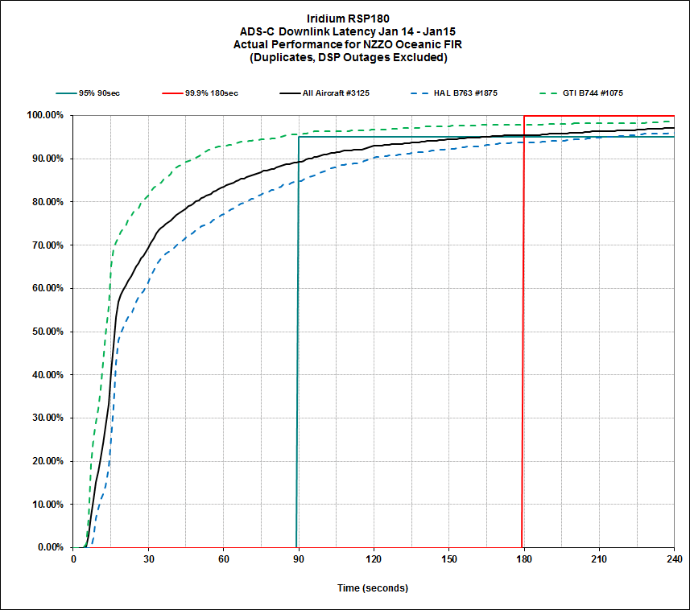
12
| ISPACG FIT 22 2015

Slide 13
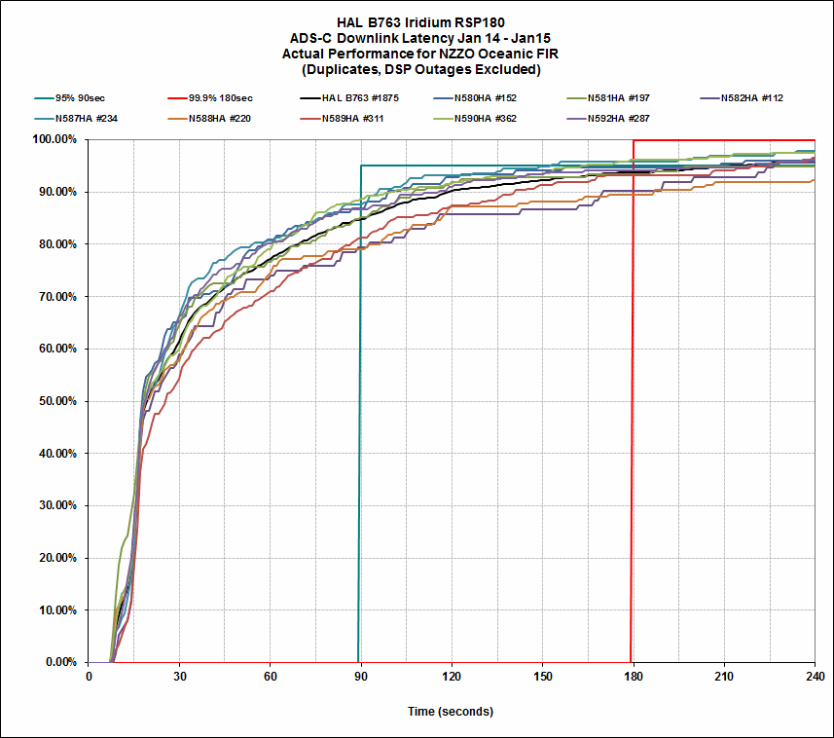
13
| ISPACG FIT 22 2015

Slide 14
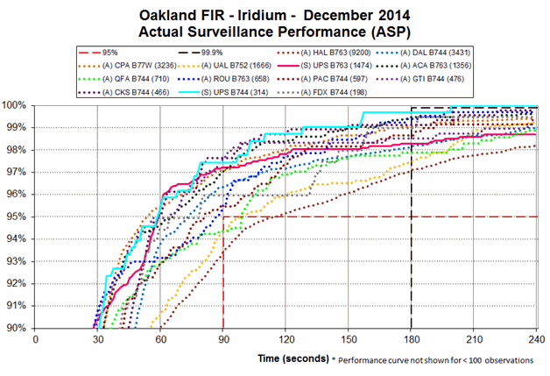
GTI
HAL
14
| ISPACG FIT 22 2015

Slide 15
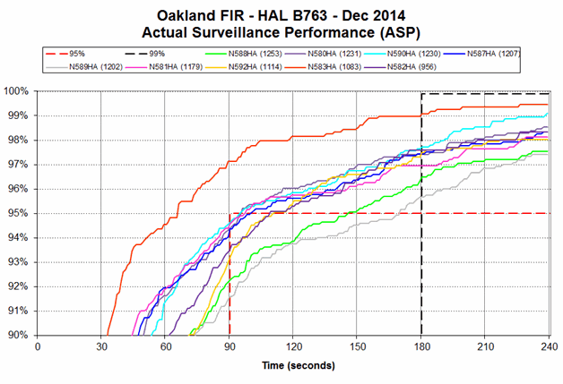
N583HA believed to have had an avionics upgrade early December 2014
15
| ISPACG FIT 22 2015

Slide 16
B787 Performance
16
| ISPACG FIT 22 2015

Slide 17
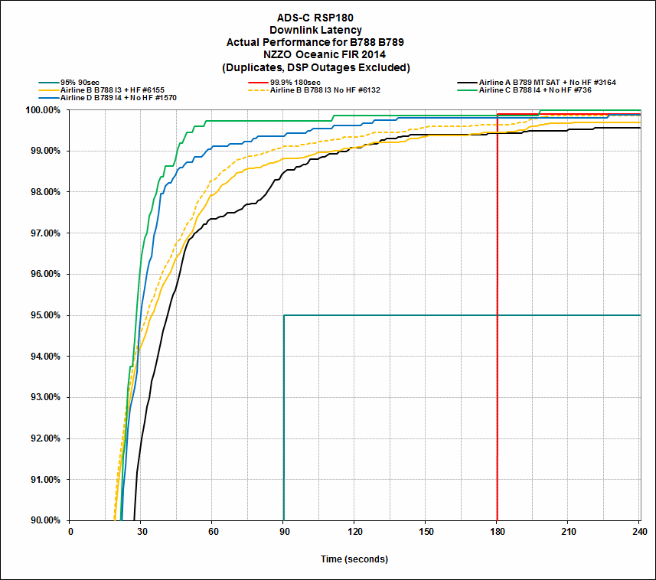
17
| ISPACG FIT 22 2015

Slide 18
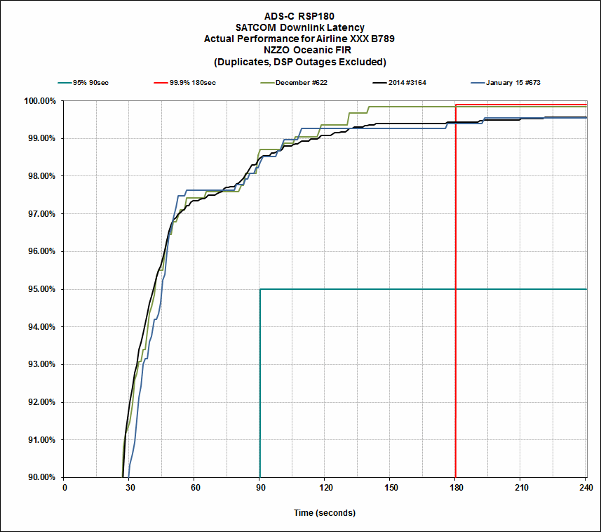
18
| ISPACG FIT 22 2015

Slide 19
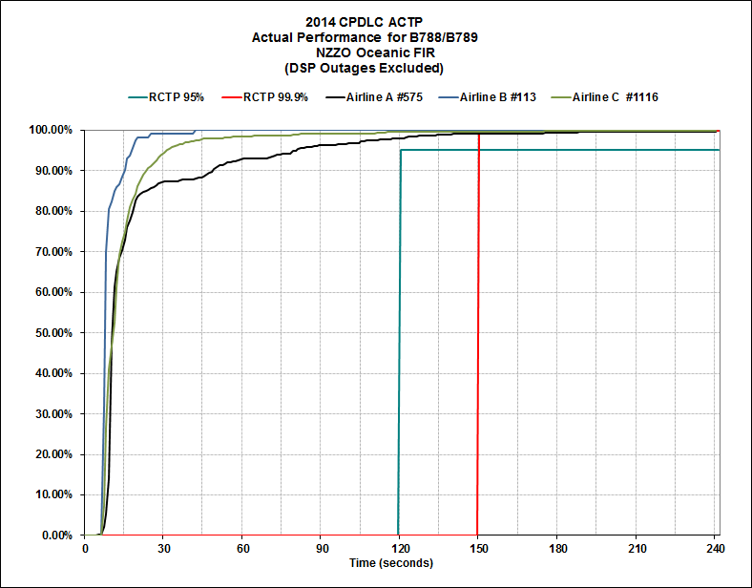
19
| ISPACG FIT 22 2015

Slide 20
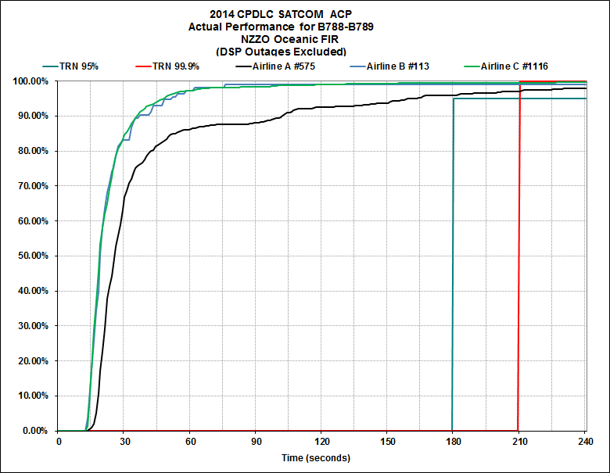
20
| ISPACG FIT 22 2015

Slide 21
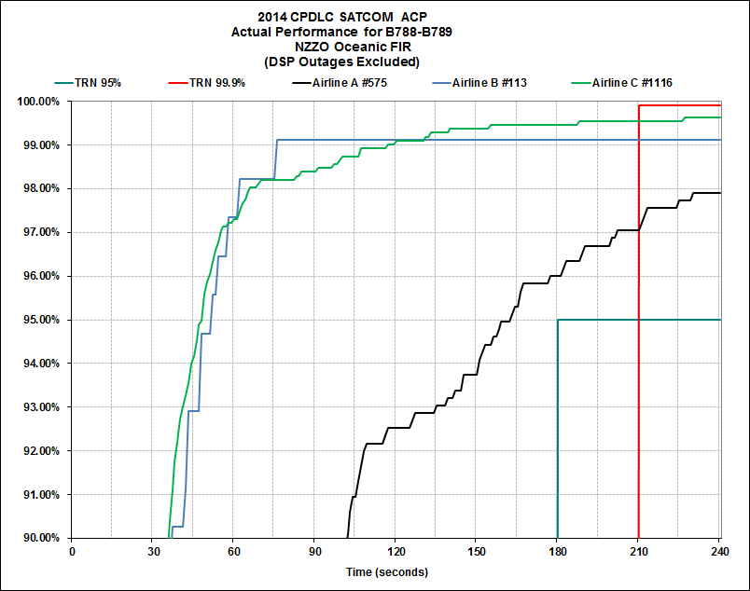
21
| ISPACG FIT 22 2015

Slide 22
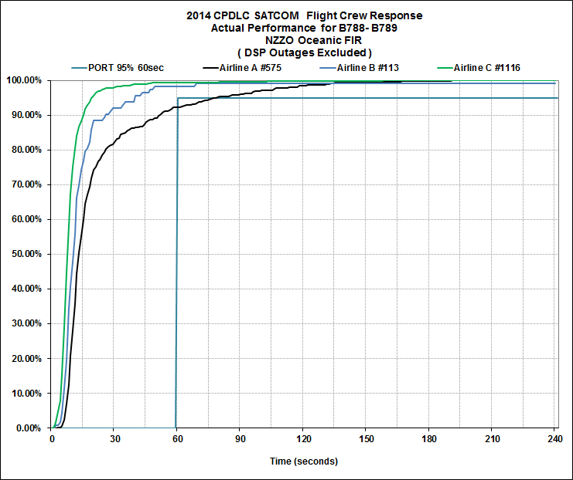
22
| ISPACG FIT 22 2015

Slide 23
Thank you

