Slide 1
YBBB data link performance monitoring
FIT21 Auckland, March 4 - 5 2014

Slide 2
Data link performance monitoring
Presentation title
Data is from YBBB for the period Jan – Dec 2013
  Outages excluded
  Occurrences of negative ACTP observed
  Occurrences where downlink being received prior to being sent observed

Slide 3
ACP (Jan-Dec 2013)

Slide 4
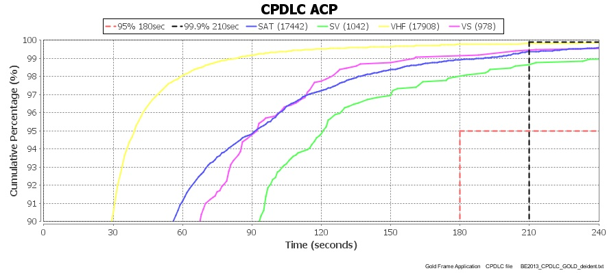

Slide 5
ACTP (Jan-Dec 2013)

Slide 6
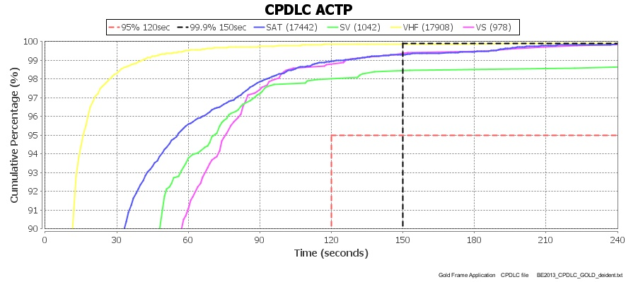

Slide 7
PORT (Jan-Dec 2013)

Slide 8
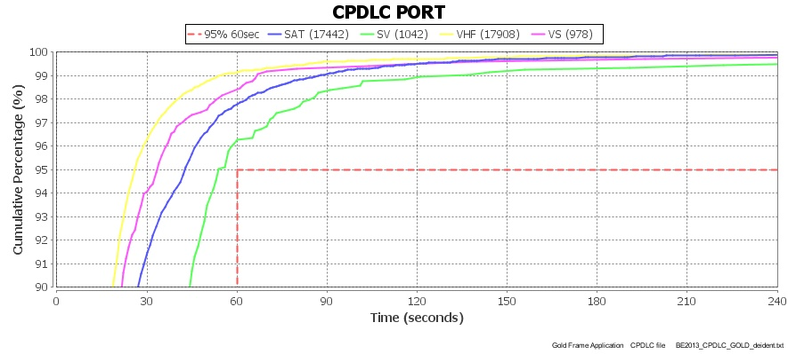

Slide 9
ACP by operator

Slide 10
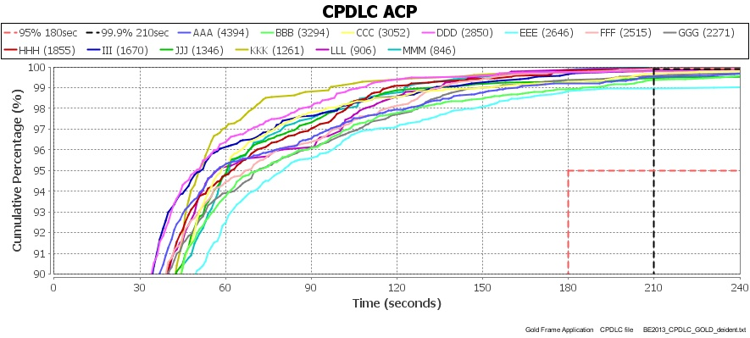

Slide 11
ACTP by operator

Slide 12
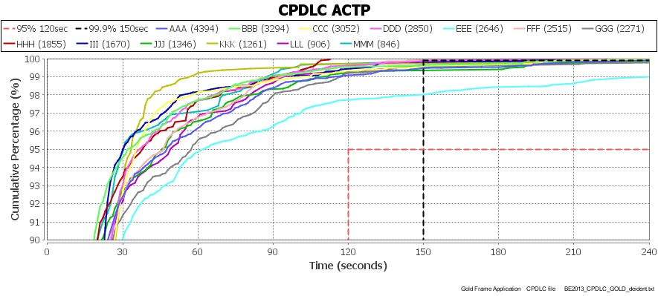

Slide 13
PORT by operator

Slide 14
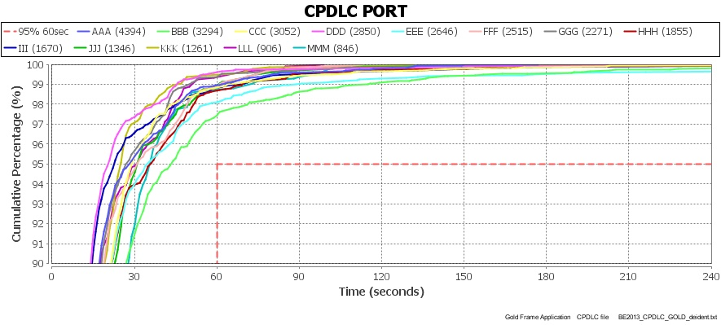

Slide 15
ADS-C Downlink latency

Slide 16
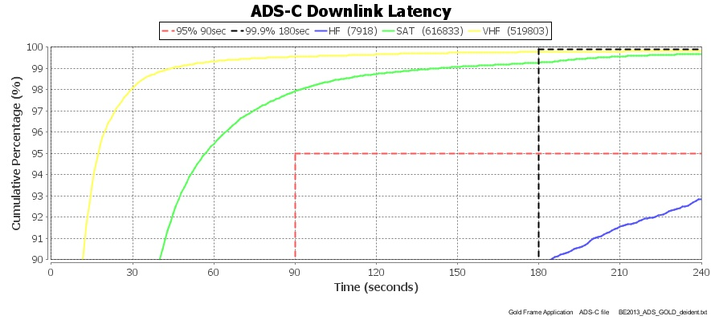

Slide 17
ADS-C latency by month

Slide 18
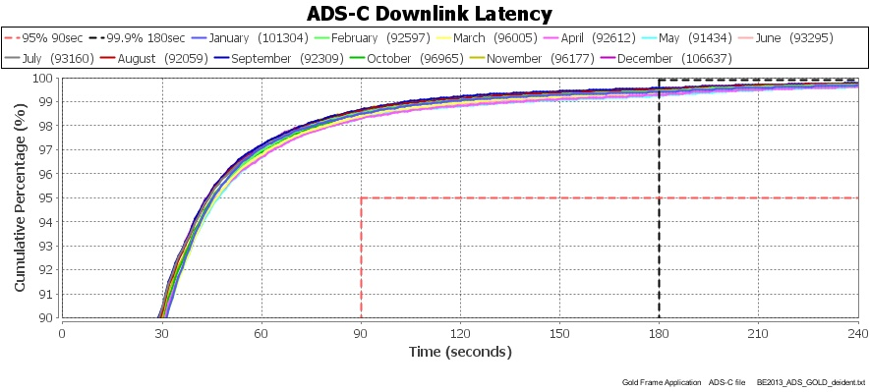

Slide 19
ADS-C latency (aircraft type)

Slide 20
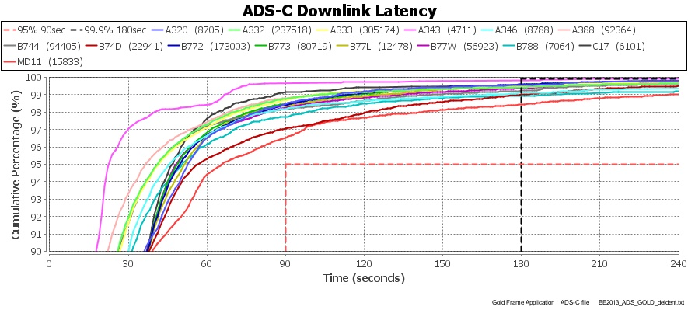

Slide 21
ADS-C latency (operator)

Slide 22
