Slide 1
Art and Science of Implementing
Trajectory Based Operations
Wendy O’Connor, Air Traffic Services (AJT-32)
Almira Ramadani, Air Traffic Services (AJT-3230)
Notes:
Preview video – reinforcing Michelle messages
Answer questions after video
https://www.faa.gov/about/office_org/headquarters_offices/ang/offices/tc/library/Storyboard/detailedwebpages/tbo.html

Slide 2
TBO Concept and Integration into the NAS
Wendy O’Connor, Air Traffic Services (AJT-32)
Notes:
The mission of the TBO Strategy and Implementation Team is to facilitate the strategic operational implementation of NexGen's vision of Trajectory-Based Operational concepts into the National Airspace System. This responsibility keenly balances cutting edge implementation of new, time-based, operational methodologies and technologies balanced with maintaining a tenable operational risk posture and practical execution in the ATC operational environment. This team also has responsibility for adjudication of GPS Testing exercise requests from the DOD, and other governmental stakeholders, to ensure safety is maintained while national security interests are supported.

Slide 3
TBO Overview
TBO is a collection of systems, capabilities, processes,
and people working together to achieve operational objectives
Time-Based Management
(TBM)
Performance Based Navigation
(PBN)
Enabling Technologies
Dep Scheduling, Airborne Metering and Automated Surface Mngmt.
Complemented by
Conventional TMIs as Needed
SWIM
DataComm
Web-based Planning Tool
Etc.
Metroplex
RNP w/RF Turns
Etc.
Helps Manage Trajectories by Scheduling and Metering Aircraft Through Constraint Points
Enables Aircraft to More Accurately Navigate Along
Their Trajectories
Expands and Automates Sharing of Common Information About Aircraft Trajectories

Slide 4

Synergy between TBM and PBN
TBM complements PBN by improving the predictability of where aircraft will be and at what time, resulting in reduced need for ATC intervention to assure safe merging and spacing, and in
increased utilization of PBN procedures
and routes.
TBM enables more accurate scheduling and metering of aircraft between their origin and destination airports.
PBN enables aircraft to more accurately navigate along
their trajectories.
PBN complements TBM by providing a network of routes and procedures that helps create more feasible schedules for constraint points to which aircraft adhere with higher compliance, resulting in
improved predictability of operations.
TBO works best when PBN and TBM complement each other.
PBN aircraft equipage is encouraged but not required.
Notes:
TBM improves use of PBN procedures to provide a structured and orderly flow.
PBN supports TBM by providing more predictability in the horizontal path, vertical profile, and the speed profile for which ETAs may be calculated. TBO benefits may be reduced with poorer ETA accuracy.
One important thing to note, is if an area doesn’t have PBN, you still get TBO. TBO works best when TBM and PBN work together, but if PBN procedures are not in place, the TBM adaptation must reflect the nominal paths, altitudes, and speeds expected within the terminal.

Slide 5
Key Elements of TBO
Increased Data Sharing and Collaboration
Ensures all systems and shareholders have a common understanding of trajectories and flight status information
Predominant Use of Time-Based Management (TBM)
Schedules and meters aircraft through key constraint points when needed. Integrates traffic management across systems, traffic flows, facilities, and domains.
Trajectory Based Operations (TBO) provides a suite of capabilities that enhance strategic planning of traffic flows, and provides tools to traffic management personnel and air traffic controllers to improve management of flights via use of 4D trajectories.
Synergy between TBM and PBN
Creates more feasible time-based schedules to which aircraft adhere with higher compliance and increases utilization of PBN procedures and routes.
Complimentary Use of TBM and Conventional Traffic Management Initiatives (TMIs)
Addresses large imbalances between capacity and demand through flexible use of conventional TMIs
Improved Decision Support Tools
Supports NAS-wide capacity-to-demand management with flexible adaptation and use based on the local needs and constraints

Slide 6
TBO Evolution
(We are Here)
Infrastructure
Initial
Full and Dynamic
En Route & Terminal Automation
TBFM
TFMS
SWIM
AIMM
Data Communications
ADS-B
PBN/Metroplex
CSS-Wx/NWP
TFDM
Arrival Metering
Extended Metering
RNAV STARS and SIDs
RNP/RNP with RF
Established on RNP
Time based Dep Management
Dep Clearances and Initial En Route Services via Data Comm
Airborne Reroutes
Pre-Departure Reroutes
CTOP
Terminal Metering
Automated Surface Mngt
Improved Dep Planning
Path Stretch
Enhanced Time-Based Arrival Metering
Improved Metering in Off-Nominal Conditions
Improved Departure Operations Using Mobile Applications
Improved Strategic Flow Management
Multiple Airport Route Separation
Improved Strategic Flight Planning
Airborne Flight Negotiation
ADS-B In enabled spacing applications
Dynamic Wake Separation
Dynamic RNP
4D Trajectory Management
Common Framework for Collaboration, Operations,
and Performance Based Navigation
Capabilities for integrated arrival and departure operations
Integrated Automation Capabilities for
Advanced Trajectory Management,
and Individual Aircraft Solutions
Operationally Available in at least one location
In Acquisition
Planned or In Research
Note: Implementation timeframes are in flux due to COVID impacts. Deployment decisions on future capabilities will depend on research results, shortfalls that remain after initial implementation and other constraints such as budget, workforce training and sustainment needs.

Slide 7
Who’s Who in TBO
Air Traffic Operations
NextGen
NAS Systems Engineering and Integration (ANG)
Architects the evolution of the NAS and provides systems engineering leadership
Facilitates the integration of TBO capabilities and emerging technologies into the NAS
Program Management Organization (AJM)
Maintains systems that support tactical operations and develops new automation capabilities
System Operations (AJR)
Responsible for optimizing the overall efficiency of the NAS and coordinating NAS-wide operations on a day-to-day basis
Air Traffic Service (AJT)
Mission Support Services (AJV)
Develops, revises, and implements procedures to improve ATC and airspace and efficiency
Oversees the alignment of new technological and operational efforts with current and anticipated operational needs

Slide 8
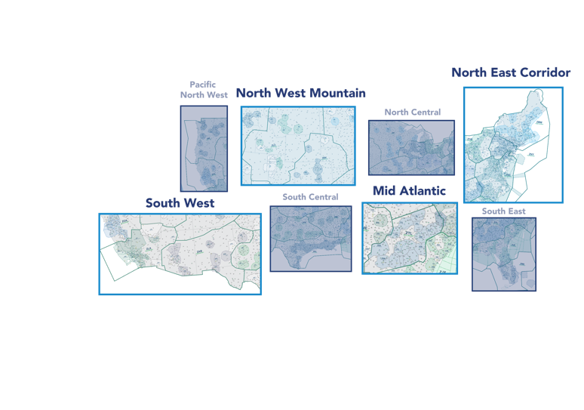
Implementation Approach
Geographically-based
Areas reflect logical and inter-dependent TBM and PBN operational relationships
Operational geographic scope is flexible and not necessarily aligned with existing airspace or organizational boundaries
Operating
Areas
Holistic
Cross-facility focused for NAS wide benefits
Integrated, incremental and systematic deployment
Opportunity-driven
Based on operational readiness, benefit opportunities, and anticipated costs and risks
Supportive
Sustained communication, training, and technical support
Planning and execution will be collaborative
Notes:
The implementation for TBO has been and will continue to be based upon 4 major factors:
Geographically-Based
Holistic
Efficient
Supportive
These factors have shaped the steps taken to select the first 3 operating areas in 2018, and the 4 operating area that was just recently selected
With particular attention paid to ensuring the selections support being holistic (cross-facility focused and integrated, incremental, systematic) and efficient (operational effectiveness, maximizing benefits and minimizing near-term costs and risks.)
FAA performed two types of analysis to select operating areas and facilities
Performed data-driven ‘Objectives-based Analysis’ (Where should we go?)
Evaluated Benefit Opportunity, Risk, and PBN Utilization
Initially completed in 2018, recently updated
Complemented with Executability Analysis (Where can we go?)
What could get in the way of successful implementation?
Comparative factors assessed:
Existing Plans/Change Bandwidth
Operational Complexity
Qualitative Issues

Slide 9

Key TBO Implementation Milestones
North West Mountain
DEN Metroplex
Extended Metering to DEN
  Infrastructure
  Dep Scheduling
  Arrival Metering
Integrated Departure Arrival Capability (IDAC)
DEN Terminal Sequencing and Spacing (TSAS)
Terminal Flight Data Manager (TFDM)
Operating Areas
North East Corridor
Extended Metering to PHL, EWR
  Infrastructure (PHL)
  Dep Scheduling
  Arrival Metering
Atlantic Coast Routes
TFDM
Mid Atlantic
Airspace/procedures infrastructure update
Evaluate extended metering for ATL
Extended Metering for ATL
  Infrastructure
  Dep Scheduling
  Arrival Metering
IDAC
TFDM
South West
LAS Metroplex
Update airspace/procedures infrastructure
Extended Metering for LAX
  Infrastructure
  Dep Scheduling
  Arrival Metering
LAX TSAS
TFDM
Deconfliction across all operating areas and FAA projects

Slide 10
TBO Implementation Structure
Guidance & Oversight
HQ Leadership
(AJT, NATCA, VP and Director–Level Leadership Across LOBs (TBO Steering Group))
AJT accountable for championing and driving TBO change throughout ATO
TBO Ad Hoc Working Group
(AJM, AJT, AJV, AJR, ANG, AJI, AJW, AVS, ARP, NATCA)
Responsible for coordinating TBO activities across FAA offices
Operating Area Field Leadership
(DO, DDO, GM/Staff, DDSO, NATCA RVPs, etc.)
AJT accountable for championing and driving TBO change throughout Operating Area FITs
TBO Implementation Support Team
(AJT-3, NATCA)
(Support from AJM, AJV, AJR, AJI, AJW)
Liaison between HQ leadership, Operating Area leadership, oversight groups, and Field Implementation Team to support TBO implementation
Facilitate coordination amongst facilities within the Operating Areas
Develop and support the execution of TBO Evolution Plans
Report implementation status to FAA leadership
Coordination
Collaborative Working Group
(AJT, NATCA, AJV, AJM, AJR)
Responsible for coordinating integration of airspace tools, procedures, and airports
Coordinate the implementation of TBO with Industry via NAC NIWGs
TBO Field Implementation Teams
Local team responsible for executing the evolution plan, troubleshooting problems, and providing on-site TBO knowledge resource
Implementation Strategy
Responsible for acting as liaison between the Deployment Team and local FIT
Field
Leadership
ATMs, TMOs, OMs, NATCA
Fac. Rep, Training
SM
Operations Teams
Responsible for providing subject matter expertise on specific capabilities and platforms as needed
Technical
POFM, FAST, OSF,
SLE, Tech Ops
Air Traffic
OS, STMCs, ATCs,
TMCs
Notes:
This is the structure we have put in place to implement TBO. It consists of teams and groups of people at all levels of the ATO at Headquarters as well as in the field.
HQ leadership and Operating Area Field Leadership
Dedicated TBO Implementation Support Team at HQ led by AJT and NATCA, but including support key staff and SMEs across the ATO/LOBs
This team includes other teams who will work and liaison directly with field, Change Strategy Teams and various Operations and Deployment Teams. You will hear a presentation from the Change Strategy with more details about their role later in this session
Collaborative Working Group guiding and coordinating implementation efforts across each Operating Area
Field Implementation Teams at each facility – local teams that will carry out coordination and execution of TBO implementation activities at each facility
A large part of TBO success will be determined by how well as these teams and groups work with each other – in particular the TBO support team, the Collaborative Working Group, and the Field Implementation Teams.

Slide 11
Field Implementation Team (FIT)
Responsible for achieving collaboration needed to integrate operations across facility boundaries
Leads Field Implementation Team and makes key implementation decisions at the facility
Champions the change and brokers collaboration and agreements within the facility, and with Operating Area Leadership
  Responsible for installing and maintaining needed hardware and software at the facility
  Develop the site-specific adaptation data that
  configures the facility’s airspace and operations
Assists in site surveys, ordering equipment,
and integrating
hardware and
software
Responsible for collaborating across facility to integrate iTBO processes into ATM practices
Contains Facility Reps (TRACON, Center, and Tower)
Tailors air traffic change management activities to facility
Assists in training content and delivery
Facility
Leadership
ATMs, TMOs, OMs, NATCA
Fac. Reps
Technical
POFM, FAST, OSF,
SLE, Tech Ops
Air Traffic
FLMs, STMCs, ATCs,
TMCs

Slide 12
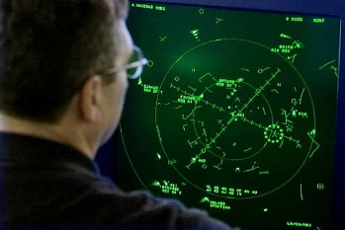

TBO Implementation Strategy
What is a Implementation Strategy?
Why do we need one?
A systematic approach that aligns people to changes in operations, process, and technology
Ultimately, the success of TBO depends upon people. Most significant challenges will center around people factors.
How do we use the TBO Implementation Strategy?
Effectively incorporate the people component into TBO planning and implementation
Drive activities that will prepare people to adopt a new way of doing business

Slide 13
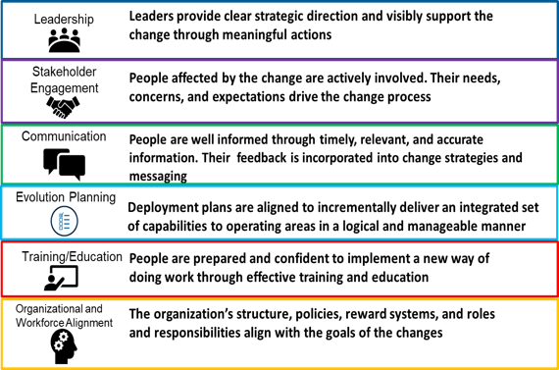
Key Elements of TBO Implementation Strategy
Intended Outcome: Preparing people to do business differently
Present
Transition
Future
Inefficient aircraft traffic management techniques
Unpredictable flow adjustments and flight impacts
Inconsistent use of available PBN procedures
Current tools and available flight data precludes optimal flight planning and operations
Inefficient static distance-based spacing goals
Ineffective integration of time-based management tools
Limited data sharing
More efficient use of available airport and airspace capacity
Reduced environmental impact and fuel burn
Uninterrupted ascents and descents
Reduced wait times in physical departure queues
Greater use of advanced PBN procedures
More effective use of airport and operator resources
Consistent and reliable schedule and travel times
Better business decisions concerning fleet management and fuel-loading
Improved understanding of flight operator intent, readiness, routing, and capabilities
Change strategy is a systematic approach that aligns people to changes in strategy, process, and technology
Notes:
Our change strategy (led by AJT):
Prepares people to make the transition for a new way of doing business
Provides us with a structured approach and plan to effectively manage the people-related aspects of change
It is all about adoption – at both the individual and organizational level
Full level of adoption by as many people/organizations as possible
Path to adoption occurs over a time period that supports accomplishing the change
By integrating Change Strategy with TBO transformation activities, the we can:
Help ensure a smoother and more effective rollout of all changes
Accelerate the stabilization period after implementation
Reduce problems, mistakes, and wasted costs associated with implementation of new technology and processes
Accelerate the timeline required to fully leverage new capabilities

Slide 14
Data-driven Decision Making and TBO Communications
Almira Ramadani, Air Traffic Services (AJT-3230)
Notes:
The mission of the TBO Integration & Analysis Team is to facilitate data-driven decision-making in support of TBO evolution and implementation. Through collaboration with NATCA, industry and other stakeholders, the Team evaluates performance to isolate outcomes of planned and accomplished TBO activities, and supports early identification and resolution of challenges at the national and local levels. We develop communication artifacts and common statements of fact that translate complex technical information into plain-English to help our external and internal stakeholders prepare for using TBO capabilities as envisioned to yield TBO benefits.

Slide 15
TBO Objectives
What are we trying to improve?
Predictability
Flight Efficiency
Throughput
Operator Flexibility

Slide 16
TBO Benefits
TBO Capability | Key Operational Improvements | Related TBO Objectives
Departure Scheduling In regular use for constrained flows at every ARTCC | Ensures smooth merge with airborne traffic Reduces vectoring and other maneuvers | Increased throughput Increased efficiency Increased predictability
Arrival Metering As of Feb 2020, in regular use for ATL, CLT, IAH, HOU, DFW, MSP, LAX, DEN, SEA, SAN, PHX, SFO, SLC. Planned PHL (2022), EWR (2023) | Spreads airborne delay over greater distance at high altitude Reduces holding Reduces reliance on static MIT restrictions | Increased throughput Increased efficiency
Extended Metering In regular use at DEN and PHX, Planned for PHL (2022) | Increases scope of airborne metering across greater distances Added constraint points for merges Increased meter list stability and predictability | Increased efficiency Increased predictability
Terminal Metering Planned DEN (2022) and LAX (2023) | Extends metering into terminal Reduces low altitude vectoring and holding Increased use of RNP approaches | Increased efficiency Increased predictability
Surface Management Planned at 89 Towers (2021-2023) | Virtual runway queues Runway balancing Integrated scheduling with TBFM | Increased efficiency Increased predictability
Strategic Planning NAS-wide, incremental improvements over years | Greater Emphasis on Strategic Decisions Earlier planning Operator provided inputs and preferences | Increased predictability Increased flexibility
Benefits are driven by specific capabilities in specific locations.
Capabilities work together synergistically to drive overall outcomes.
Notes:
Benefits are driven by specific capabilities in specific locations

Slide 17
Key Metrics of Value
TBO Objective | Outcomes | Key Metric of Value
Increased Predictability | Increased Day-of-Operation Schedule Integrity | Proportion of “on-time” arrivals relative to ETAs on the day-of-operation Proportion of cancellations and diversions on the day-of-operation
 | Increased Flight Path Confidence | Use of RNP IAP w/RF Procedure Conformance Filed vs. flown
 | Reduced End-to-End Variability | Variance in end-to-end times Distribution of flights (by magnitude of delay) Occurrences and the amount of “double” delays
Increased Efficiency | More Efficient Delay Redistribution | Distance over nominal in terminal airspace during periods of high-demand Ground delays during nominal operations
 | Add’ Efficiency Gains | Descent efficiency: time and distance in level-flight at low altitude Distance in Terminal Airspace (reduction via use of RNP IAP w/RF)
Increased Throughput | More Efficient Use of Available Capacity | Throughput and spacing between aircraft during periods of high-demand
 | Increased Capacity in Certain ops conditions | AARs under the same operating conditions
Increased Flexibility | Increased Route Flexibility | How often do operators provide and get their rerouting (vs delay) preferences
Notes:
We know how to turn increased throughput and flight efficiency into monetary gains...
How to evaluate and quantify predictability (even flexibility) is lot more difficult … also, operator preferences often vary by stakeholder…

Slide 18
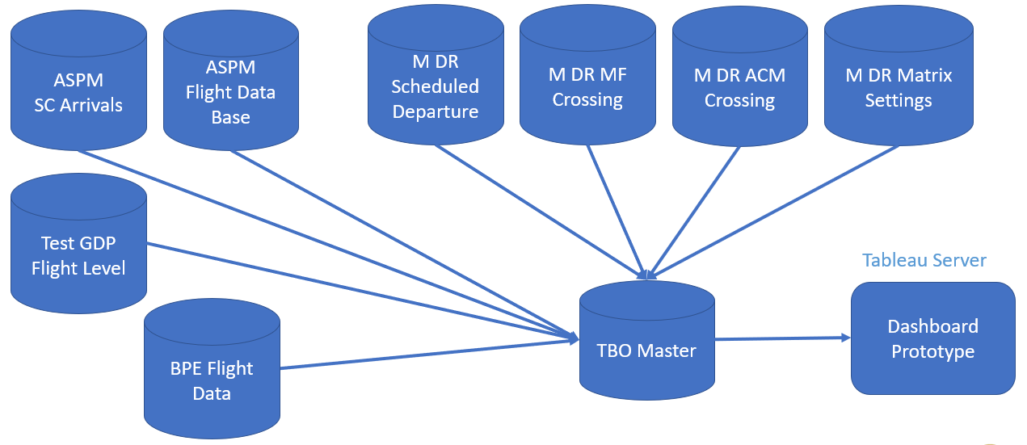
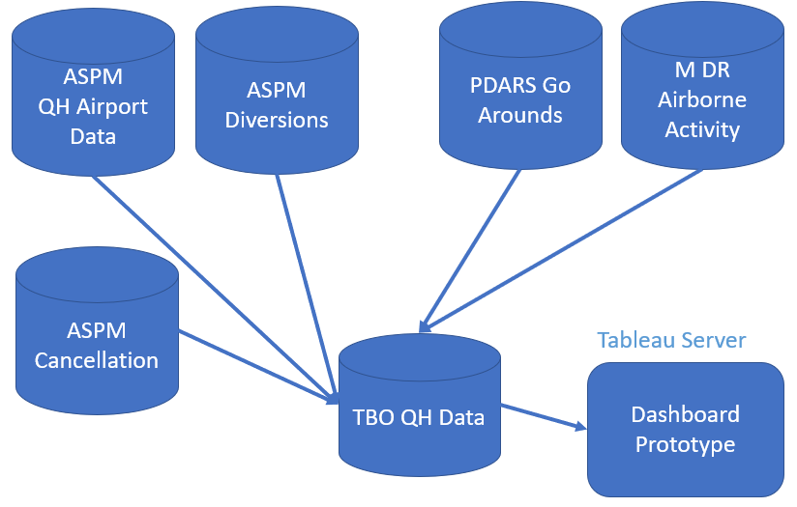
TBO Dashboard Prototype Overview
Individual Flight Data
TBO Dashboard aims to evaluate outcomes from TBO deployment and use
Airports
ATL, DEN, EWR, PHL, LAX
Data Range
1/1/2019 – 9/14/2021
Data Sources:
    FAA ASPM: Flight and airport performance
    CAASD TBFM Data Acquisition System: Flight performance and active use
  “Living Tool”
    Enhancements will be prioritized and implemented based on user-feedback
Quarter Hour Airport Data

Slide 19
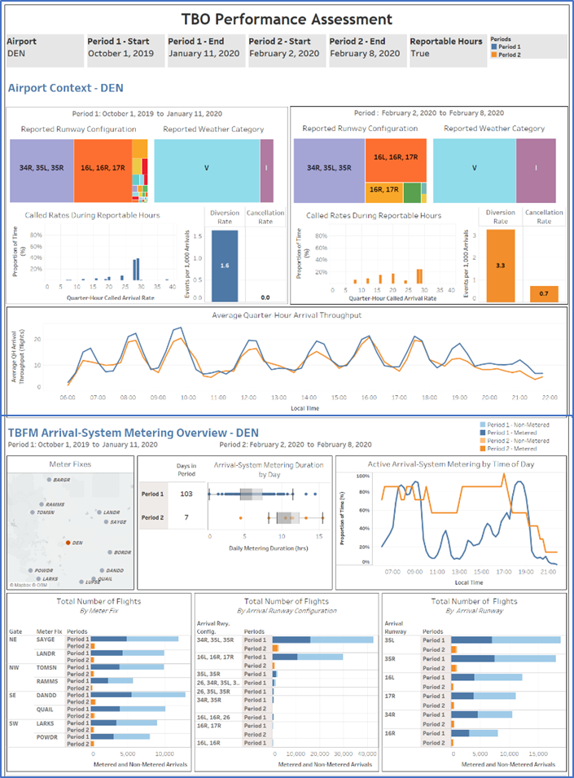
TBO Dashboard: Key Sections
TBO Dashboard aims to evaluate outcomes from TBO deployment and use
Available within the AJR-G Analytical Suite
Three key sections displayed on one page
  Airport Context: high level information for the airport during each time range
  Arrival Metering System Overview: high level metering overview at the airport during each time range
  Operational Topics of Interests: deeper dive into topics and conditions of interest

Slide 20
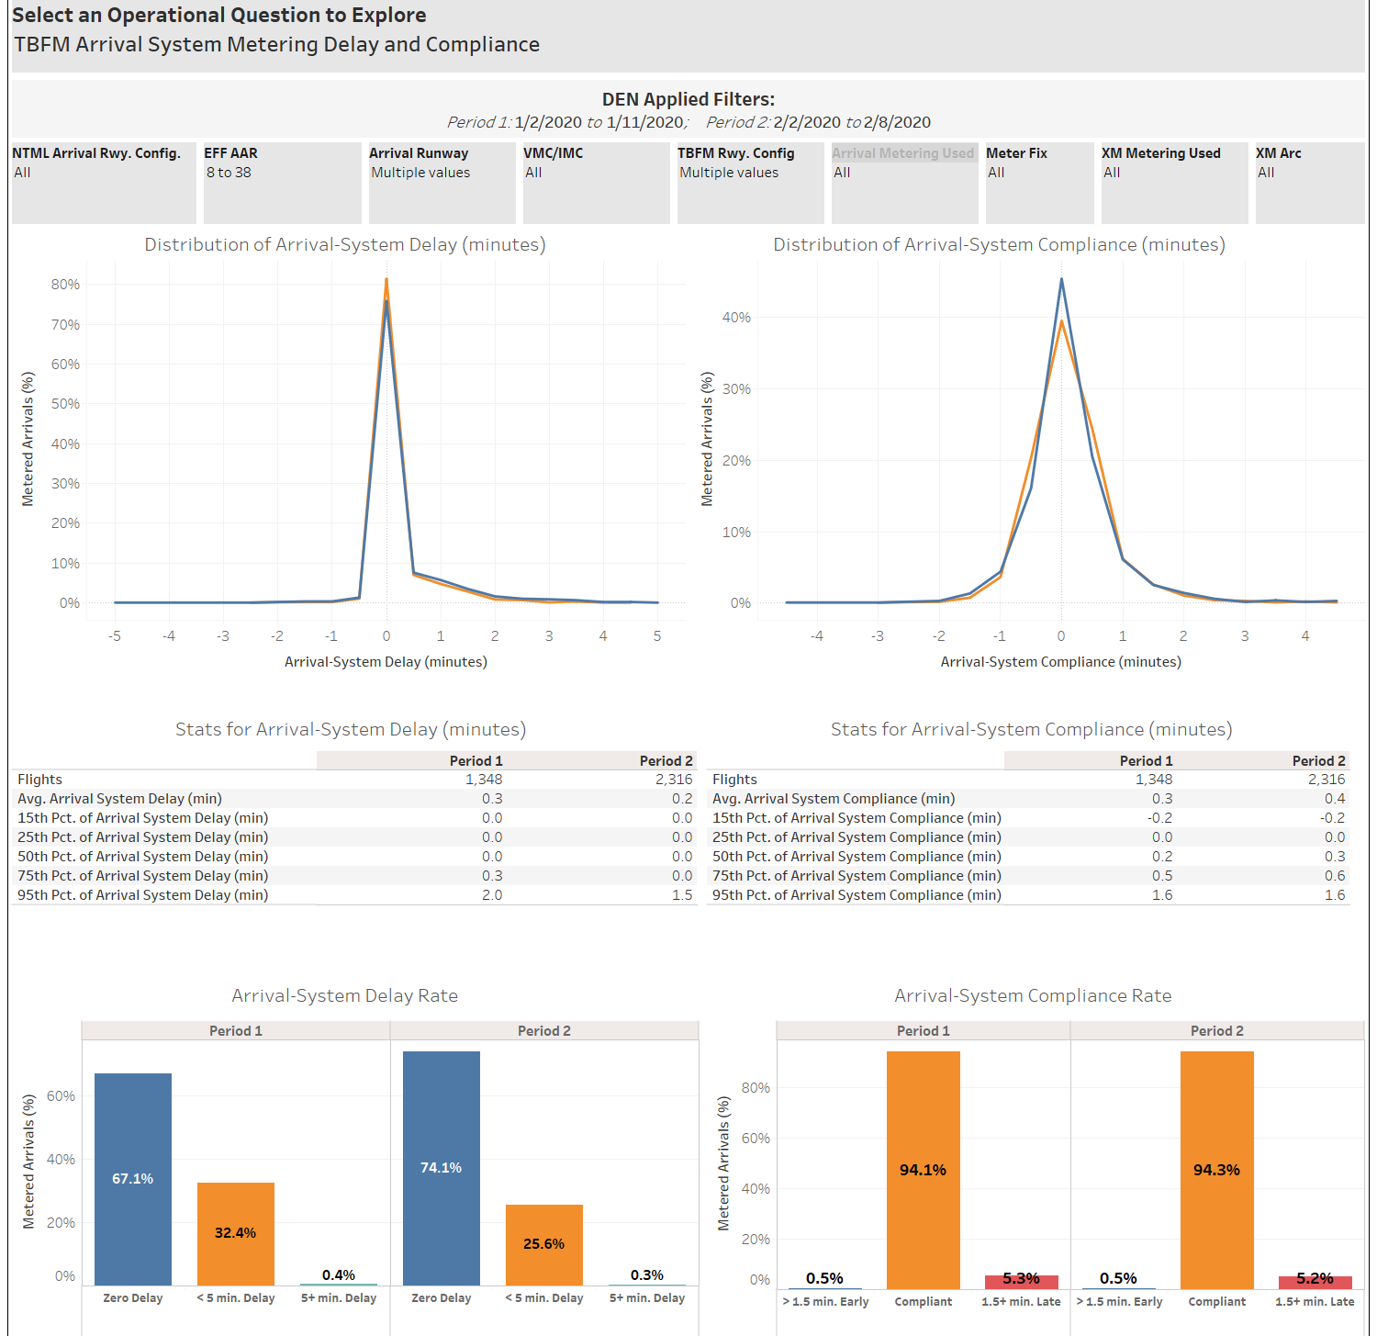
TBO Dashboard: Example #1
Operational Topics of Interests
TBFM Arrival System Metering Delay and Compliance
TBFM Extended Metering Delay and Compliance
TBFM Departure Scheduling Delay and Compliance
Time in TRACON For Metered Flights
Runway Inter-Arrival Times and Quarter Hour Throughput
Time Between Aircraft Through the Meter Fix
Taxi Out and Departure Times at Origin Airports
Go-Arounds
TBFM Assigned Runway Compared to Arrival Runway Used

Slide 21
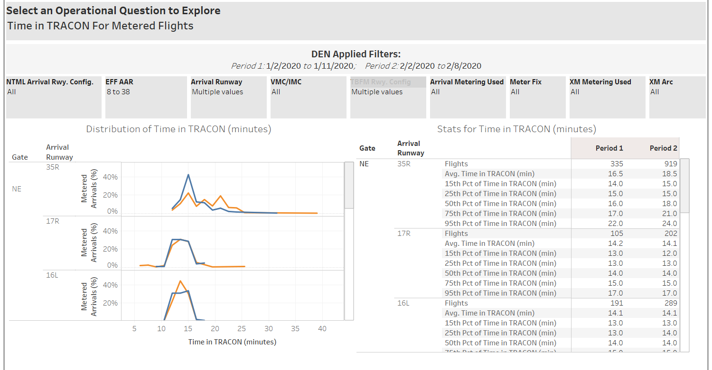
TBO Dashboard: Example #2
Operational Topics of Interests
TBFM Arrival System Metering Delay and Compliance
TBFM Extended Metering Delay and Compliance
TBFM Departure Scheduling Delay and Compliance
Time in TRACON For Metered Flights
Runway Inter-Arrival Times and Quarter Hour Throughput
Time Between Aircraft Through the Meter Fix
Taxi Out and Departure Times at Origin Airports
Go-Arounds
TBFM Assigned Runway Compared to Arrival Runway Used

Slide 22
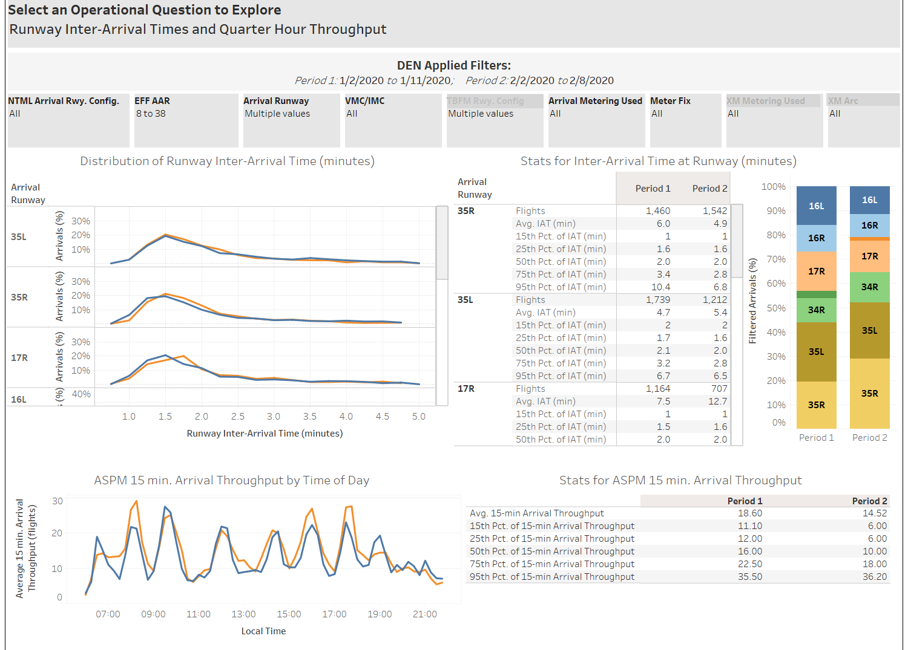
TBO Dashboard: Example #3
Operational Topics of Interests
TBFM Arrival System Metering Delay and Compliance
TBFM Extended Metering Delay and Compliance
TBFM Departure Scheduling Delay and Compliance
Time in TRACON For Metered Flights
Runway Inter-Arrival Times and Quarter Hour Throughput
Time Between Aircraft Through the Meter Fix
Taxi Out and Departure Times at Origin Airports
Go-Arounds
TBFM Assigned Runway Compared to Arrival Runway Used

Slide 23
Future Enhancements
Enhance filters
  Improve ability to select or exclude flights that occurred during specific conditions (weather, demand, etc.)
  Introduce new filters (e.g. time of day, congestion level, etc.)
  Customize filters by operational question of interest
Integrate additional traffic flow management (TFM) capabilities
  Support analysis of specific traffic flows
  Expand filters, metrics and displays for Departure Scheduling analysis
  Integrate delays across TBFM capabilities
  Integrate use and outcomes associated with TFM initiatives (MITs, GDPs, etc.)
Integrate additional metrics and displays
  Distance-based metrics
  PBN use and outcomes
  Metrics of interest to flight operators
Your needs: please send an email to 9-ajt-tbo@faa.gov

Slide 24



TBO Integrated Communication Team
Leadership
Stakeholder Engagement
Communication
Team has representatives from: AJT, ANG, AJM, AJR, and NATCA
Mobilizes member’s respective leadership to provide input and approval for TBO messaging, and prepares them to be active communicators
Collaborates to ensure TBO messages are consistent, accurate, relevant, resonant, and tailored to stakeholder needs, preferences, and interests
Coordinates to ensure communication activities are timely, non-duplicative, and meet stakeholder information needs
Identifies and leverages appropriate communication channels and vehicles to distribute TBO messaging
Develops and monitors feedback mechanisms to evaluate the effectiveness of communication activities, and incorporating feedback as appropriate to improve TBO communications
More information: www.faa.gov/air_traffic/technology/tbo/
Questions: 9-AJT-TBO@faa.gov

Slide 25






Venues for Industry Engagement on TBO
Train
Connect
Engage
More information: www.faa.gov/air_traffic/technology/tbo/
Questions: 9-AJT-TBO@faa.gov
Notes:
FAA has been and will continue engaging with Industry on TBO regularly through many different venues, and will continue to provide updates as new information becomes available:
We have shared information about TBO, including deployment timelines, in many different venues; this information often focused on specific TBO components – NEC and PBN plans and accomplishments; TBFM, TFMS and SWIM enhancement plans and timelines; TFDM development and deployment plans and timelines; DataComm, etc.
Sometimes we when we are talking about specific capabilities or initiatives … we may not say “TBO” … but all of these things are connected (e.g., PERTI, surface CDM, use of TOS, PDRR …. )
This venue, the TBO Industry Day, aims to focus on overall TBO development, plans, deployments and accomplishments
We do not want to slow-down our progress by introducing unnecessary reporting requirements
We do not need a TBO WG, but steady information exchange and collaboration
How often do wee need to meet?
What is the best way to engage our executives?
We are already planning / thinking about…..
Possible Questions
Where can operators go to learn more about TBO and how it will impact them?
How will the FAA keep operators informed about TBO progress?
How can operators provide input and recommendation to FAA about TBO priorities?
How do we get a regular connectivity on the TBO effort? Need a better way to get status and understand upcoming capabilities and operator requirements.
Could operators provide a set of operational POCs? They would be identified as TBO SMEs for the FAA – provide operator input and provide visibility for us.
Could we build on previous FAA/NATCA support for interfacing with tech pilots?

Slide 26
Wrap-up and Questions https://www.faa.gov/air_traffic/technology/tbo/
9-AJT-TBO@faa.gov

