Slide 1
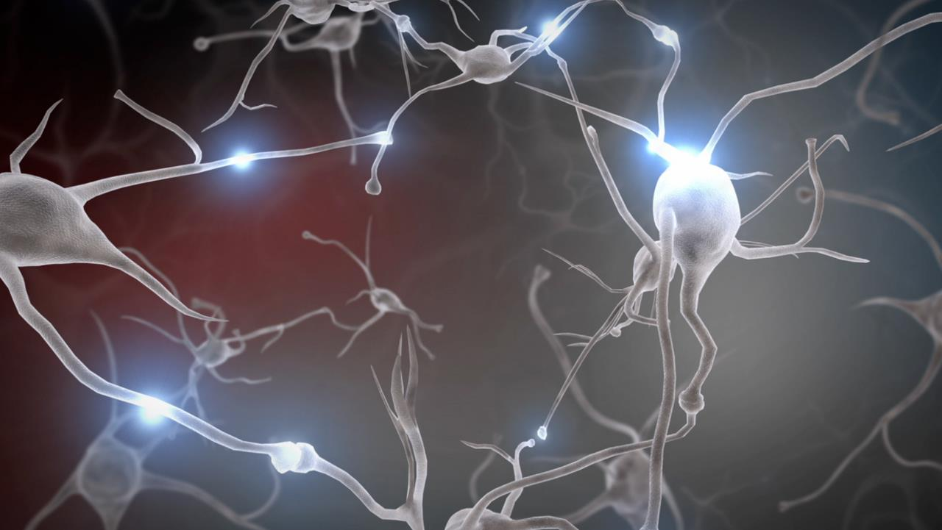
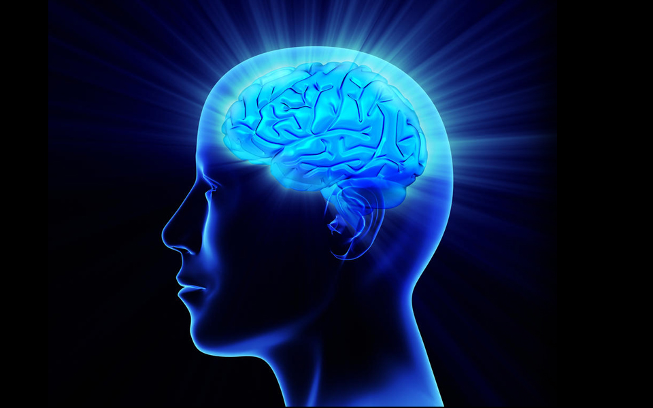
Analysis vs. Intuition
Decision-Making in the Aviation Environment
George Emilio
Serco Inc.

Slide 2
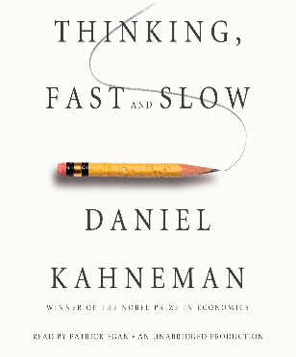
The Two Systems Model
System 1 (Intuitive)
System 2 (Analytic)
Our primitive, animal brain
Our evolved scientific brain
Highly connected to our senses
Isolated from our senses
Parallel processing = fast
Serial processing = slow
Frugal calorie demands
Intense calorie demands
Naturalistic Decision Making
Rapid mental simulations based on experience of what mostly works
Multi - Attribute Utility Theory
Deliberative trade-off analysis
From an evolutionary standpoint, humans will generally defer to System 1 unless they need help solving the problem at hand.
Cognitive biases often occur when System 1 fails to “wake up” System 2 for help. Watch out for System 1 fast, impulsive decisions.

Slide 3
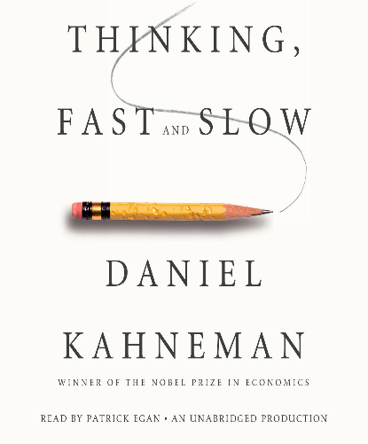
Cognitive Biases
Bias | Description
Ambiguity Effect | “Better the Devil you know.” – a person is more likely to select a known risk over an unknown risk; even if it’s riskier.
Anchoring Bias | Rely excessively on the first piece of information
Attention Bias | Previous significant events considered more important even when unlikely.
Attention Tunneling | Excessive focus on a single task
Automaticity | “Going through the motions” and missing relevant information
Availability Bias | Fiction repeated often enough becomes fact
Base Rate Fallacy | Failure to consider base rate when considering new evidence.
Confirmation Bias | Only looking for information that confirms a previously held model.
Overconfidence Bias | “It can’t happen to me”
Plan Continuation Bias | Forge ahead with the original plan
Prospective Memory | Preoccupation with immediate tasks. Urgent over important.

Slide 4
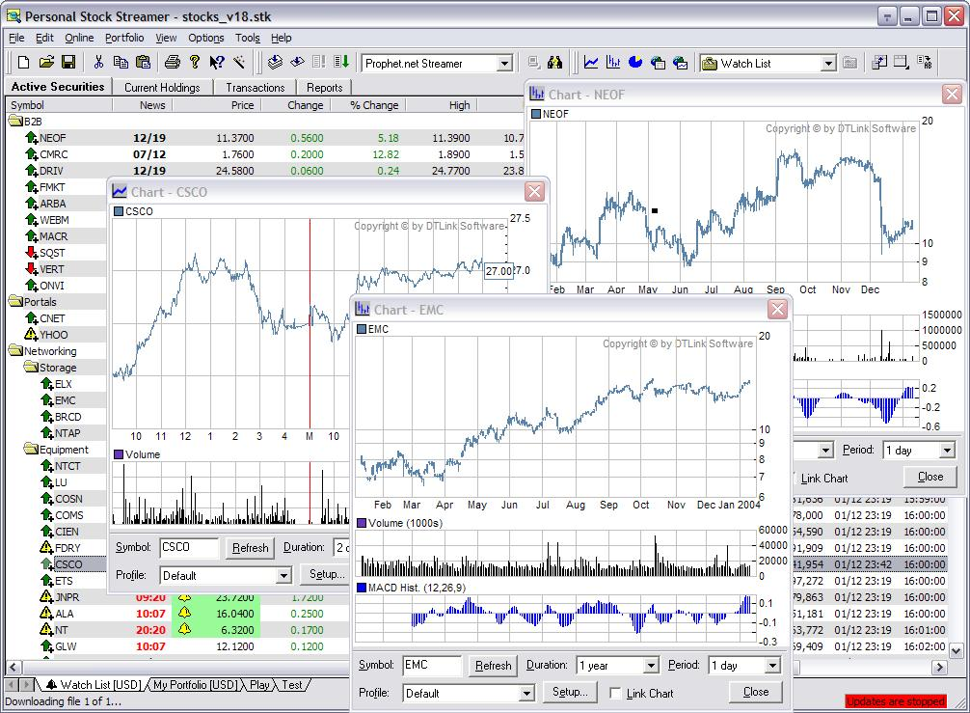
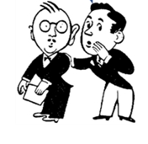
But….System 2 can also be fooled…
Buy 30 shares
Sell 30 shares
VS.
The “Allure of Technology”– bulldozing System 1 into submission

Slide 5
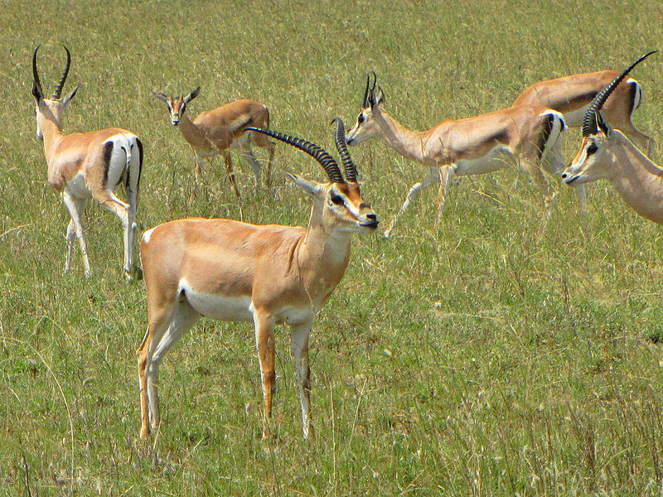
System 1 is remarkably adept at assessing risk…

Slide 6
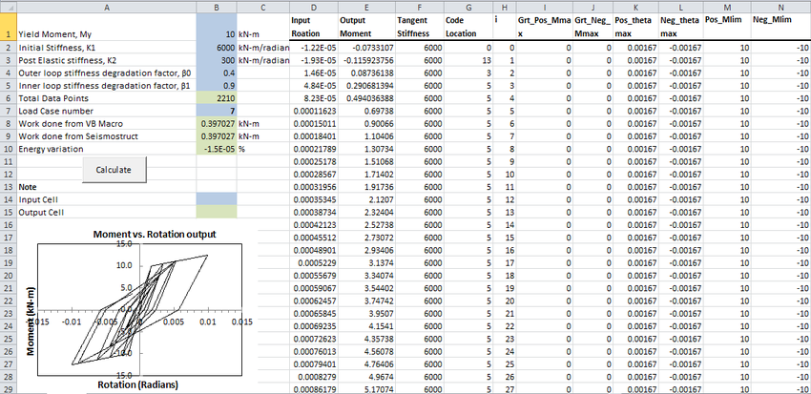
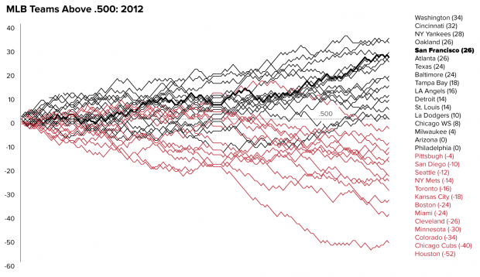
…and remarkably adept at visual interpretation
…But System 1 can’t understand a spreadsheet.

Slide 7
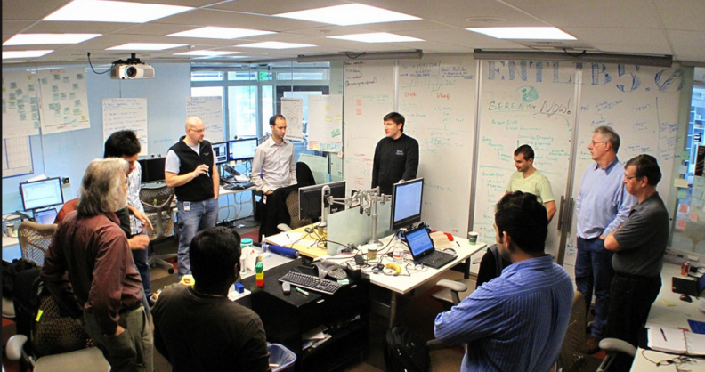
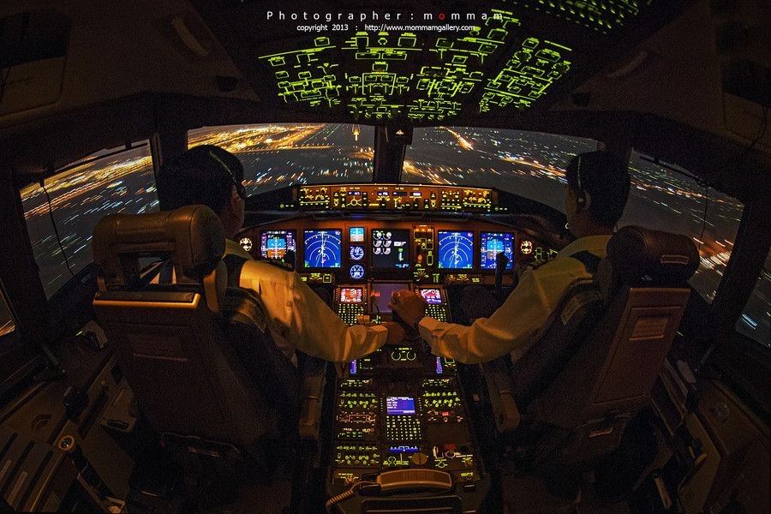
So, where does this fit it?

Slide 8
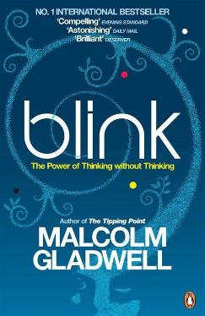
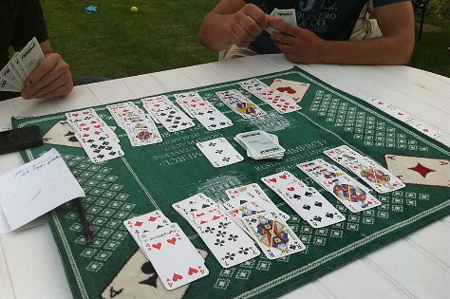
System 1 vs. System 2: University of Iowa Experiment
GAME A - Control
GAME B – Unfairly Rigged
A sample population is given a choice to play either of two card games (Game A or Game B) where they gamble to make money. They can play either game and can switch games at any time. What participants don’t know is that Game B is rigged; they will lose money.
On average, participants of Game B begin to verbalize misgivings at the 50th card. By the 80th card, they’ve had enough and make the decision to switch to Game A.
Participants are connected to sensors to measure stress and brain activity.
Participants begin showing signs of stress by about the 10th card. This is System 1.
It takes another 40 cards for System 2, with its thoughtful, serial, and slow processes to catch on and another 30 cards to make the rational decision to stop playing. System 1 was ready to bail at card 10.

Slide 9
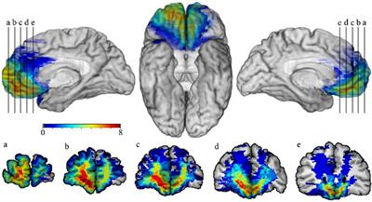
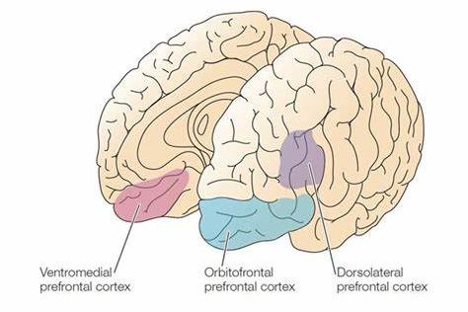
System 1 Brain Activity Scans
Ventromedial Prefrontal Cortex (VPC)
The VPC is closely associated with the sense of smell…we actually smell risk
“Something doesn’t smell right”
People with VPC damage have difficultly making decisions.
System 2 is a thinker….not a doer.

Slide 10
Recommendations
Visually dense information (data density) appeals to System 1.
…But System 1 can’t read a spreadsheet.
System 1 is vulnerable to impulsive decisions.
…But System 2 can “bulldoze” System 1 into submission missing System 1 contributions.
So, first ask “what does your gut say?” to get a System 1 contribution before System 2 overtakes the conversation.
System 1 doesn’t speak. Its language is in rapid mental projections. You need time for System 1 and System 2 to get in synch…sleep on it.
Proper analysis needs System 2. But decisions need System 1.
Analysis Camp -- Analysis outperforms intuition due to better consistency and lower bias.
Intuitive Camp -- In complex, uncertain, and fast-paced environments naturalistic decisions outperform analysis.

Slide 11
Summary
Analysis Viewpoint
Traditional scientific thought
Traditional risk management
Kahneman
Avoid cognitive biases
Intuition Viewpoint
Naturalistic Decision Making
Recognition-Primed Decisions
Gigerenzer, Klein, Gladwell
System 1 also has its place
Understanding the strengths and weaknesses of your System 1 and System 2 brain can make you a better decision-maker.
When designing aviation systems, remember things move fast and the clock never stops. System 2 won’t always be able to keep up. Design for System 1.

Slide 12
Bibliography
[1] D. Kahneman, Thinking, Fast and Slow, New York: Farrar, Straus, and Giroux, 2010.
[2] G. Gigerenzer, Gut Feelings: The Intelligence of the Unconscious, New York: Viking, 2007.
[3] M. Gladwell, Blink: The Power of Thinking Without Thinking, New York: Little, Brown and Company, 2005.
[4] A. Damasio, Descartes Error: Emotion, Reason and the Human Brain, New York: G.P. Putnam's Sons, 1994.
[5] S. Dekker, Drift into Failure: From Hunting Broken Components to Understanding Complex Systems, Surrey, England: Ashgate, 2011.
[6] N. Taleb, The Black Swan: The Impact of the Highly Improbable, New York: Random House, 2010.
[7] G. Klein, Streetlights and Shadows: Searching for the Keys to Adaptive Decision Making, Cambridge, MA: MIT Press, 2009.
[8] E. Tufte, The Visual Display of Quantitative Information, Cheshire, CT: Graphics Press, 2001.
[9] G. Klein, Sources of Power: How People Make Decisions, Cambridge, MA: MIT Press, 1998.
Contact Information
George Emilio
george.emilio@serco-na.com
703-725-7156

