Slide 1
AI/ML and the
Art and Science of V&V
Ron Keesing, VP for AI
Leidos Technical Fellow
keesingr@leidos.com

Slide 2
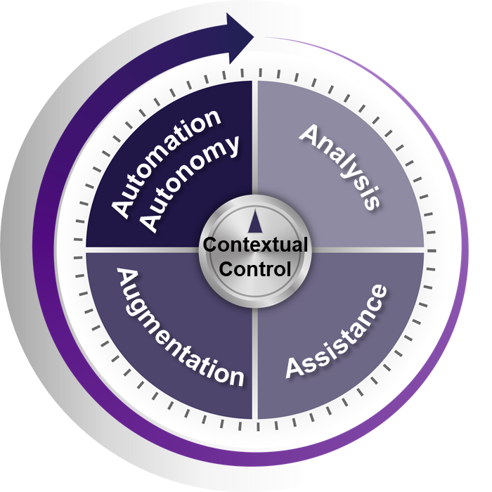
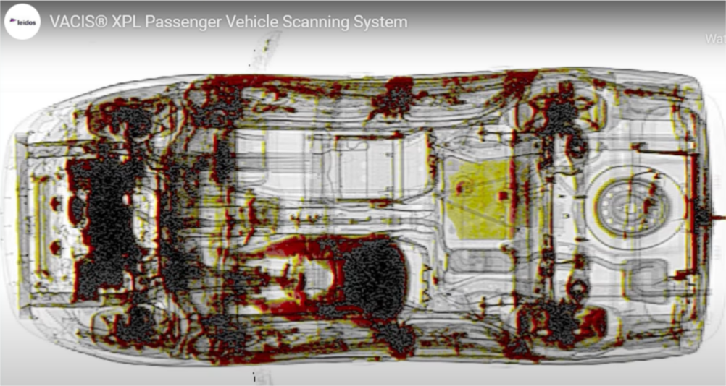
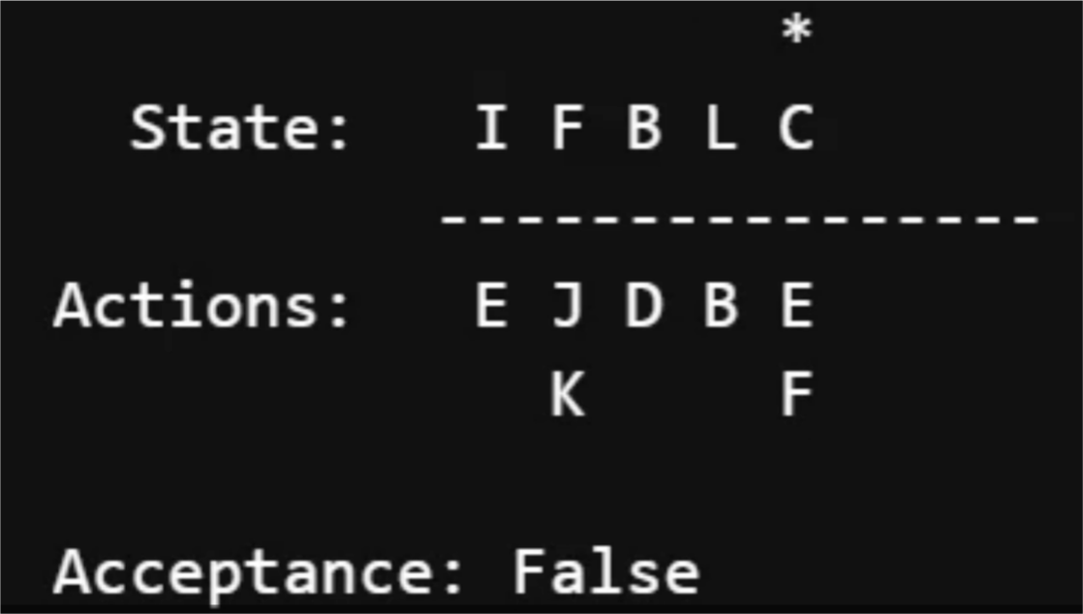
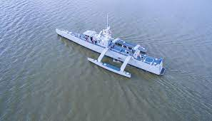
AI/ML and the Art and Science of V&V at Leidos
Art
Using AI/ML to
improve V&V
V&V of AI/ML Systems
Science

Slide 3



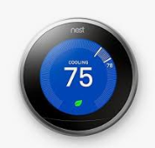


AI and ML
Artificial Intelligence (AI): Development of systems that use human-like intelligence to solve problems
  AI systems exist along a spectrum of the type of intelligence they exhibit
Assisted
Augmented
Autonomous
Machine Learning (ML): A subfield of AI in which systems learn to solve problems through experience rather than being explicitly programmed
Modern ML makes development of AI systems faster, cheaper, and more effective

Slide 4
Why ML?
What factors have driven success of ML over last decade?
  Growth in data
    Shared, massive datasets (ImageNet, ActivityNet, etc.)
    Smartphones / Video / IoT / Self-driving cars
  Novel algorithms/techniques
    Deep Learning / Convolutional Neural Networks
    Attentional Models
    Generative Adversarial Networks
    Reinforcement Learning
  Parallelized/virtualized/specialized HW
    GPUs, FPGAs, Neural Chips
  New libraries / tools
    Python, PyTorch, TensorFlow, Keras, AutoML…

Slide 5
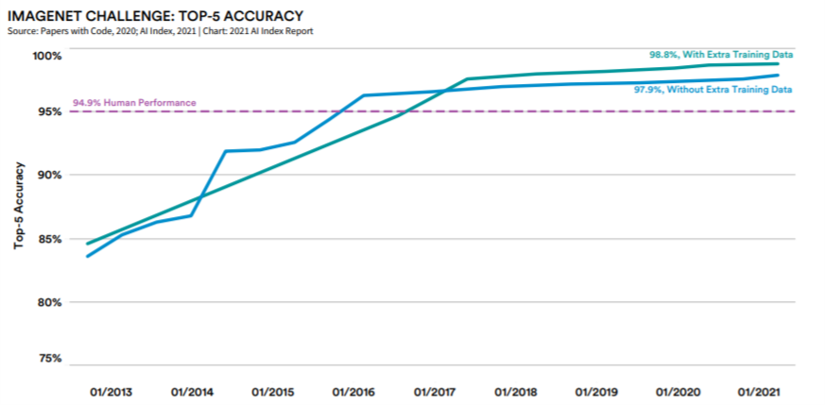
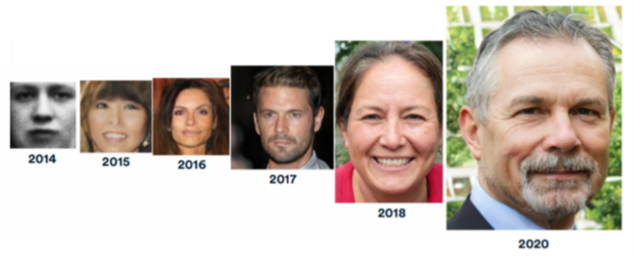
Why ML? - SOTA from AI Index 2021
ML continues to advance in a broad range of applications, including…
…Computer Vision…
…Synthetic Data Generation…

Slide 6
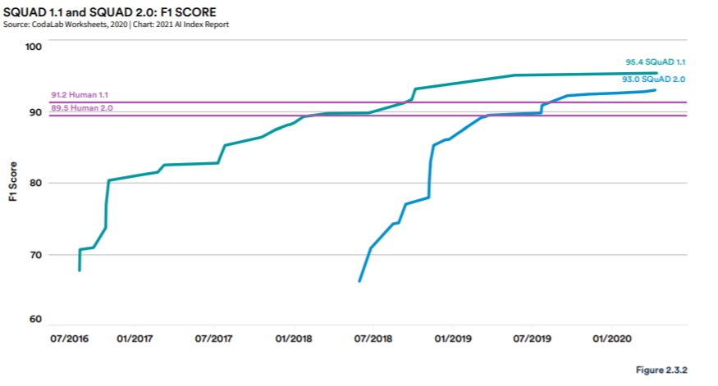
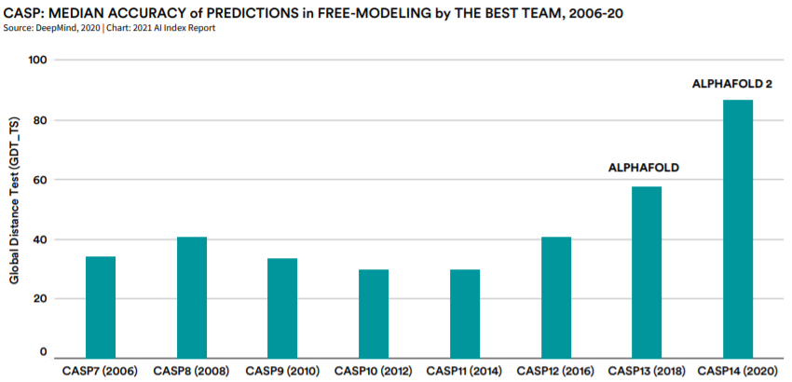
Why ML? - SOTA from AI Index 2021
…Natural Language Understanding…
…and even
Scientific Discovery

Slide 7
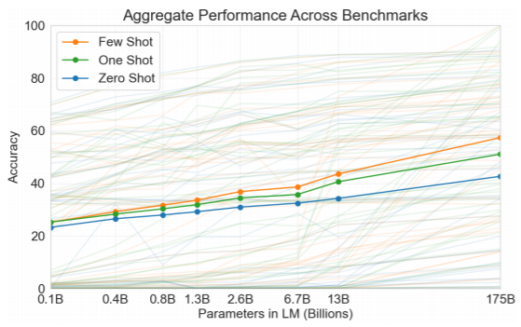
The Challenge of Complexity for AI V&V
Models keep getting larger and more complex and performing better and better as they get bigger…
Source: https://arxiv.org/pdf/1905.11946.pdf
Source: https://arxiv.org/pdf/2005.14165.pdf

Slide 8
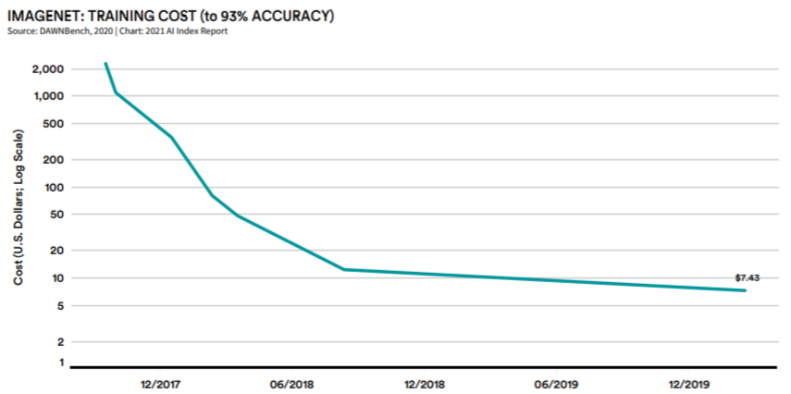
The Challenge of Complexity for AI V&V
…while becoming cheaper and cheaper to build

Slide 9
AI/ML and the Art and Science of V&V at Leidos
Developing AI Trust
Art
Using AI/ML to
improve V&V
V&V of AI/ML Systems
Science

Slide 10
The Art of Applying AI to V&V: Selecting the problem
According to several surveys, 85% of AI projects eventually fail to bring their intended results to the business
Data
Value
Generation
One common reason AI projects fail is lack of good business case definition
Key requirements include:
Data (ideally labeled)
Opportunity to reduce cost or
deliver new value-generating capability

Slide 11


The Art of Applying AI to V&V: Selecting the problem
According to several surveys, 85% of AI projects eventually fail to bring their intended results to the business
Data
Value
Generation
Another key factor in many AI failures is lack of trust. Without trust…
Mission owners won’t resource AI projects
System owners won’t allow it to be deployed
Trust
Users will block adoption or just turn it off
Key stakeholders in AI trust for V&V include:
Regulators
Systems Engineers
Test Engineers

Slide 12
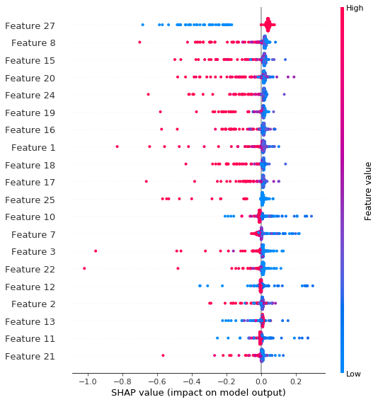
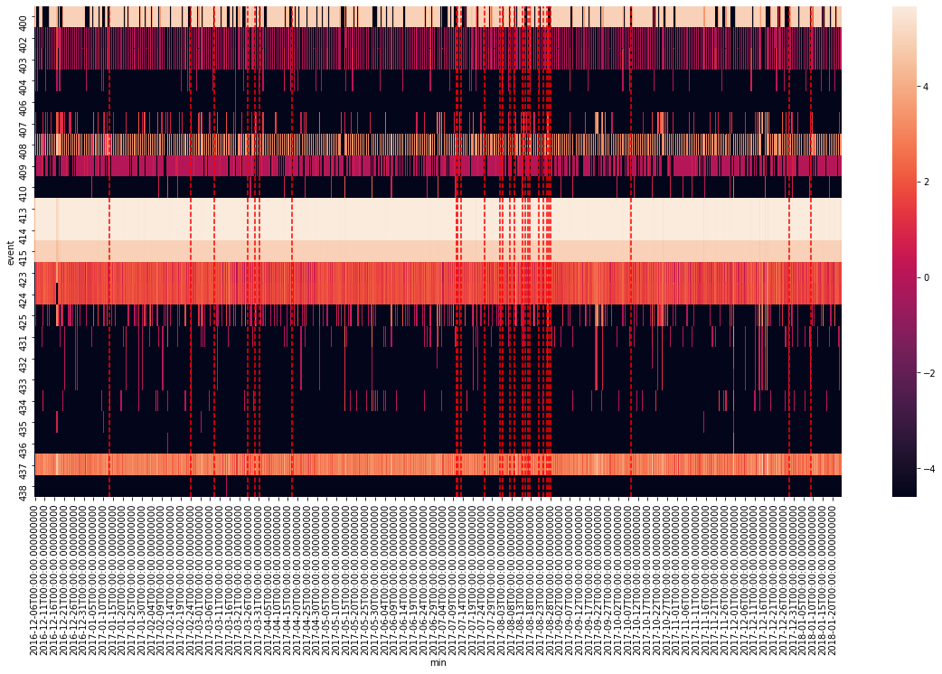
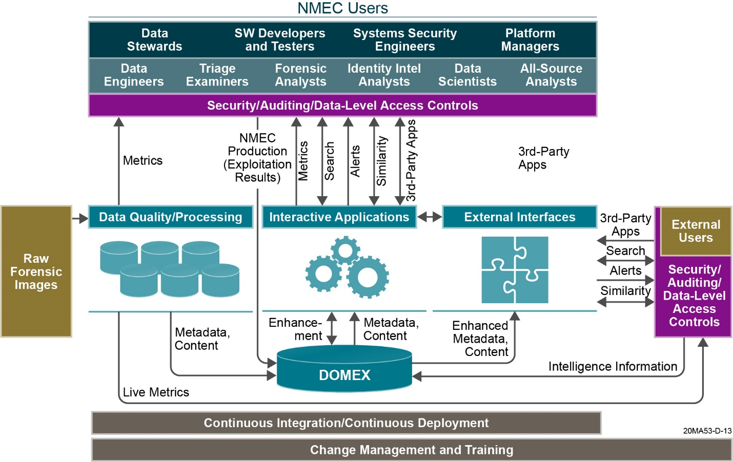
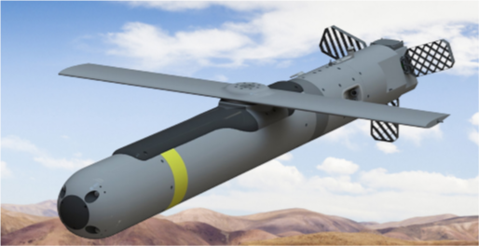








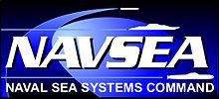
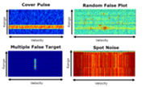


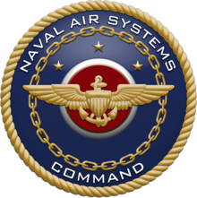
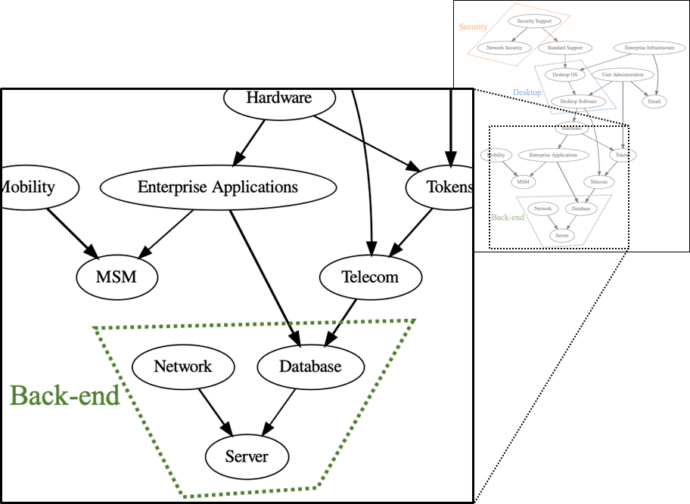
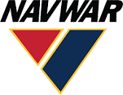



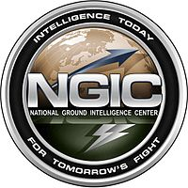



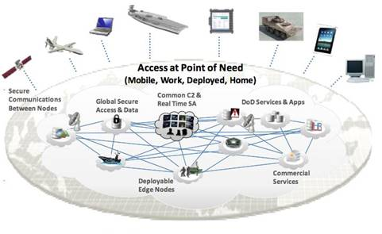



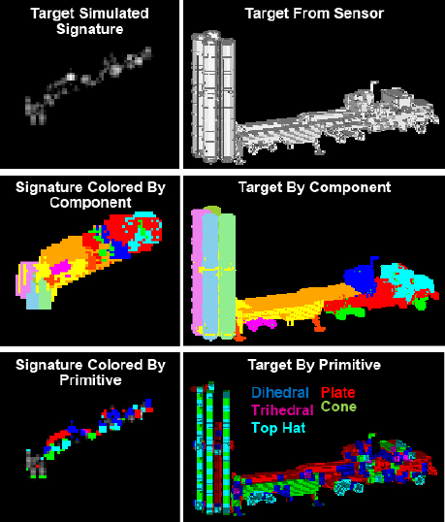
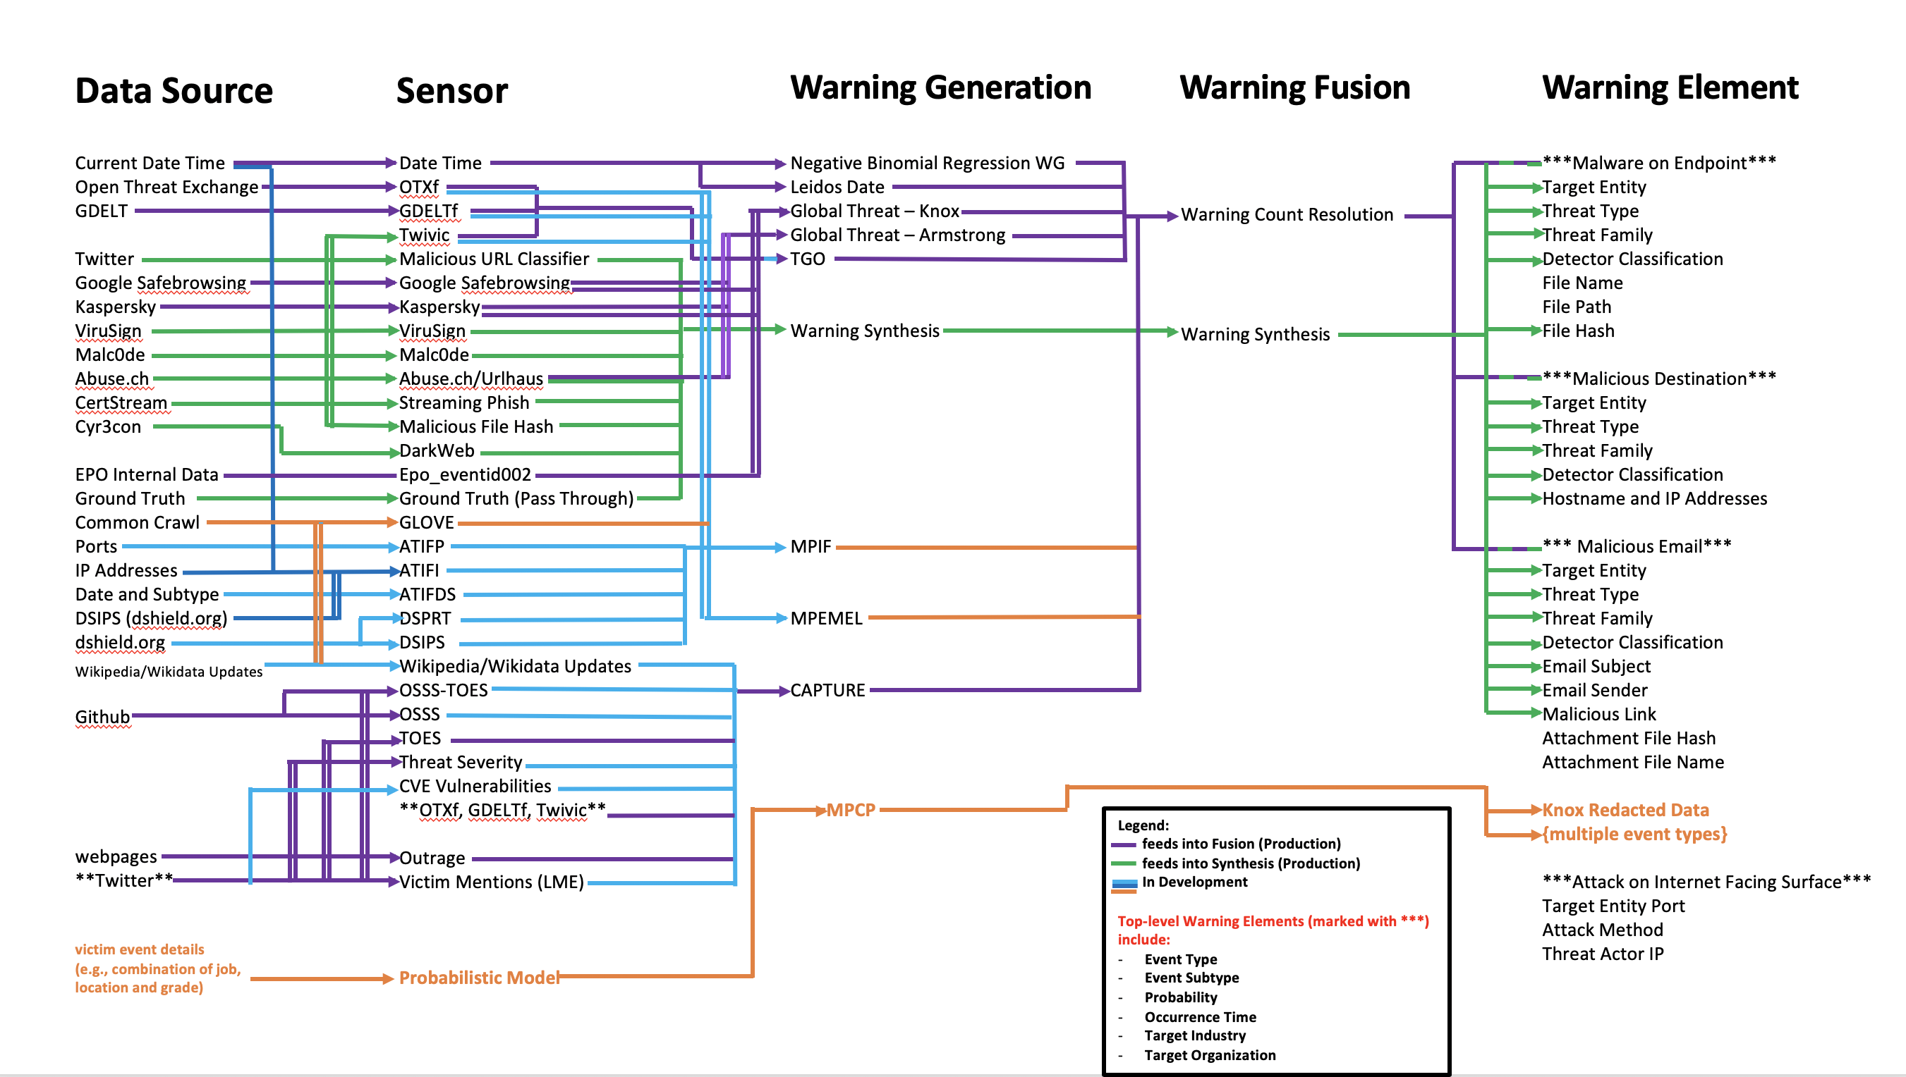
Trusted AI Experience at Leidos
Intelligence Analysis
Predictive Analytics
Autonomy
C2
Trusted AI
Cognitive EW
AI Ops
Health Care
Edge to
Cloud
Physical
Security
Cybersecurity
ATR

Slide 13
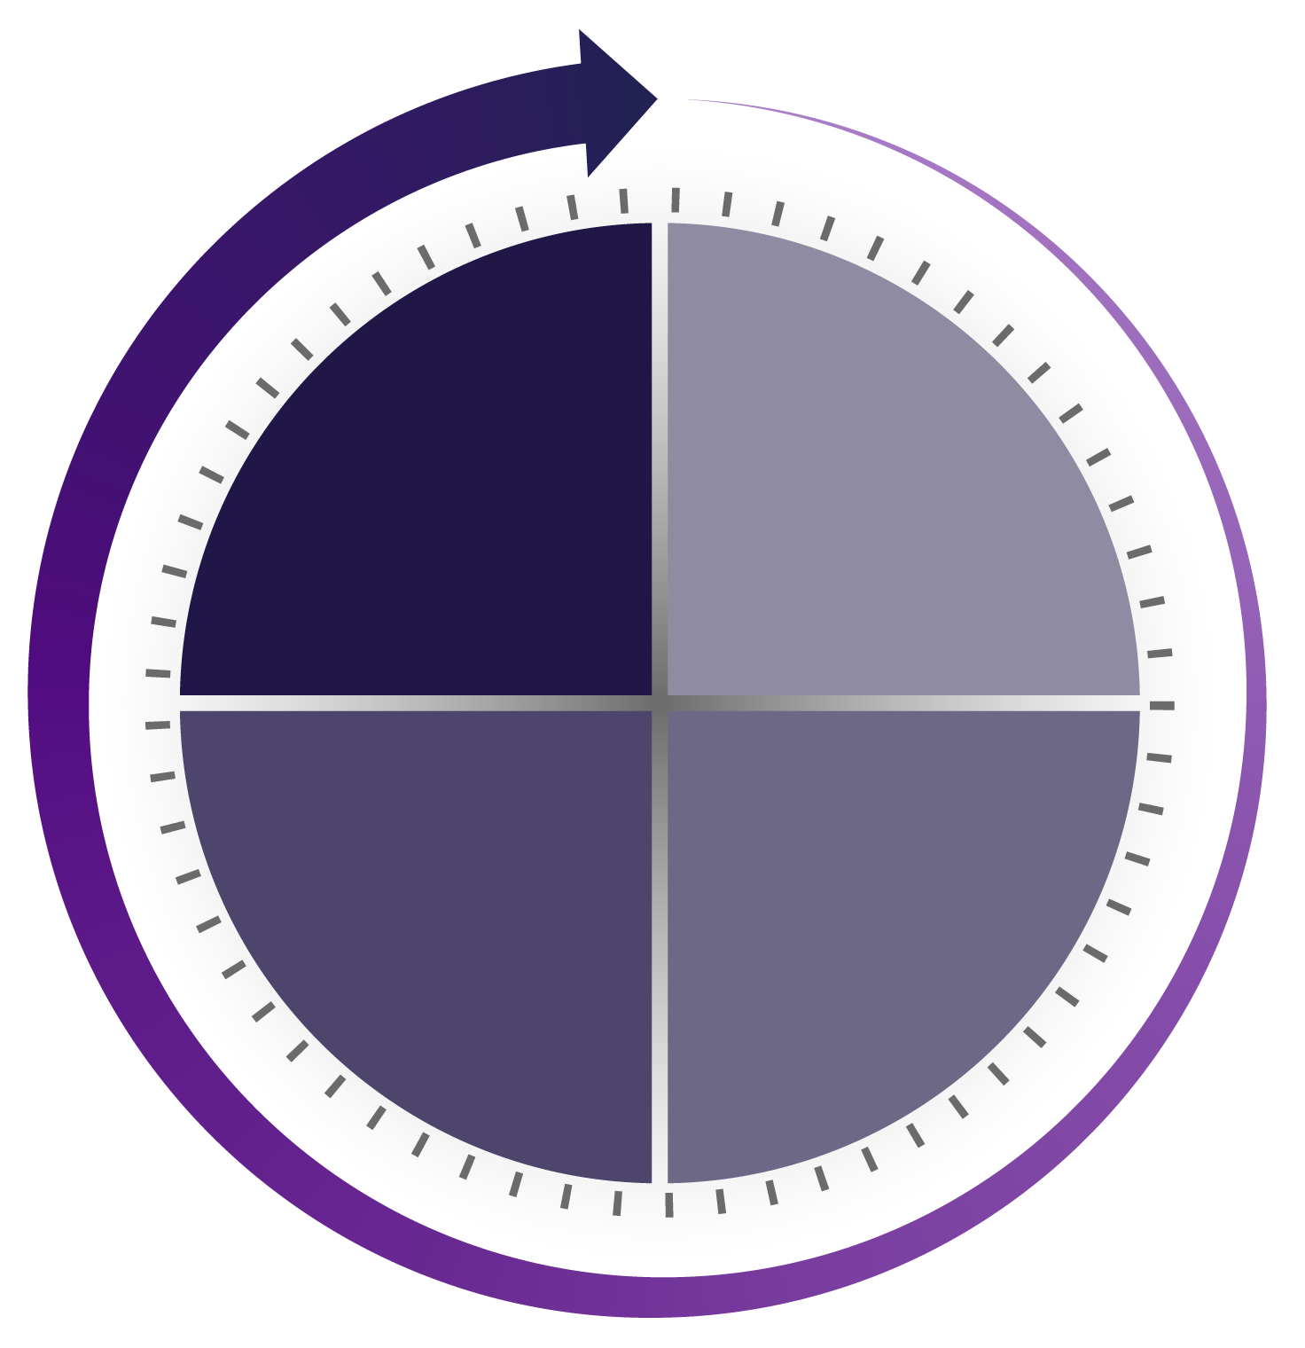


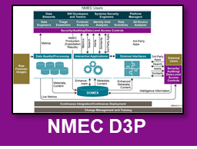
4A Methodology for AI Trust
Replace humans for complex tasks
  Control, decide, act, navigate, collaborate, achieve goals
Feedback/data drives AI capabilities
Human on-the-loop (OTL) control
Characterize initial data
Design data strategy
Identify / rank opportunities for AI
Estimate ROI, risk
Deliver Data Science capabilities
Analysis
Automation
Autonomy
Analysis
Augmentation
Assistance
Augmentation
Assistance
QTC
AI helps humans work in new ways
  Track, transform, organize, predict, warn, hold state
Feedback/data drives AI capabilities
Human ITL control
AI improves efficiency of workflows
  Aggregate, alert, enrich, recommend, visualize
User feedback improves accuracy
Human in-the-loop (ITL) control

Slide 14
Trusted AI Opportunities in the V&V space
Automated root cause analysis
Automated testing
Adaptive testing
Data cleansing
Data QA
Accelerating data analysis
Automated hypothesis testing
Analysis
Automation
Autonomy
Analysis
Augmentation
Assistance
Test case generation
Coverage analysis
Data discovery through enrichment
Requirement recommendation
Data discovery by similarity
  Requirements
  Test cases
  Data
Test case recommendation
Verification AoA
Test case analysis
Augmentation
Assistance

Slide 15
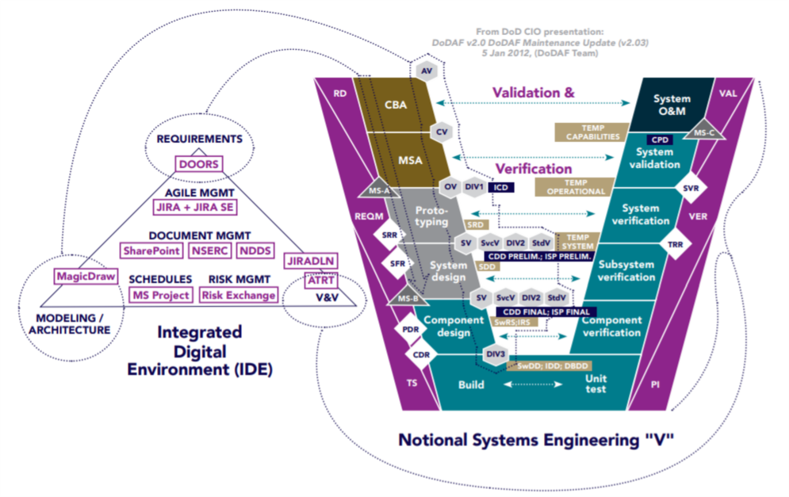
Example UC for Trusted AI in V&V
Major DoD Program of Record
Mature processes are in place for V&V, which is a critical requirement for such a system
Can AI be used to improve the
V&V process?
Where could we insert Trusted AI?

Slide 16
The Art of Applying AI to V&V: Selecting the problem
When we analyzed the current V&V process, we were able to design a compelling business case: reducing SME labor to analyze differences between simulation and live testing
Data (ideally labeled):
  Many events, each with thousands of sub-events, all well-labeled
Opportunity to increase efficiency or deliver new value-generating capability:
  This is one of the most expensive and time-consuming V&V processes
  Automation also helps reduce risk of key SME retirement/departure
Trust
  Focused on assistance – reducing effort on work humans already do

Slide 17
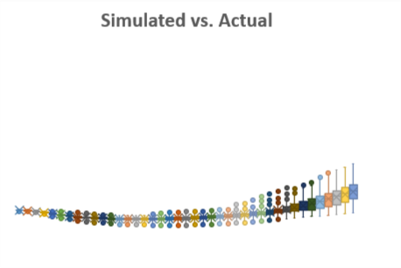
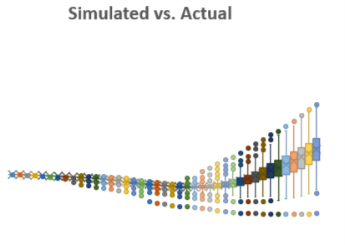

The Art of Applying AI to V&V: Sample Data

Slide 18
AI/ML and the Art and Science of V&V at Leidos
Art
Using AI/ML to
improve V&V
V&V of AI/ML Systems
RL-based Subversion and Automated Discovery of Test Cases
Science

Slide 19
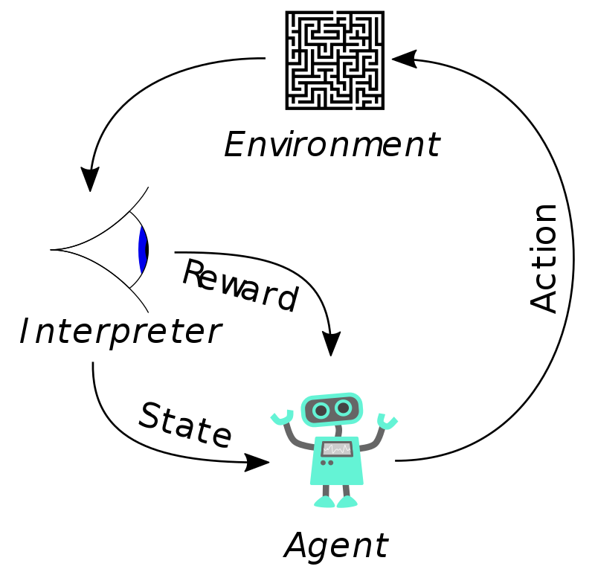
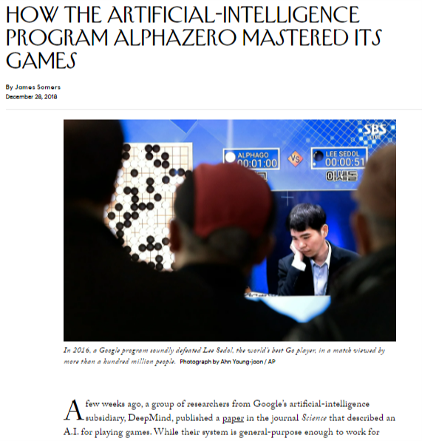
Reinforcement Learning
Unlike many ML algorithms (CNNs, transformers, etc.) that learn from data, Reinforcement Learning (RL) models learn from experience
New Yorker, December 2018

Slide 20
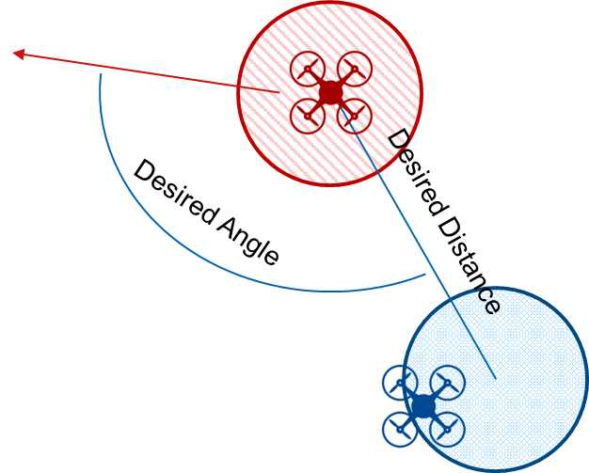
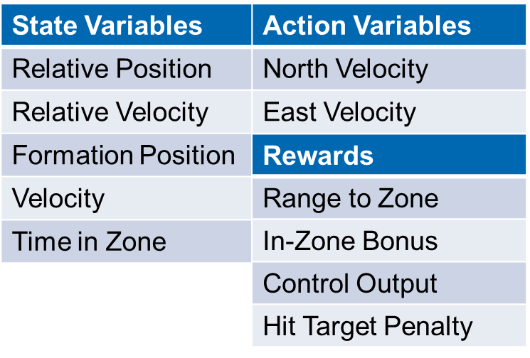

Reinforcement Learning Example: Drone Flying
RL models can be used in many applications, like adaptive control
  Example: RL drone control
    RL can learn to fly the blue agent in formation with red agent
    Red agent is flying a random set of waypoints at random speed

Slide 21
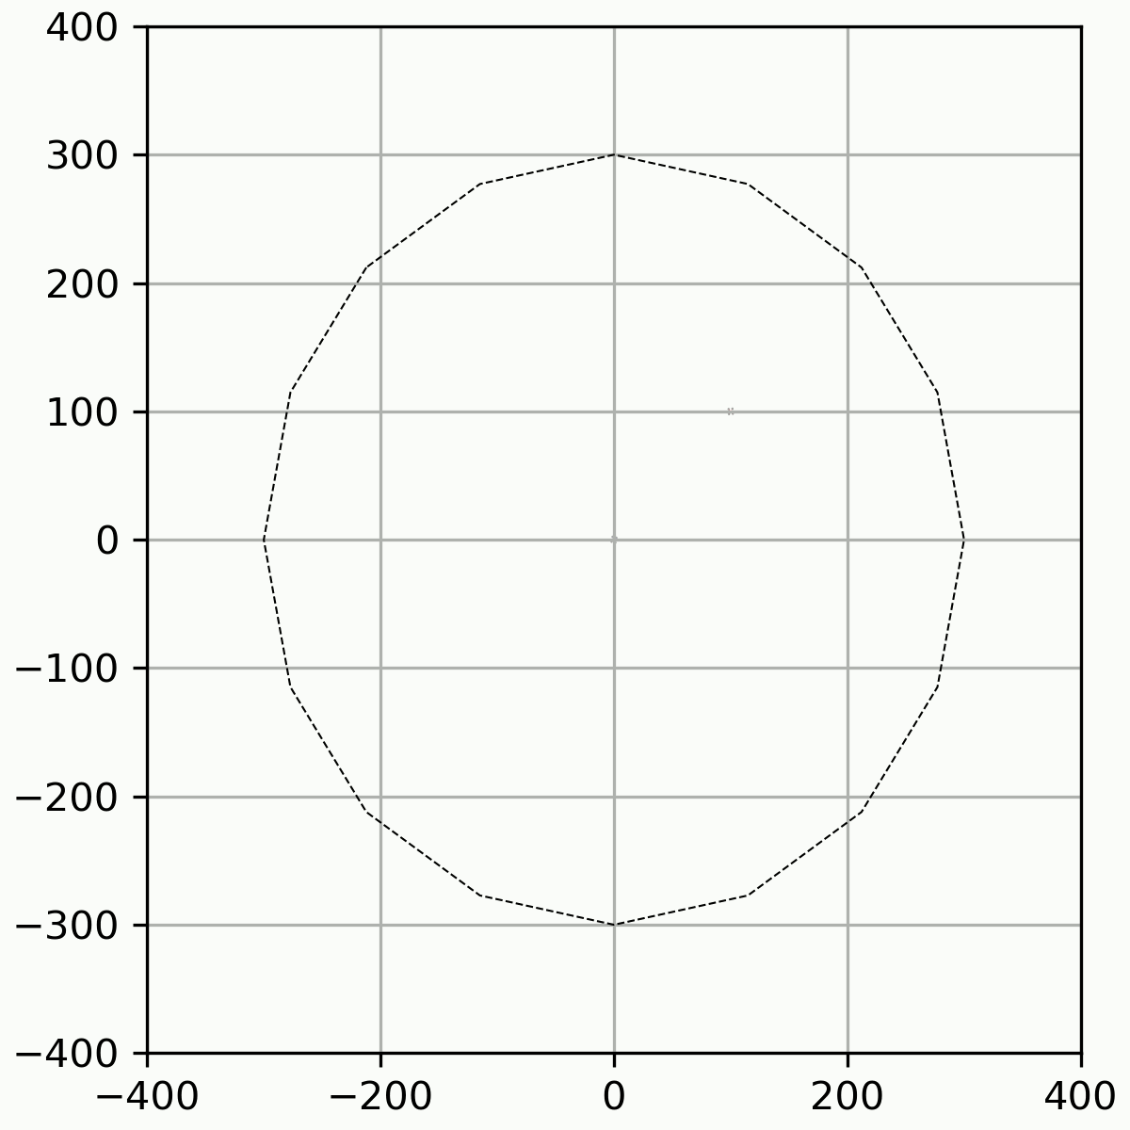
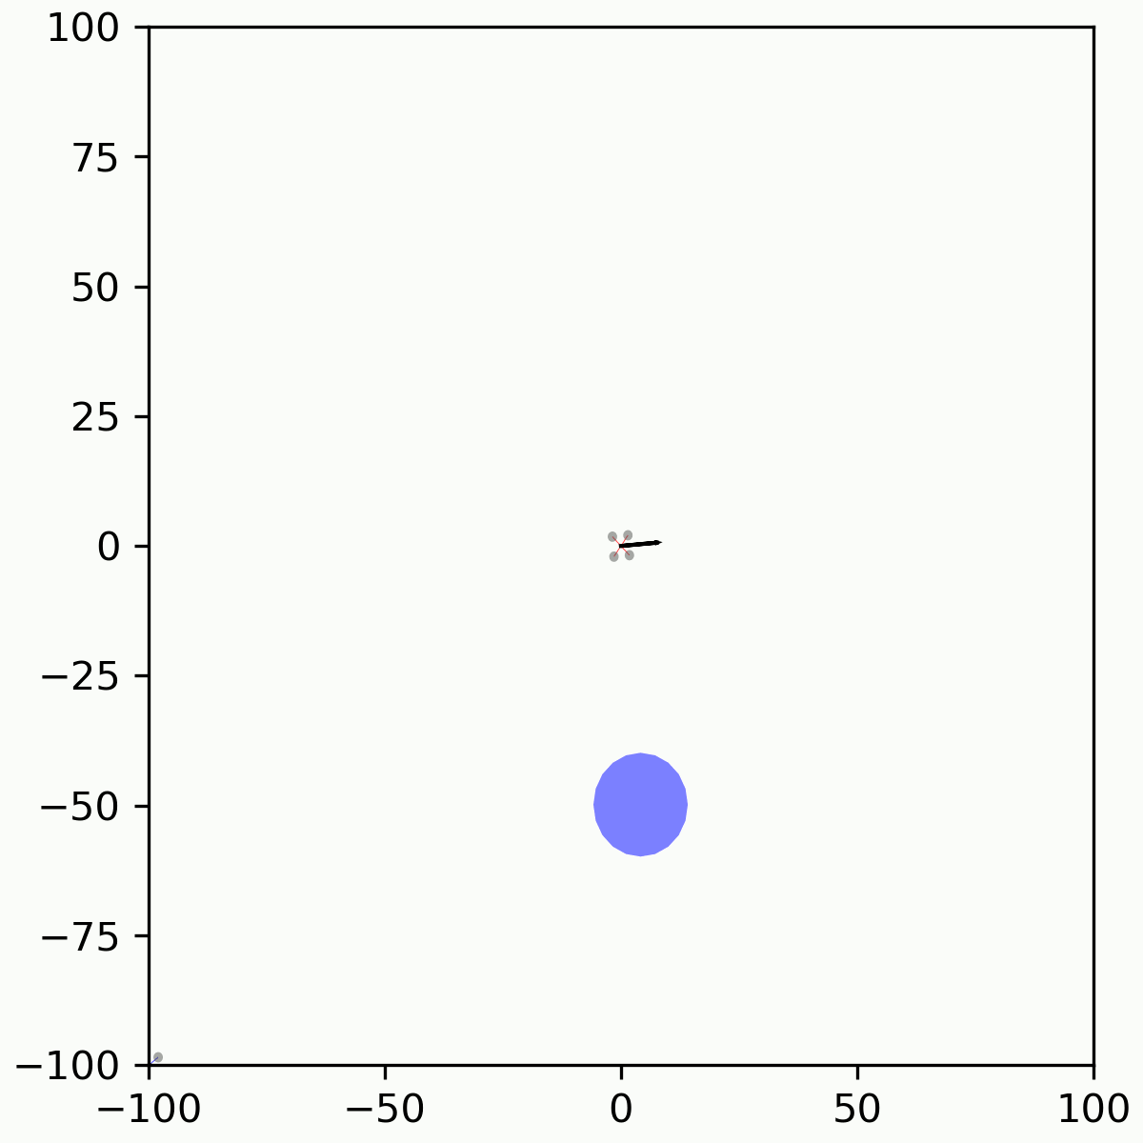

Reinforcement Learning Example: Drone Flying
Top-Down View
Target-Centric View

Slide 22
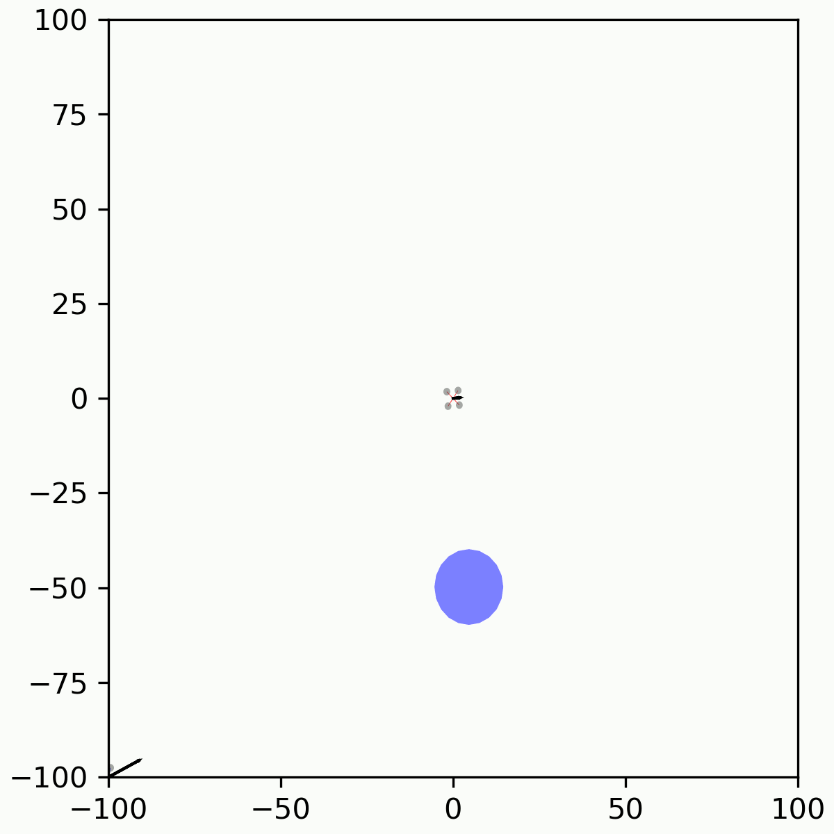
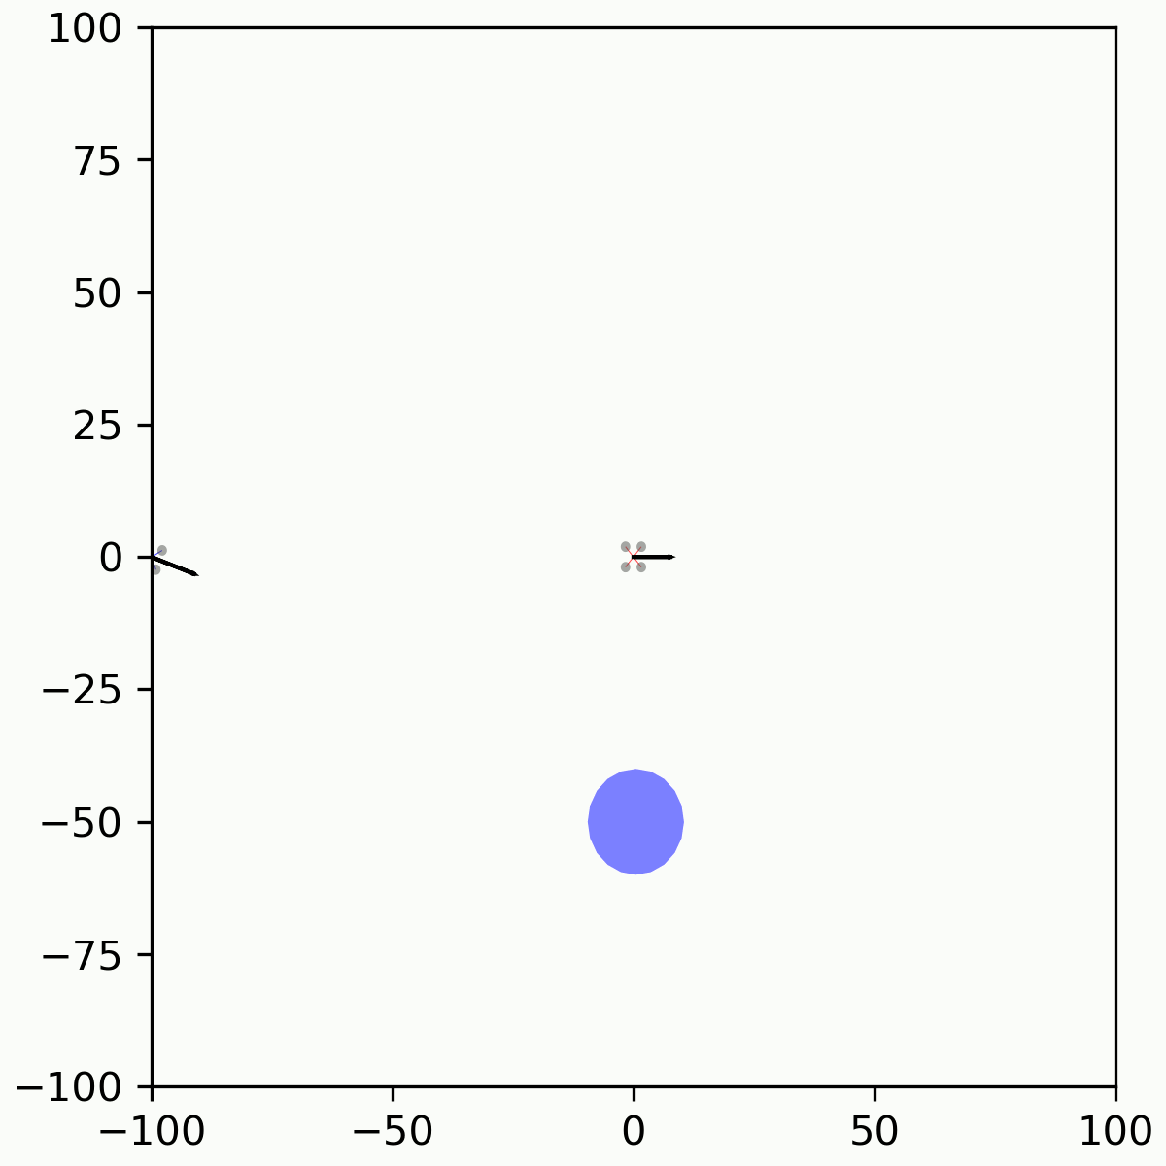
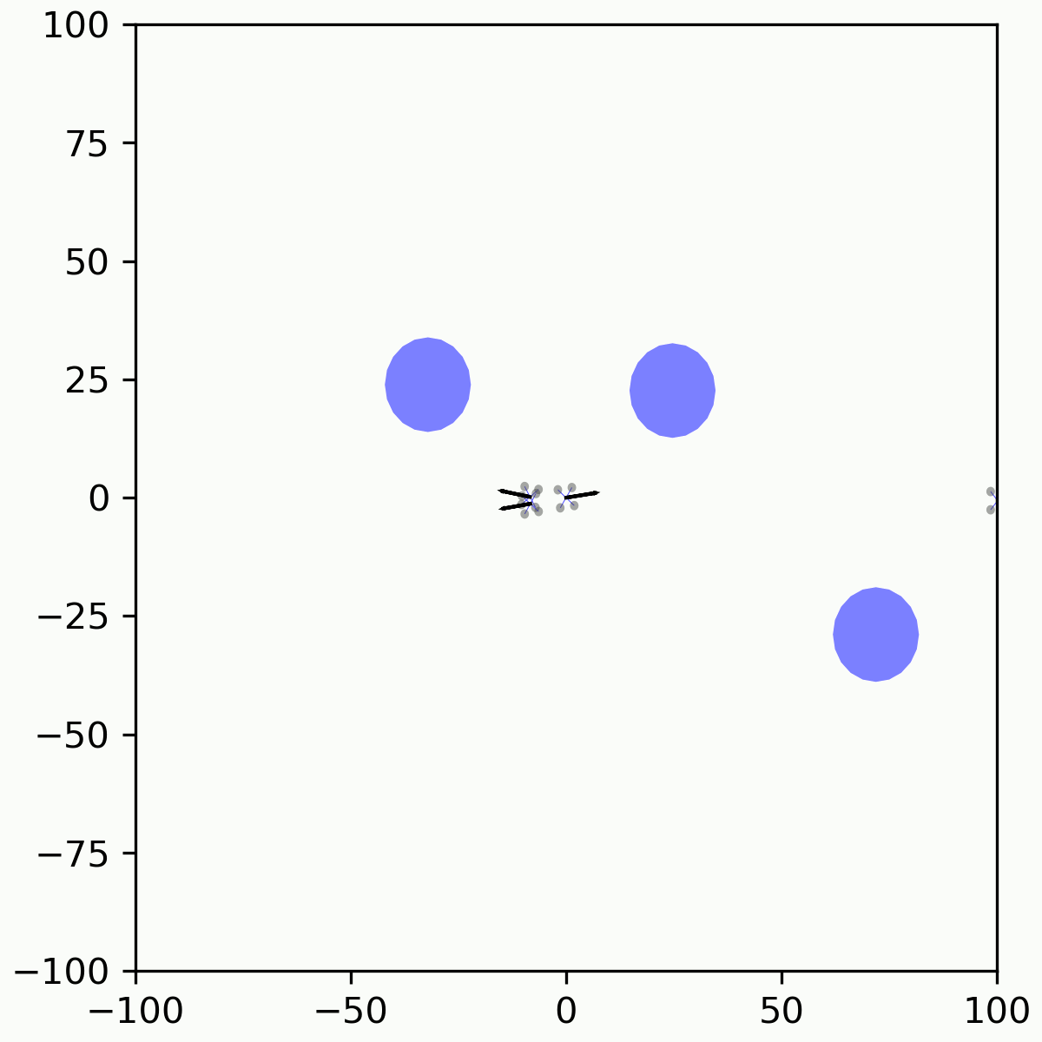
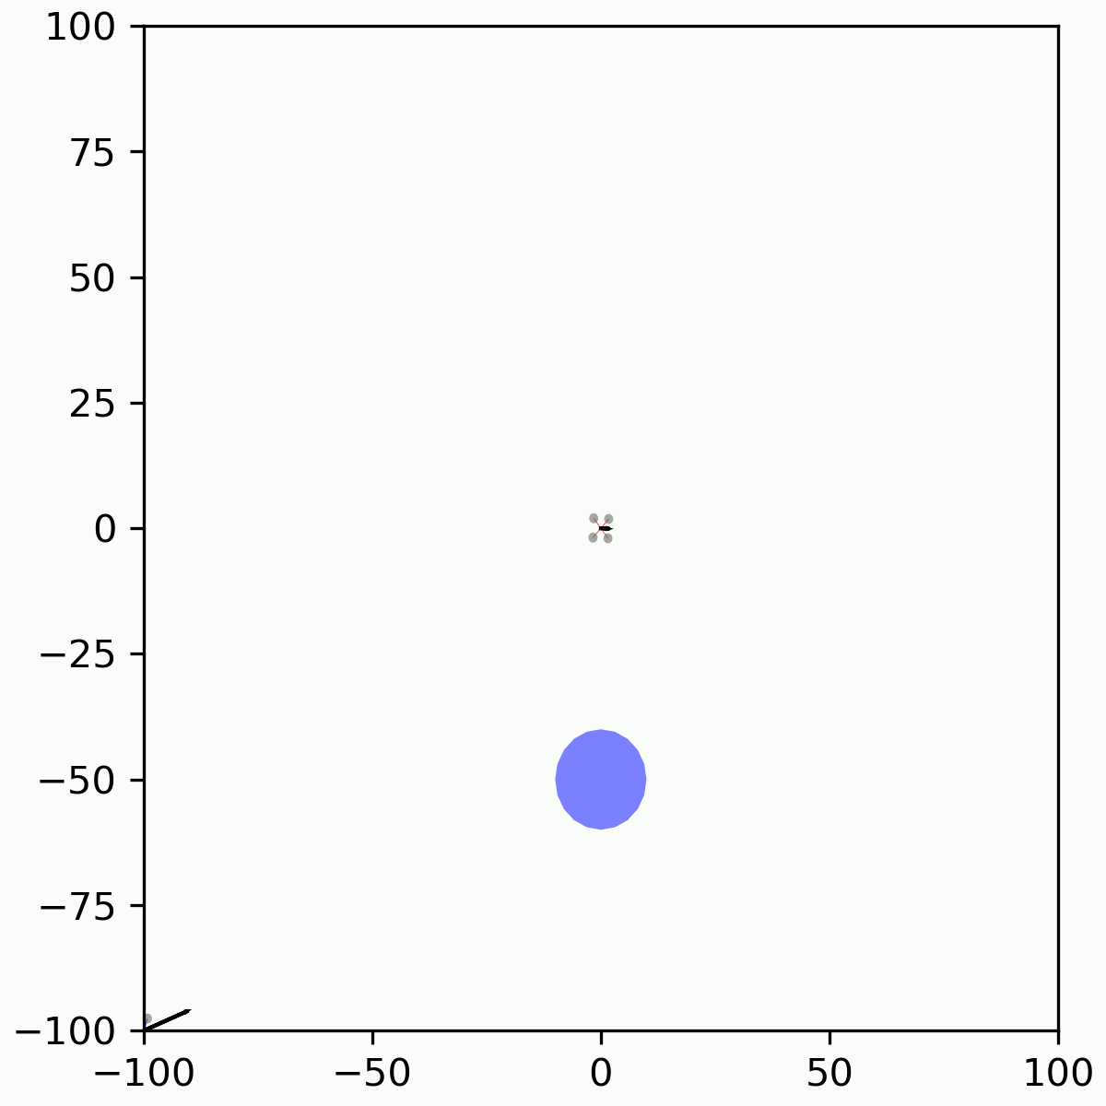
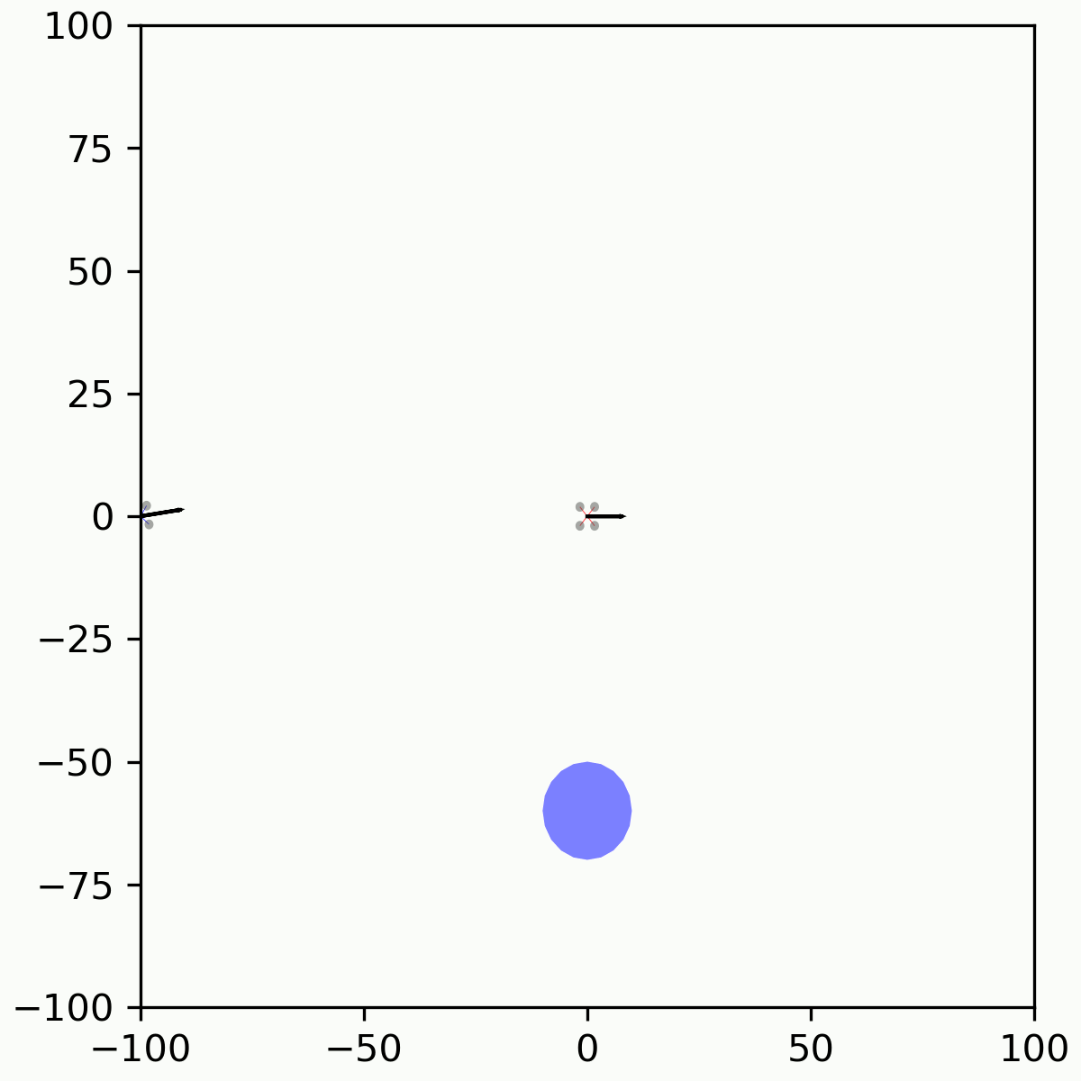
Reinforcement Learning Example: Drone Flying
Randomized Target
Behavior
Cyclical Formation Point
Multi-ship Formation
Inertial Formation Point
Variable Range
Formation Point

Slide 23
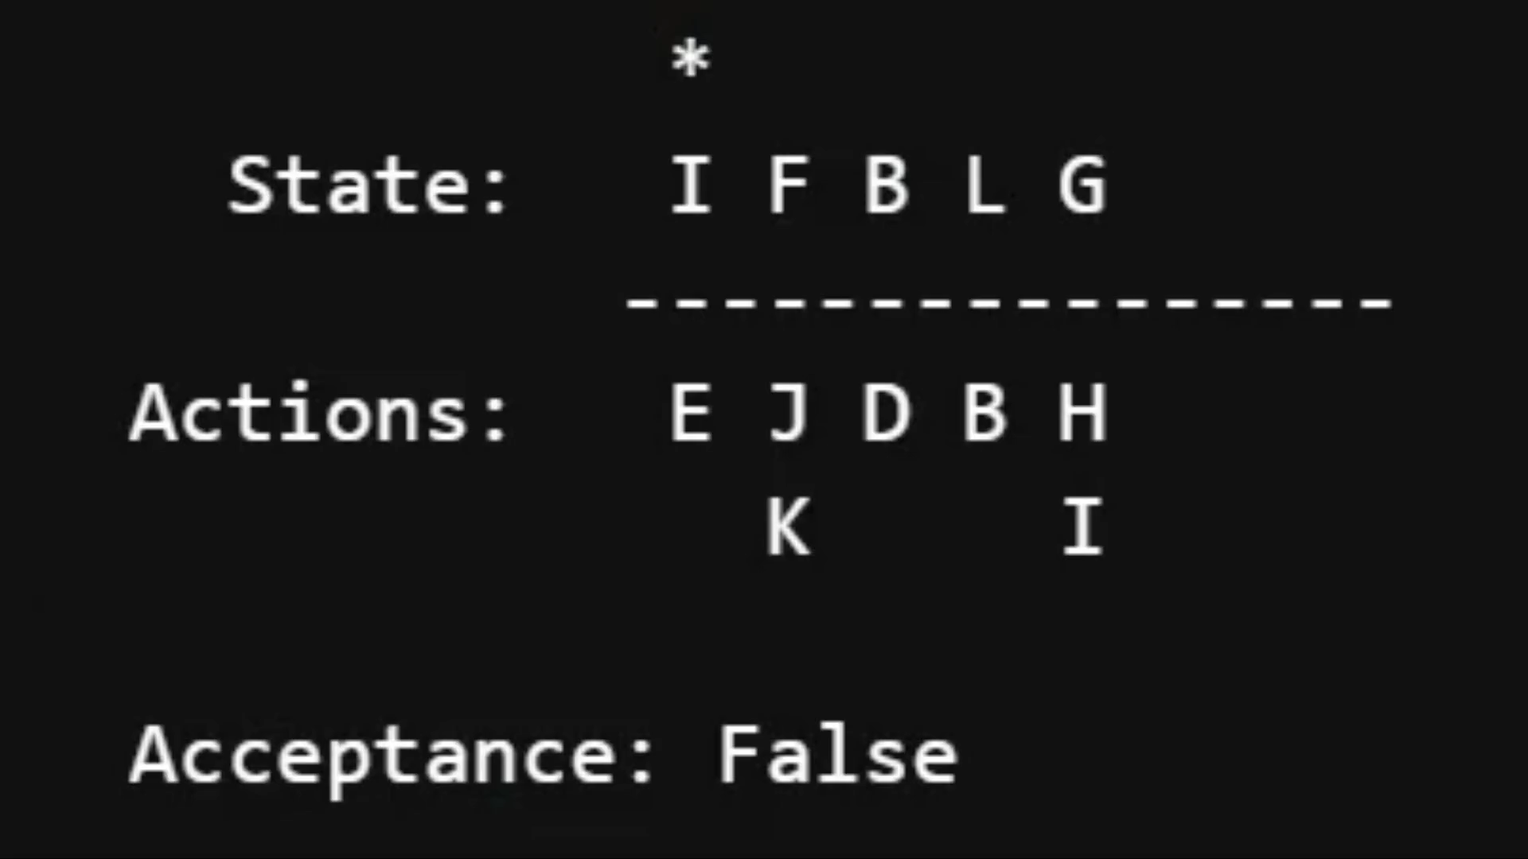
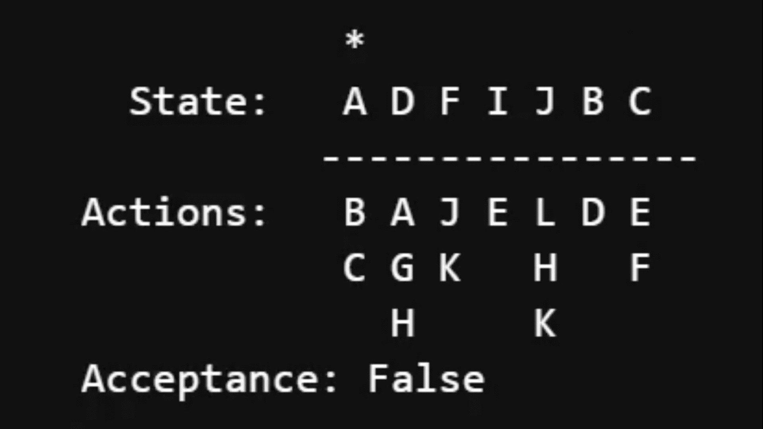
How can RL be used to generate test cases?
If the reward for an RL system is based on learning how to drive states on a system through actions, it will learn ways to do so
No Training
Trained with RL

Slide 24
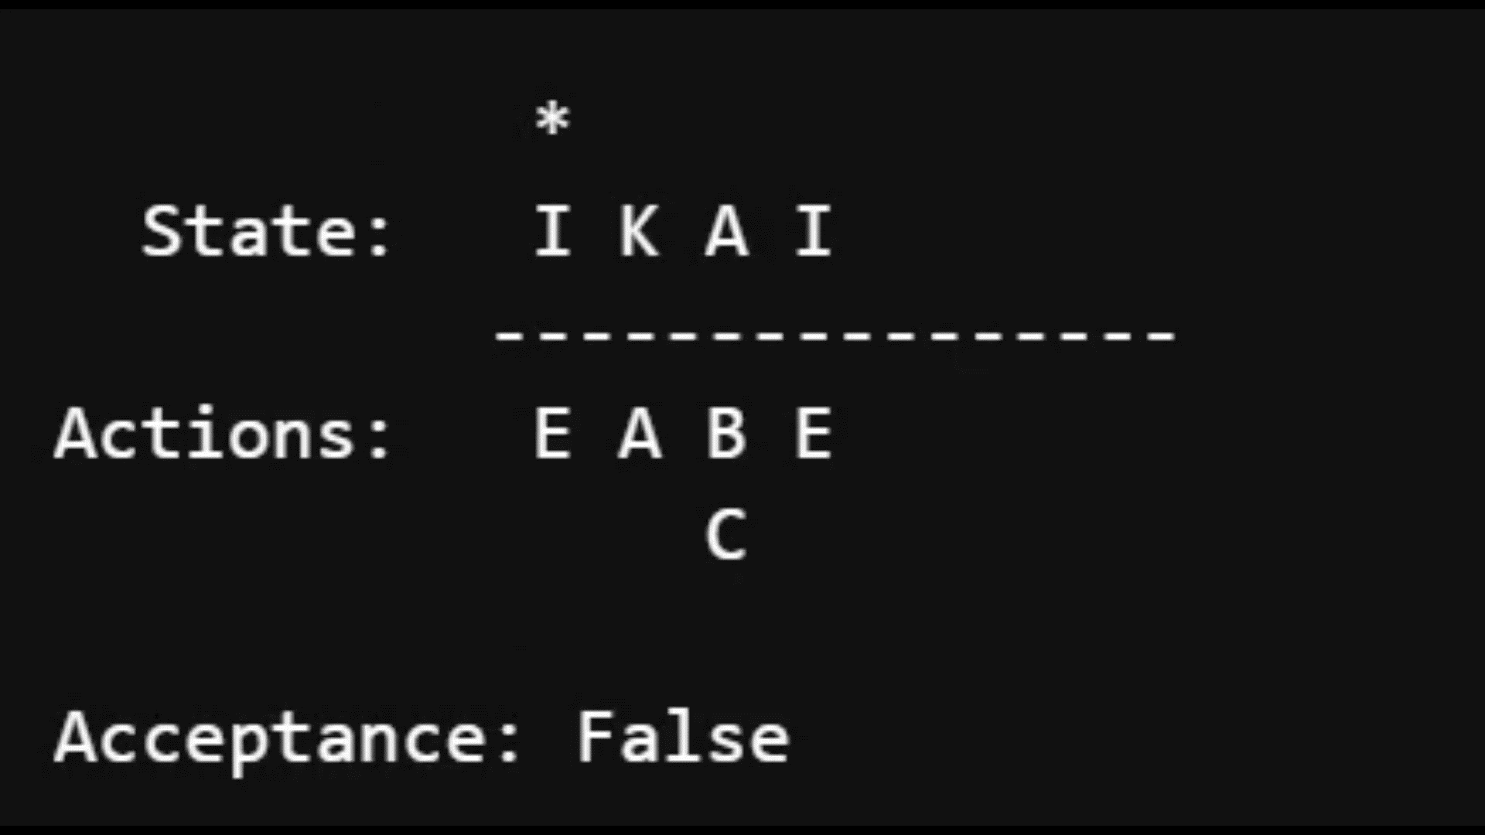
How can RL be used to generate test cases?
That sequence of actions can also be based on subverting a system against design requirements
  Gaps show up in several ways – for example as actions the agent learns that fall outside requirements
Bug in Acceptance Criteria found with RL
Bug: Uprotected transition

Slide 25
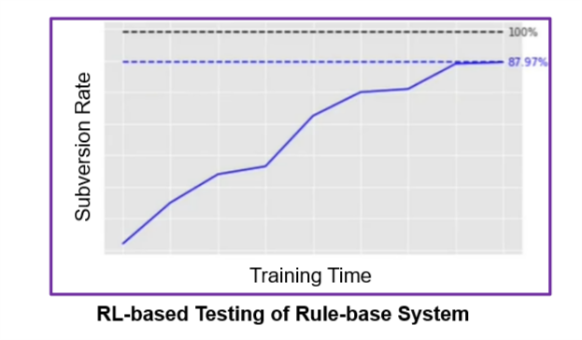
Using RLs for Subversion
This technique works to find gaps in widely used commercial products

Slide 26
Using RLs for Test Case Generation through Subversion
This technique could also be applied to V&V of human safety critical systems, identifying test cases sequences of safe (or unsafe) commands or transitions
It can also be used to find gaps in cyber-physical systems

Slide 27
AI/ML and the Art and Science of V&V at Leidos
Art
Using AI/ML to
improve V&V
V&V of AI/ML Systems
Science

Slide 28
AI/ML and the Art and Science of V&V at Leidos
Designing for Verifiability
Art
Using AI/ML to
improve V&V
V&V of AI/ML Systems
Science

Slide 29
AI/ML and the Art and Science of V&V at Leidos
Art
Using AI/ML to
improve V&V
V&V of AI/ML Systems
Science
Distribution-Aware V&V

Slide 30
AI/ML and the Art and Science of V&V at Leidos
Art
Using AI/ML to
improve V&V
Continuous, Contextual V&V
V&V of AI/ML Systems
Science

