Slide 1
A National Agenda for Software Engineering Research and Development: Architecting the Future of Software Engineering 16th Annual FAA Verification and Validation Virtual Summit Anita Carleton Division Director, Software Solutions Division John Robert Deputy Director, Software Solutions Division September 29-30, 2021

Slide 2
Copyright 2021 Carnegie Mellon University.
This material is based upon work funded and supported by the Department of Defense under Contract No. FA8702-15-D-0002 with Carnegie Mellon University for the operation of the Software Engineering Institute, a federally funded research and development center.
The view, opinions, and/or findings contained in this material are those of the author(s) and should not be construed as an official Government position, policy, or decision, unless designated by other documentation.
NO WARRANTY. THIS CARNEGIE MELLON UNIVERSITY AND SOFTWARE ENGINEERING INSTITUTE MATERIAL IS FURNISHED ON AN "AS-IS" BASIS. CARNEGIE MELLON UNIVERSITY MAKES NO WARRANTIES OF ANY KIND, EITHER EXPRESSED OR IMPLIED, AS TO ANY MATTER INCLUDING, BUT NOT LIMITED TO, WARRANTY OF FITNESS FOR PURPOSE OR MERCHANTABILITY, EXCLUSIVITY, OR RESULTS OBTAINED FROM USE OF THE MATERIAL. CARNEGIE MELLON UNIVERSITY DOES NOT MAKE ANY WARRANTY OF ANY KIND WITH RESPECT TO FREEDOM FROM PATENT, TRADEMARK, OR COPYRIGHT INFRINGEMENT.
[DISTRIBUTION STATEMENT A] This material has been approved for public release and unlimited distribution. Please see Copyright notice for non-US Government use and distribution.
This material may be reproduced in its entirety, without modification, and freely distributed in written or electronic form without requesting formal permission. Permission is required for any other use. Requests for permission should be directed to the Software Engineering Institute at permission@sei.cmu.edu.
DM21-0617

Slide 3
CMU SEI is a DoD R&D Federally Funded Research and Development Center
Established in 1984 at Carnegie Mellon University (CMU)
Charged to improve the state of the practice of software engineering and cybersecurity
Added AI Engineering in 2018
Collaborates with CMU and broadly in academia, government, and industry
Capable of conducting both fundamental research and classified work
~610 staff members
FY20 total funding ~$140M Offices in Pittsburgh and DC, with locations near customer facilities in MA, TX, and CA

Slide 4
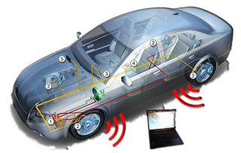
Key Points
Our ever-growing dependence on software-reliant systems makes it imperative to continually innovate in software engineer­ing theories, tools, & practices.

Slide 5
Key Points - 2
Our ever-growing dependence on software-reliant systems makes it imperative to continually innovate in software engineer­ing theories, tools, & practices.
Due to software’s ubiquity in today’s systems we must learn how to develop & assure software continuously & insert new capabilities as quickly as possible.

Slide 6
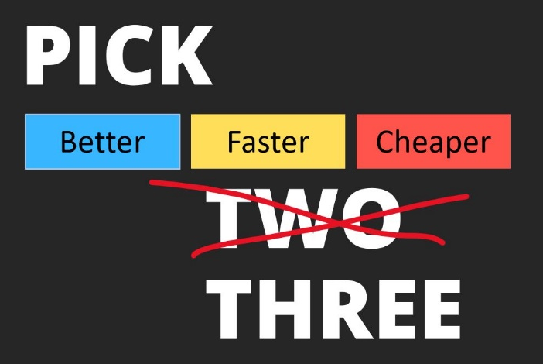
Key Points - 3
Our ever-growing dependence on software-reliant systems makes it imperative to continually innovate in software engineer­ing theories, tools, & practices.
Due to software’s ubiquity in today’s systems we must learn how to develop & assure software continuously & insert new capabilities as quickly as possible.
Future systems & fundamental shifts in software engineering require new research.
e.g., rapidly deploying critical systems requires software engineering advances.

Slide 7
Key Points - 4
Our ever-growing dependence on software-reliant systems makes it imperative to continually innovate in software engineer­ing theories, tools, & practices.
Due to software’s ubiquity in today’s systems we must learn how to develop & assure software continuously & insert new capabilities as quickly as possible.
Future systems & fundamental shifts in software engineering require new research.
Since new types of systems continue to push beyond what current software engineering theories, tools, & practices can support, CMU’s Software Engineering Institute (SEI) led a study to reevaluate & redefine how software should be developed.

Slide 8
Key Points - 5
Our ever-growing dependence on software-reliant systems makes it imperative to continually innovate in software engineer­ing theories, tools, & practices.
Due to software’s ubiquity in today’s systems we must learn how to develop & assure software continuously & insert new capabilities as quickly as possible.
Future systems & fundamental shifts in software engineering require new research.
Since new types of systems continue to push beyond what current software engineering theories, tools, & practices can support, CMU’s Software Engineering Institute (SEI) led a study to reevaluate & redefine how software is developed.
CMU SEI’s study was intended to catalyze the software engineering community by creating a multi-year research & development vision, strategy, & roadmap for engineering next-generation software-reliant systems.

Slide 9
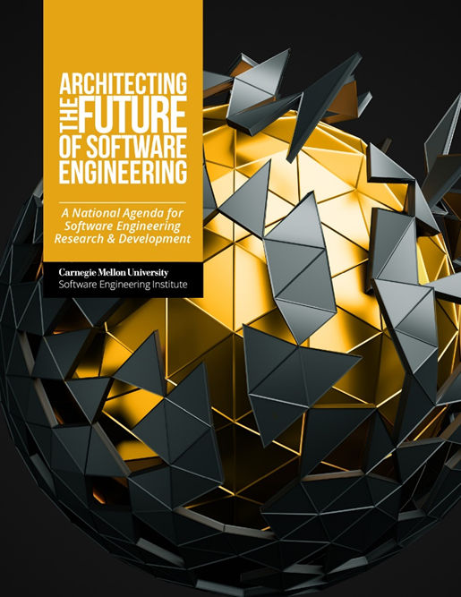
Objectives of this Presentation
Discuss the research agenda set forth in the SEI’s Software Engineering Study
Expected public release is September, 2021

Slide 10
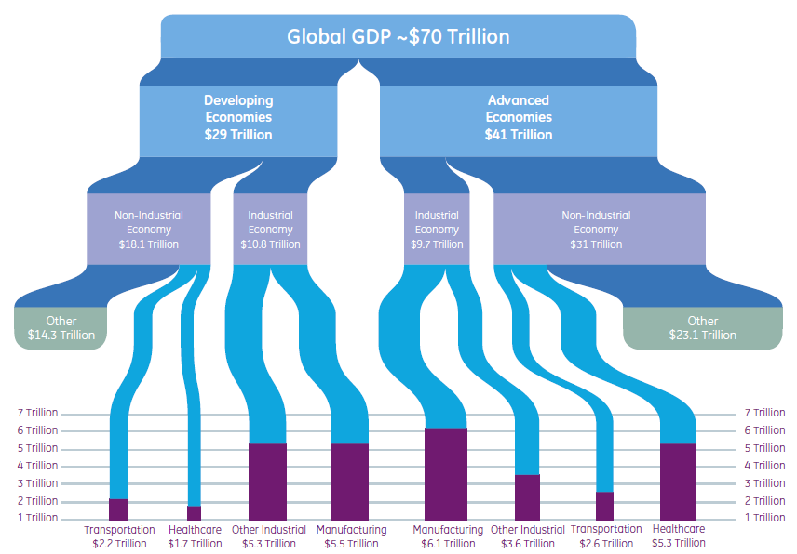
Focus of Research Agenda for Software Engineering
Software is vital to competitiveness, innovation, & security.
Global economies, infrastructure, education, entertainment, & healthcare all depend on software.

Slide 11
Focus of Research Agenda for Software Engineering
Improving software quality & productivity requires a community effort to:
Identify future challenges in engineering software-reliant systems.

Slide 12
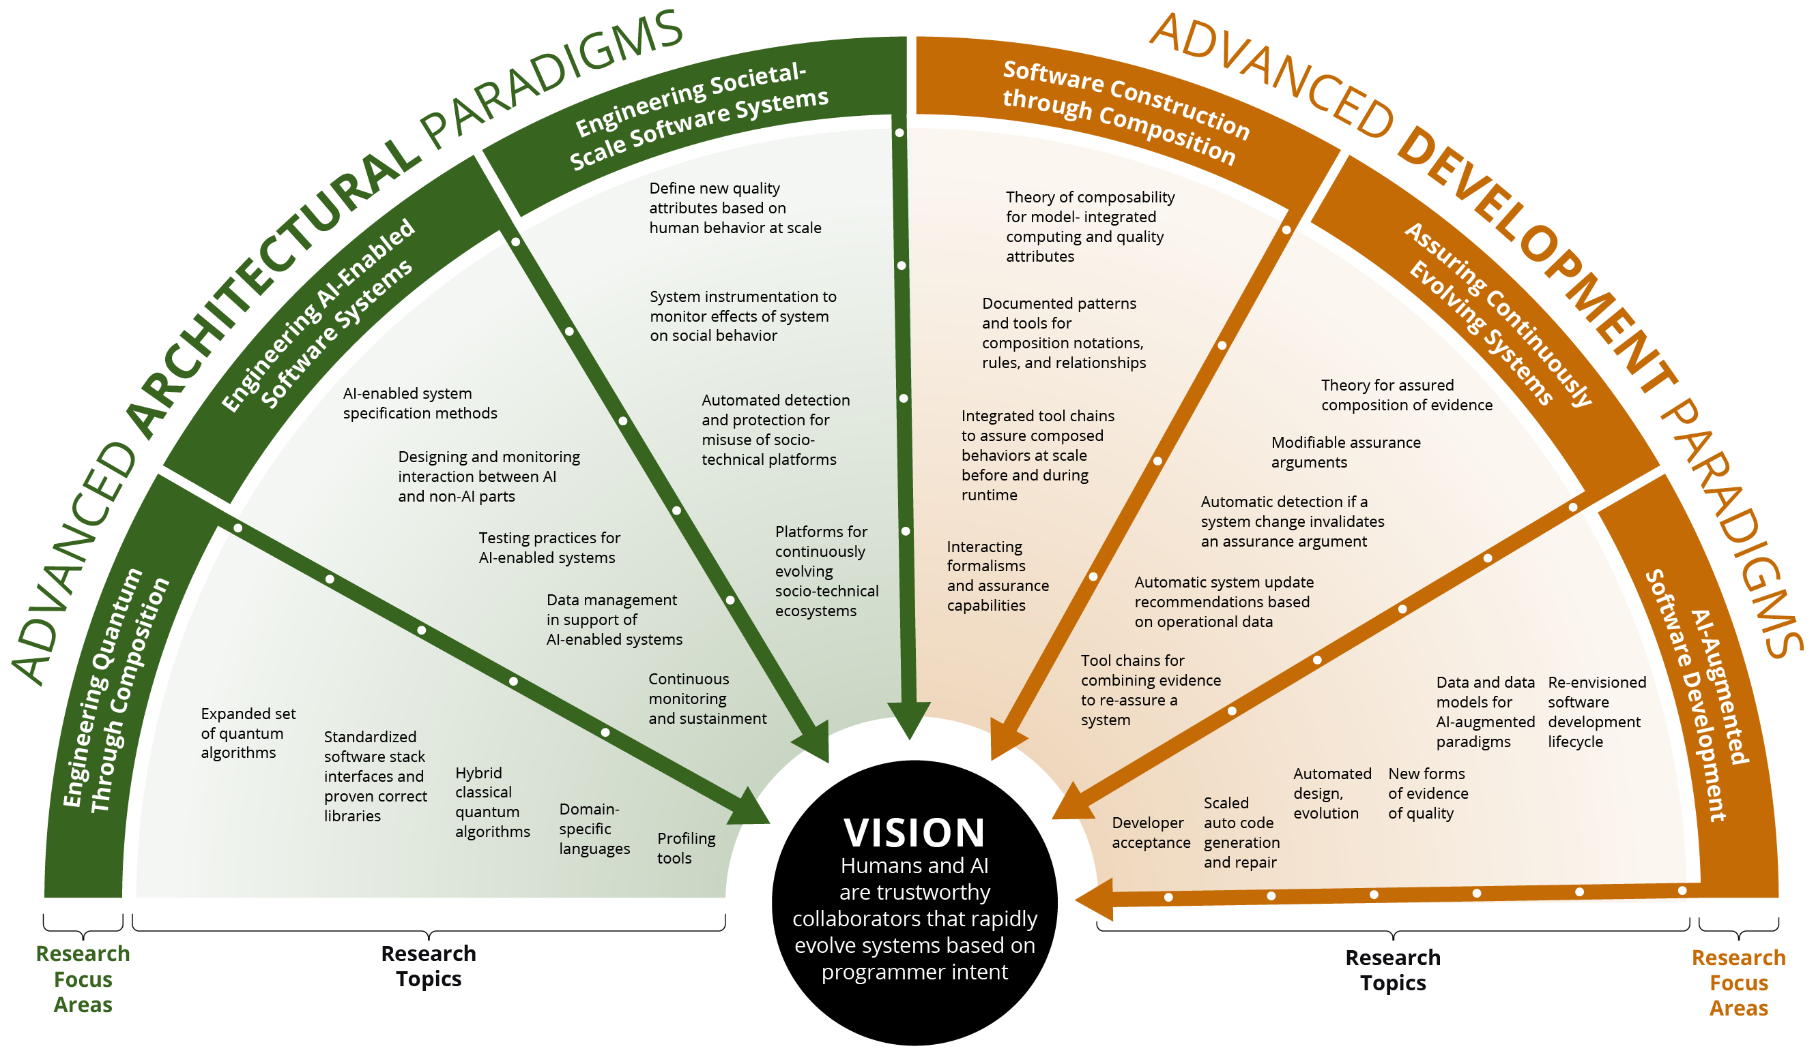
Focus of Research Agenda for Software Engineering
Improving software quality & productivity requires a community effort to:
Identify future challenges in engineering software-reliant systems.
Develop a research roadmap that will drive advances in foundational software engineering principles across system types
e.g., intelligent, autonomous, safety- critical, & data intensive systems.

Slide 13
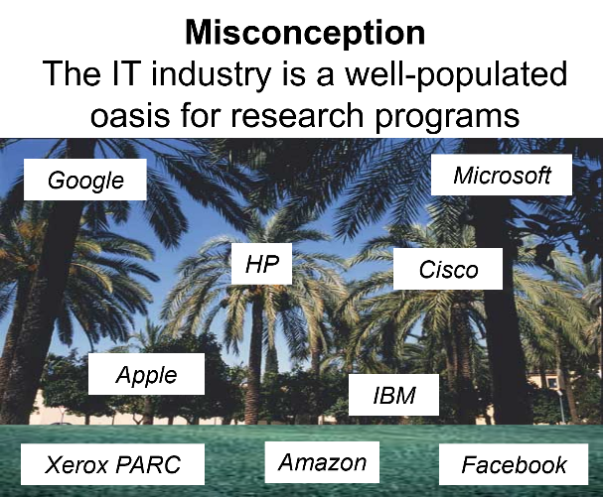
Focus of Research Agenda for Software Engineering
Improving software quality & productivity requires a community effort to:
Identify future challenges in engineering software-reliant systems.
Develop a research roadmap that will drive advances in foundational software engineering principles across system types
Raise the visibility of software to the point where it receives the sustained recognition commensurate with its importance to security & competitiveness.

Slide 14
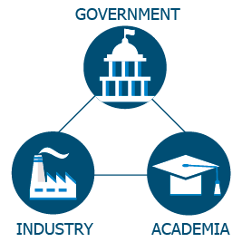
Focus of Research Agenda for Software Engineering
Improving software quality & productivity requires a community effort to:
Identify future challenges in engineering software-reliant systems.
Develop a research roadmap that will drive advances in foundational software engineering principles across system types
Raise the visibility of software to the point where it receives the sustained recognition commensurate with its importance to security & competitiveness.
Enable strategic partnerships & collaborations to drive innovation among governments, industry, & academia.

Slide 15
Abstract & Advisory Board
Software is vital to our country’s global competitiveness, innovation, & national security. It also ensures our modern standard of living & enables continued advances in defense, infrastructure, healthcare, commerce, education, & entertainment. As the DoD’s federally funded research & development center (FFRDC) focused on improving the practice of software engineering, the Carnegie Mellon University (CMU) Software Engineering Institute (SEI) is leading the community in creating this multi-year research & development vision & roadmap for engineering next-generation software-reliant systems.
Advisory Board
Deb Frincke, Chair Associate Laboratory Director for National Security Sciences, Oak Ridge National Laboratory
Vint Cerf Vice President & Chief Internet Evangelist, Google
Penny Compton Vice President for Software Systems, Cyber, & Operations, Lockheed Martin Space
Tim Dare Deputy Director for Prototyping & Software, Office of the Under Secretary of Defense for Research & Engineering; Lead of National Defense Authorization Act Section 255 (former)
Sara Manning Dawson Chief Technology Officer, Enterprise Security, Microsoft
Jeff Dexter Senior Director of Flight, Software & Cybersecurity, SPACEX
Yolanda Gil Director of Knowledge Technologies, Information Sciences Institute, University of Southern California
Tim McBride President, Zoic Labs
Michael McQuade Vice President for Research, CMU
Nancy Pendleton Vice President & Senior Chief Engineer for Mission Systems, Payloads & Sensors, Boeing Defense, Space & Security
William Scherlis Director Information Innovation Office, DARPA

Slide 16
New System Types Require New R&D Advances
New types of systems
Trends
highly adaptive mission systems
systems that perform data fusion at a huge scale
highly available business enterprises
personal digital assistants—that really assist
dynamically integrated, secure, & personalized holistic healthcare
smart cities, buildings, roads, cars, & transportation systems
scale motivating the need for safe & resilient software composition
rapid & assured continuous software evolution
addressing workforce gaps in software talent
artificial intelligence (AI)-inspired automation
evidence-based assurance that a system behaves as intended
impact of cyber-social platforms on social behavior, creating societal scale impact
primacy of data (data has become as important as code)

Slide 17
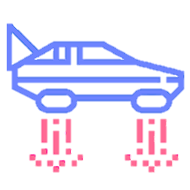
Approach for Developing Study
Advisory Board
Computing Landscape
Emerging Technologies
Literature Review
Expert Interviews
Workshops
Future Scenarios
Research Agenda Study: Roadmap / Outcome
Diverse Ecosystem
Ecosystem acts on findings (hopefully!)
Cast a wide net with input from many communities
Codify findings in an actionable way

Slide 18
Emerging Vision of the Future of Software Engineering
The current notion of software development will be replaced by one where the software pipeline consists of humans & AI as trustworthy collaborators that rapidly evolve systems based on user intent.
Requires advances in development paradigms & architectural paradigms

Slide 19
Emerging Vision of the Future of Software Engineering
The current notion of software development will be replaced by one where the software pipeline consists of humans & AI as trustworthy collaborators that rapidly evolve systems based on user intent.
Advanced development paradigms lead to efficiency & trust at scale.
Humans leverage trusted AI as a workforce multiplier for all aspects of software creation & sustainment.
Formal assurance arguments are combined & analyzed to assure & efficiently (re)assure continuously evolving software.
Enhanced software composition mechanisms enable predictable construction of systems at increasingly large scale.
Advanced architectural paradigms enable the predictable use of new computational models.
Theories & techniques drawn from behavioral sciences are used to design large-scale socio-technical systems, yielding more predictable outcomes.
New analysis & design methods facilitate the development of quantum-enabled systems.
AI & non-AI components interact in predictable ways to achieve enhanced mission, societal, & business goals.

Slide 20
Software Engineering Roadmap with Research Focus Areas & Research Objectives (10-15 Year Horizon)
VISION
Humans & AI are trusted collaborators that rapidly evolve systems based on user intent
AI-Augmented Software Development
New forms of evidence of quality
Automated design, evolution, & analysis tools
Scaled auto code generation & repair
Developer acceptance
Re-envisioned software development life-cycle
Data & data models for AI-augment paradigms
Tool chains for combining evidence to reassure a system
Automatic system update recommendations based on operational data
Interacting formalisms & assurance capabilities
Automatic detection if a system change invalidates an assurance argument
Modifiable assurance arguments
Continuous monitoring & sustainment
Integrated tool chains to assure composed behaviors at scale before & during runtime
Platforms for continuously evolving socio-technical ecosystems
Theory for assured composition of evidence
ADVANCED DEVELOPMENT PARADIGMS
Assuring Continuously Evolving Systems
Profiling tools
Documented patterns & tools for composition notations, rules, & relationships
Theory of composability for model-integrated computing & quality attributes
Automated detection & protection for misuse of socio-technical platforms
Data management in support of AI-enabled systems
Domain-specific languages
Software Construction through Composition
System instrumentation to monitor effects of system on social behavior
Testing practices for AI-enabled systems
Hybrid classical quantum algorithms
Define new quality attributes based on human behavior at scale
Designing & monitoring interaction between AI & non-AI parts
ADVANCED ARCHITECTURAL PARADIGMS
Standardized software stack interfaces & proven correct libraries
Engineering Societal-Scale Software Systems
AI-enabled system specification methods
Expanded set of quantum algorithms
Engineering AI-Enabled Software Systems
Engineering Quantum Computing Software Systems
SEI Internal Use Only

Slide 21
Research Focus Areas: Development Paradigms
AI-Augmented Software Development
Assuring Continuously Evolving Systems
Software Construction through Composition
The focus of this research area is on what AI-augmented software development will look like at each stage of the development process & during continuous evolution, where it will be particularly useful in taking on routine tasks.
The goal of this research area is to develop a theory & practice of rapid & assured software evolution that enables efficient & bounded reassurance of continuously evolving systems.
This research area focuses on methods & tools that enable the specification & enforcement of composition rules for component-based technologies & platforms that allow both the creation of required behaviors & the assurance of these behaviors.

Slide 22
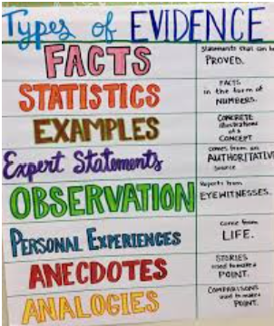
Assuring Continuously Evolving Systems - 1
This research area focuses on providing evidence-based assurance arguments that a system will behave as intended as it evolves continuously to incorporate new capabilities & dynamically self-adapts its operating configuration(s) at runtime in response to changing mission demands & environmental conditions.
Must consider both desired functionality & quality attributes.
This research area requires advances in
“Theory of evidence”
“Theory of evolution”

Slide 23
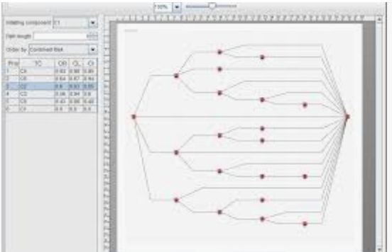
Assuring Continuously Evolving Systems - 2
“Theory of evidence” for
combining different types of evidence & …
automatically creating (semi-)formal arguments or assurance cases
“Theory of evolution” for
understanding how potential system changes propagate & possibly lead to new failure modes or vulnerabilities
automatically generating & analyzing runtime data & generate system improvement suggestions
combining human expression of intent & with operation data to generate & assure change requests
using AI to automatically generate evolution trajectories

Slide 24
Research Focus Areas: Architectural Paradigms
Engineering Societal-Scale Software Systems
Engineering AI-Enabled Software Systems
Engineering Quantum Computing Software Systems
This research area leverages the social sciences to develop new software engineering approaches that enable predictable behavior of software systems consisting of people as system components.
This research area focuses on exploring which existing software engineering practices can reliably support the development of AI systems, as well as identifying & augmenting software engineering techniques for systems with AI components.
Our goals in this research area are to first enable current quantum computers to be easily programmed, & then enable increasing abstraction as larger, fully fault-tolerant quantum computing systems become available.

Slide 25
Summary of Study Findings
1.
Maintaining national software engineering proficiency is a strategic advantage. Software engineering affects everything, because software is everywhere.
Maintaining national software engineering proficiency requires sustained research. New types of systems will continue to push beyond the bounds of what current software engineering theories, tools, and practices can support.
Maintaining national software engineering proficiency requires fostering strategic partnerships. We need to enable strategic partnerships and collaborations to drive innovation in software engineering research among industry, research laboratories, academia, and government.
Maintaining national software engineering proficiency requires sustained investment. Ensure policy makers recognize the benefits of software engineering as a critical national capability.
5.
The vision of software engineering needs to change. The current notion of a software development pipeline will be replaced by one where AI and humans collaborate to continuously evolve the system based on programmer intent.
Focusing on re-assuring systems will enable continuous and rapid incorporation of new capability. Because software is ubiquitous there is an increasing need for software to continuously evolve to include new capability.
New design principles are needed for societal-scale systems. The growing recognition of software’s impact is generating new quality attribute requirements for which better design approaches are needed.
The software engineering workforce needs to be (re-)conceived. We need to better understand the nature of the needed workforce and what to do to foster its growth.
2.
6.
3.
7.
4.
8.

Slide 26
Recommendations
Our goal is to catalyze change that advances software engineering, which in turn will lead to more trustworthy and capable software-reliant systems in the future. Advancing software engineering requires supportive policy, research funding, researchers, practitioners, and cross-fertilization with other research communities.
Research recommendations are necessary to catalyze change
Enable AI as a reliable system capability enhancer.
Develop a theory and practice for software evolution and re-assurance at scale.
Develop formal semantics for composition technology.
Mature the engineering of societal-scale socio-technical systems.
Catalyze increased attention on engineering for new computational models, with a focus on quantum-enabled software systems
Enactment recommendations focus on institutional obstacles, including economic, human, and policy barriers
Investment priority should reflect the benefits of software engineering as a critical national capability.
Institutionalize ongoing advancement of software engineering research.
Develop a strategy for ensuring an effective workforce for the future of software engineering.

Slide 27
Discussion

