Slide 1

John Frederick, Manager, V&V Strategies and Practices Branch (ANG-E5A)
Date: September 29, 2021
16th Annual V&V Summit
The Fusion of Art and Science

Slide 2

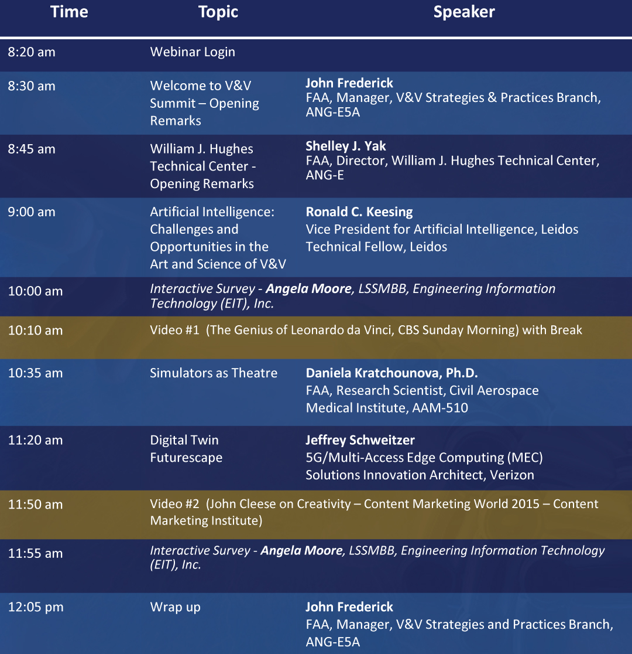
AGENDA DAY 1

Slide 3
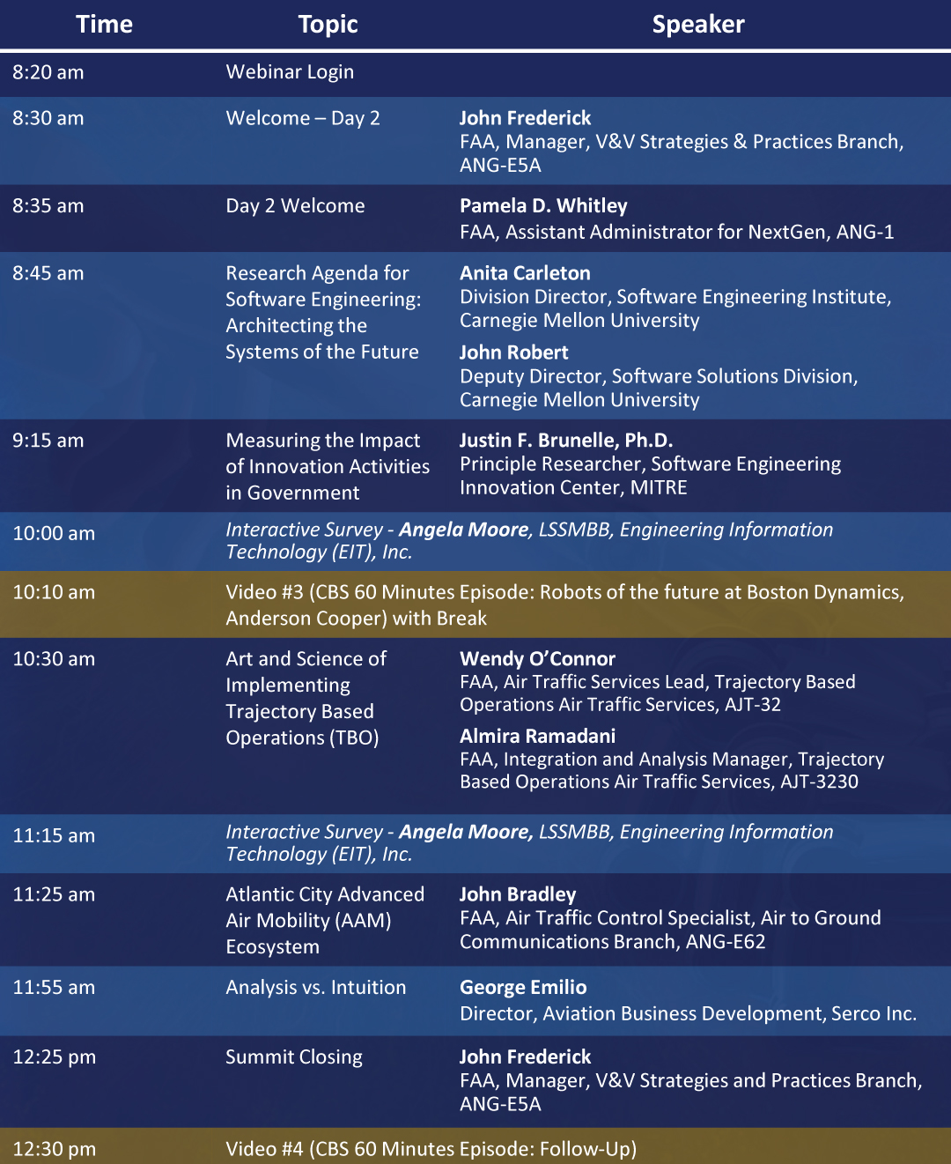
AGENDA DAY 2

Slide 4
16th Annual Verification & Validation Summit
Information
Visit the V&V Summit 2021 Website:
  Agenda
  Speaker Biographies
  Presentations
  Art and Science Information
  Summit Feedback
  https://www.faa.gov/about/office_org/headquarters_offices/ang/library/events/v_vsummits/v_vsummit2021/
Q&A area - used to type questions during the Summit
Chat area (read only) – used for communications from the host or speakers
eLMS Training credit available for FAA Federal Employees (faa.gov email) – must attend both days
Google Chrome is the preferred browser

Slide 5


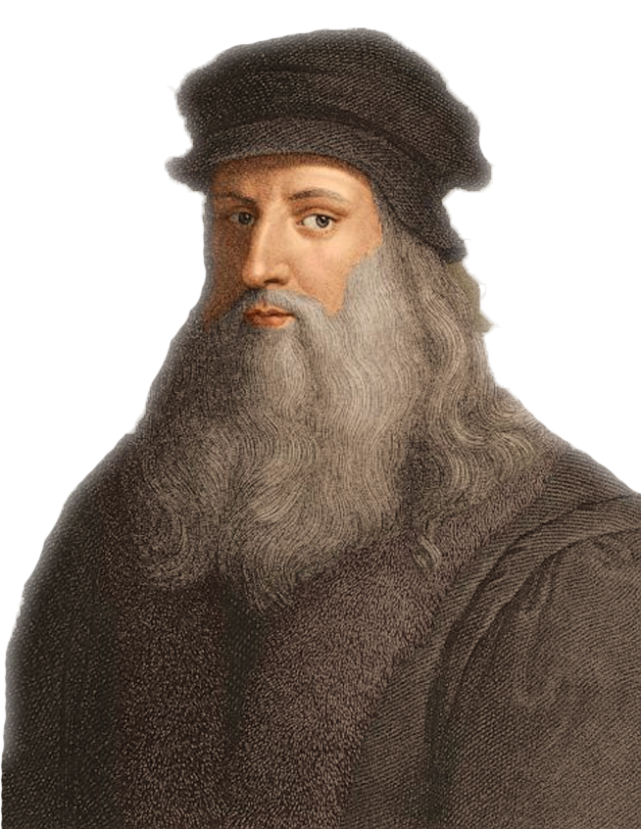
“To develop a complete mind: Study the science of art; study the art of science. Learn how to see. Realize that everything connects to everything else.”
― Leonardo da Vinci

Slide 6
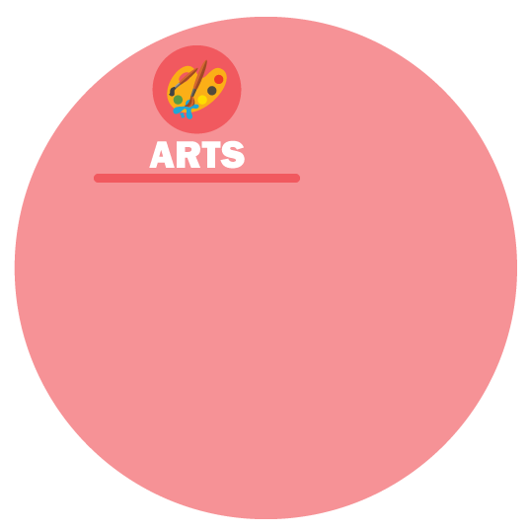





The Intersection of Art and Science
Magic
Creativity
Subjective
Perspective
Instinctive
Sensory
Intuition
Curiosity
Discovery
Innovation
Analytics
Objective
Experiment
Study
Laws/Physics
Facts/Data

Slide 7
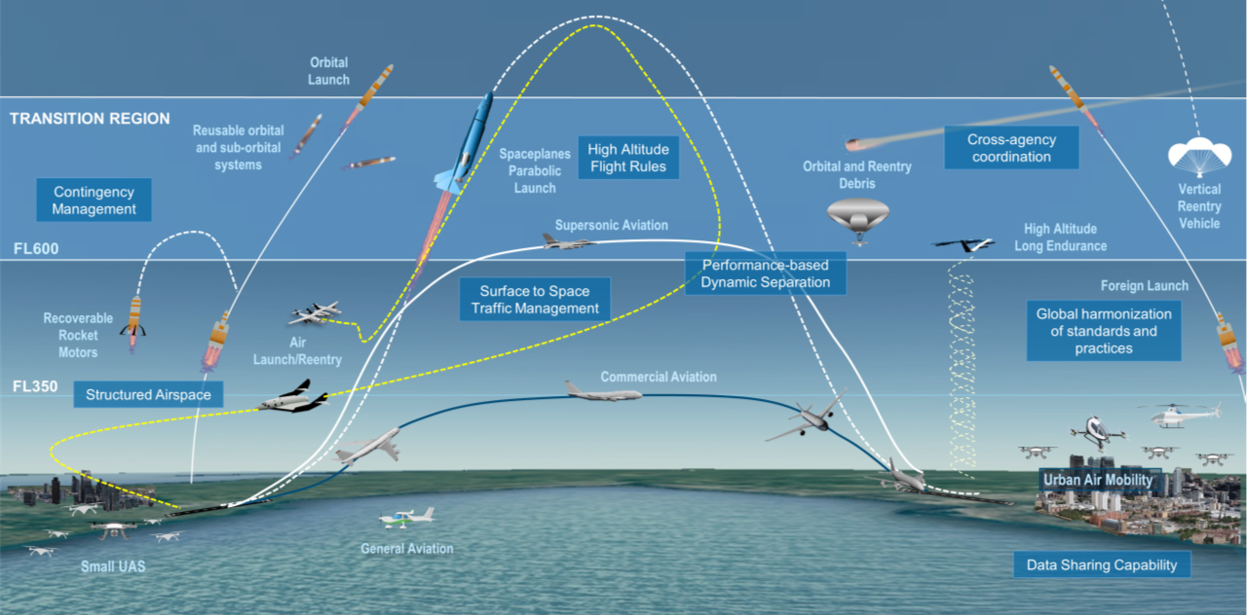
Changes in Aviation: Will Create Opportunities for Creative Innovation

Slide 8

The Fusion of Art and Science Challenge
The future of the air transportation system will involve:
Technology evolution requires us to be more than scientists and engineers to innovate safe and effective creative solutions
Challenge: Think like Leonardo
  How can we be more innovative and creative in our projects and mission?
  How can we foster Art and Science Fusion thinking in our teams and organizations?
    Artificial Intelligence
    Machine Learning
    New air traffic control concepts
    Advanced technology avionics
    Info-Centric NAS
    Urban air mobility
    Unmanned vehicles
    Autonomous vehicles
    Frequent NAS space travel operations
    Supersonic and hypersonic aircraft
Humans have the magical ability to weave information into narratives

