Slide 1
SUPER BOWL
Sunday, February 13, 2022
SoFi Stadium, Los Angeles, California

Slide 2
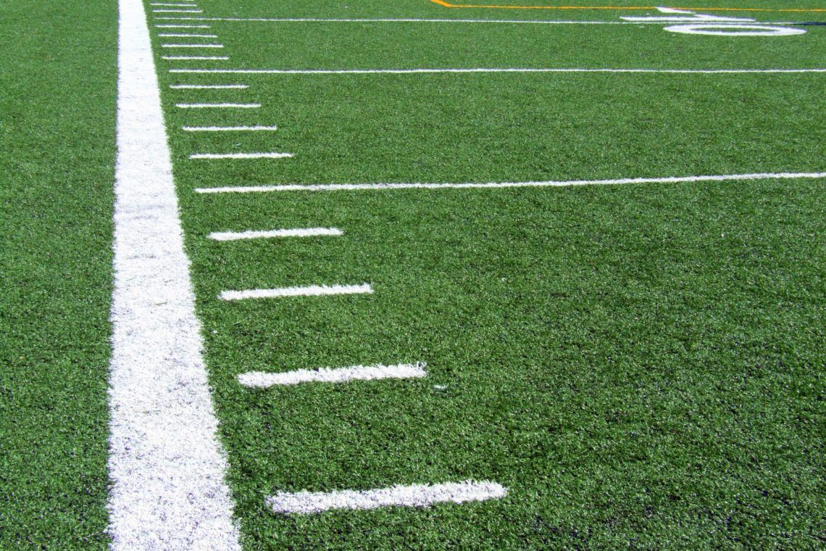
Table of Contents
Peak Arrival and Departure Times Slide 3
No Drone Zone - request SGI waivers Slide 21
NFL Aviation Parking Reservations Slides 5-6
TFR Information Slides 7-20
Gateway Screening Slides 22-23

Slide 3
Anticipated Peak Arrival and Departure Times
ARRIVALS in Local time:
Saturday: 1000 – 1800 PST
Sunday: 0900 - 1200 PST
DEPARTURES in Local time:
Sunday: 2200 - 0300 (Monday AM PST)
Monday: 0700 - 2000 PST
Monday volume is a mix of Arrivals and Departures.
The majority will be Departures, with
peak volume expected between 0900 and Noon PST

Slide 4
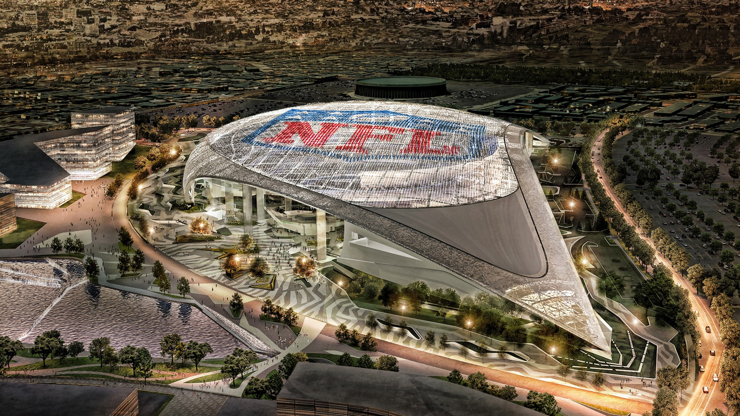
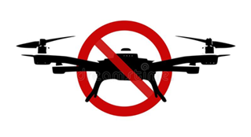
NO DRONE ZONE

Slide 5
NFL Aviation Parking Reservations

Slide 6
NFL Transportation PPR Program
Each year, the NFL develops a Super Bowl parking reservation program for GA aircraft.
The SB LVI program uses an airport criteria baseline, and is tailored to SCT and ZLA airspace.
Reservation slots are developed site-specific, for airports meeting the criteria for inclusion in the NFL Reservation Program.
The FAA participates in developing the slots, that assist in managing General Aviation volume.
Each participating airport has an allocation of slots, and the airport authority works with FBOs to determine the number of slots for each FBO.
The reservation program is effective from Wednesday, February 9, 2022, through Monday, February 14, 2022.

Slide 7
TFR Information

Slide 8
Super Bowl LVI TFR DRAFT Information
All information is subject to change prior to publication
Pre-Game Tailgate
Super Bowl LVI
UAS Restrictions
Crewed and UAS Restrictions
Centered near
SoFi Stadium
Centered near
SoFi Stadium
10 NMR inner ring (excluding LGB Class D)
30 NMR outer ring
SFC - 17,999 MSL
1 NMR
SFC - 3000 AGL
February 13, 2022
1000 – 1430 Local
February 13, 2022
1430 – 2030 Local

Slide 9
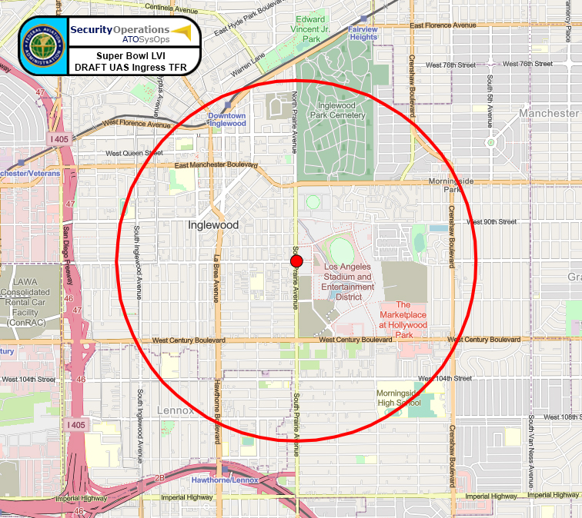
Super Bowl LVI – Pre-game Tailgate TFR DRAFT

Slide 10
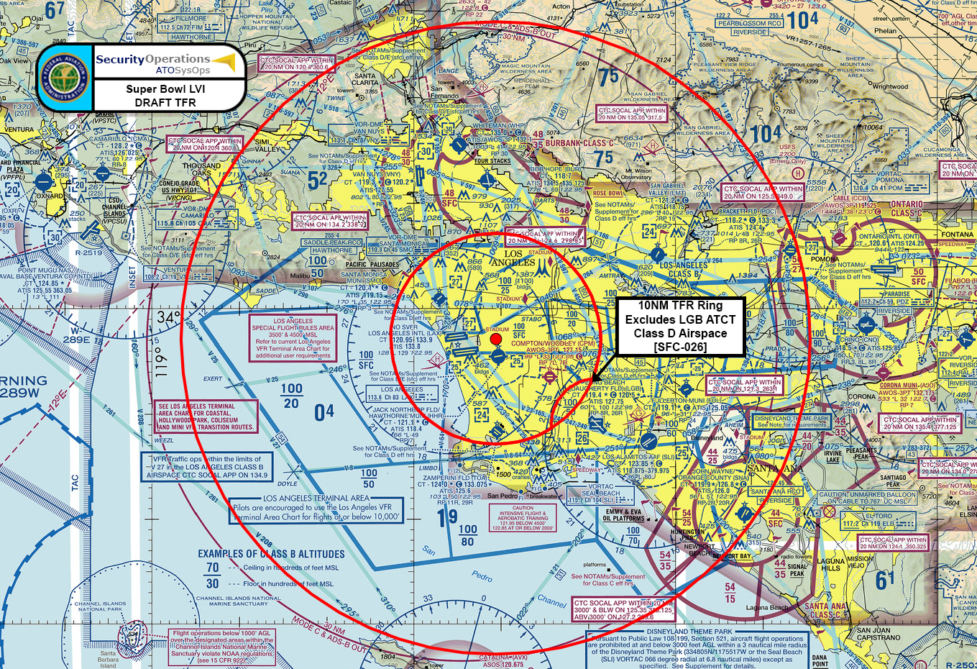
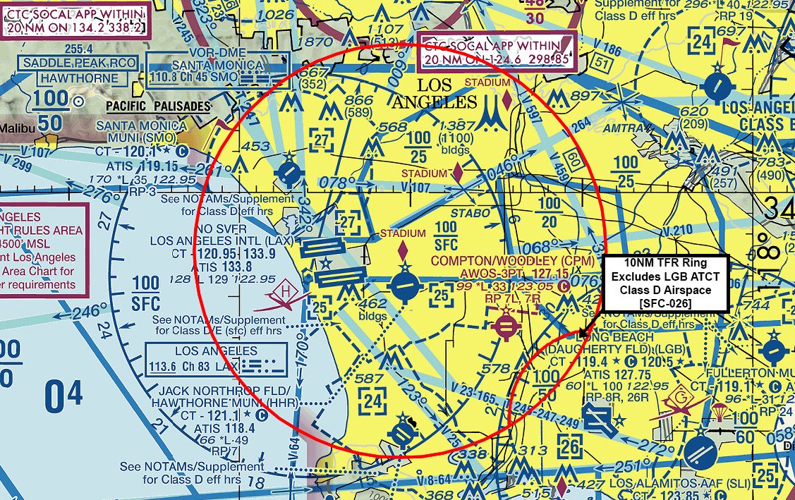
Super Bowl LVI – Main Event TFR DRAFT

Slide 11
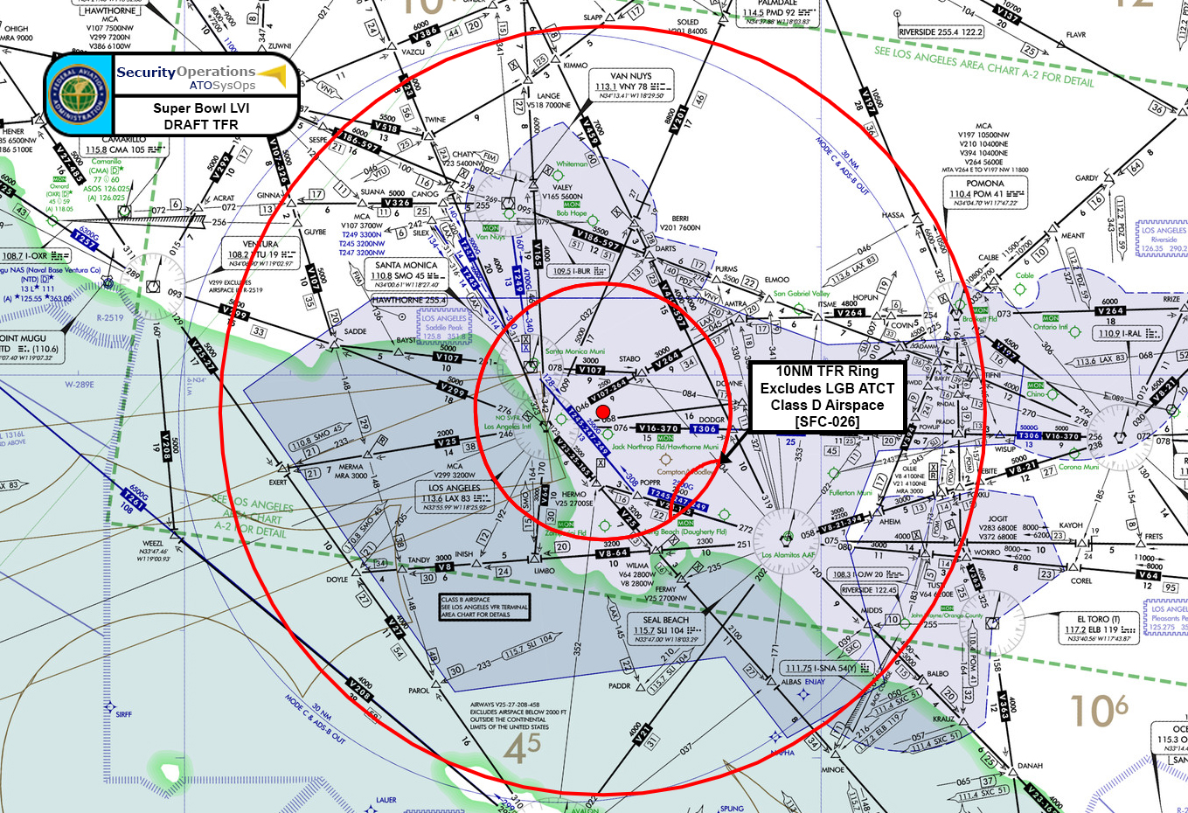
Super Bowl LVI – Main Event TFR DRAFT

Slide 12
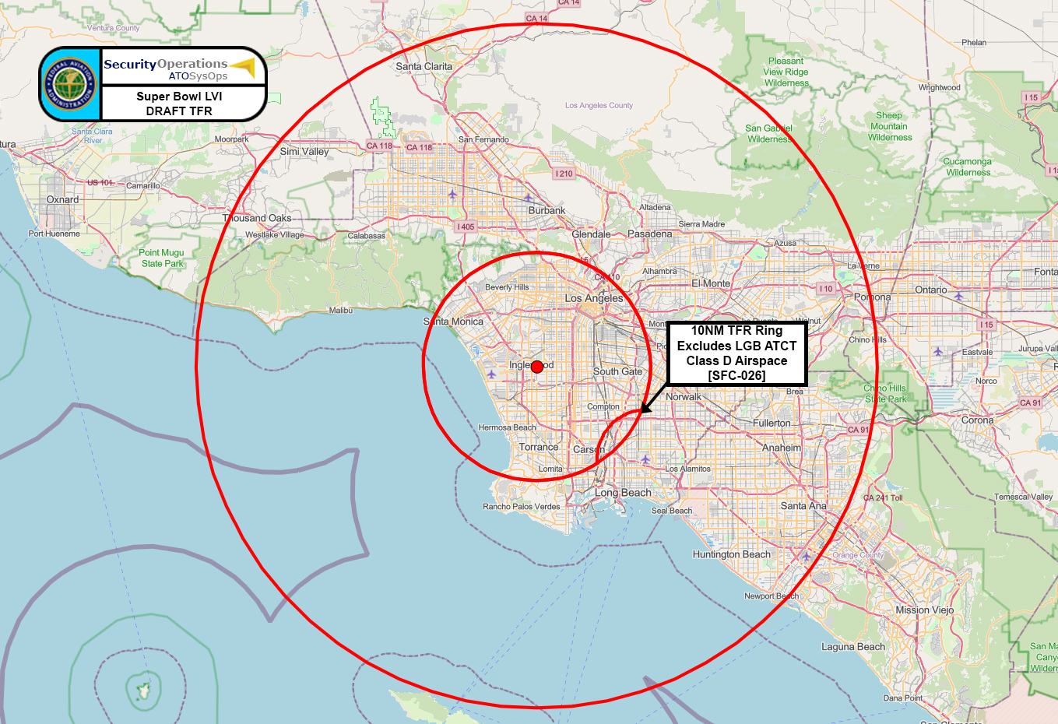
Super Bowl LVI – Main Event TFR DRAFT

Slide 13
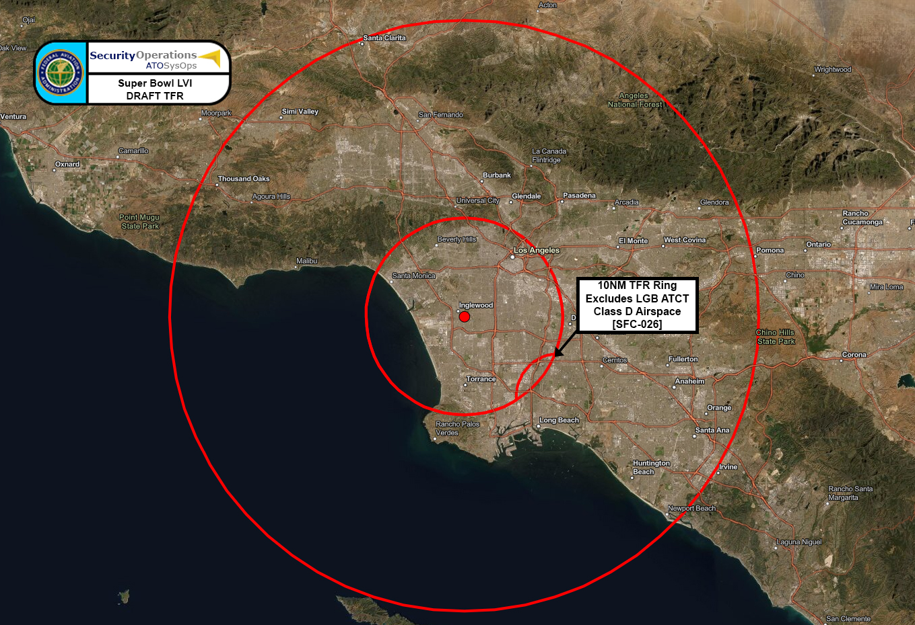
Super Bowl LVI – Main Event TFR DRAFT

Slide 14
TFR Prohibited Operations
Unmanned Aircraft Systems (UAS)
Flight Training
Practice Instrument Approaches
Aerobatic Flight
Glider Operations
Parachute Operations
Ultralight
Hang Gliding
Banner Towing Operations
Sightseeing Operations
Model Aircraft Operations
Model Rocketry
Seaplane/Amphibious Water Operations
Balloon Operations
Agriculture/Crop Dusting
Animal Population Control Flight Operations

Slide 15
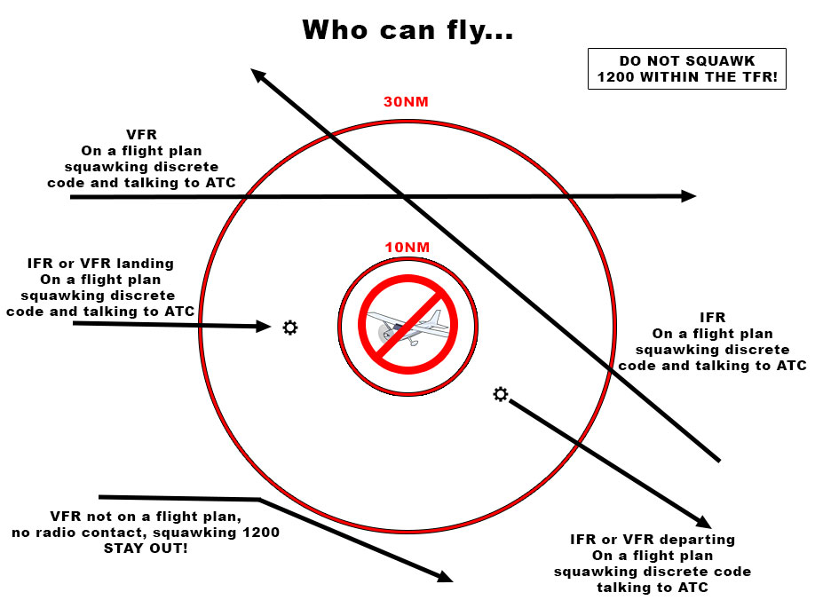
TFR Refresher – 10 / 30 NMR (14 CFR 99.7)

Slide 16
TFR Chart – 10 / 30 NMR (14 CFR 99.7)
Approved Aircraft | 10 NMR TFR | 30 NMR TFR | Requirements
Law Enforcement | YES | YES | Advance coordination
Military | YES | YES | Advance coordination
Air Ambulance | YES | YES | Advance coordination
Air Carriers (scheduled) | YES | YES
Air Cargo (scheduled) | YES | YES | Must be on a discrete code. Immediately notify FLM, OMIC, and DEN.
General Aviation | NO | YES | Must be on a discrete code. Immediately notify FLM, OMIC, and DEN.
VFR | NO | YES | Must be on a discrete code. Immediately notify FLM, OMIC, and DEN.
Other – (1200 codes, etc.) | NO | NO | Must be on a discrete code. Immediately notify FLM, OMIC, and DEN.

Slide 17
TFR Refresher – 10 / 30 NMR (14 CFR 99.7)
Operations in the outer (30 NMR) ring
All aircraft operating in the TFR must be on an active IFR or VFR flight plan with a discrete beacon code assigned by ATC.
Aircraft must be squawking the assigned discrete beacon code prior to exiting or entering the TFR, and at all times while within the TFR.
Two-way communication with ATC must be maintained at all times while operating in the TFR.

Slide 18
TFR Refresher – 10 / 30 NMR (14 CFR 99.7)
Operations in the inner (10 NMR) ring
Permissible only for FAA approved Law Enforcement, approved military directly supporting the Super Bowl, and approved Air Ambulance flights, when squawking an assigned discrete beacon code.
TSA-approved aircraft must call 858-537-5900 (SoCal TRACON) prior to departure.
Permissible only for regularly scheduled commercial passenger and all-cargo carriers, operating under one of the following TSA-approved Standard Security Programs/Procedures, and arriving into and/or departing from 14 CFR Part 139 airports.
Aircraft Operator Standard Security Program (AOSSP)
Full All-cargo Aircraft Operator Standard Security Program (FACAOSSP)
Model Security Program (MSP)
Twelve Five Standard Security Program (TFSSP) All-cargo
All-cargo International Security Procedure (ACISP)
Note: the inner ring has a cutout to EXCLUDE Class D Airspace of LGB ATCT

Slide 19
TFR Refresher – 10 / 30 NMR (14 CFR 99.7)
Operations in the inner (10 NMR) ring
The TSA will govern and administer requests from operators intending to enter, exit, or operate within the 10 NMR inner ring.
Beginning February 7, 2022, the TSA will accept requests for Gateway Screening reservations. Contact the TSA at 310-242-2940.
Gateway hours will be from 1430 – 2030 Local, on February 13, 2022.
Gateway Screening will be conducted at two FBOs at LAX – Atlantic Aviation, and Signature Flight Support.
TSA-approved aircraft must call 858-537-5900 (SoCal TRACON) prior to departure.
Note: the inner ring has a cutout to EXCLUDE Class D Airspace of LGB ATCT

Slide 20
TFR Refresher – 10 / 30 NMR (14 CFR 99.7)
FEDERAL AVIATION ADMINISTRATION
HEADQUARTERS, WASHINGTON, DC
SUPER BOWL LVI
FLIGHT ADVISORY
At the request of the Department of Homeland Security, the Federal Aviation Administration will establish airspace restrictions over Super Bowl LVI, to be played February 13, 2022 at SoFi Stadium in Inglewood, CA. NOTAMs will be issued depicting a 99.7 “Special Security Instruction” Temporary Flight Restriction (TFR) to be implemented as follows:
Under the authority granted by 49 USC, the FAA may apply restrictions within airspace under its jurisdiction. Any person who knowingly and willingly violates these restrictions may be subject to certain criminal and/or civil penalties. Pilots who violate security TFRs or procedures may be intercepted, detained and interviewed by Law Enforcement/Security Personnel. They may also be subject to the following actions:
The FAA may take administrative action, including imposing civil penalties and the suspension or revocation of airmen certificates;
The United States Government may pursue criminal charges, including charges under Title 49 of the United States Code, Section 46307;
The United States Government may use deadly force against the airborne aircraft, if it is determined that the aircraft poses an imminent security threat.
10NMR INNER RING RESTRICTIONS:
On February 13, 2022 from 1430-2030 PST, all aircraft flight operations are prohibited from the surface up to, but not including FL180 within a 10 Nautical Mile Radius (NMR) of 335709N/1182038W or the LAX/VORTAC 060 degree radial at 4.5NM except as follows:
Approved Law Enforcement, approved Military aircraft directly supporting the Super Bowl and approved Air Ambulance flights, squawking an assign discrete beacon code, are permitted within the inner ring as coordinated.
Regularly scheduled commercial passenger and all-cargo carriers operating under one of the following TSA-approved Standard Security Programs/Procedures: Aircraft Operator Standard Security Program (AOSSP), Full-All Cargo Aircraft Operator Standard Security Program (FACAOSSP), Model Security Program (MSP), Twelve Five Standard Security Program (TFSSP) All Cargo, or All-Cargo International Security Procedure (ACISP) and are arriving into and/or departing from 14 CFR Part 139 airports.
Departures from Long Beach Airport (KLGB) that remain within the confines of the LGB Class Delta airspace.
All aircraft departure operations within the 10NMR area must be security screened by TSA at Los Angeles International Airport (KLAX) prior to departure. Aircraft operators must register with the TSA for Gateway Screening no less than 24 hours prior to their scheduled departure time. Gateway Screening reservations may be obtained by contacting the TSA beginning at 0000 Local on February 7, 2021, at (310) 242 2940.
10NMR TO 30NMR OUTER RING RESTRICTIONS:
On February 13, 2022 from 1430-2030 PST, all aircraft flight operations are prohibited from the surface up to, but not including FL180, between the 10NMR and the 30NMR of 335709N/1182038W or the LAX/VORTAC 060 degree radial at 4.5NM except as specified below:
All aircraft arriving or departing local airfields, and workload permitting, ATC may authorize transit operations. Aircraft may not loiter. All aircraft entering and exiting the TFR must be on an active IFR or VFR flight plan and must be assigned a discrete beacon code by an Air Traffic Control (ATC) facility. Aircraft must be squawking that code prior to departing within, and entering the TFR.
All aircraft entering or exiting the TFR must remain in two-way radio communication with ATC.
IN EFFECT FOR THE ENTIRE TFR:
For operations within this TFR, all emergency/life-saving flights (medical/law enforcement/firefighting) must coordinate with the FAA at the Southern California Terminal Radar Approach Control (TRACON) prior to their departure at (858) 537-5900 to avoid potential intercept or delays.
The following operations are not authorized within this TFR: flight training, practice instrument approaches, aerobatic flight, glider operations, parachute operations, ultralight, hang gliding, balloon operations, agriculture/crop dusting, animal population control flight operations, banner towing operations, sightseeing operations, maintenance test flights, model aircraft operations, model rocketry, Unmanned Aircraft Systems (UAS), and utility and pipeline survey operations.
The FAA point of contact for Super Bowl LVI is the System Operations Support Center, available 0700- 2300 Eastern at (202) 267-8276.
PRE-GAME ACTIVITY IN THE VICINITY OF SOFI STADIUM:
Within 1NM and 3000 AGL around SoFi Stadium (335709N/1182038W or the LAX/VORTAC 060 degree radial at 4.5 NM), unless otherwise authorized, all UAS operations are prohibited during the following times:
February 13, 2022, 1000-1430 PST
UAS ACTIVITY
UAS operators who do not comply with applicable airspace restrictions are warned that pursuant to 10 U.S.C. section 130(i), and 6 U.S.C. section 124(n), the Department of Homeland Security (DHS), Department of Justice (DOJ), and the Department of Defense (DOD) may take security action that results in the interference, disruption, seizure, damaging, or destruction of unmanned aircraft deemed to pose a credible safety or security threat to protected personnel, facilities, or assets.
UAS operations are authorized within the defined SSI airspace if in compliance with the requirements listed below:
Prior to TFR activation, the UAS flight operation has been pre-approved by the FAA System Operations Support Center (SOSC) at 202-267-8276 based on criteria established by the sponsoring federal agency in coordination with the FAA;
Requests for pre-approved UAS flight operations can expect disposition of their request in a minimum of 48 hours.
If the pre-approved UAS flight operation is conducted in direct support of an active national defense, homeland security, law enforcement, firefighting, search and rescue, or disaster response mission, and prior notification has been provided to the designated facility contact; or
If the pre-approved UAS flight operation is conducted in direct support of a significant and urgent governmental interest and is approved by the FAA SOSC in advance of entering the defined SSI airspace; and
The pre-approved UAS flight operation complies with all other applicable federal aviation regulations.
Warning
The FAA recommends that all aircraft operators check NOTAMs OFTEN for mandatory airspace restrictions prior to operations within this region. Specific instructions and restrictions are available at http://tfr.faa.gov , once the NOTAM has been issued.

Slide 21
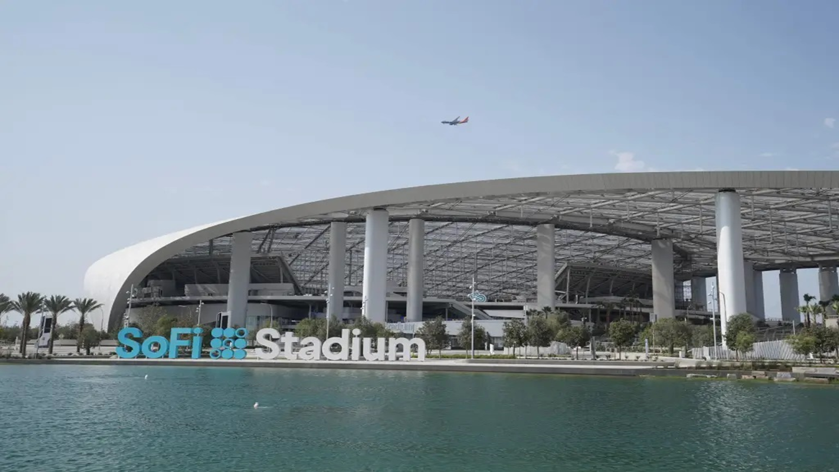
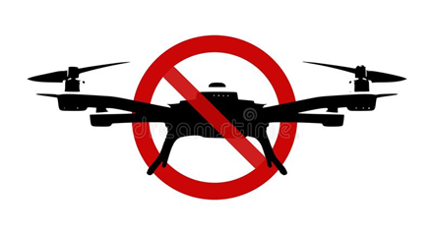
NO DRONE ZONE
https://www.faa.gov/uas/resources/community_engagement/no_drone_zone/
Special Government Interest (SGI) waivers may be issued to cover applicable UAS operations during TFRs. Any requests should be forwarded to the FAA System Operations Support Center at: 9-ATOR-HQ-SOSC@faa.gov

Slide 22
Gateway Screening

Slide 23
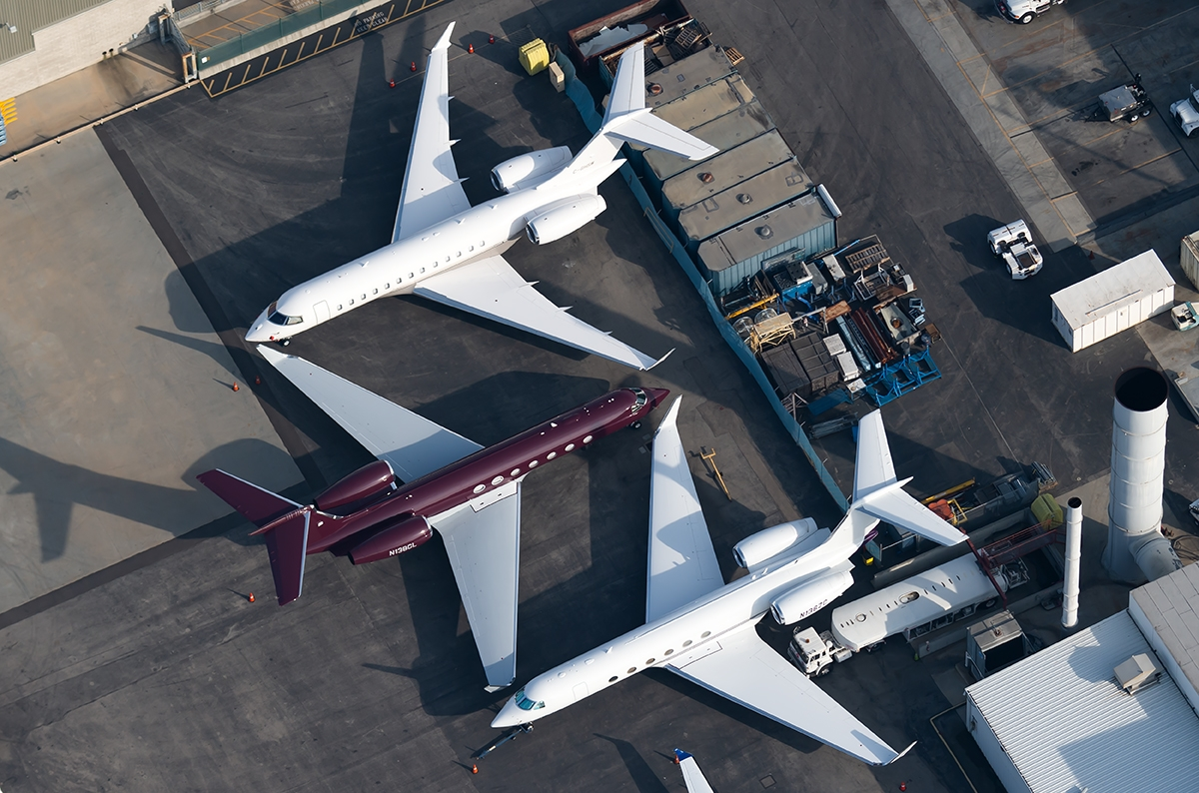
Gateway Screening - LAX
The Transportation Security Administration (TSA) will govern and administer Gateway Screening operations for general aviation aircraft intending to depart LAX during the effective times of the TFR.
Gateway Screening requires coordination with the TSA in addition to the airport arrival and departure reservation.
Reservation booking phone number and times of service will be provided in the “Main Event” TFR NOTAM.

