Slide 1
Resilience
An architectural viewpoint

Slide 3
Dictionary* definition of resilience
1 : the capability of a strained body to recover its size and shape after deformation caused especially by compressive stress
2 : an ability to recover from or adjust easily to misfortune or change
PPD 21 definition of resilience
The term "resilience" means the ability to prepare for and adapt to changing conditions and withstand and recover rapidly from disruptions.
*Merriam Webster

Slide 4
Dictionary definition of resilience
1 : the capability of a strained body to recover its size and shape after deformation caused especially by compressive stress
2 : an ability to recover from or adjust easily to misfortune or change
PPD 21 definition of resilience
The term "resilience" means the ability to prepare for and adapt to changing conditions and withstand and recover rapidly from disruptions.

Slide 5
Definition of resilience
1 : the capability of a strained body to recover its size and shape after deformation caused especially by compressive stress
2 : an ability to recover from or adjust easily to misfortune or change

Slide 6
An ability to recover from misfortune

Slide 7
Higher resilience
Crisis
Functionality
Low resilience
Time
Adapted from - Furuta K. (2015) Resilience Engineering. In: Ahn J., Carson C., Jensen M., Juraku K., Nagasaki S., Tanaka S. (eds) Reflections on the Fukushima Daiichi Nuclear Accident. Springer, Cham

Slide 8
NAS Resiliency
Contingency Operations
Pre-Incident
Post-Incident Operations
Preparedness
Incident
Recovery
A facility's and/or adjacent facility’s ability to respond during, and immediately after, a disruption to avoid or reduce mission impact
The ability to return the airspace to its advertised capacity in its final state.
Avoidance and Mitigation
The ability of preventative activities and infrastructure design and implementation in place to reduce or limit the impact to a facility’s mission from a disruption
Operational Response
Airspace Recovery

Slide 9
Measuring NAS Resiliency
Resiliency Index (RI): The measure of the Agency’s ability to prepare for and adapt to changing conditions and withstand and recover rapidly from disruptions
Made up of a weighted score from each of the following indices:
Avoidance & Mitigation Index (AMI) – The measure of the ability to reduce the likelihood and impact of a disruption - measured against required service performance
Operational Response Index (ORI) – The measure of the ability to respond during, and immediately after, a service disruption to temporarily restore the effected airspace - measured against efficiency targets in 1900.47
Airspace Recovery Index (ARI) - The measure of the ability to return the airspace to its advertised capacity, in its final state – measured against the ability to return the airspace in 6 months
Notes:
No availability or reliability requirement for a facility

Slide 10
Definition of resilience
1 : the capability of a strained body to recover its size and shape after deformation caused especially by compressive stress
2 : an ability to recover from or adjust easily to misfortune or change

Slide 11
An ability to adjust easily to change​

Slide 13
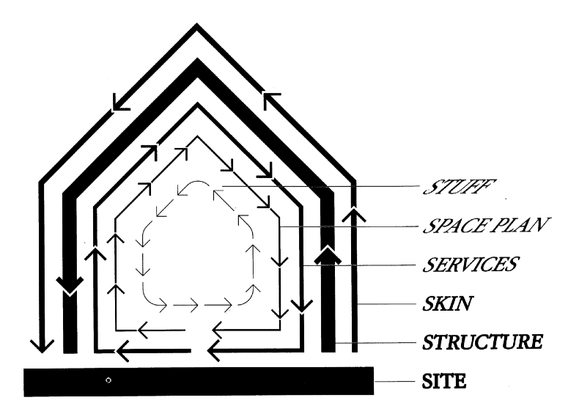
Shearing Layers of Change (Brand, 1994, p. 13)

Slide 15
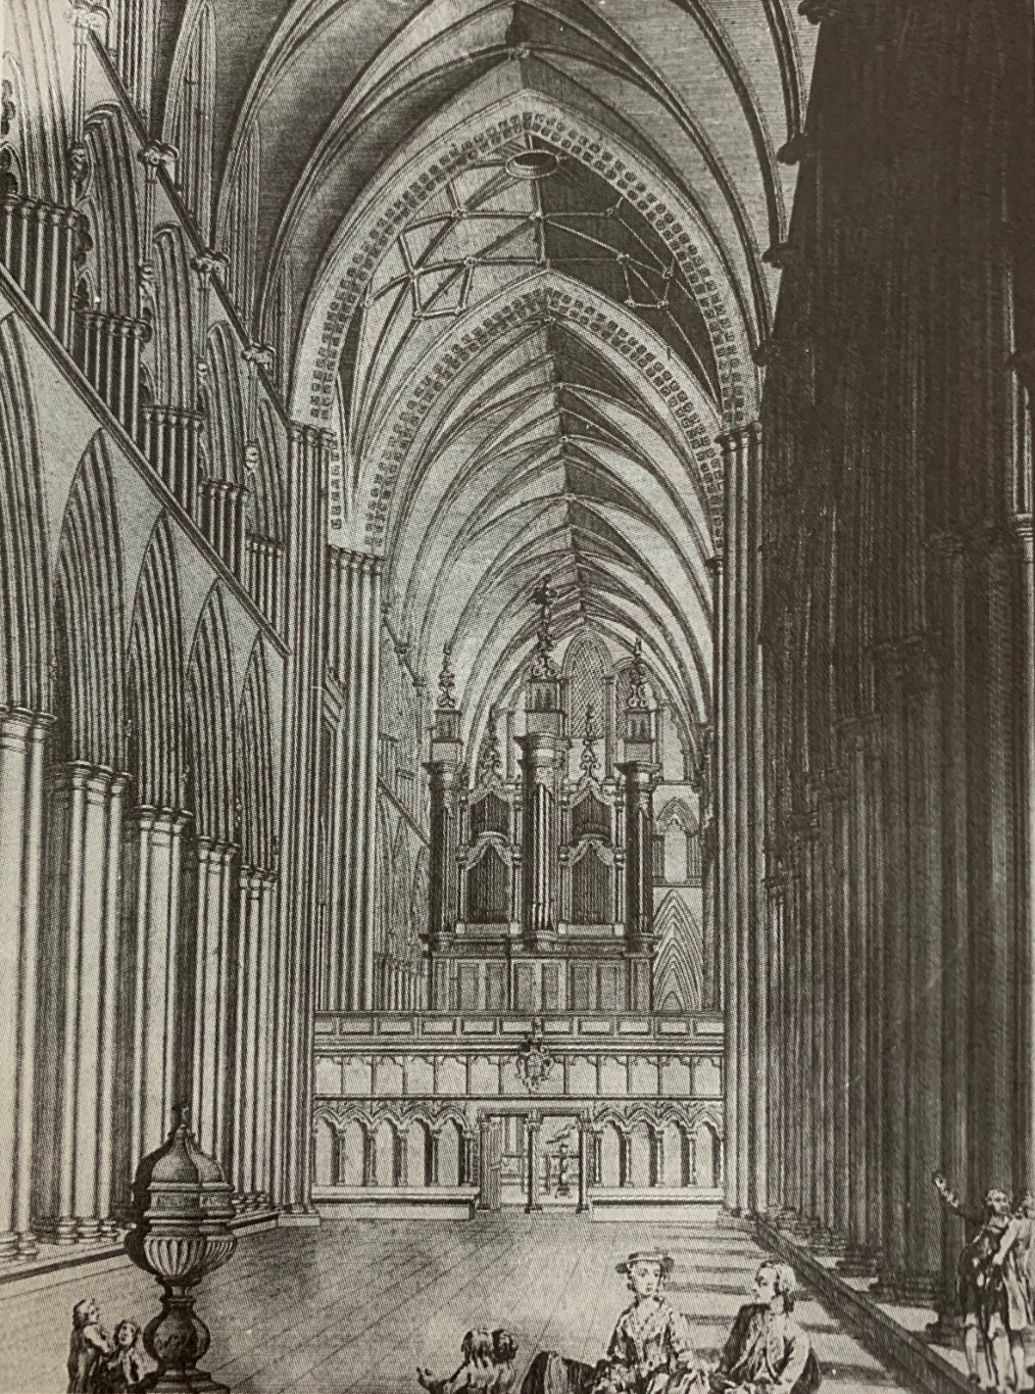
From, "How Buildings Learn; Brand, 1994

Slide 16
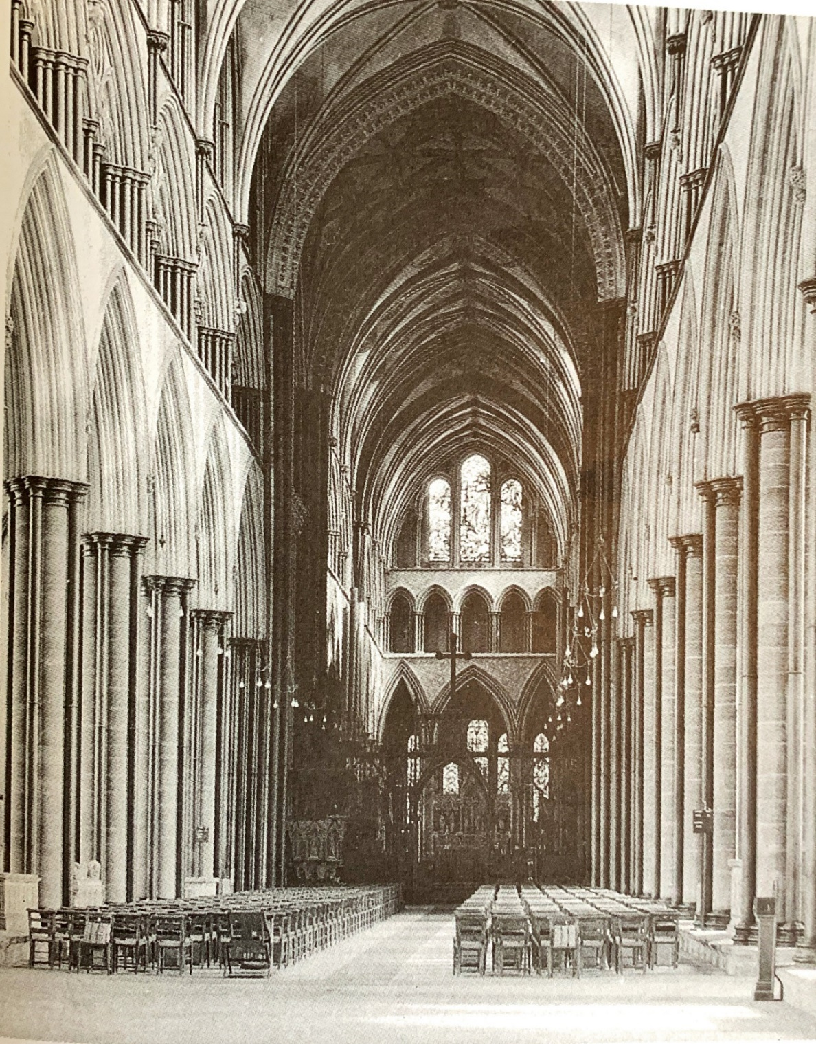
From, "How Buildings Learn; Brand, 1994

Slide 18
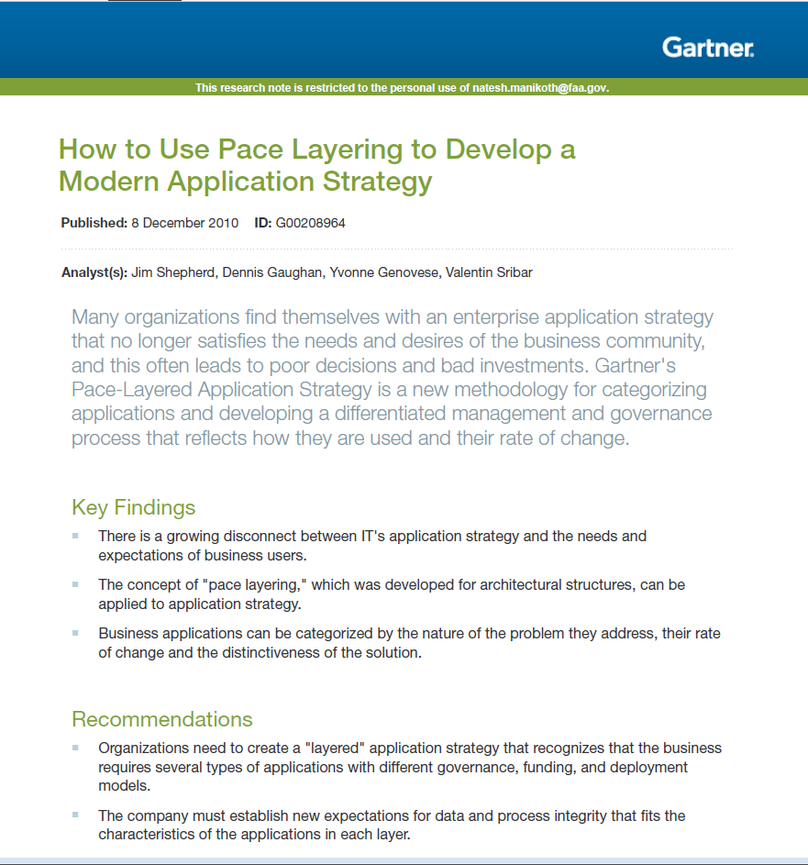

Slide 19
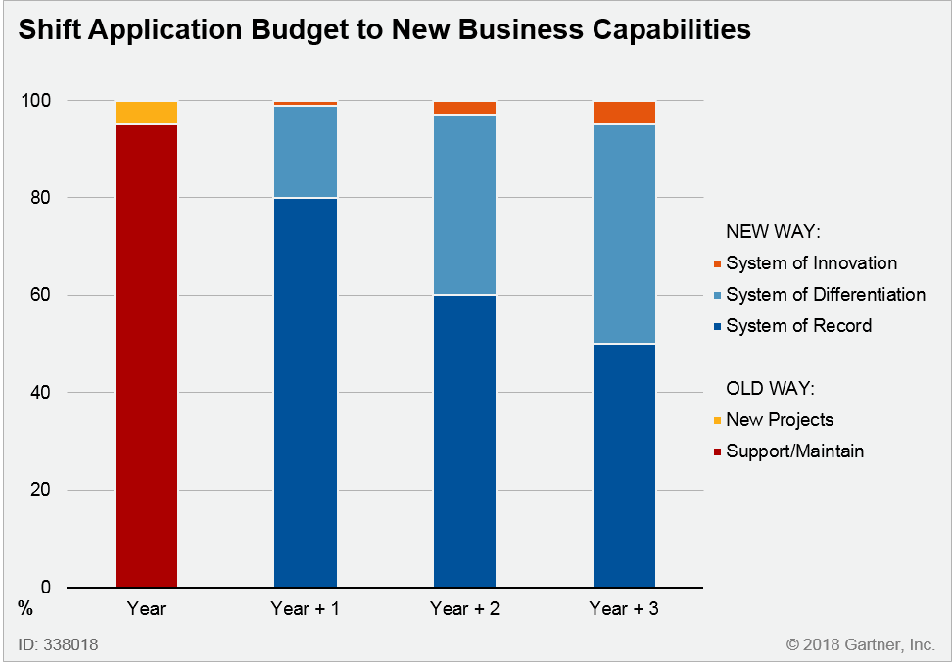
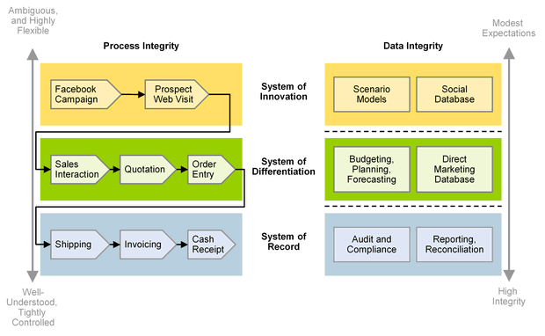

Slide 20
Fashion
Commerce
Infrastructure
Governance
Culture
Nature
The order of a healthy civilization. The fast layers innovate; the slow layers stabilize. The whole combines learning with continuity
https://jods.mitpress.mit.edu/pub/issue3-brand
Notes:
In a more recent 2018 article, revisiting the premise of his 1994 book, he proposes 6 layers to understand the changes to civilizations from this model of different layers exhibiting different rates of change. Each layer has distinct characteristics – and operates somewhat independently while still influencing the layers above and below it.

Slide 21
Fashion
Commerce
Infrastructure
Governance
Culture
Nature
Adapted from https://jods.mitpress.mit.edu/pub/issue3-brand
Notes:
In a complex adaptive system such as a civilization, Brand says, the slow layers stabilize, the fast layers innovate. Instead of breaking under stress, the system flexes, yields. Some parts respond quickly to external shocks allowing the slower parts to ignore the shocks and maintain their stabilizing role.

Slide 22
NAS MS
NAS ME
NAS CI
Regulations
Culture&Values
Phys Infra
The order of a healthy NAS. The fast layers innovate; the slow layers stabilize. The whole combines learning with continuity
Adapted from https://jods.mitpress.mit.edu/pub/issue3-brand
Notes:
There is nothing magical or pre-ordained about the number of layers. Here it is merely an expository tool. But I have chosen to retain the 6 layered picture for convenience.

Slide 23
Acquisition strategy
SDLC
Architectural approaches

Slide 25
