Slide 1
Resilience
and
Requirements Management (RqM)
in The
Program Management Organization (PMO)
Prepared for: V&V Summit
Date: September 20, 2018
Prepared for: V&V Summit
Date: September 26, 2019

Slide 2
WELCOME
2019 V&V Summit

Slide 3
Ann McDonald, ASQ-CSQE, CSM®, MBA
Volpe, The National Transportation Systems Center
U.S. Department of Transportation
Jennafer Miller, PMP, CSM®
Evans Incorporated
2019 V&V Summit
Notes:
Ann and Naffer

Slide 4
Present Requirements Management (RqM) Processes in The PMO
Discuss Elements of Resilience and RqM
Create a Winning Hand Together
Goals
Today’s
2019 V&V Summit
Notes:
Ann

Slide 5
How many of you…?
… see a connection between Resilience and RqM?
… have heard of Ikigai?
2019 V&V Summit
Notes:
Naffer

Slide 6
Resilience
capacity to recover quickly from difficulties; toughness
2019 V&V Summit
Notes:
Naffer

Slide 7
Resilience and Requirements Management
VUCA
Volatility
Uncertainty
Complexity
Ambiguity
2019 V&V Summit
Notes:
Naffer
This slide will depend upon whether we are introducing VUCA or refreshing their memories about VUCA…
John, Ann and I don’t see either of the VUCA videos on the draft agenda, and we are wondering if:
You would like for us to insert one of them here in our presentation
If they are going to hear/learn about VUCA on day 1 in a different way
We are wondering because we wanted to know how to introduce it within the context of our presentation, and we will do that differently if they are hearing about it for the first time at that point

Slide 8
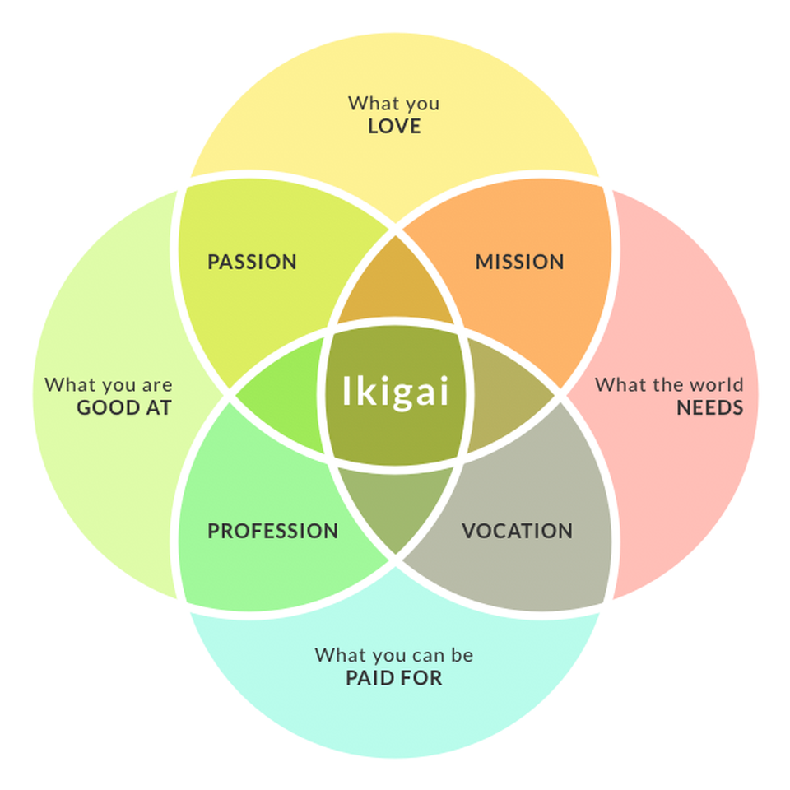
Resilience and Ikigai
A Japanese word
Composed of “Iki” (life) and “Gai” (value/worth)
It means value in living
(pronounced “eye-ka-guy”)
BODETREE, ADAPTED FROM FRANCESC MIRALLES
2019 V&V Summit
Notes:
Naffer
Ikigai is a reason to jump out of bed every morning
It is "a reason for being."
The word "ikigai" is usually used to indicate the source of value in one's life or the things that make one's life worthwhile.
Ikigai is connected to resilience
We are going to introduce the concept of Ikigai into our conversation around resilience and requirements management
“Your ikigai is at the intersection of what you are good at and what you love doing,” says Hector Garcia, the co-author of Ikigai: The Japanese Secret to a Long and Happy Life.
It is a lifestyle that strives for balance

Slide 9
PMO Requirements
Management
2019 V&V Summit
Notes:
Ann
How many people were here last year?
We gave an overview of RqM in the PMO last year
THIS year…

Slide 10
The RqM Umbrella
VUCA
RqM
Safeguards and Protects
Program
Baseline
Architecture
2019 V&V Summit
Notes:
Ann
The antithesis of RqM stability is VUCA– Volatility, Uncertainty, Complexity, Ambiguity, and the PMO put RqM in place to help programs guard against VUCA
Helps reduce volatility across programs and the impact of changing or new requirements
RqM protects programs:
Aids in stabilizing Program Requirements by establishing program RqM Governance/Process
Assists in maintain CM baselines (NAS Functional BL, Program Functional BL, Allocated BL, Product BL, Operational BL and Facility BL)
Safeguards defined System and Architecture via traceability
VUCA tries to disrupt program requirements but the RqM Umbrella protects them from the VUCA Storm
When we were here last year, we talked about RqM at a high level
This year, with the theme of Resiliency, we are going to show how RqM helps programs to be more resilient.

Slide 11
Resilience and RqM - VUCA
Volatility…
Uncertainty…
Complexity…
Ambiguity…
… Metrics
… Bi-directional Traceability
… Stakeholder Engagement
… Management Reserve
2019 V&V Summit
Notes:
Ann
Resilience is linked to having a sense of purpose, and Requirements Management helps define and perpetuate that sense of purpose for a program
We are going to focus on the aspects that provide resilience. The RqM Umbrella protects the program with key features of the RqM Process.
Some examples are:
Volatility…
… Metrics (Combat Volatility) Defined program generated and reported Req Volatility and Stability metrics
Uncertainty…
… Bi-directional Traceability (Minimizes uncertainty and establishes connectivity from the RD up to the NAS and down through V&V…)
Complexity…
… Stakeholder Engagement (Because both internal and external stakeholders are defined and engaged they have a shared understanding)
Ambiguity… … Management Reserve (Defined use of MR for both known and unknowns provides a buffer against ambiguity)

Slide 12
The PMO RqM Process
Metrics
Core Process Collaboration
Program Governance
Escalations
Stakeholder Engagement
Use of Management Reserve
2019 V&V Summit
Notes:
Ann
All of these Processes keep RqM and Programs Resilient
These are all defined in the SOP, and they are the elements that are captured in the Program’s RqM Plan.
We have a template that includes all of these process steps that linked to the features defined the SOP
Since we covered all the process steps last year, this year with the theme of Resiliency, we are going to show how RqM helps programs to be more resilient.
So lets pull on one of the petals…
BACKUP INFO IF THERE ARE QUESTIONS ABOUT THE OTHER FEATURES
This is the process for managing the REQs throughout the AMS lifecycle.
PMO RqM added:
Governance/adjudicating authority at Program Level
Stakeholder identification and engagement
Financial boundaries on new and changed REQs (MR)
Escalation for Awareness and Adjudication
RqM Metrics for Volatility and stability
Bidirectional traceability
Collaboration with other Key Process Areas (KPAs) (CM, RIO, MR, V&V)

Slide 13
The PMO RqM Process – Stakeholder Engagement
Define stakeholders
Establish Periodicity of Engagement
Ensure new or changed requirements are communicated effectively and efficiently
Establish buy-in
Stakeholder Engagement
2019 V&V Summit
Notes:
Ann
(Who can see how Stakeholder Engagement helps stability of Requirements? – Because they are all engaged, their shared understanding…)
When RqM in the PMO first launched a key feature was Stakeholder Engagement
Define stakeholders- Define internal and external stakeholders in RqM Plan
Establish Periodicity of Engagement- Communication methods and periodicity
Ensure new or changed requirements were communicated effectively and efficiently
Establish buy in -Giving your stakeholders a toe hold in the development, analysis, execution and delivery of req’s provides them with as sense of purpose on the program as well as a shared vision

Slide 14
Resilience and RqM – Complexity
Internal and External Stakeholders as Teams
Clear Roles and Responsibilities
Shared vision and mission
Communications
Meetings
2019 V&V Summit
Notes:
Ann
When your stakeholders are left out they may have a differing view of what the program is going to deliver. They are like the rowers in the boat – all going in different directions. The Stakeholder Engagement feature of RqM protects the program by helping internal and external stakeholders achieve a common understanding of the program requirements.
So the complexity can be neutralized by conducting RqM Stakeholder Engagement.
========
BACKUP FROM OUR FROM OUR SLIDES:
Develop a Communications
Management Plan for
engaging stakeholders
Communicate Early
Communicate Often
Identify all program stakeholders
Define periodicity of meetings to:
Update stakeholders on requirements development
Resolve requirements issues in a facilitated forum (e.g., User Teams, Work Groups)
Contributing factor to low volatility
REFERENCE MATERIAL:
Tying this back to the concept of VUCA, we pointed out the connection between Stakeholder Engagement and Complexity.
Working with Internal and External Stakeholders aids in creating provides a shared vision of a complex programs, issues, and requirements
https://www.sciencedirect.com/science/article/pii/S1469029213000058?via%3Dihub
Results and conclusions
Team resilience was defined as a dynamic, psychosocial process which protects a group of individuals from the potential negative effect of the stressors they collectively encounter. It comprises of processes whereby team members use their individual and combined resources to positively adapt when experiencing adversity. Findings revealed four main resilient characteristics of elite sport teams: group structure, mastery approaches, social capital, and collective efficacy. This study extends resilience research in sport psychology by providing greater conceptual clarity of resilience at a team level. The implications of the findings for those conducting research in this area and for those consulting with elite sport teams are discussed.

Slide 15
A boat doesn’t go forward if each one is rowing their own way. -Swahili Proverb
2019 V&V Summit
Notes:
Ann
Stakeholder engagement in Requirements Management provides resiliency
It takes us from individual stakeholders rowing in their own directions to a unified team of stakeholders rowing together
That, in turn, brings us back to the
shared sense of purpose,
the shared vision,
common goals, or
set of requirements
Its sets the program up for calm waters and smooth sailing!

Slide 16
PMO RqM and
Ikigai
2019 V&V Summit
Notes:
Naffer
We have talked about VUCA and RqM, and now we are going to fold the concept of Ikigai into our discussion about Resilience and RqM

Slide 17
Resilience and RqM
Resilience is
linked to
having a
sense of
purpose
2019 V&V Summit
Notes:
Naffer
As Ann discussed earlier, the Stakeholder Engagement feature of RqM protects the program by helping internal and external stakeholders achieve a common understanding of the program requirements, a shared sense of purpose.
RqM also helps define and perpetuate that sense of purpose for a program

Slide 18
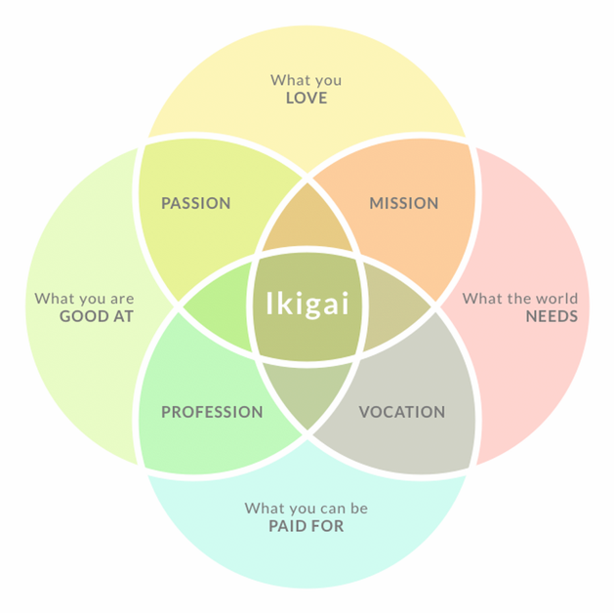
BODETREE, ADAPTED FROM FRANCESC MIRALLES
2019 V&V Summit
Notes:
Naffer
IKIGAI’s 4 core pillars:
what we enjoy doing
the impact we wish to make
is it profitable?
are we focused towards excellence?
These pillars do not stand independent of one another
Where they intersect is where the Ikigai resides

Slide 19
Resilience and RqM - Ikigai
Roles and Responsibilities
Program
Processes
Product
BODETREE, ADAPTED FROM FRANCESC MIRALLES
2019 V&V Summit
Notes:
Naffer From the requirements management context, we can consider these along side of:
Program – Your programs exist because there was a need that had to be met
Product – Your products and deliverables may be more tangible (software refresh, equipment installs, etc.) or more intangible (business process reengineering, leadership development, etc.)
Processes – Flowcharts, such as The Process Flowmap, the Escallation flowchart, and these are illustrations of those processes, that are also accessible and understandable by all in thein a RqMP, as an example
Roles and Responsibilities – This is one of the most important aspects of a program’s success, it deserves the utmost attention, should be detailed, aligned
What is a person’s role?
…→ What is a person’s place/purpose in a program?
Get specific, internal and external R&R charts in the RqMP
Keeps people aligned, informed
Keeps things from falling through the cracks
Synergistically / avoiding and breaking down stovepipes / this is a holistic way of looking at it- stakeholders have different perspectives- RqM is supposed to meet the operational need of everyone in the program, and the stakeholder engagement is to help manage expectations, keep aligned with the product desired
Note:
Vocation = a strong feeling of suitability for a particular career or occupation. synonyms:calling, life's work, mission, purpose, function, position, niche
More a person's employment or main occupation, especially regarded as particularly worthy and requiring great dedication.
A vocation is an occupation to which a person is specially drawn or for which they are suited, trained, or qualified.
Profession- a paid occupation, especially one that involves prolonged training and a formal qualification.
The five traditional professions are architecture, clergy, engineering, law and medicine.

Slide 20
Resilience and RqM – Ikigai
The “Resilience – Ikigai Property”
If Ikigai → Resilience
Then →
&
If Resilience → RqM
2019 V&V Summit
Notes:
Naffer
Everyone, according to the Japanese, has an ikigai
What I am positing to you today is that every program also has an ikigai
Ikigai is deeply connected to resilience… which we’ve discussed today is connected to requirements management
The “Resilience-Ikigai Property” is one that I created out of the preparation for this presentation. We have seen that Ikigai is deeply and intrinsically connected to Resilience, and we have seen that Resilience is deeply and intrinsically connected to RqM. Therefore, via the “Resilience-Ikigai Property”, we can see that… it’s all perfectly logical
In season 3, in the episode “Let That Be Your Last Battlefield,” Spock says, “Change is the essential process of all existence.”
Our work, our programs, are inevitably going to face obstacles and change
It’s how we prepare for those obstacles and change, how we approach them, work through them, and then reflect back upon them that will determine how our work and programs grow, strengthen, and demonstrate resilience
Another relevant quote: Our species can only survive if we have obstacles to overcome. You remove those obstacles. Without them to strengthen us, we will weaken and die. — Captain Kirk

Slide 21
Resilience and RqM – Ikigai
Best Practices & Lessons Learned
nothing is siloed,
everything is connected
2019 V&V Summit
Notes:
Naffer
Building on the reflecting back on facing obstacles and changes- essential to program management, and an essential aspect of a resilient program, is:
learning from challenges, obstacles, and changes,
reflecting on them,
collecting lessons learned,
developing best practices,
and continuing to grow and strengthen from them.
As we’ve been discussing today, and as was Ann’s focus on Stakeholder Engagement, AND as is highlighted in the concept of ikigai – nothing is siloed, everything is connected.
Segue into the Engagement Exercise

Slide 22
The Ikigai of Your Work
Roles & Respons-ibilities
Program
Processes
Product
2019 V&V Summit
Notes:
The Ikigai of your work: Whether a part of an organization, a member of a project team, and entrepreneur and team of one, we all share universal aspects of our work, and we can all consider the Ikigai of what we do.
We are now going to look at the different pillars of Ikigai and how they relate to different aspects of your work and how they link to RqM.

Slide 23
Engagement Exercise First Group – Create a set of the same rank
Find 4 people with cards of the same rank as yours
- Discuss the Question on the back of your card
- Identify 2-3 key takeaways to bring to the next group
2019 V&V Summit
Notes:
First grouping - Like-Aspects of RqM, Resiliency, and Ikigai

Slide 24
Engagement Exercise First Group – Create a set of the same rank
Example:
Rolls & Responsibilities
What is your favorite type of roll for a sandwich?
I have an ace
I find 4 other aces
The 5 of us turn our cards over and find the same question
KAISER
BRIOCHE
SESAME BUN…
We discuss the question
… Is that a roll?
2019 V&V Summit

Slide 25
In Your Groups…
… Discuss the question on the back of your card
… Identify 2-3 key takeaways to bring to the next group
TIME IS
UP
1
MIN
3
MINS
5
MINS
4
MINS
2
MINS
2019 V&V Summit
Notes:
First grouping - Like-Aspects of RqM, Resiliency, and Ikigai

Slide 26
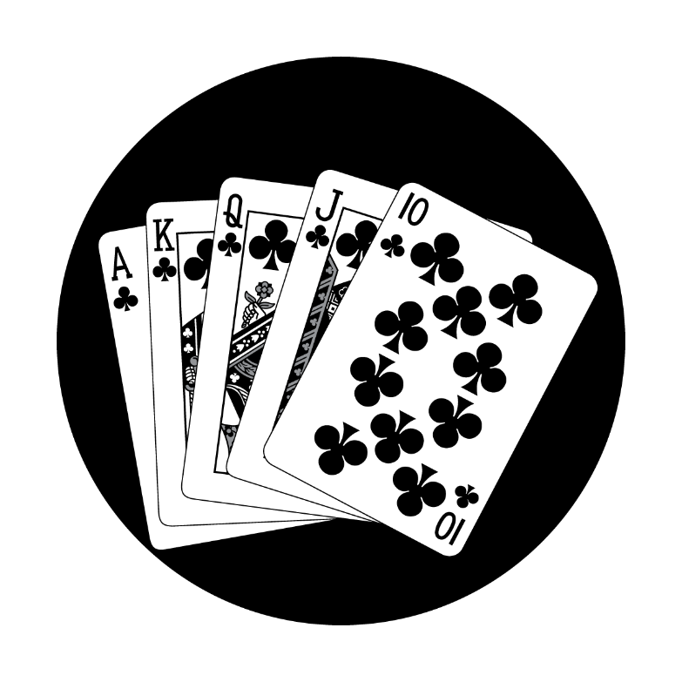
Engagement Exercise Second Group – Create a Royal Flush
Find 4 people with cards that create a Royal Flush with you
- Discuss the takeaways you brought from the first group
- How do all of your cards connect together, to Resilience and to RqM?
2019 V&V Summit
Notes:
Second grouping – Bringing the pillars together, creating a winning hand together

Slide 27
In Your Groups, Discuss…
… The takeaways you brought from the first group
… How all of your cards connect together, to Resilience, & to RqM
TIME IS
UP
1
MIN
3
MINS
5
MINS
4
MINS
2
MINS
2019 V&V Summit
Notes:
Second grouping – Bringing the pillars together, creating a winning hand together

Slide 28
The Ikigai of Your Work
Roles & Responsibilities
Describe a go-to person in your work.
Program
What problem is your work solving?
Processes
How are best practices & lessons learned captured AND incorporated in your work?
Product
How are your stakeholders engaged in development of your work?
2019 V&V Summit
Notes:
The Ikigai of your work: In your groups, you discussed these questions. Now…

Slide 29
How Will You Think About The Ikigai of Your Work?
How will you engage your team?
What will you bring back?
What will you do now?
How will you engage your stakeholders?
2019 V&V Summit
Notes:
The Ikigai of your work: … Now what? How will you champion the ikigai of your work? Help to find it, define it, refine it, share it out…?
Against the backdrop of RqM…
How will you engage your team? – With your team, engage more members of your team, differently, the same (what’s working that you have shared today)?
What will you do now? – Differently, the same (what’s working that you have shared today)?
What will you bring back? – To your work, your team, your project?
How will you engage your stakeholders? – Internal, external, differently, the same (what’s working that you have shared today)?

Slide 30
Resilience + RqM + Ikigai = Your Winning Hand
2019 V&V Summit
Notes:
Naffer

Slide 31
2019 V&V Summit
Notes:
Naffer and Ann

Slide 32
Points of Contact
Ann McDonald, ASQ-CSQE, CSM®, MBA
Volpe, The National Transportation Systems Ctr,
U.S. Department of Transportation
Office: 617-494-2276
Cell: 857-270-8959
ann.mcdonald@dot.gov
Jennafer Miller, PMP, CSM®
Evans Incorporated
Cell: (571) 276-8381
jmiller@evansincorporated.com
2019 V&V Summit
Notes:
Naffer and Ann

Slide 33
THANK YOU
2019 V&V Summit

