Slide 1
RESILIENCE ENGINEERING
Managing Safety in the 21st Century
Richard Abbott, Director of Safety
Objectstream, Inc.

Slide 2
CONTENT
1
Complex Socio-Technical Systems
2
Traditional Safety Management
3
Dynamic Safety Model
4
Resilience Engineering
5
Final Thoughts
OBJECTSTREAM.COM
2019 OBJECTSTREAM ALL RIGHTS RESERVED

Slide 3
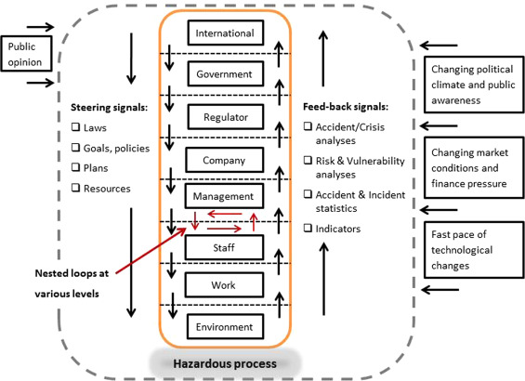
Complex Socio-Technical Systems
Nyman, M.; Johansson, M.(2015) International Journal of Disaster Risk Reduction
OBJECTSTREAM.COM
2019 OBJECTSTREAM ALL RIGHTS RESERVED

Slide 4
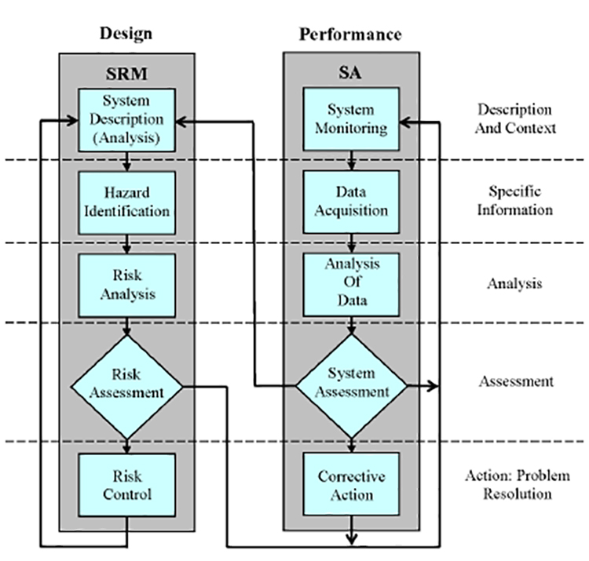
Traditional Safety Management
OBJECTSTREAM.COM
2019 OBJECTSTREAM ALL RIGHTS RESERVED

Slide 5
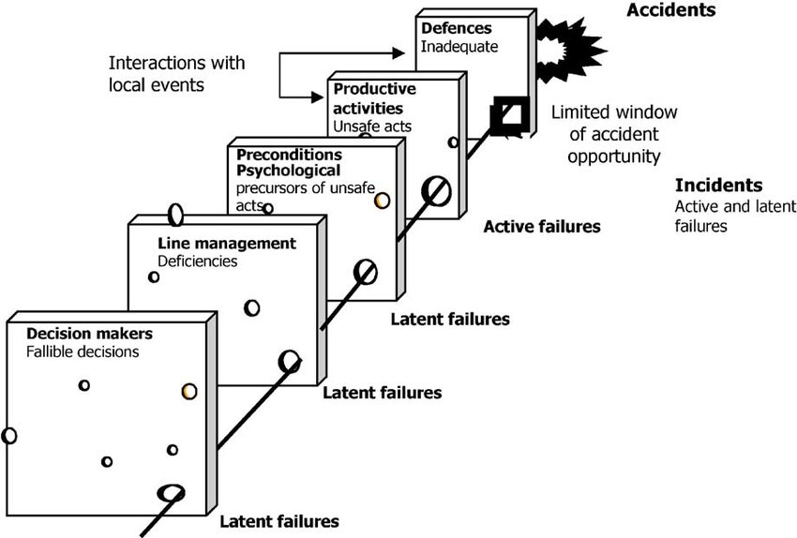
Reason Swiss Cheese Model
OBJECTSTREAM.COM
2019 OBJECTSTREAM ALL RIGHTS RESERVED

Slide 6
Dynamic Safety Model
Economic Failure Boundary
Accident Boundary
Management Pressure Towards Efficiency
Accident
Error Margin
Counter-gradient
New Rules
Recent Accidents
Gradient Towards Least Effort
Safety Campaigns
Unacceptable Workload Boundary
Modified from Rasmussen 1997; Dr. R.J. Cook 2006
OBJECTSTREAM.COM
2019 OBJECTSTREAM ALL RIGHTS RESERVED

Slide 7
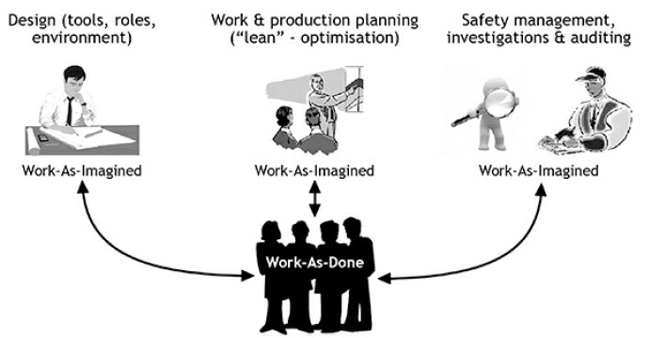
Work as Imagined vs. Work as Done
Hollnagel, E. (2018) Safety II in Practice
OBJECTSTREAM.COM
2019 OBJECTSTREAM ALL RIGHTS RESERVED

Slide 8
Resilient Performance Abilities (Potentials)
Resilience – an expression of how people, alone or together, cope with everyday situations – large and small – by adjusting their performance to the condition. An organization’s performance is resilient if it can function as required under expected or unexpected conditions alike (changes, disturbances, opportunities.) Dr. Eric Hollnagel, 2017.
RESPOND
MONITOR
LEARN
ANTICIPATE
Knowing what to do
Knowing what to look for
Knowing what has happened
Knowing what to expect
OBJECTSTREAM.COM
2019 OBJECTSTREAM ALL RIGHTS RESERVED

Slide 9
Final Thoughts
Aviation is a complex socio-technical system of systems.
Traditional SMS is useful but was built for systems that were more easily understood and able to be decomposed.
Traditional SMS focuses on minimizing what can go wrong.
Managing safety in the 21st century focuses on learning what goes right and doing more of that.
Things go right most of the time because humans adapt to the situation.
Safety is not about the absence of negatives; it’s about the presence of capacities. Johan Bergström; Sidney Dekker, Foundations of Safety Science 2019
Resilience Engineering helps an organization assess, develop, monitor, and continuously improve their resilient performance potentials.
OBJECTSTREAM.COM
2019 OBJECTSTREAM ALL RIGHTS RESERVED

Slide 10
Biju Kurian
President
405-942-4477
biju.kurian@objectstream.com
Sandra Schreiner
VP of Growth & Strategy
405.397.0229
sandra.schreiner@objectstream.com
OBJECTSTREAM.COM
2019 OBJECTSTREAM ALL RIGHTS RESERVED

