Slide 1
PMO ATS En Route & Oceanic
Second Level Engineering, AJM-25
Resilience in a Maintenance Organization
2019 V&V Summit
September 26, 2019
Sonceré W. Woodford

Slide 2

Air Traffic Organization
Air Traffic Organization
Air Traffic Services
Flight Program Operations
Management Services
Mission Support Services
Program Management Organization
Safety & Technical Training
System Operations Services
Technical Operations
AJM-1
Program Control & Integration
Endorsed by Congress in 2011
Major acquisitions that support NextGen and sustainment programs for legacy systems
Agency business solutions and infrastructure programs
Air Traffic Systems (ATS) provides 24 hour a day, 7 day per week NAS technical support for thousands of pieces of Air Traffic Control automation and Decision Support Systems
AJM-25 provides Second Level Engineering Support for En Route & Oceanic Systems
AJM-21
Air Traffic Mgmt Programs
AJM-2
Air Traffic Systems
AJM-22
Decision Support Programs
AJM-3
Enterprise Services
AJM-24
Terminal SLE
AJM-4
Surveillance Systems
AJM-25
En Route & Oceanic SLE

Slide 3
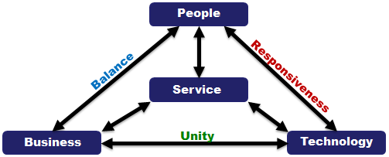
En Route & Oceanic SLE (AJM-25)
The William J. Hughes Technical Center, Atlantic City, NJ
The Program Office, Washington, DC
The Air Traffic Control System Command Center (ATCSCC), Warrenton, VA
The 21 Air Route Traffic Control Centers, CONUS
The 2 Combined Center Radar Approach Controls (CERAPs), San Juan & Guam
The Honolulu Control Facility, Honolulu, HI

Slide 4
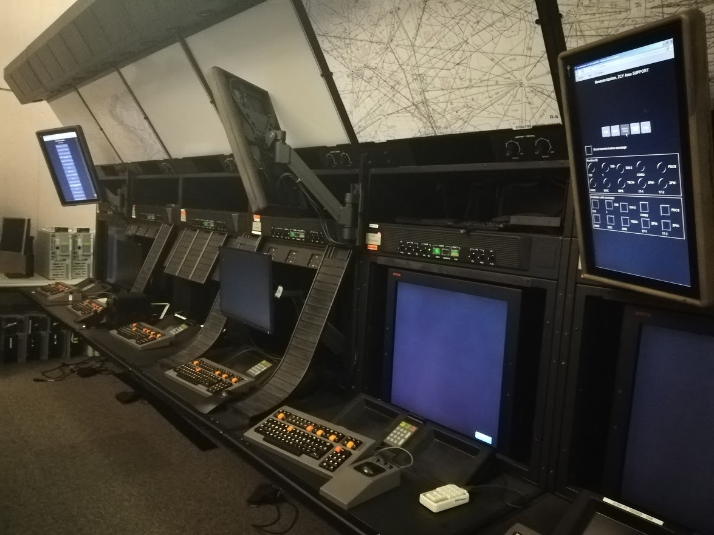
En Route & Oceanic SLE (AJM-25)
350+ Diverse and talented professionals who provide technical expertise to sustain and improve En Route & Oceanic Air Traffic Control Systems.
We specialize in the following disciplines and services:
  Project Management
  Engineering and Requirements
  Adaptation, Software, Hardware, and Firmware
  Safety, Security, and Networking
  Design & Development and Builds & Control
  Test & Evaluation
  Site Support
  Configuration Management (CM)/Process Development & Improvement
  Technical Editing and Quality Control (QC)
Use our fully sustained laboratories to recreate,
test, and evaluate modifications to software and hardware baselines at the En Route
& Oceanic operational facilities
We deliver and support quality products as the modification Office of Primary Responsibility (OPR), while ensuring the safety of the traveling public.

Slide 5
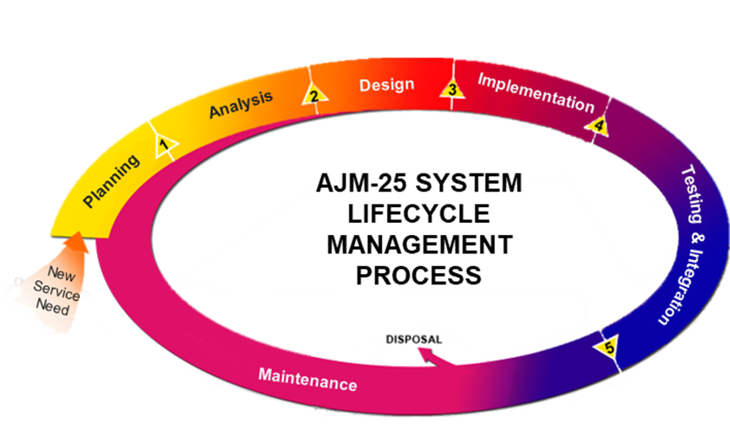

AJM-25 Portfolio: 24 Systems
AJM-25 Structure & Systems
Field Automation Support
Program Management
Adaptation
Site Support
Systems Requirements
Design Development
Test
Mission Support

Slide 6
Lab Utilization for SLE Testing

Slide 7
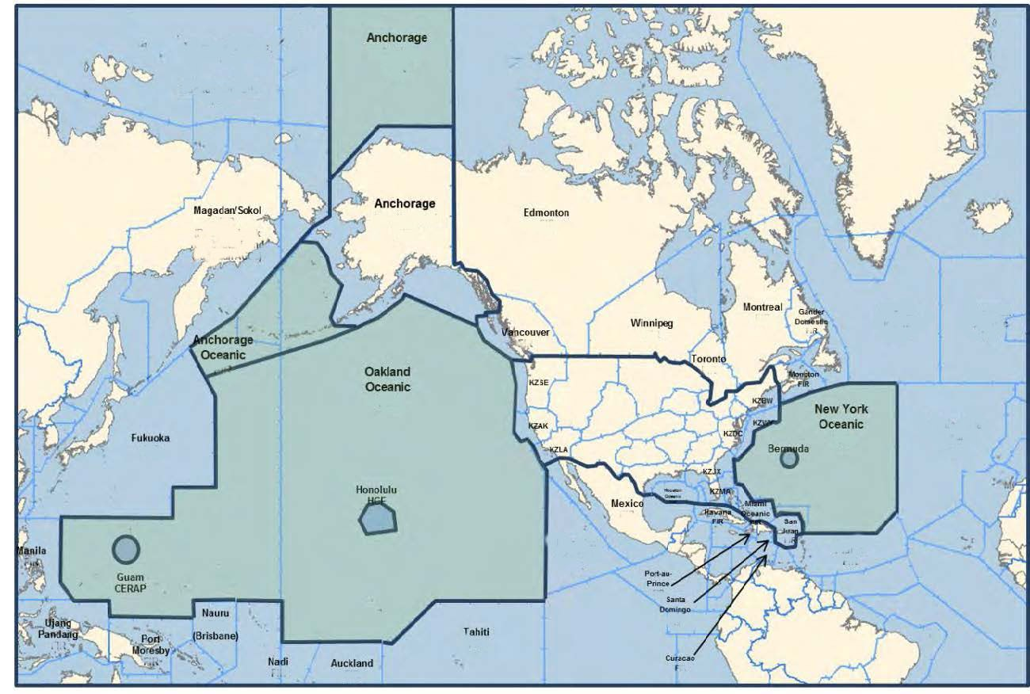

AJM-25: The Big Picture
AJM-25 Programs & Airspace
17% of the world’s controlled airspace by volume
29,383,568 square miles of US domestic and Oceanic airspace
44,000+ flights per day
3.3 million square miles of Atlantic Ocean airspace
21.3 million miles of Pacific Ocean airspace
Oceanic
ECG
ERAM
FDIO
TFMS
SAPT
RAPPI
TFMS
MEARTS
ATOP
Data Comm
TBFM
ECG
ATOP
OFDPS
DOTS
MEARTS
LBR
IDSR
DSP
FDIO
FDPS
ERIDS
CTS
APM
Abacus

Slide 8
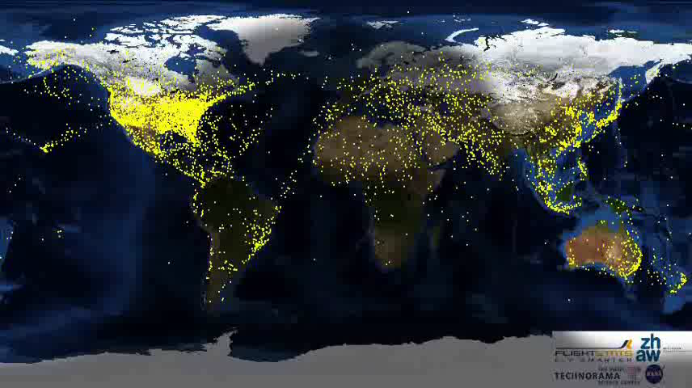
Real Time Air Travel
Every plane within the red oval travels safely to and from their destinations via AJM-25 maintained systems.

Slide 9
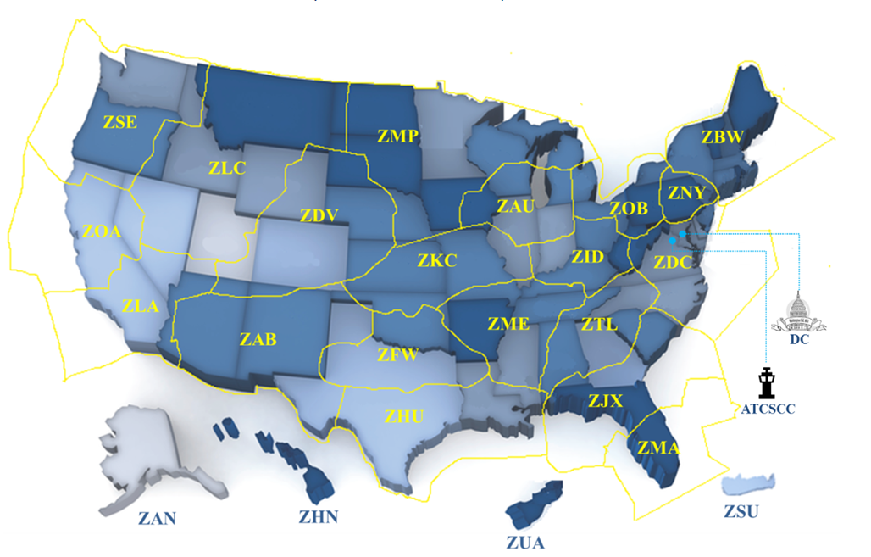









Second Level Engineering Key to Resiliency
Our Field Automation Teams
We provide En Route Air Traffic Control (ATC) services at the following locations:
All domestic airspace through 21 Air Route Traffic Control Centers (ARTCCs)
The Air Traffic Control System Command Center (ATCSCC)
The 2 Combined Center Radar Approach Control (CERAP) facilities in the US territories of Guam and San Juan, Puerto Rico
The Honolulu Control Facility (HCF)
Teams are the eyes, ears, and voice in the building for SLE
Onsite @ each Ops Facility:
  (1) Program Operations Field Manager – POFM
  (3) to (7) Specialists

Slide 10
Field Automation Support Team (FAST)
This SLE team performs activities and provides guidance associated with updating and coordinating National Adaptation and local adaptation changes at:
21 Air Route Traffic Control Centers (ARTCCs)
2 Combined En Route Approaches (CERAPs)
Honolulu Control Facility (HCF)
FAST Specialists troubleshoot air traffic issues, support Tech Ops in trouble shooting hardware issues, support the Test and Training Environment, and participate in Key-site testing of new system releases.
Key FAST
Incorporating the Chart Date and Interim Chart Date National Adaptation changes into the site specific adaptation.
Supporting Local Adaptation Maintenance as directed by Air Traffic at the respective facility.
Performing Adaptation changes, inspection and validation. Coordinating with affected neighbors.
Researching, Evaluating, Planning, and Testing adaptation changes to support Airspace Redesign and hardware/software updates.
Activities
10

Slide 11
Airspace & Procedures
This office is the primary focal point for:
  Requesting automation changes
  Addressing Facility AT trouble reports
  Providing adaptation data
They submit the bulk of the ATC trouble reports, adaptation change requests, and system enhancement requests that are implemented and tested by the FAST Specialists.
POFM & FAST Touchpoints
Operational Support Facility (OSF)
The OSF team is the Terminal Services automation support component which is equivalent to our En Route and Oceanic Service FAST team.
They interface directly with POFM/FAST to coordinate changes between the Terminal and En Route environments.
Traffic Management Unit
The Traffic Management Unit (TMU) Air Traffic Controllers analyze the demand on the ATC system and implement initiatives that are relayed to En Route and Terminal controllers. They use Decision Support Services and tools to balance air traffic demands, traffic flows, and system capacity to ensure maximum efficiency of the NAS.
The FAST Specialists develop, test, and maintain the adaptation data and help troubleshoot system issues found by the TMU controllers.
Stakeholders
Airspace & Procedures
Tech Ops
Technical Operations is responsible for:
Maintenance, monitoring, and operation of all NAS equipment and services
Environmental infrastructure of all NAS facilities
The majority of FAST interaction will be with the Automation Service Support Center (SSC) and the Systems Operation Center (SOC).
The SOC is responsible for the coordination of all maintenance at the facility and services within the Air Route Traffic Control Center (ARTCC) airspace. They monitor operational NAS systems on a real time basis and ensure that all maintenance is performed without impacting AT operations.
Terminal Facilities
Operational Support Facility (OSF)
Plans & Programs or Infrastructure Support
POFM/FAST
Touchpoints
Flight Data
Training & Workforce Development
William J. Hughes Technical Center (WJHTC)
Traffic Management Unit (TMU)
Technical Operations (Tech Ops)

Slide 12
Proactive Measures to ensure Resiliency
Create and maintain a Job Aid for the ATC Watch desk at each facility
  An action guide for the Operations Manager In Charge (OMIC)
  Takes the guess work out of what to do in case of a failure
  Allows all stakeholders to speak the same language
  Maintained and Distributed by SLE
  Updates are made for every software release, if needed
  Released on our En Route & Oceanic Website
  Available thru En Route Information Display System (ERIDS)

Slide 13
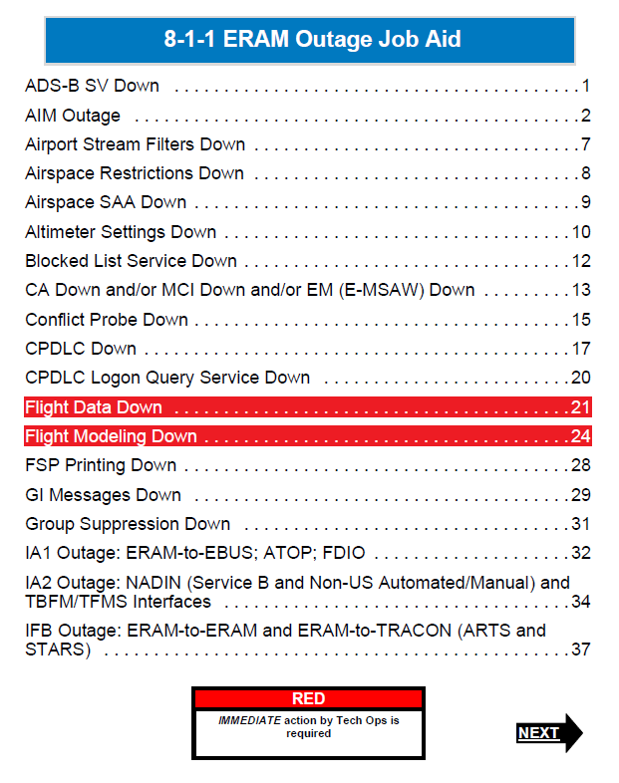
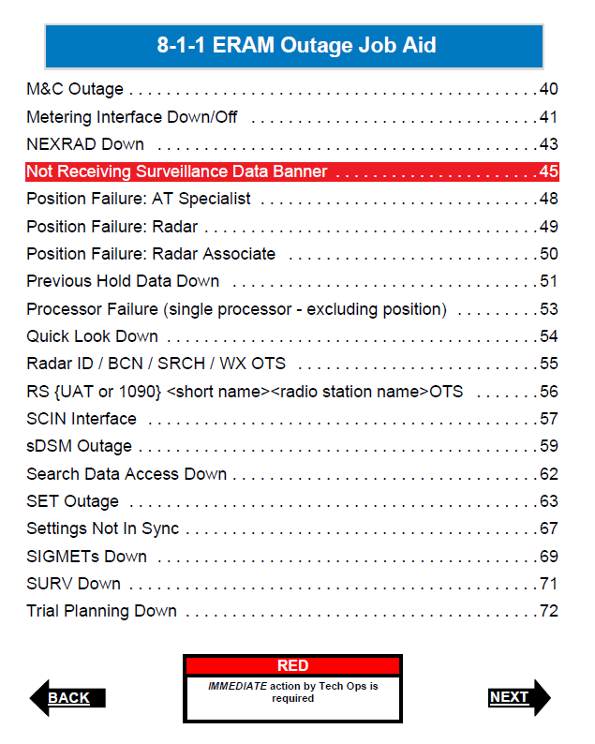
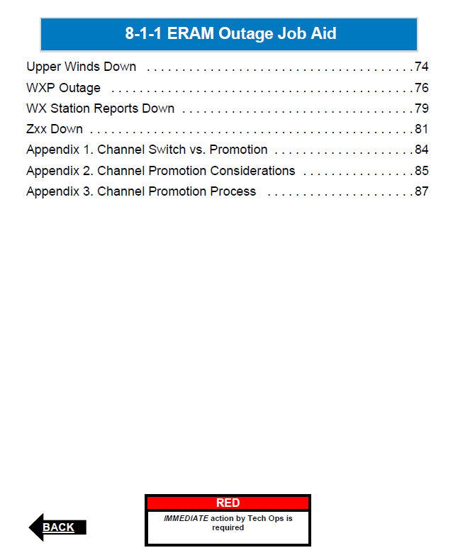
Order 8-1-1 ERAM Outage Job Aid
  Provides information on: System failure impacts, User impacts, Actions to be taken, and Who to communicate with

Slide 14
Proactive Measures to ensure Resiliency
Table top exercises at Operational facilities
    Simulated exercises with facilitated discussions to improve performance during failures
    Allow Operational teams to make critical decisions in constrained situations
  Goals:
    Improve local stakeholder communication
    Enhance national communication and response times during periods of lost or degraded services
    Improve our collective teams abilities to respond and support system malfunctions and service loss events
    Capture lessons learned based on facility-specific experiences and expertise

Slide 15
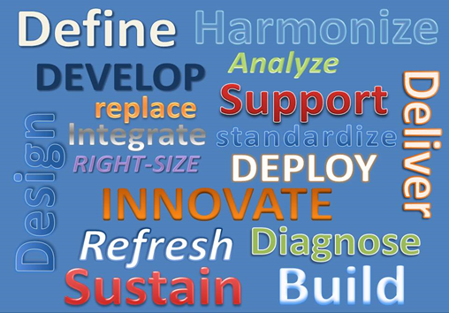
ERAM Table Top Exercises
  Table top Participants:
Air Traffic Manager (ATM)
Operations Managers (OMs)
Traffic Management Officer (TMO)
Technical Operations Managers (TOM) and Technical Operations staff
PMO Program Operations Field Manager (POFM)
Local bargaining unit representatives from National Air Traffic Controllers Association (NATCA) and Professional Aviation Safety Specialists (PASS)
Service Operations Center (SOC) Manager and NAS Operations Managers (NOMs) representatives
Supervisor Traffic Management Coordinator (STMC)
Safety and Technical Training (AJI) Manager
Last exercises conducted in 2016
Planning 2020 update to exercises
SLE Site Support Engineers leading effort

Slide 16
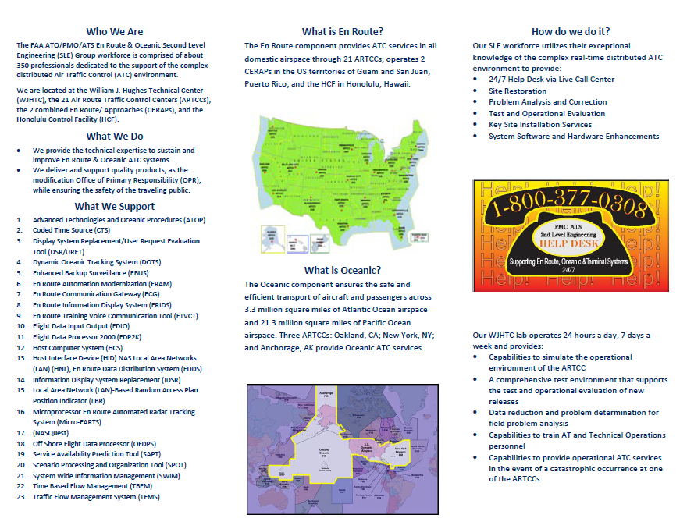
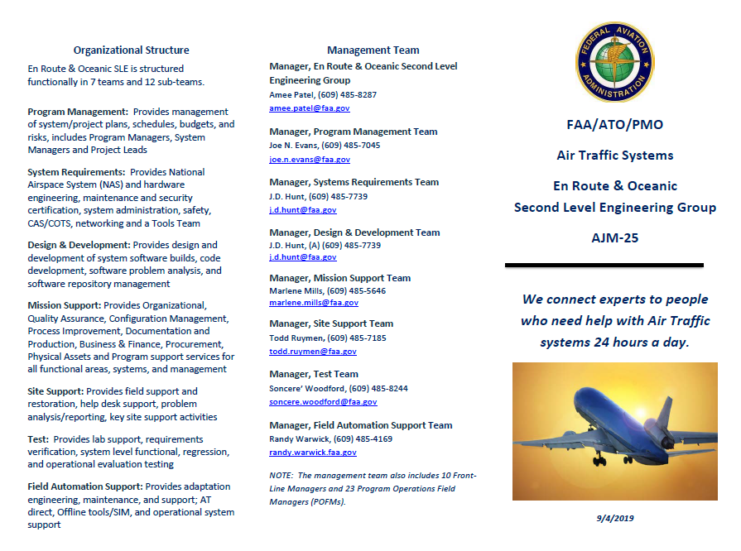
Additional Information
For additional information about Second Level Engineering,
see our Brochure or contact: Soncere.Woodford@faa.gov
16

