Slide 1

September 13-14, 2017
John Frederick
V&V Strategies and Practices Branch Manager - ANG-E5A

Slide 2


Objective of the
V&V Summits
“Knowledge has to be improved, challenged, and increased constantly, or it vanishes.”
Peter F. Drucker

Slide 3

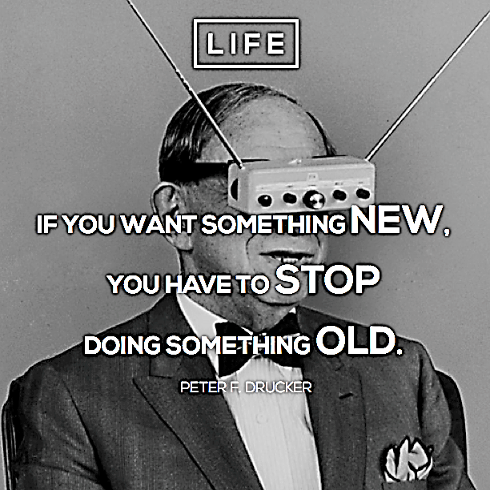

Slide 4
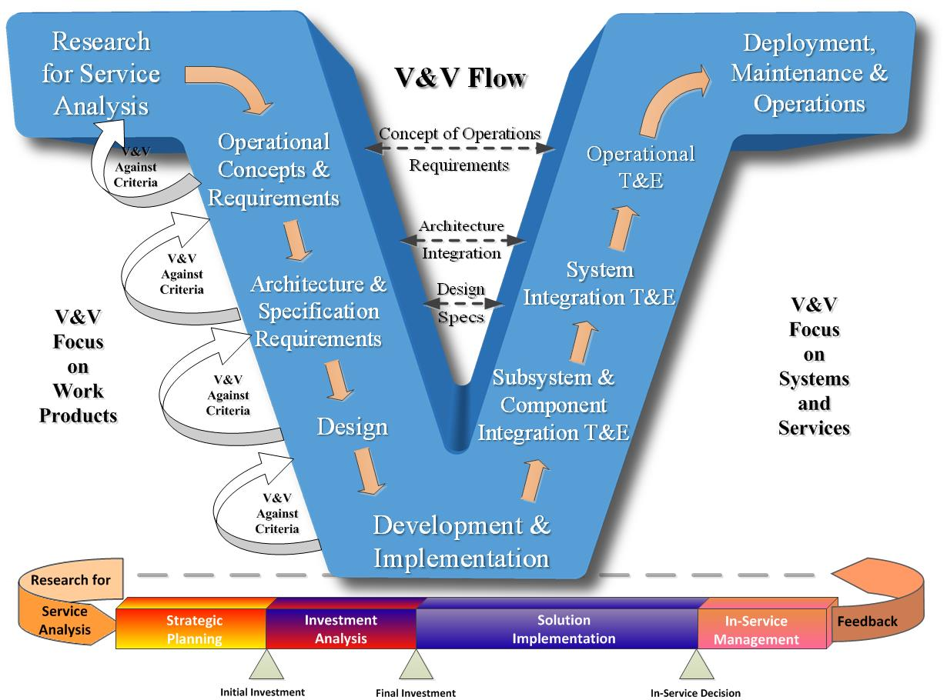
Goals of V&V

Slide 5



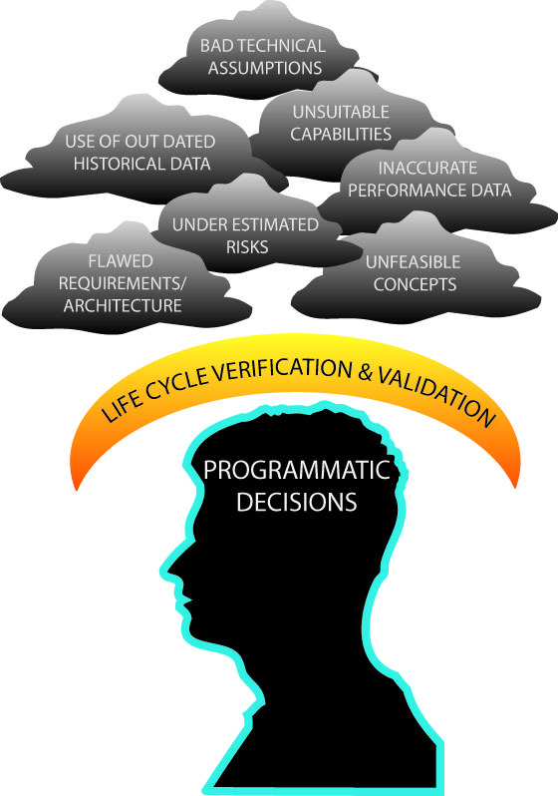
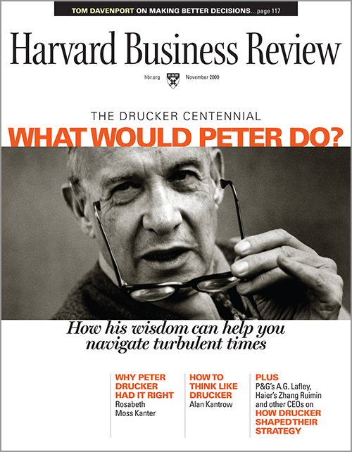
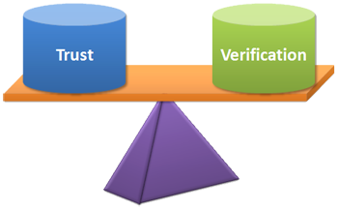
Adopting V&V Principles
Validation

Slide 6
Show V&V Summit Video: Evolution of the V&V Summits

