Slide 1

John Frederick
Manager, V&V Strategies and Practices Branch
September 25, 2019

Slide 2
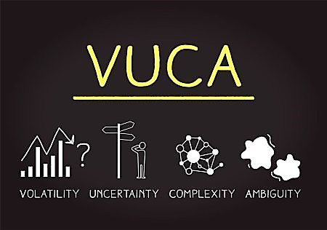
Fast-changing World vs a VUCA World
Chaos was the law of nature; Order was the dream of man.
Henry Adams (1838 – 1918)

Slide 3
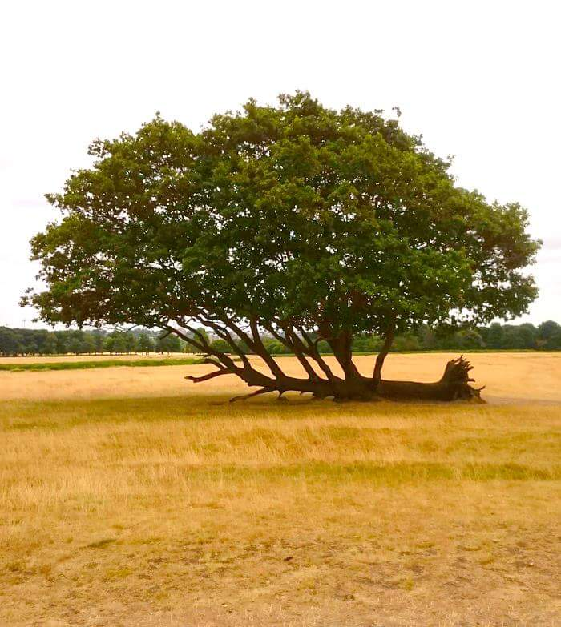
Resilience Defined
Bounce back
Recover from a disturbance
The capacity to cope with setbacks
Keep going in the face of adversity
Adapt well to change
Ability to thrive
  Not just survive
  Innovation from adversity
Bounce forward

Slide 4



The Various Domains of Resilience
People/Procedures - respond and adjust to changing conditions
Organizations - respond and adapt to sudden or expected disruptions to survive and prosper
Resilient Engineering - focuses not just on system recovery
  Building things right from the beginning
  Minimizing recovery actions needed
  Learning from the past
  Anticipate to innovate

Slide 5
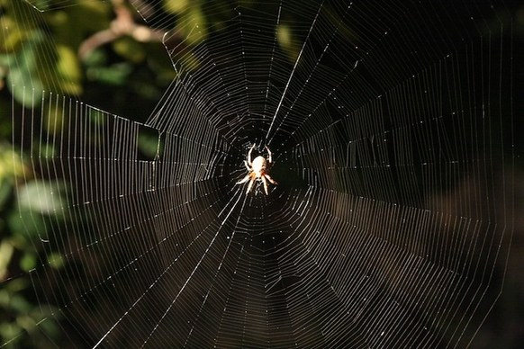
What Makes Something Resilient?
The superior performance of a silk web is not due merely to its strength, but …
arises from the nonlinear responses of the interconnected silk threads
Nothing produces resilience like connections

Slide 6

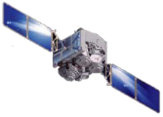





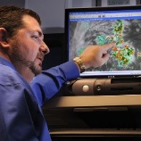

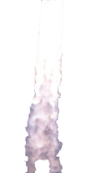
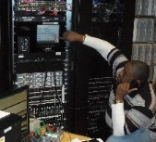
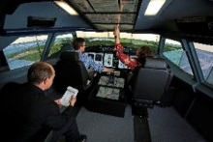


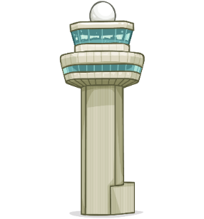
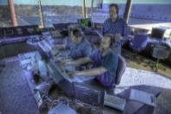

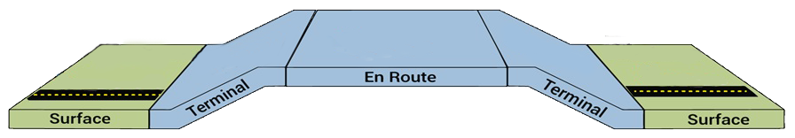
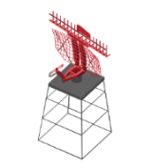



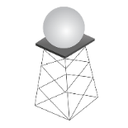



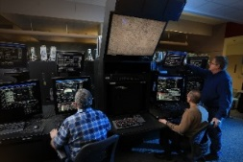
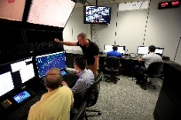
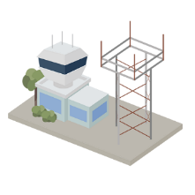
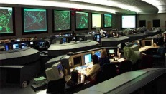
The NAS in a VUCA World
GROUND/SATELLITE
BASED NAVIGATION and SURVEILLANCE
Integration of the NAS
NAS WEATHER SENSORS
AND PROCESSORS
DATA
COMMUNICATION and
INFORMATION MANAGEMENT
Commercial Space
&
Unmanned A/C Systems
TERMINAL
AUTOMATION
VOICE COMMUNICATION
TOWER SYSTEMS
COCKPIT
Trajectory Based Operations (TBO) Integration
COMMAND CENTER
FLIGHT SERVICES
EN ROUTE/OCEANIC AUTOMATION

Slide 7
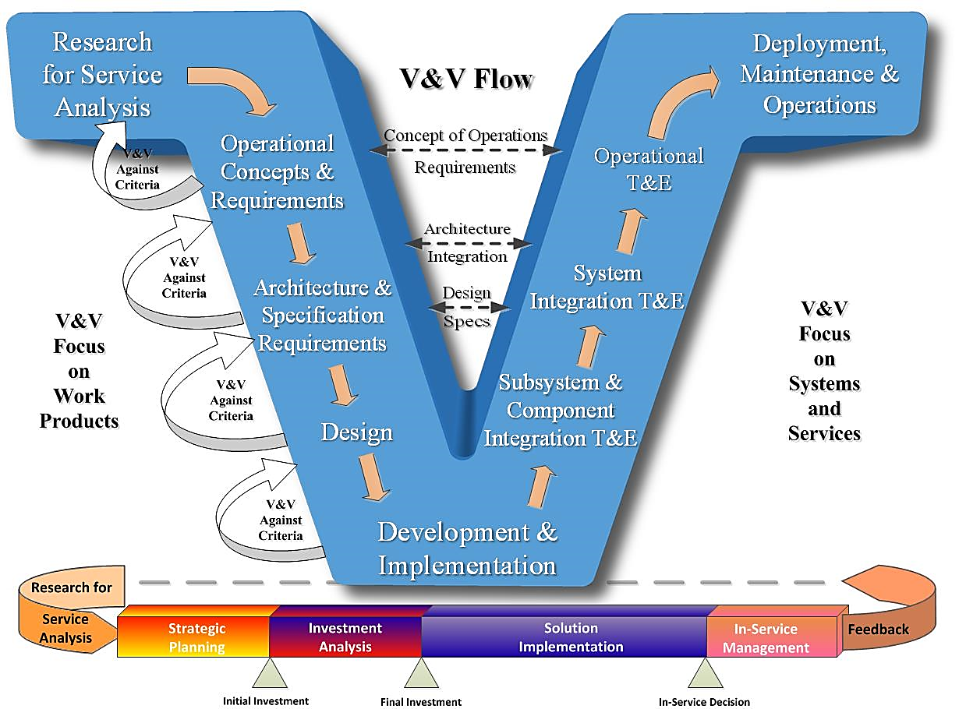
Vee Model
Optimize: Shift Left V&V

