Slide 1
UAS Traffic Management (UTM): Resilience of the NAS
Praveen Raju
September 2019

Slide 2
Organization & Mission
FAA Office of NextGen
Portfolio Management and Technology Development Directorate
Enables innovation within the FAA
Coordinates technology advancement programs to improve aviation system safety, capacity, and efficiency
Supports development of concepts and Pre-Implementation Systems Engineering for technical capabilities
* NextGen is not involved in operational airspace management including approving Certificates of Waiver or Authorization (COA) or Part 107 waivers

Slide 3
UAS Capability Development Cycle
NASA
NextGen
Air Traffic Organization
Demo
Initial Concept
Identified Service
Initial Prototype
Refined Requirements
Prototype
Refinement
Test, Analyze, & Demo
Concept Refinement
Training & Procedures
Final Requirements
NAS Integration
In-Service Maintenance
Initial Research
Concepts & Validation
Deployment
Continuous External Stakeholder Engagement
Industry
Security Partners

Slide 4
FAA Offices
ANG - NextGen
Concepts, Evaluation
Prototyping, Demonstration
AUS - UAS Integration
Aviation safety
UAS Standards
AJM - Program Management Organization
Implementation
Software Deployment
ASH – Security and Hazardous Materials
AJR – Systems Operations Security
AJV - Mission Support Services
AGC - Legal Counsel
Information Security
FAA Infrastructure Protection
Government Security Stakeholder Engagement
Operations
Regulation
DHS, DOD, DOJ, etc.
Other FAA Stakeholders
Support as necessary
AJT – Air Traffic Services
Air Traffic Control
Separation Standards
UAS Traffic Management

Slide 5
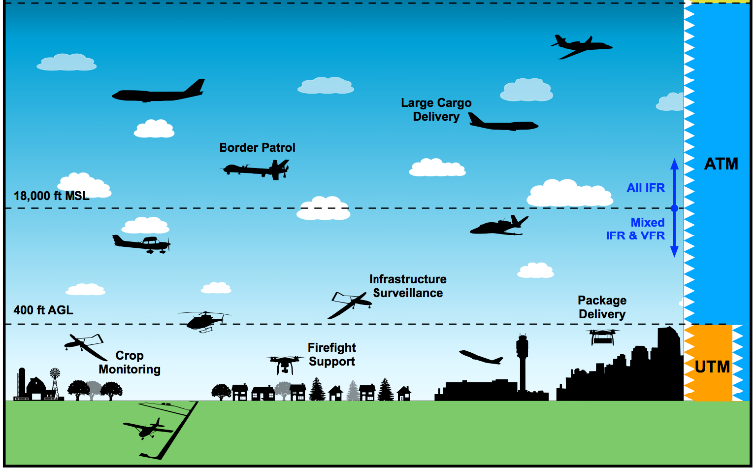
Future UAS Operating Environment
UAS are certified and receive traditional air traffic services where required.
UAS meet established performance requirements and cooperatively separate through shared situational awareness. Air traffic services not provided.

Slide 6
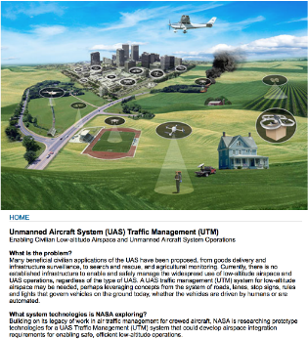
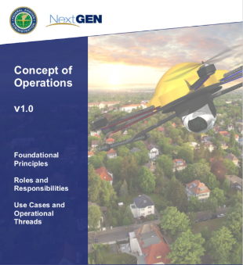
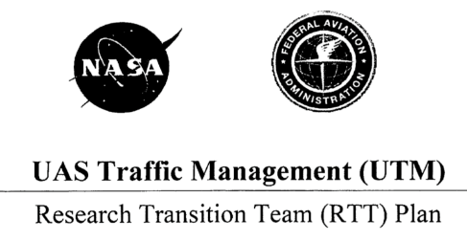
UAS Traffic Management System (UTM)
In collaboration with NASA, the FAA is developing a prototype system to enable small UAS operations

Slide 7
UTM Overview
Community-based, cooperative traffic management system, where the Operators are responsible for the coordination, execution, and management of operations, with rules of the road established by FAA
UTM is the manner in which the FAA will support operations for small automated drones operating nominally below 400 ft
UTM will provide the capability to exchange information among the service suppliers and with the FAA in support of remote identification, prioritized operations, and airspace restrictions
Many UTM services needed to manage drone traffic will be provided by commercial service suppliers (Amazon, ANRA, AirMap, AiRXOS (GE), Collins, Praxis, Simulyze, Uber, Wing, etc.)
UAS Service Suppliers will offer services for flight planning, communications, separation, and weather for drone operations

Slide 8
UTM Guiding Principles
Principles
FAA interacts with UTM for information/data exchange purposes, as required
FAA does not provide track and locate services; however, FAA retains their authority and responsibility to manage the airspace
FAA has on-demand access to information regarding UTM operations, including, but not limited to, flight status, aircraft location, and intent information
FAA may require certain data to be logged/archived by Operators to support requests for information (e.g., safety, security, or post-hoc analysis of events of interest) by the FAA and other authorized stakeholders
All UAS operators under the UTM construct, are responsible for tracking their own aircraft and sharing data with other users as required
Key UAS-related services
Authorization/Authentication
Airspace configuration of static and dynamic geo-fence definitions
Weather and wind prediction and sensing
Conflict avoidance (e.g., airspace notification)
Demand/capacity management
Large-scale contingency management (e.g., GPS or cell outage)
Remote ID and Tracking

Slide 9
UTM Components and Functions
NASA research defines UTM roles and responsibilities between FAA as Air Navigation Service Provider (ANSP) and industry
FAA implements foundation for UTM (registration, LAANC, remote ID)
Automation drives IT requirements and resource needs
FAA Cloud Services
FAA Data Sources
Additional UTM Capabilities
Additional Charting
Authorized Operating Areas
Remote Identification
UAS Registration
Notification (LAANC)
Authorization (LAANC)
ATC Coordination
Dynamic Restrictions (2209)

Slide 10
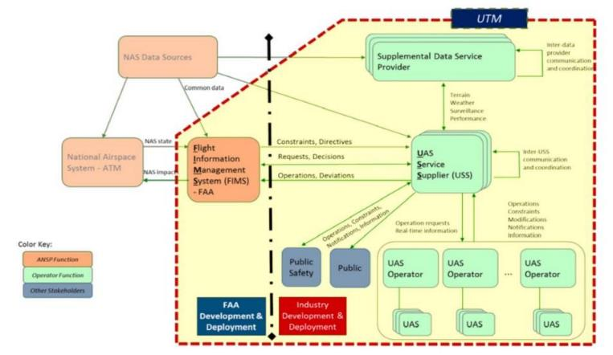
UTM Information Exchange
Actors within the UTM Framework
UAS Service Suppliers (USS)
Provide various services to UTM participants
Exchange information with the FAA
FAA
UAS Operators
State, Local, and Tribal Entities
General Public

Slide 11
UTM Ecosystem
FAA Capabilities
Industry Capabilities
USS 1
FAA Cloud Services
USS 2
FAA cloud environment hosts applications and databases such as:
UAS Registration
UAS Facility Maps
Airspace Authorization
Flight Information Management System (FIMS)
Etc.
USS 3
FAA Authoritative Data Sources
Commercial UAS Service Suppliers (USS)
host applications and services such as:
Flight Planning
Strategic UAS traffic de-confliction
Weather
Flight Restrictions
Etc.
UAS Operators and Other Users
Public Safety
Law Enforcement
General Public
Etc.

Slide 12
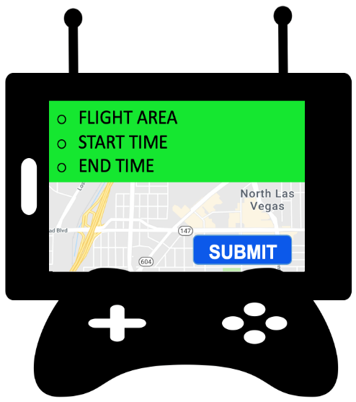
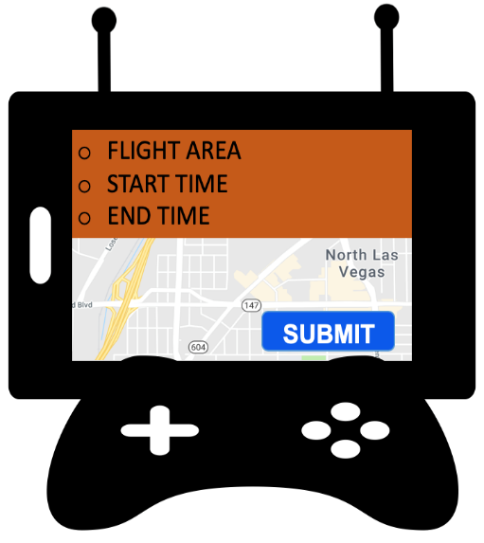
Flight Planning with UTM
Operators send info to USS (desired flight area, times, etc.)
USS:
Checks with other USSs to find and deconflict overlapping operations
Checks airspace authorization requirements as necessary
Shares flight data with USS Network
USS 1
USS
Network
Operators receive feedback for deconfliction
USS 2

Slide 13
USS Services Categorization
Category 1 – Government-Qualified Services
Services to UAS operators that may be provided directly by the government or by an FAA-qualified third party that has been qualified to perform the service; examples include the transmission of airspace authorizations (DroneZone and LAANC), or remote identification services
Category 2 – Operational Support Services
Category 2 services may be certified separately if requirements can be properly allocated by industry
2(a): Services supporting UTM for a subscribing operator
Includes services that require an operational USS network
Use of these services will be identified and included as part of individual UAS operational approval if required by regulation or waiver/exemption
Minimum set of services for ”UTM Operations” may be dictated by regulation where operator cooperation is needed
Examples: Strategic Deconfliction, Conformance monitoring, Dynamic Rerouting
2(b): Additional support services to the Operator
Includes services that can be provided without a USS Network
Use of these services will be identified and included as part of individual UAS operational approval
Examples: Weather, Obstacles

Slide 14
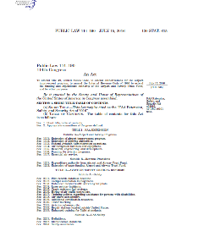
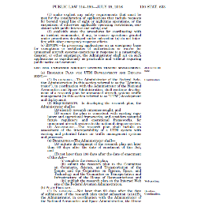
Rules and Standards
UTM concepts rely on collaboration and compliance
Proposed UAS Rules

Slide 15
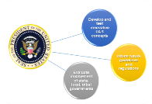
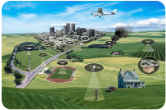
FAA Initiatives for sUAS Airspace Access
UAS Integration
Pilot Program (IPP)
UAS Traffic Management
Pilot Project (UPP)
Presidential directive for the Secretary of Transportation and FAA to create a partnership framework for private sector and state/local/tribal governments to achieve broader national policy
Advances UAS Industry by informing regulations that permit more complex, demand-driven UAS operations
Pushes the boundaries of UAS use by expanding what is routinely authorized under the sUAS rule
Looks at what UAS might do in the NAS (e.g. package delivery, pipeline inspections, etc.)
Demonstrates capabilities in their operational environment
Congressional directive (FAA Extension, Safety, Security Act of 2016) for FAA and NASA to partner in order to advance safe UAS / Drone Integration at the lower altitudes through traffic management
Reaffirmed in FAA Reauthorization Act of 2018
Forum for Industry collaboration with NASA and FAA to evaluate and demonstrate UTM technologies and capabilities
Development of FAA / Commercial Service Supplier data exchange capabilities, leading to technical requirements for deployment
Information Sharing Network for UAS operating below 400 ft.

Slide 16
UTM Pilot Program Flight Test Highlights
3 USE CASES
3 LIVE DEMOs
Demo Window
4/22 – 8/1
3 UAS TEST SITES
9 UAS SIMULATION & TEST EVENTS
Simulations began: 4/22
Test Runs began: 5/28
Live Demonstrations: 6/13, 7/10, 8/1
Notes:
Background information the UTM Pilot Program Demonstration in coordination with the three test sites
VT MAAP 4 USSs: Wing, AirXOS, AirMap, ANRA
Operators used a variety of aircraft, including the Wing package delivery aircraft associated with Wing’s recently approved certificate for delivery under Part 135.
NPUASTS 3 USSs: Simulyze, Collins Aerospace, AirXOS
Operators included Collins Aerospace and the NPUASTS flight operators
NIAS 5 USSs: AirXOS (GE), Uber Elevate, ANRA Technologies, Amazon Prime Air, Praxis

Slide 17
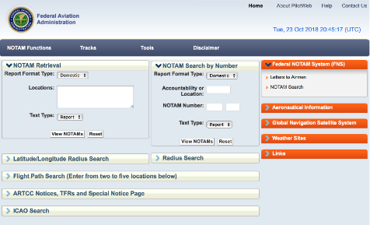
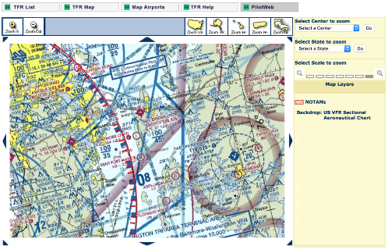
UAS Volume Reservation (UVR) Capability
New, faster way to communicate that UAS operators should not enter an area Currently in test and demonstration stage
Notice to Airmen (NOTAM)
Temporary Flight Restriction (TFR)

Slide 18
UVR - Initiator View
Initiated by pre-approved applicants
Request would contain similar data needed to initiate a TFR
Submitted via a USS Government-qualified to provide UVR service
Distributed via USS Network to appropriate operators and UTM participants
Public portal would be available to display UVRs
Government-Qualified USS, INC.
INITIATOR
START/END
LOCATION
CREATE UVR

Slide 19
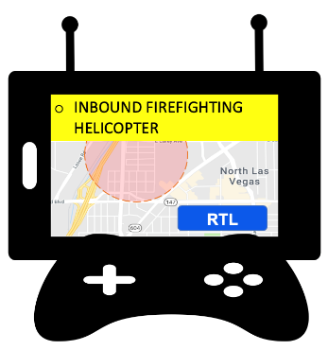
UVR - UAS Operator View
!
UVR can automatically notify UAS Operators about nearby emergency activities in near real-time
Such activities may include aircraft or ground operations
Examples include search and rescue, firefighting, medevac, law enforcement on ground, etc

Slide 20
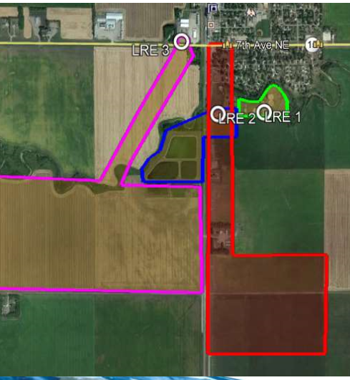
UVR Live Tests and Demonstrations
UVR Capability Demonstrated at UTM Pilot Program Test Sites
Mid-Atlantic Aviation Partnership (MAAP) – June 13, 2019
USS partners: Airmap, Wing Aviation, ANRA Technologies, and AirXOS
Northern Plains UAS Test Site (NPUASTS) – July 10-11, 2019
USS partners: Simulyze, Collins Aerospace, and AirXOS
Nevada Institute for Autonomous Systems (NIAS) – August 1, 2019
USS partners: AirXOS (GE), Uber Elevate, ANRA Technologies, Amazon Prime Air, and Praxis

Slide 21
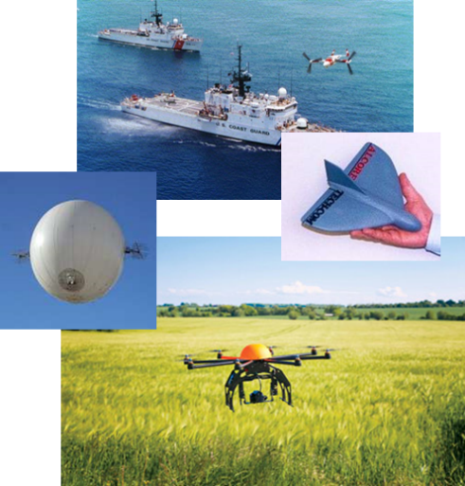
Lessons Learned to Date
Operations first yields results
Synchronizes the FAA with industry
Promotes inspiration
Informs performance-based standards
Incremental approaches to UAS integration are best
NOT all-inclusive regulatory solutions
UAS integration vision must be Modular and Scalable
Integration of legacy users requires planning and prioritization
Partnering with Industry is important
Drone Advisory Committee; ARC; UAST
Security issues must be addressed

Slide 22
UTM Pilot Program Next Steps
Transfer UAS Volume Reservation Test Architecture and Lessons Learned to the implementing organization(s)
Phase 2 of the UTM Pilot Program Demonstration, as mandated by the FAA Reauthorization of 2019 (H.R. 302 SEC. 376), will include Remote ID concepts, methods of compliance to support the FAA rulemaking activities, and the next enhancement to the UTM Ecosystem
Notes:
Talking Points:
Demonstration Media Day release from the FAA is planned to happen in August 12, 2019
AOC is developing the media output
Phase 1 Final Report – September 30, 2019
Phase 2 planning - Q1 of FY20

Slide 23
Additional Work on UTM Capabilities Underway
UTM Messaging Security
Data Correlation Capability

Slide 24
UTM Message Security
Focus on integrating security into the message format for communications between FAA’s UTM systems and UAS Service Suppliers
Security objectives identified based on UTM use cases, FAA Security Policies, and practices from other FAA enterprise services and programs
Authorization | Non-Repudiation | Authentication | Data Integrity | Encryption
Ensures that only authorized USSs can perform certain tasks, such as submitting dynamic restrictions. | Uses a digital signature to prove the sender sent the message; protecting the sender and receiver. | Verifies the identify of the messaging entity, ensuring they are who they say they are. | Verifies that the message contents have not been altered. | Obscures the contents of sensitive messages, such as PII or DOD information.
Technical solutions for further analysis to meet these objectives will be based on industry standards and FAA policy and requirements.
Analysis includes consideration of:
System architecture and information flows
Network and in-transit security measures used by FAA Cloud Services
Notes:
FAA Security Policies of Focus:
JO 1370.48 National Airspace System (NAS) Identity and Access Management (IAM)
1370.121 FAA Information Security and Privacy Program & Policy
Acronyms Defined:
FAA Cloud Services (FCS)
Low Altitude Authorization and Notification Capability (LAANC)
System Wide Information Management (SWIM)
UAS Service Suppliers (USS)
UAS Traffic Management (UTM)

Slide 25
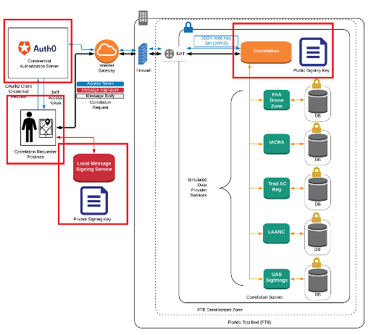
Correlation Capability Highlights
Single source secure access to appropriate FAA information about UAS operations
Fast and efficient retrieval of FAA data in near-real time and post-event investigations
Able to query and correlate information from simulated FAA web services including:
FAA DroneZone
Aircraft Registration
Airman Certification
Airspace Authorizations
UAS Sighting Reports

Slide 26
Path to Implementation
Operational Implementation
Technology Development
Industry Standards
Rules and Regulations
Operational Concepts
Infrastructure

Slide 27
Contact
faautm@faa.gov
praveen.raju@faa.gov

