Slide 1


The Limitations of risk management
If risk management is so effective, how did we end up with the 2007 financial crisis?
George Emilio

Slide 2
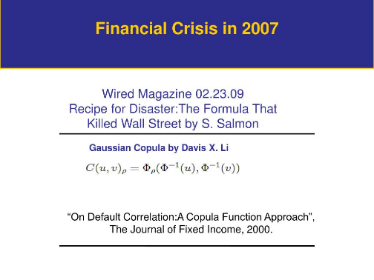
Risk Management in the Financial Industry
The troubled American International Group Inc., for example, was a leader in risk management and even maintained a risk-management subsidiary. Its former CEO Maurice R. “Hank” Greenberg boasted that AIG had “the best risk management [departments] in the damn industry.” Bear Stearns Cos. claimed the “best-in-class processes in analyzing and managing … risk”; even the New York Times cited the company’s “carefully honed reputation for sound risk management.” Fannie Mae touted its “excellent credit culture and risk-management capabilities,” and Lehman Brothers Holdings Inc. prided itself on a “culture of risk management at every level of the firm.”
https://sloanreview.mit.edu/article/how-to-manage-risk-after-risk-management-has-failed/
What Went Wrong?
Gaussian Copula Formula – simplified risk dependencies to pool mortgages
The math paradox – using simplified math to make risk approachable
  Quants vs Traders
  Sophisticated math becomes opaque to the user community
  Simple math may just be wrong

Slide 3
The Limitations of Risk Management
The Math Paradox: using dubious math to keep things simple
Probabilities (the language of risk) can be counter-intuitive
Cognitive Biases invade subjective processes
Risk Management: Necessary, but not sufficient to ensure safety…it has its limits.

Slide 4
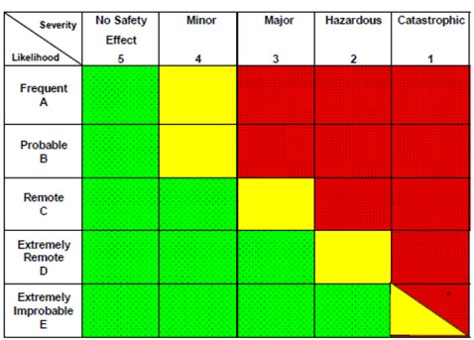
The Math Paradox
Risk is a pretty simple equation: RISK = PROBABILITY x IMPACT
Flight Risk of a Single General Aviation Flight
The impact of two deaths
Scenario #1: Baseline
Scenario #2
Scenario #3
CLEAR & SEVEN DAY
STORMY, LOW CEILINGS
TWO PILOTS
In this Scenario: Two pilots are safer…but still riskier

Slide 5
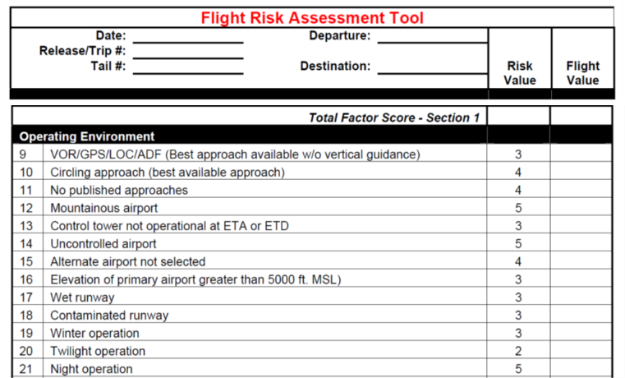
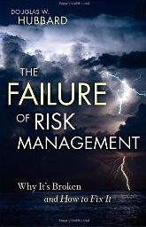
The Math Paradox: Problems with simplified math
The problem with ordinal scales
1
2
3
4
5
100% increase
50% increase
33% increase
25% increase
https://www.researchgate.net/publication/220498878_Problems_with_scoring_methods_and_ordinal_scales_in_risk_assessment/link/0912f4fa65c8550faf000000/download
MATH PROBLEMS
Ordinal scales are misleading
Risks don’t necessarily add
Doesn’t account for Correlated Risks
Doesn’t account for uncertainty of input data
Doesn’t output an actual risk rating (R=Pb x Impact)
Isn’t based on actual accident data
“These ordinal scoring methods are the benchmark for the analysis of risks…and all of them, without exception, are borderline or worthless. In practice, they may make many decisions far worse than they would have been using merely unaided judgments.”
Douglas Hubbard
The Failure of Risk Management

Slide 6
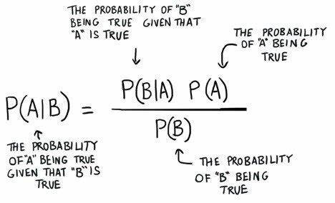
Probabilities can be counter-intuitive: Are accident statistics operationally relevant?
Bayes Rule
Statistic: Probability of Wind Given Accident
Probability of Accident (Baseline)
Probability of Accident Given Wind
WIND
The probability of wind
DAY
STATISTIC TELLS US: THE PROBABILITY OF WIND GIVEN AN ACCIDENT
ACCIDENT
STATISTIC
OPERATIONALLY RELEVANT
WE NEED: THE PROBABILITY OF AN ACCIDENT GIVEN WIND
Is Day dangerous, or just probable?

Slide 7
Probabilities can be counter-intuitive: False Alarms pervade hazard identification
Example: Medical Testing
Disease affects 1 in 100,000 Americans.
Test is 99% effective: 1% false alarm rate, 1% missed alarm rate.
You’re told you have the disease. What does that mean?
Condition | Odds
Before the Test | 1 in 100,000
After the Test | 1 in 1,000
With 340,000,000 Americans, we can expect 3,400 infections. If we test every American…
Missed Alarms = .01 x 3,400 Infections = 34 Missed Alarms
False Alarms = .01 x ≈340M Healthy Americans = 3,400,000 False Alarms
Disease Odds = 3,400 infections/3,400,000 False Alarms = 1/1,000
When events are rare, false alarms can be a problem.
Big data will exacerbate the issue.

Slide 8
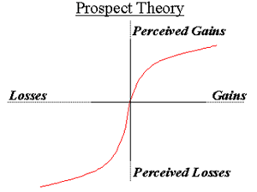
Cognitive Biases can invade risk management processes
Which do you prefer:
A. 100% chance of receiving $400
B. 80% chance of receiving $500
Risk Tolerance: Kahneman & Tversky
If you have a preference, then
Risk ≠ Probability x Impact
Which do you prefer:
A. 100% chance of losing $400
B. 80% chance of losing $500
Risk tolerance is non-linear, subjective property.

Slide 9
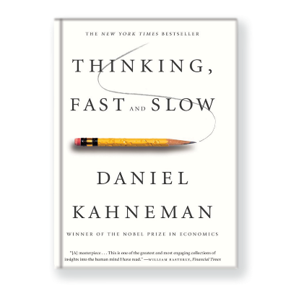
Cognitive Biases will invade risk management’s subjective processes
Bias | Description
Ambiguity Effect | “Better the Devil you know.” – a person is more likely to select a known risk over an unknown risk; even if it’s riskier.
Anchoring Bias | Rely excessively on the first piece of information
Attention Bias | Previous significant events considered more important even when unlikely.
Attention Tunneling | Excessive focus on a single task
Automaticity | “Going through the motions” and missing relevant information
Availability Bias | Fiction repeated often enough becomes fact
Base Rate Fallacy | Failure to consider base rate when considering new evidence.
Confirmation Bias | Only looking for information that confirms a previously held model.
Overconfidence Bias | “It can’t happen to me” --#1 human bias
Plan Continuation Bias | Forge ahead with the original plan
Prospective Memory | Preoccupation with immediate tasks. Urgent over important.
Get-Home-Itis | Additional risks accepted to get home.
http://aviationweek.com/bca/cockpit-cognitive-biases-can-cause-real-trouble

Slide 10

Limits of Risk management
Risk Management often uses dubious math to keep things simple.
Risk Management relies on the language of probabilities…that can be counter-intuitive.
Cognitive biases will invade subjective processes.

Slide 11
Benefits of resilience management
1. Risk is a characteristic of the hazard (hard to measure)…
    …Resilience is a characteristic of the organization (easy to measure).
2. Risk Management relies on counter-intuitive event probabilities…
…Resilience Management emphasizes impact to better fit unpredictable environments.
3. Risk Management is an effort of analysis (pulling data apart to look for new insights)…
    …Resilience Management is an effort of synthesis (looking for new conceptual viewpoints that provide a better fit to new environments).
John Boyd: http://pogoarchives.org/m/dni/john_boyd_compendium/destruction_and_creation.pdf#:~:text=Boyd%20September%203%2C%201976%20To%20comprehend%20and%20cope,by%20a%20changing%20environment.%20In%20this%20sense%2C%20the

Slide 12

Questions
George Emilio
Director of Aviation Research
Serco Inc.
george.emilio@serco-na.com
707-725-7156

