Slide 1
Embracing Resilience and Innovation to Power the Future
2020 V&V Summit
Mark DeNicuolo
September 2019

Slide 2
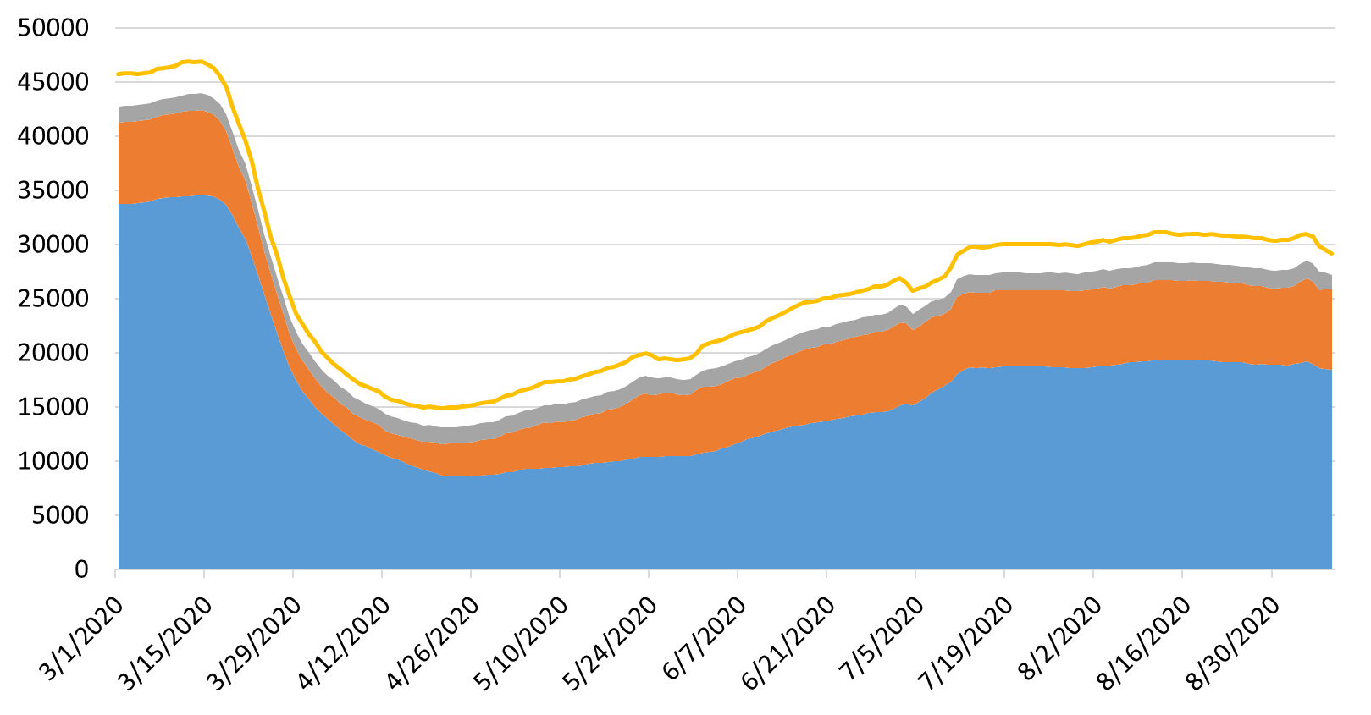
IFR Flight Counts by User Class

Slide 3
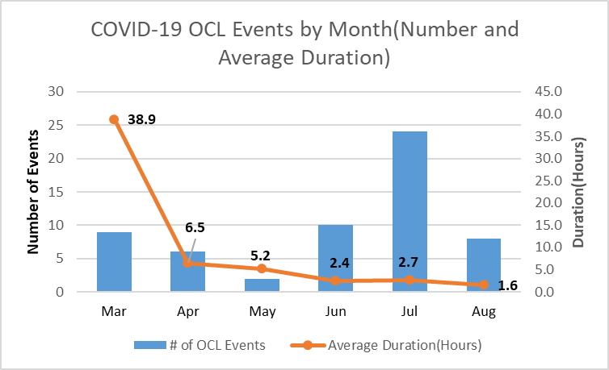
Number and Average Duration of COVID-19 Events at Core-30 Facilities.(March-August 2020)

Slide 4
Tower Service Ops Summary

Slide 5

Breifing Name

Slide 6


Slide 7
Hidden Figures
Insert Movie Clips
  1:19:07 – 1:19:57 Dorothy programs IBM
  1:27:36 – 1:27:59 West Computers reassigned

Slide 8
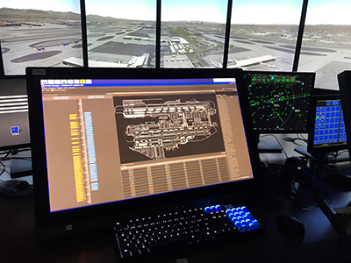
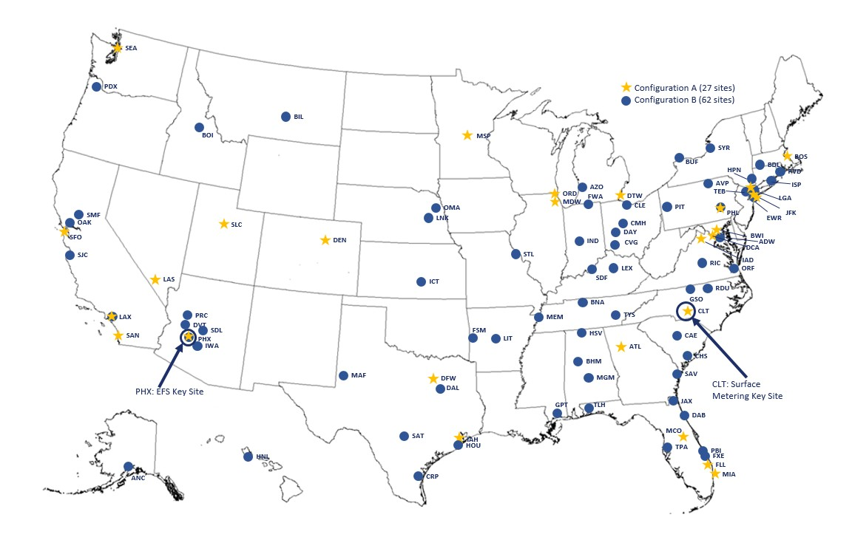
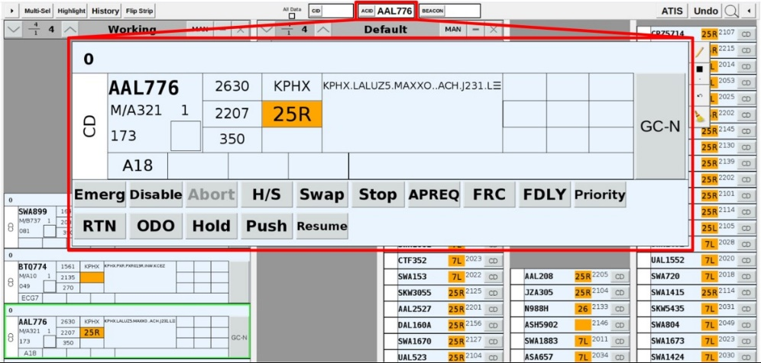
Terminal Flight Data Manager (TFDM)

Slide 9
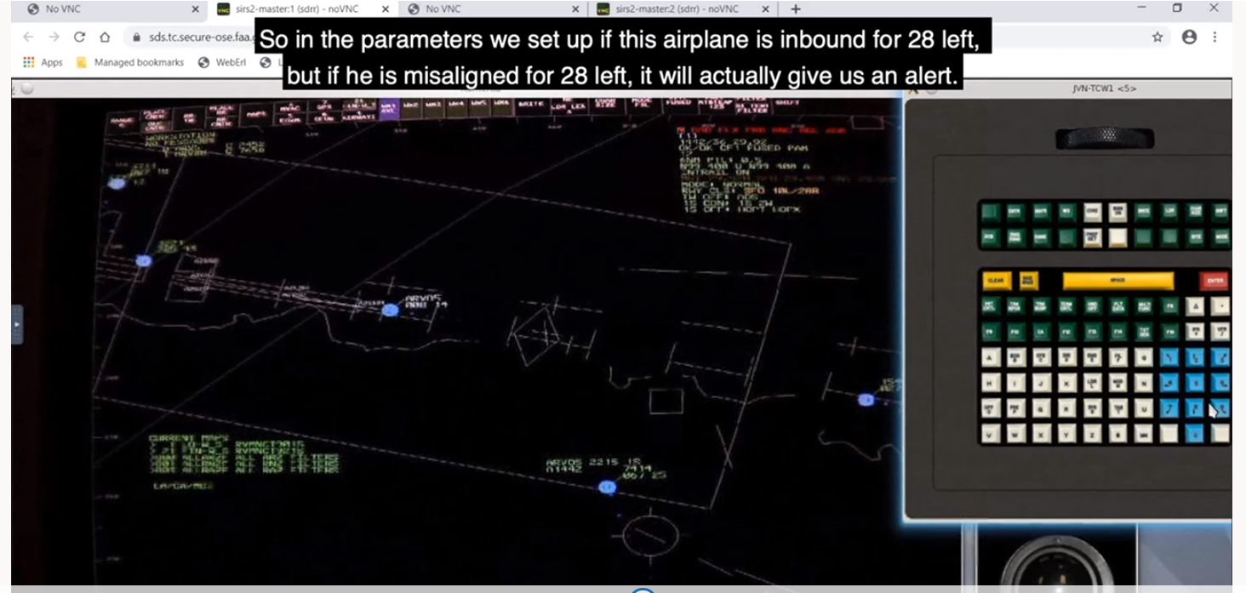
Approach Runway Verification

Slide 10
En Route Systems with Remote Testing Capabilities
  En Route
    En Route Automation and Modernization (ERAM)
    International Civil Aviation Organization (ICAO)/Canadian Automated Air Traffic Management System (CAATS)
    Data Communication (Data Comm) Enterprise
  Oceanic
    Advanced Technologies and Oceanic Procedures (ATOP)
    Flight Data Processing System (FDPS)
    Offshore Flight Data Processing System (OFDPS)
  Decision Support
    Airborne Reroute (ABRR)
    Ground-Based Interval Management–Spacing (GIM-S)
    Service Availability Prediction Tool (SAPT)
    Time Based Flow Management (TBFM)

Slide 11
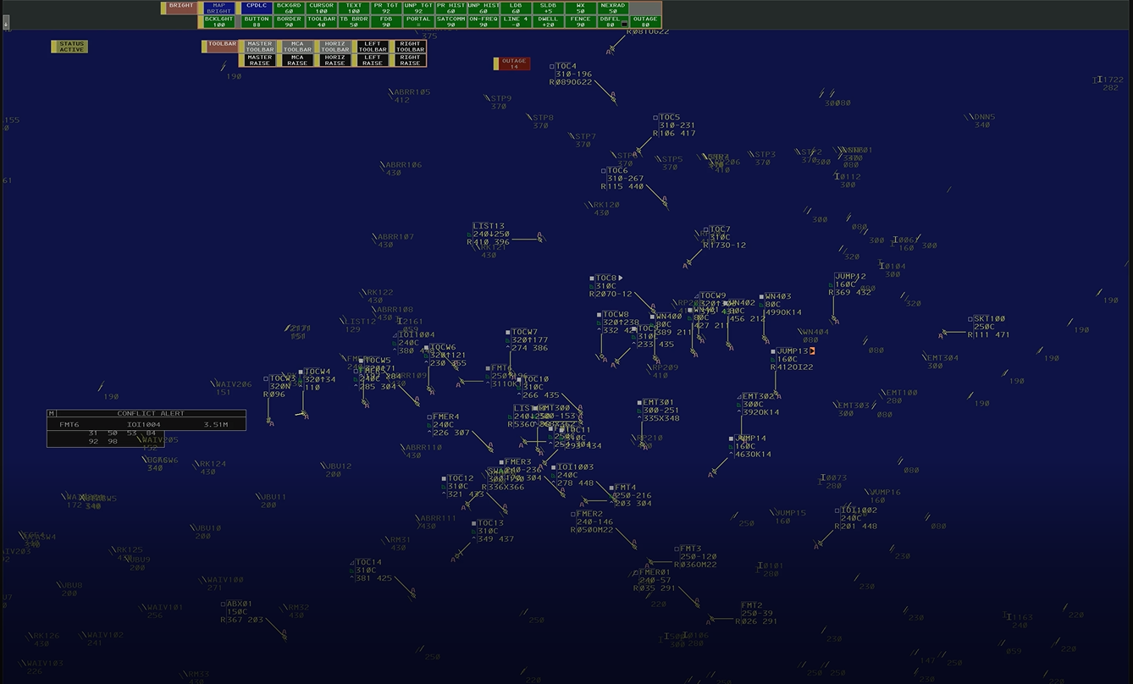
ERAM R-Position from Remote Location

Slide 12
Test Innovation Tiger Team
  Exploring innovative acquisition and second level engineering test methods:
    Shift Left V&V and Agile T&E
    End-to-End Enterprise Testing Environment
    Standardized Tool Set (Action tracker/ Tools PTR tracking)
    Contracts Recommendations
  Team Includes:
  NextGen Test & Evaluation Organizations
  Air Traffic Organization Test Organizations
    Program Management Organization
    Technical Operations

Slide 13
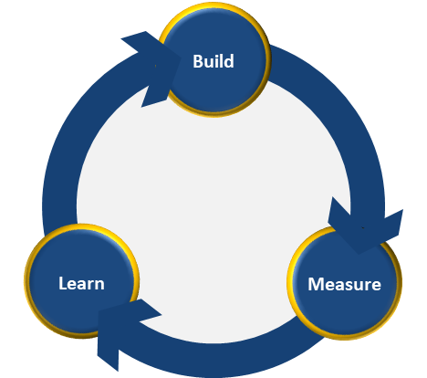
Overview
Mid-Project Check-In
Inception
Discovery
Framing
What problem
are we tackling?
What Solutions
Might Work?
Which solution are
we stating with?
Kick-Off
What problems exist?
Scoping
Many Users
Many Problems
One User
One Problem
Many Solutions
One Solution
CI/CD Pipeline (Includes Test and Security Validation)
MVP Development and Support
Initial
Assumptions
Plan The Project
Start
Discover/Prioritize User Pain Points
Midpoint Check-In
Identify Solution and Prioririze Features
Inception
Start Development
Iterative Feedback
Users Engage to Validate Outcomes
User Interviews are Ongoing throughout the entire timeline (builds out MVP and Refines Concepts and Requirements)

