Slide 1

Diversity of Thought:
How Black Swans Help
Build a Resilient Test Culture
Colonel Steven W. Speares
Air Force Test & Evaluation
Phone: 703 697-0190 or DSN 227-0190
E-mail: steven.speares@us.af.mil
Notes:
This brief was created by the author and does not represent the official position or opinion of the Department of Defense or the United States Air Force

Slide 2

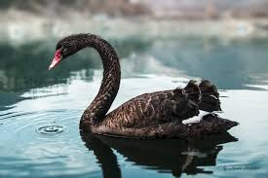
The Basics
Black Swan event
  A rare, unexpected event that drives large impact or consequence
  After it occurs, hindsight dictates that it should have been expected, because the data were there but unaccounted for
Resilience
  The capacity to recover quickly from difficulties; toughness
  The ability of something to spring back into shape; elasticity
Notes:
Black swan pic from: https://www.google.com/url?sa=i&url=https%3A%2F%2Fthebulletin.org%2F2014%2F11%2Fnuclear-war-the-black-swan-we-can-never-see%2F&psig=AOvVaw0xMOgBtY_yerFJsXozlRGz&ust=1599941919344000&source=images&cd=vfe&ved=0CAIQjRxqFwoTCJDFw6L24esCFQAAAAAdAAAAABAD
Rocky pic from: https://www.google.com/url?sa=i&url=https%3A%2F%2Fwww.pinterest.com%2Fpin%2F785948572446573030%2F&psig=AOvVaw2VDmvrTGJ4fz0NRKZcsvt1&ust=1599942062385000&source=images&cd=vfe&ved=0CAIQjRxqFwoTCLC3udT24esCFQAAAAAdAAAAABAE

Slide 3

The Stage Setter – Part 1
2019 FAA V&V Conference
Why Verification & Validation (V&V)?
Notes:
FAA pic from: https://www.google.com/imgres?imgurl=https%3A%2F%2Fupload.wikimedia.org%2Fwikipedia%2Fcommons%2Fthumb%2Fc%2Fc8%2FSeal_of_the_United_States_Federal_Aviation_Administration.svg%2F1200px-Seal_of_the_United_States_Federal_Aviation_Administration.svg.png&imgrefurl=https%3A%2F%2Fen.wikipedia.org%2Fwiki%2FFederal_Aviation_Administration&tbnid=KWki3QTTpV-rOM&vet=12ahUKEwitxrzK9-HrAhUmRFMKHeJ3DsUQMygAegUIARDKAQ..i&docid=2duNwfm5uWYVxM&w=1200&h=1200&q=FAA&ved=2ahUKEwitxrzK9-HrAhUmRFMKHeJ3DsUQMygAegUIARDKAQ

Slide 4
Why V&V?
V
Top-Level Requirements
Operational Test
High-fidelity simulation
Cyber ranges
Threat ranges
Open-air ranges
Software factories
Public domain
System Design
System & SoS Test
Subsystem Design
Subsystem Test
Wind tunnels
Anechoic chambers
Engine test stands
Arc heaters
Acceleration ranges
Test tracks
Software integration labs
Software factories
Hardware in the loop facilities
Component Design
Component Test
Fabrication
The Systems Engineering “V”
Test is integral to the systems engineering process
Complex systems won’t be resilient without testing them

Slide 5
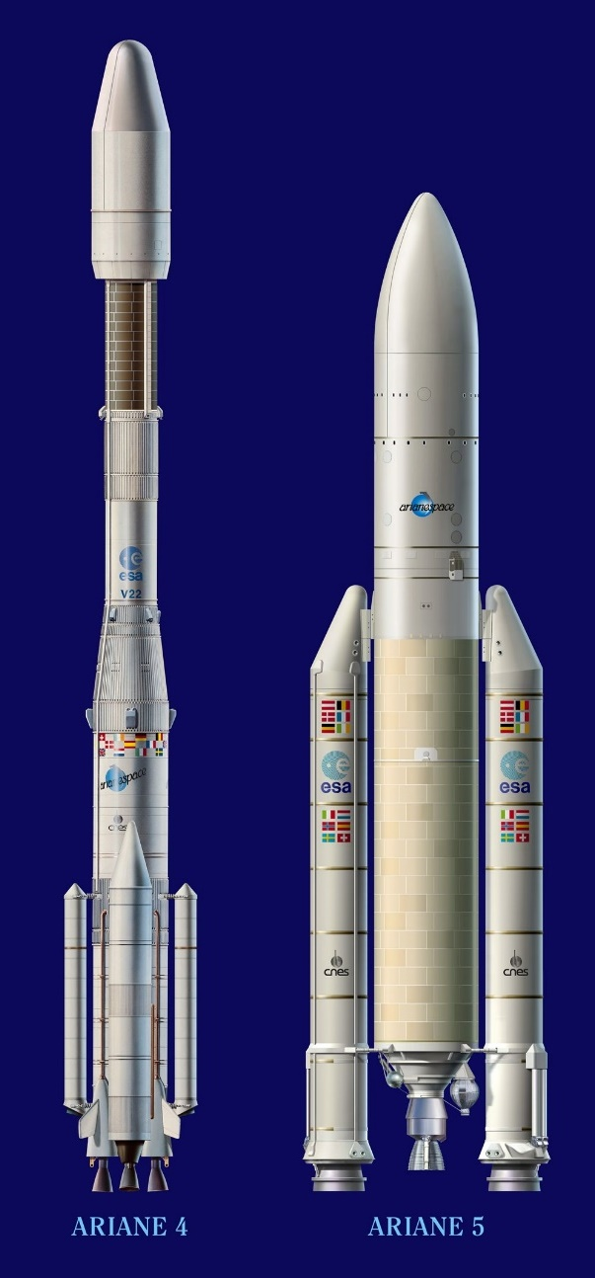
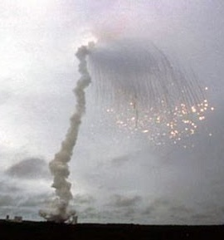
Ariane 5 (4 Jun 1996)
First launch of Ariane 5
  $500M loss - broke up 37 sec into flight
  S/W failure commanded errant engine response
Ariane 4 software reused on Ariane 5
  Inertial reference system (IRS) components not needed, but retained for commonality
Validation Failure of S/W systems reqmts
  No overflow exception handler on unused IRS
  No test of overflow condition because no reqmt
Insufficient systems-level testing
  Component level tests
  IRS testing used simulated data, not real (HITL) data
  Recommendation: Test not just what the system should do, but what it should not
37 sec
Notes:
Ariane 4/5 image from: https://www.google.com/imgres?imgurl=https%3A%2F%2Fwww.esa.int%2Fvar%2Fesa%2Fstorage%2Fimages%2Fesa_multimedia%2Fimages%2F2003%2F02%2Fthe_ariane_launcher_family_artist_s_view%2F9654211-3-eng-GB%2FThe_Ariane_launcher_family_artist_s_view_pillars.jpg&imgrefurl=https%3A%2F%2Fwww.esa.int%2FESA_Multimedia%2FImages%2F2003%2F02%2FThe_Ariane_launcher_family_artist_s_view&tbnid=11s0HZFC2uWp4M&vet=12ahUKEwiX2tGTlOnrAhUE0lMKHaz4CIAQMygFegUIARCsAQ..i&docid=8Mz99kGJ69GmYM&w=1920&h=1537&q=Ariane%204%20vs.%20Ariane%205&hl=en&ved=2ahUKEwiX2tGTlOnrAhUE0lMKHaz4CIAQMygFegUIARCsAQ
Ariane 5 explosion image from: https://www.google.com/imgres?imgurl=https%3A%2F%2Fi.ytimg.com%2Fvi%2FPK_yguLapgA%2Fhqdefault.jpg&imgrefurl=https%3A%2F%2Fwww.youtube.com%2Fwatch%3Fv%3DPK_yguLapgA&tbnid=MAcfPFVsM6xI-M&vet=12ahUKEwj5gL70k-nrAhVDNlMKHUP1A7cQMygAegUIARCmAQ..i&docid=pwBS_-UFLyE-2M&w=480&h=360&q=Ariane%205%20explosion&hl=en&ved=2ahUKEwj5gL70k-nrAhVDNlMKHUP1A7cQMygAegUIARCmAQ

Slide 6
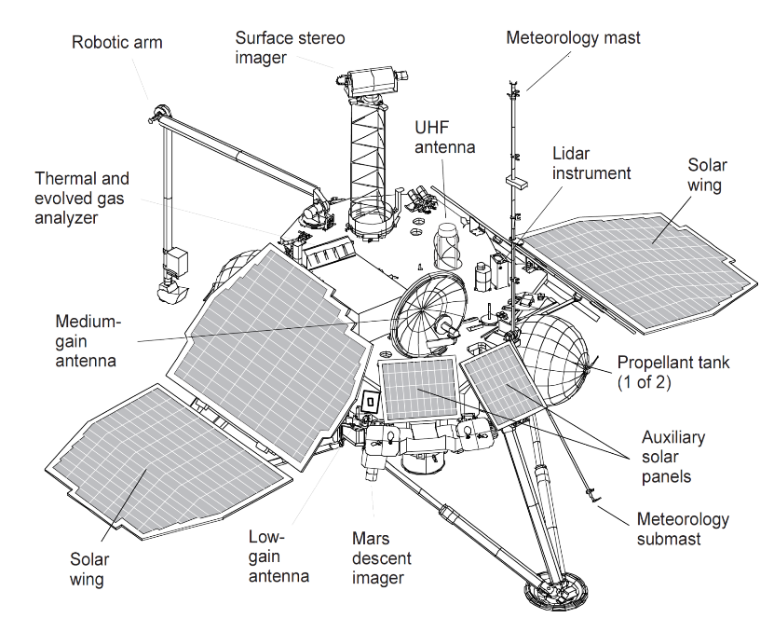
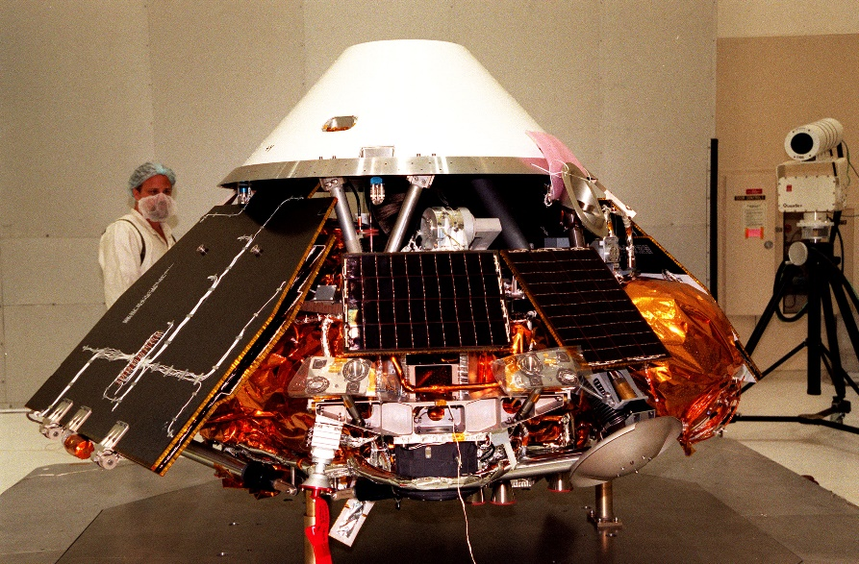
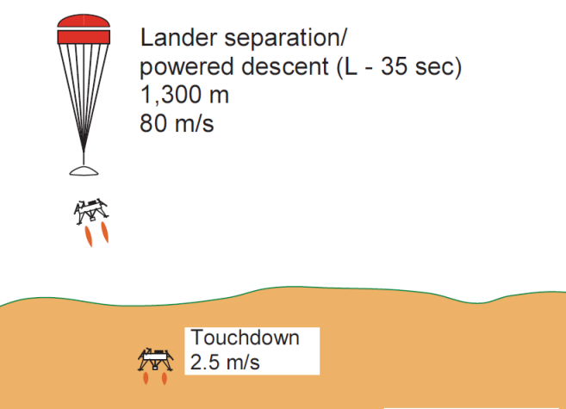
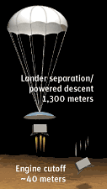
Mars Polar Lander (3 Dec 1999)
All parts/components worked as designed
Software response to transient signals
Inadequate testing…
  Flight software not subjected to fault-injection testing
  Touchdown S/W not tested in landing configuration
Recommendation: “Reinforce the system-level test principle of test as you fly, and fly as you test.”
Faster, better, cheaper was the culprit (JPL PM)
Notes:
Mars Polar Lander inspection image from: https://www.google.com/imgres?imgurl=http%3A%2F%2Fwww.americaspace.com%2Fwp-content%2Fuploads%2F2019%2F01%2Fmarspolarlandertesting.jpg&imgrefurl=https%3A%2F%2Fwww.americaspace.com%2F2019%2F01%2F06%2Fcould-not-have-survived-20-years-since-nasas-ill-fated-mars-polar-lander%2F&tbnid=OW-a82IzzfINXM&vet=12ahUKEwjisaK2lOnrAhVNC1MKHW_tCj0QMygGegUIARDLAQ..i&docid=ms5LTGDLDSa9bM&w=1920&h=1263&q=Mars%20Polar%20Lander&hl=en&ved=2ahUKEwjisaK2lOnrAhVNC1MKHW_tCj0QMygGegUIARDLAQ
Mars Polar Lander diagram image from: https://www.google.com/imgres?imgurl=https%3A%2F%2Fupload.wikimedia.org%2Fwikipedia%2Fcommons%2Fa%2Fa5%2FMars_Polar_Lander_-_spacecraft_diagram.png&imgrefurl=https%3A%2F%2Fcommons.wikimedia.org%2Fwiki%2FFile%3AMars_Polar_Lander_-_spacecraft_diagram.png&tbnid=iZ0XS0n9oFh2cM&vet=12ahUKEwjisaK2lOnrAhVNC1MKHW_tCj0QMygOegUIARDcAQ..i&docid=pRkkg5rFf55lwM&w=1803&h=1432&q=Mars%20Polar%20Lander&hl=en&ved=2ahUKEwjisaK2lOnrAhVNC1MKHW_tCj0QMygOegUIARDcAQ
Mars Polar Lander descent image from: https://www.google.com/url?sa=i&url=https%3A%2F%2Fcommons.wikimedia.org%2Fwiki%2FFile%3AMars_Polar_Lander_-_landing_diagram.png&psig=AOvVaw0z56LXDOTDO86gR7Ehm1ED&ust=1600190538577000&source=images&cd=vfe&ved=0CAIQjRxqFwoTCOiPjveU6esCFQAAAAAdAAAAABAK
Mars Polar Lander engine cutoff image from: https://www.google.com/url?sa=i&url=https%3A%2F%2Fskyandtelescope.org%2Fastronomy-news%2Fmars-polar-lander-found-at-last%2F&psig=AOvVaw0z56LXDOTDO86gR7Ehm1ED&ust=1600190538577000&source=images&cd=vfe&ved=0CAIQjRxqFwoTCOiPjveU6esCFQAAAAAdAAAAABAD

Slide 7
Why Resilient V&V?
V
Top-Level Requirements
Operational Test
High fidelity simulation
Cyber ranges
Threat ranges
Open air ranges
Software factories
Public domain
System Design
System & SoS Test
Subsystem Design
Subsystem Test
Wind tunnels
Anechoic chambers
Engine test stands
Arc heaters
Acceleration ranges
Test tracks
Software integration labs
Software factories
Hardware in the loop facilities
Component Design
Component Test
Fabrication
The Systems Engineering “V”
Every node is a risk vector
Need integrated systems test and fault injection

Slide 8

The Stage Setter – Part 2
2019 FAA V&V Conference
Resilience lessons learned and takeaways
Notes:
Start with Why image from: https://www.google.com/imgres?imgurl=https%3A%2F%2Fsimonsinek.com%2Fwp-content%2Fthemes%2Fstart-with-why%2Fdist%2Fimages%2Fwebflow%2FBooks-SWY.jpg&imgrefurl=https%3A%2F%2Fsimonsinek.com%2F&tbnid=9NbGmWp4rq73mM&vet=12ahUKEwiXosmA-OHrAhWPoFMKHVmBAioQMygGegUIARC5Ag..i&docid=9iIKRC4wmHlLLM&w=924&h=924&q=start%20with%20why&ved=2ahUKEwiXosmA-OHrAhWPoFMKHVmBAioQMygGegUIARC5Ag

Slide 9

This is 2020: The Good
Fundamental shift in the nature of test
Platform-specific to platform-agnostic
DEVSECOPS, software resilience, and chaos engineering
Notes:
Level Up Code works logo from: https://www.google.com/url?sa=i&url=https%3A%2F%2Ftwitter.com%2Flevelup_cw&psig=AOvVaw04mKs8lTAYtOH8WSiCdwc2&ust=1599942554379000&source=images&cd=vfe&ved=0CAIQjRxqFwoTCKC5y8344esCFQAAAAAdAAAAABAN

Slide 10

This is 2020: The Bad
Funding challenges
Organizational Inertia
Lack of relevant expertise
Notes:
Expert image from: https://www.google.com/imgres?imgurl=https%3A%2F%2Fwww.philmjones.com%2Fwp-content%2Fuploads%2F2018%2F07%2Fexpert-1024x508.jpg&imgrefurl=https%3A%2F%2Fwww.philmjones.com%2F4-things-need-succeed-expert-business%2F&tbnid=RFvIDXoPJV7SBM&vet=12ahUKEwjRgI2C-eHrAhWk8FMKHdudCWgQMygEegUIARDaAQ..i&docid=FsYn0loiR6stnM&w=1024&h=508&q=expert&ved=2ahUKEwjRgI2C-eHrAhWk8FMKHdudCWgQMygEegUIARDaAQ

Slide 11
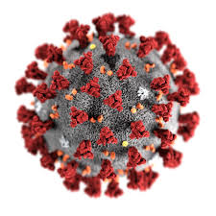

This is 2020: The Ugly
COVID-19
Notes:
Corona virus image from: https://www.google.com/imgres?imgurl=https%3A%2F%2Fca-times.brightspotcdn.com%2Fdims4%2Fdefault%2F3a2a756%2F2147483647%2Fstrip%2Ftrue%2Fcrop%2F3000x1655%2B0%2B0%2Fresize%2F840x463!%2Fquality%2F90%2F%3Furl%3Dhttps%253A%252F%252Fcalifornia-times-brightspot.s3.amazonaws.com%252F85%252Fff%252Fdd01791e96731ce838b07c8e511c%252Fda599c37ec1b4f15824bb9806e6a66c2&imgrefurl=https%3A%2F%2Fwww.latimes.com%2Fscience%2Fstory%2F2020-02-29%2Fhow-this-coronavirus-kills-its-victims&tbnid=N1th-MrCZ3T6FM&vet=12ahUKEwiw-IWV-eHrAhXXMFMKHUq0CnMQMygNegUIARCdAQ..i&docid=EAo2lIEhtiIQnM&w=840&h=463&q=corona%20virus&ved=2ahUKEwiw-IWV-eHrAhXXMFMKHUq0CnMQMygNegUIARCdAQ
The world is closed image from: https://www.google.com/imgres?imgurl=https%3A%2F%2Fstrategyofthings.io%2Fwp-content%2Fuploads%2F2020%2F05%2Fedwin-hooper-Q8m8cLkryeo-unsplash-1.jpg&imgrefurl=https%3A%2F%2Fstrategyofthings.io%2Fcovid-19-new-normal&tbnid=0N81lVONXjzp-M&vet=12ahUKEwiBmpS2-eHrAhVy8VMKHZilDOkQMyg5egQIARAi..i&docid=qfQw97bK7snAAM&w=2400&h=1600&q=new%20normal&ved=2ahUKEwiBmpS2-eHrAhVy8VMKHZilDOkQMyg5egQIARAi

Slide 12

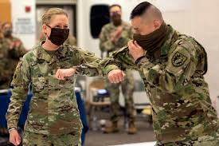
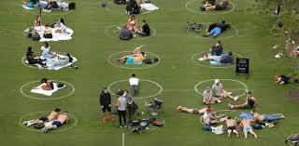

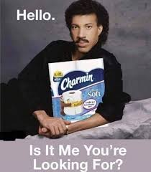

The Reality
The “New Normal”
Notes:
Social distancing park image from: https://www.google.com/imgres?imgurl=https%3A%2F%2Fcdn.abcotvs.com%2Fdip%2Fimages%2F6201195_052120-cc-ap-domino-park-circles-2-img.jpg&imgrefurl=https%3A%2F%2Fabc7chicago.com%2Fnew-york-park-circles-domino-dolores-san-francisco%2F6201143%2F&tbnid=u_Xgz0B0TtBUnM&vet=12ahUKEwiC-KuZ-uHrAhUQU1MKHd4dDc8QMygDegUIARCDAQ..i&docid=H29JaO-E66hTKM&w=1280&h=720&q=social%20distancing%20park&ved=2ahUKEwiC-KuZ-uHrAhUQU1MKHd4dDc8QMygDegUIARCDAQ
Tom Hardy masks image from: https://www.google.com/imgres?imgurl=https%3A%2F%2Fm.hindustantimes.com%2Frf%2Fimage_size_1200x900%2FHT%2Fp2%2F2020%2F04%2F25%2FPictures%2F_e11920ae-86af-11ea-a351-6978c1d205f3.jpg&imgrefurl=https%3A%2F%2Fwww.hindustantimes.com%2Fhollywood%2Ftom-hardy-puts-on-a-mask-again-this-time-to-shop-for-groceries-amid-covid-19-outbreak-see-pics%2Fstory-Fl6C6oYrPdVb9x8BPrdTBL.html&tbnid=qlXXMiTeSKYQHM&vet=12ahUKEwj3yKDG-uHrAhXGO1MKHWGOBWUQMygAegUIARDAAQ..i&docid=Ztl4Fy8Lj-2_KM&w=1200&h=675&q=tom%20hardy%20mask&ved=2ahUKEwj3yKDG-uHrAhXGO1MKHWGOBWUQMygAegUIARDAAQ
Elbow bump image from: https://www.google.com/imgres?imgurl=https%3A%2F%2Fmedia.defense.gov%2F2020%2FMay%2F05%2F2002294812%2F-1%2F-1%2F0%2F200501-Z-FD650-1047.JPG&imgrefurl=https%3A%2F%2Fwww.defense.gov%2Fobserve%2Fphoto-gallery%2Figphoto%2F2002294812%2F&tbnid=i6ub4ImlXsnGJM&vet=10CM4BEDMowAFqFwoTCIiV1uT64esCFQAAAAAdAAAAABAC..i&docid=RlODCZa1gAnS5M&w=4475&h=2983&q=elbow%20bump&ved=0CM4BEDMowAFqFwoTCIiV1uT64esCFQAAAAAdAAAAABAC
Quarantine image from: https://www.google.com/imgres?imgurl=https%3A%2F%2Fi.pinimg.com%2F736x%2Ffc%2F31%2F7f%2Ffc317f27461db2afcaf1e0a898356166.jpg&imgrefurl=https%3A%2F%2Fwww.pinterest.com%2Fpin%2F195765915041467102%2F&tbnid=aQbk-eZZc-AZRM&vet=12ahUKEwjgm5e-i-nrAhXGNlMKHQw1CzcQMygLegUIARCjAQ..i&docid=FPMhzOE_2FoNWM&w=720&h=756&q=quarantine%20memes&ved=2ahUKEwjgm5e-i-nrAhXGNlMKHQw1CzcQMygLegUIARCjAQ
Virtual learning image from: https://www.google.com/imgres?imgurl=https%3A%2F%2Fi.pinimg.com%2Foriginals%2F80%2Fe3%2F81%2F80e381b2b13e9bae1f42c3130451628d.png&imgrefurl=https%3A%2F%2Fwww.pinterest.com%2Fpin%2F197736239877995453%2F&tbnid=iWyIazjBgIG4RM&vet=12ahUKEwjDw7-ZjOnrAhXEDlMKHbm6CA0QMygFegUIARCqAQ..i&docid=m78vjJyzn3O28M&w=1000&h=1000&q=virtual%20school%20memes&ved=2ahUKEwjDw7-ZjOnrAhXEDlMKHbm6CA0QMygFegUIARCqAQ
Lionel Ritchie image from: https://www.google.com/imgres?imgurl=https%3A%2F%2Fsomethingtolaughat.com%2Fwp-content%2Fuploads%2F2020%2F03%2FIMG_4388.jpg&imgrefurl=https%3A%2F%2Fsomethingtolaughat.com%2Fvideo%2Flionel-richie-coronavirus-toilet-paper-meme%2F&tbnid=YLqjbqunr2HGEM&vet=10CHgQMyidAWoXChMIsOKuwYzp6wIVAAAAAB0AAAAAEAI..i&docid=-cQ4Zag52RmxgM&w=828&h=944&q=toilet%20paper%20memes&ved=0CHgQMyidAWoXChMIsOKuwYzp6wIVAAAAAB0AAAAAEAI

Slide 13

The Response
Physical
Organizational
Some positives, caveated success
Resilience in action
Notes:
Ron Burgundy image from: https://www.google.com/imgres?imgurl=https%3A%2F%2Fwww.bluesilvershift.com%2Fwp-content%2Fuploads%2F2020%2F03%2FEscalated-Quickly-BlueSilverShift.png&imgrefurl=https%3A%2F%2Fwww.bluesilvershift.com%2Fwhat-is-your-company-doing-and-are-you-prepared-for-the-impacts-of-covid-19%2F&tbnid=_JkYM07tJ-yMqM&vet=12ahUKEwiT9MefjenrAhVN0VMKHZLYCwkQMygPegUIARDJAQ..i&docid=QrAIK0dYwb7NfM&w=800&h=800&q=that%20escalated%20quickly&hl=en&ved=2ahUKEwiT9MefjenrAhVN0VMKHZLYCwkQMygPegUIARDJAQ

Slide 14
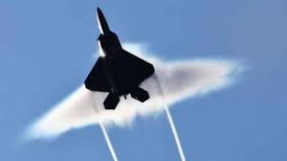
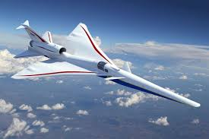
The Revelation
Cultural Resilience is the Key
Resilience in Attitude
Breaking resident barriers
Symptom of the pandemic (the enabling Black Swan)
Notes:
Raptor image from: https://www.google.com/imgres?imgurl=https%3A%2F%2Fcdn.mos.cms.futurecdn.net%2FcANw82ZibKCUhXijz5P82P-1200-80.jpg&imgrefurl=https%3A%2F%2Fwww.livescience.com%2F32518-can-you-see-a-sonic-boom.html&tbnid=oUz-dyJNM7pPzM&vet=12ahUKEwjjppDtjenrAhVS0lMKHR0hAKwQMygTegUIARDiAQ..i&docid=3qeGPIUjNoDqOM&w=600&h=336&q=sound%20barrier&hl=en&ved=2ahUKEwjjppDtjenrAhVS0lMKHR0hAKwQMygTegUIARDiAQ
X-59 image from: https://www.google.com/imgres?imgurl=https%3A%2F%2Fupload.wikimedia.org%2Fwikipedia%2Fcommons%2Fd%2Fdf%2FLow-Boom_Flight_Demonstrator.jpg&imgrefurl=https%3A%2F%2Fen.wikipedia.org%2Fwiki%2FLockheed_Martin_X-59_QueSST&tbnid=iQLPqZzNC7bQ0M&vet=12ahUKEwjrluOKjunrAhXS0VMKHdOYAuAQMygCegUIARCwAQ..i&docid=unHcDTpMMIttuM&w=5184&h=3456&q=X-59&hl=en&ved=2ahUKEwjrluOKjunrAhXS0VMKHdOYAuAQMygCegUIARCwAQ

Slide 15
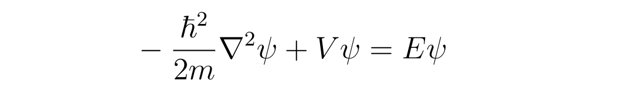
The Resilience Equation
Notes:
Time-independent Schrodinger equation from Panda the Red paper: https://medium.com/cantors-paradise/schrodingers-equation-f1554df74f59

Slide 16

The Resilience Equation
Cultural Resilience = Competence x Confidence
A product of acumen & attitude
Notes:
Esse Quam Videri image from: https://www.google.com/imgres?imgurl=https%3A%2F%2Fi.pinimg.com%2Foriginals%2F8a%2Fd4%2Fcd%2F8ad4cd6d2e11f711c9f458fcca68fe53.png&imgrefurl=https%3A%2F%2Fwww.pinterest.com%2Fpin%2F73042825179980834%2F&tbnid=gNOX9o-l_eFkYM&vet=12ahUKEwjVgJ_LkOnrAhXMglMKHbU2AMcQMygIegUIARDJAQ..i&docid=OTx0JkxpyZHJ4M&w=432&h=564&q=nc%20state%20motto&hl=en&ved=2ahUKEwjVgJ_LkOnrAhXMglMKHbU2AMcQMygIegUIARDJAQ

Slide 17

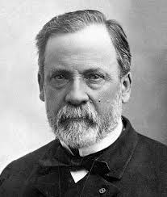



The Historic Basis
Mizuta Masahide
Pasteur
Churchill
“Safety Third”
Apollo 12
Notes:
Louis Pasteur image from: https://www.google.com/imgres?imgurl=https%3A%2F%2Fupload.wikimedia.org%2Fwikipedia%2Fcommons%2F4%2F42%2FLouis_Pasteur.jpg&imgrefurl=https%3A%2F%2Fen.wikiquote.org%2Fwiki%2FLouis_Pasteur&tbnid=xZ4lhVtRGSejbM&vet=12ahUKEwiMkvfskOnrAhWS0FMKHUztBwMQMygDegUIARDfAQ..i&docid=OTxHED7Do07ioM&w=861&h=1017&q=louis%20pasteur&hl=en&ved=2ahUKEwiMkvfskOnrAhWS0FMKHUztBwMQMygDegUIARDfAQ
Masahide image from: https://www.google.com/imgres?imgurl=https%3A%2F%2Fnow-zen.com%2Fblog%2Fwp-content%2Fuploads%2F2010%2F04%2FFullMoonSumidaRiver.jpg&imgrefurl=https%3A%2F%2Fnow-zen.com%2Fblog%2F2010%2F06%2Fmizuta-masahide-1657-1723%2F&tbnid=fy_wHepMug7ecM&vet=12ahUKEwie75ePkenrAhWS0FMKHUztBwMQMygDegUIARCFAQ..i&docid=puad2q4G3HRITM&w=320&h=237&q=mizuta%20masahide&hl=en&ved=2ahUKEwie75ePkenrAhWS0FMKHUztBwMQMygDegUIARCFAQ
Churchill image from: https://www.google.com/imgres?imgurl=https%3A%2F%2Fcdn.images.express.co.uk%2Fimg%2Fdynamic%2F1%2F590x%2F50th-Anniversary-Death-of-Winston-Churchill-Facts-About-Sir-Winston-Churchill-554789.jpg&imgrefurl=https%3A%2F%2Fwww.express.co.uk%2Fnews%2Fuk%2F554789%2FSir-Winston-Churchill-50-Facts&tbnid=XX4XcHlVm8SpnM&vet=12ahUKEwjsxZKlkenrAhXD8VMKHYARBeYQMygcegUIARCJAg..i&docid=oF-fVoW6R-j8WM&w=590&h=350&q=winston%20churchill&hl=en&ved=2ahUKEwjsxZKlkenrAhXD8VMKHYARBeYQMygcegUIARCJAg
Mike Rowe image from: https://www.google.com/imgres?imgurl=https%3A%2F%2Fa57.foxnews.com%2Fstatic.foxnews.com%2Ffoxnews.com%2Fcontent%2Fuploads%2F2018%2F09%2F1024%2F512%2Fdirty-jobs-mike-rowe-660.jpg%3Fve%3D1%26tl%3D1&imgrefurl=https%3A%2F%2Fwww.foxnews.com%2Fentertainment%2Fmike-rowe-dirty-jobs-rowed-trip-discovery-channel&tbnid=jQ0QWCGOiR40xM&vet=12ahUKEwippMrHkenrAhVG61MKHT5vALsQMyglegUIARCaAg..i&docid=X0eX2A7t4M0nvM&w=1024&h=512&q=mike%20rowe&hl=en&ved=2ahUKEwippMrHkenrAhVG61MKHT5vALsQMyglegUIARCaAg
Apollo 12 image from: https://www.google.com/imgres?imgurl=http%3A%2F%2Fwww.spacefacts.de%2Fmission%2Fpatches_hi%2Fapollo-12.jpg&imgrefurl=http%3A%2F%2Fwww.spacefacts.de%2Fmission%2Fenglish%2Fapollo-12.htm&tbnid=X0Miqzjo3liaWM&vet=12ahUKEwjd7YzikenrAhWIsFMKHc9WAcsQMygTegUIARD2AQ..i&docid=EI0n09PypCNBjM&w=2000&h=1998&q=apollo%2012&hl=en&ved=2ahUKEwjd7YzikenrAhWIsFMKHc9WAcsQMygTegUIARD2AQ

Slide 18

The Need
The 20s are the new 30s
Unmanned systems, Space travel
Relativistic effects of the modern world
Never know when the next Black Swan will arrive
Notes:
Agility Prime logo from: https://www.google.com/imgres?imgurl=https%3A%2F%2Fagilityprime.com%2Fimg%2FAgilityPrime_small_logo.4a6b1f08.svg&imgrefurl=https%3A%2F%2Fagilityprime.com%2F&tbnid=J6Dq7_gs1RThdM&vet=12ahUKEwi75vz4kenrAhXDHVMKHQB4AzEQMygBegUIARCVAQ..i&docid=Kg8Q4dXVHQHzOM&w=800&h=360&q=agility%20prime%20logo&hl=en&ved=2ahUKEwi75vz4kenrAhXDHVMKHQB4AzEQMygBegUIARCVAQ

Slide 19

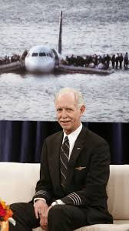
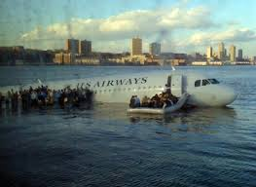
The Miracle on the Hudson
Notes:
Plane in water image from: https://www.google.com/imgres?imgurl=https%3A%2F%2Fwww.wired.com%2Fimages_blogs%2Fautopia%2F2010%2F01%2Fus_airways_1549_cropped.jpg&imgrefurl=https%3A%2F%2Fwww.wired.com%2F2010%2F01%2Fsullys-miracle-on-the-hudson-airbus-for-sale%2F&tbnid=bURJWzCJaEp93M&vet=12ahUKEwi2iNWVkunrAhXBElMKHd8-BMAQMygLegUIARDnAQ..i&docid=g2jmaGew4xLgoM&w=593&h=432&q=miracle%20on%20the%20hudson&hl=en&ved=2ahUKEwi2iNWVkunrAhXBElMKHd8-BMAQMygLegUIARDnAQ
Chesley “Sully” Sullenberger image from: https://www.google.com/url?sa=i&url=https%3A%2F%2Fwww.tampabay.com%2Fopinion%2Fcolumns%2Fsully-sullenberger-we-saved-155-lives-in-the-miracle-on-the-hudson-now-lets-vote-for-leaders-wholl-protect-us-all-20181102%2F&psig=AOvVaw2Mw1Y_pBrCI5XRI99KeZMD&ust=1600189933330000&source=images&cd=vfe&ved=0CAIQjRxqFwoTCKif7NWS6esCFQAAAAAdAAAAABAD
Sully image from: https://www.google.com/imgres?imgurl=https%3A%2F%2Fwww.telegraph.co.uk%2Fcontent%2Fdam%2Ffilms%2Fspark%2Fsully%2Fsully-tom-hanks-aaron-eckhart-cu_trans_NvBQzQNjv4BqEduPGWXTgvtbFyMaMlYatm4ovIMMP_5WSTNAIgCzTy4.JPG%3Fimwidth%3D450&imgrefurl=https%3A%2F%2Fwww.telegraph.co.uk%2Ffilms%2F0%2Fsully-miracle-hudson-review-superb-drama-suits-hanks-eastwood%2F&tbnid=Q82tjz9_bTe9CM&vet=10CFIQMyjxAWoXChMIqJ_s1ZLp6wIVAAAAAB0AAAAAEAo..i&docid=bJ2n2S1U5qgBuM&w=480&h=300&q=miracle%20on%20the%20hudson&hl=en&ved=0CFIQMyjxAWoXChMIqJ_s1ZLp6wIVAAAAAB0AAAAAEAo

Slide 20
Questions?

