Slide 1
Building a Modern Resilient Workforce
V&V Summit 2019
Peter D’Amico & Cuong Nguyen
September 26, 2019

Slide 2
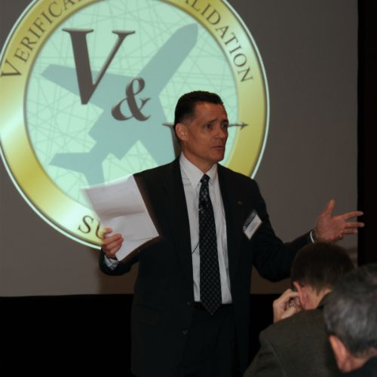
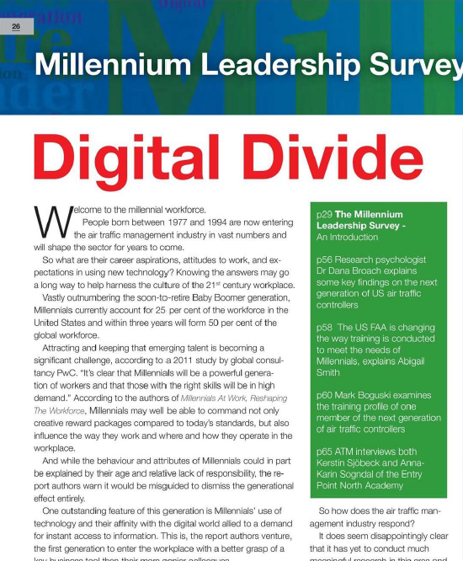
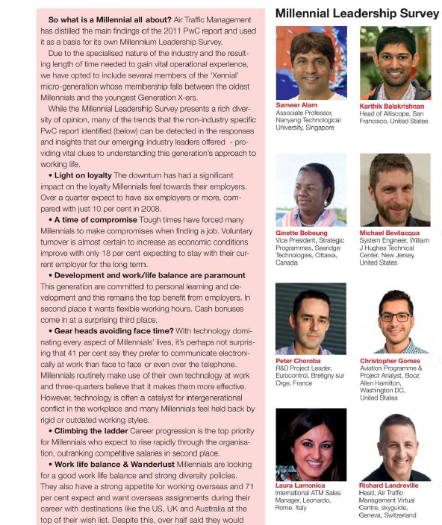

Slide 4
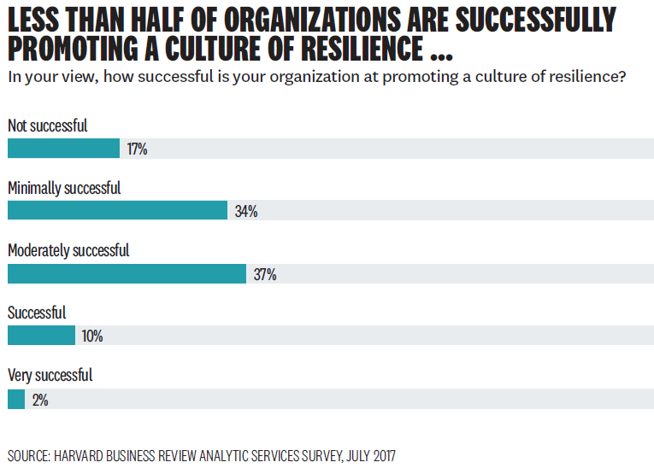

Slide 5
“In times of turmoil the danger lies not in the turmoil itself but in facing it with yesterday’s logic” –Peter Drucker

Slide 6
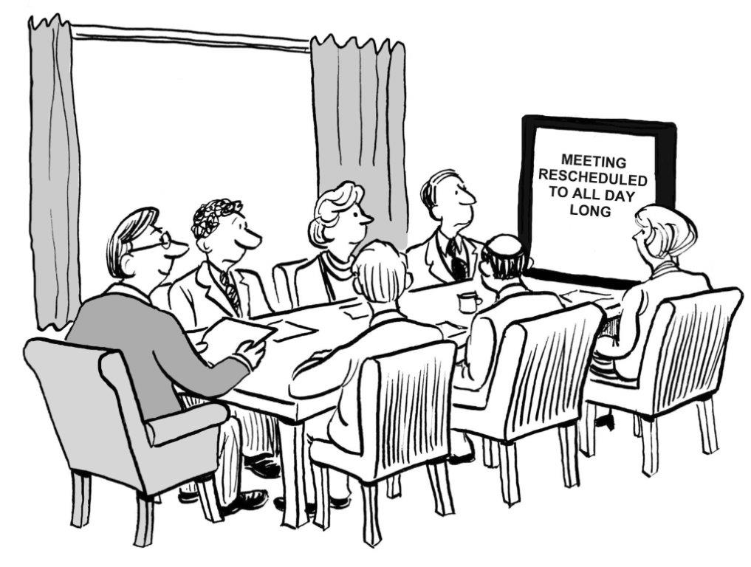
How We Achieve Resiliency Has Changed
We cannot rely on the same tactics and practices as before to build a resilient workforce

Slide 7
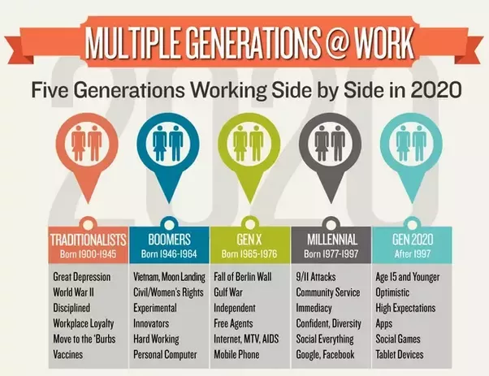

Slide 9
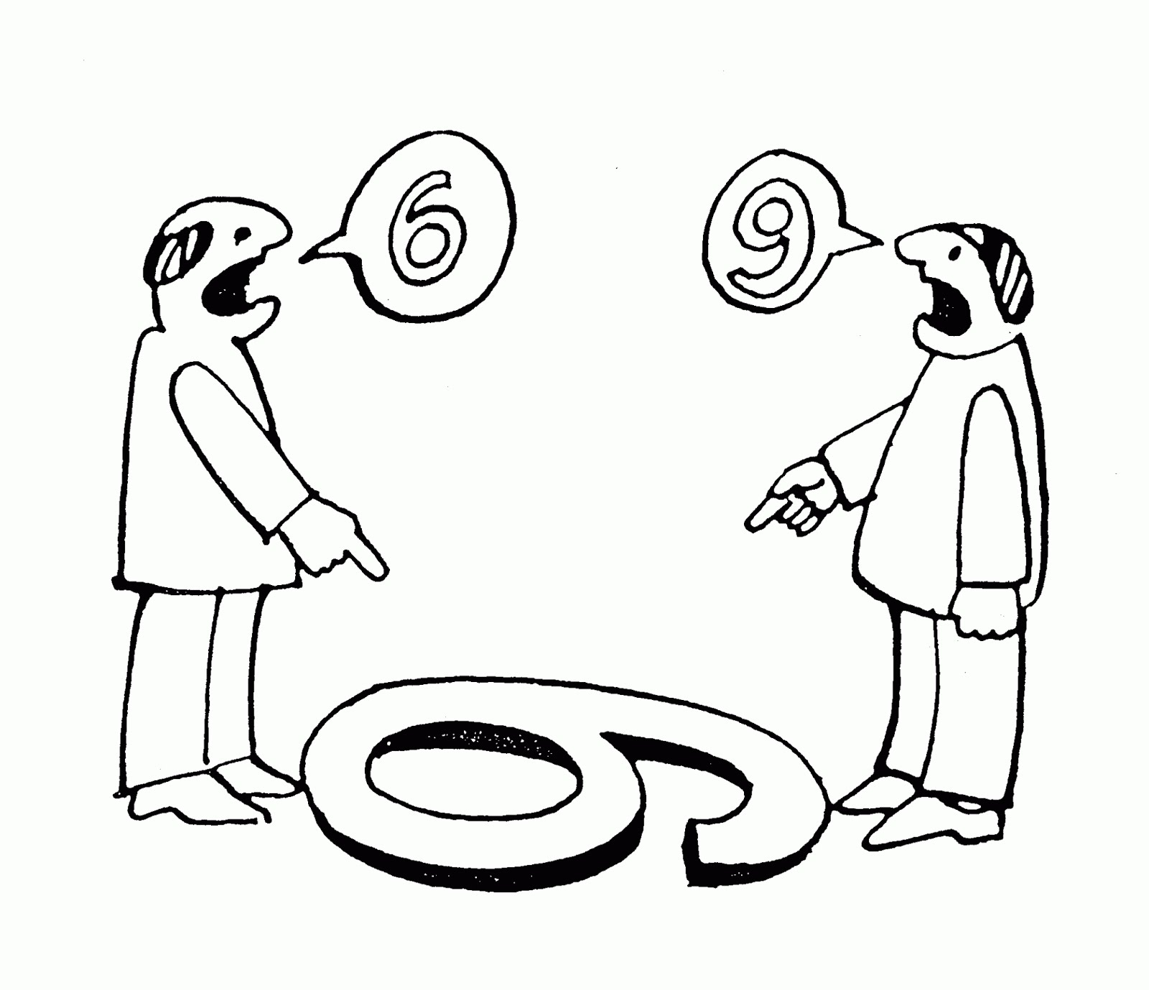
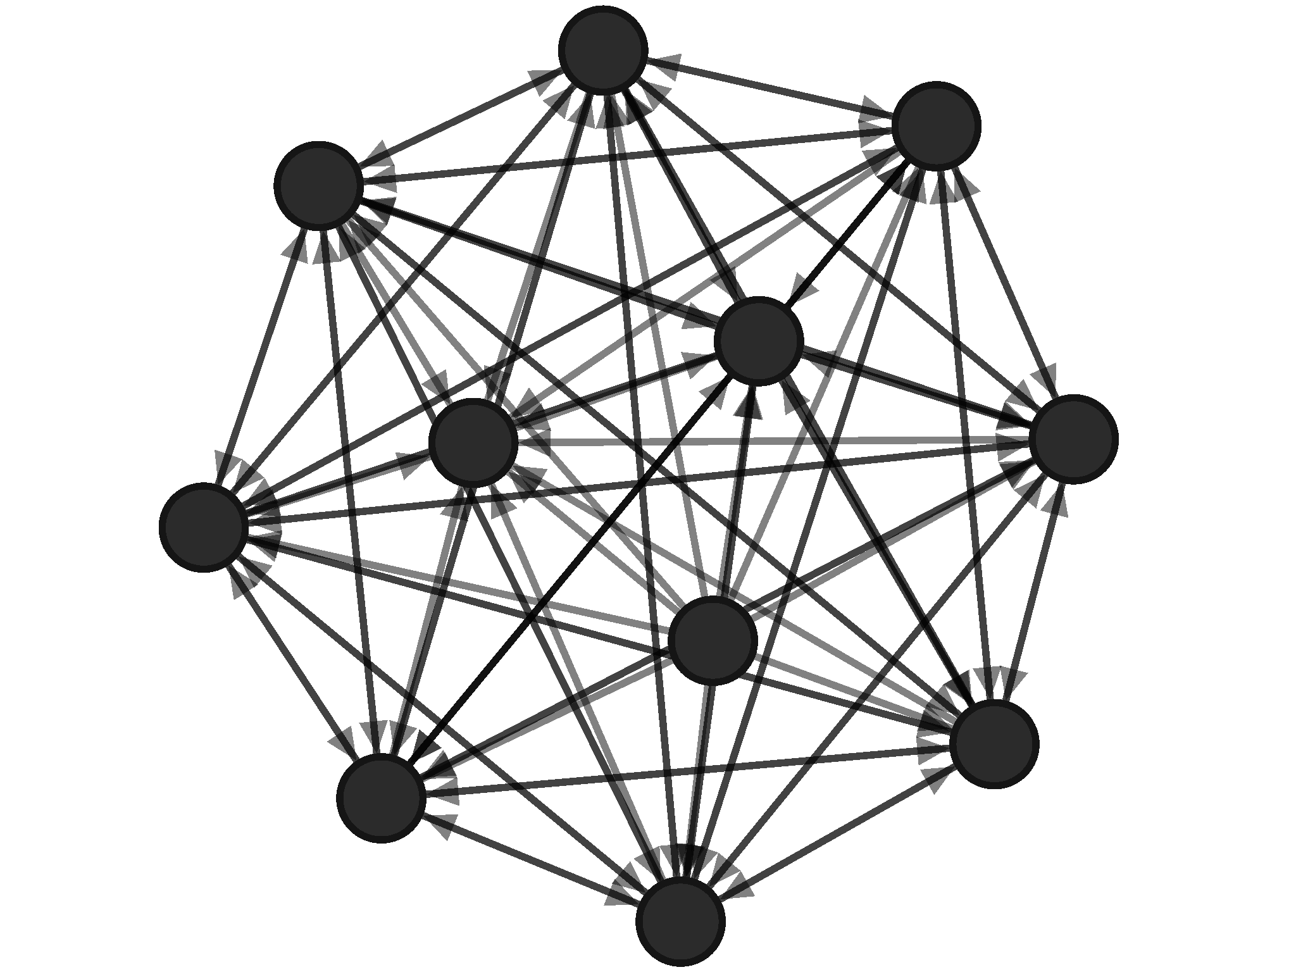
The Recipe for Resiliency
Perception
Connectedness
Trust

Slide 10
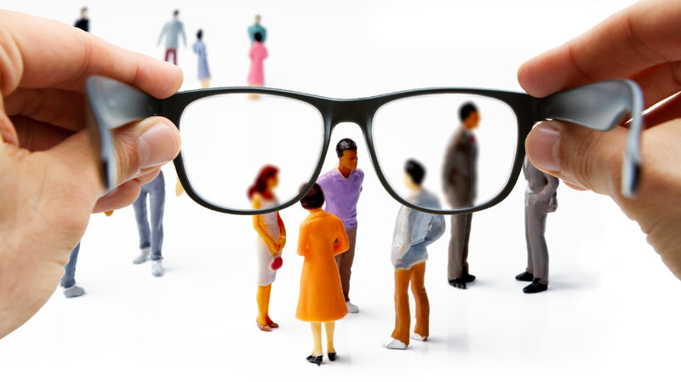
Perception
The lens in which you see the world
Optimism is important… but not blind optimism
Do employees feel empowered?
Notes:
Perception: The ability to see reality
No two people see the world in the same way and we have a graphic later on showing the difference in perception in the workforce today
Optimism is important... But not blind optimism
Empowering teams to make decisions

Slide 11
Connectedness
People want to feel like they belong or are a part of a community
Challenge the rigid structure, and silos
From a state of separateness to connectedness

Slide 12
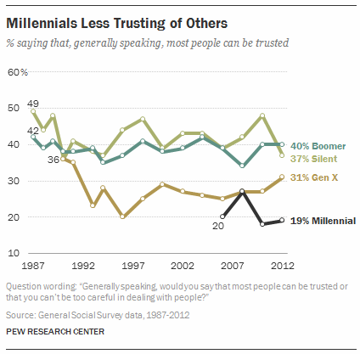
Trust
Millennials are already considered less trusting of others than previous generations
Good work is stagnated by interpersonal conflict, political infighting, lack of trust
When Millennials believe their company has a high-trust culture, they’re > 22 times more likely to want to work there for a long time

Slide 14
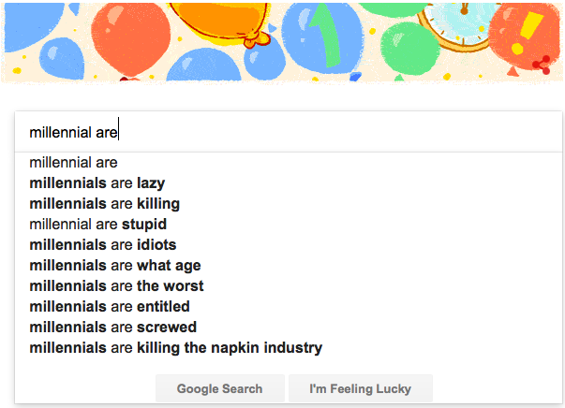

Slide 17
Failed parenting strategies
“Helicopter Parents”
Children with schedules

Slide 18
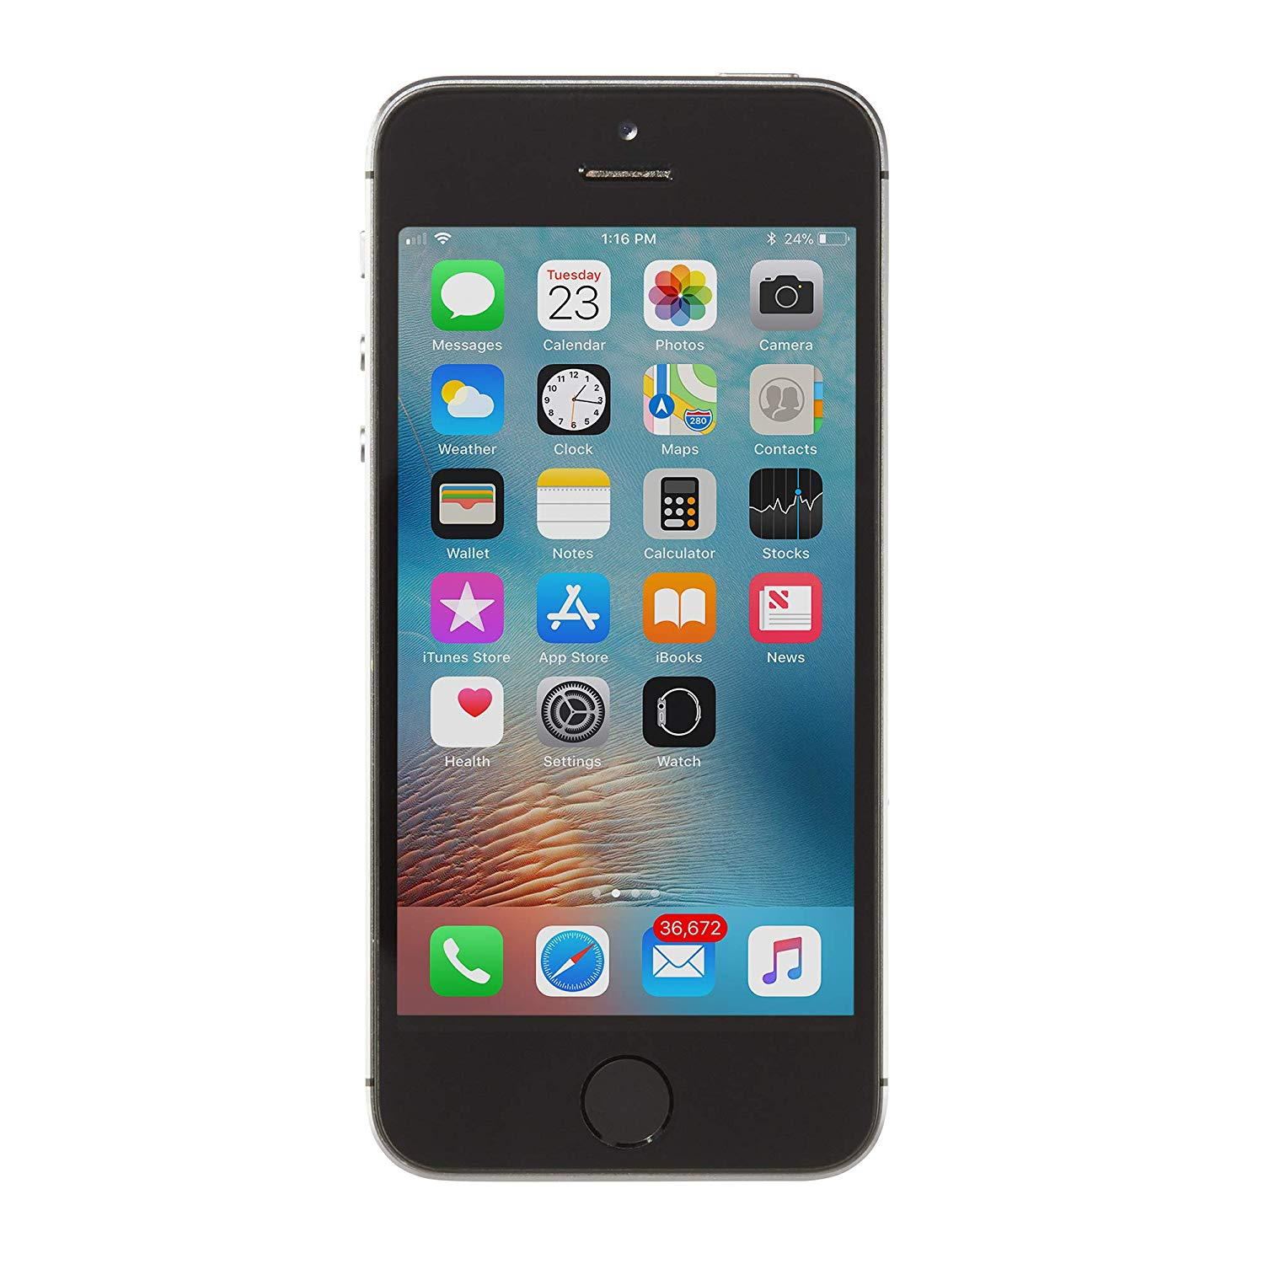
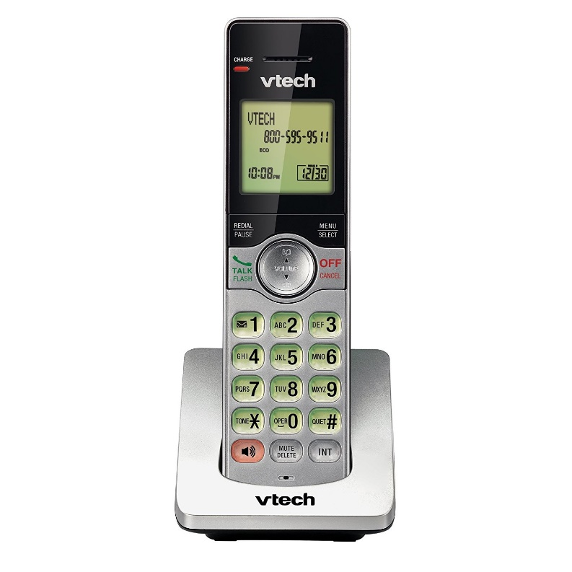
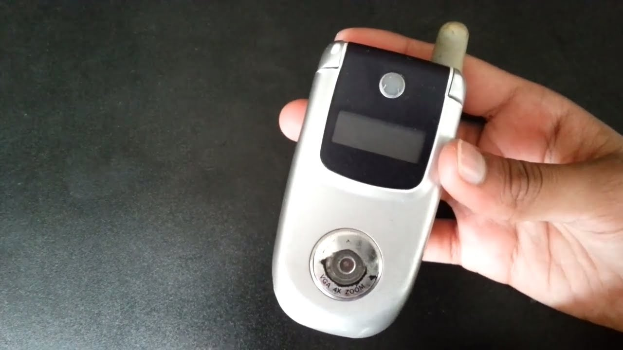
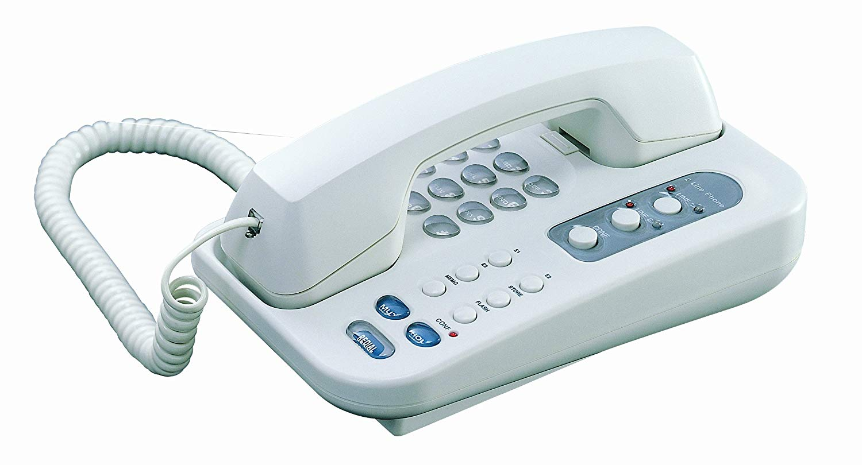
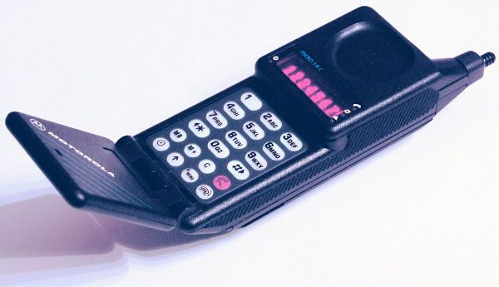
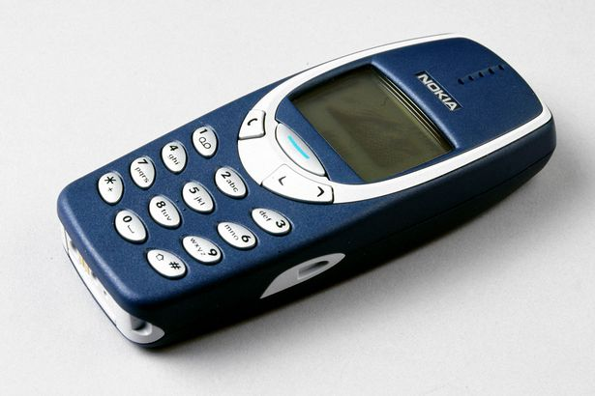
Constant, rapid change in tech
Video Games
Constant feedback
Incremental achievements
Instant Gratification
2-day shipping
On-demand streaming
Credit cards
Dating

Slide 19
Constant, rapid change in tech
Video Games
Constant feedback
Incremental achievements
Instant Gratification
2-day shipping
On-demand streaming
Credit cards
Dating

Slide 20
Constant, rapid change in tech
Video Games
Constant feedback
Incremental achievements
Instant Gratification
2-day shipping
On-demand streaming
Credit cards
Dating

Slide 21
Constant, rapid change in tech
Video Games
Constant feedback
Incremental achievements
Instant Gratification
2-day shipping
On-demand streaming
Credit cards
Dating

Slide 22
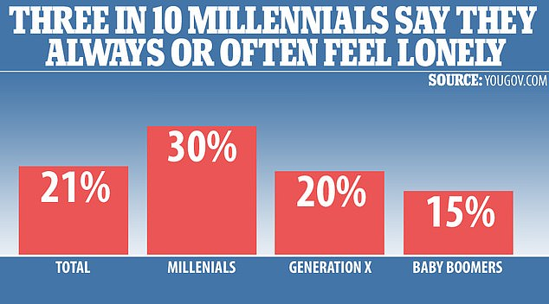

Slide 23
Economic uncertainty
Globalization and outsourcing
Debt, marriage, and home

Slide 24
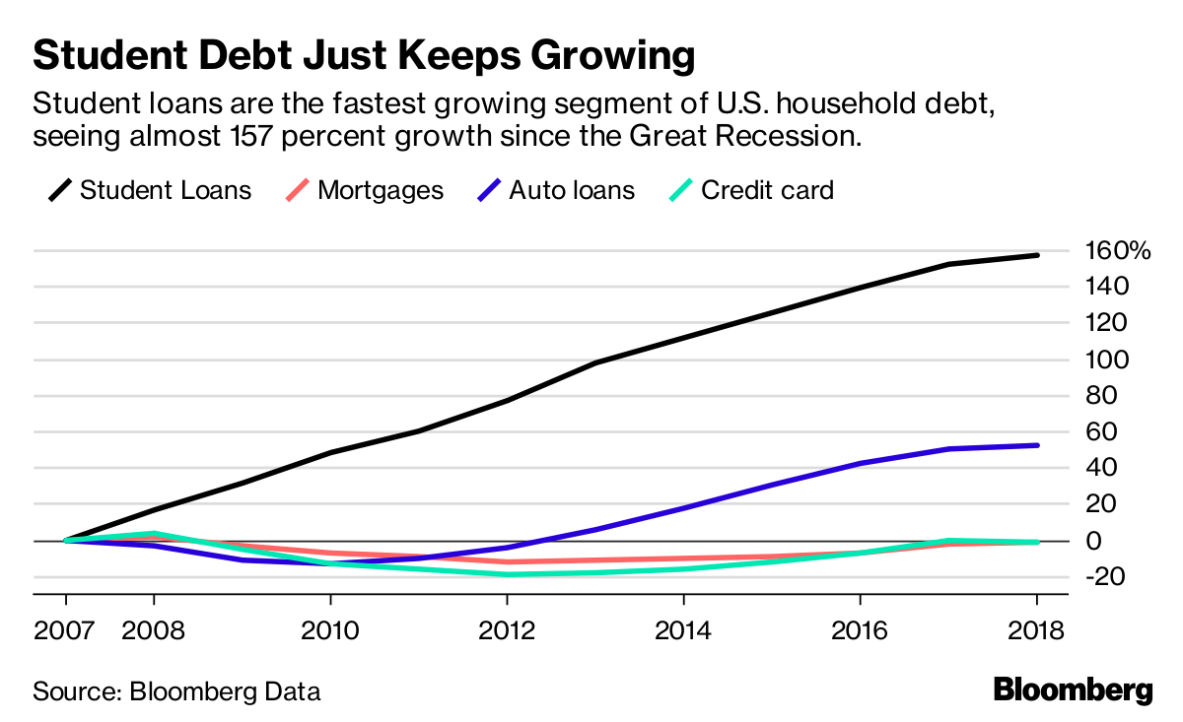

Slide 25
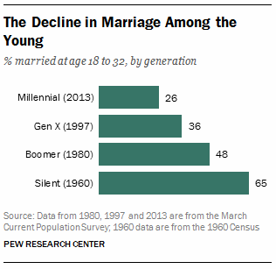
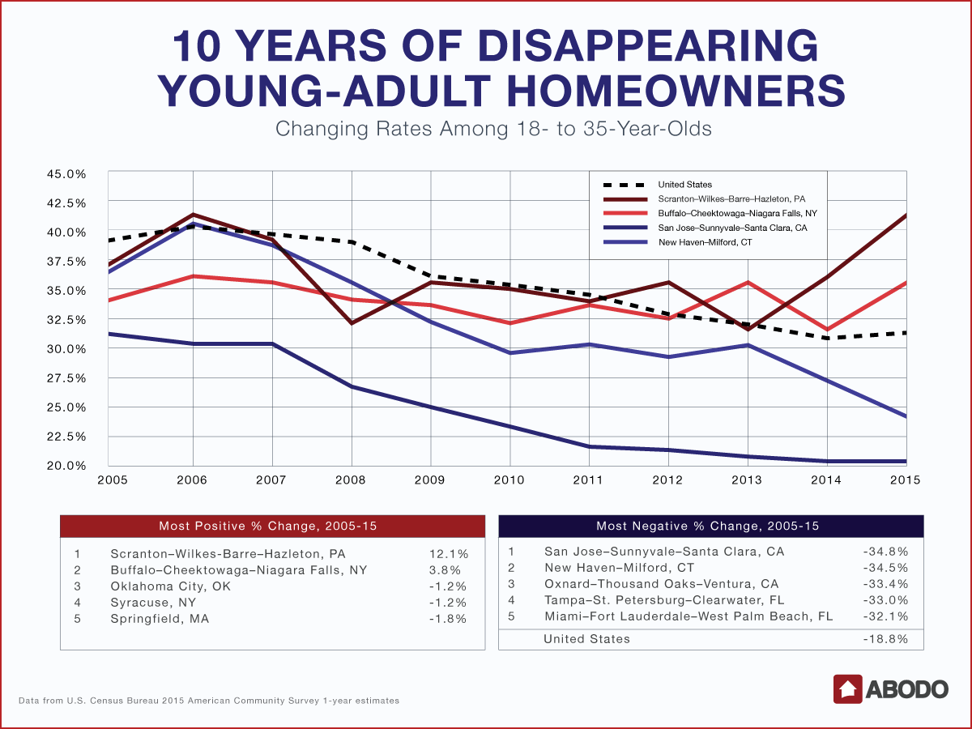
https://www.pewsocialtrends.org/2014/03/07/millennials-in-adulthood/

Slide 26
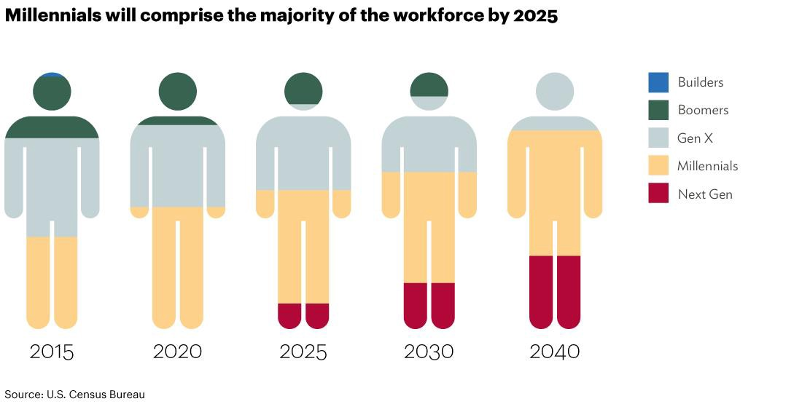

Slide 27
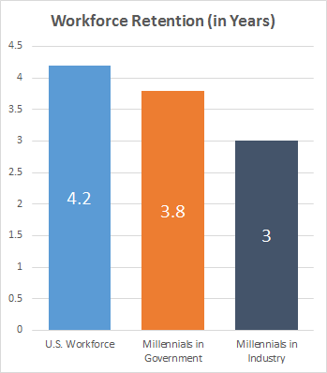
Millennial Retention
National average, regardless of age is 4.2 years
Millennial average is about 3 years
Millennials, on average, leave their government jobs after 3.8 years

Slide 28
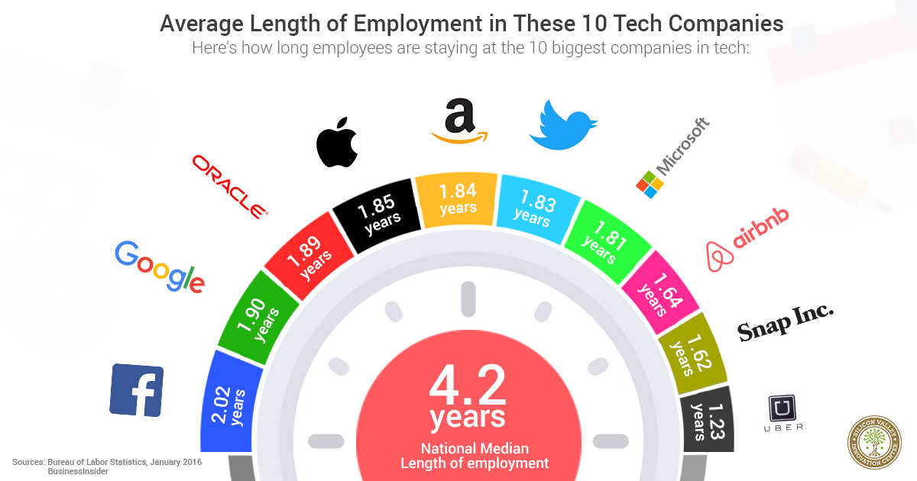
Prestige & Sexiness Matter…at First

Slide 29
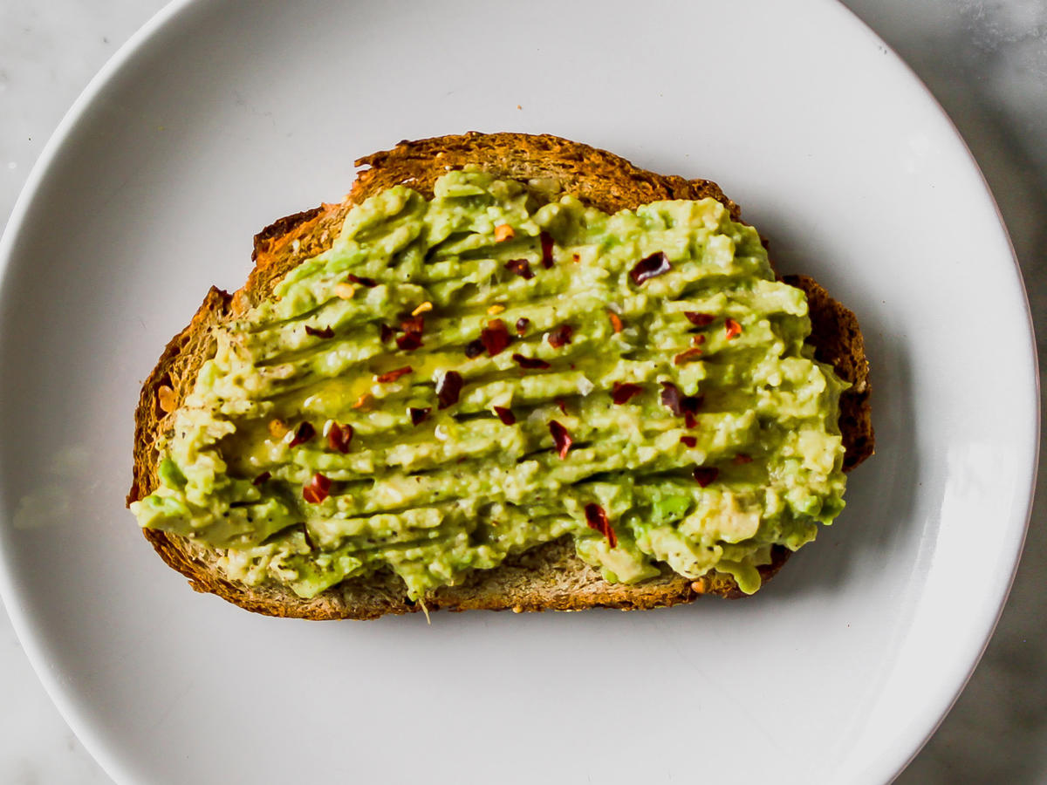
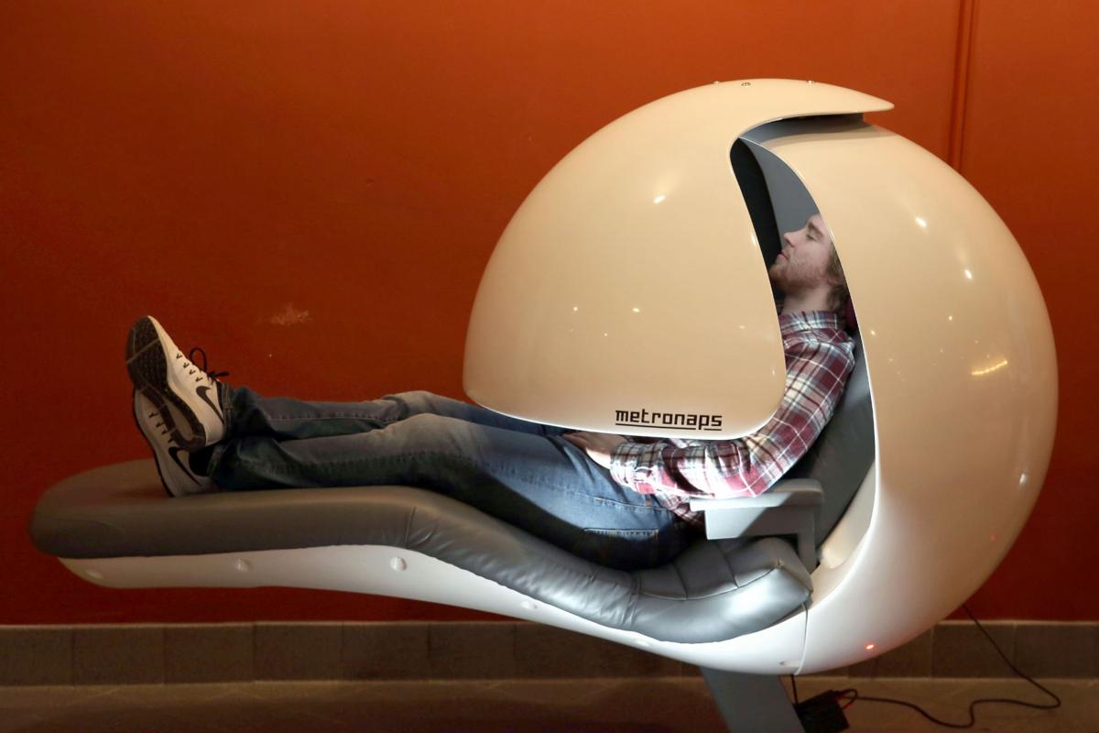
What We Thought We Wanted

Slide 30
Meaningful Work with the Government
Giving Back
87% donated to charity in 2014
Meaningful Work
86% claim their work is important
80% say they can see how their work relates to their agencies goals
Company Values
61% consider a company’s commitment to the community

Slide 31
Government Challenges
Bureaucracy
Silos
Shut downs
Hiring process
Adoption of new tech
Government is slow to adapt
Seniority over meritocracy
Millennials prefer achievement - based rewards

Slide 32
Past Motivators
Job security
Competitive salary
Pension
Health benefits

Slide 33
What We Really Wanted
Career Progression & Personal Development
91% of Millennials think progression is a top priority when choosing a new jobs
Freedom and Autonomy
94% say it is important to promote a sense of autonomy… Only 34% are doing so
Preference for remote work
Mentorship (“coaches not bosses”)
78% favor creating formal mentoring programs… but 31% are actually doing so

Slide 34
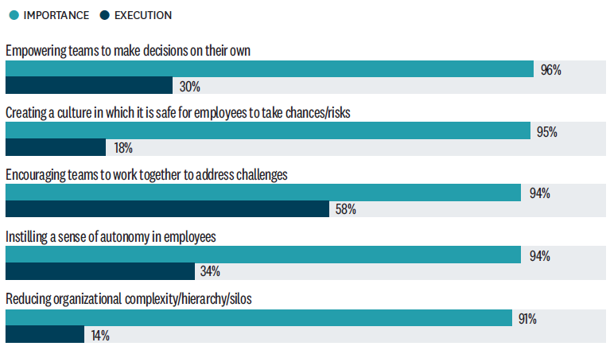

Slide 35
Trust
Perception
Connectedness

Slide 36
What Can We Do?
Engagement
Clear career paths
Continuous feedback

Slide 37
Our New Administrator
Stephen Dickson was sworn in on August 12
Prioritizing the FAA’s response to industry
challenges and rapid change
We expect more from work now than in the past
We need to elevate:
Enthusiasm for our mission
Shared values and a sense of community
Recognition for excellent work
Ongoing coaching and development

Slide 38
Perception
Connectedness
Trust

