Slide 1
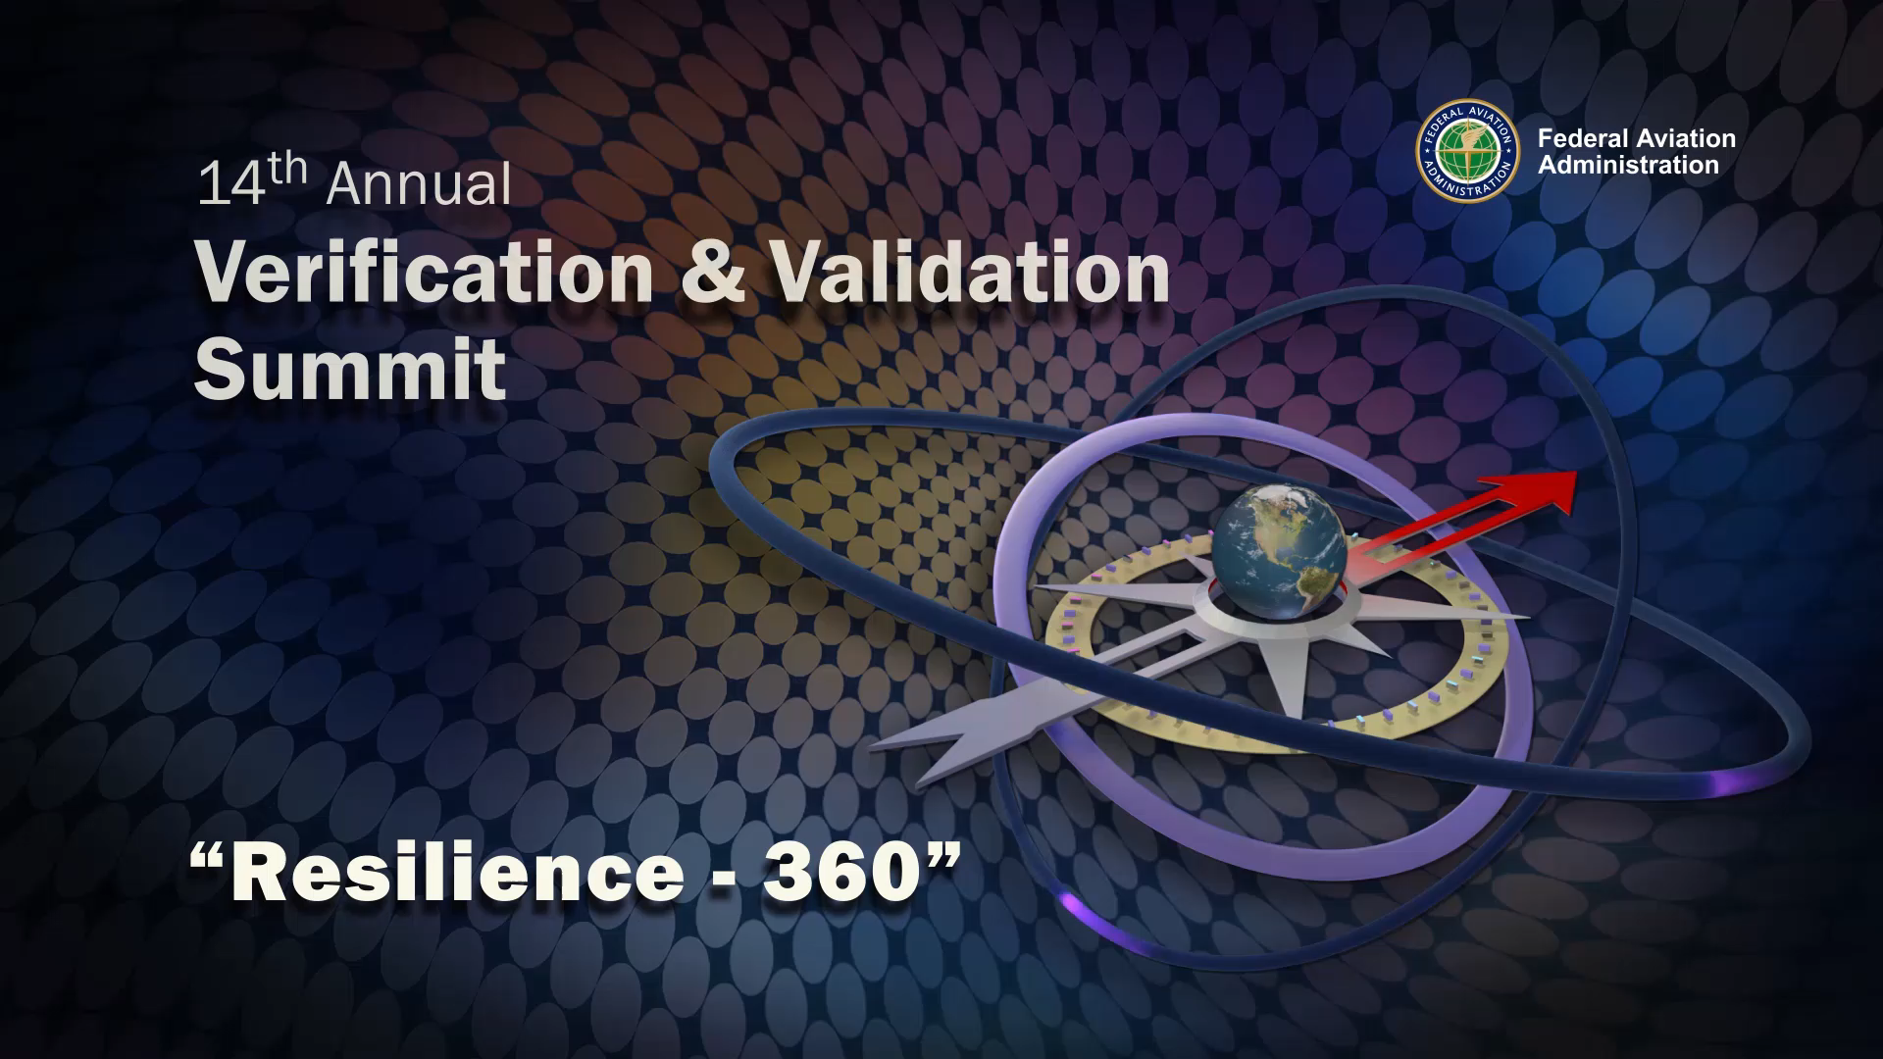
Shelley J. Yak
Director, FAA William J. Hughes Technical Center

