Slide 1
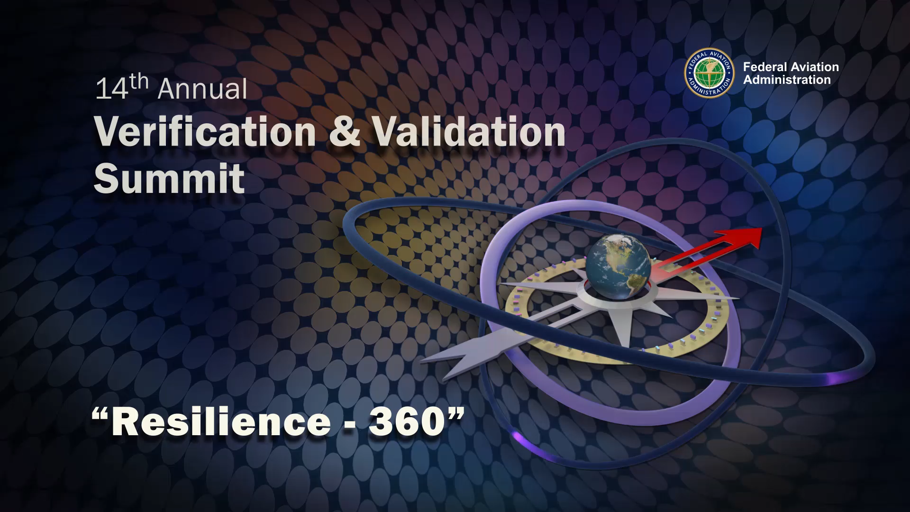
Gene Hayman – Moderator
Vice President, FAA Account Executive, CACI International Inc.
George Emilio
Senior Analyst, Serco
James H. Washington
CEO, JJW & Associates, LLC
Rebecca Guy
Deputy Director,
Air Traffic Systems, FAA

