Slide 1
Matthew Monaco, Director
Aerospace Mission Solutions
Ensuring Resiliency in
Autonomous Systems
Through Advanced V&V
Notes:
This discussion is a subset of a broader report developed by noblis on the future of autonomous systems and the potential benefits and challenge. While this report only looks at V&V, the entire report takes an expansive look a the overall state of autonomy.

Slide 2
Autonomous Systems at Scale
Multiple, Heterogenous Machines — Differing in size, capability, mobility, sensing and compute power; Each assigned a specific task based on system objectives.
Connected (wirelessly) — Enables coordination and information sharing; communications may not be ubiquitous, and some machines spend time outside of communication range.
Self-Organizing — Capable of some level of independent adaptation to events in their environment without direct human intervention. This self-organizing capability augments one or more human controllers who set higher level objectives for the system.
Notes:
Because there is little control an3d they operate within human space, they are considered safety-critical
Rapid increases in technology have created a data-rich environment wherein the integration of autonomous systems – distributed devices, sensors,, artificial intelligence, and robotics – becomes increasingly complex
Three characteristics of an autonomous system being deployed at scale – this is the concept the presentation is built around

Slide 3
A Model for the Implementation of Autonomy
Low-End Functionality in Bounded Envelope
High-Level Functionality Hand-in-Hand with Human
System-Wide Autonomous Functionality
Confidence in System Grows with Users and General Public
Notes:
Two types of trust are required – system trust (confidence that the system behaves as intended) and operational trust (confidence that system helps the user perform the assigned task)
Adoption is a combination of technology and public acceptance, with public acceptance being the leading factor. This is concept is modal independent, but can serve air transportation.
Low-end functionality includes putting local autonomous decisions into controlled envelops limiting their actions to a proven subset
, aw
As acceptance grows higher-level functionality can be incorporated – creating a “human over the loop” concept. The machines automate lower level functionality and builds up recommendations for the human, leaving them to make the ultimate decisions. This is designed to empower the human to have greater authority and awareness while reducing their cognitive load
With sufficient acceptance and verification of behavior, the entire system can eventually be handed over to automation
- Full autonomy is defined by non-determinism and presence of emergent behavior within the system

Slide 4
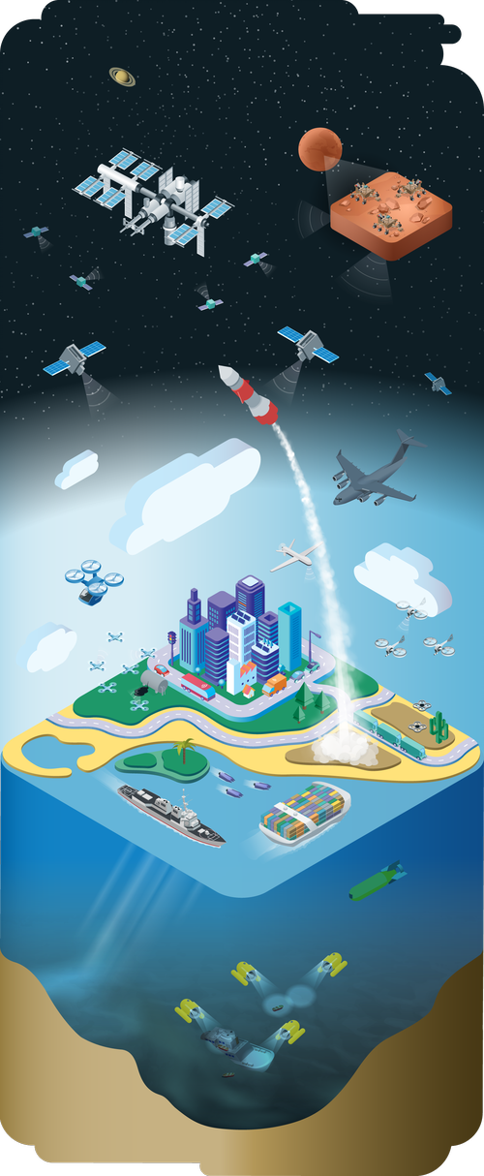
Resiliency Challenges in Autonomy
 | Lack of Consensus On and Adoption of Common Standards
 | Prevalence of Proprietary Software and Hardware Interfaces
 | Insufficient Verification and Validation Methods
 | Lack of Trust Between Systems, Operators, and Networks
 | Security as an Afterthought
Notes:
Broader set of challenges that that must be addressed for autonomy at large scale – the focus of this presentation is V&V
Couple of point summary:
Similar to other nascent industries, a wave of consolidation is required to establish leadership in standards and adoption. Investment can be hampered until leadership in standards is established
Lack of standards leads to early market proprietary systems as the first to market can establish footholds and first mover advantages
V&V challenges
Complex environment – large size and high complexity, may be partially unknown at design time
Complex software – program logic are adaptive, learning, and self-diagnosing
Non-deterministic behavior – autonomous systems may react differently to the same inputs over time, since knowledge changes over time

Slide 5
Verification and Validation Methods for Autonomy
Challenges
Traditional approaches alone may not meet the challenges of adaptive and non-deterministic systems
Dynamic and unpredictable environments
Emergent behavior (acquired knowledge)
Lack of test repeatability
Lack of reliable and certifiable V&V methods
Labor/cost/time intensity of traditional V&V
Current and Evolving Approaches
Approaches exist to attempt to address autonomy testing challenges:
Modeling and Simulation
Virtual Testing
Transparent Engineering
Advanced V&V Techniques
Continued research into formal verification of non-deterministic and autonomous systems is required to develop new V&V approaches
Notes:
Machine learning is brittle and must be able to account for black swan events
Existing methods (Fault tolerance, fault removal, fault avoidance) of V&V for systems that can learn, self-diagnose, and apply knowledge to decision making can be labor intensive, costly, and time consuming
The paradigm of V&V for autonomous systems changes based on the “unknown”
Traditional methods may not be able to address adaptive learning or a system that improves over time. The same is true for addressing the non-deterministic nature of autonomy.
How do you ensure systems non-deterministic systems are verifiable and that the results can be repeated.
While existing V&V techniques will continue to be the cornerstone of ensuring resilient autonomous systems they must be coupled with new techniques
Both the application new evolving approaches and research into addressing the broader sense of verifying nondeterminate systems

Slide 6
Emerging Test Approaches for Autonomous Systems
Test Approach | Advantages | Work to be Done
Model-Based MBSE, UML, run time monitoring | Enables incremental development Model debugging and automatic code generation Adaption awareness and emergence properties through mathematic models | Integration of model-checking throughout the process Integration of monitoring techniques and runtime verification
Evolutionary software abstraction, agent-based software | Evaluates autonomous agents as a means of building confidence in behavior and greater agent dependability | Development of design and programming constructs for agent interactions that work towards shared system goals
Adaptive Stress simulation-based, Markov decision process, reinforcement learning | Deep Reinforcement Learning produces more likely failure scenarios compared to other methods | Incorporation of more realistic models with tighter constraints on the events of interest
Virtual software-in-the-loop virtual integration, physics-based models, 3D/4D simulation | Testing without hardware or environment at risk Evaluation of alternative hardware components prior to implementation Modeling autonomous systems with repeatable test experiments | Development of more realistic simulations Addressing complexity and noise of the real world Development of algorithms to address rational decision making in an autonomous system
Notes:
Goal of many of these approaches is to reduce effort so more scenarios can be addressed with the same resources – helping to battle the challenges of autonomy
While there are many existing approaches address the complexity of autonomous systems, our intent was not to try and address or survey all of them. We did review a number of approaches and use cases that address testing challenges for autonomous systems, especially those operating in safety-critical environments.
V&V trends that are gaining wider acceptance:
Modeling and simulation: applying model-based testing methods can find failures and reduce defects early in the process and reduce time to detection and cost of implementation
Virtual testing: applying virtual methods to represent operational environments to reduce cost and risk as the tests can be frequently repeated
Transparent engineering: building additional transparency into the engineering process failures can be identified earlier in the design process
Other advanced techniques: -static analysis, assessing code without execution
Modeling-checking, ensuring model of a system satisfies all requirements and catching system-level errors
Compositional verficaction, decompose properties of a system into properties of its components → then model checking the components separately
Most autonomous systems use a model-based approach, not implemented in code.

Slide 7
Research into V&V of Autonomous Systems
Approaches to Support Formal Verification
Higher-Fidelity Simulations and Tests
Increased Observability
into Architectures
Explicitly Managing Uncertainty
Notes:
One quote saw was that it may require more than a decade to develop a fundamental understanding of the theoretical principles and various ways that v&v methods can be applied to autonomous systems
Goal of this slides is not to dive into a survey of current research in the area of V&V for autonomous systems, but instead focus on four priorities:
Advancing the technologies used for the formal verification of autonomous systems
More robust simulation ability (like the previous slide)
Breaking the “black box” of autonomous systems – better understanding the underlying architecture of a decision-making system
Managing the uncertainty of systems through more approaches such as control envelops, such as mentioned on the previous slide
Formal methods, while there is significant potential for their application, the limited ease of use for non-experts and large state-spaces may limit their application
Will take a second to mention certain areas of research investment that will be critical for advancing V&V of autonomous systems:
Static analysis techniques assess code without execution, reducing the potential for dangerous operations that have to be checked by other methods
Model-checking efficiently checks that a model of a system satisfies all requirements, providing a robust way to catch system-level errors (e.g. concurrency, deadlocks, etc.)
Compositional verification – often referred to as a “divide and conquer” approach decomposes properties of a system into properties of its components. Components are model checked separately, guaranteeing the verification of the entire system if each component is verified

Slide 8
Towards Improving Resiliency Through V&V
Focus on Data
Machine learning requirements and design are implicit in training data. Data approach must ensure complete coverage of scope.
Automate Virtually, Early, and Continuously
Autonomous testing and test scenario development help mitigate increased resource needs.
Plan for Failed Operations
Test for black swans and false correct decisions. Focus monitoring on safety in addition to correctness.
Notes:
Our observations from the outcome of our analysis is that T&E for autonomous systems is likely more of an incremental innovation than a disruption….
Planning must happen continuously and in parallel with execution
V&V will require continued advancements in T&E so that run-time architectures can constrain systems to a set of allowable, predictable, and recoverable behaviors that are integrated early in the development process
Testing methods will need to integrate development and operational testing and employ new ways to test the entire system
V&V is also the long pole in the tent – many of the required technologies to deploy autonomy exist, but the ability to V&V limits their deployment

Slide 9
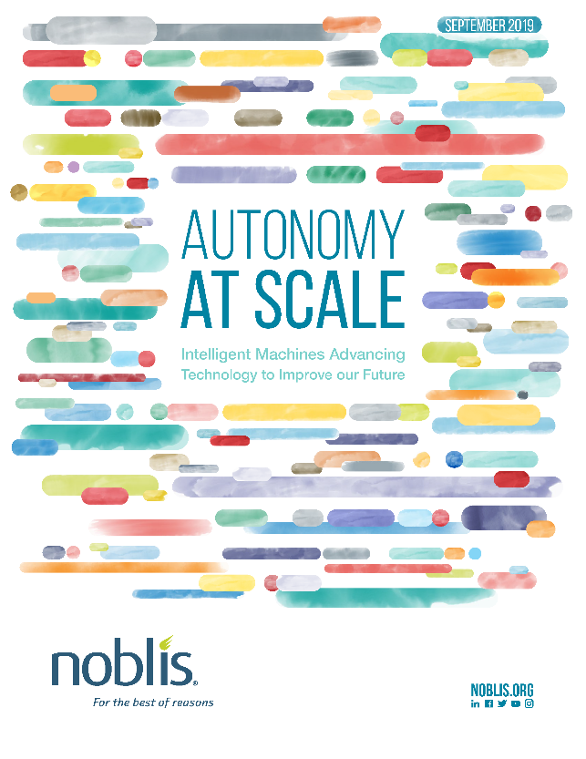
Autonomy at Scale
Autonomy at Scale explores the promise, costs, and challenges associated with emerging massive-scale systems of autonomous machines in key domains and use cases.
The report addresses:
Key Autonomy Technologies: sensors; position, navigation, and timing (PNT); machine learning; and wireless connectivity
Case Studies: surface and air transportation; space systems; and adversarial environments
Autonomy Challenges: cyber security and interoperability
To request a free copy of this report, email answers@noblis.org
Notes:
Our goals was to forecast the future of large scale autonomy for the federal government by addressing a number of civilian, defense, and intelligence use cases; we also reviewed technologies that are enablers for autonomy at this scale.
Report is available now and is consumable as individual topic papers or as an entire volume.

