Slide 1
V&V of Autonomous and ML enabled systems
Dionisio de Niz, Ph.D.
Principal Researcher & Technical Director
Assuring Cyber-Physical Systems
Notes:
Title Slide
Title and Subtitle text blocks should not be moved from their position if at all possible.

Slide 2
Copyright 2020 Carnegie Mellon University.
This material is based upon work funded and supported by the Department of Defense under Contract No. FA8702-15-D-0002 with Carnegie Mellon University for the operation of the Software Engineering Institute, a federally funded research and development center.
The view, opinions, and/or findings contained in this material are those of the author(s) and should not be construed as an official Government position, policy, or decision, unless designated by other documentation.
NO WARRANTY. THIS CARNEGIE MELLON UNIVERSITY AND SOFTWARE ENGINEERING INSTITUTE MATERIAL IS FURNISHED ON AN "AS-IS" BASIS. CARNEGIE MELLON UNIVERSITY MAKES NO WARRANTIES OF ANY KIND, EITHER EXPRESSED OR IMPLIED, AS TO ANY MATTER INCLUDING, BUT NOT LIMITED TO, WARRANTY OF FITNESS FOR PURPOSE OR MERCHANTABILITY, EXCLUSIVITY, OR RESULTS OBTAINED FROM USE OF THE MATERIAL. CARNEGIE MELLON UNIVERSITY DOES NOT MAKE ANY WARRANTY OF ANY KIND WITH RESPECT TO FREEDOM FROM PATENT, TRADEMARK, OR COPYRIGHT INFRINGEMENT.
[DISTRIBUTION STATEMENT A] This material has been approved for public release and unlimited distribution. Please see Copyright notice for non-US Government use and distribution.
This material may be reproduced in its entirety, without modification, and freely distributed in written or electronic form without requesting formal permission. Permission is required for any other use. Requests for permission should be directed to the Software Engineering Institute at permission@sei.cmu.edu.
Carnegie Mellon® is registered in the U.S. Patent and Trademark Office by Carnegie Mellon University.
DM20-0656

Slide 3
AI And Software Development
Software Engineering for AI
  How to build AI-enabled systems
  How to V&V AI-enabled systems
AI for Software Engineering
  AI to help develop software
  AI to help V&V

Slide 4
AI for Software Engineering
Support Development
  Vulnerability detection
  Auto code repair
  Defect prediction
  Capture design¹
    Using code vectors
      Snippets of code in abstract syntax tree
    and design pattern detection
    Structural, behavior, semantic information
Support V&V
  Test Generation
  Code parameters for verification:
    Worst-Case Execution Time (WCET) of real-time software
¹James Ivers, Ipek Ozkaya, Robert L. Nord: Can AI Close the Design-Code Abstraction Gap? 34th Automated Software Engineering Conference, Software Engineering Intelligence Workshop 2019

Slide 5
AI for Worst-Case Execution Time
Find the inputs to a program that exhibits the WCET
  Input vector not always obvious due to complex (undocumented) processors
    Speculative execution
    Caches
  Approach
    Run program with multiple inputs
    Genetic algorithm to generate inputs
    Selection of input based on execution time observed

Slide 6


V&V of AI/ML: Machine Learning Simplified View
cat
dog
…
…
…
…
$$x_{1}$$
$$x_{2}$$
$$x_{3}$$
$$x_{4}$$
$$Y=f(w_{0}+w_{1}x_{1}+w_{2}x_{2}+w_{3}x_{3}+w_{4}x_{4})$$

Slide 7
V&V Machine Learning Challenges
Computation not based on application logic (Trained ML)
  Neurons triggered by combined weighted input
  Weights “trained” in learning face
Computation changes at runtime (Evolving ML)
  As neural network learns it changes computation
  Behavior / Computation not known at design time

Slide 8
V&V Approaches for Trained ML
Reluplex¹
  Applied to the ReLu activation function:
    Y = max(0,x)
  Extends Simplex LP solver
  Encode the equations connecting input to outputs as constrains in LP
  Create new variables for active (non-zero) and inactive (zero) outputs
  Explore assignments that satisfy constrains
  Applied to ACAS
Verisig²
  For closed-loop Cyber-Physical System
  Transforms NN into hybrid system
    Transform sigmoid activation into quadratic equation
  Use reachability tools (e.g. dReach) to verify output
¹Katz, Guy, Barrett, Clark, Dill, David L., Julian, Kyle, Kochenderfer, Mykel J.” Reluplex: An Efficient SMT Solver for Verifying Deep Neural Networks”. Computer Aided Verification. 2017.
²Radoslav Ivanov, James Weimer, Rajeev Alur, George J. Pappas, Insup Lee. “Verisig: verifying safety properties of hybrid systems with neural network controllers” HSCC ’19

Slide 9




V&V Approach for Evolving ML
Add Enforcer
  Watch for safety property $φ$
  Replace unsafe actions
Formally: specify, verify, and compose multiple enforcers
  Logic: Enforcer intercepts/replaces unsafe action
  Timing: at right time
  Physics: verified physical effects
Protect enforcers against failures/attacks
at(x,y)
Controller
Logical
Enforcer
moveTo(x,y)

Slide 10
Verifying Physics (Control Theory)
Model physics using control theory
System includes
  Physical vehicle and environment
  Software controlling airplane
Evaluate if combined system
  Behaves like a “cone” with point at bottom
    Theoretically known as Lyapunov function
  Enforcer periodically “samples” (monitors) for attacks
    If between enforcer sample attacker disturbs
      Theory verifies that system still in “cone” after attack
    Model also evaluates if enforcer recovery keeps system in cone

Slide 11
Analysis of Mission Progress
Idea:
Provide a sequence of waypoints that represent a sequence of equilibrium points around which we define the Safe Set.
Goal:
Safety transition from one waypoint to the next one.
Liveness (in the case of no errors)
switch to x^{j+1}
switch to x^{j}
switch to x^{j+2}
Notes:
Draw a bigger one

Slide 12
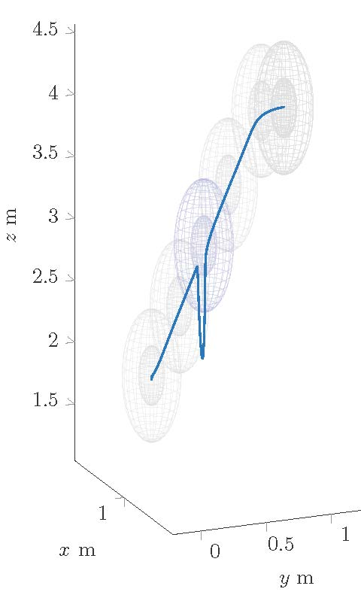
Analysis of Mission Progress Enforcing Unsafe Behavior
System model of a drone across mission
Safety “cone” in 3-D is a sphere
Evaluate attack and enforcer recover

Slide 13
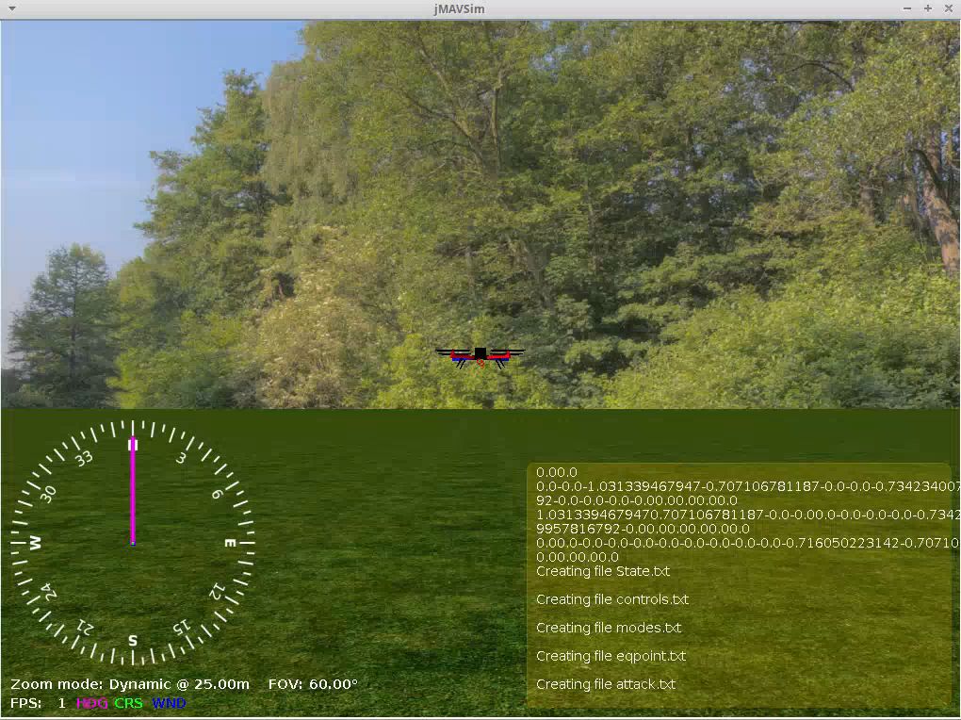
Drone Experiment

Slide 14
Are We Done Yet?
Scalable Verification
  Only verify safety-critical components
  Guarding unverified one
Trust
  Protect verified components
  Against attacks or bugs from unverified components

Slide 15


Enforcing Unverified Components
$$s$$
$$α$$

Slide 16

Enforcing Unverified Components
$$s$$
$$α$$
Look for ant picture attribution in : https://commons.wikimedia.org/wiki/File:Ant_illustration.jpg

Slide 17

Enforcing Unverified Components
$$s$$
$$α$$
Untrusted
Trusted?

Slide 18

But enforcer can be corrupted (bug or cyber attack)
$$s$$
$$α$$
Untrusted
Trusted?
Look for ant picture attribution in : https://commons.wikimedia.org/wiki/File:Ant_illustration.jpg

Slide 19
Add Memory Protection
$$s$$
$$α$$
Untrusted
Trusted
Trusted = Verified & Protected

Slide 20
Are We Done Yet?
Timing can still be corrupted
  Guaranteed correct value
  BUT potentially at wrong time
Trusted timely actuation
  Tamper-proof time-triggering mechanism
  In sync with periodic controller
  In sync with expected untrusted

Slide 21






Periodic Execution Must Finish by Deadline
$$s$$
$$α$$
$$s$$
$$α$$
$$s$$
$$α$$
$$s$$
$$α$$
Untrusted
time
Trusted

Slide 22
Periodic Execution Must Finish by Deadline
$$s$$
$$α$$
$$s$$
$$α$$
$$s$$
$$α$$
$$s$$
$$α$$
Untrusted
time
Trusted

Slide 23

Periodic Execution Finish by Deadline
Untrusted
Trusted
Memory
Miss deadline:
crash
$$s$$
$$α$$
$$s$$
$$α$$
$$s$$
$$α$$
Trusted
Timing
time

Slide 24
Periodic Execution Finish by Deadline
Untrusted
Trusted
Memory
Miss deadline:
crash
$$s$$
$$α$$
$$s$$
$$α$$
$$s$$
$$α$$
Trusted
Timing
time
time

Slide 25

Periodic Execution Finish by Deadline
$$s$$
$$α$$
$$s$$
$$α$$
$$s$$
$$α$$
Trusted
Memory
time
Trusted
Timing
$$α^{∗}$$
time

Slide 26
Real-Time Mixed-Trust Computation
$$s$$
$$α$$
$$s$$
$$α$$
$$s$$
$$α$$
Untrusted
VM
Trusted
Memory
time
Trusted
Timing
Mixed-Trust Task
$$α^{∗}$$
UberXMHF
Verified space protection
Timing guarantees for temporal enforcer
VM scheduler
Timing guarantees in absence of failures
In sync with hypervisor scheduler
Trusted
Hypervisor
time

Slide 27
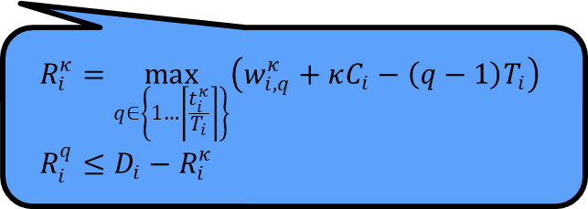
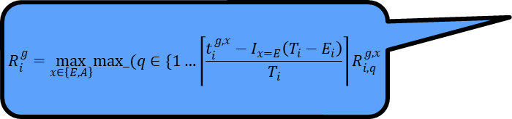
Real-Time Mixed-Trust Computation
$$s$$
$$α$$
$$s$$
$$α$$
$$s$$
$$α$$
Untrusted
VM
Trusted
Memory
time
$$R_{i}^{g}=\max_{x∈\left\{E,A\right\}}max_(q∈\{1…\left\lceil \frac{t_{i}^{g,x}−I_{x=E}\left(T_{i}−E_{i}\right)}{T_{i}}\right\rceil R_{i,q}^{g,x}$$
Trusted
Timing
Mixed-Trust Task
$$α^{∗}$$
UberXMHF
Verified space protection
Timing guarantees for temporal enforcer
VM scheduler
Timing guarantees in absence of failures
In sync with hypervisor scheduler
Trusted
Hypervisor
time
$$R_{i}^{κ}=\max_{q∈\left\{1…\left\lceil \frac{t_{i}^{κ}}{T_{i}}\right\rceil \right\}}\left(w_{i,q}^{κ}+κC_{i}−\left(q−1\right)T_{i}\right) \\ R_{i}^{q}≤D_{i}−R_{i}^{κ}$$

Slide 28
Concluding Remarks
AI for Software Engineering – Software Engineering for AI
ML Verification for Trained ML
  LP-Based
  Hybrid rechability for CPS
ML Verification for Evolving ML
  Enforcers to
    Monitor and
    Correct unsafe actions
Focus on key properties:
  Safety
  Security
Combined Relevant Scientific Domains
  Timing
  Logic
  Physics (Control)
Verification only effective if protected!
  Verified Protection: Hypervisor

