Slide 1
Team Resiliency
Presented by Suzanne Styc, Director (A), ANG Management Services (ANG-A)

Slide 2
Resilience of Engineered Systems
A resilient organization adapts effectively to surprise
Resilience is the ability to provide required capability in the face of adversity; adversity is any condition that may degrade the desired capability of a system*
To fully achieve this, one must also consider the resilience of the organizational and human systems which enable the life cycle of an engineered system
RESILIENCE
ROBUSTNESS
* Systems Engineering Body of Knowledge
Notes:
A resilient organization adapts effectively to surprise.
When we talk about designing highly available systems, we usually cover techniques such as redundancy, retries, fallbacks, and failovers. We think about what might go wrong (e.g., server failure, network partition), and design our system to gracefully handle these situations. People often confuse between robustness and resilience.
Robustness refers to systems that are designed to effectively handle known failure modes. Resilience, on the other hand, describes how well the system can handle troubles that were not foreseeable by the designer. You can think of robustness as being able to deal well with known unknowns, and resilience as being able to deal well with unknown unknowns.
Systems Engineering Body of Knowledge defines Resilience as the ability to provide required capability in the face of adversity.

Slide 3
Personal Resilience
Capacity to withstand, adapt to, and recover from stress and adversity
Behaviors, thoughts, and actions that promote personal well being and mental health
Capability to maintain or return to a state of well being after a crisis
Notes:
A recurring theme in resilience engineering is about reasoning holistically about systems, as opposed to breaking things up into components and reasoning about components separately. This perspective is known as systems thinking, which is a school of thought that has been influential in the resilience engineering community.
If I ask any person to give me a simple definition of resiliency, the answer is always “to bounce back.” That’s certainly on the mark for the first definition by Merriam-Webster: “The ability of something to return to its original size and shape after being compressed or deformed.”
Now, this works just fine if you’re a piece of steel, a willow tree, or a sofa cushion—but not if you’re a human being. When we experience the compression of stress or an event that knocks us down—in this case, a deadly, global pandemic—we’re forever changed. You either stay down or grow through it.

Slide 4
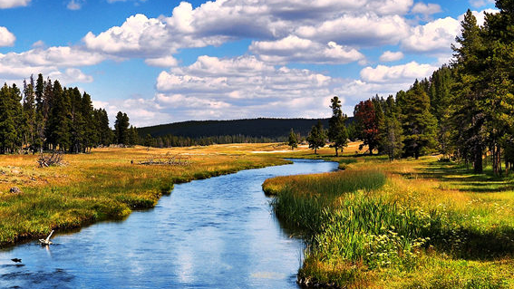
Resiliency Defined
“No man ever steps in the same river twice, for it’s not the same river and he’s not the same man.” - Heracleitus, Greek philosopher (born ca. 544 BC)
Resiliency ultimately means managing your energy so that you have the mental, emotional, physical, and spiritual hardiness to get up and move forward.
Notes:
Don't try to solve problems with the same thinking that created them. Resilient people do not make the same mistake again and again. They're willing to be honest about why they failed, and they take the time to think about what didn't work.
You need energy to run your career, to handle your household, to raise your kids, or to simply care for others
Resilient people search for meaning. They develop a "personal why" that helps them have a clear sense of purpose, which helps them view setbacks from a broader perspective. To make it through the tough times takes resilience. It requires that we pay attention to the complexities of our own experiences, listen to our emotions, and be willing to learn from disappointment and failure as well as success and motivation.

Slide 5
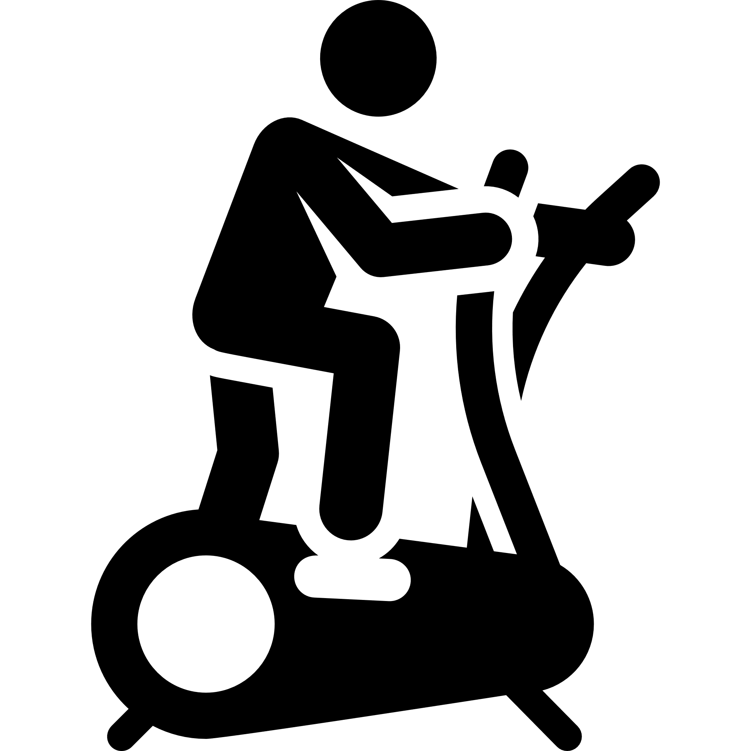
Dimensions of Resiliency
Physical flexibility
Endurance
Strength
Emotional range and flexibility
Positive feelings
Self-regulation
Relationships
PHYSICAL
EMOTIONAL
COHERENCE
Commitment to core values
Flexibility and tolerance of others values and beliefs
Intuition
Attention Span
Mental flexibility
Optimistic world view
Incorporating multiple points of view
MENTAL
SPIRITUAL

Slide 6
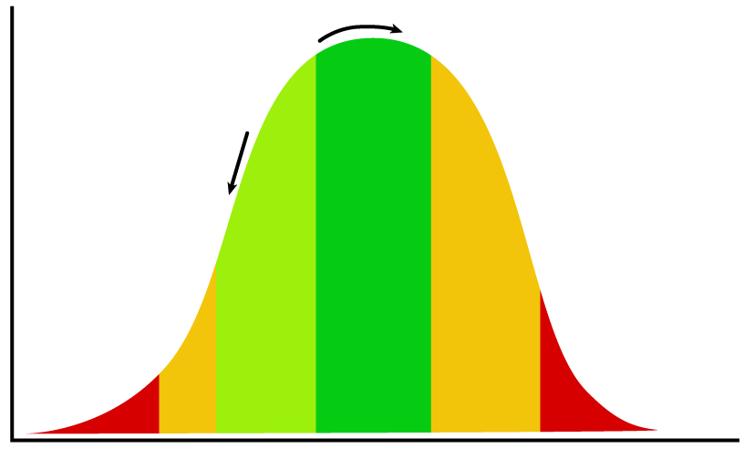
Pressure and Performance Curve
HIGH
IDEAL ZONE
Zone of Delusion
Optimal Performance
The link between pressure and performance
PERFORMANCE
BOREDOM
IDLENESS
COMFORT
STRETCH
STRAIN
BURNOUT
LOW
LOW
MODERATE
HIGH
VERY HIGH
LEVEL OF PRESSURE
Source: Delphis.org.uk
Notes:
Leaders can't change the world if they're burnt out. detachment
We’ve all experienced the negatives and positives of pressure. Too much and you feel you can’t cope. Not enough, and you struggle to get anything done.
Aiming for the sweet spot in the middle, where the right amount of pressure equals peak performance, takes careful self-management and practice.
The pressure performance curve is a management tool that can help. Its zones of comfort and stretch are the ideal path to peak performance, and the dangers of boreout, burnout, and the zone of delusion, are something of which we all need to be aware.

Slide 7
Resiliency in the Workplace
Notes:
https://www.youtube.com/watch?v=uTpY8DGYGtY

Slide 8
Team Resilience
Capacity to withstand and overcome stressors
Ability to sustain performance in the face of adversity
Capability to handle and bounce back from challenges
Ability to maintain cohesiveness during tests and difficulties
Source: Alliger, et al, “Team resilience: How teams flourish under pressure”, J Org Dyn, 44 (3), 2015
Notes:
Team resilience as the capacity of a team to withstand and overcome stressors in a manner that enables sustained performance; it helps teams handle and bounce back from challenges that can endanger their cohesiveness and performance.
QUESTION: What are some common situations that require a team to be resilient?
Difficult assignments
Time pressure
Insufficient resources
Conflict within the team or with people outside the team
High consequence work
Challenging conditions
Hazardous work
Angry/upset customers
Inadequate work output by one or more team members
Unclear team roles
Ambiguity of direction/goals

Slide 9
Domains of Team Resilience
1
2
3
VISION
Shared sense of purpose and goals to drive decision making
COLLABORATION
Collective sharing of the workload to reduce anxiety
REASONING
Creativity and innovative problem solving when facing challenges
4
5
6
TENACITY
Persistence in the face of difficulties
COMPOSURE
Apply clear and critical thinking; manage conflict
HEALTH
Care of self and collective care of the team
Notes:
Vision – This is the most important domain because all other domains are guided by what the team wants to achieve. Having clear vision allows the team to be decisive when facing tough choices, and to maintain perspective when facing challenges. The more clarity the team has, the easier it is to make decisions — it is clear what’s important and what’s not. This helps the team stay focused.
Collaboration – Collective work within the team towards a shared purpose and direction. Its purpose is to join the efforts and perspectives of team members to produce solutions and results far greater than anyone could produce working alone. Sharing the load to reduce anxiety on any one team member.
Reasoning – Creativity and innovative problem solving is incredibly useful when facing challenges along the way. This is what the reasoning domain is all about — taking action ahead of time to prevent things from going wrong in the first place. In fact, it’s mostly about proactive action.
Tenacity – Persistence is the key. The team realizing that mistakes will crop up regularly, takes them in stride, and learns from them.
Composure – The team is able to regulate emotions when facing adversity or conflict. It’s the ability to be calm when you’re facing conflict or hearing about a sudden change at work.
Health –

Slide 10
Indicators of a Resilient Team
Challenge resolution – Addresses problems quickly and effectively
Health - Handles challenges while sustaining team physical, emotional, and mental health
Resources – Maintains tangible, social, and emotional resources
Recovery – Quickly recovers to previous levels of effectiveness and health after a challenge or to new improved levels
On-going viability – Maintains the capacity to meet new challenges
Trust – Demonstrates the dimensions of trust
Communication – Values open, honest, and frequent communication
Notes:
Challenge resolution – Address a problem as quickly and effectively as possible given the constraints of the situation
Health – Handle the challenge in a way that sustains their team’s health, positive team spirit, communications, and mood
Resources – Maintain or even ‘‘bank’’ tangible and social/emotional resources for use going forward
Recovery – Are able to quickly ‘‘bounce back’’ to previous levels of effectiveness and health after a challenging experience–in some instances becoming even stronger as a result
On-going viability - Because of their ability to handle challenges, innate health, preservation/renewal of needed resources and ability to recover, resilient teams maintain viability and are ready to meet new challenges
Trust – 1) I trust you are capable (competent) of delivering on commitments, 2) I believe you will do what you say, and 3) I believe you have my best interest and the team’s best interest at heart
Communication – The team communicates openly and honestly, and maintains frequent communications
Key when working remote from each other

Slide 11
Building Team Resilience
Develop tools, SOPs, checklists, or guidebooks
Conduct team resilience training or facilitated discussions
Conduct post-challenge debriefs
Create a team resilience culture
Notes:
Develop Tools, etc. - Leaders can ensure that their team has access to the right tools to enable them to deal with future challenges. For common challenges, or those that can be anticipated, it can be helpful to assemble checklists and guides that provide advice for dealing with the challenge.
Team Resilience Training - Resilience can be developed through facilitated team working sessions and structured training. A good starting place for developing team resilience is to conduct a team resilience discussion. During this type of meeting the team can:
Identify recent challenges the team experienced
Anticipate forthcoming challenges and specify the ‘‘early warning signs’’ to be alert for
Review the common resilience behaviors and markers
Choose a few resilience behaviors that the team agrees to employ more frequently going forward.
Post-Challenge Debriefs - Remember, while resilience is a capacity, it only becomes observable when challenges arise. So perhaps the most efficient and powerful way to build resilience is to conduct post-challenge debriefs. The research is quite clear: well conducted debriefs work.
Team Resilience Culture
Speak up, ask questions, and openly share bad news and early signs of potential problems;
Maintain composure during ‘‘emergencies;’’
Defer to expertise, not just rank or seniority;
Keep an eye on one another and offer support before (to minimize), during (to manage), and after (to mend) a challenge;
Vocalize the need to switch to/from normal and emergency modes;
Thank people for helping out and discussing challenges.

Slide 12
Behaviors to Sustain Team Resilience
Minimize
Manage
Mend
Anticipate challenges and plan contingencies
Understand current readiness
Identify early warning signs
Prepare to handle stressors
Assess challenges quickly and accurately
Address chronic stressors
Maintain processes under stress
Regain situation awareness
Conduct team debrief
Address concerns or risk points
Express appreciation
Notes:
Minimize is before, Manage in during the event, and Mend is after the event. It is an iterative cycle, the more you practice it the better you become at it.

Slide 13
Key Takeaways
Building and nurturing team resilience is an ongoing pursuit
Team resilience directly impacts performance
Embrace a growth mindset
Notes:
Embrace a growth mindset: Well-renowned Stanford psychologist Carol Dweck has successfully proven that developing a growth mindset—versus a fixed mindset—can create not only a love of learning but also a resilience when faced with a challenge or what seems like a setback.

Slide 14
QUESTIONS

