Slide 1










Global SBAS Status
Satellite Based Augmentation System (SBAS) Interoperability Working Group (IWG)
November 2021

Slide 2
Agenda
Executive Summary
Appendix A: SBAS Benefits
Appendix B: SBAS Systems Status
Appendix C: SBAS System Evolution
Appendix D: Interoperability Working Group
2

Slide 3
SBAS Key Points
SBAS can provide safe navigation for En-route through Category-1 Precision Approach flight operations
  Internationally standardized service for aviation navigation and approach operations (ICAO Annex 10)
  Includes Receiver Autonomous Integrity Monitoring (RAIM) to support navigation when SBAS systems are not available.
  Supports Area Navigation (RNAV) and Required Navigation Performance (RNP) operations
  Free from direct user charges worldwide
Increasing SBAS system deployments indicate that SBAS services will be available for many years
SBAS can provide benefits to airlines, air traffic management, and air navigation
3

Slide 4
SBAS En-route Benefits
- Airlines
SBAS is a primary navigation system
  Position source for navigation and Automatic Dependent Surveillance – Broadcast (ADS-B) requirements
  Eliminates the operational requirement to ensure GPS availability using RAIM prediction tools
SBAS provides RNAV and RNP capability
  Improves availability for all RNAV routes
  Flexibility to design more efficient airspace and instrument procedures
    Shorter flight paths
    4-D Operations (Continuous Descent Final Approach (CDFA))
    United States use of Q and T routes
  Significant reductions in fuel consumption
  Enhanced traffic management
4

Slide 5
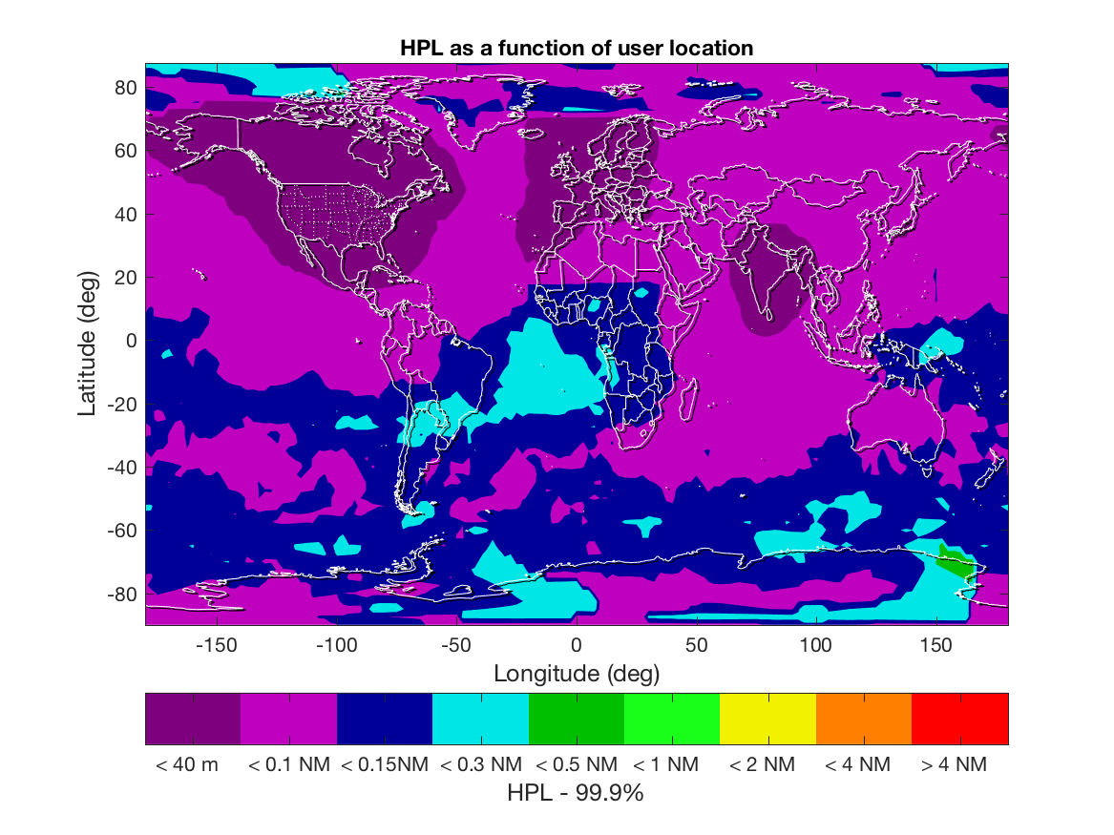
Combined SBAS/RAIM Receiver
Nominal Horizontal Performance
Combined SBAS/RAIM receiver supports en-route and terminal navigation globally with much higher availability in SBAS coverage
5

Slide 6
SBAS Approach Benefits
- Airlines
Enables RNP approach operations to Category I minima
  Requires appropriately equipped runway
  Depends on SBAS Receiver Equipment Type and integration
Potential to reduced operational costs
  Increased options for alternate runways
  Provides for best PBN capability
  Backup capability when ILS is unavailable
  Lower fuel load requirements and increase dispatch reliability
Enabler for RNP Authorization Required (AR) operations
SBAS guidance not impacted by barometric pressure, temperature fluctuations or incorrect barometric setting
6

Slide 7
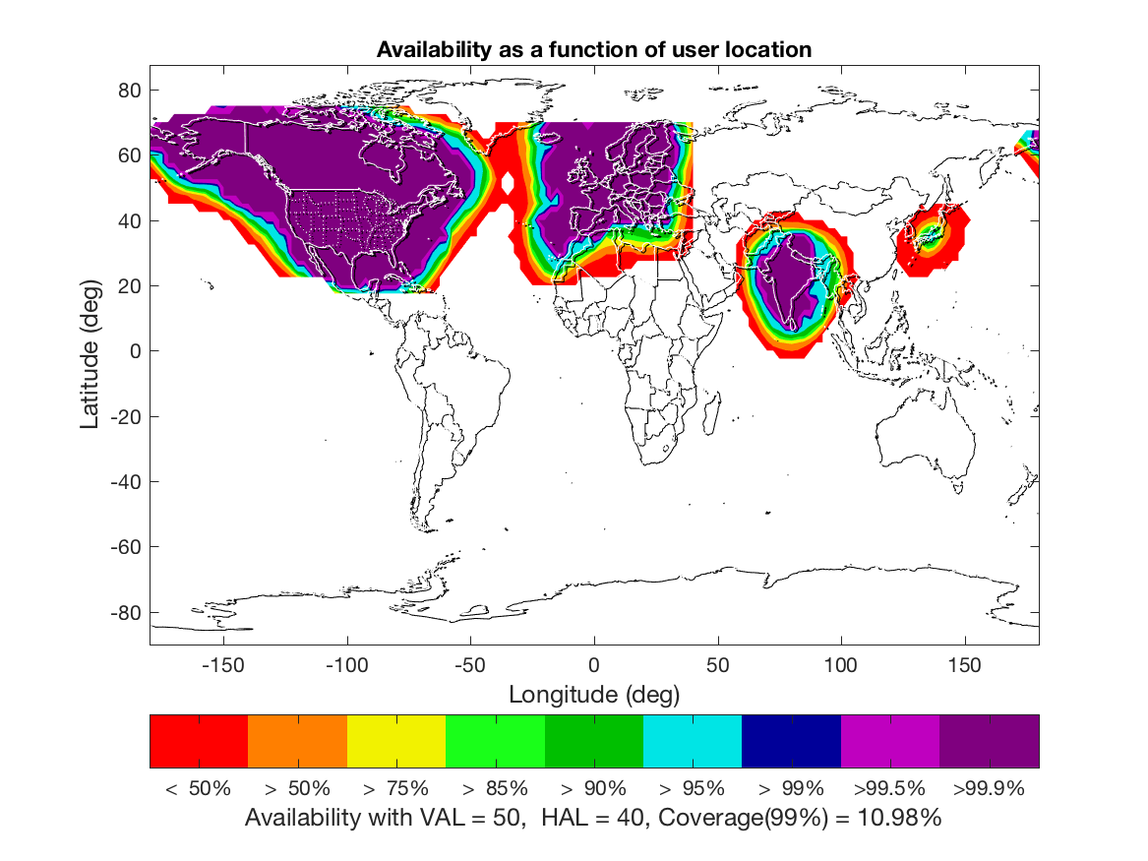
Current Approach Availability with LPV-Capable SBAS Receivers
Typical Approach (APV / LPV) Service Availability
7

Slide 8
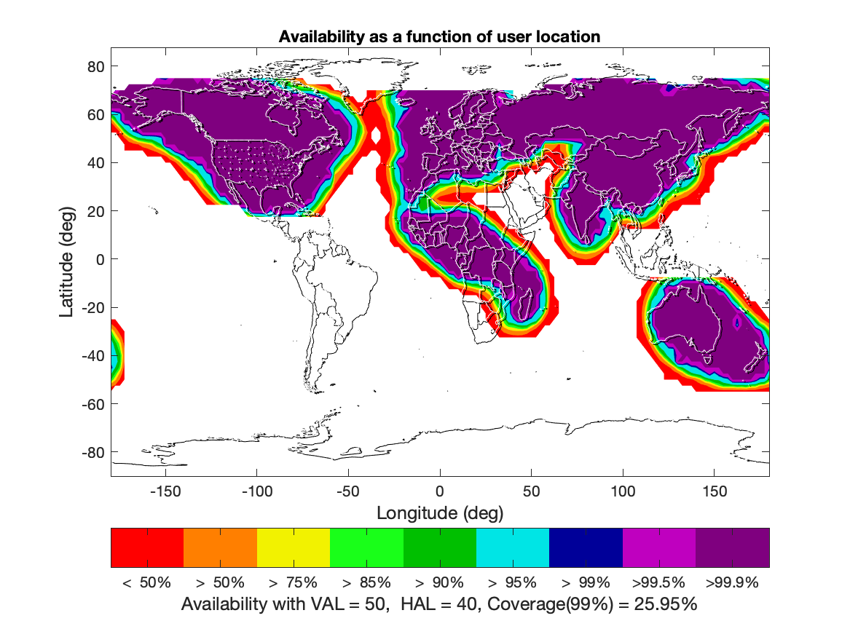
Future Approach Capability with
SBAS evolutions Next 2-4 Years
Estimated APV / LPV Service Availability
8

Slide 9

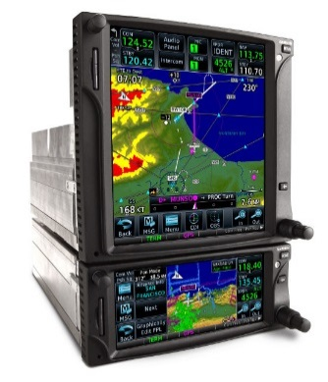

SBAS Equipment Classes
Terminal
Class Beta-1/2/3
(Sensor)
TSO-145
Class 1 – Oceanic to Approach (LNAV)
Class 2 – Oceanic to Approach (LNAV/VNAV)
Class 3 - Oceanic to Approach (LNAV/VNAV, LP, LPV)
Class Delta 4
(Approach Sensor)
TSO-146
Class Gamma-1/2/3
(Sensor + Display)
TSO-146
Lateral Navigation (LNAV) / Vertical Navigation (VNAV)
9
Notes:
Oceanic to approach includes Oceanic, domestic, en-route, terminal to approach.
By MOPS classification
Beta: GPS/SBAS Sensor that determines position with integrity. Class Beta equipment provides position other aircraft components, like a Flight Management System.
Gamma: GPS/SBAS position sensor and navigation function to provide path deviations relative to a selected path. Class gamma are stand-alone, panel-mounted equipment.
Delta*: GPS/SBAS position sensor and navigation function to provide path deviations relative to a selected final approach path
Class 1: oceanic to approach (LNAV) (uses slow and fast corrections)
Class 2: add LNAV/VNAV (uses slow, fast, and ionosphere corrections)
Class 3: adds LP and LPV capability (severe major / hazardous development assurance)
Class 4*: final approach segment operation
Class D and Class 4 are only paired together in [Class Delta 4]
Class Gamma and Class Beta can be paired with Class 1, 2, or 3

Slide 10
SBAS Equipment
Considerations
SBAS Satellite Tracking
  Legacy DO-229D compliant equipment can only use SBAS satellites from the lower 19 codes.
  Require DO-229E equipment to track all SBAS satellite codes
Intended use
  To support RNP approach (including LPV and Category-I minima), need
    Class Beta-3 or Class Delta-4 receiver with aircraft integration to support LPV
    Class Gamma-3 standalone navigator
10

Slide 11


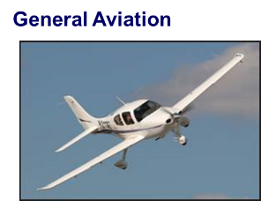
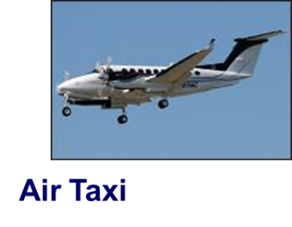
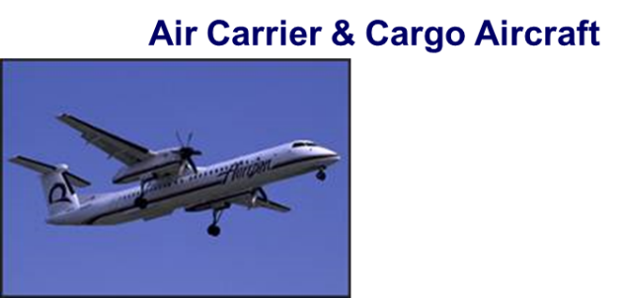



SBAS Equipped Aircraft
982
148,054
96,150
140
Optional LPV capability expected or under study for Airbus family, Boeing 737/777/787 and ATR-600
11
Notes:
Updates:
FAA: Sept 30 2021, for LPV equipped
For MSAS
Now 40 airline equipage
~100 general aviation

Slide 12
Key SBAS Benefits
– Air Navigation Service Providers
SBAS is a regional navigation service
SBAS service does not require the installation or maintenance of ground-based navigation aids or landing systems
  Opportunity to rationalize existing systems or expand where there are no current systems
SBAS guidance requires no airport “critical and sensitive areas” and has the potential to support new or advanced procedures
  Approaches to runways unable to site or install an Instrument Landing System (ILS)
  RNP to xLS transitions
  Noise and/or fuel reducing approach paths
ANSPs recognize the potential and are expanding SBAS offerings
12

Slide 13
Published SBAS Procedures
EGNOS | 2011
Cat-I | 304
LPV | 740*
Operational
CWAAS | 2007
LPV | 656
Planned Year
SDCM
MSAS | 2007
NPA only
LPV | 2023
KASS | 2023
BDSBAS | 2024
WAAS | 2003
Cat-I | 1057
LPV* | 4088
LP | 731
*LPV count includes Category 1 approaches
GAGAN | 2013
LPV | 65 Pending publication
A-SBAS | 2025
SouthPAN | 2027
Localizer Performance (LP) with vertical guidance (LPV)
13
Notes:
CWAAS Update: 10/07/2021
WAAS Update: 10/07/2021
EGNOS Update: 10/07/2021
MSAS Update: 11/30/16
GAGAN Update 11/30/16

Slide 14
Conclusion
SBAS offers significant benefits to aviation
  Enhances PBN operations for all phases of flight, from en-route through Category I equivalent approach
  Position source to meet ADS-B requirements
  Vertically guided approaches up to Category 1 minima
Expanding availability of safe SBAS approaches worldwide
  Four operational systems with plans for continued improvement and additional procedures
  New systems in procurement
    China, Korea, Africa (ASECNA), Russia, Australia/New Zealand
Benefits will be available to Aircraft operators that begin to integrate SBAS in their navigation strategy now
14

Slide 15
Agenda
Executive Summary
Appendix A: SBAS Benefits
Appendix B: SBAS Systems Status
Appendix C: SBAS System Evolution
Appendix D: Interoperability Working Group
15

Slide 16
SBAS Background
Satellite Based Augmentation System (SBAS) provides the accuracy, integrity, service continuity and availability needed to rely on Global Navigation Satellite System (GNSS) navigation for all phases of flight, from en-route through Category I equivalent approach
SBAS technology provides the opportunity to cover very large areas of airspace and areas formerly not served by other navigation aids
SBAS adds increased capability, flexibility, and often, more cost-effective navigation options than adding additional legacy ground-based navigation aids
SBAS can be used in many non-aviation applications
16
Notes:
16

Slide 17
SBAS Background
International Civil Aviation Organization (ICAO) Standards And Recommended Practices (SARPs) provides overarching standards and guidance for Global SBAS implementation
SARPs criteria define Approach with Vertical guidance (APV) as being a stabilized descent using vertical guidance
SBAS Interoperability Working Group (IWG) is the forum for SBAS service providers to assure common understanding and implementation of the SARPs
IWG forum allows coordination to enable use of a single avionics technology designed to easily transition from one SBAS region to another
17

Slide 18
SBAS Benefits
SBAS is an enabler for Federal Aviation Administration (FAA) Next Generation Transportation System (NEXTGEN) and the European Commission (EC) Single European Sky Air Traffic Management Research (SESAR) initiatives
SBAS equipment provides position accuracy and integrity sufficient to meet most stringent ADS-B surveillance requirements
SBAS can support the decommissioning of ground-based Navigation Aids (NAVAIDs)
18
Notes:
Although GNSS is associated primarily with navigation, GNSS is also the backbone of ADS-B surveillance applications. As such, GNSS positioning and track-keeping functions are no longer “confined” to being a navigation enabler to an airspace concept. GNSS, in this case, is also an ATS surveillance enabler. The same is true of data-link communications: data are used by an ATS surveillance system (for example, in ADS-B and navigation).
18

Slide 19
SBAS Benefits
SBAS supports Performance Based Navigation (PBN) capability
  PBN improves efficiency and capacity while reducing environmental impacts
SBAS is a low cost equipage solution to achieve Required Navigation Performance (RNP)
SBAS clock and ephemeris corrections improve the availability of RNP for users throughout the entire GEO footprint
19
Notes:
9613: The key difference between them is the requirement for on-board performance monitoring and alerting. A navigation specification that includes a requirement for on-board navigation performance monitoring and alerting is referred to as an RNP specification. One not having such requirements is referred to as an RNAV specification.
As a result of decisions made in the industry in the 1990s, most modern RNAV and RNP systems provide on-board performance monitoring and alerting, therefore the navigation specifications developed for use by these systems can be designated as RNP.
Performance-based navigation. Area navigation based on performance requirements for aircraft operating along an ATS route, on an instrument approach procedure or in a designated airspace.
The Performance-based Navigation (PBN) concept specifies that aircraft RNAV or RNP system performance requirements be defined in terms of accuracy, integrity, continuity and functionality required for the proposed operations in the context of a particular airspace concept, when supported by the appropriate navigation aid (NAVAID) infrastructure. Compliance with WGS 84 and data quality prescribed in Annex 15 are integral into PBN.
19

Slide 20
SBAS Benefits – En-Route/Terminal
SBAS is a primary navigation system
SBAS provides Area Navigation (RNAV) and RNP capability
  Improves availability for all RNAV routes
  Eliminates the operational requirement to ensure GPS availability using RAIM prediction tools
  Flexibility to design more efficient airspace and instrument procedures
Significant potential reduction in track dispersion
Supports Trajectory Based Operations (TBO)
  4-D Operations (Continuous Descent Final Approach (CDA))
  Significant reductions in fuel consumption
20

Slide 21
SBAS Benefits - Approach
Supports RNP approaches down to LNAV, LNAV/VNAV, LP and LPV minima.
Provides Category I (CAT I) equivalent vertical guidance at any qualifying runway
  Localizer Performance with Vertical guidance (LPV)
  SBAS service does not require the installation or maintenance of ground-based landing system navigation aids
SBAS position and guidance do not change with barometric and temperature fluctuations and are not impacted with improper aircraft barometric altimeter settings
SBAS guidance requires no airport “critical areas” and has the potential to improve runway throughput
SBAS can support RNP AR operations
21

Slide 22
SBAS Benefits
beyond aviation
SBAS benefits extend beyond aviation
    To all modes of transportation (maritime, highways and railroads)
    To applications other than transportation
  Proven enhancement of GPS-only position accuracy in different environments
  Enabling to enhance performance of present commercial applications using GPS
    No extra costs in new systems (consumer-grade chipsets SBAS-enabled, just requiring a suitable configuration)
    Capability to implement customized solutions for the delivery of added value services further exploiting SBAS features
22

Slide 23
SBAS Benefits
beyond aviation, ex. road and freights transport
  More robust localization and monitoring, enabling:
  Better control and support to law enforcement and
  Enhanced management/planning
  Higher safety
  Provision of added value commercial services
23

Slide 24
SBAS Interoperability
- SARPs
ICAO SARPs Annex 10 and Aviation Minimum Operational Performance Standards support the interoperability of different SBAS systems
  Seamless transition between SBAS service areas
24

Slide 25
Agenda
Executive Summary
Appendix A: SBAS Benefits
Appendix B: SBAS Systems Status
Appendix C: SBAS System Evolution
Appendix D: Interoperability Working Group
25

Slide 26
SBAS Status:
Operational Systems
Wide Area Augmentation System (WAAS) – United States
  Operational since 2003
  Supports en-route, terminal and approach operations
    CAT I-like approach capability (LPV-200)
  Over 4,819 published approaches to LP and LPV minima at 2,232 airports
    Includes over 500 Part 139 airports accessible to commercial aircraft
  Over 148,000 equipped aircraft
MICHIBIKI (Guidance) Satellite-based Augmentation System (MSAS) - Japan
  Operational since 2007
  Supports en-route, terminal and non-precision approach operations
  RNAV/RNP approaches at 40 airports and RNP AR approaches at 26 airports
  Over 140 equipped aircraft (100 general aviation, 40 airline), with expectation to increase to over 190 total equipped aircraft by 2023 following delivery of Mitsubishi Regional Jets.
26
Notes:
26

Slide 27
SBAS Status:
Operational Systems
European Geostationary Navigation Overlay Service (EGNOS) – European Union
  Open Service was declared in October 2009
  Safety-Of-Life Service has been operational since March 2011
  Supports en-route, Terminal and Approach operations
    Approved LPV-200 service in 2015 with first approach in 2016
  Over 740 published approaches to LPV minima at 293 airports
Global Positioning System (GPS) Aided Geostationary Earth Orbit (GEO) Augmented Navigation (GAGAN) - India
  RNP 0.1 certification declared in December 2013
  APV 1 certification declared in April 2015
    Kishangarh Airport procedures published, to be effective July 14, 2022
    66 approached developed and in various stages of implementation
  Supports en-route, Terminal, and Approach operations
27
Notes:
27

Slide 28
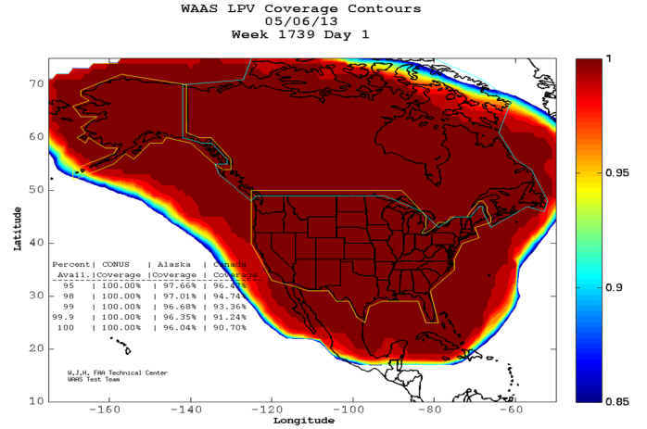
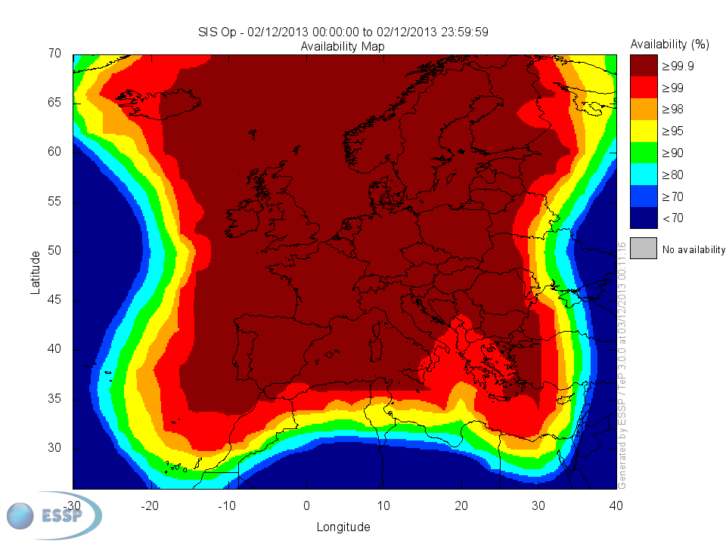
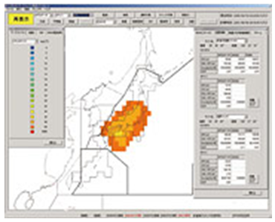
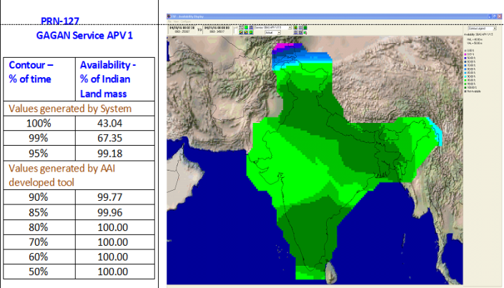
Current SBAS Performance
APV-1 Availability
Sources and additional detail:
WAAS LPV Coverage (http://www.nstb.tc.faa.gov/24Hr_WaasLPV.htm)
MSAS (http://www.nec.com/en/global/solutions/cns-atm/navigation/msv.html)
EGNOS LPV Coverage (https://egnos-user-support.essp-sas.eu/new_egnos_ops/maps_apv1)
GAGAN (http://gagan.aai.aero)
WAAS
EGNOS
MSAS
(Note: Graphic shows Vertical Protection Level
Vertically-guided operations are not yet authorized.)
GAGAN
28

Slide 29
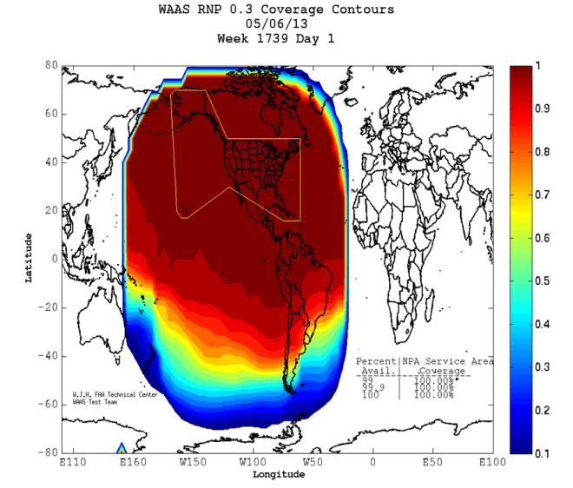
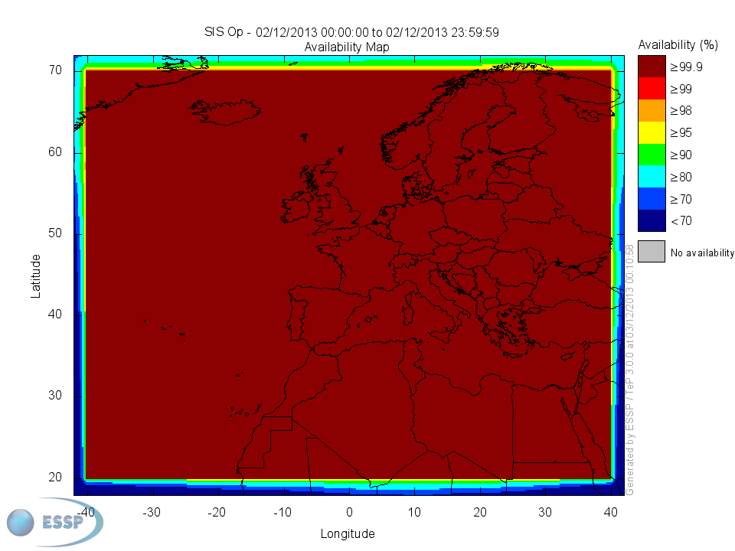
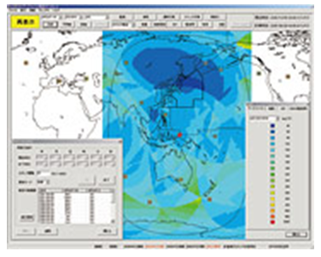
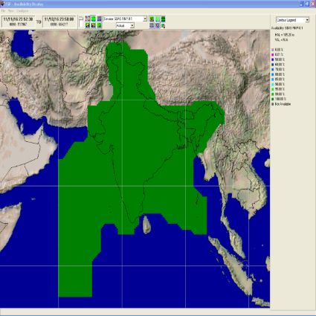
Current SBAS Performance
Non-Precision Approach Availability
(such as RNP 0.3)
WAAS
EGNOS
MSAS
(Horizontal Protection Level Display)
Sources and additional detail:
WAAS (http://www.nstb.tc.faa.gov/24Hr_WaasRNP3.htm)
MSAS (http://www.nec.com/en/global/solutions/cns-atm/navigation/msv.html)
EGNOS (https://egnos-user-support.essp-sas.eu/new_egnos_ops/maps_npa)
GAGAN (http://gagan.aai.aero)
GAGAN
29

Slide 30

SBAS Status:
Systems Under Development
BDSBAS - China
  In development with the plan to support en-route, terminal and approach
  All 3 GEOs with orbital slots 80°E, 110.5°E, and 140°E have been successfully launched and completed in-orbit tests
  27 monitoring stations, 2 data processing centers, 1 operation control center and 3 uplink stations have been deployed
  On-air testing with the BDSBAS SF and DFMC services started June 2020
  Certification for BDSBAS SF service expected in 3-4 years
30
Notes:
30

Slide 31
SBAS Status:
Systems Under Development
Korean Augmentation Satellite System (KASS) - Korea
  In development with plans for supporting en-route, terminal and approach operations in Korea
  Program kick-off in October 2014, Preliminary Design Review in April 2017
  Malaysian Measat-3D will be the first KASS satellite, and launched on June 23, 2022
  SBAS services provision objectives
    Full APV services by 2023
31
Notes:
31

Slide 32
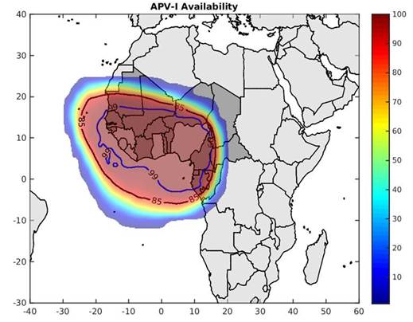
SBAS Status:
Systems Under Development
Augmented Navigation for Africa (ANGA) - Agency for Air Navigation Safety in Africa and Madagascar (ASECNA)
  18 Member States in Africa & Indian Ocean
  In development with plans for supporting en-route down to Cat-1 operations in the ASECNA area of responsibility (18 Member States, 6 Flight Information Regions, 16 million km²) with a potential progressive coverage to the continent:
    Early open/pre-operational SBAS services (L1) available since September 2020
    Operational SBAS services (L1) from 2025
    Operational SBAS services (DFMC) beyond the horizon 2028/2030
ANGA pre-operational APV-1 service
32
Notes:
32

Slide 33

SBAS Status:
Systems Under Development
Southern Positioning Augmentation Network (SouthPAN) - Australia and New Zealand
  In development for en-route, Terminal, and RNP approach to 200-ft minima
  Testbed program commenced in February 2017 with L1 GPS, L1/L5 GPS + E1/E5a GAL, L1 GPS PPP, and L5 GPS + GAL PPP services
  Whole-of-industry approach to a National Positioning Infrastructure Capability led by Geoscience Australia and Land Information New Zealand, with support from the Civil Aviation Safety Authority, Airservices Australia, NZ Civil Aviation Authority, Airways NZ, and other industry organisations
  Acquisition program commenced July 2018, full services planned for 2027
  Satellite transponder secured (I4F1) to aid integration and testing activities
  More information is available on http://www.ga.gov.au/scientific-topics/positioning-navigation/positioning-for-the-future/satellite-based-augmentation-system
Predicted NPA & LPV-200 Service Areas
33
Notes:
33

Slide 34
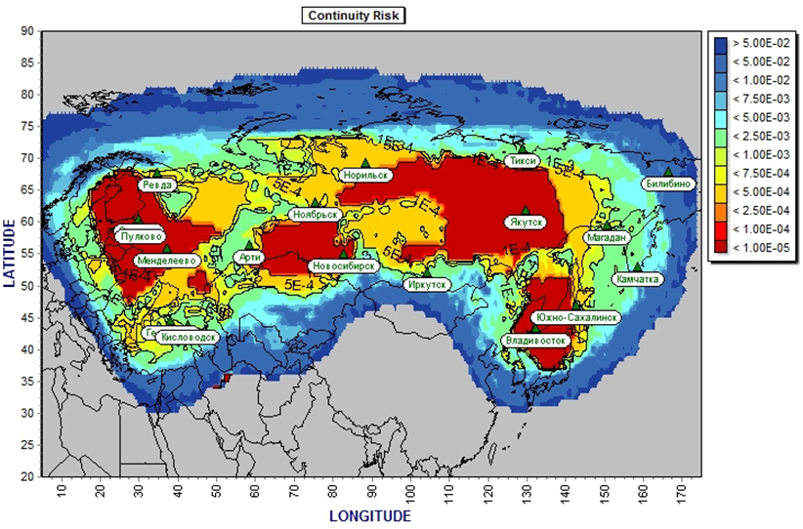
SBAS Status:
Systems Under Development
System of Differential Correction and Monitoring (SDCM) - Russia
  In development with plans for horizontal and vertical guidance (APV-1)
    Completed system test, undergoing system certification through 2020
    Initial service will be L1 SBAS coverage over Russian territory
  L1/L5 SBAS service and L1/L3 GLONASS precise point positioning service planned
APV-1 Continuity Risk
SDCM (IWG-25 Brief - SDCM 25-27 Jun 2013 ENG)
34
Notes:
19 in Russia: Moscow, Mendeleevo (Moscow district), St.Petersburg, Svetloye (St.Petersburg district), Lovozero (Murmansk district), Artie (Sverdlovsk district), Gelendzhik, Kislovodsk, Novosibirsk, Noyabrsk, Irkutsk, Norilsk, Tiksi, Yakutsk, Vladivostok, Petropavlovsk-Kamhatskiy, Yuzhno-Sakhalinsk, Magadan, Bilibino. 6 outside: Yerevan (Armenia), Minsk (Belorussia), Nur-Sultan (Kazakhstan), Novolazarevskaya (Antarctica), Bellinsgauzen (Antarctica), Progress (Antarctica)
34

Slide 35
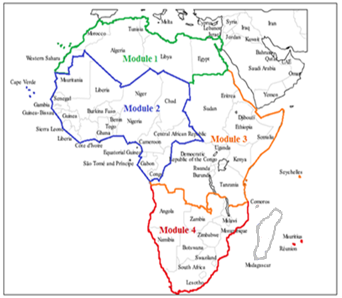
SBAS Status:
Potential future systems
EGNOS in Africa Programme - Africa & Indian Ocean region
  Initiative for SBAS/EGNOS development and services provision in Africa, beyond ASECNA area of responsibility
  Coordinated and supported by the pan-African instrument “EGNOS-Africa Joint Programme Office” through Africa-EU Strategic Partnership
Modular approach foreseen
DFMC services foreseen
OS GPS, GPS+GALILEO by 2025
SoL NPA GPS, GPS+GALILEO by 2026
SoL NPA+APV1+LPV200 GPS, GPS+GALILEO by 2028
Indicative only- approach
35

Slide 36
Agenda
Executive Summary
Appendix A: SBAS Benefits
Appendix B: SBAS Systems Status
Appendix C: SBAS System Evolution
Appendix D: Interoperability Working Group
36

Slide 37
SBAS Evolution
Dual Frequency
GNSS Dual Frequency Operations
  Increases SBAS availability and performance by direct avionics correction of ionospheric signal delay
    Specifically during ionospheric storms and in equatorial regions
  Improves robustness against unintentional interference
SBAS Service Provider Objectives
  Avionics manufacturers support multi-constellation/multi-frequency avionics as flight-certified navigation solutions
  Provide continued support to legacy L1-only users
  Provide an improved level of service for SBAS operations (lower DH)
  Support cooperative development of future SBAS standards consistent with ICAO Block upgrades
The slides that follow show a progression of scenarios in which combined SBAS coverage can provide LPV service. These scenarios are based on a generalized set of assumptions across all systems and may not represent program plans of individual SBAS providers.
37

Slide 38
SBAS Evolution
Multiple Constellation
GNSS Multiple-Constellation Operations
  Develop standards to enable augmentation of multiple constellations by SBAS
    DFMC SBAS Definition Document captures concept and system / subsystem requirement
      Enables SBAS to augment up to four constellations
      Concept only requires SBAS to augment a single constellation
    DFMC SBAS Interface Control Document defines proposed DMFC interface messages
      Supports augmentation of 4 constellations concurrently
38

Slide 39
SBAS Evolution
DMFC SBAS User Equipment
Development of DFMC SBAS MOPS
  In 2019, EUROCAE published Galileo/GPS SBAS MOPS (ED-259)
  RTCA and EUROCAE have agreed to develop a joint MOPS
    Initial publication with DFMC SBAS and legacy RAIM capability in 2022
    Revision to expand scope planned in subsequent years
Parallel SARPs development
  Core constellation SARPs approved by ICAO NSP in November 2020
      GPS L5, GLONASS CDMA, Galileo, BeiDou
  DFMC SBAS SARPs approved by ICAO NSP in November 2020
  The SARPs amendments are in the State letter approval process for effectiveness in November 2023
Projecting readiness of approved certified aviation equipment around 2027
39

Slide 40
Example SBAS EVOLUTION
40

Slide 41
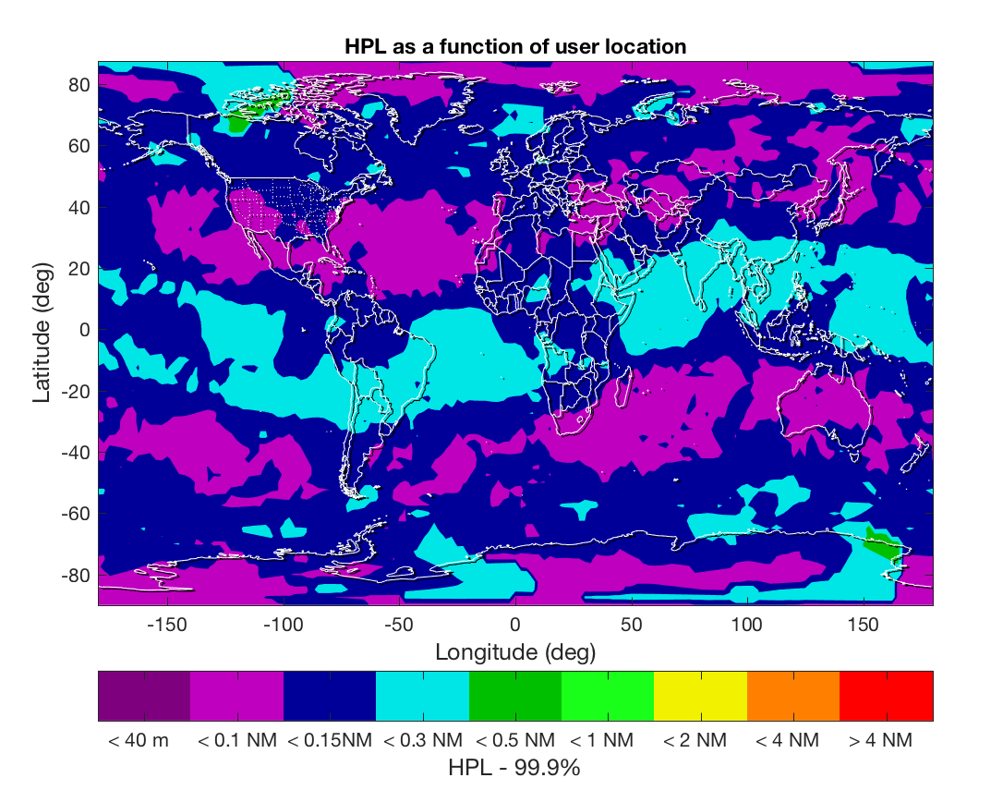
Example RAIM Receiver
Estimated 99.9% HPLs for a RAIM-only receiver
41

Slide 42
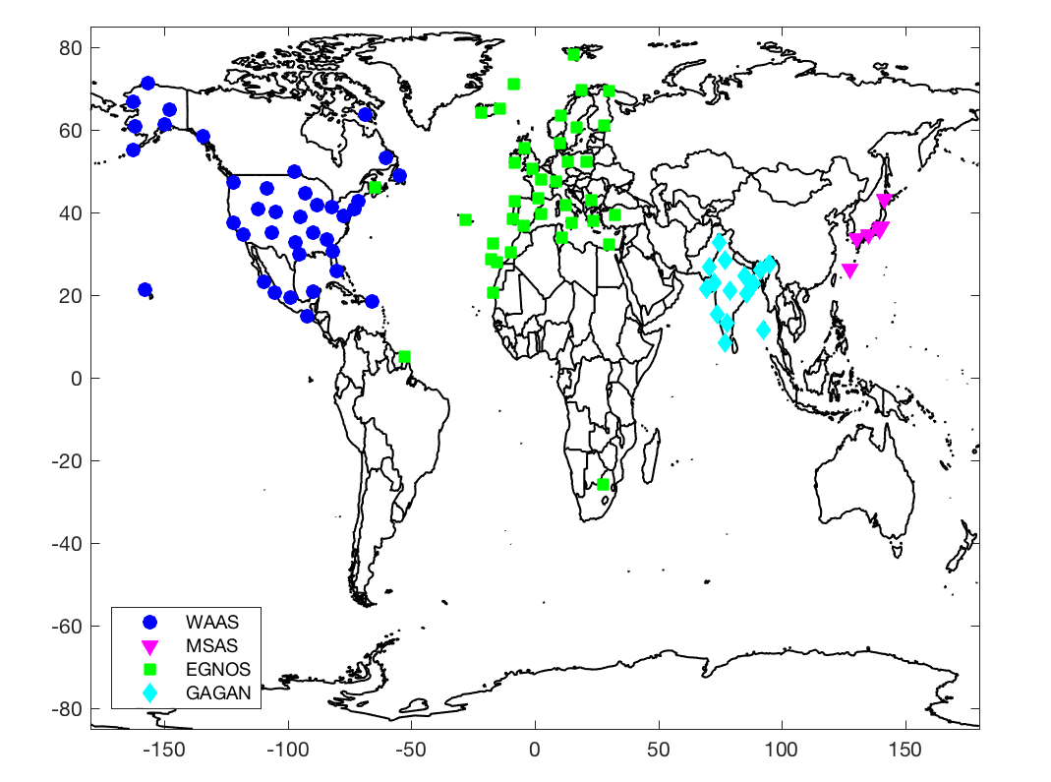
SBAS Reference Stations
Current SBAS Systems
42

Slide 43
Example Combined SBAS/RAIM Receiver
Estimated 99.9% HPLs for a combined SBAS/RAIM receiver
43

Slide 44

Current APV-1 Performance
Estimated APV / LPV Service Availability with current SBAS capability
44

Slide 45
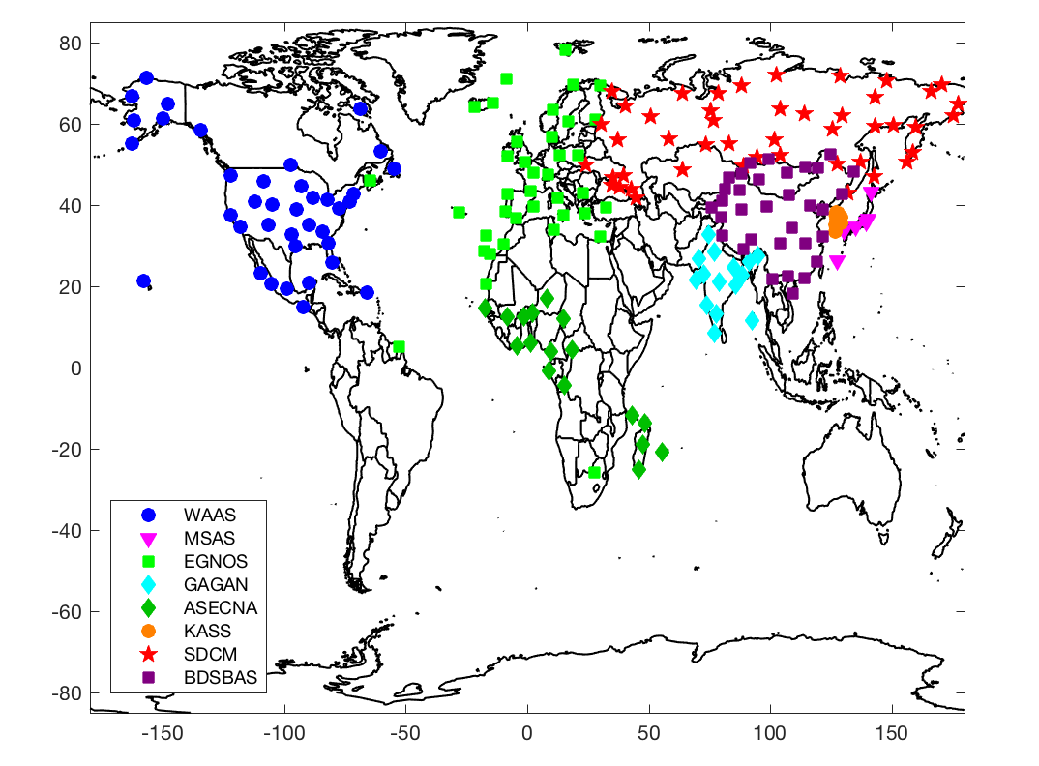
SBAS Reference Stations
All Planned SBAS Systems
45

Slide 46
Estimated APV-1 Performance
All Planned SBAS
Estimated APV / LPV Service Availability
46

Slide 47
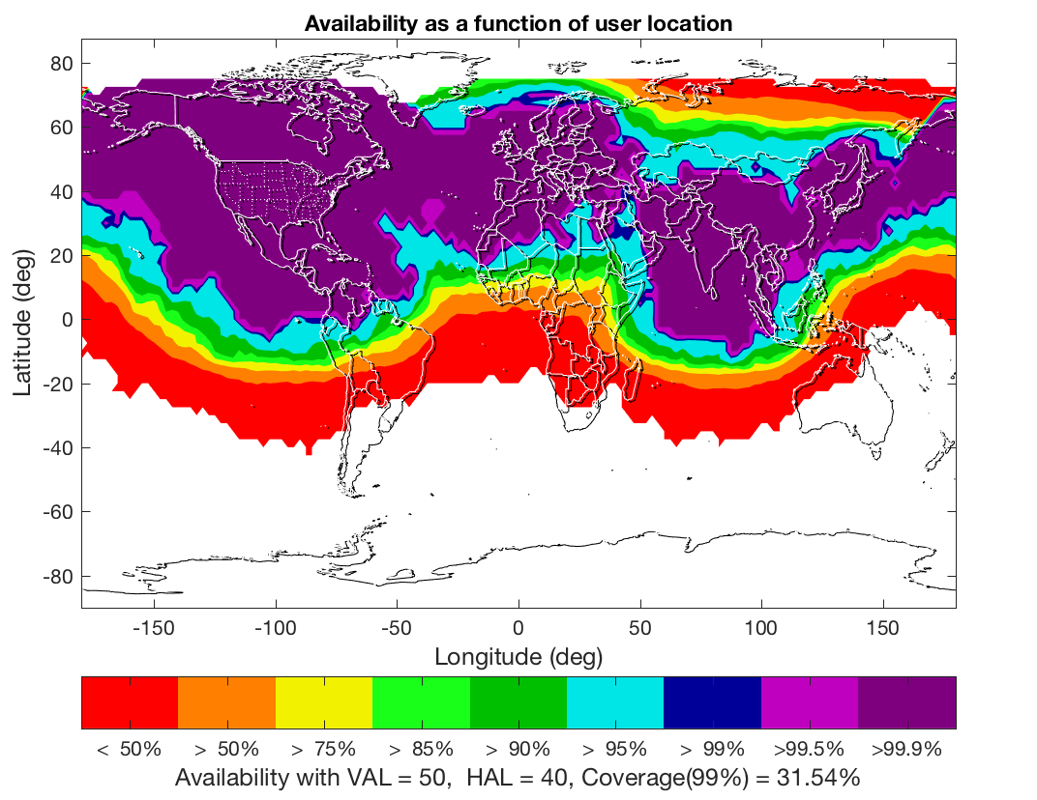
Dual Frequency SBAS
Current SBAS Systems
47

Slide 48
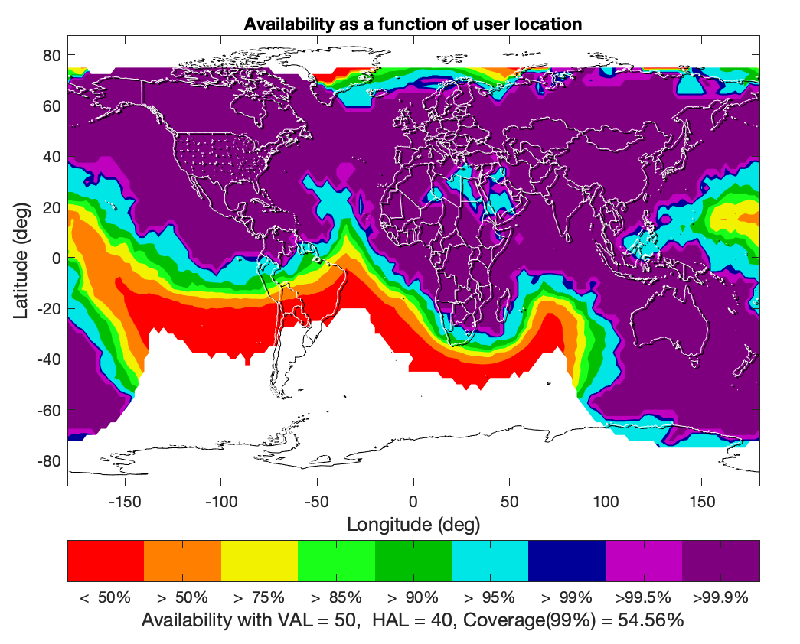
Dual Frequency SBAS
Current and Future SBAS Systems
48

Slide 49
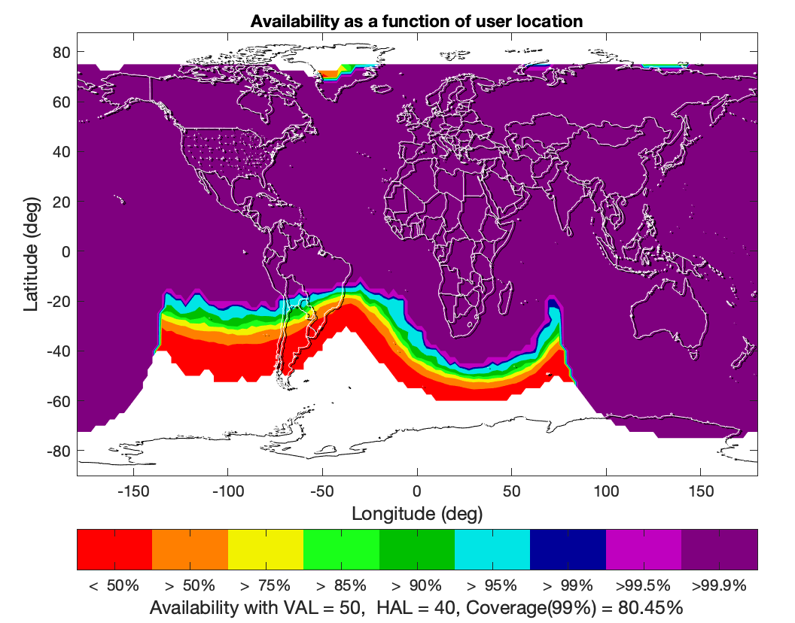
Dual Frequency / Constellation
With Future SBAS Systems
49

Slide 50
Agenda
Executive Summary
Appendix A: SBAS Benefits
Appendix B: SBAS Systems Status
Appendix C: SBAS System Evolution
Appendix D: Interoperability Working Group
50

Slide 51
SBAS Interoperability
Working Group (IWG)
SBAS IWG objectives established to support technical interoperability and cooperation
  Objective 1: Harmonize SBAS modernization plans
  Objective 2: Forum for discussion on SBAS requirements
  Objective 3: Harmonize technical improvements based upon operational and user feedback
  Objective 4: Research and Development (R&D) cooperation on key SBAS technologies
  Objective 5: Support joint SBAS promotion
51

