Slide 1
Are We Shifting Left Enough? FAA Emerging Strategies to Identify and Resolve Cyber Vulnerabilities Early in the Development Cycle

Slide 2
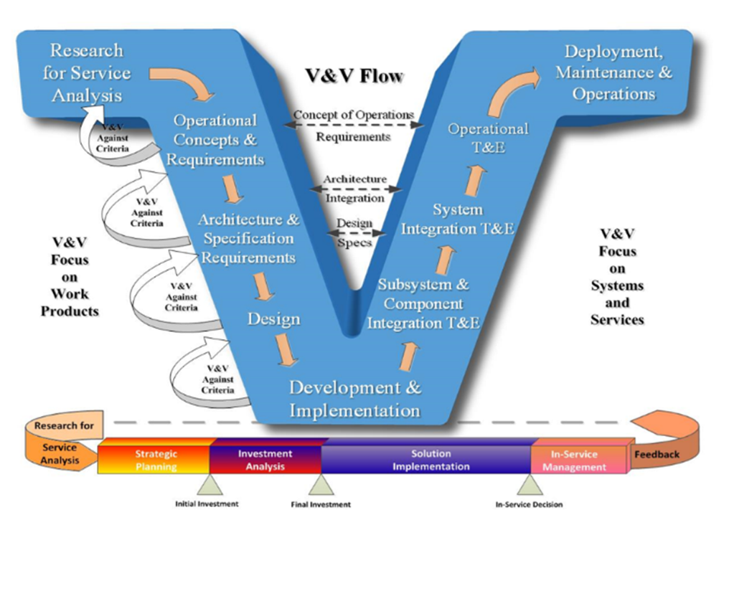
The V-Model Verification & Validation (V&V) Process
Verification Phases
Validation Phases
Traditionally, a V-model approach is used to conduct Verification and Validation (V&V) during a product’s Lifecycle Process.
The V-model establishes an association between each phase of Testing and Development.
Development = Verification Phase
Testing = Validation Phase
Generally, the physical infrastructure is replicated in a Development Service Verification test bed prior to going into the Operational environment
Each are self-contained and have to be informally or formally tested.
These tests are generally performed manually by an independent QA/QC program.

Slide 3
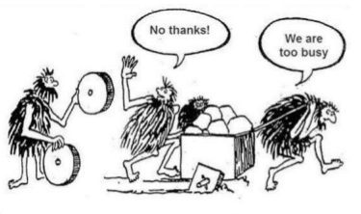
Challenges the Status Quo
Could you use something better?
Traditionally, code is subjected to security as the last phase before release which often creates a time crunch.
Developers are usually working till the last minute, leaving the security team little time to ensure the code is secure.
When vulnerabilities are exposed, either the release is delayed or the development team has to scramble to correct each security issue while the security team has to scramble to check the revisions.
This creates a great deal of expense and slows down application release and launches
If iterations are released in haste, the chances of overlooking or under-prioritizing a vulnerability are significant.
To fully implement a Shift Left Approach, a change in culture is necessary

Slide 4
Shifting Left, Secure by Design
Verification Phases
Validation Phases
The complexity of the NAS and the ever-evolving cyber threats are driving the need for security involvement earlier in the software development life cycle
Shift Left = SecDevOps versus DevSecOps
Objective is to introduce Cyber requirements, V&V and Test & Evaluation (T&E) activities earlier in the Development Cycle
Identifies and Mitigates Risk Earlier
Lowers long-term costs
Assures an on-time schedule

Slide 5
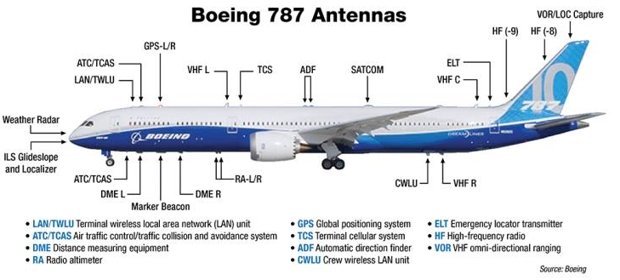
Evolving Mitigation Activities
The FAA is using mitigation activities to minimize risk in Development and Operational Environments
We are building segmented Operating Environments (OEs) to protect our Mission Critical (MC) and Mission Essential (ME) Systems/Services with Enterprise Cybersecurity Capabilities
Managed Enterprise Security Monitoring:
Integrate different monitoring and detection tools
Automate tasks for simpler, more effective security operations
Security Enterprise Asset Management:
Centralized capability
Support collection of specific ATO assets for each environment
Centralized NAS Software Security Management:
Improves cyber security posture of the NAS
Provides centralized capability for security patch & protection updates
Managed Enterprise Security Protections (Shared Telco):
Implemented via a Network Edge Protection capability
Support secure NAS operations when running in a Zero-Trust environment
Like the NAS, Aircraft Systems are comprised of many supporting systems and services. In both, Segmentation is broadly used as a Defense-in-Depth Strategy

Slide 6
Benefits
Secure by Design
Security issues are anticipated and remediated early
Relationships between developers, testers, security teams, and IT operations staff are streamlined
Increased Delivery Speed & Reduced Cost
Testing is one of the top reasons for release delays.
Shift Left cybersecurity supports faster application delivery because there is no pause in coding while cyber teams perform their V&V and T&E reviews.
Continuous testing means security flaws are caught sooner, so fixes are easier and less costly to make.
Shift Left security reduces the time between releases by enabling DevOps and security to work in parallel thereby reducing overall product cost.

Slide 7
Questions

