Slide 1
Airport and Airway Trust Fund (AATF)
Federal Aviation Administration
Fact Sheet
Updated: February 2025

Slide 2
AATF History
Created by the Airport and Airway Development and Revenue Act of 1970 to finance aviation programs:
Revenues are derived from aviation-related excise taxes on passengers, cargo, and fuel
The aviation excise taxes are augmented with contributions from the General Fund
Provides funding for capital improvements to the U.S. airport and airways system
In FY 2023 Trust Fund contributions were 87% of the FAA budget and 94% in FY 2024.
During the COVID-19 pandemic and the commitment to help respond to the downturn in air traffic activity that followed, FAA received a greater amount of funding from the General Fund than before 2020. For example, the Trust Fund taxes and fees provided FAA with 86.9% of its funding in FY 2018 and 93.8% of the agency’s funding in FY 2019.
Since 2022, the General Fund contributions have been augmented by investments made by the Infrastructure Investment & Jobs Act.

Slide 3
AATF Funds these accounts
FAA accounts:
Grants-in-Aid for Airports (augmented with funding from the General Fund)
Facilities and Equipment
Research, Engineering, and Development
Operations (partly supported by the AATF with the rest of budgetary resources coming from the General Fund)
Department of Transportation accounts:
Essential Air Services (EAS) program
Grants-in-Aid for Airports has been supplemented by more than $400 million annually from the General Fund since FY18, with a $532M commitment in FY24. Additionally, because of the extraordinary need resulting from the COVID pandemic, a total of $20 billion in assistance to airports was provided in three coronavirus relief bills in FY 2020 and FY 2021.
Additionally, the Infrastructure Investment and Jobs Act invests $15 billion in airport infrastructure, $5 billion in airport terminals, and another $5 billion in air traffic facilities over 5 years.

Slide 4
Trust Fund Excise Taxes Structure
Trust Fund Excise Tax Revenue Sources | Rates effective as of January 1, 2025 for CY2025
Domestic passenger ticket tax | 7.5 percent $5.20 per passenger per segment; indexed to the Consumer Price Index $11.40 per passenger; indexed to the Consumer Price Index $21.90 per passenger; indexed to the Consumer Price Index 7.5 percent of value of miles 4.3 cents per gallon 19.3 cents per gallon 21.8 cents per gallon Note: Effective after March 31, 2012 a 14.1 cents per gallon surcharge for fuel used in fractional ownership flights 6.25 percent on the price paid for transportation of domestic cargo or mail
Domestic flight segment tax (excluding flights to or from rural airports)
Tax on flights between the continental United States and Alaska or Hawaii (or between Alaska and Hawaii)
International arrival and departure tax
Tax on mileage awards (frequent flyer awards tax)
Domestic commercial fuel tax
Domestic general aviation gasoline tax
Domestic general aviation jet fuel tax
Tax on domestic cargo or mail

Slide 5
AATF FY 2024 Excise Tax Revenues
(in millions of dollars)
$707
$398 $121
$166
Transportation of persons
Use of International Air Facilities
Transportation of property
$4,956
Aviation Gasoline
Aviation Fuel Other than Gas Non-commercial
Aviation Fuel Commercial
$11,944
Total excise tax revenue $18,292M*
*In FY24, there were refunds from the trust fund of $162.9M for aviation fuel taxes and $3.8M for aviation taxes other than gasoline.

Slide 6
FAA Accounts & AATF Funding
(in thousands of dollars)
ACCOUNT NAME | FY 2020 ACTUAL | FY 2021 ACTUAL | FY 2022 ACTUAL | FY 2023 ACTUAL | FY 2024 ACTUAL
Operations | $10,630,000 | $11,001,500 | $11,414,100 | $11,915,000 | $12,729,624
General | $111,000 | $482,500 | $5,000,000 | $1,921,179 | $636,477
AATF | $10,519,000 | $10,519,000 | $6,414,100 | $9,993,821 | $12,093,150
Facilities & Equipment | $3,045,000 | $3,015,000 | $2,892,888 | $2,945,000 | $3,191,250
AATF | $3,045,000 | $3,015,000 | $32,892,888 | $2,945,000 | $3,191,250
Research, Engineering, & Development | $192,665 | $198,000 | $248,500 | $255,000 | $255,000
AATF | $192,665 | $198,000 | $248,500 | $255,000 | $255,000
Grants in Aid for Airports | $3,750,000 | $3,750,000 | $3,904,180 | $3,908,555 | $3,882,392
Contract Authority (AATF) | $3,350,000 | $3,350,000 | $3,350,000 | $3,350,000 | $3,350,000
General Fund Appropriation | $400,000 | $400,000 | $554,180 | $558,555 | $532,392
Supplemental | $10,000,000 | $10,009,000 | $100,000 | $0 | $0
CARES Act | $10,000,000 | $0 | $0 | $0 | $0
CRSSA | $0 | $2,000,000 | $0 | $0 | $0
American Rescue Plan | $0 | $8,000,000 | $0 | $0 | $0
Employee Leave Fund | $0 | $9,000 | $0 | $0 | $0
Hurricane Relief | $0 | $0 | $100,000 | $0 | $0
IIJA Authority | $0 | $0 | $5,000,000 | $ 5,000,000 | $ 5,000,000
Facilities and Equipment | $0 | $0 | $1,000,000 | $ 1,000,000 | $ 1,000,000
Airport Infrastructure Grants | $0 | $0 | $3,000,000 | $ 3,000,000 | $ 3,000,000
Airport Terminal Program | $0 | $0 | $1,000,000 | $ 1,000,000 | $ 1,000,000
AATF | $17,106,665 | $17,082,000 | $12,905,488 | $16,543,821 | $18,914,400
GF | $511,000 | $882,500 | $5,554,180 | $2,479,734 | $1,168,869
FAA Account Total | $17,617,655 | $17,964,500 | $18,459,668 | $19,023,555 | $20,083,269
Supplemental Total | $10,000,000 | $10,009,000 | $100,000 | $0 | $0
IIJA Authority Total | $0 | $0 | $5,000,000 | $5,000,000 | $5,000,000
GRAND TOTAL | $27,617,665 | $27,973,500 | $23,559,668 | $24,023,555 | $25,083,269

Slide 7
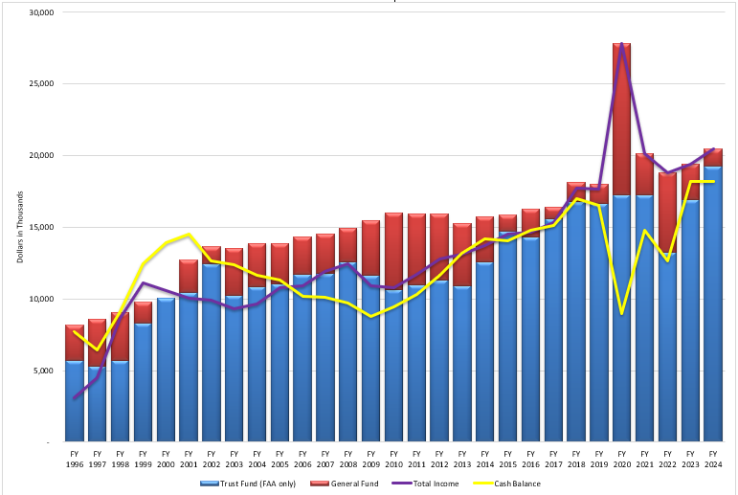
General Fund/Trust Fund Share
(in thousands of dollars)

Slide 8
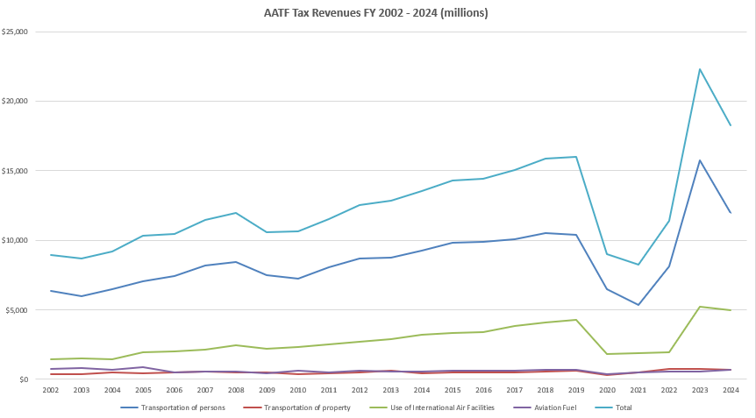
AATF Tax Revenue Trends
AATF Tax Revenues FY 2002 – 2024 (millions)

Slide 9
Infrastructure Investment & Jobs Act (P.L. 117-58)

