Slide 1
Convergence and Innovation: Pitfalls, Progress, and Promise
Federal Aviation
Administration
Carla A. Hackworth, Ph.D.
Aerospace Human Factors Research Division

Slide 2



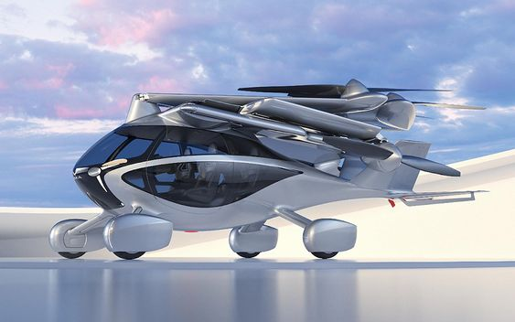


Convergence: technologies, information, processes come together resulting in a new approach or utility
…”Science gathers knowledge faster than society gathers wisdom.”
― Isaac Asimov

Slide 3

Convergence for Whom?
Human capabilities and limitations: how it applies to design, development, and evaluation of equipment, systems, facilities, procedures, jobs, environments, staffing, organizations, and personnel management for safe, efficient, and effective human performance, including using technology

Slide 4

Goldmine
Converging Technologies for Improving Human Performance NANOTECHNOLOGY, BIOTECHNOLOGY, INFORMATION TECHNOLOGY AND COGNITIVE SCIENCE
NSF/DOC-sponsored report
Edited by Mihail C. Roco and William Sims Bainbridge, National Science Foundation June 2002 Arlington, Virginia
“The Federal Government should establish a national research and development priority area on converging technologies focused on enhancing human performance.”p Xii

Slide 5
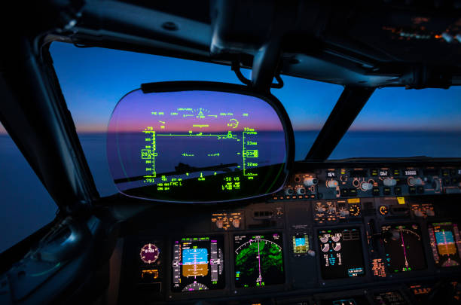
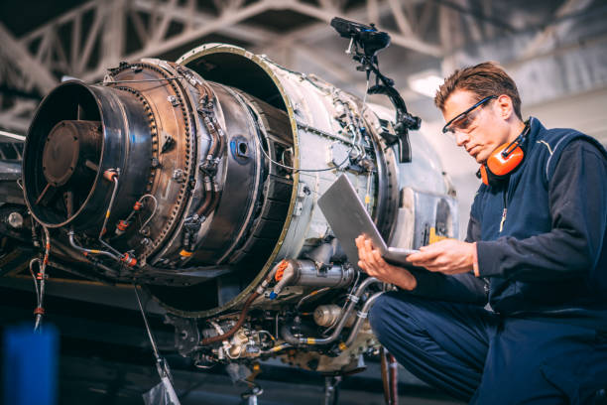
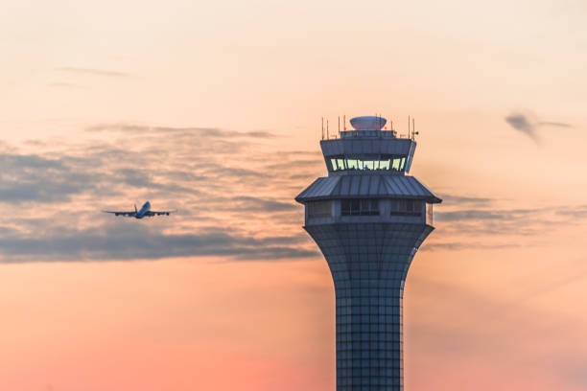
Human factors research using innovative scientific methodologies to inform aviation advances in technology, operations, and human performance. Empower data-driven decision-making that improves efficiency of the National Airspace System.

Slide 6
Converging Technologies for Improving Human Performance
“The Federal Government should establish a national research and development priority area on converging technologies focused on enhancing human performance.”
Design and optimize work environments
Consider human capabilities and limitations
  Creativity, fatigue, attention, user interface, human error
Understand how human psychological, social, physical and biological characteristics affect job performance in aerospace occupations
Optimize capabilities, protect limitations
Notes:
Human factors research using innovative scientific methodologies to inform aviation advances in technology, operations, and human performance. Empower data-driven decision-making that improves efficiency of the National Airspace System.

Slide 7
Predictions Twenty Year
“Vision for Enhancing Human Abilities and Societal Performance”
Wearable sensors for health information-pollutants
Robots and software agents
Skill and knowledge acquisition faster
Improved individual and team communication
Human body resistant to stress, biological threats, and aging process
Adaptive machines
Technological enhancements for physical and mental health challenges
Data security effective measures against biological, chemical, radiological, and nuclear attacks
Instantaneous access to information
Expanded creativity
Notes:
Wearable sensors for health information-pollutants
Technological enhancements for physical and mental health challenges

Slide 8

Predictions Twenty Year
“Vision for Enhancing Human Abilities and Societal Performance”
Genetic editing, modification with ethical consensus
Space exploration and mining of resources
Intelligent production and design
Smart farming
Improved and efficient transportation
Science will leverage other disciplines and accomplishments
Brain Machine Interface

Slide 9
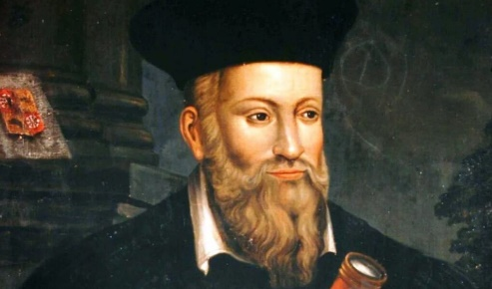
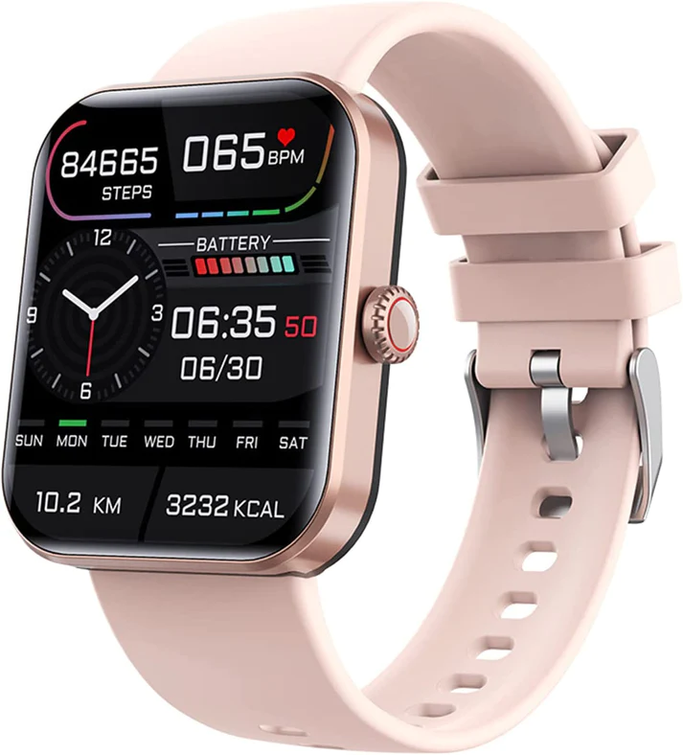
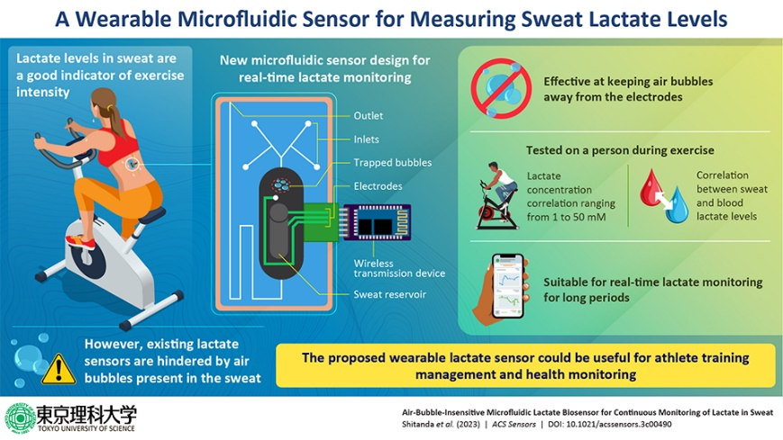




20+ years and….
20+ years and….
Just as I predicted
Sensors in healthcare
Mental Health Apps, NLP
Biosensor patch for wounds-ie smart bandage
Xenotransplantation
Genetic editing: CRISPR
Notes:
Mbunge 2021 sensor
Title of original paper :Air-Bubble-Insensitive Microfluidic Lactate Biosensor for Continuous Monitoring of Lactate in SweatJournal :ACS SensorsDOI :10.1021/acssensors.3c00490

Slide 10

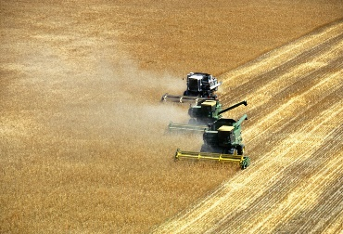

20+ years and….
20+ years and….
Space exploration and mining: Several, Asteroid belt between Mars and Jupiter
Smart farming: apps, monitoring, smart tractors, smart greenhouses, drones
Improved and efficient transportation: EVs AI Fleet integration, Assisted Driver (ADAS), and equity
  Uber and Lyft subsidized
  Science will leverage other disciplines and accomplishments: 3D bone
Notes:
The 100th FAA licensed commercial space operation so far this year launched in August, up from 74 for all of 2022!
Essential safety-critical ADAS applications include:
Pedestrian detection/avoidance
Lane departure warning/correction
Traffic sign recognition
Automatic emergency braking
Blind spot detection

Slide 11
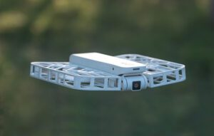
Continued advances
Adaptive machines
The Drone that Flies Itself Hoverair X1 - DRONELIFE
AFRL AI agents successfully pilot XQ-58A Valkyrie uncrewed jet aircraft
Published Aug. 3, 2023
Air Force Research Laboratory Public Affairs
  machine-learning trained, artificial intelligence algorithms on an XQ-58A Valkyrie.
Edible Drones
Delivery
Notes:
Title of original paper :Air-Bubble-Insensitive Microfluidic Lactate Biosensor for Continuous Monitoring of Lactate in SweatJournal :ACS SensorsDOI :10.1021/acssensors.3c00490
The 100th FAA licensed commercial space operation so far this year launched in August, up from 74 for all of 2022!
Essential safety-critical ADAS applications include:
Pedestrian detection/avoidance
Lane departure warning/correction
Traffic sign recognition
Automatic emergency braking
Blind spot detection

Slide 12
Convergence and compliance
CBS MORNINGS
"Transportation disaster" closes schools, leaves students stranded in Louisville, Kentucky
BY ADRIANA DIAZ, ANALISA NOVAK
AUGUST 16, 2023 / 11:31 AM / CBS NEWS
Design for optimal, degrees of freedom, in reality, observe human behavior

Slide 13

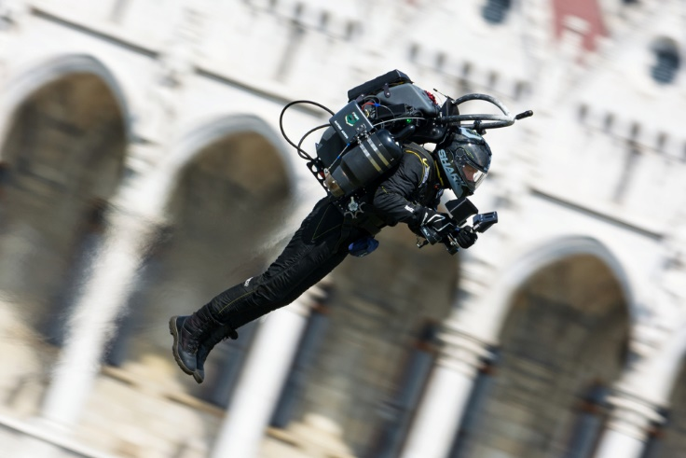
Final Thoughts
Vision for Enhancing
Human Abilities and Societal Performance
Ethics and equity
Safety and autonomy
Privacy and security
Mental Health
  Soraj Hongladarom
    Jan 2021 MIT Technology Review
      Buddhism and AI
Regulation
Asimov global solutions for global problems
Leslie 2020
Notes:
How is success measured? What was improved? Unintended consequences?
Do no harm--Buddah

Slide 14
Metric of Success: Societal Performance
Design of Everyday Things (2013)
Design for a Better World (2023)
“At this unique moment in history of technical achievement, improvement of human performance becomes possible. Caught in the grip of social, political, and economic conflicts, the world hovers between optimism and pessimism.”p3

Slide 15

Questions?

