Slide 1
Effective delivery of advanced capabilities begins with tight feedback loops
August 10, 2023
Robin Yeman
Space Domain Lead

Slide 2
Abstract:
Digital Engineering has transformed art of the possible for engineering however, the current state of practice still leverages a Waterfall lifecycle with stage gate milestones and test beginning far too late into the lifecycle. This approach results in compromised quality, excessive rework, increased cost, and inefficiency of system delivery. To address these challenges, there is a growing need for a tight feedback loop process in digital engineering that begins with test and iteratively and incrementally builds system through continuous integration. This requires modular architecture, stable interfaces, and system instrumentation for data throughout development.
A tight feedback loop for digital engineering encompasses the entire lifecycle, starting with building executable requirements with behavior-based tests, solution design through development, continuous integration, automated deployment, and observable data in maintenance that feeds back into requirements through a tight feedback loop framework. This iterative process ensures that design decisions are informed by actual performance data, allowing for better alignment with customer needs and operational requirements.
The tight feedback loop fosters collaboration among multidisciplinary teams, breaking down silos and enabling shared understanding and knowledge exchange. With integrated tools and data repositories, engineers from different disciplines can work cohesively, seamlessly transitioning between design, simulation, and validation stages. This integration reduces duplication of effort, enhances communication, and accelerates decision-making processes, ultimately leading to faster time-to-market and improved product quality.
In conclusion, a tight feedback loop for digital engineering is crucial to overcome the challenges posed by the phase gate approach with disconnected functions. By beginning with executable requirements, continuous integration, automated deployments, and observable operations increases quality, reduces costs, and improves efficiency. Embracing a tight feedback loop empowers engineers to leverage data-driven insights, promote collaboration, and continuously iterate on designs, ultimately driving innovation and advancing the field of digital engineering.

Slide 3
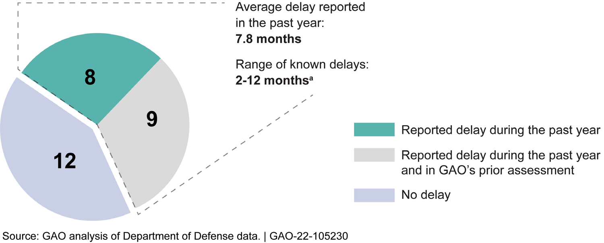
What is the problem
Notes:
Did you know in the last decade 45% of major defense acquisition programs have had cost overruns? How about that 36% of those major defense programs had scheduled delays? Here's the kicker Only 16% met cost, scope, and schedule.

Slide 4
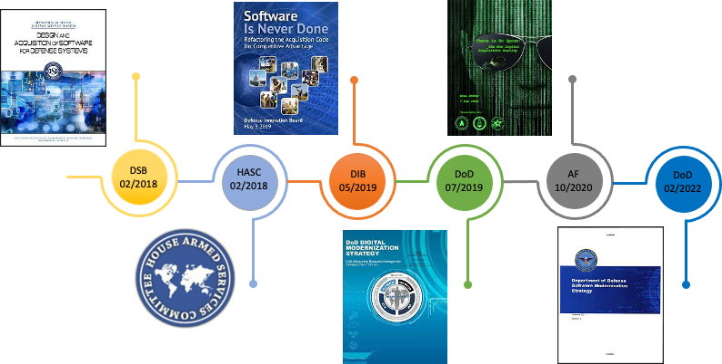
Recommendations Made
Notes:
Did you know in the last decade 45% of major defense acquisition programs have had cost overruns? How about that 36% of those major defense programs had scheduled delays? Here's the kicker Only 16% met cost, scope, and schedule.

Slide 5
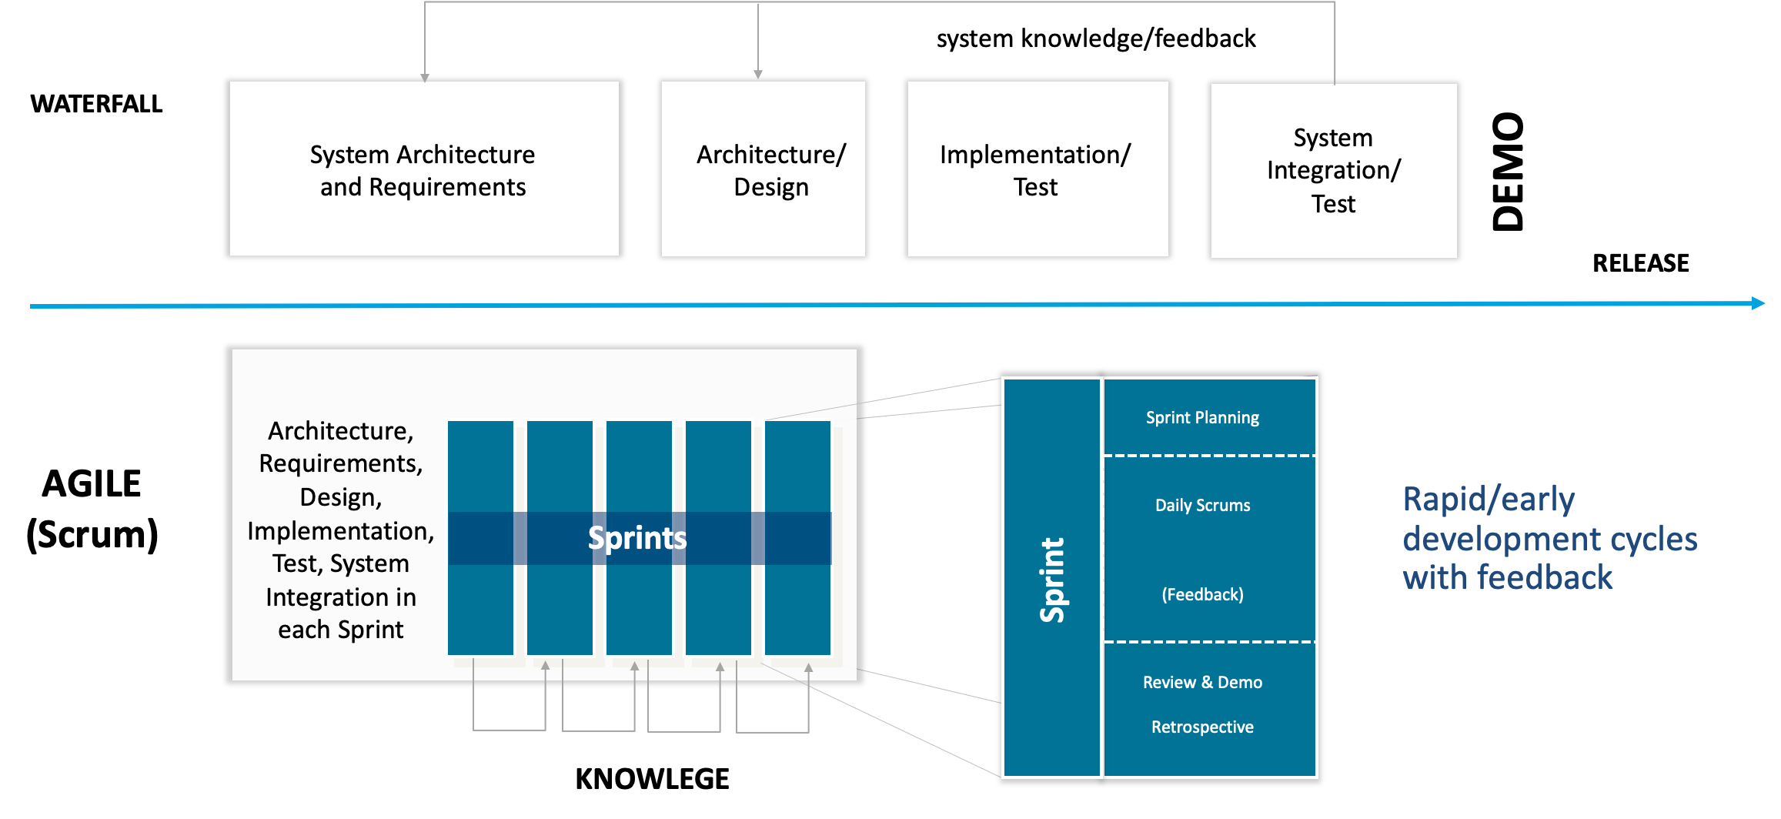
Agile vs. Waterfall
“Agile Projects are 3X more likely to succeed than Waterfall projects

Slide 6
Moving to tight feedback loops
Activities as opposed to phases that have smaller batch sizes and are repeated.

Slide 7
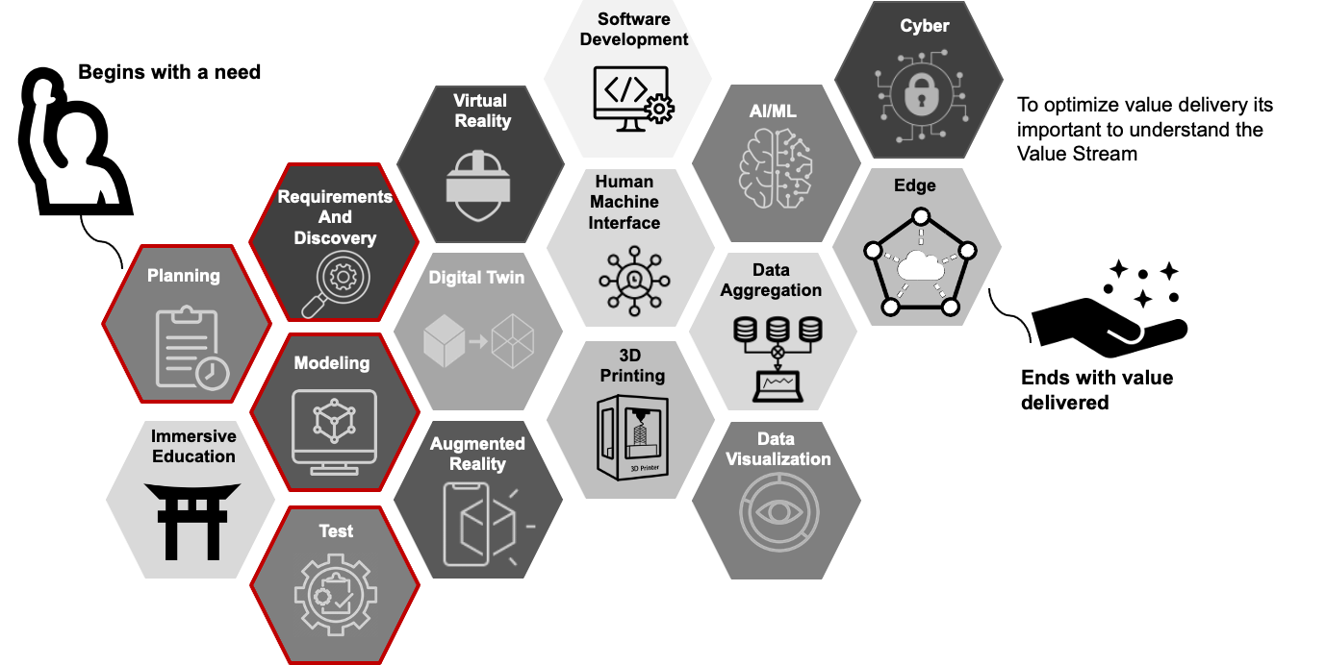
Digital Engineering Value Stream
Value Stream:
set of actions that take place to add value to a customer from the initial request through realization of value by the customer

Slide 8
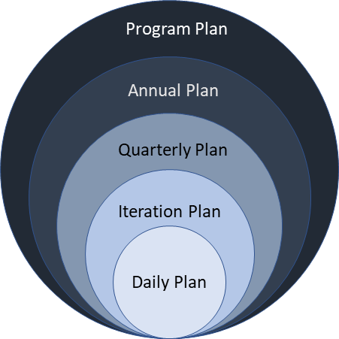
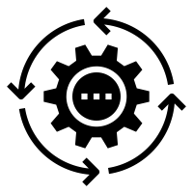
Apply multiple horizons of planning
Moving from predictive to empirical

Slide 9
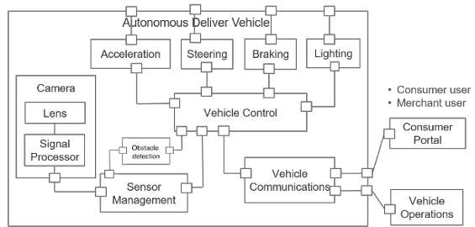
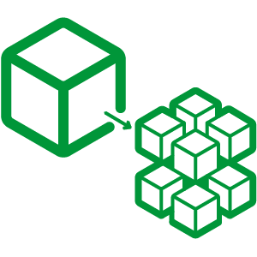
Architect for change and speed with MBSE
Highly cohesive and loosely coupled with standardized interfaces

Slide 10
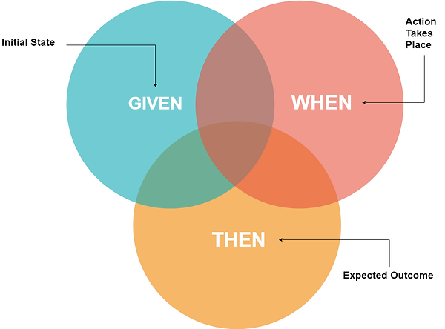
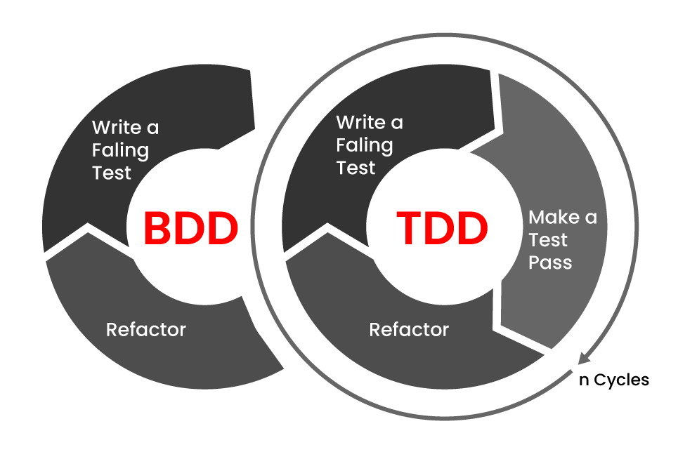
Shift left
Begin with test to build executable requirements

Slide 11
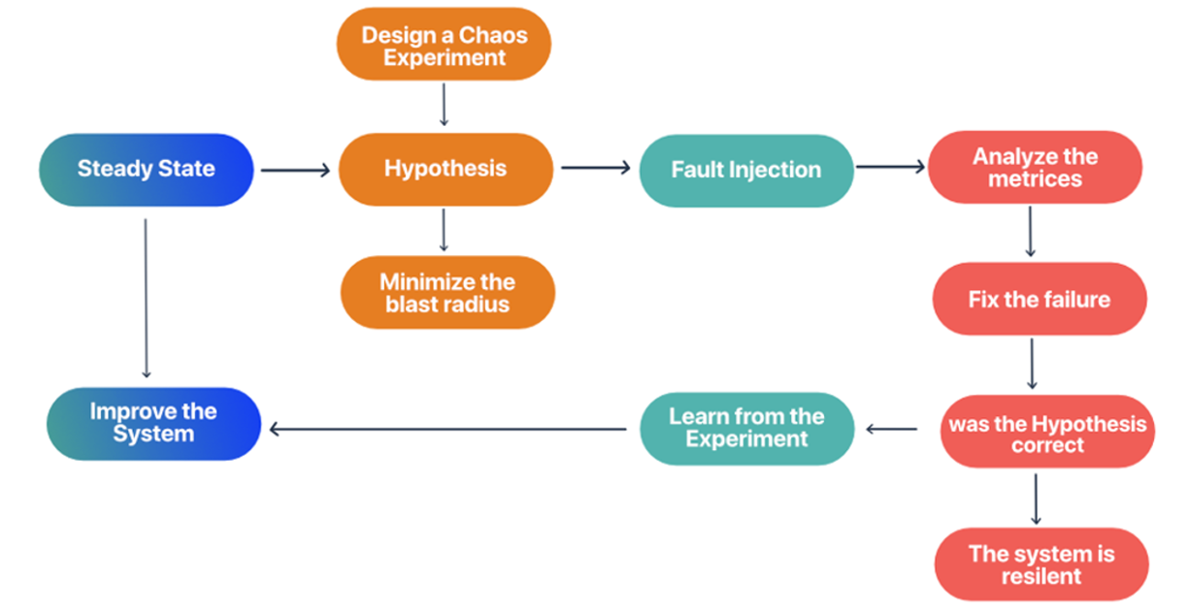
Chaos Engineering
Inject faults into the system to build resilience into the system
How does this work?

Slide 12
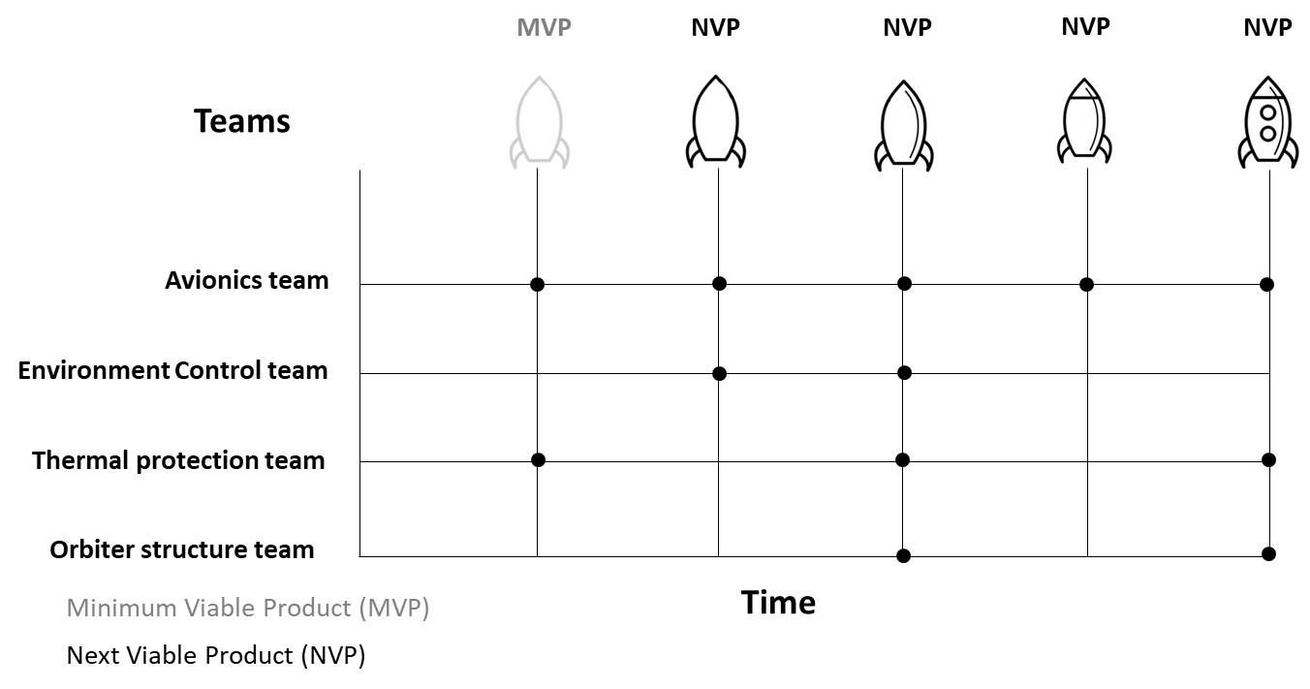
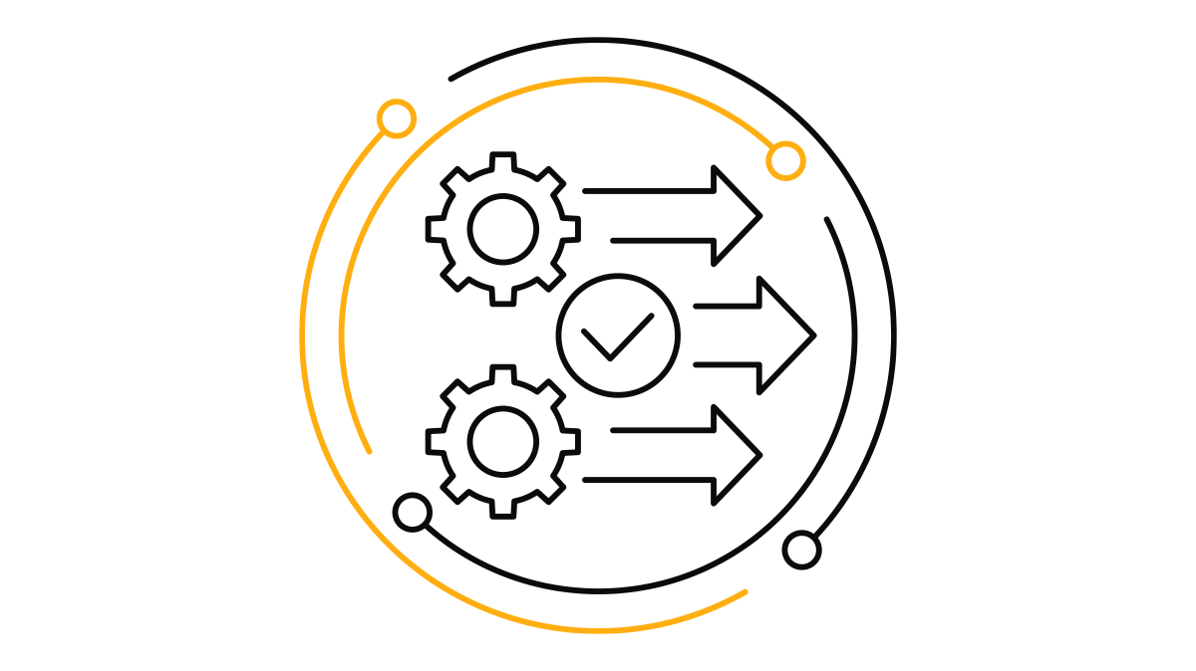
Integrate early and often
Across the entire system

Slide 13
Instrument the system for observability
Intentional development
required to obtain observability

Slide 14
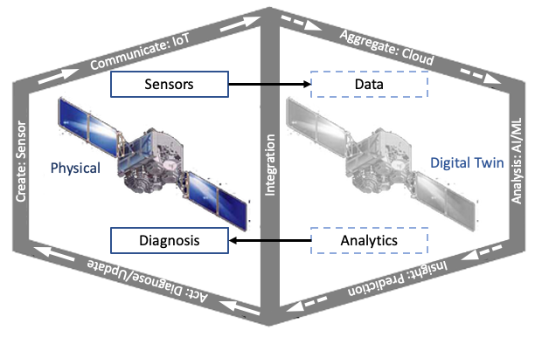
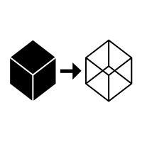
Digital Twins
Validate the product before it exists in the real world and
Iterate regularly

Slide 15
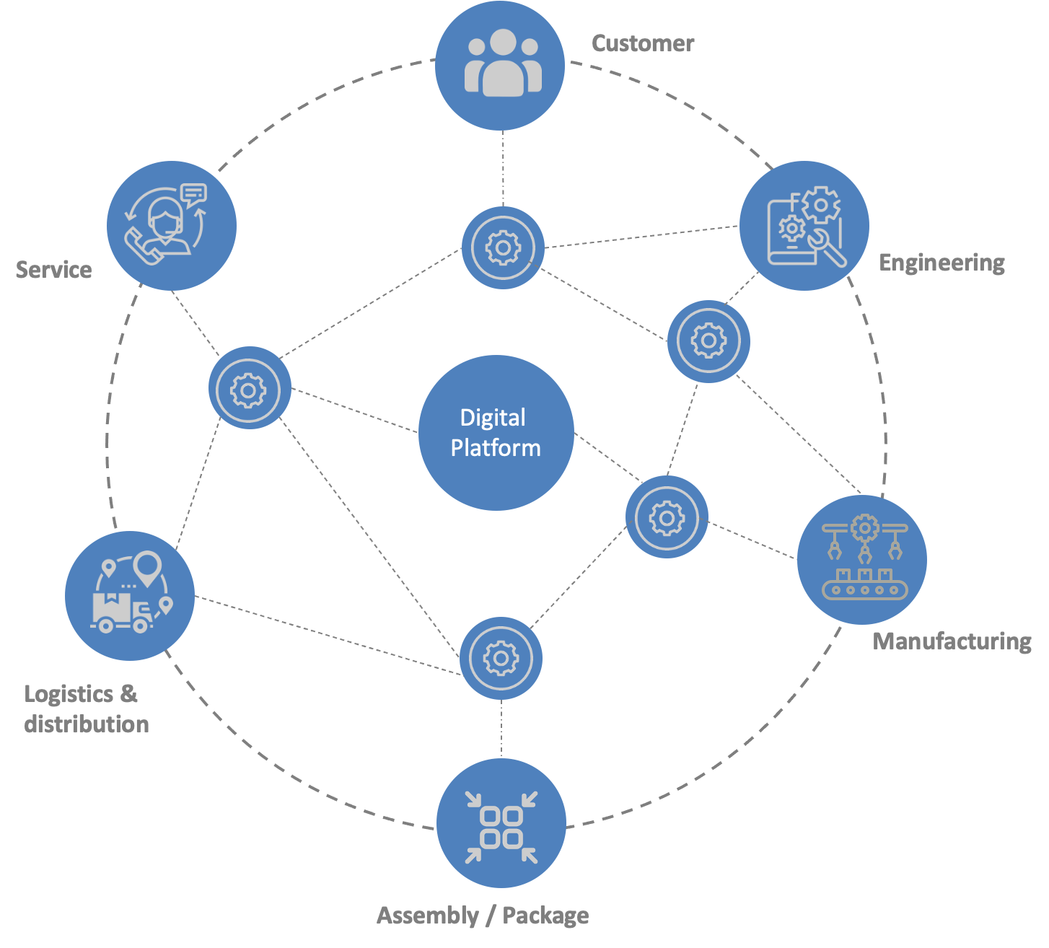
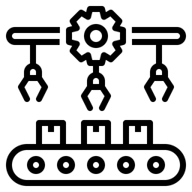
Digital Platform
Don’t forget
Manufacturing
Bringing in manufacturing
early ensures that we can
assemble economically at scale

Slide 16
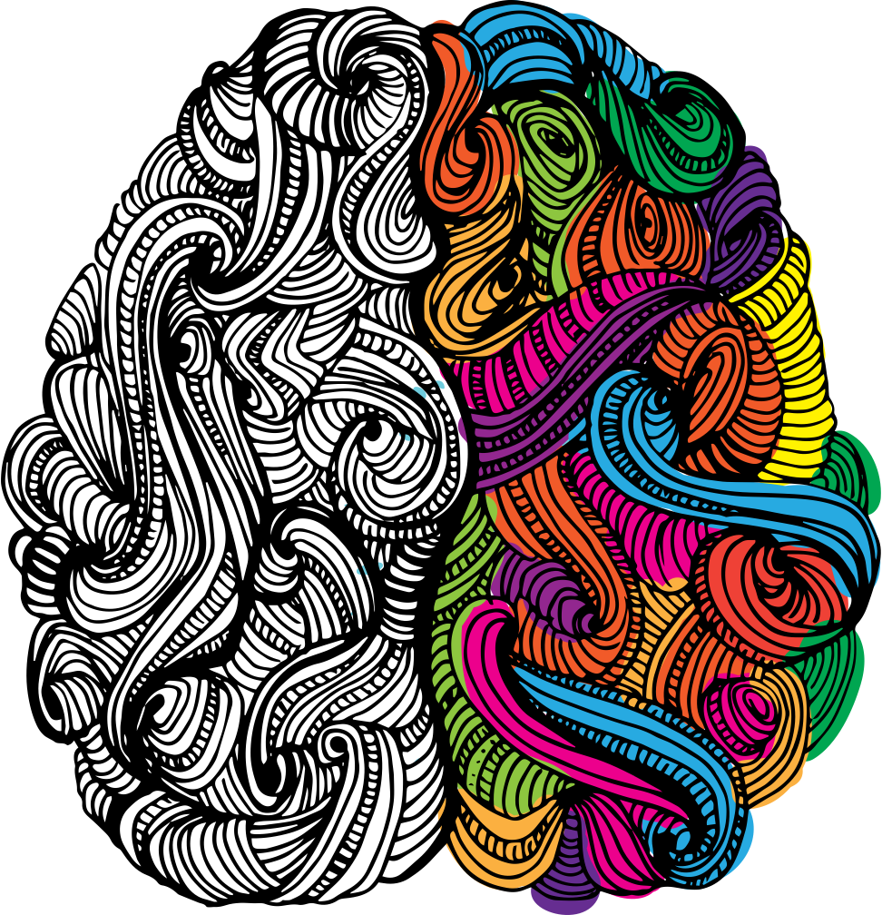
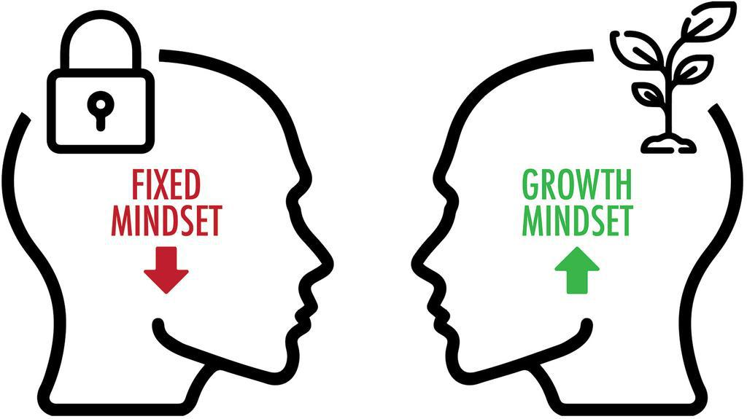
Apply growth mindset
Every data point is an opportunity to learn
"It's kind of fun to do the impossible." - Walt Disney

Slide 17
The goal is to learn faster
Through validated delivery of value!!!
Delivering in the digital Age is different than the industrial age.

Slide 18
Questions

