Slide 1
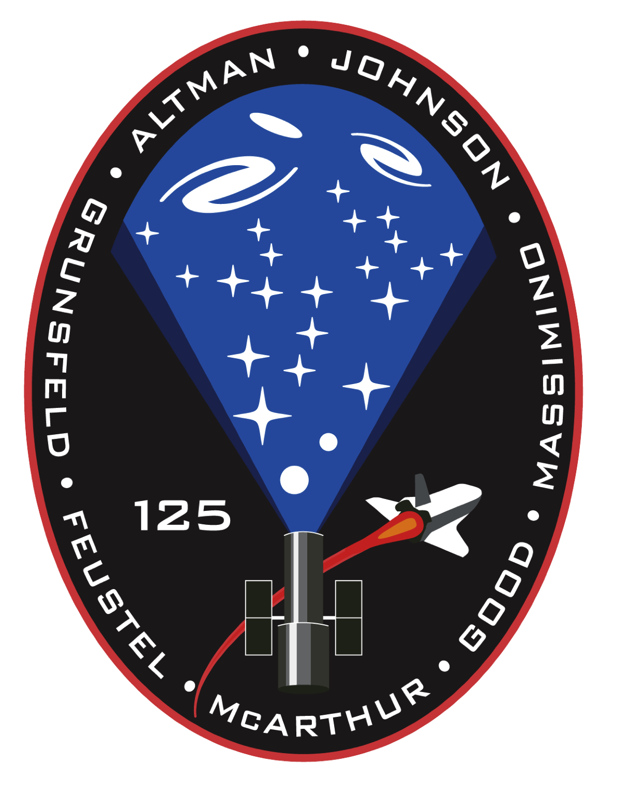
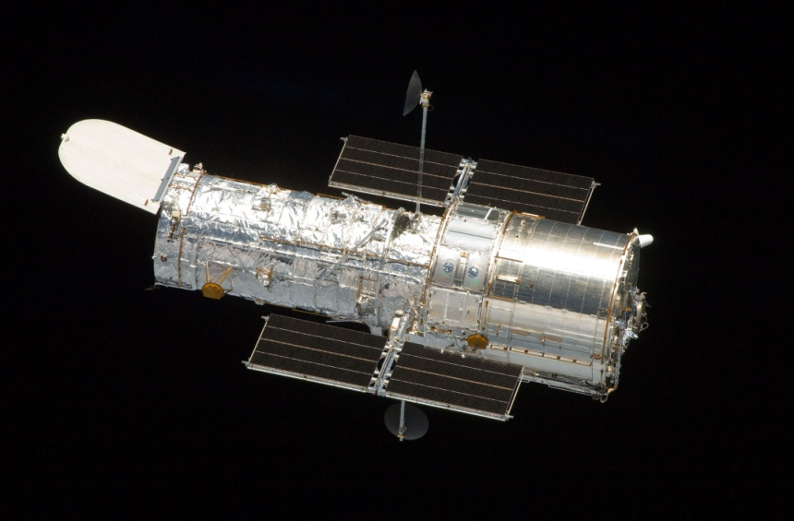

Slide 2
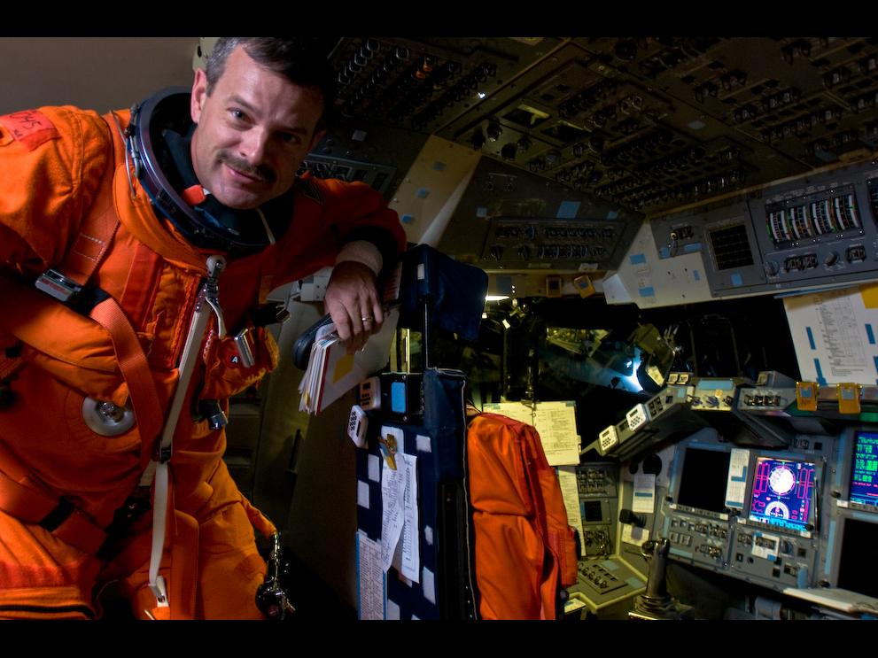
Scott Altman
CDR, STS-125
Hubble Servicing Mission 4
Reach for the Stars!
How V&V Makes it Happen
27 September 2023

Slide 3
Verification and Validation (V&V)
V&V is a disciplined approach to assessing select products, along with associated product components and work products, throughout the lifecycle of a system, service, facility, or operational change. The conduct of V&V ensures that a quality product is built and that it satisfies operational requirements and service needs.

Slide 4
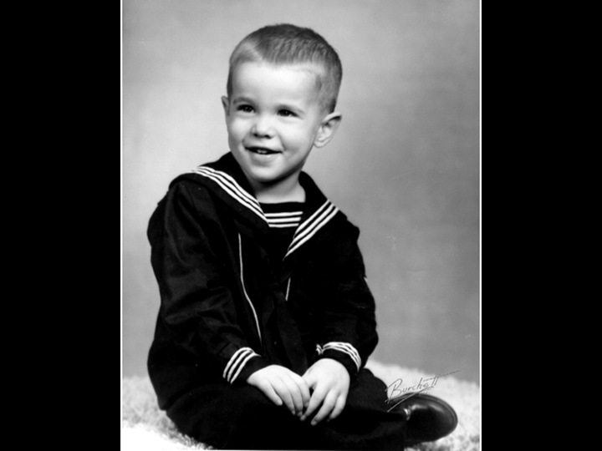

Slide 5
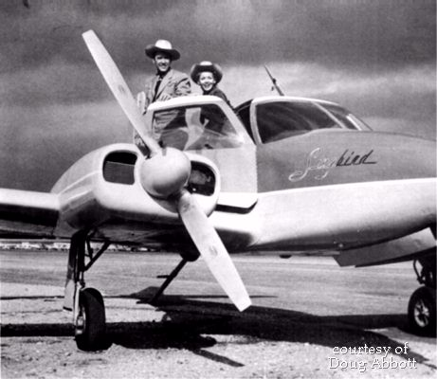

Slide 6
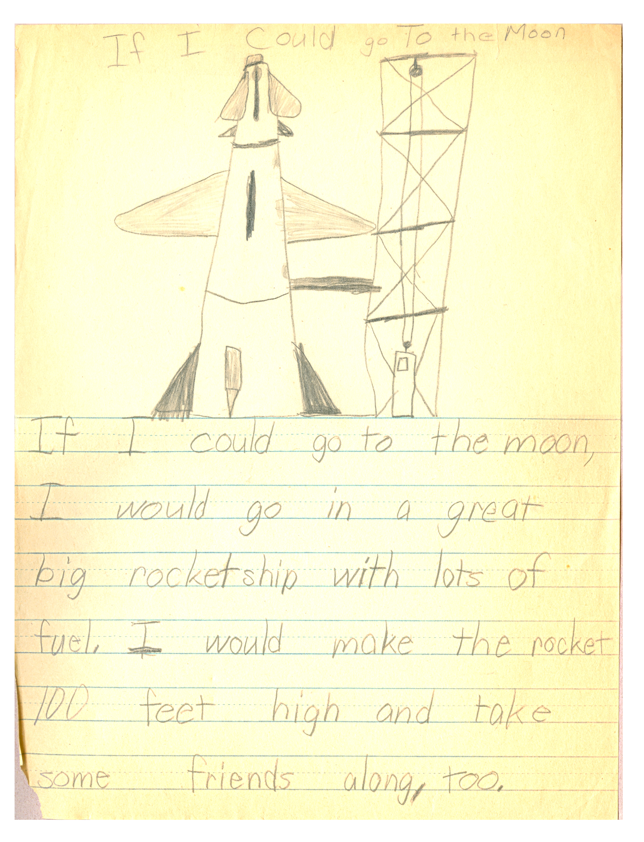

Slide 7
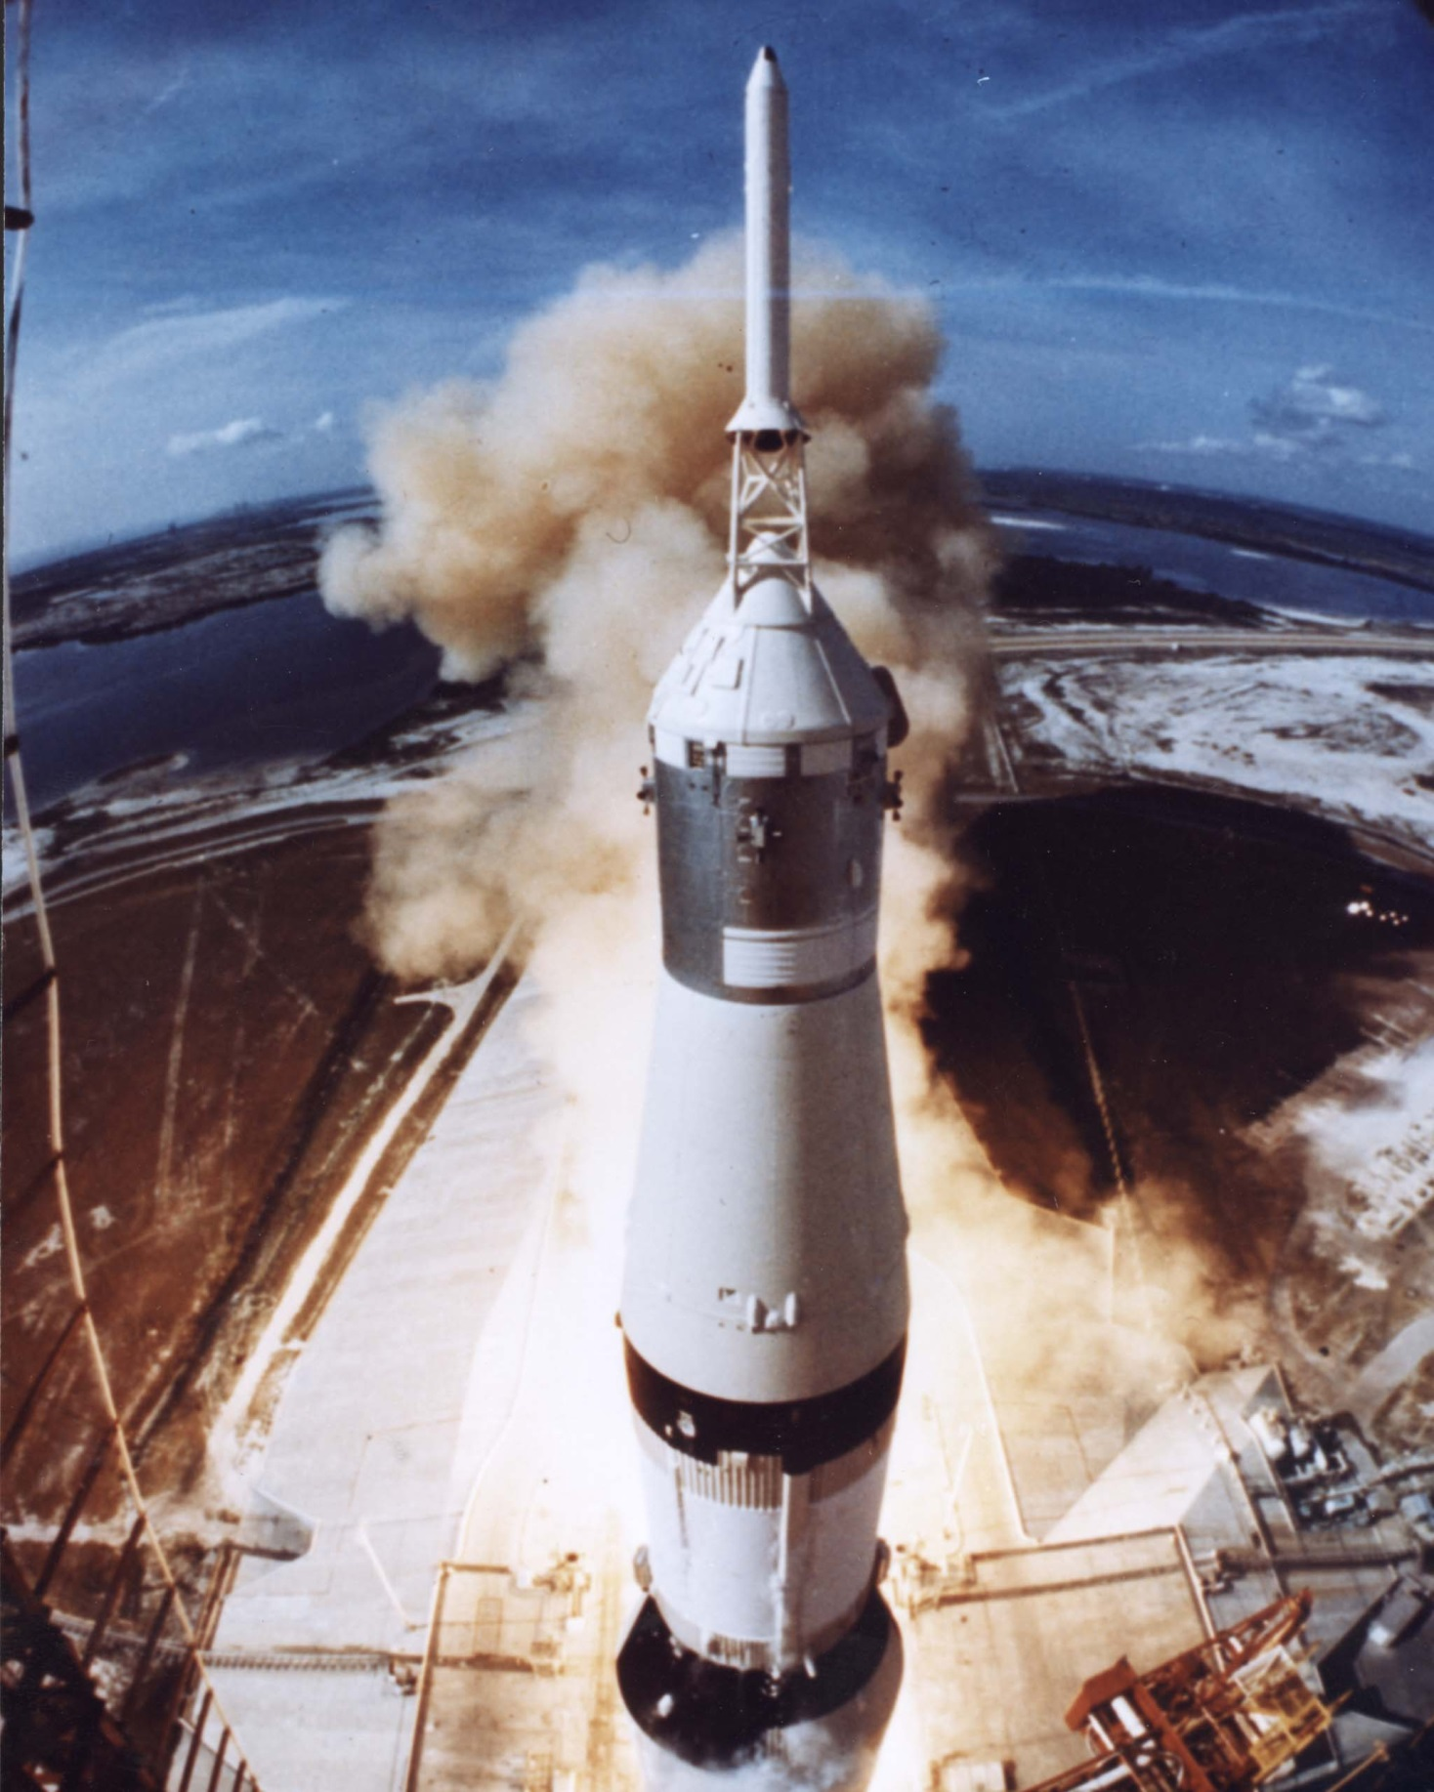

Slide 8
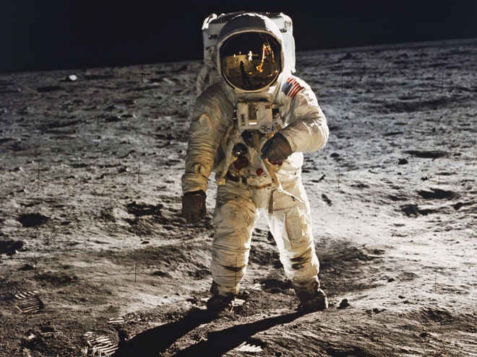

Slide 9
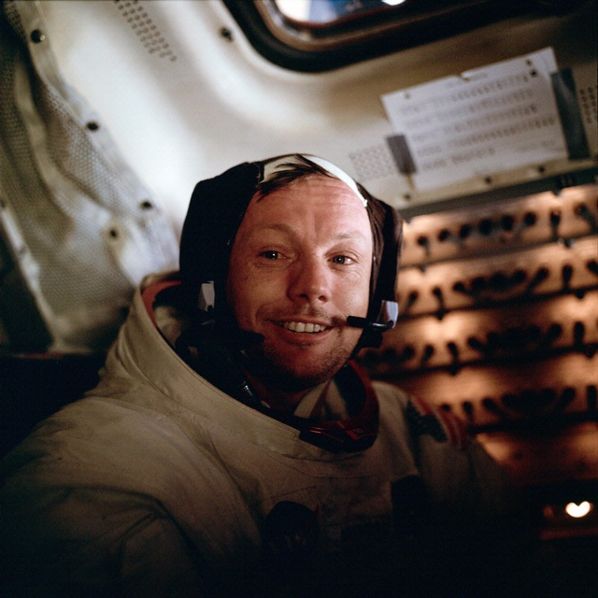

Slide 10
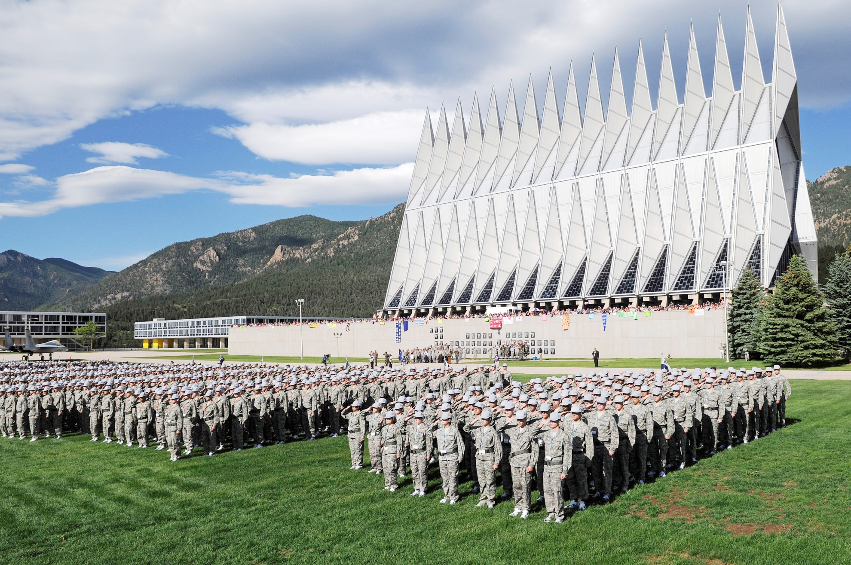
Air Force Academy
Notes:
Edison, paperboy, high school basketball, dreams,

Slide 13
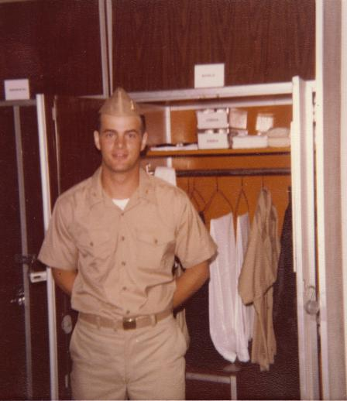

Slide 14
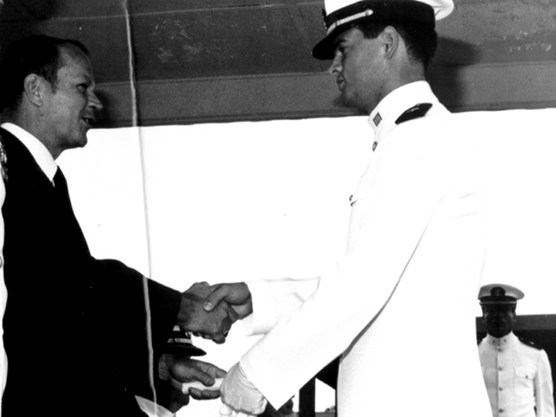

Slide 15
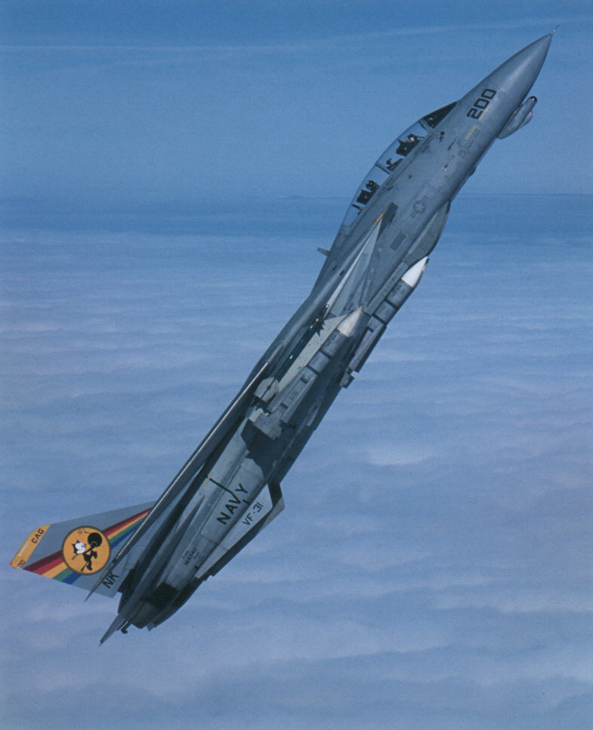

Slide 16
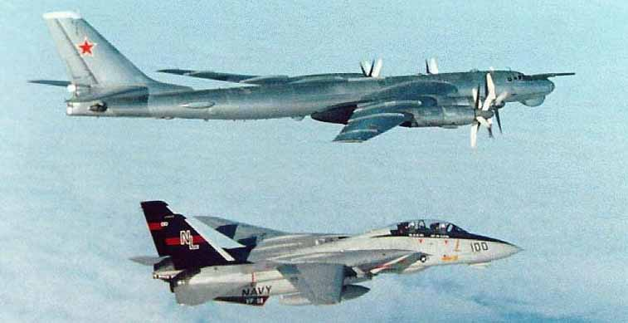

Slide 18
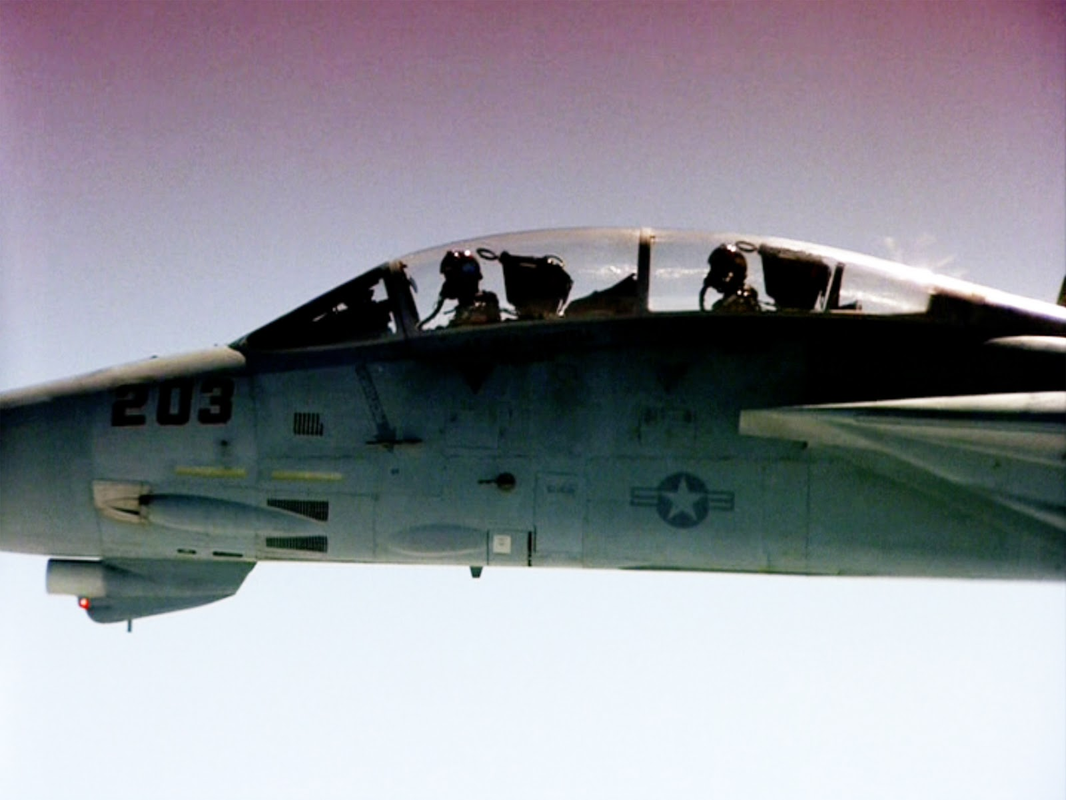

Slide 20
Top Gun: Maverick saves Cougar:
https://youtu.be/ZYXFTKSEEO0?si=rFhMsRvzyDH9BsbT&t=337

Slide 22
Tom Cruise buzzes the control tower | Top Gun | CLIP
https://www.youtube.com/watch?v=1IzH_R4EXMw

Slide 26
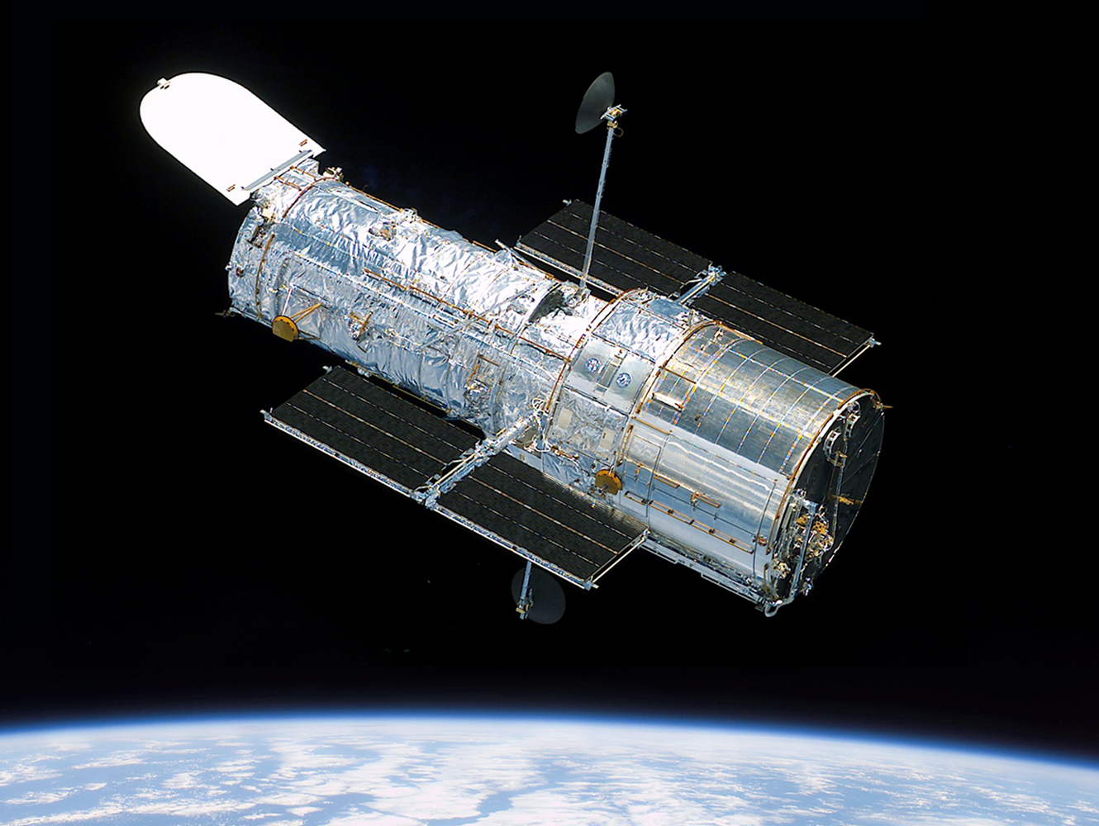

Slide 27
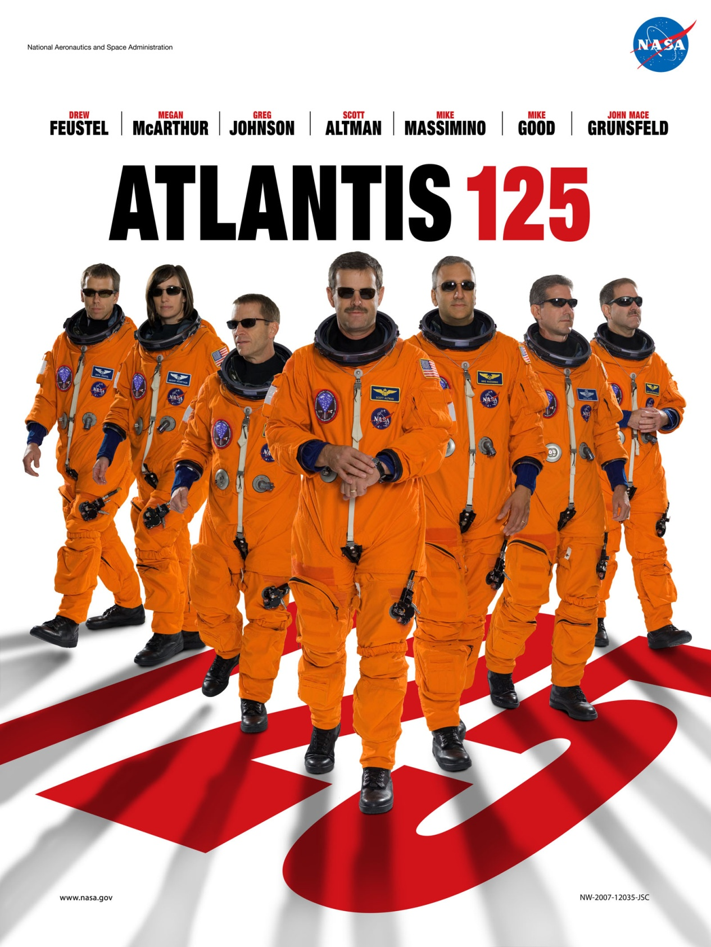

Slide 28
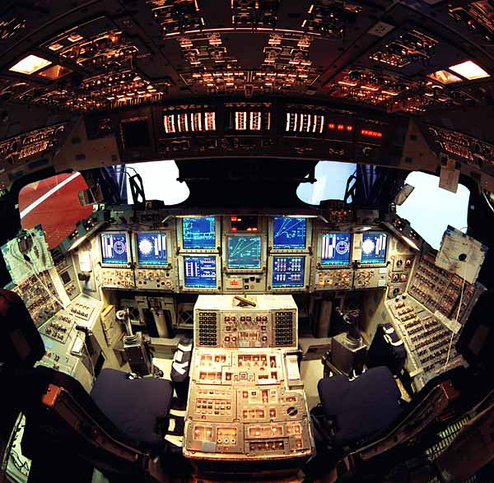

Slide 29
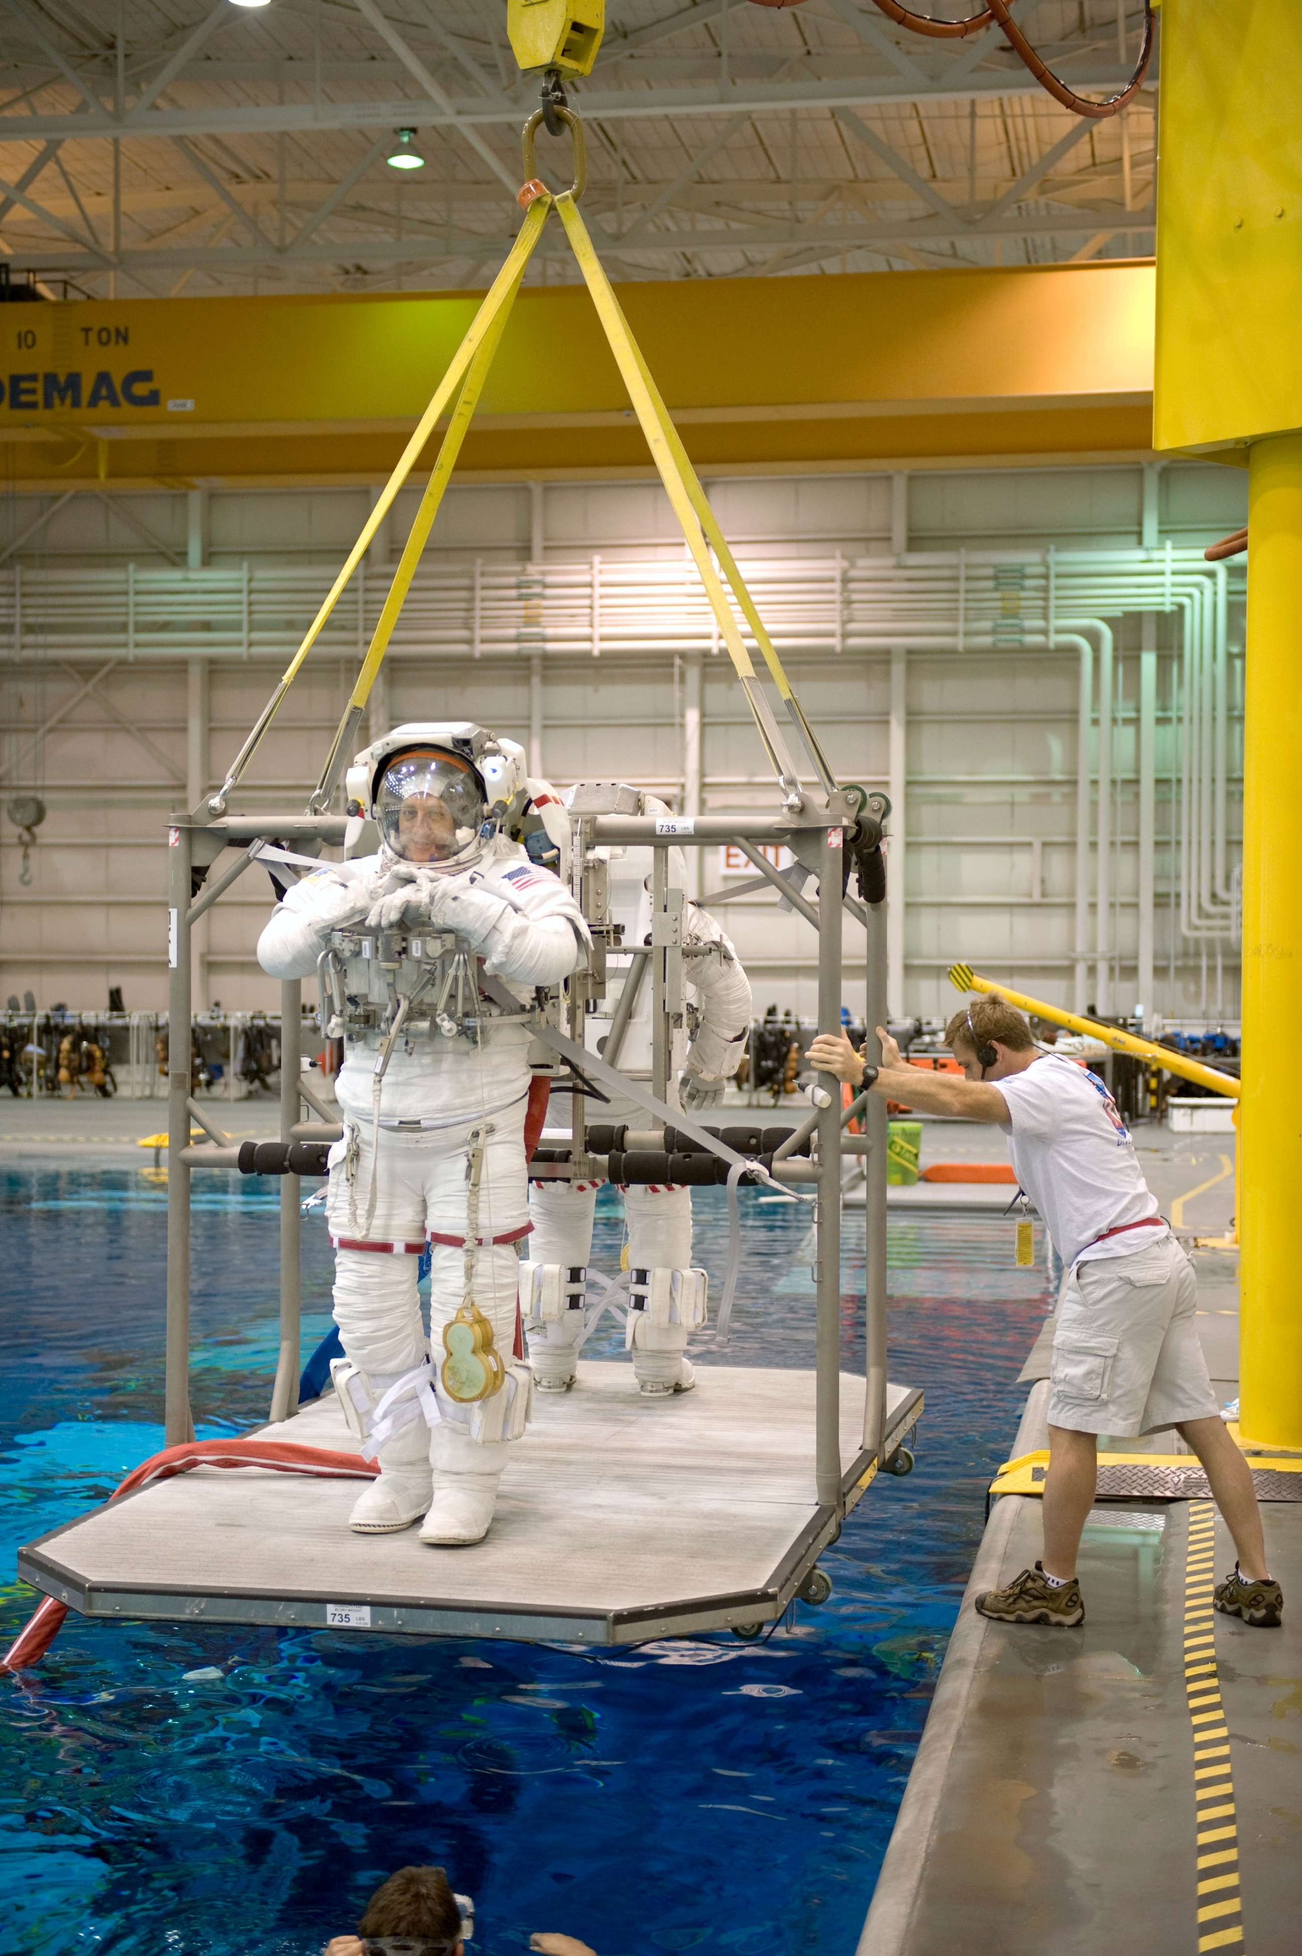

Slide 30
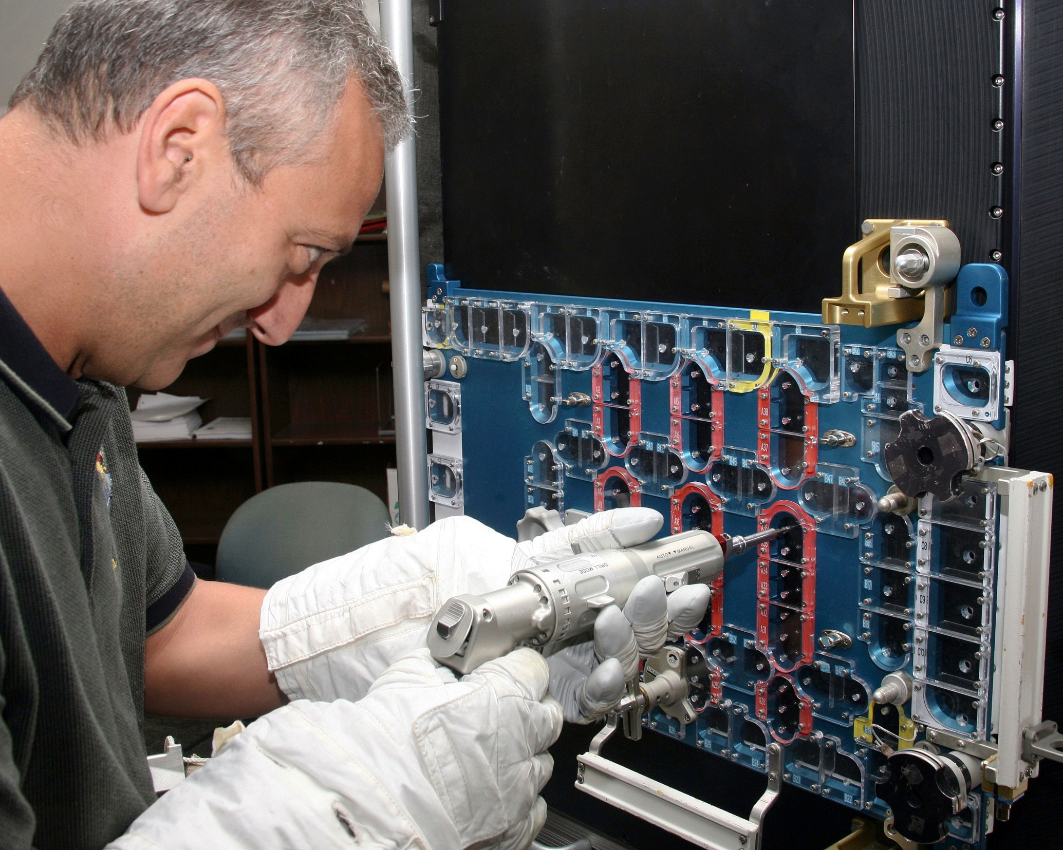

Slide 31
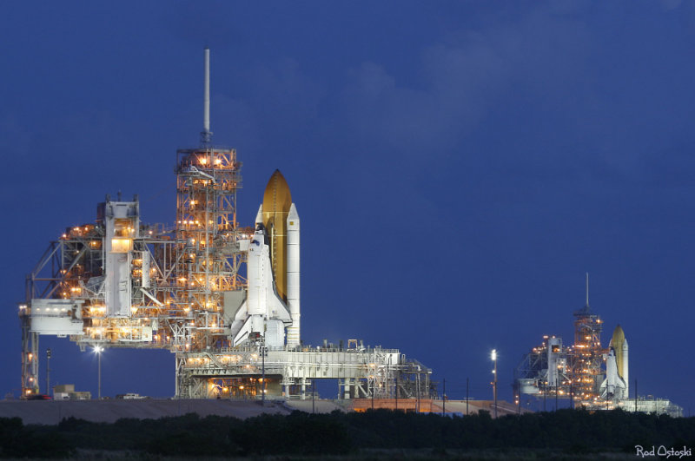

Slide 33
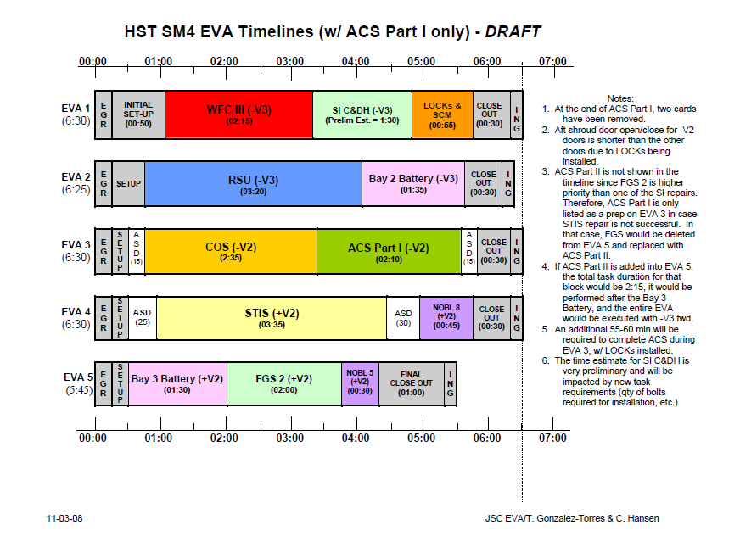

Slide 34
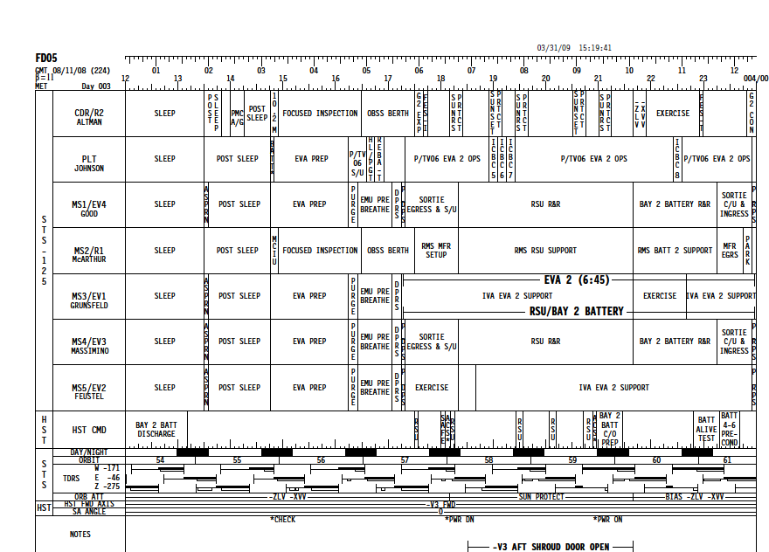

Slide 36
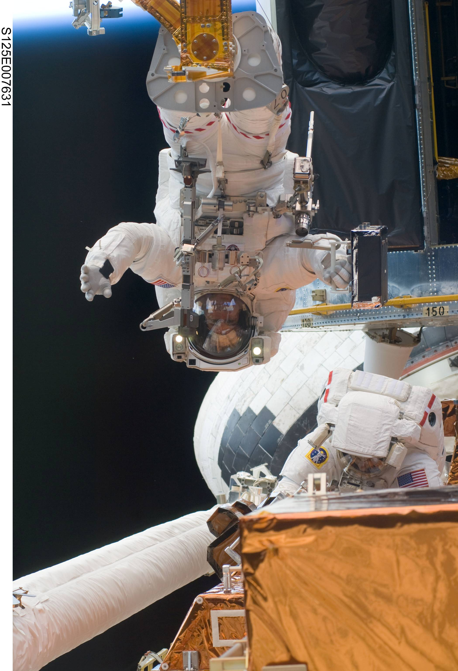

Slide 38
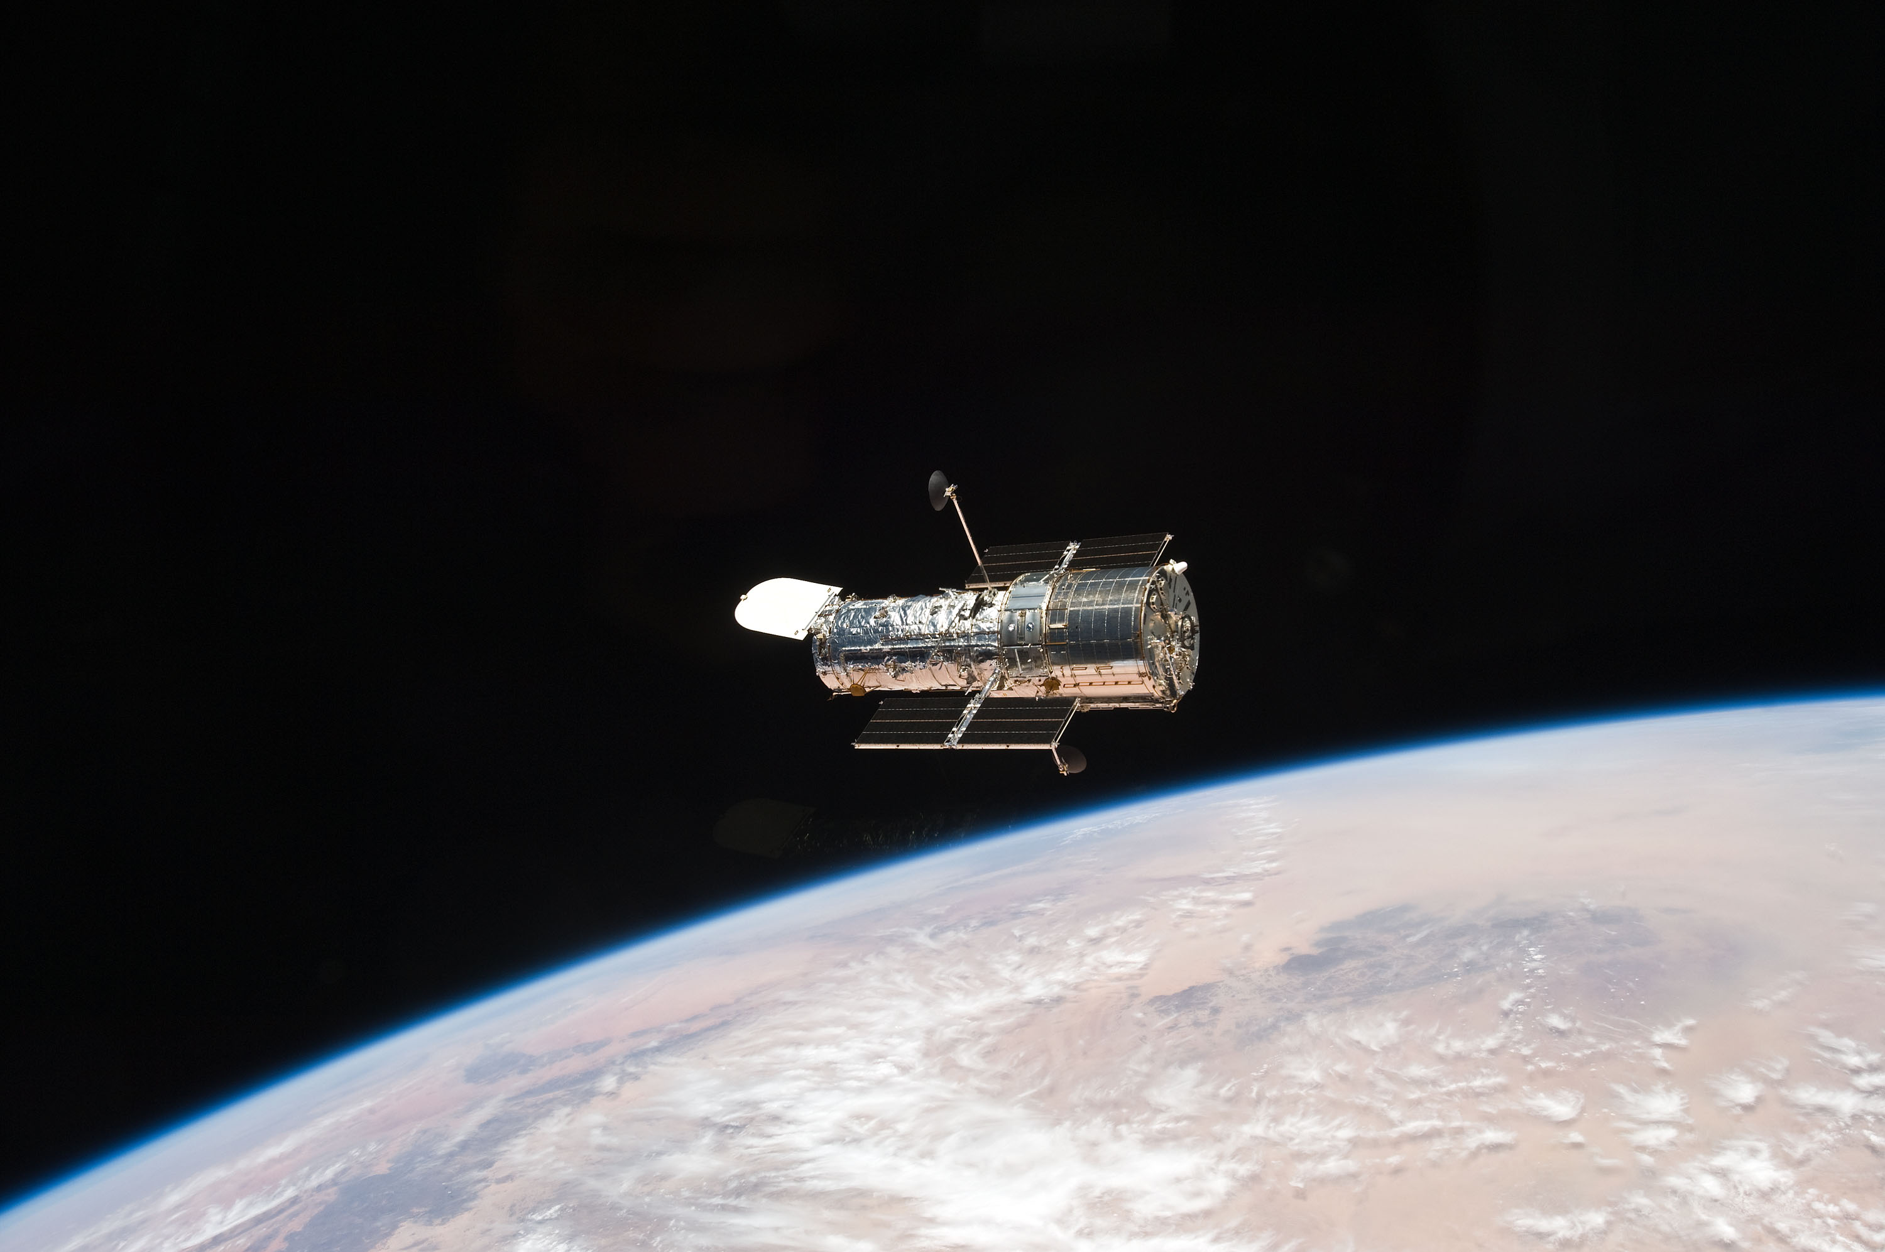

Slide 39
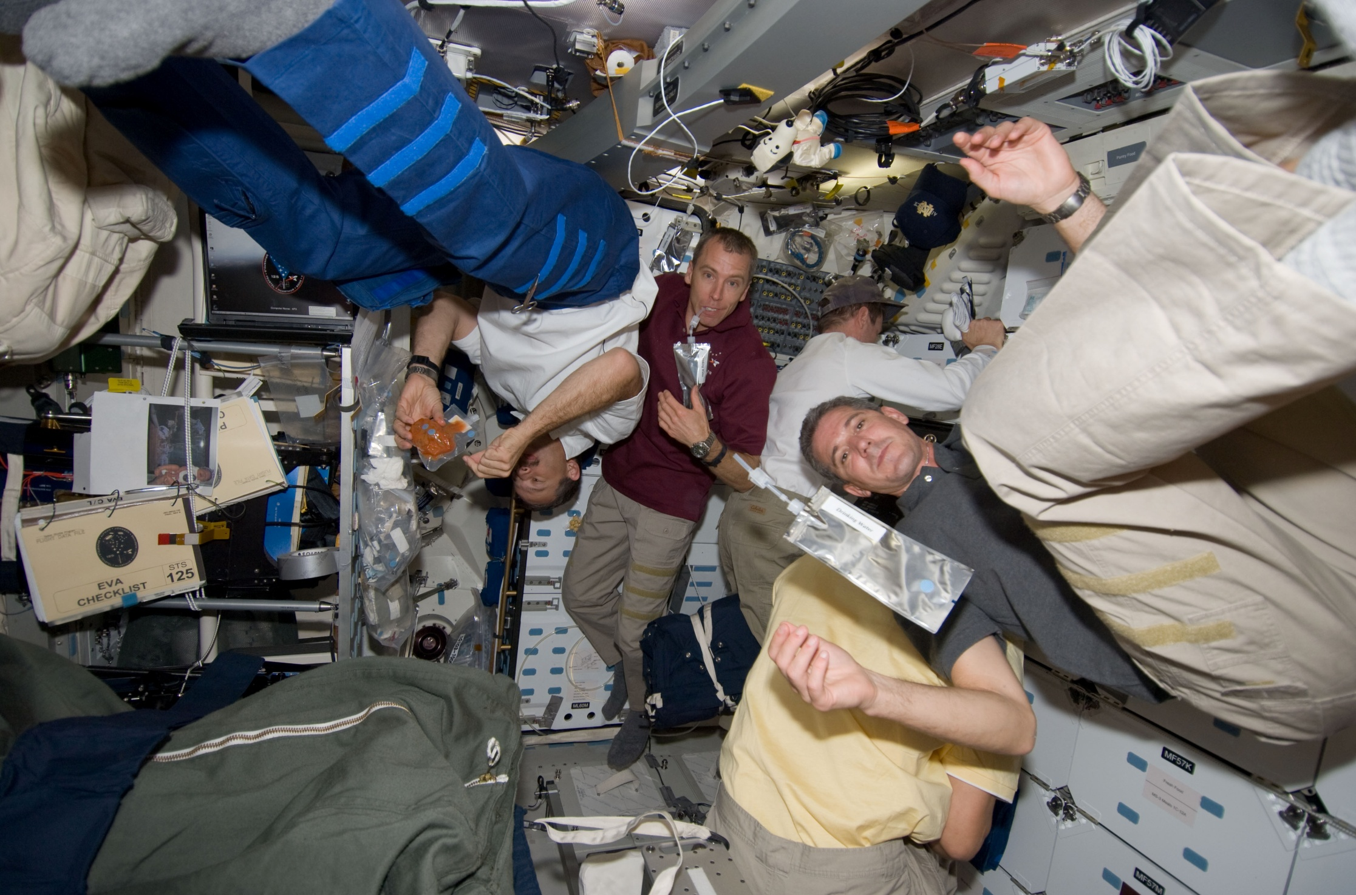

Slide 41
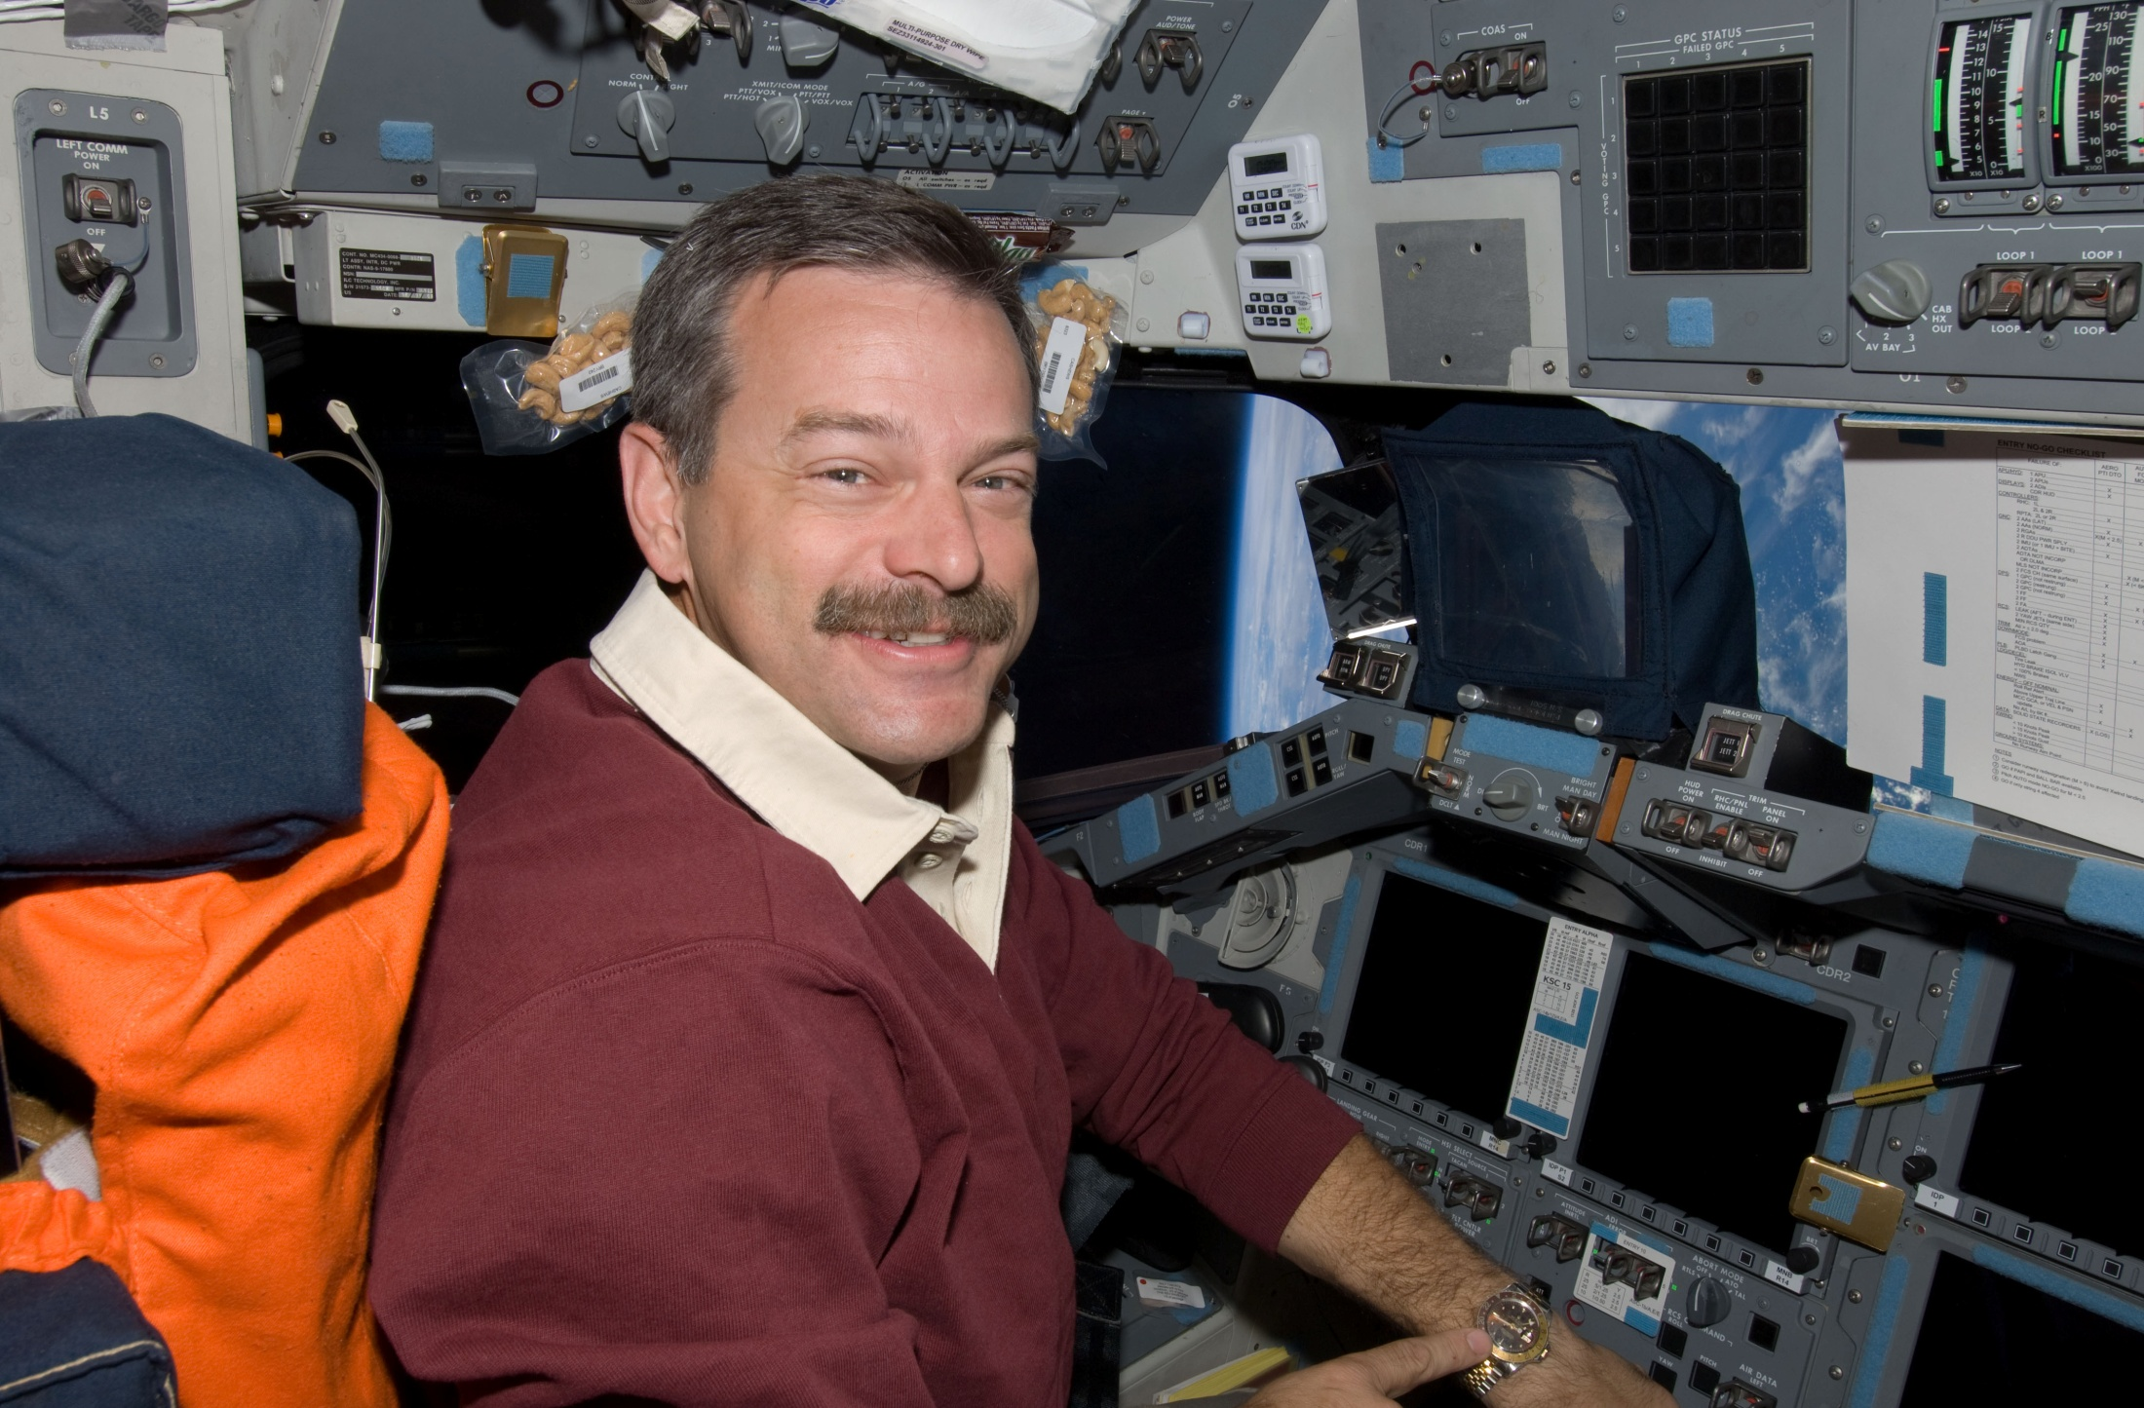

Slide 42
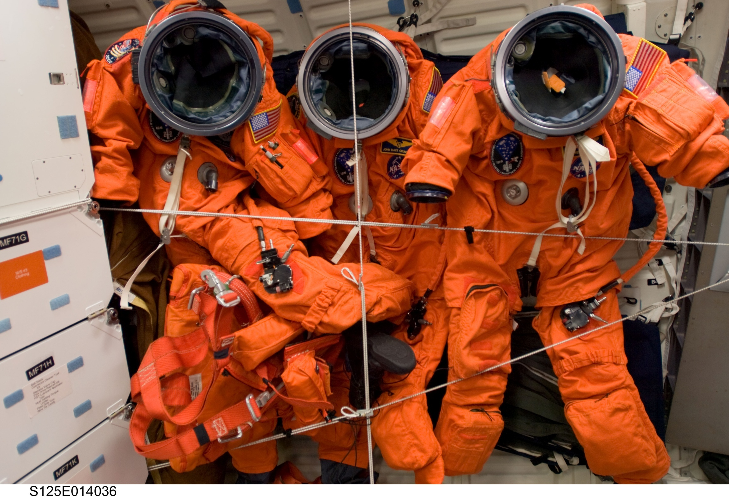

Slide 43
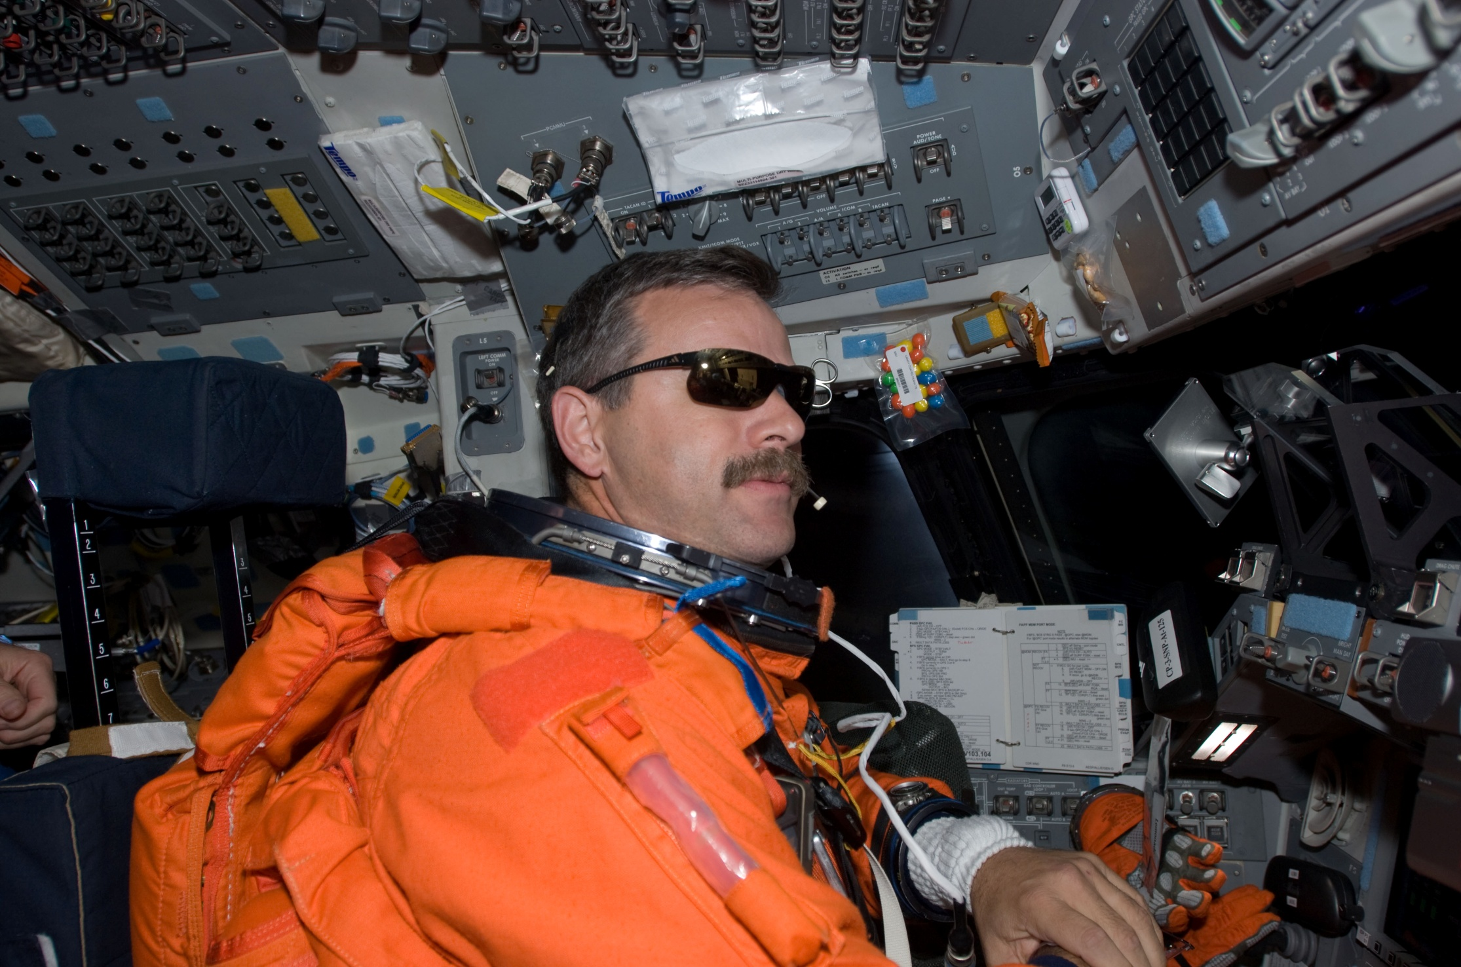

Slide 45
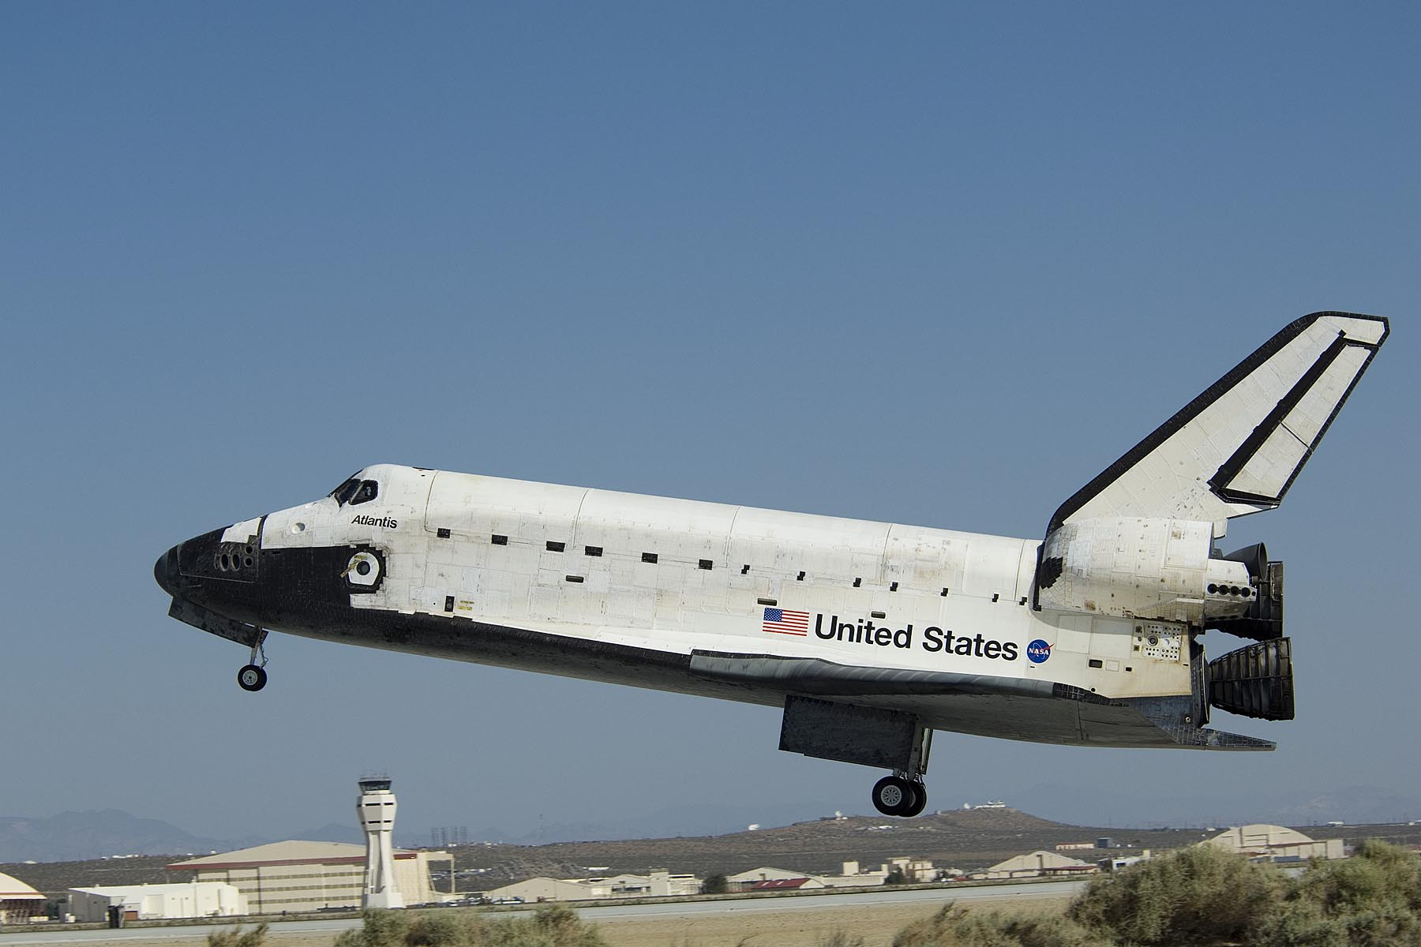

Slide 46
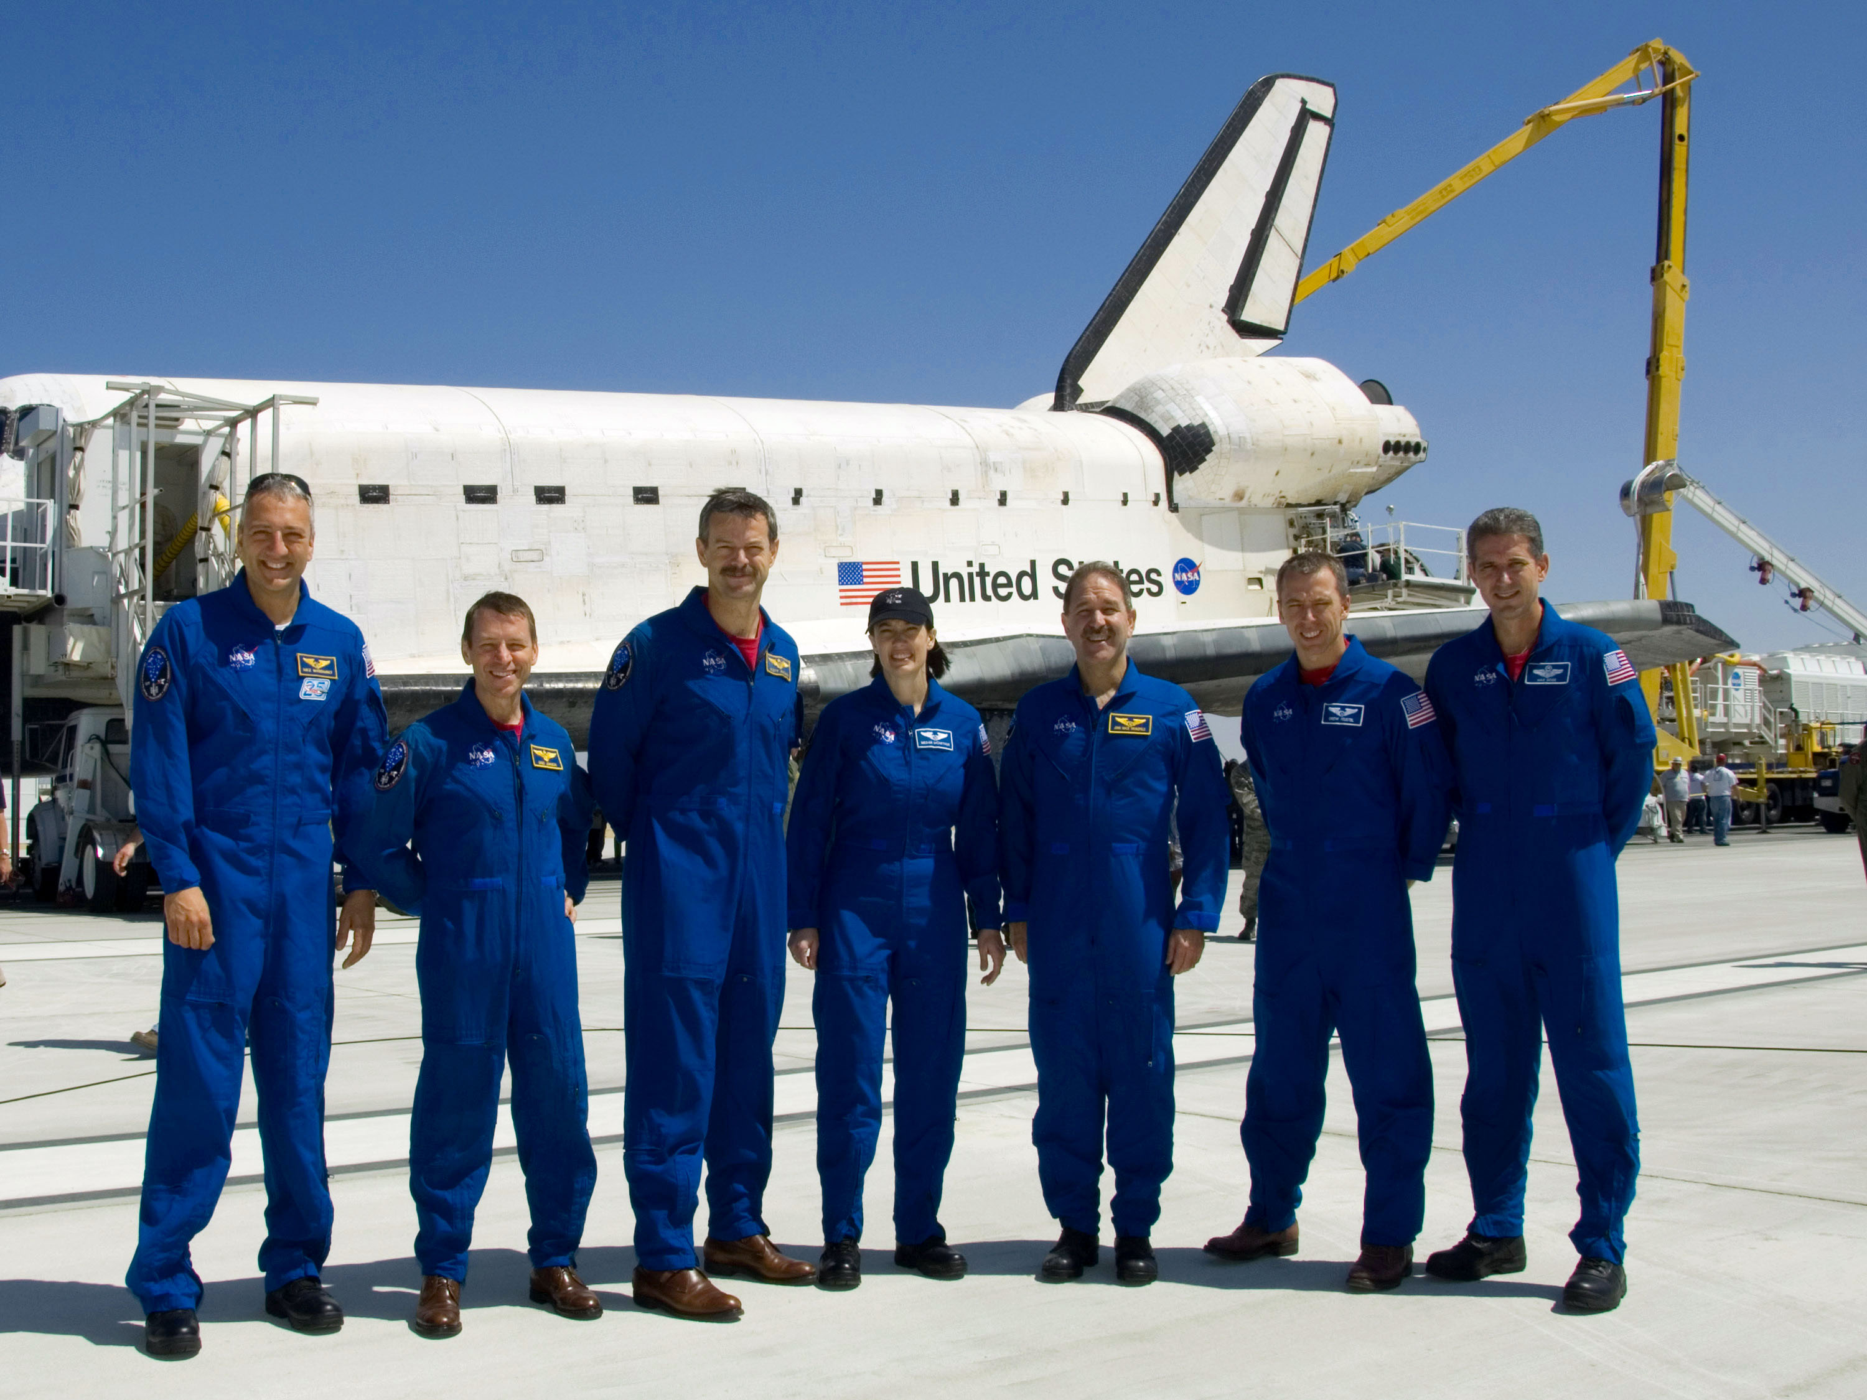

Slide 47
What elements made the flight a success?
Commitment to a common goal
Repair and Renew Hubble
Teamwork and Support
Crew, JSC, GSFC, KSC, HSV, MAF, ARC, SSC
Communication
Stay in sync, identify needs, meet requirements
Preparation
Over 3 years dedicated, with extra hours across all teams
Imagination
Ability to use skills in new ways in flight to accomplish the job

Slide 48
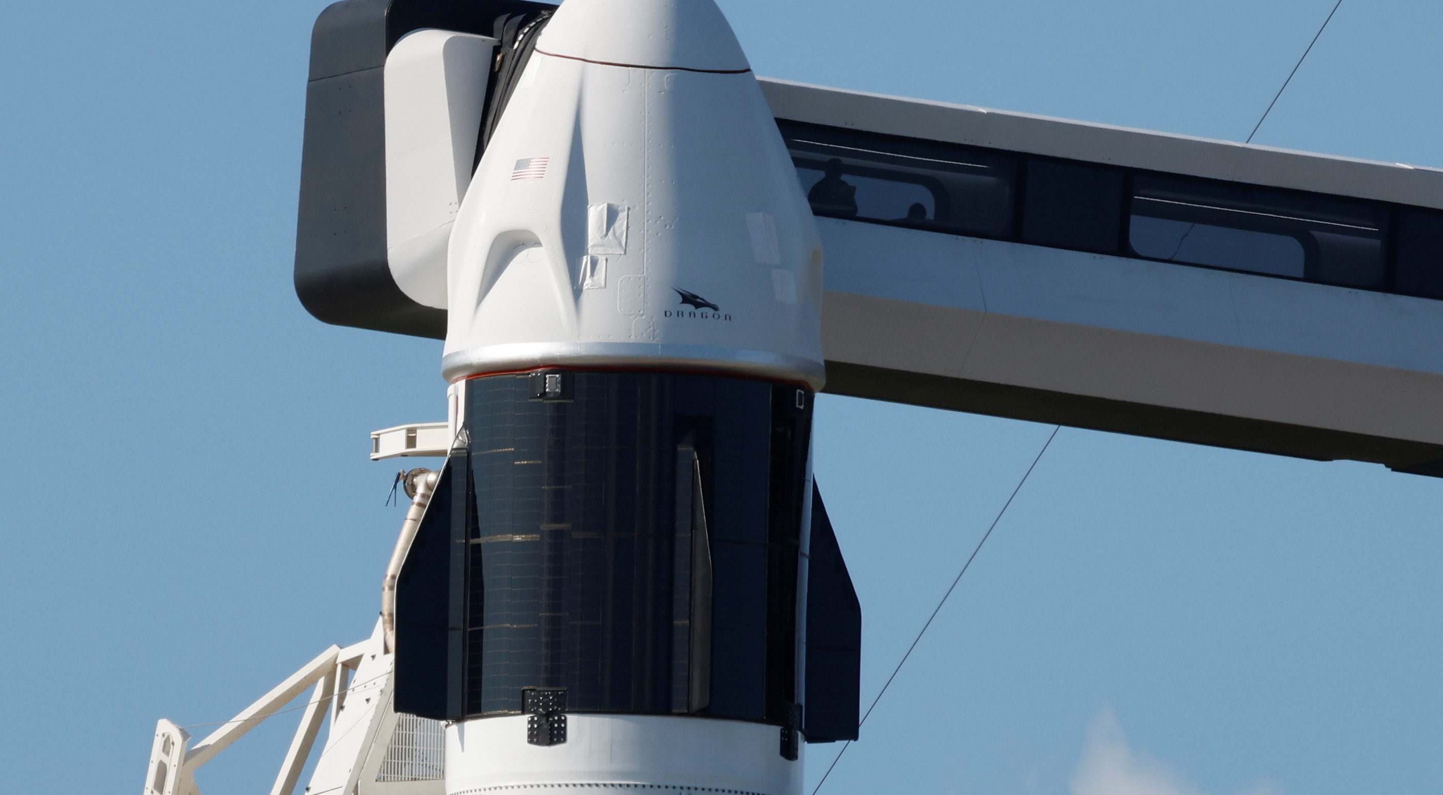

Slide 49
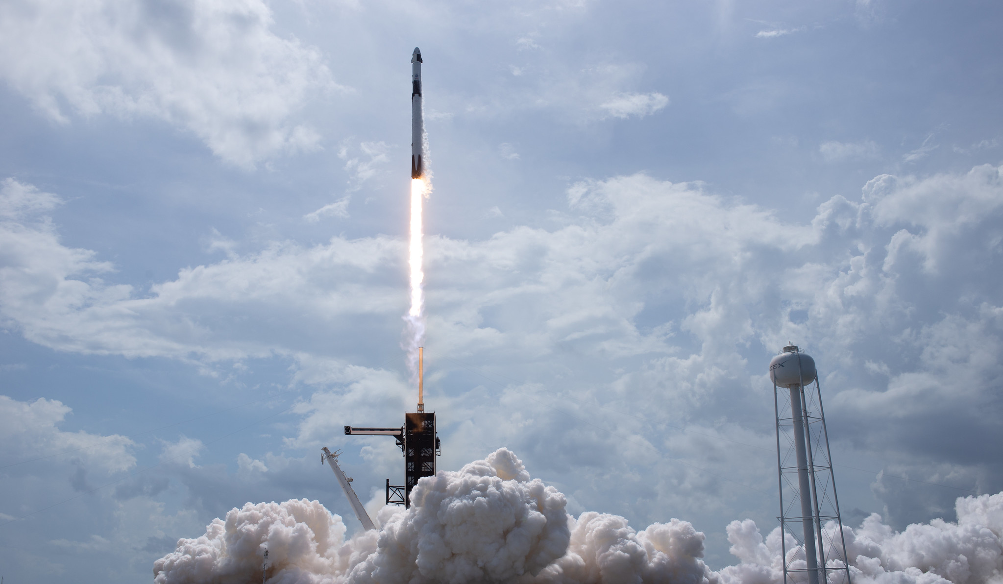
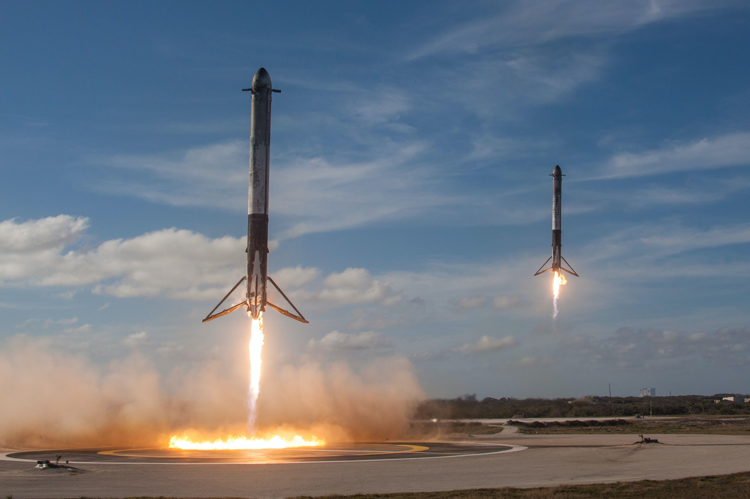

Slide 53
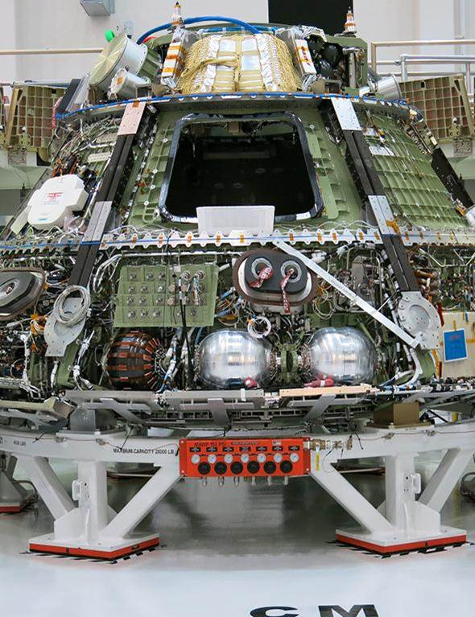
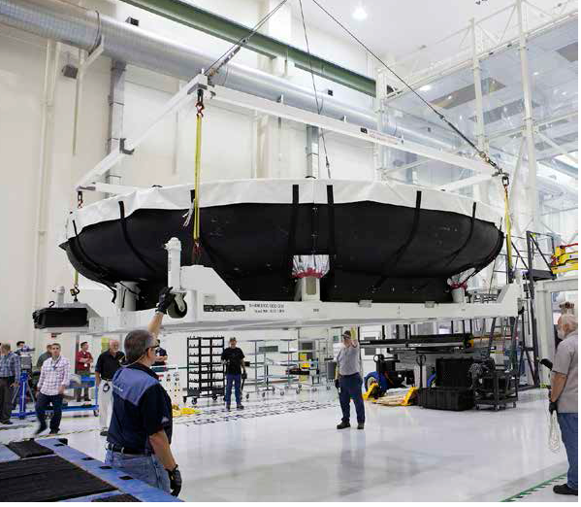
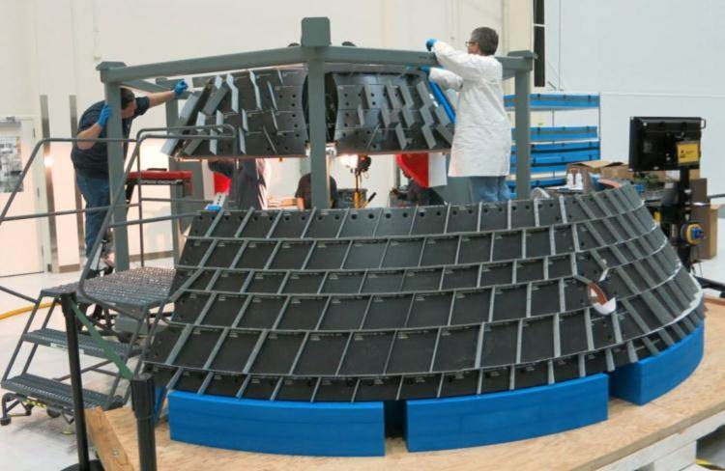
Building the Orion Vehicle at KSC

Slide 54
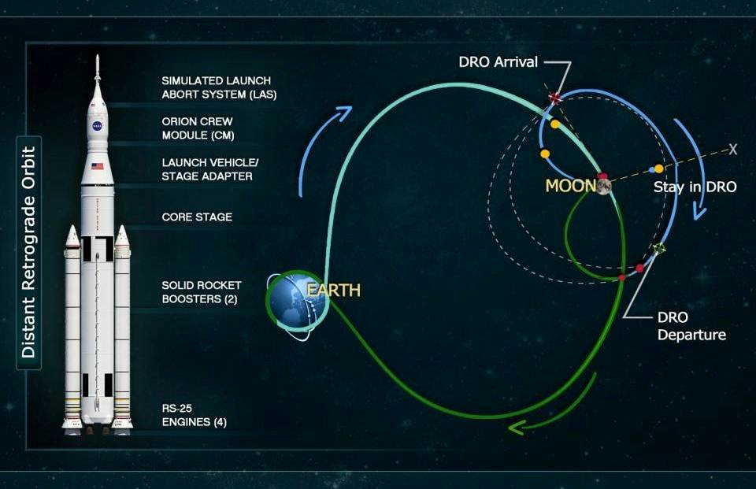
Orion support to Lockheed Martin

Slide 55
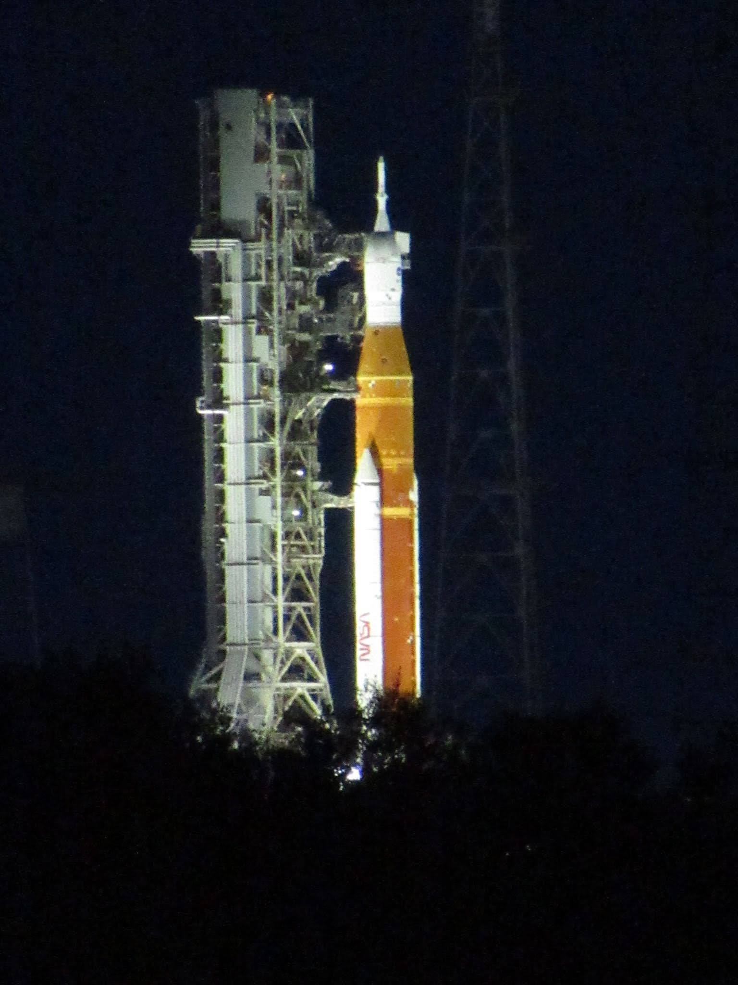

Slide 56
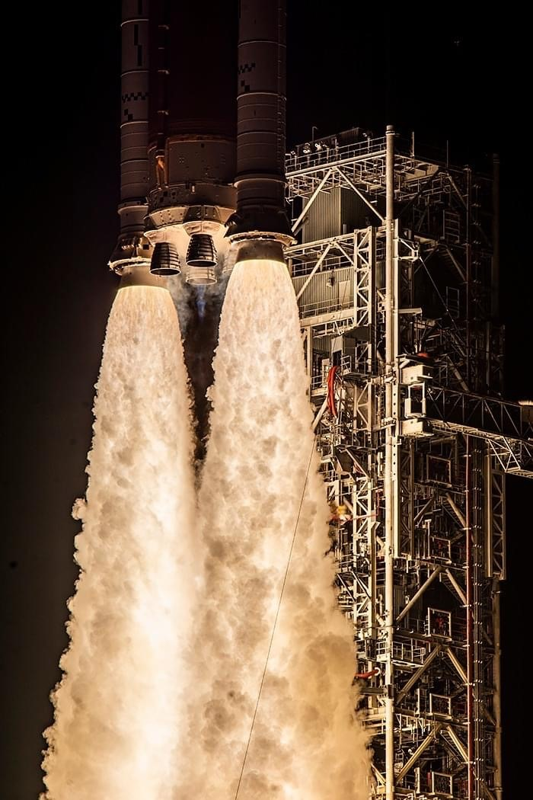

Slide 57
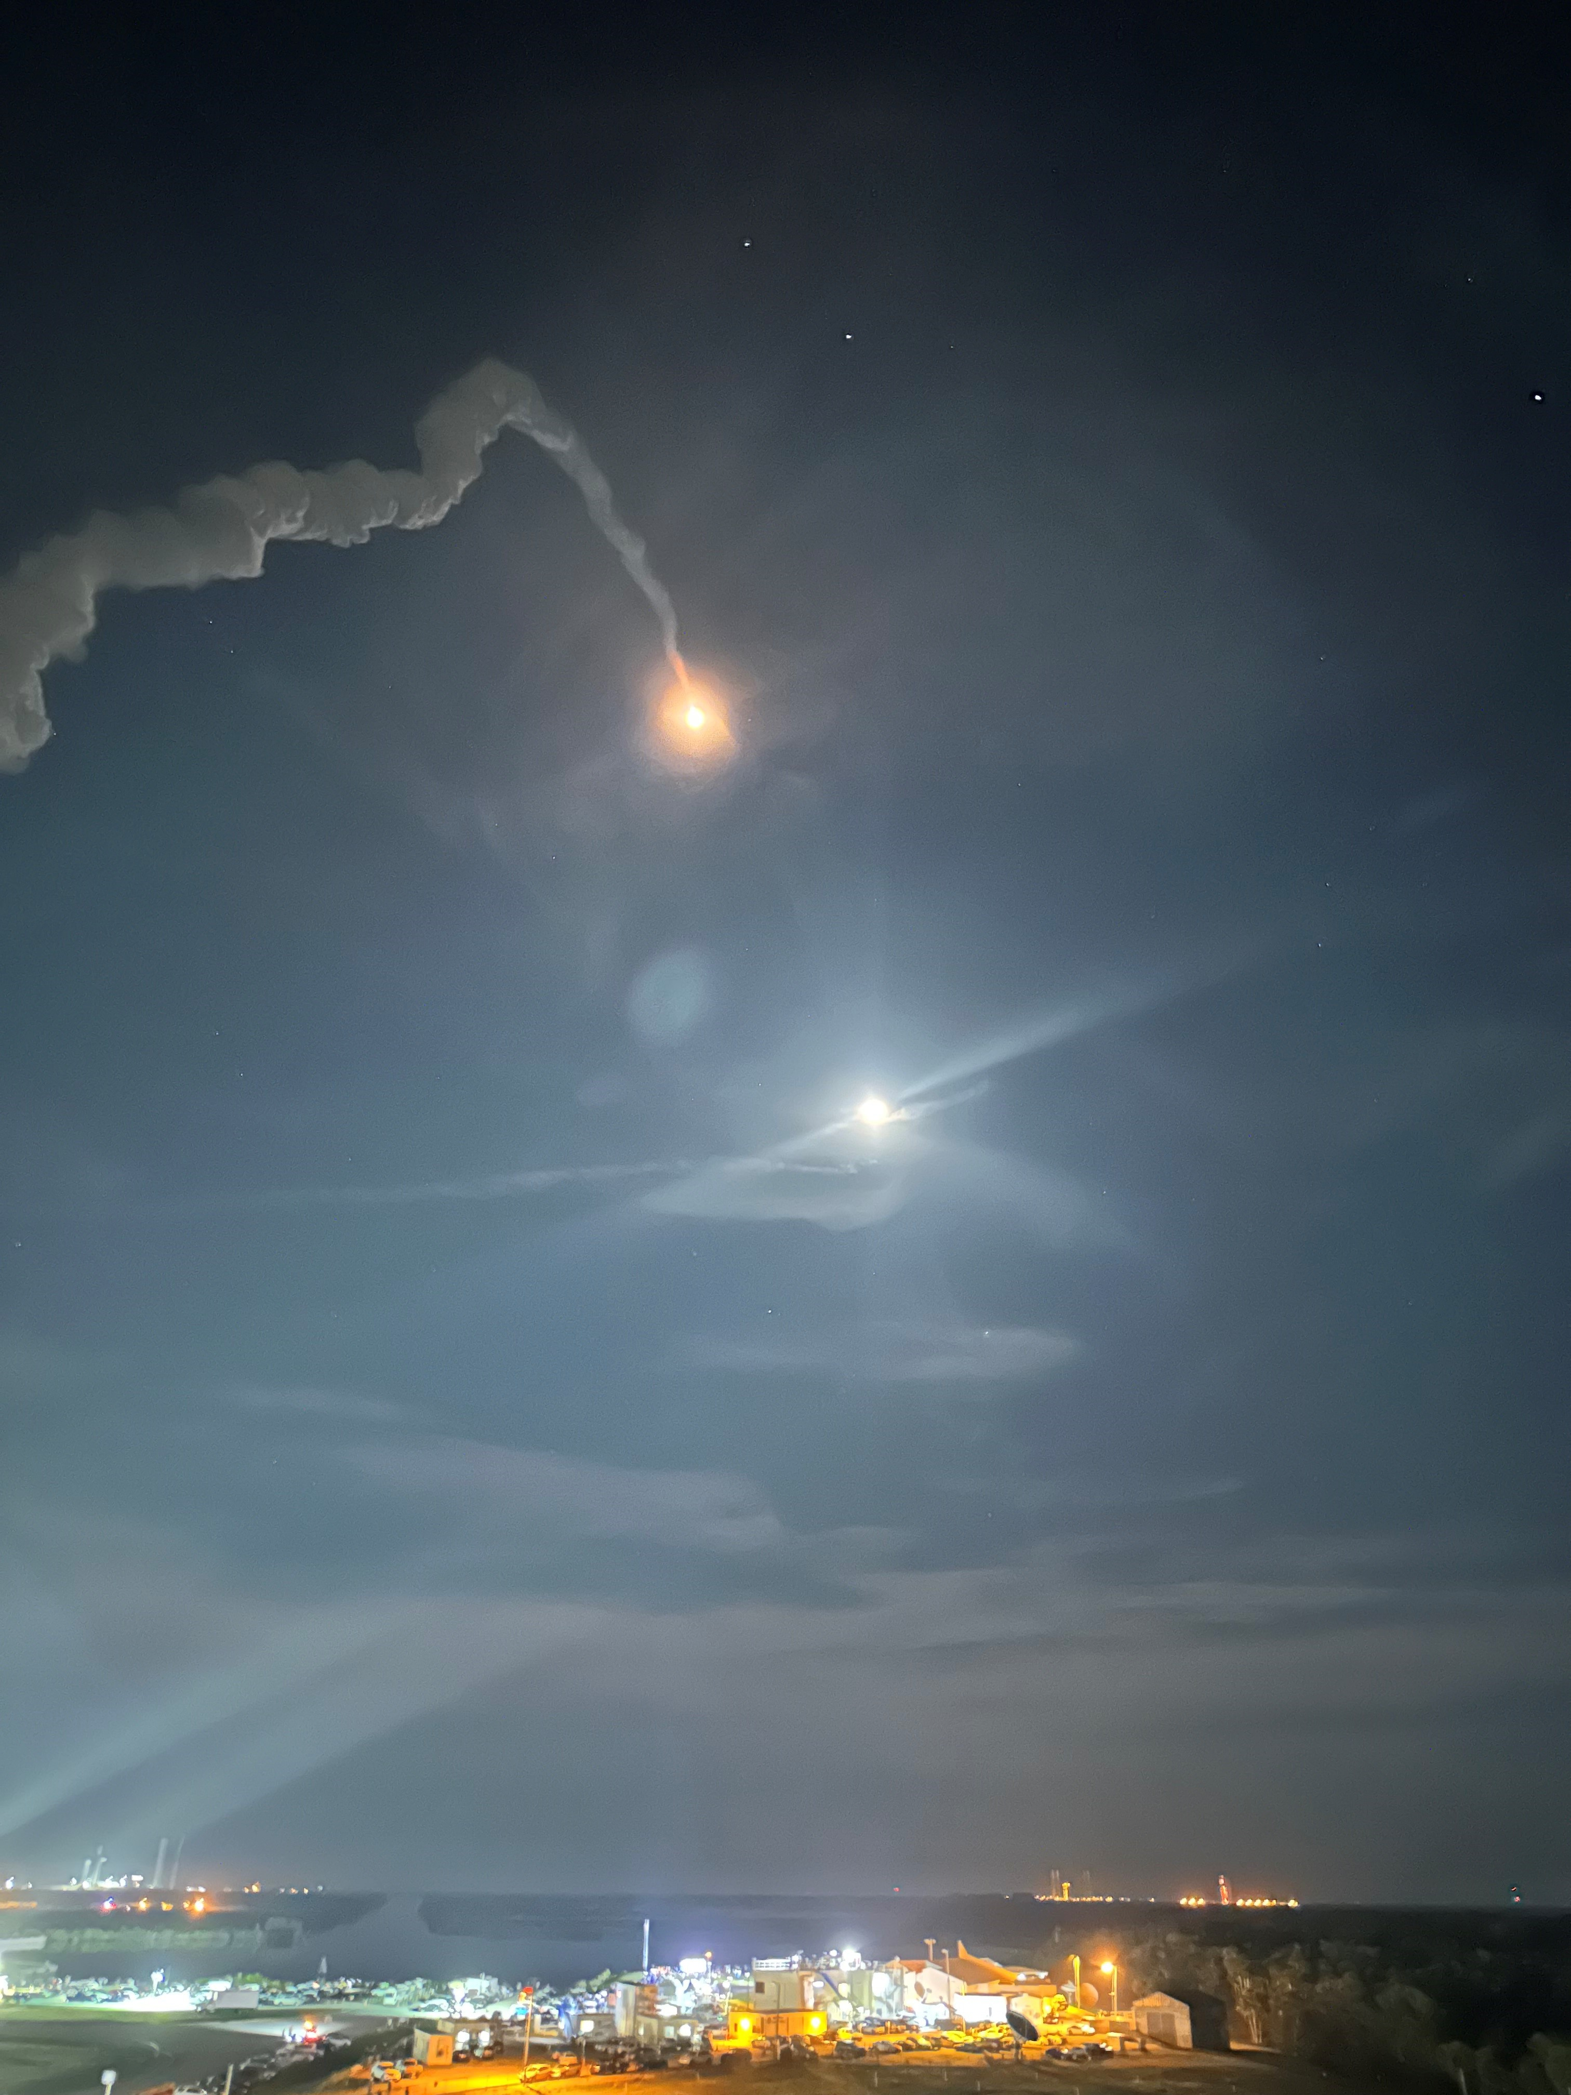

Slide 58
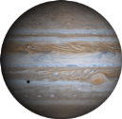
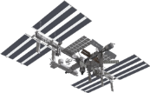
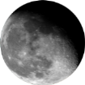
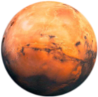
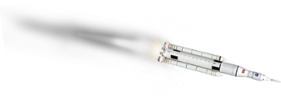
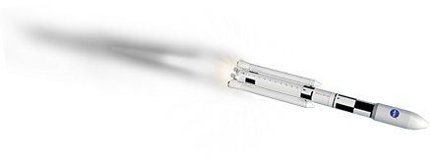
The future of exploration
Lagrangian Point L2
274,000 mi
Near-Earth Asteroid
~3,100,000 mi
International
Space Station
220 mi
Europa
390,400,000 mi
Mars
34,600,000 mi
Moon
239,000 mi
Commercial
Partners
70 t
130 t
Earth
Space Launch System and Orion enable solar system exploration
Notes:
NOTES:

Slide 61
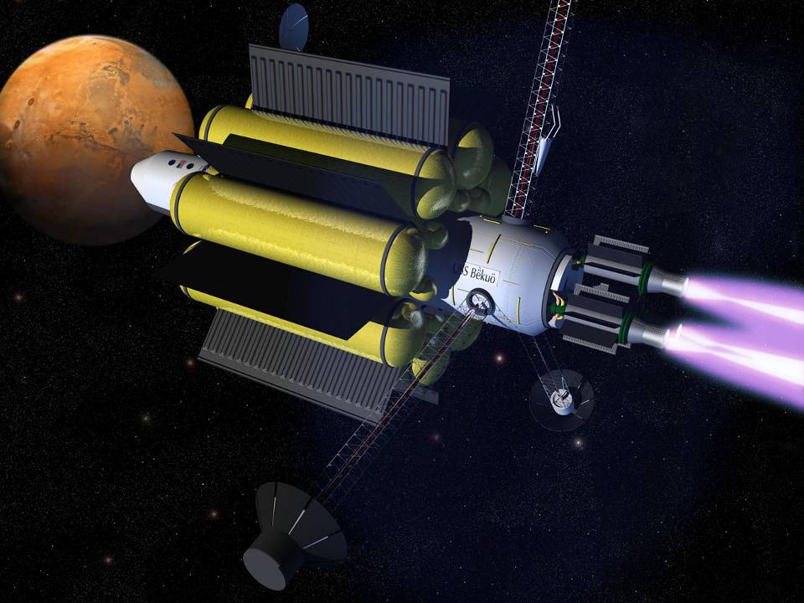
Notes:
The artist rendition depicts a nuclear electric ship en route to Mars. Three nuclear fission reactors at the end of long booms produce about 4 Mega Watts of electrical power each. The electricity is fed by superconducting transmission lines to the engine bay where 3 VaSIMR plasma engines provide 12 Mega Watts of continuous electric propulsion. The engines are always on, accelerating the ship half way on its journey and decelerating it the other half. The continuous acceleration provides a sort of artificial gravity. Peak ship velocity reaches about 50Km/sec (in the reference frame of the Sun.) Higher speeds and accelerations are possible with greater power. Nuclear electric plasma rockets of the VaSIMR type could deliver crew and cargo to Mars in as little as 39 days and could provide ultra fast transportation for humans and robots to all planets of the solar system.
VaSIMR (Variable Specific Impulse Magnetoplasma Rocket) engines do not use chemical reactions to produce rocket thrust. Instead the hydrogen is turned into plasma, a super hot gas at temperatures higher than the interior of the Sun. The plasma is created by electromagnetic waves in a magnetic chamber and expelled through a magnetic nozzle. Advanced superconducting magnets generate the strong fields required by the engine.
The propellant for the ship is hydrogen or deuterium (heavy hydrogen.) Electrical power from the reactors and proper insulation in the vacuum of space will allow the hydrogen to be stored in liquid or perhaps in solid form. VaSIMR engines are very frugal, consuming only about 1/1000 of the propellant per second required by present day rockets. The propellant in Bekuo has two other important uses: 1) it aids in the cooling of the superconducting lines and engine magnets and 2) it provides an effective shield for the crew against the radiation of space. Hydrogen is the best radiation shield known. The ship’s architecture takes advantage of this by wrapping the propellant tanks around a central core, which serves as living quarters for the crew. Hydrogen is also the most abundant element in the universe. Our ships are likely to find ample supplies of propellant everywhere they go.
Some day, VaSIMR engines will evolve further into fusion rockets, where the plasma will ignite in a controlled thermonuclear reaction providing even higher power. The extreme power will enable continuous acceleration at levels approaching 1g, thereby eliminating the physiological deconditioning of the crew on long space voyages. Such rockets will enable humans to leave our solar system and embark on a journey to the stars.
The name Bekuo means shooting star in the language of the Bri-Bri Indians of Costa Rica, descendants of the Maya. The name honors our Native Americans, the first scientists and astronomers of the new world.

Slide 62
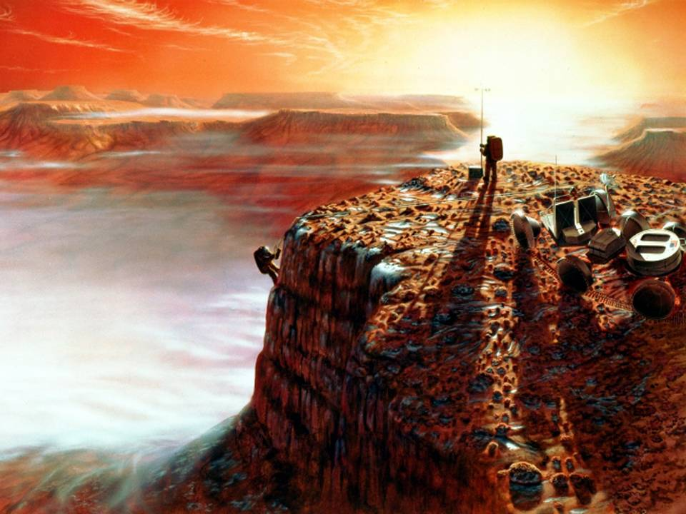

Slide 63
