Slide 1
The Federal Highway Administration: A Century of Innovation Deployment
Carl K. Andersen
Acting Director, Office of Safety and Operations Research and Development
© 2022 Getty Images.

Slide 2
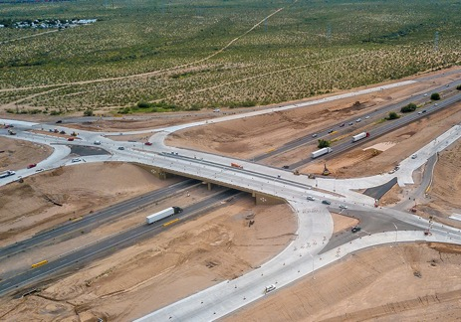
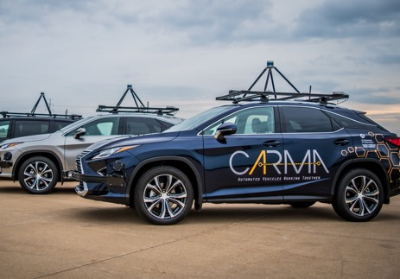
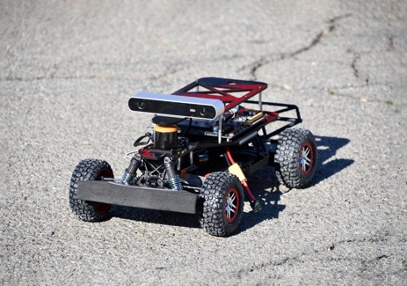
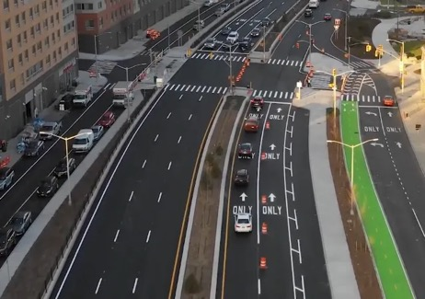
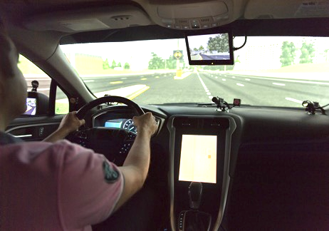
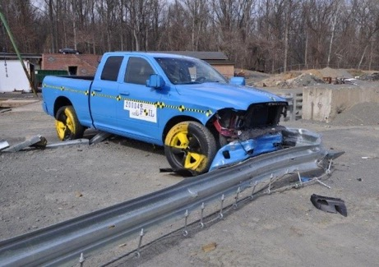
Agenda
Mission/Goals/Organization.
Innovation Process.
Four Examples of Innovation Deployment Approaches.
Questions.

Slide 3
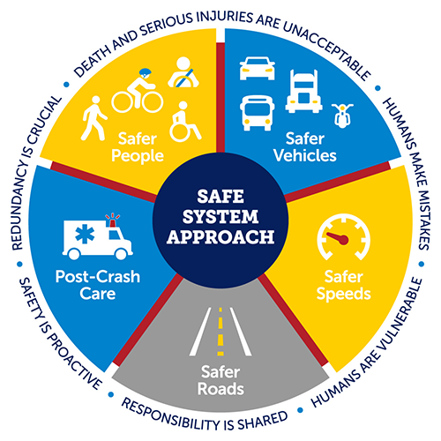
FHWA Mission
To deliver a world-class system that advances safe, efficient, equitable, and sustainable mobility choices for all while strengthening the Nation’s economy.
FHWA Strategic Plan FY2022-2026 (dot.gov)

Slide 4
Goals
Safety.
Economic strength and global competitiveness.
Equity.
Climate and sustainability.
Transformation.
Organizational excellence.

Slide 5
Organization
Administrator
Office of Research, Development, and Technology
Program Offices
Office of Innovation and Workforce Solution
Director of Field Services
Office of Innovation Implementation – Resource Center
Federal Aid Division Offices
Notes:
1905: The same year the U.S. Forest Service (FS) was established, the Division of Tests of the Bureau of Chemistry and the Office of Public Road Inquiries in the U.S. Department of Agriculture were consolidated into the Office of Public Roads (OPR).
1914: Director Logan W. Page created the Division of Park and Forest Roads, under the Office of Public Roads.
1916: The Federal-Aid Road Act, approved July 11, 1916, established the basis for the Federal-Aid highway program in cooperation with the States. In 1917, 10 districts were established, with each district given the responsibility for the construction of rural Post Roads in cooperation with the State highway departments, and for the survey, construction, and maintenance of National Forest roads in cooperation with the FS and the State and local authorities.
1919: The Agriculture Appropriation Act for fiscal year 1919 changed the name of the Office of Public Roads and Rural Engineering to the Bureau of Public Roads (BPR).
1938: Congress responded to a growing public need for dedicated highway research by acquiring 235.3 hectares (581 acres) of land in McLean, VA, for a roadway research facility.
1939: The BPR was transferred from the U.S. Department of Agriculture to become the Public Roads Administration of the Federal Works Administration.
1956: The 1956 Federal-Aid Highway Act initiated construction of the Interstate System and established the Highway Trust Fund. Major organizational changes were made in the BPR.
1967: The U.S. Department of Transportation was established. The BPR was transferred from the Department of Commerce and became a part of the Department of Transportation, as the Federal Highway Administration.

Slide 6
Innovation Process - Conceptual
Needs Assessment, Peer Review & Evaluation
Needs
Strategic Research
Development Test & Evaluation
Technology Delivery
Basic / Advanced
Applied
Deployment
RD&T
HQ
RC
DOs
Notes:
All FHWA units are involved in the Research, Development, and Deployment programs.

Slide 7
Four Examples of Innovation Deployment
Evaluation of Low-Cost Safety Improvements Pooled Fund Study (ELCSI-PFS).
Every-Day Counts (EDC).
Virtual Open Innovation Collaborative Environment for Safety (VOICES).
Open-Source Software.

Slide 8
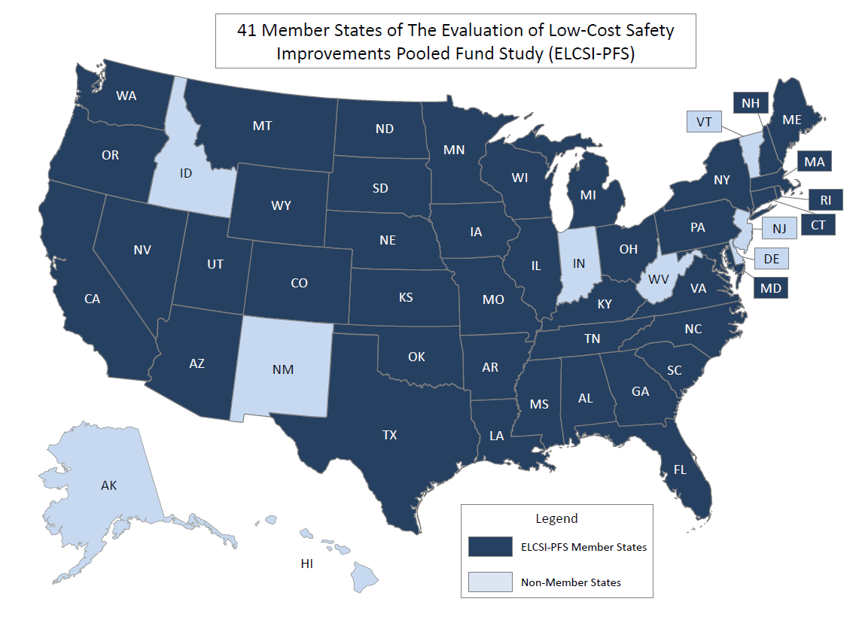
ELCSI-PFS
ELCSI–PFS was established with 23 State members to study existing (tried) and experimental strategies from 2005 through 2010.
At 19 years, and with 41 State members to date, the study is still going strong and is the largest FHWA pooled fund study.
Source: FHWA.
Notes:
Objective
…to develop reliable estimates of the effectiveness of the safety improvements that are identified as strategies in the National Cooperative Highway Research Program (NCHRP) Report 500 Guides...by conducting scientifically rigorous before-after evaluations at sites in the U.S. where these strategies are being implemented
Total cost has been $8.5M over 19 yrs, or approximately $447K per year.
Develops Crash Modification Factors, B/C ratios, and Statistical methodologies for evaluations for advancing safety research.
Has produced over 850 crash modification factors since inception in 2005.

Slide 9
Everyday Counts
Market-Ready, Proven…Underutilized
Every State has advanced 19 or more of the innovations promoted in the first six EDC rounds, and some states adopted 40 or more innovations.
Round 1 (2011-2012) 14 Innovations
Round 2 (2013-2014) 13 Innovations
Round 3 (2015-2016) 12 Innovations
Round 4 (2017-2018) 11 Innovations
Round 5 (2019-2020) 10 Innovations
Round 6 (2021-2022) 7 Innovations
Round 7 (2023-2024) 7 Innovations
Every Day Counts | Federal Highway Administration (dot.gov)
Notes:
Key Message: How is the innovation going to be game-changing in terms of saving lives, saving time, saving money, and improving quality? We are looking for a more global, larger-scale transformative innovation.
Background: It may appear that there are fewer and fewer innovations with each successive cycle. We were very successful in being able to have some of the more straightforward, smaller, or “lower-hanging fruit” innovations in the earlier cycles. In later cycles, we have been able to focus on the innovations that are going to have the biggest impact. It seems like the “sweet spot” number of innovations is approximately 8 to 10 innovations in a cycle.
What makes a good EDC innovation?
Game changing: How the innovation is transformative in saving time and money or improving quality.
Urgency and scale: Potential to shorten project delivery and positively impact the environment, safety, congestion, freight movement, construction techniques, contracting methods, project costs, maintenance, preservation, or emergency response.
Readiness: Whether the innovation is ready to be deployed nationally. Consider the two-year cycle.
National impact: Potential to benefit the transportation system.
Staff capacity: Ability to fully support the innovation deployment team.

Slide 10
EDC-7 Innovations
Nighttime Visibility for Safety
Next Generation Traffic Incident Management: Technology for Saving Lives
Integrating Greenhouse Gas (GHG) Assessment and Reduction Targets in Transportation Planning
Environmental Product Declarations for Sustainable Project Delivery
Rethinking Disadvantaged Business Enterprise for Design-Build
Strategic Workforce Development
Enhancing Performance with Internally Cured Concrete (EPIC²)
Notes:
JULIE

Slide 11
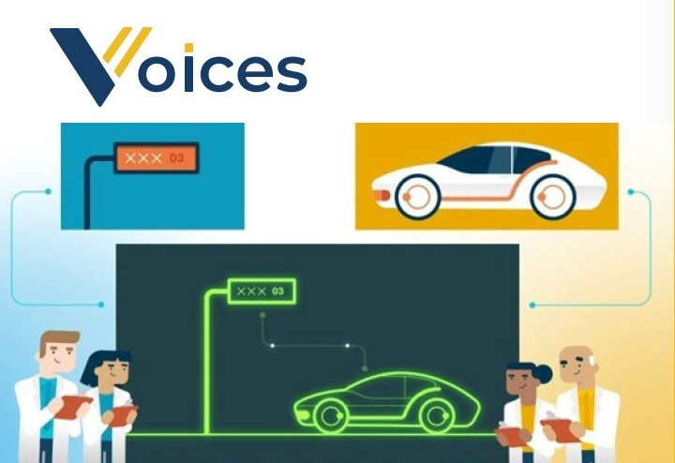
VOICES and Distributed Testing
The Virtual Open Innovation Collaborative Environment for Safety (VOICES) is a test network developed by MITRE under contract to OST-R. The network has been transferred to MITRE to build and operate. | Distributed testing is the capability FHWA developed for the surface transportation industry to perform geographically-distributed tests using mixed-reality tools (simulation, lab tests, track tests) across multiple organizations.
The USDOT contract ends in September 2024. | USDOT will continue to pursue distributed testing as a method of answering different types of research and development questions.
VOICES is like the internet… …while distributed testing is like applications and websites on the Internet.
Source: FHWA.
Notes:
VOICES and distributed testing. What are they and what is the difference?

Slide 12
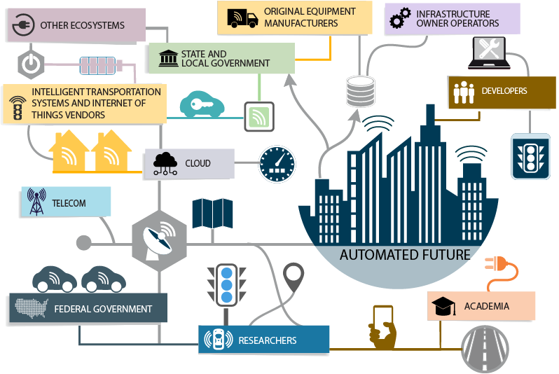
Collaborative Testing Challenges
The lack of a simple, effective, and efficient mechanism to perform collaborative research and testing is due to:
Multiplicity of stakeholders.
Natural silos.
Trust deficits.
Intellectual property and competitive pressures.
Cost and resource barriers.
Lack of interoperable test tools and environment.
Multiplicity of stakeholders.
Natural silos.
Trust deficits.
Intellectual property and competitive pressures.
Cost and resource barriers.
Lack of interoperable test tools and environment.
Source: USDOT. Modified by FHWA.

Slide 13
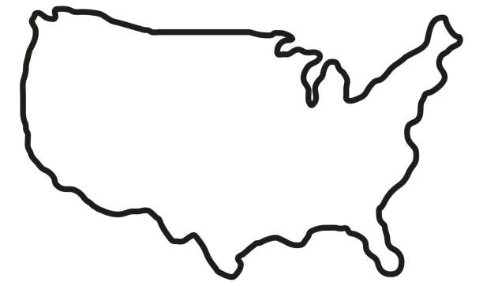
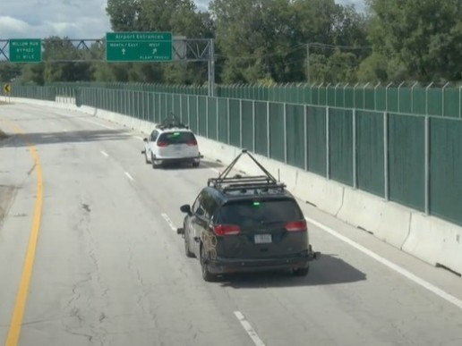
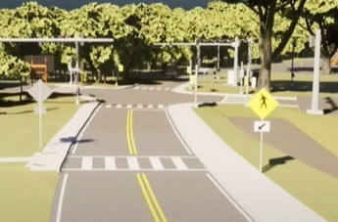
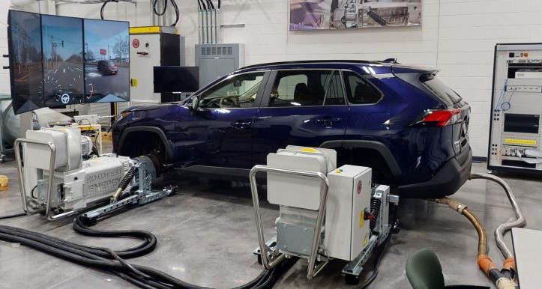
What Does it Take to do a Distributed Test?
Test Elements
Can be physical or simulated and under human or automated control. All elements will have digital representations during the test.
Live vehicle on test track.
Digital twin.
Secure Network
Connects all test sites securely and reliably.
Source: FHWA.
© 2022 CARLA.
TENA Tools
Uses “common language” to exchange data. Also includes test execution management tools.
Hardware/software/human-in-the-loop simulation.
Scenario
Defines scenario to execute a test, such as digital maps, signal phase and timing (SPaT), object initial states, etc.
TENA = Test and Training Enabling Architecture.
© 2020 Oak Ridge National Laboratory.
Map source: USDOT. Modifications made by FHWA.
Notes:
Very efficient because only ground truth states and message data are passed around, which is then rendered on the edge.

Slide 14
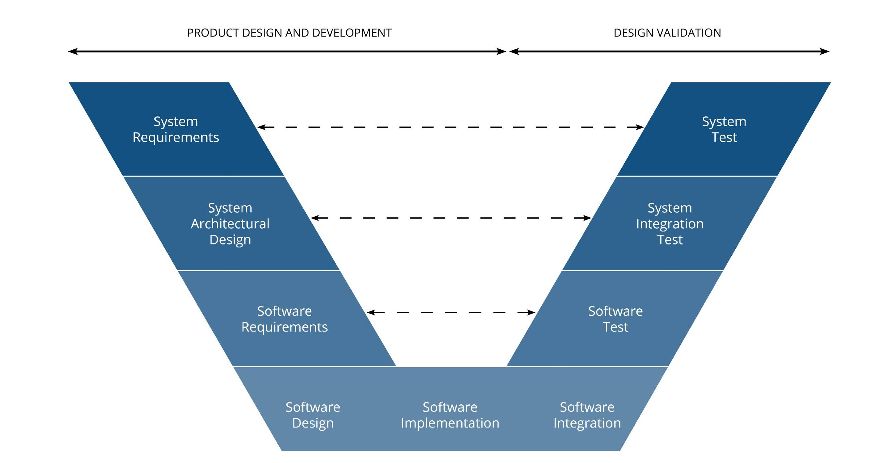
How can we use distributed testing?
Distributed testing can be used in various stages of technical maturation
Early prototyping examples
Interoperable eco-driving of multiple, diverse algorithms
Systems integration testing examples
Cross-jurisdictional operations
Cyber testing
Deployment interoperability testing examples
CV2X radios
EV charging?
Distributed testing is characterized by:
Increasing fidelity of representations – mixed-reality testing enriches validation process
Emphasis on closed-loop interactions and feedback between multiple, diverse elements
Use of standard message formats

Slide 15
Distributed Testing Benefits
REDUCE COSTS by resolving integration issues early in a virtual environment.
RE-USE MODELS even when working across different simulation platforms.
COLLABORATE with others to advance best practices and innovative system-of-systems solutions that improve transportation safety, efficiency, and equity.
PROTECT INTELLECTUAL PROPERTY while securely connecting with others.

Slide 16
Open-Source Software
FHWA develops open-source software to allow other researchers to use federally funded tools to advance transportation-related R&D.
The Connected and Automated Vehicle (CAV) Telematics Tool is an open-source, web-based platform and an example of this process.
Supports cooperative driving automation (CDA) research.
Facilitates real-time data collection and streaming from vehicles and infrastructures.
Provides a dashboard on which users can visualize data.
Source: FHWA.

Slide 17
Components
Hardware:
Edge device or a computer connected physically to the entity to collect the data.
Cellular network provider to stream the data.
Software:
Data processing server to process the data.
Time-series database to store collected data.
User-interface to visualize and analyze data.

Slide 18
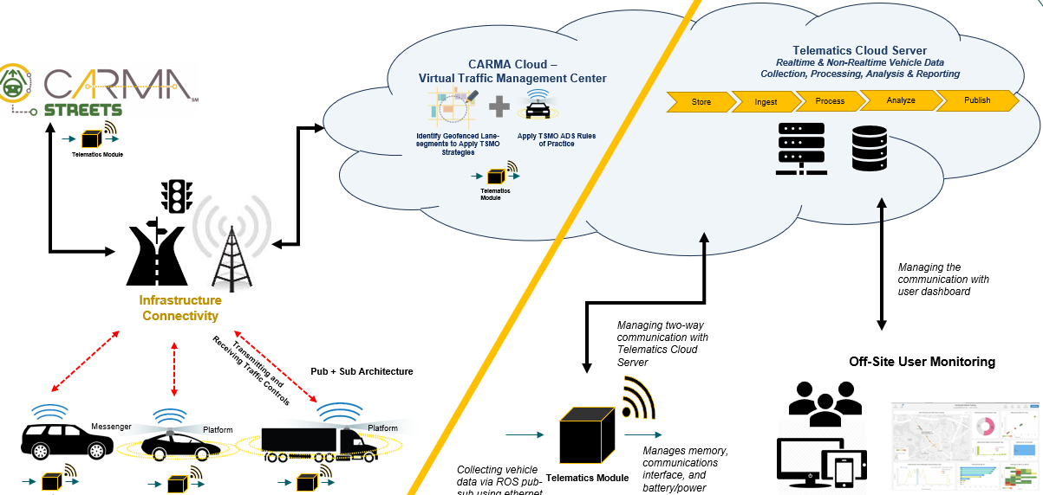
High-Level Interaction Diagram
℠
Telematics Cloud Server
Realtime and Non-Realtime Vehicle Data Collection, Processing, Analysis and Reporting
CARMA Cloud:
Virtual Traffic Management Center
Store
Ingest
Process
Analyze
Publish
Identify Geofenced Lane-
Segments to Apply TSMO Strategies
Apply TSMO ADS Rules of Practice
Telematics Module
Telematics Module
Infrastructure Connectivity
Managing the communication with user dashboard
Infrastructure Connectivity
Managing two-way communication with Telematics Cloud Server
Transmitting and Receiving Traffic Controls
Pub + Sub Architecture
Off-Site User Monitoring
Messenger
Platform
Platform
Collecting vehicle data via ROS pub-sub using ethernet port
Manages memory, communications interface, and battery and power management
Telematics Module
Telematics Module
Telematics Module
(Pub/Sub)
Telematics
Module
TSMO = transportation systems management and operations.
Source: FHWA.⁾
Notes:
The presenter will walk-through this diagram, explaining all the systems that Telematics tool interface with – Vehicles, Infrastructure, Cloud. Explain in detail, which technologies are involved with data collection, streaming and analysis in the overall telematics tool ecosystem.

Slide 19
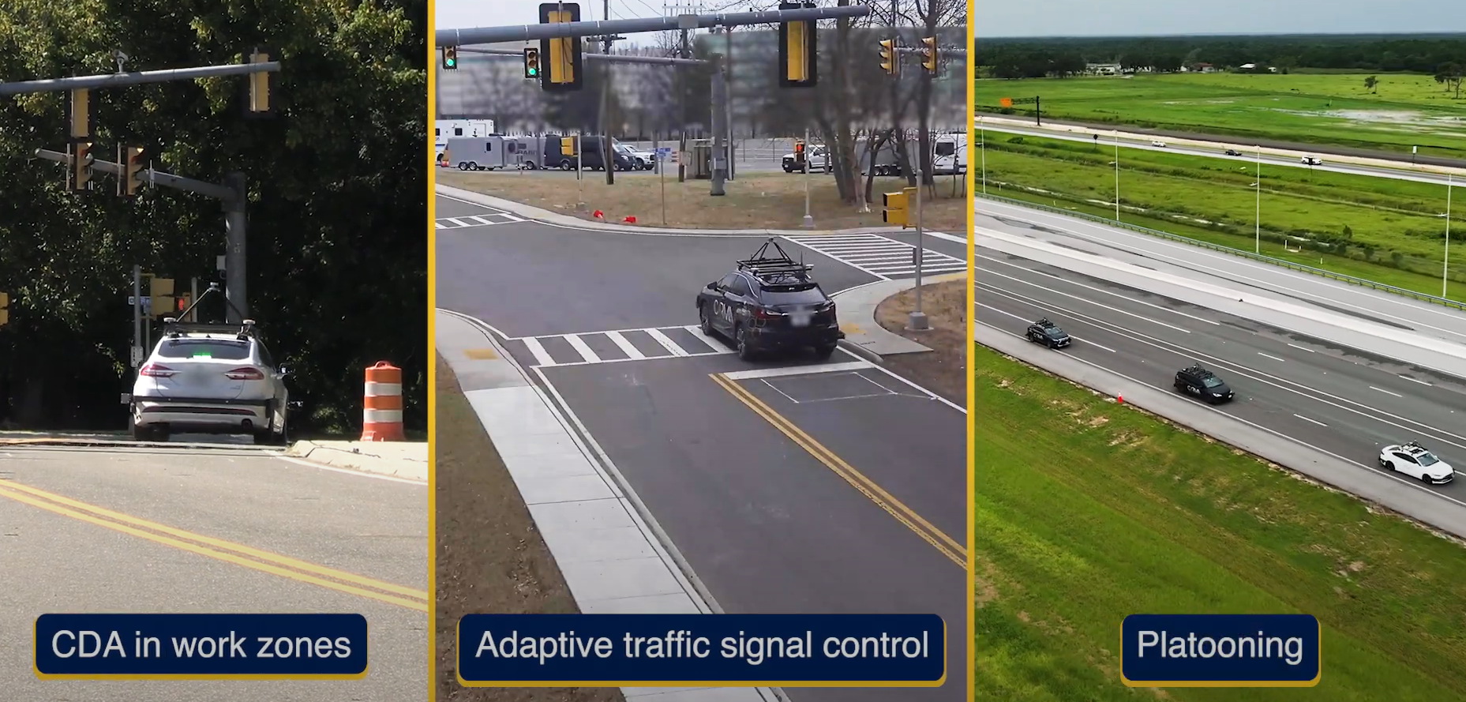
Supports Any Use Case Involving Vehicles
Source: FHWA.

Slide 20
Key Features
This tool facilitates realtime data collection and streaming. The tool can track many different types of data, including:
Current speed of vehicle.
Acceleration.
Distance from end of lane.
Vehicle lane status.
Basic safety messages.
Traffic signal phases.
CAV Telematics Tool Tutorial: https://www.youtube.com/watch?v=miU74slm0zk.

Slide 22
Carl Andersen
Acting Director, Office of Safety and Operations Research and Development Carl.Andersen@dot.gov

