Slide 1
Holistic Approaches to Delivering Complex Solutions:
People, Process, Technology, Culture
May 8, 2024
Crisanne Nolan
Agile Transformation Engineer
Continuous Deployment of Capability Directorate

Slide 2
Copyright 2024 Carnegie Mellon University.
The view, opinions, and/or findings contained in this material are those of the author(s) and should not be construed as an official Government position, policy, or decision, unless designated by other documentation.
NO WARRANTY. THIS CARNEGIE MELLON UNIVERSITY AND SOFTWARE ENGINEERING INSTITUTE MATERIAL IS FURNISHED ON AN "AS-IS" BASIS. CARNEGIE MELLON UNIVERSITY MAKES NO WARRANTIES OF ANY KIND, EITHER EXPRESSED OR IMPLIED, AS TO ANY MATTER INCLUDING, BUT NOT LIMITED TO, WARRANTY OF FITNESS FOR PURPOSE OR MERCHANTABILITY, EXCLUSIVITY, OR RESULTS OBTAINED FROM USE OF THE MATERIAL. CARNEGIE MELLON UNIVERSITY DOES NOT MAKE ANY WARRANTY OF ANY KIND WITH RESPECT TO FREEDOM FROM PATENT, TRADEMARK, OR COPYRIGHT INFRINGEMENT.
[DISTRIBUTION STATEMENT A] This material has been approved for public release and unlimited distribution. Please see Copyright notice for non-US Government use and distribution.
This material may be reproduced in its entirety, without modification, and freely distributed in written or electronic form without requesting formal permission. Permission is required for any other use. Requests for permission should be directed to the Software Engineering Institute at permission@sei.cmu.edu.
Carnegie Mellon® is registered in the U.S. Patent and Trademark Office by Carnegie Mellon University.
DM24-0558

Slide 3
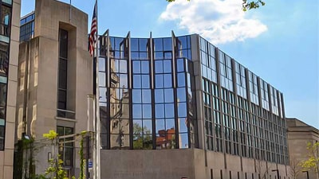
The Software Engineering Institute (SEI) at Carnegie Mellon University is a Federally Funded Research and Development Center (FFRDC)—a nonprofit, public–private partnership that conducts research for the United States government.
One of only 10 FFRDCs sponsored by the U.S. Department of Defense (DoD), the SEI conducts R&D in software engineering, systems engineering, cybersecurity, and many other areas of computing, working to introduce private-sector innovations into government.
We work with partners throughout the U.S. government, the private sector, and academia. These partnerships enable us to take innovations from concept to practice, closing the gap between research and use. Our researchers provide support directly to individual programs, often on-site, to help them meet their capability goals, from acquisition strategy through sustainment.

Slide 4
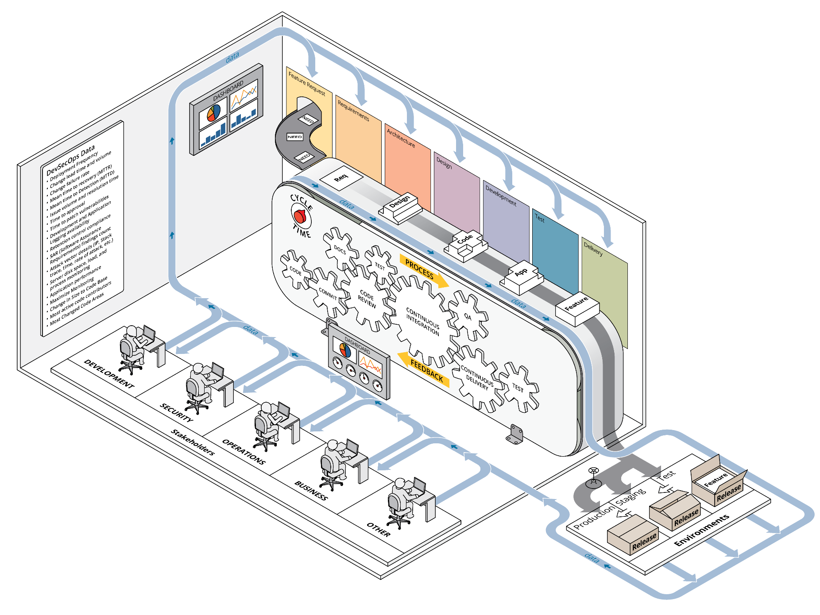
Organizations Holistically Deliver Complex Solutions
A holistic approach to improvement of the organization’s capability considers the organization as a whole.
Technology
People
Process
Culture

Slide 5
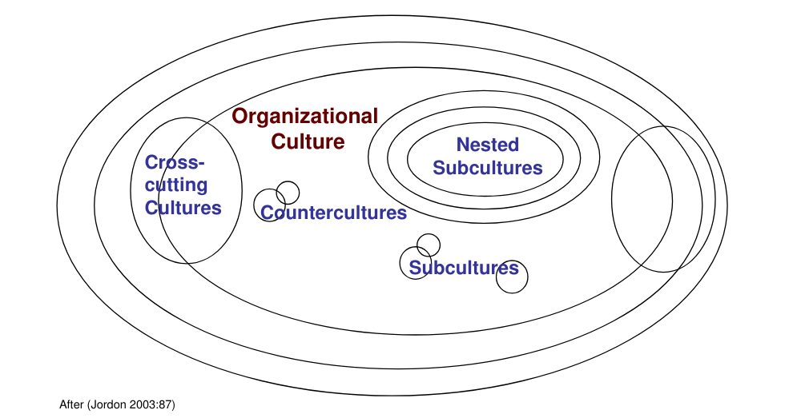

Slide 6
Layers of Culture
Culture is a pattern of shared basic assumptions that a group learned as it solved its problems that has worked well enough to be considered valid.
Therefore, these assumptions are taught to new members as the correct way to perceive, think, and feel in relation to those problems.
Artifacts
Shared
Espoused
Values
Artifacts
Basic
Assumptions
Values
Artifacts
Artifacts
Adapted from Edgar Schein, Organizational Culture and Leadership.

Slide 7
Cultural Alignment in a Complex Systems Environment
Highly Aligned Culture
Culture
Misaligned Culture
Moderately Aligned Culture
Poorly Aligned Culture

Slide 8
Adler’s Size of Technology
Level of Learning Required
Culture
Strategy
Structure
Procedures
Skills
Time to
Adjust
Magnitude of Technological
Change Sought
Years
Weeks
Small
Large
Adapted from Paul Adler, “Adapting Your Technological Base,” Sloan Management Review, Fall 1990, pp. 27-36.

Slide 9
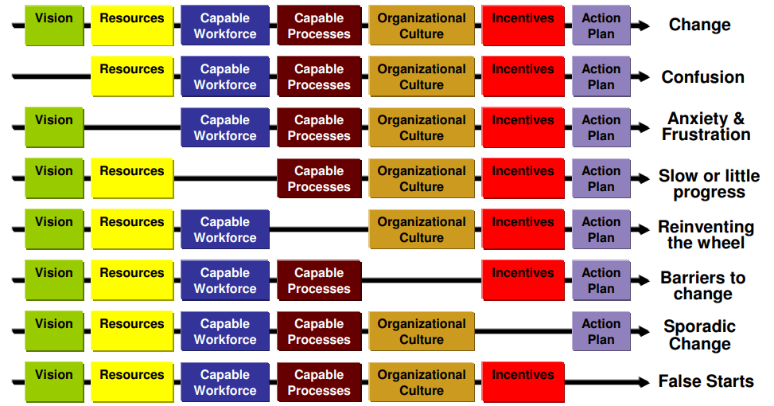
Holistic Elements of Change
Adapted from P. Buttles-Valdez, D. Ambrose, 1987. Personal Communication

Slide 10
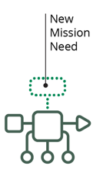
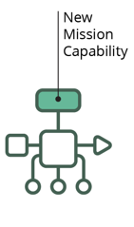
Learning Enables Innovation
Development/Execution
Month 1
Month 2
Month 3
Month 4
Month 5
Planning/Learning

Slide 11
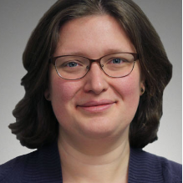
Crisanne Nolan
Agile Transformation Engineer
Telephone: +1 412.268.7622
Email: ccampus@sei.cmu.edu

Slide 12

The Adopter Continuum
“The Chasm”
Innovators
“Techies”
Early Majority
“Pragmatists”
Laggards
“Skeptics”
Early Adopters
“Visionaries”
Late Majority
“Conservatives”
Source: Geoffrey Moore, Crossing the Chasm, 1991

Slide 13
Adoption Commitment
Internalization
Assumption
Institutionalization
Synergy
Implementation
support mechanisms
dominate Trial Use,
Adoption, and
Institutionalization
Adoption
Unintended Uses
Commitment
Trial Use
Possibilities
Understanding
Concepts
Communication
mechanisms dominate
Contact, Awareness,
and Understanding
Awareness
Buzzwords
Contact
Names
Time

