Slide 1
Info-Centric National Airspace System Validation Implications
Stéphane Mondoloni - PhD, MBA
September 28, 2023
Approved for Public Release; Distribution Unlimited. Case Number 23-3097

Slide 2
The Info-Centric NAS
Vision for an Info-Centric NAS
Image: Federal Aviation Administration

Slide 3
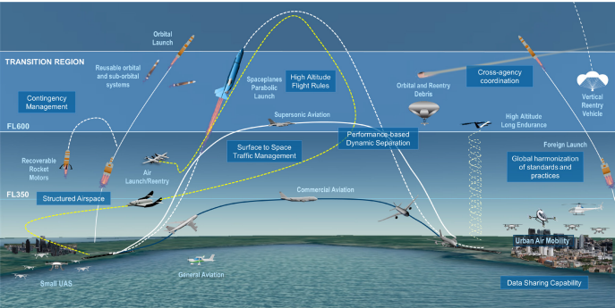
The Info-Centric NAS
Operations
Information
Infrastructure
Integrated Safety Management
Images: Federal Aviation Administration, MITRE

Slide 4
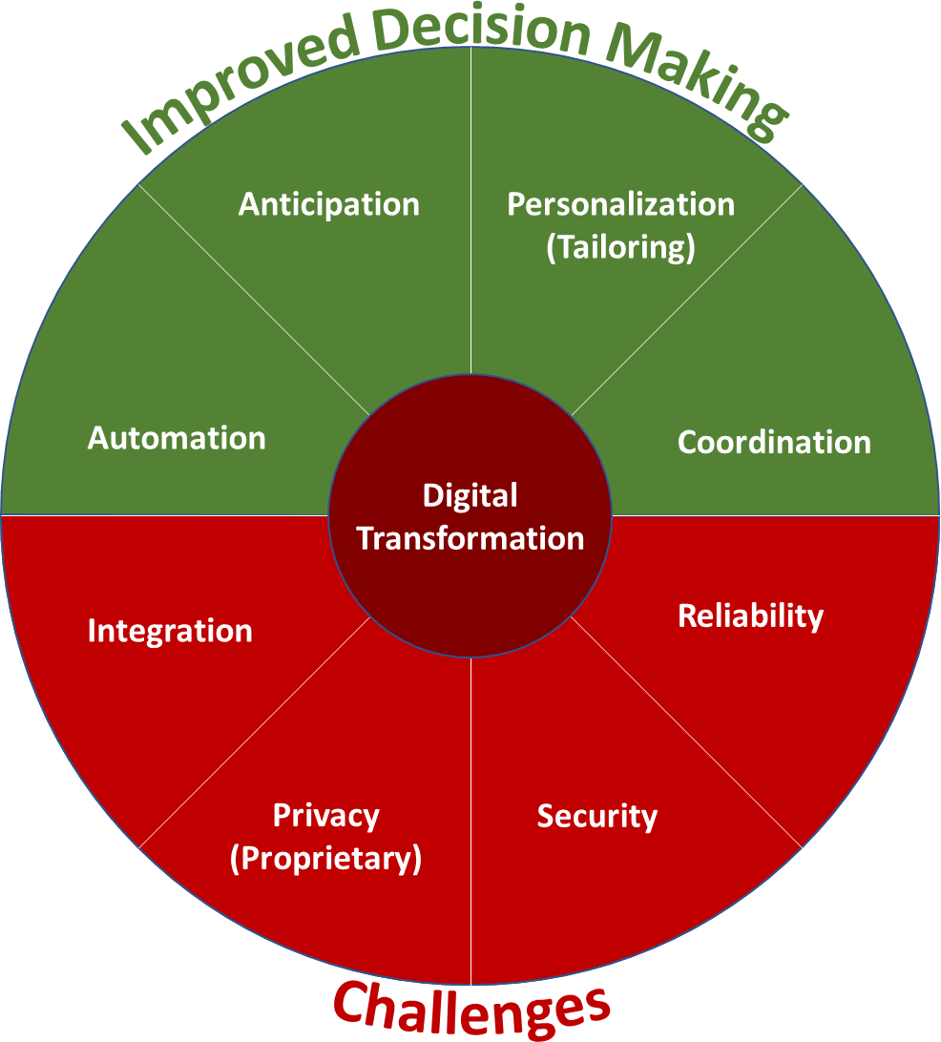
Digital Transformation of the NAS
Obtain
Connect
Secure
Manage
Display
Operations
Apply the information to improve existing / enable new operations
Become performance-based
Standards
☑
Infrastructure
While modernizing the architecture
Adapted from Xavier Zamora, Programming Business Models Through Digital Density
… And leveraging private services
Multi-Stakeholder
Images: MITRE

Slide 5
Information in the Info-Centric NAS
Image: MITRE

Slide 6
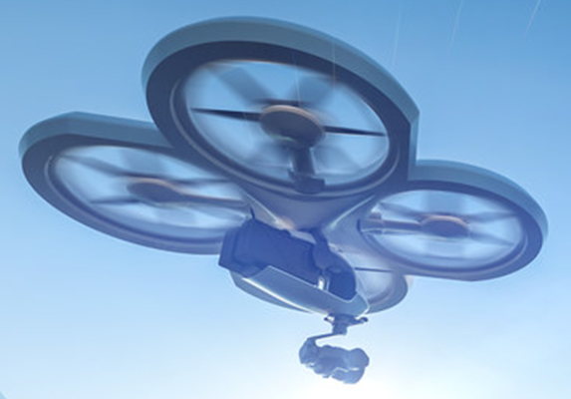
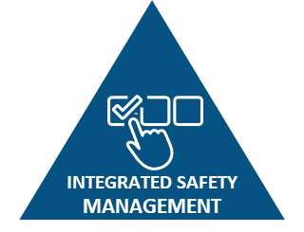
Information – Lynchpin for Improving the NAS
Today
Cloud Technologies
~Terabytes/flight
Lots more!
Cybersecurity
Future
IoT
Digital Twins
Data Analytics
Autonomy
Machine Learning
Images: MITRE
To Improve

Slide 7
Resilience through Information Ubiquity
Ubiquitous information – makes ML possible, provides knowledge of uncertainty
i
Event
Actual
Imputed
Events may degrade information quality
Algorithms allow projection with less data
Models can forecast state for some period
Graceful degradation of system performance
Information
Machine Learning
Loss of data is not complete loss of information
Digital Twins
Images: Personal Photo

Slide 8
Operations in the Info-Centric NAS: Trajectory Based Operations (TBO) and Extensible Traffic Management (xTM)
Operations
Image: MITRE

Slide 9
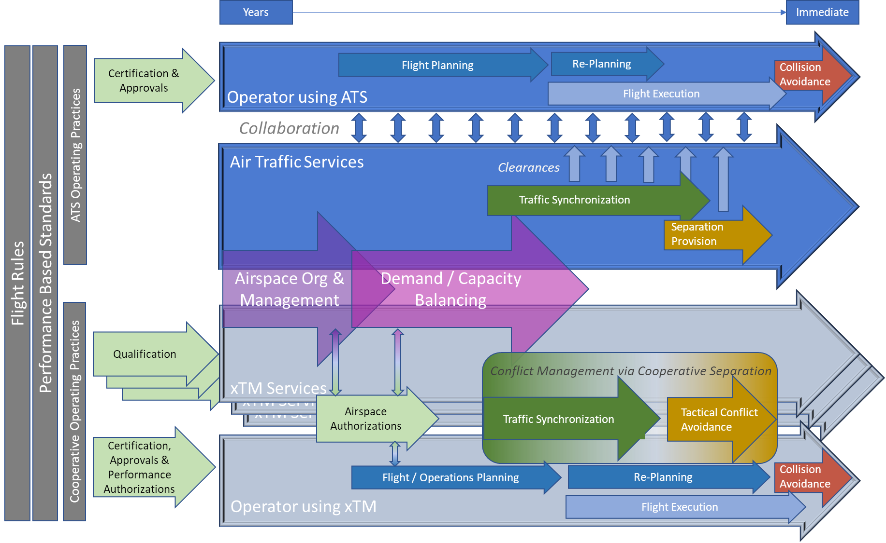
xTM TBO

Slide 10
Leveraging Private Services Operations & Infrastructure
Operations
Infrastructure
Images: MITRE

Slide 11
Range of Possibilities
Government
Private
Finance - $
Revenue - $
ID Need
Requirements
Design
Develop
Operate
Maintain
Own
Design-develop
$
$
$
$
Range of combinations exist
Market-driven
Private
$
$
$
$
$
Examples:
xTM service suppliers in a federated environment
Infrastructure elements (e.g., fully commercial, managed services)
Information service providers
Cloud service providers

Slide 12
Lessons from Ecosystem Failures
Lessons from business ecosystems
Failure rate ~85%
Six of seven failure modes attributable to bad ecosystem design vs execution
Source: BCG Henderson Institute

Slide 13
Summary
Digital Transformation of the NAS
&
Ecosystem Development

Slide 14
Closing Slide
Stephane Mondoloni
smondoloni@mitre.org
https://linkedin.com/in/stephane-mondoloni/

Slide 15
NOTICE
This work was produced for the U.S. Government under Contract 693KA8-22-C-00001 and is subject to Federal Aviation Administration Acquisition Management System Clause 3.5-13, Rights In Data-General, Alt. III and Alt. IV (Jan 2009).
The contents of this document reflect the views of the author and The MITRE Corporation and do not necessarily reflect the views of the Federal Aviation Administration (FAA) or the Department of Transportation (DOT). Neither the FAA nor the DOT makes any warranty or guarantee, expressed or implied, concerning the content or accuracy of these views.
For further information, please contact The MITRE Corporation, Contracts Management Office, 7515 Colshire Drive, McLean, VA 22102-7539, (703) 983-6000.
© 2023 The MITRE Corporation. All Rights Reserved.

