Slide 1
18th Annual V&V Summit
Opening Remarks
John Frederick, Manager
FAA V&V Strategies and Practices Branch
September 27-28, 2023
Convergence:
Maximize and Manage

Slide 2
V&V Summit Information
Welcome Summit Attendees to the 18th Annual V&V Summit
Our first in-person convergence since 2019
eLMS Training Credit — Federal employees
faa.gov email address must check in both days to receive training credit
Feedback Forms in Summit Folder — Please fill out and return at end of each day and place on registration table

Slide 3
More V&V Summit Information
Location of this year’s presentations:
https://www.faa.gov/about/office_org/headquarters_offices/ang/library/events/v_vsummits/
Link will be sent to all attendees
Google: V&V Summit 2023
Wi-Fi Password and Zoom Update
Area Restaurants — Restaurant List in Folders
Resorts Self-Parking $10 with Voucher (Registration Table)

Slide 4
V&V Summit Agenda
Agenda is in the handout folder
Time for networking and collaboration during breaks
Two interactive polling sessions on Day 1
Design of Experiments Interactive Exercise on Day 2
Informative videos shown during breaks
Vee Model and Double Diamond Design Model (convergence vs divergence) in handout folder
1.5 hours allocated for lunch and networking on Day 1
Presentations will start at 8:30 a.m. on Day 2
End by 4:30 p.m. on Day 1 and 12:30 p.m. on Day 2

Slide 5
18th Annual V&V Summit Theme
“Convergence: Maximize and Manage”

Slide 6
Word of the Day: Convergence
Convergence is great! — It needs to be maximized!
Collaboration of people and organization
Integration of systems
Combined operations and services
Unified policies and standards
Utilizing new and diverse technologies for new and diverse capabilities
Convergence is a pain! — It needs to be managed!
Collaboration of people and organization
Integration of systems
Combined operations and services
Unified policies and standards
Utilizing new and diverse technologies for new and diverse capabilities
Effective convergence cannot exist without effective divergence
- We need both -

Slide 7
It’s About Balance
Last Year’s Theme: “Enabling Dynamic Innovation with Rigor”
Addressed: Balancing risky and rapid innovation while focusing on safety and effective rigor
This year’s summit also focuses on balance
Convergence is the path to innovation
Divergence (the opposite of convergence) is also needed for innovation
Yin and yang is an ancient Chinese philosophy
Reminds us that balance is the key to prosperity
Prosperity is achieved through the balance of opposing but complementary forces

Slide 8
Double Diamond Model: Effective Solutions and Innovation
Double Diamond: A design process model popularized by the British Design Council in 2005
A process of exploring an issue more widely or deeply and then taking focused action
Divergence fuels effective convergence
Double Diamond is a visual representation of the dance between divergence and convergence - similar to Yin and Yang principles
https://www.stubbscreative.com

Slide 9
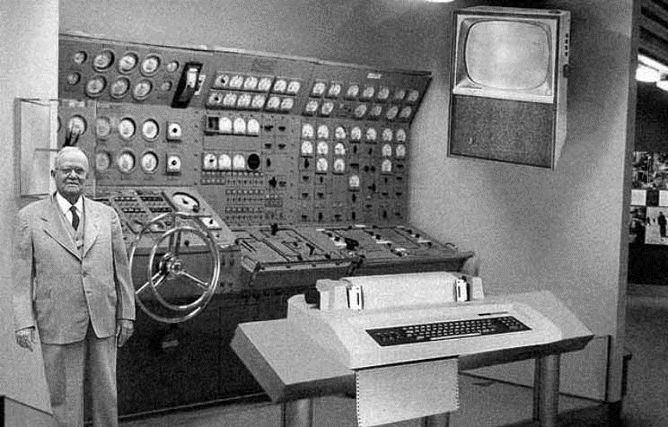
Points From Last Summit on Knowledge-based Innovation
All the necessary knowledge was available by 1918, but the first operational digital computer did not appear until 1946
Convergence among different kinds of knowledge is essential to spark innovation
Innovation is both conceptual and perceptual
An ability to see potential solutions and new capabilities where none previously existed
“Would-be innovators must also go out and look, ask, and listen” (Harvard Business Review)
Divergence
V&V Summits are about knowledge convergence with a focus on new concepts and improved perceptions — divergence

Slide 10
The Stage is Set for the V&V Summit
The presenters are diverse
The topics are relevant and challenging
The speakers are exceptional experts
The attendees are dedicated, collaborative, and engaged
V&V Summit Yin Yang Challenge: Open your minds to divergent possibilities and look for opportunities to converge on new concepts and innovative solutions

