Slide 1
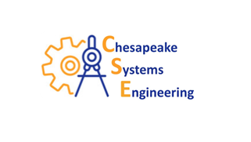
National Background Investigation Services (NBIS) A Case Study in Integration of Agile Development with DOD Mandated V&V
C. David Brown, PhD, PE, CTEP
Chesapeake Systems Engineering

Slide 2
What is NBIS
The federal government’s one-stop-shop information technology (IT) system for end-to-end (E2E) personnel vetting—from initiation and application to background investigation, adjudication, and continuous vetting.
One consolidated system designed to deliver robust data protection, enhance customer experience, and better integrate data across the enterprise.
The Defense Counterintelligence and Security Agency (DCSA) assumed operational control and responsibility for NBIS while it was still in development from the Defense Information Systems Agency (DISA) on October 1, 2020.

Slide 3
NBIS Development and V&V (T&E)
Agile and DevSecOps based continuous development test and delivery process
Continuum of test and evaluation that builds on the DT&E that is embedded in the Agile and DevSecOps processes and transitions through early user testing and finally to full-up operational test and evaluation (OT&E)
Majority of the developmental testing (DT) is performed by the development team.
In the Government acquisition scenario, such as with NBIS, some independent DT is required to ensure that the Government contract requirements are being upheld.
Also, Government acquisition mandates that the traditional Agile user demonstration be augmented by user acceptance testing and independent operational testing.
All of this testing is integrated as much as possible to eliminate unnecessary duplication of testing.

Slide 4
Agile Test & Evaluation Principles and Best Practices
Team is Responsible – development by small highly motivated and committed teams
User Engagement
Testing
Integrated tightly with development – test driven development
A continuous process
Test scripts are derived from User Stories
Collaborative with users and user representatives

Slide 5
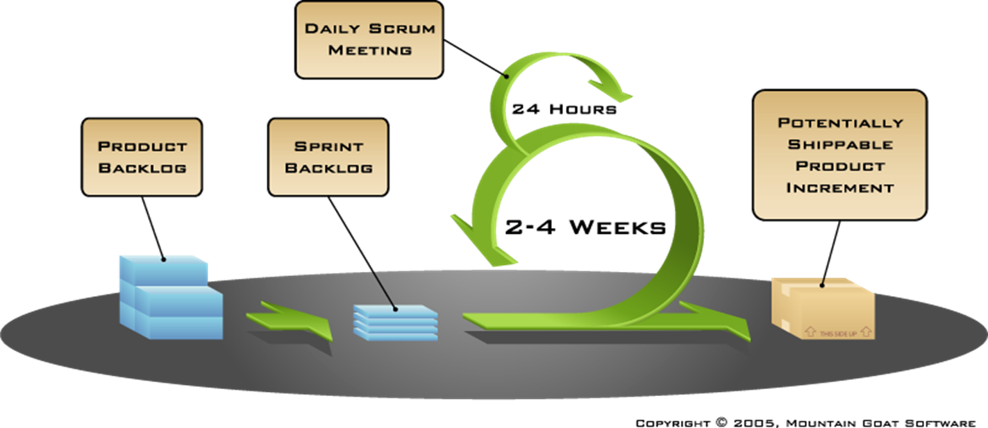
Agile Scrum Team Sprint
Agile teams are cross-functional, self-organizing entities that can define, build and test, and where applicable deploy, increments of value
Led by Scrum Master
Includes coders, tester(s), product owner
Scrum optimizes teams for communication and value delivery
Sprints are of constant fixed duration

Slide 6
DevSecOps (Development Security Operations)
Continuous process
Incremental capability delivered as available
Multiple steps conducted simultaneously
Significant automation
Replaces, augments, or complements the SE process?

Slide 7
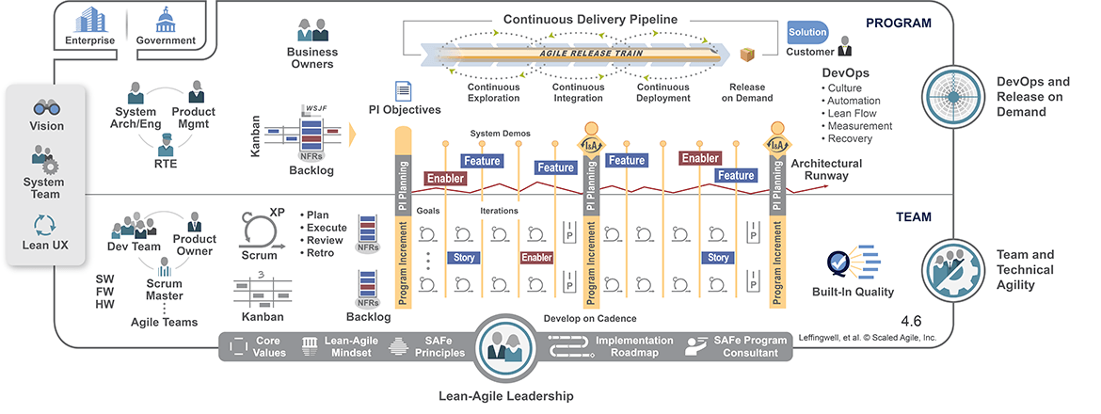
Scaled Agile Framework (SAFe®)

Slide 8
SAFe® Agile Issues
Small teams focused on small pieces of the overall development
User engagement doesn’t include other stakeholders
Fractionized development is difficult to integrate
Properly addressing requirements often requires integration across multiple team developments

Slide 9
V&V (T&E) Integrated into SAFe® Agile
User Demo and Limited User Testing
Limited Formal OT and Cyber Testing
Release on Demand
Formal Cyber Testing & Continuous OA
Automated Vendor Unit and Component Testing
Inter-Component and System Integration Testing

Slide 10
An Integrated Systems Engineering and Agile Process
User Need
Validate
Operational T&E
Validation
Generate Requirements
System Requirements
Verify
SoS Integrated Test
Integrate & Test at Systems Level
Verification
Identify Functions
Physical Definition
Allocate Functions
to Software

Slide 11
NBIS Evaluation Strategy: High Level View
Unclassified
Vendor Testing
Release / Software Acceptance Testing
Mission Thread / Capability Acceptance Testing
Operational Testing
Dev Environment
Test Environment
Production
Test Environment
Is the release ready?
Do the new capabilities and/or features work?
Is the system operationally effective & suitable?
Does the system support the users needs?
Operational Effectiveness
Performance Testing
Suitability Assessments
DT Cyber
Cyber Survivability
Playground(s) & Staging for Onboarding
Training

Slide 12
NBIS Evaluation/Test Stages
Stage
Description
o serve as an operationally relevant/representative test environment and is focused on "User Acceptance Testing (UAT)" and "Business Process Validation" testing.
Testing in this environment is done on code that is:
• Stable SoS code at the solution level
• Configuration Control Locked (environment frozen).
Environment Progression
OA
LUT
PROD
NBIS System of Systems (SoS) Release is put into operation for its intended use by the end users. When ready, code is pulled into the Production Environment in a "Blue" state and is made available to a controlled user base. When ready for transfer to a "Green" state, it is then made available to the full user base.
PRODUCTION
OPERATIONAL TESTING
Serves as an operationally relevant/representative test environment and is focused on "User Acceptance Testing (UAT)" and "Business Process Validation" testing. Testing in this environment is done on code that is:
• Stable SoS code at the solution level
• Configuration Control Locked (environment frozen).
Refer to slide notes for more information.
OT ENV
INT ENV
NBIS INTEGRATION TESTING
At the end of each sprint, code is pulled into this secure environment where the PMO’s NBIS independent integration test team conducts testing on the full SoS. This involves end-to-end testing to determine if the flow of the SoS from start to finish is behaving as expected. The purpose of performing this testing is to identify system dependencies and to ensure that data integrity is maintained between various system components and products. This includes interface testing with NBIS integrated components and products, and designated external data sources.
PMO ENV
DEVELOPMENT INTEGRATION TESTING
Testing at this stage of development includes functional, vendor product-to-product interface and integration testing. Testing is user story guided automated testing augmented where needed by manual testing. This environment may be used by EBSO to conduct a Product Owner Level Feature Review on each NBIS Product that is part of the designated NBIS Release
DEV
ZONE
UNIT TESTING
Essential part of the software development process where the smallest testable parts of a Product are individually and independently scrutinized for proper operation as defined by approved user stories. Testing is user story guided automated testing and augmented where needed by manual testing. Code is tested daily during development within these environments.
Notes:
Business Process Validation Testing will:
• Include Business Process regression testing (which involves the library of automated NBIS test packages)
• Add new test cases covering the business processes added by the current NBIS Release
• Include performance/load testing.
Business Process Validation test cases will be automated and integrated with the DevSecOps pipeline to the greatest extent possible.
Business Process Validation test cases that cannot be automated or executed within the DevSecOps pipeline will be executed either prior to or in parallel with User Acceptance Testing (UAT).
UAT will focus on exercising system capabilities that have:
• Been added (by the NBIS Release that is being tested)
• Been significantly changed (by the NBIS Release that is being tested)
• Not been sufficiently tested (in previous NBIS Releases).
Business Process Validation and performance/load test scenarios will be executed in parallel with UAT events. This will be done to:
• Ensure testing is conducted under operationally relevant load conditions
• Supplement the number of test runs conducted by user participants to meet confidence thresholds.

Slide 13
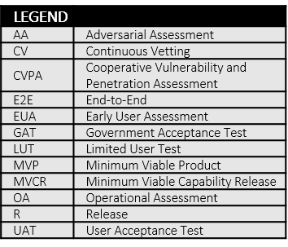
The Evaluation Strategy: Building Knowledge, Answering Questions, Supporting Decisions
Patches, Emergency Fixes, Etc.
Agencies & Mission Thread/ Ready for Full Scale Use
Unit & Integration Testing
Software Ready for GAT
LUT
Yes
Some or all users may elect to start using portions of incrementally delivered capability prior to full capability integration
Yes
Software Ready for EUA
Ready for Sustained Operational Use
No
GAT
Software Deployed to Production
OA
Yes
Ready for Production
Software Deployed to Test Environment
No
EUA
No
Yes
IOT&E FOT&E AS Needed
No
Mission Thread/ Integrated Capability Ready for E2E
No
Mission Thread/ Integrated Capability Ready for UAT
Defects/Bugs & Enhancements
Defects/Bugs & Enhancements
Defects/Bugs & Enhancements
E2E
Yes
Yes
No
Integrated Capability Ready for LUT
UAT
Defects/Bugs &
Enhancements
Defects/Bugs &
Enhancements
No
Solution and/or Product Backlogs Updated

Slide 14
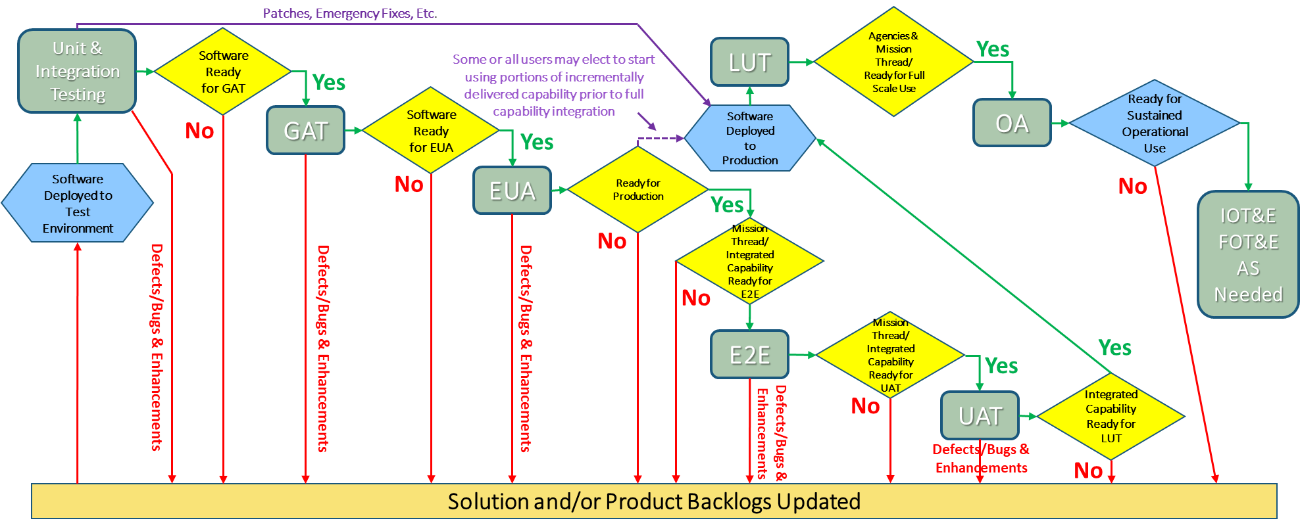
Informing Release/Code Deployment Decisions
GAT
EUA
Government Acceptance Testing (GAT):
Do new capabilities & features work as designed?
Supplements EUA & UAT (process variables & confidence thresholds)
Conducted in the “INT” test environment by JITC testers
Includes Performance/Load Testing
Early User Assessments (EUA):
Do new capabilities & features meet the user need?
DCSA SMEs are introduced to new capabilities & features
Provides a venue for early user feedback: Jira bugs/defects & surveys
Facilitated by JITC in the “INT” test environment

Slide 15
Informing Readiness for Limited Operational Use
E2E
UAT
End-to-End (E2E) Testing:
Do applicable mission threads work as designed?
Tests from the end user’s experience by simulating real user scenarios
Primary purpose is to determine readiness for UAT
Conducted by JITC testers w/ simulated data in the “INT” test environment
User Acceptance Testing (UAT):
Do applicable mission threads meet the user need?
Primary event for determining NBIS operational effectiveness & usability
Test scenarios developed by JITC in concert with DCSA SMEs
Conducted in the “INT” test environment with operationally relevant users

Slide 16
Informing Readiness for Full Scale Operational Use
CUI//FOR OFFICIAL USE ONLY
LUT
OA
IOT&E FOT&E AS Needed
Operational Cybersecurity Testing
Live/Limited User Testing (LUT):
Limited # of users & transactions
Pilot Agencies conduct activities related to specific mission threads
JITC observes operations use, tracks issues, surveys users, & assesses suitability
Operational Assessments (OA):
Primary event to validate Suitability and Operational Effectiveness by Mission Area
Predominantly an observation event to include service operations & monitoring
Includes survey of active NBIS users
Cooperative Vulnerability and Penetration Assessment(s) (CVPA):
Necessary to improve readiness for AA events
Used to scope AA events
Adversarial Assessment(s) (AA):
Required to determine NBIS Cyber Survivability Status

Slide 17
In Summary - Integrated Evaluation Elements
Evaluation of Capability | Data Source(s)
Is it there? Is it done? | Agile Process, DevSecOps
Does it work? | Agile User Demos, GAT, E2E
Does it meet the user needs? | EUA, UAT
Is it effective? | LUT, OA/OT&E
Is it suitable? | LUT, OTT, OA/OT&E
Is it survivable/secure? | Agile, Dev Pen Testing, Cooperative Pen Testing, Adversarial Assessment

