Slide 2
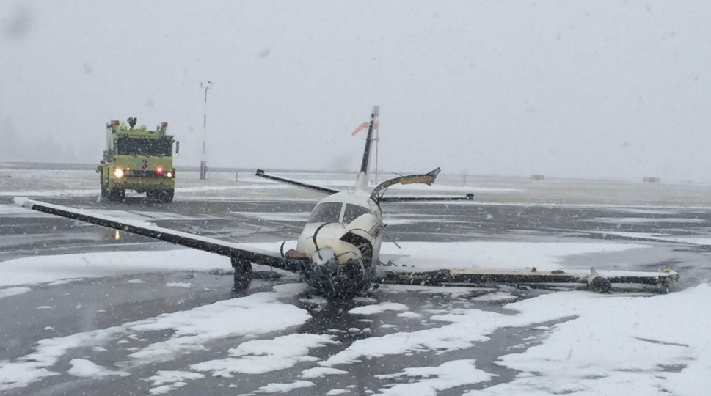
#1 on the list of Contributing Factors for General Aviation Accidents is Inadequate Preflight Preparation/Planning
AIM, Section 7-6-1 (2022 Version)

Slide 3
Advisory Circular 91-92 Pilot’s Guide to a Preflight Briefing
Encourages pilots to conduct preflight self-briefings
Shows pilots how to conduct a regulatory compliant preflight self-briefing using automated resources
Assists pilots in complying with Title 14 of the Code of Federal Regulations (14 CFR) part 91, §§ 91.103 that states each pilot in command shall become familiar with all available information concerning their flight before departure

Slide 4
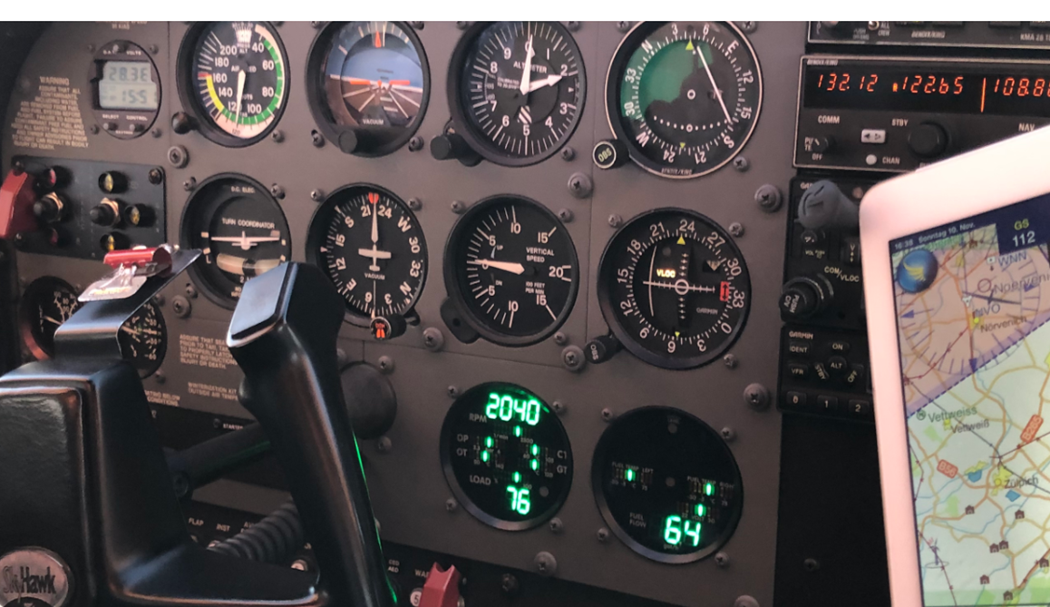
Benefits of Self-Briefing Skills
There are several reasons why developing the knowledge and skill to conduct a preflight self-briefing using online weather resources is an advantage and highly recommended by the FAA:
Enhances the pilots’ weather interpretation and risk management skills to better understand real time weather data affecting their route of flight
Pilots become more comfortable with using available weather resources
Assists pilots in making better “go-no-go” decisions
Prepares pilots to assess risk of constantly changing weather conditions while in flight

Slide 5
FAA Flight Service Preflight Self-Briefing WINGS Courses
VFR & Student Pilots
IFR Student & IFR Pilots
faasafety.gov/wings
ALC-683: Conducting Preflight Self-Briefings for Student and VFR Pilots
faasafety.gov/wings
ALC-889: Conducting Preflight Self-Briefings for IFR Pilots

Slide 6
The Preflight-Planning Process Flow
Conduct Steps 1,2,3,4 as early as possible before the flight
After Step 4
If needed, go to Step 1 (e.g., add a fuel stop)
Repeat Steps 2,3,4 in the days and hours prior to the flight
A Go decision is never final. Apply Steps 2,3,4 again right before departure and determine if it’s still safe to fly
Once airborne continue to collect and process the weather and aeronautical information for the remaining flight segments
As risks evolve or present, develop mitigations
The “Go-No-Go” decision becomes a “Continue-on” or “Divert/Land” decision
Five Steps to Safety
1
2
3
4
5

Slide 7
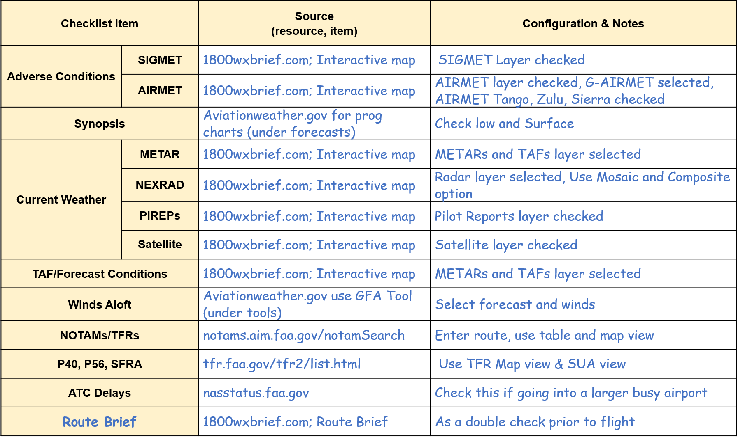
Preflight Self-Briefing Checklist

Slide 8
1800wxbrief.com Weather Log
Click “Evaluate” button on Flight Plan Form to generate weather log
Flight Plan Form
Weather Log

Slide 9
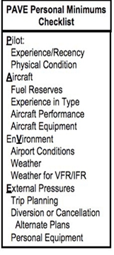
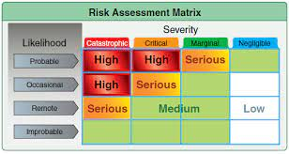
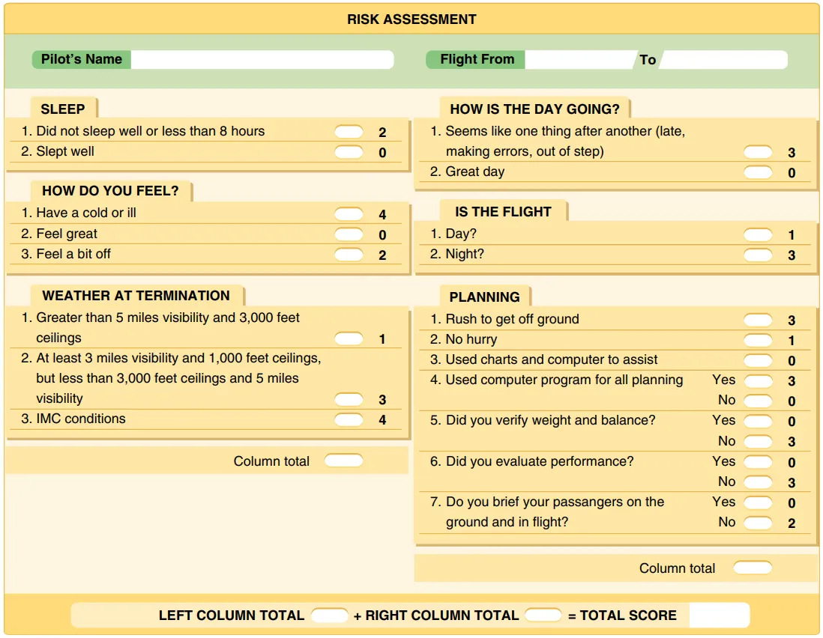
Risk Identifying, Assessing and Mitigating Tools
Mitigating the Risk
Wait until the weather is VFR
Take an IFR current & IFR proficient pilot
Cancel the flight
Consider driving
Source: Risk Management Handbook FAA-H-8083-2
Notes:
PAVE & I’M SAFE tool to identify risk before each flight (Chapter 3 Risk Management Handbook FAA-H-8083-2)
Assessing Risk (Risk Assessment Matrix Tool Chapter 4 (Risk Management Handbook (FAA-H-8083-2)

Slide 10
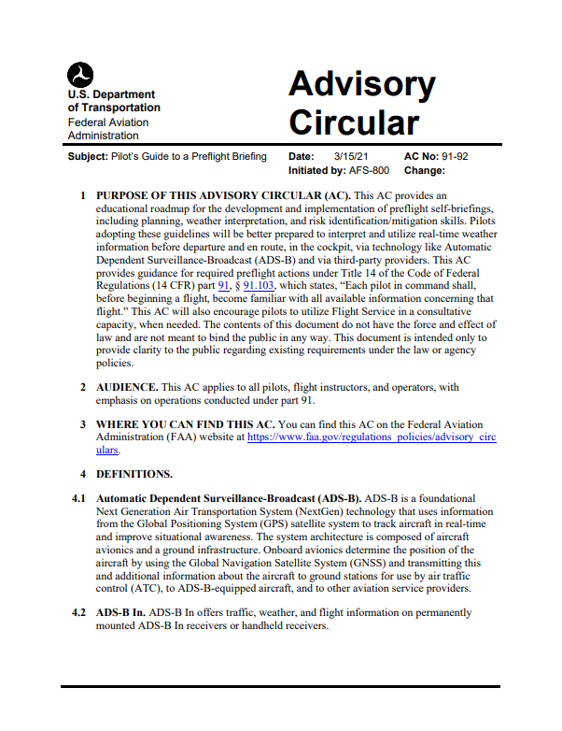
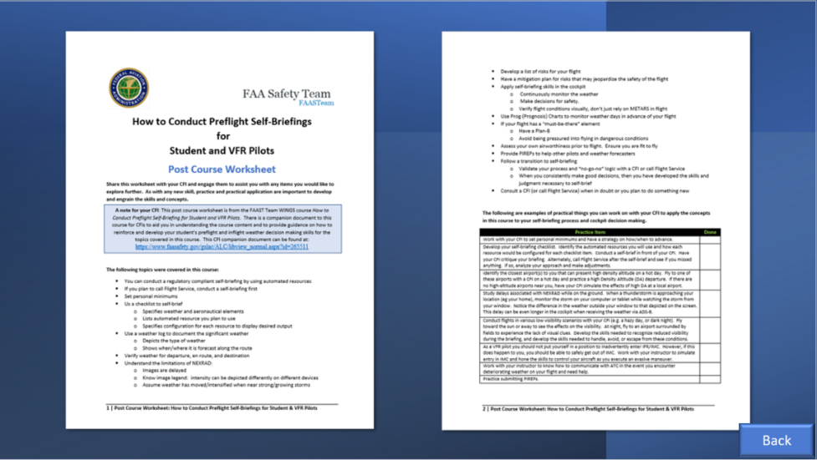
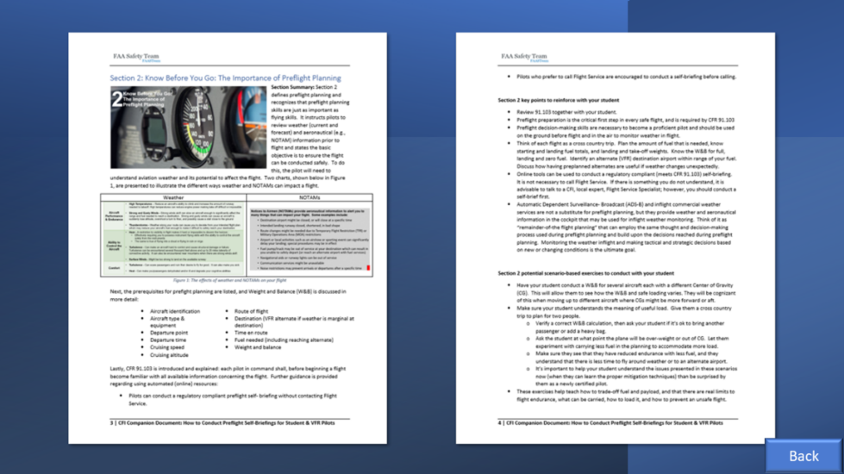
FAA Resources for the Flight Instructor
VFR/IFR WINGS Course
WINGS Student Worksheet
WINGS Instructor Companion Document
AC 91-92

Slide 12
AC 91-92 Resource List

Slide 13
WINGS Courses Government Preflight Self-Briefing Resource List
1800wxbrief.com | Leidos Flight Service – FAA Contract Vendor
weathercams.faa.gov | FAA Weather camera network
aviationweather.gov | NOAA/Government aviation weather website
fly.faa.gov/rmt/nfdc_preferred_routes_database.jsp | FAA Preferred Routes
nasstatus.faa.gov | FAA Flight Delay Information
nhc.noaa.gov | National Hurricane Center (NHC)
notams.aim.faa.gov/notamSearch | Federal NOTAM System (FNS) NOTAM Search
spc.noaa.gov | NOAA Storm Prediction Center (SPC)
ssd.noaa.gov/VAAC/vaac.html | Volcanic Ash Advisory Centers (VAAC)
sua.faa.gov | Special Use Airspace (SUA)
tfr.faa.gov/tfr2/list.html | Temporary Flight Restrictions (TFR)
weather.gov | National Weather Service Forecast Office
weather.gov/aawu | Alaska Aviation Weather Unit (AAWU)
weather.gov/hfo | NWS Forecast Office Honolulu, HI
wpc.ncep.noaa.gov | Weather Prediction Center (WPC)
Note: Third-party online resources may also be used to conduct preflight self-briefings

Slide 14
Research

Slide 15
Transition Strategy for Safe Self-Briefings
If you are new to self-briefing or currently call Flight Service for preflight planning, it’s important to make the transition to self-briefing in a safe manner
Follow a transition strategy to measure and refine your skills
Using a checklist, conduct a self-briefing and identify the risks for the flight, then make your “go-no-go” decision
Discuss with your flight instructor your decision logic, the weather products you used, and your final assessment. Compare your assessment with that of your flight instructor
If needed, call Flight Service to discuss or confirm meteorological or aeronautical information obtained through online resources
When your assessments become consistent with those of the flight instructor or briefer, you have developed the skills necessary to begin trusting your own judgement
As you add/encounter new or more complex items during flight planning, revert to the transition strategy to ensure your skills and assessments continue to improve

Slide 16
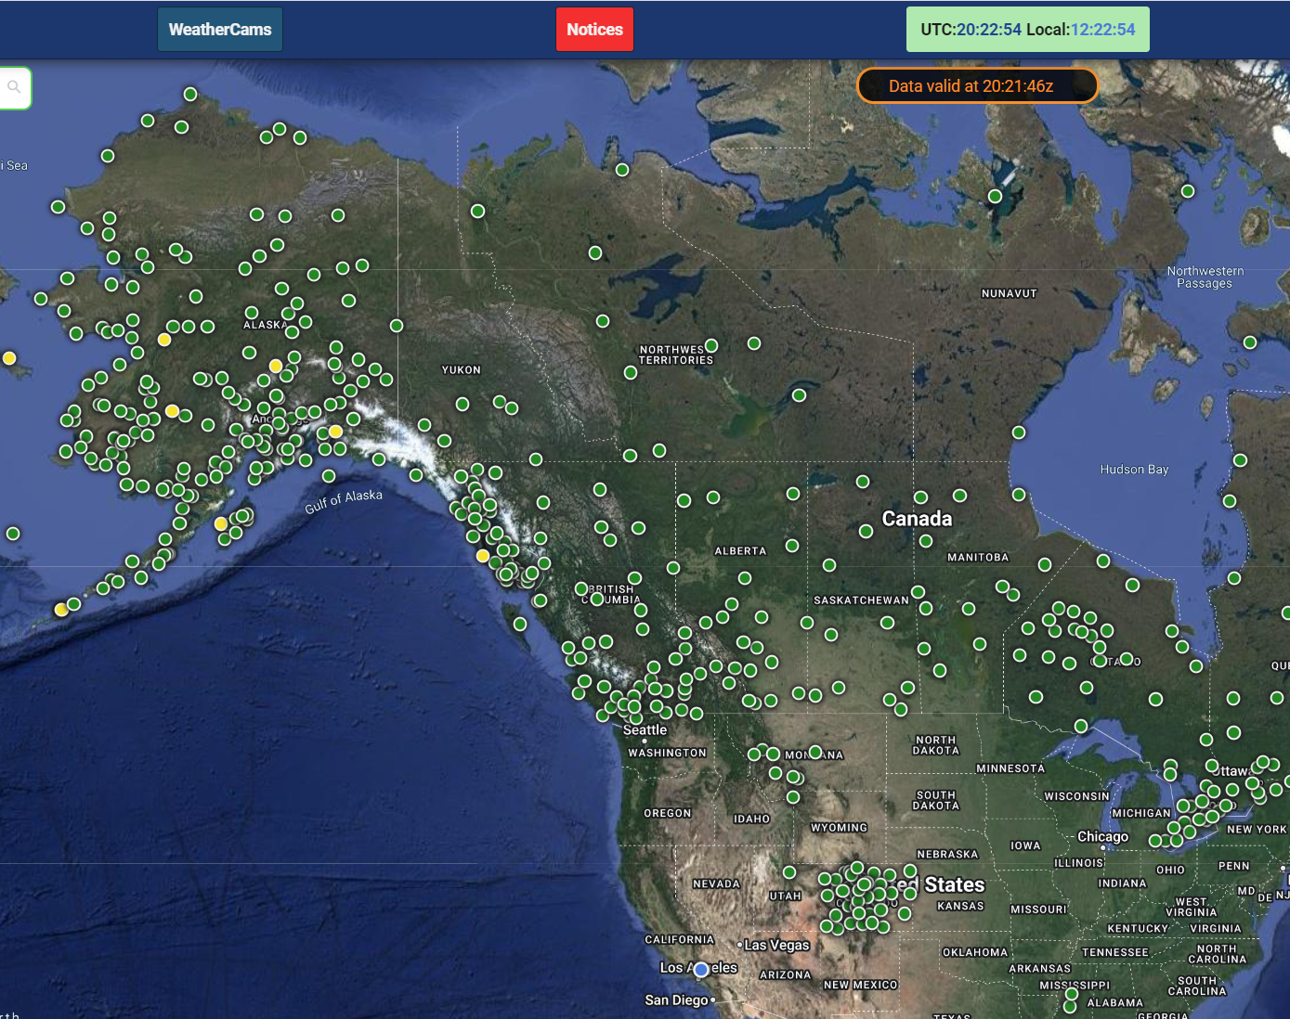
Weather Camera Program
FAA Camera Sites
230 Alaska
11 Hawaii
3rd Party Hosted Sites
6 Alaska
219 NAV Canada
43 Colorado
1 Michigan
Preflight Planning Website
Images, METARS, TAFS
Satellite, RADAR, RCO/RCAGs
Airports, Sectionals, NOTAMs
2 Mississippi
8 Montana
1 Utah
Notes:
Mentions mission and goals

Slide 17
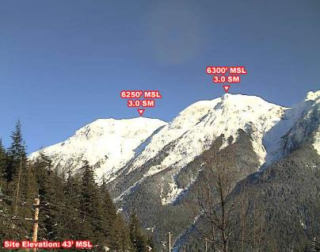
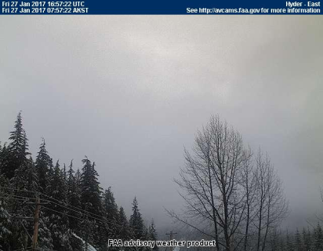
Know Before You Go & Check Enroute
Clear-Day Comparison Image
Current Image
A self-briefing resource to enhance preflight planning and improve decision making before and after takeoff

Slide 18
Weather Camera Impact
85% reduction in weather-related accidents
69% reduction in weather-related flight interruptions
Recommended by the NTSB
Recommended by the Senate Transportation Housing and Urban Development (THUD) Committee

Slide 19
Program Expansion
Applications
Near mountains/high terrain
Common flight routes with gaps in certified weather stations
Heliports/Hospitals
Lakes/Rivers with float-plane operations
Validate airport conditions
Feedback Welcome
Do you have an opinion on a recommended location?
Send me an email and tell me where and why at:
Daniel.C.Pope@faa.gov

