Slide 1
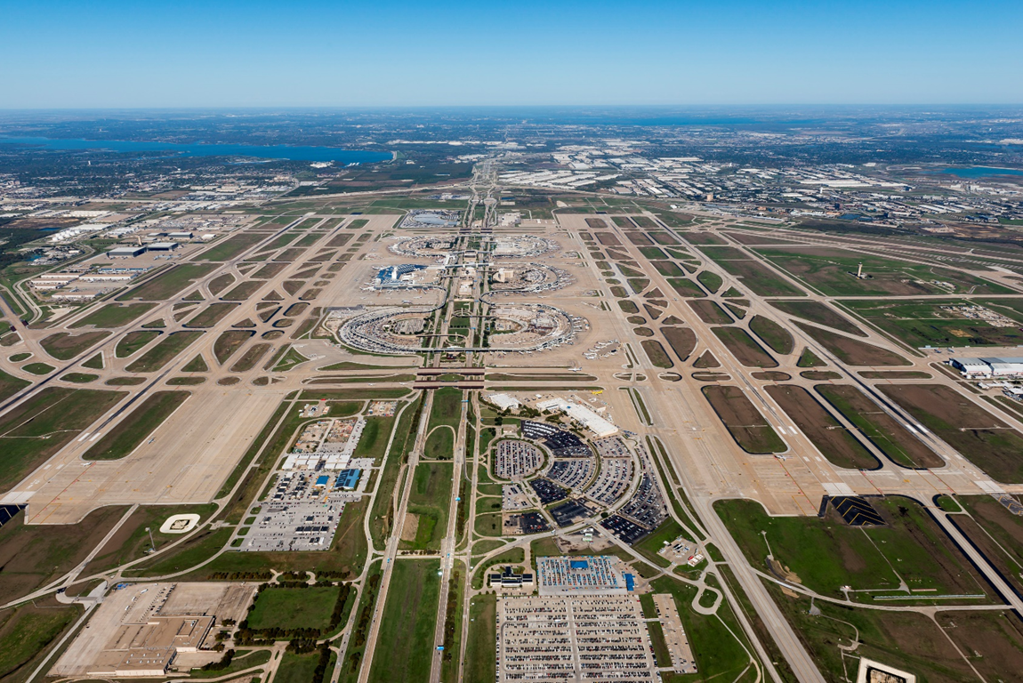
Identify the Different Components of an Airport
Lecture Guide in support of STEM ACTIVITY: Create and Airport Layout Plant
Updated June 2023

Slide 2
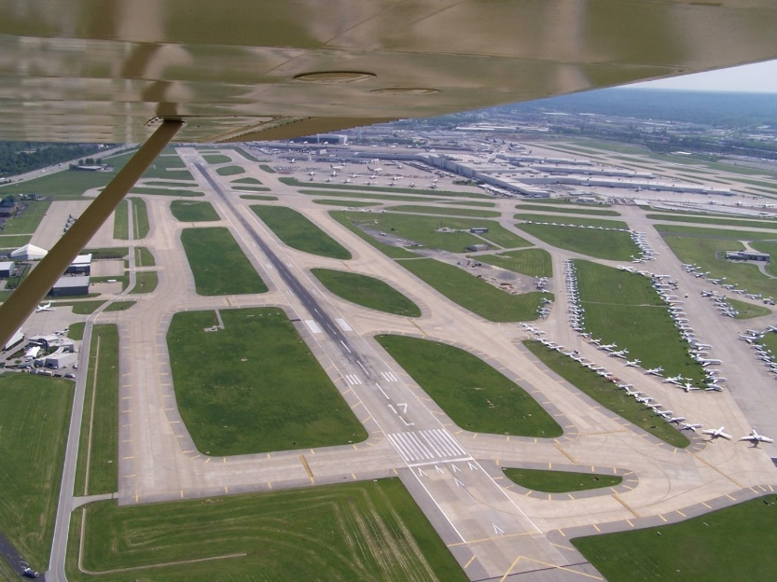
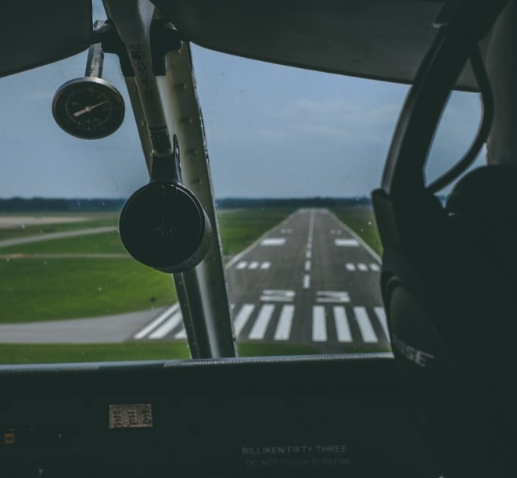
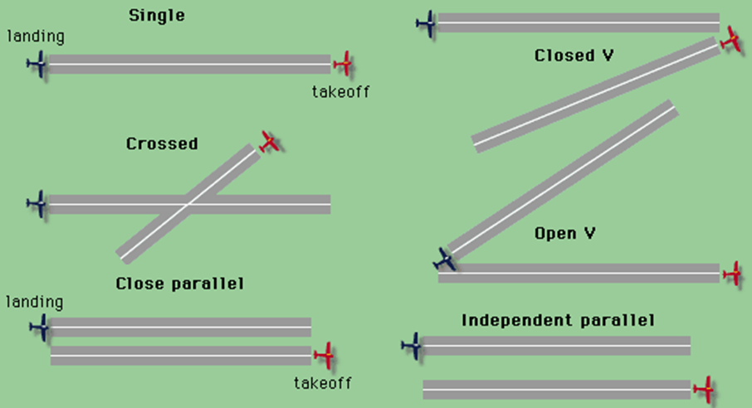
Airport Paved Surfaces
Runways
Most runways are made with asphalt, concrete, or grass.
Runways are aligned with the outbound magnetic heading
The runway numbers are based on the first two numbers of the magnetic heading
Parallel runways are labeled using terms such as left, center or right
Runway surface markings are painted white
Check out this video on runways!
Apprx. 3 minutes

Slide 3
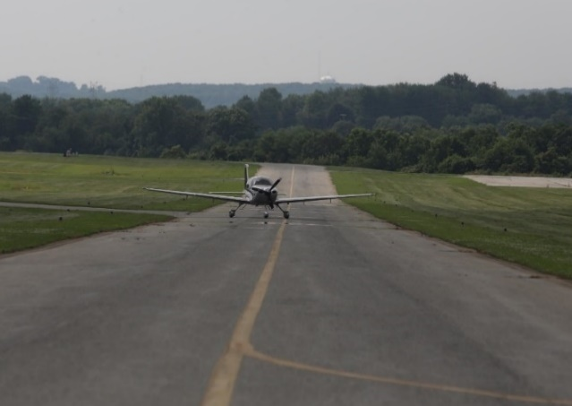
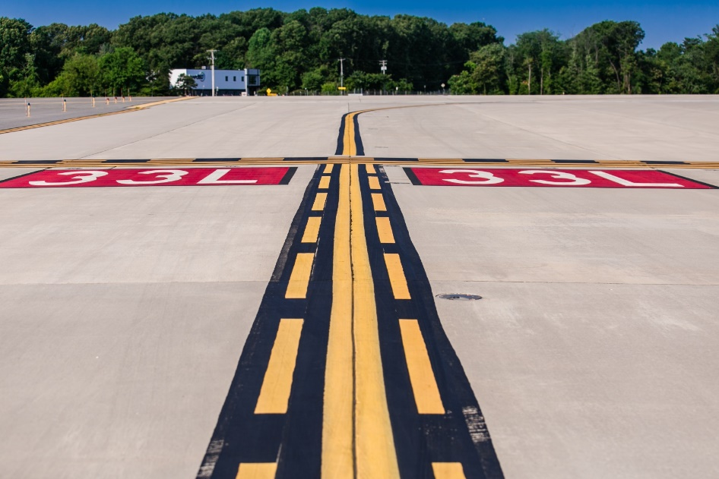
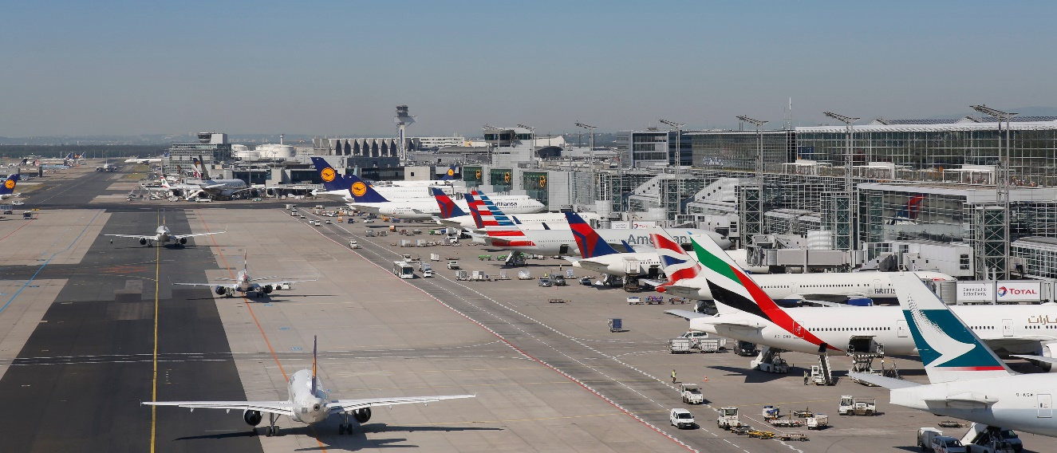
Airport Paved Surfaces
Taxiways, Aprons and Ramps
Taxiway surface markings are painted yellow
The most critical taxiway marking is the runway hold position bar
Primary taxiways are identified with a letter. Taxiway connectors are identified with a letter number combination
Taxiways have blue edge lights
Check out this video on taxiways!
Apprx. 3 minutes

Slide 4
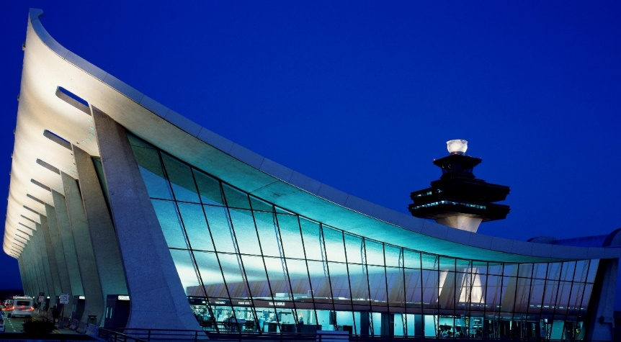
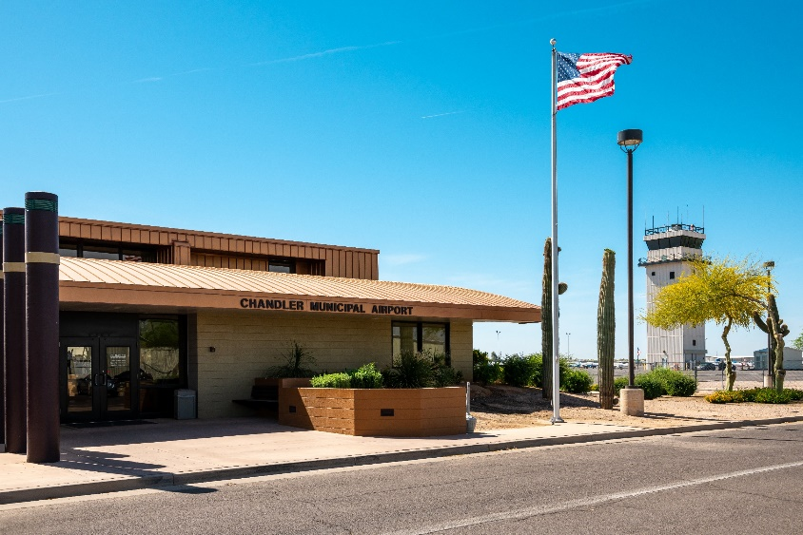
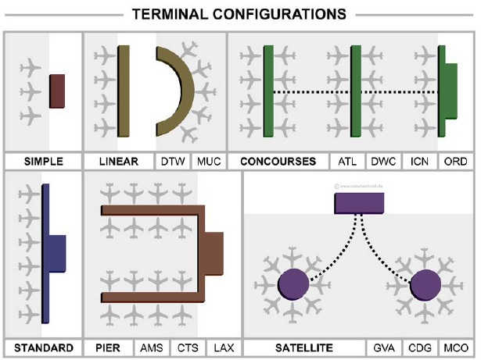
Airport Buildings
Primary entrance point for passengers
Intended to assist passengers moving from the landside to the airside of an airport
Terminal designs range from small one room buildings to multi-building island configurations that stretch across several miles.
Terminals may include baggage, security, offices, restaurants, shopping areas, and more
Terminals
Check out this video on terminals!
Apprx. 6 minutes

Slide 5
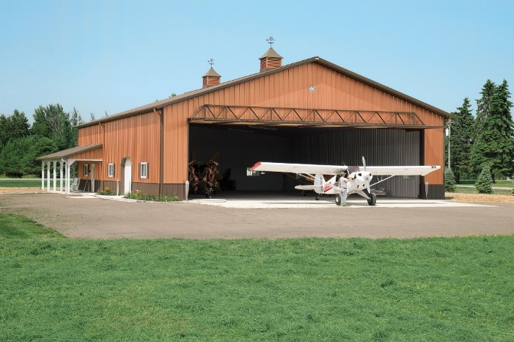
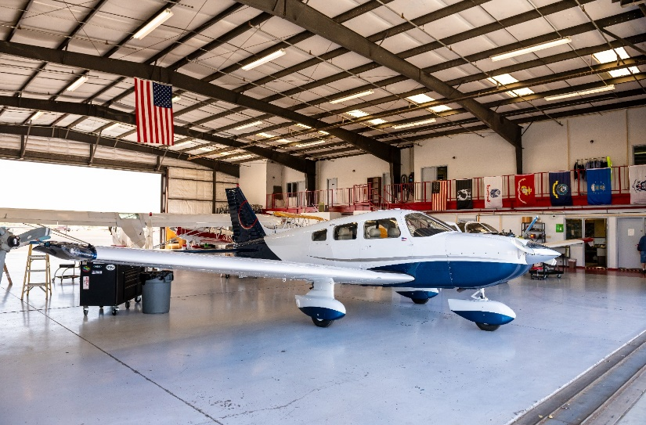
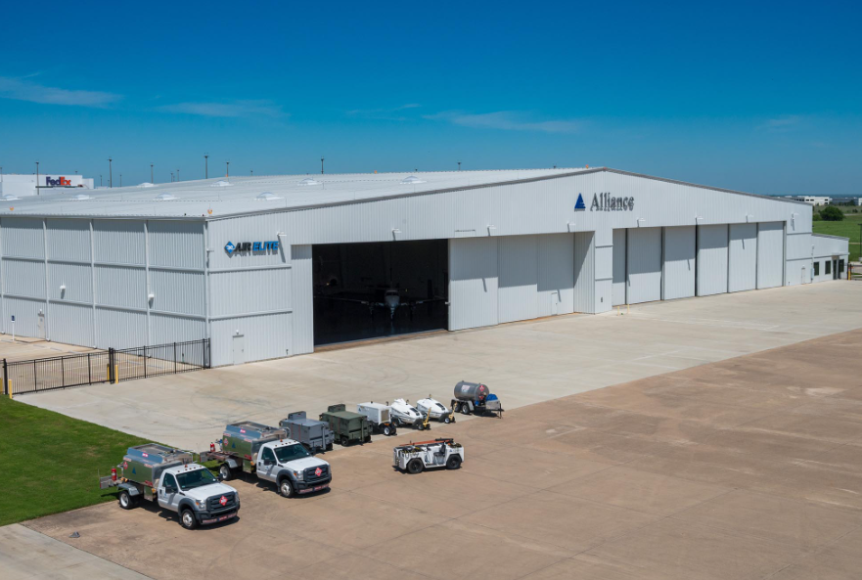
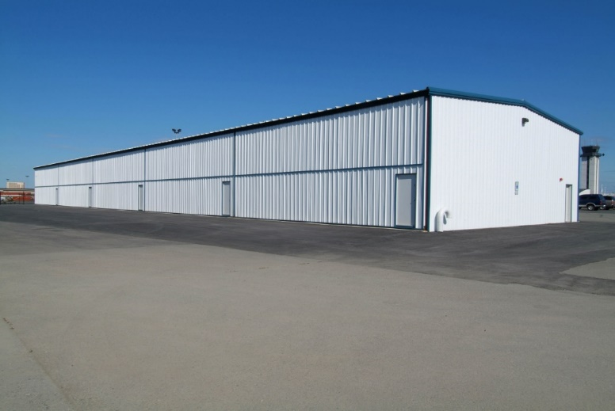
Airport Buildings
Hangars
Preferred parking location for aircraft
Location of aircraft repair and paint shops
Hangars normally do not have any windows.
One of the largest cantilever hangars in the world is at Alliance Airport with over 840,000 sq. feet.
Check out this video on terminals!
Apprx. 1:30 minutes

Slide 6
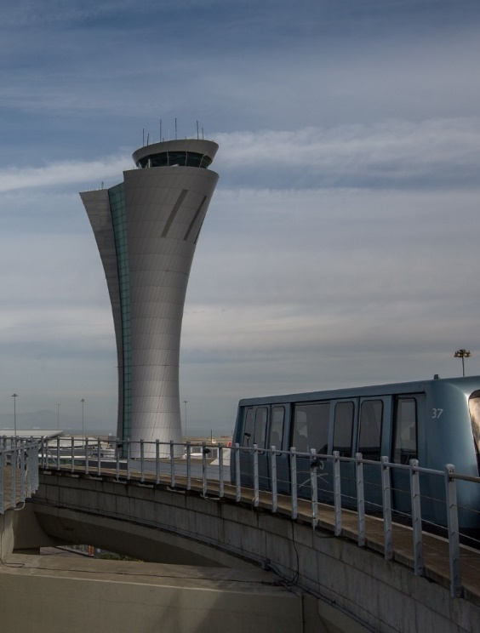
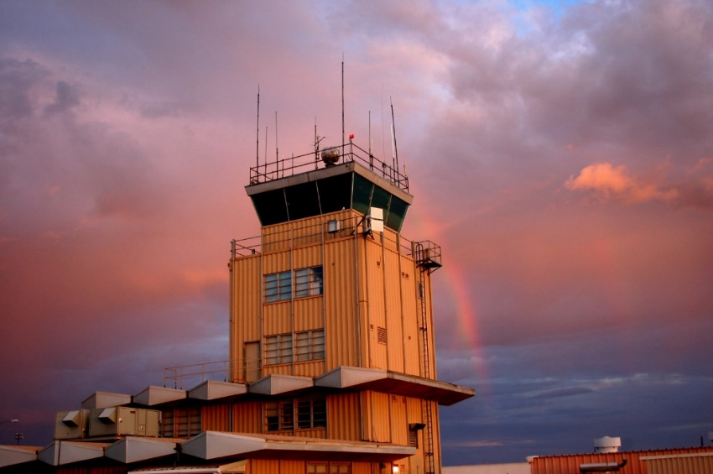
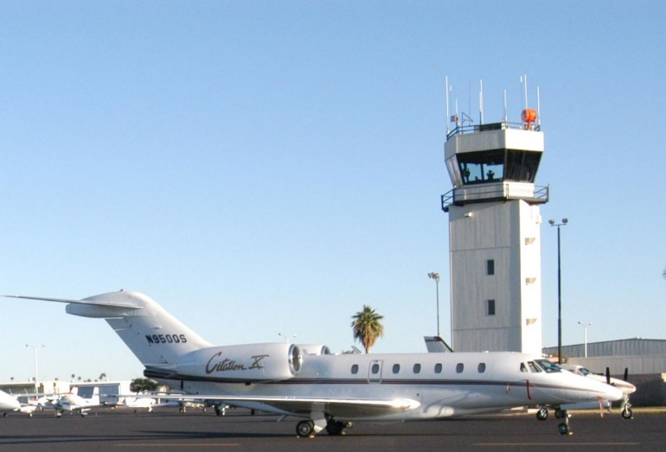
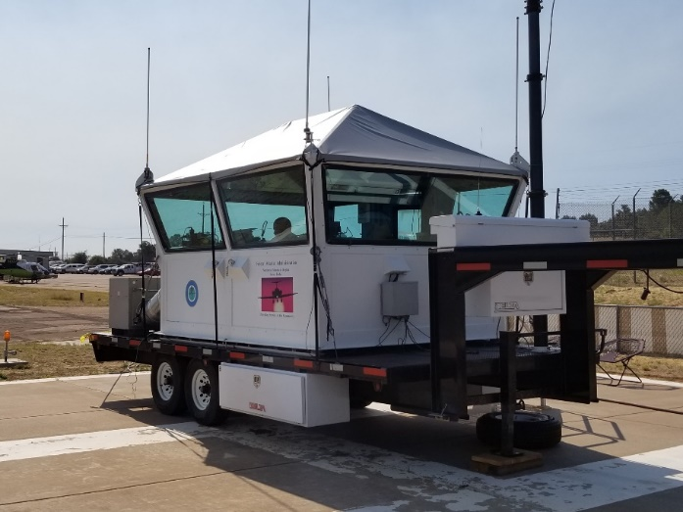
Airport Buildings
Air Traffic Control Towers
Air traffic control towers are built to see all the movement surfaces on an airport
Towers’ heights vary depending on the setup of each airport.
Tower hours of operation vary based on the traffic at each airport
Not every airport has an air traffic control tower
All movement around the airfield is directed and monitored by air traffic controllers
Check out this video on terminals!
Apprx. 1 minute

Slide 7
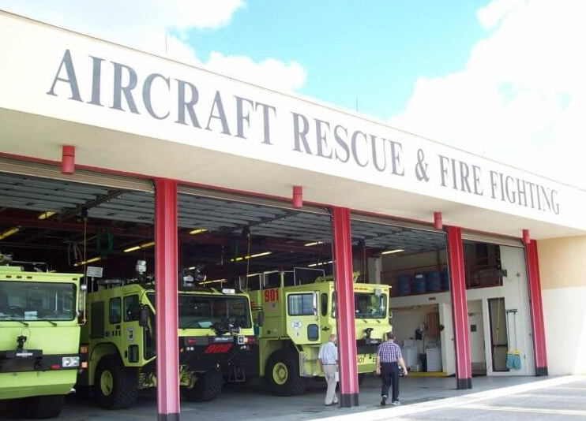
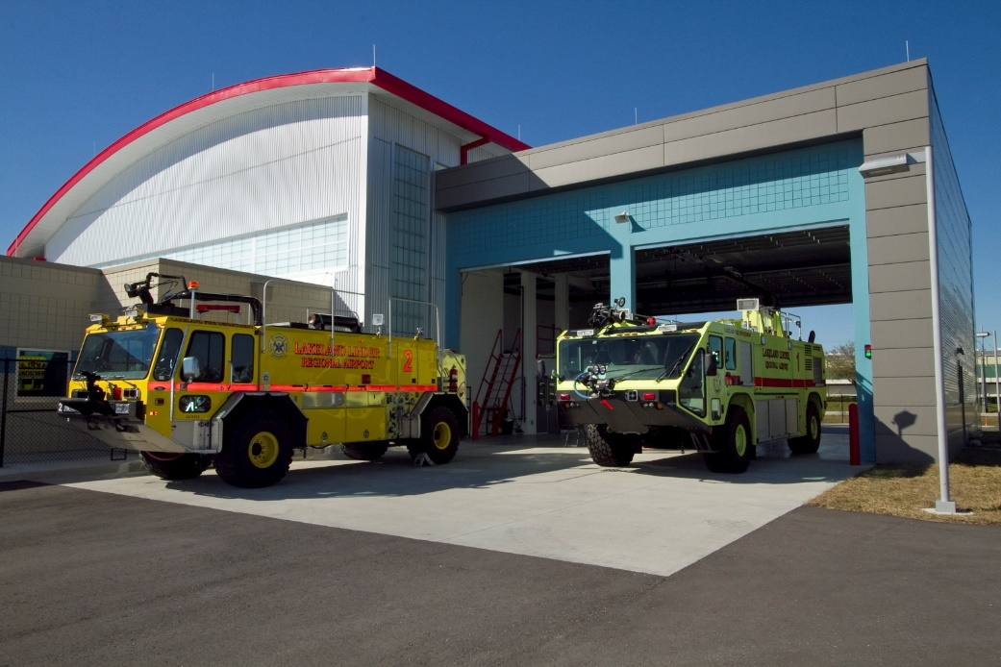
Airport Buildings
Aircraft Rescue and Firefighting
ARFF requires special training to work around and with aircraft
ARFF Firefighters respond to accidents, incidents, medical emergencies, and more
ARFF stations are staffed at all hours that an airport is open so they usually include living areas for the firefighters
All operators of Part 139, commercial service airports, are required to have ARFF services onsite
Check out this video on ARFF!
Apprx. 3:30 minutes

Slide 8
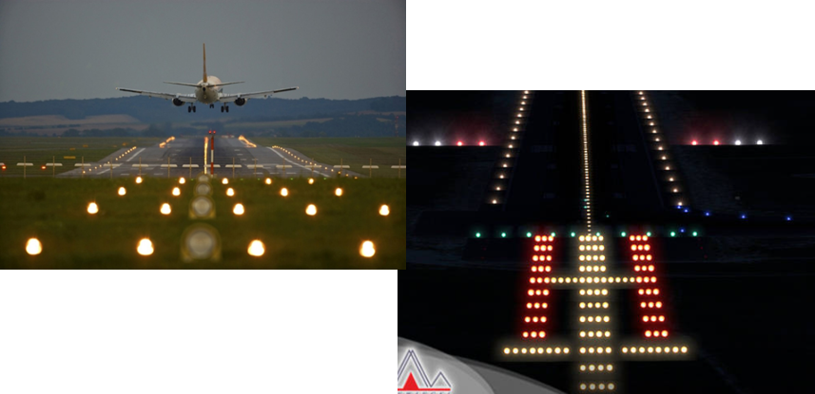
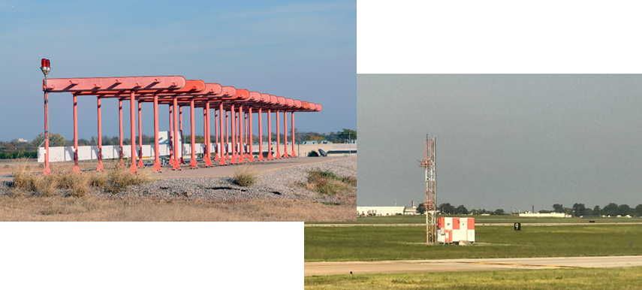
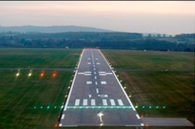
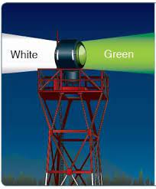
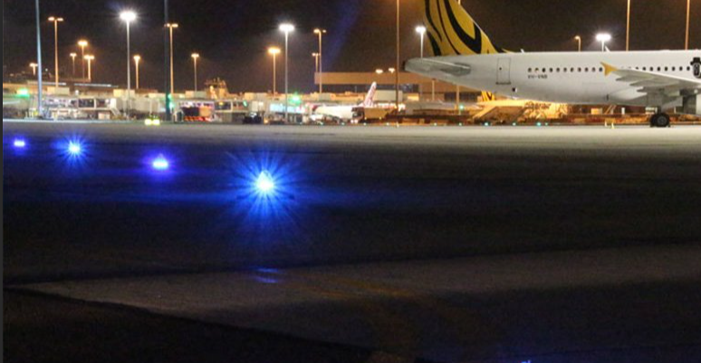
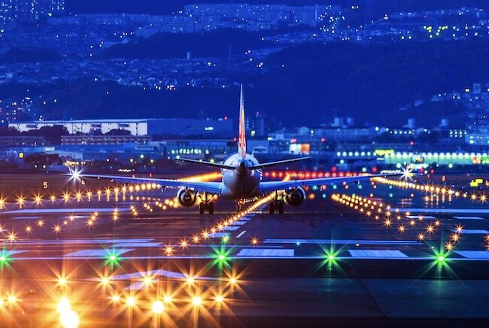
Airport Lighting Systems
Runway Lights
Instrument Landing System (ILS)
Beacons, Glide Slopes, & More
Taxiway Lights
Check out this video on airport lights!
Apprx. 6 minutes

Slide 9
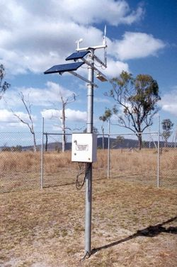
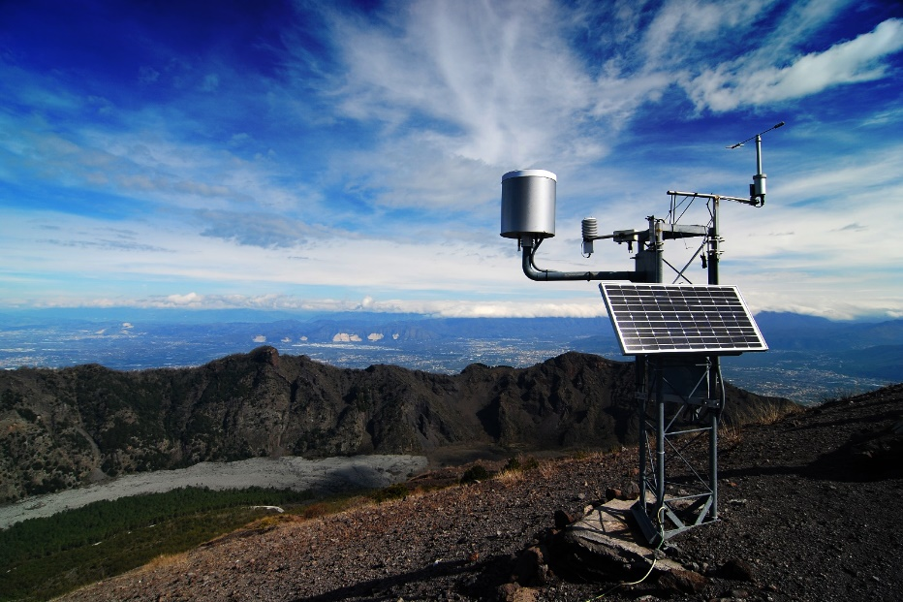
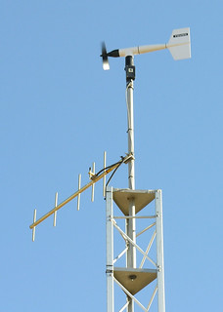
Airport Weather Systems
ATIS, ASOS & AWOS
All three systems provide similar information such as cloud conditions, visibility, and wind speed
ATIS provides weather and airport information such as runway in use and NOTAMS
ASOS and AWOS are automated weather reporting systems
ASOS and AWOS are similar but an ASOS is newer and provides additional services not available on an AWOS.
Check out this video on weather systems!
Apprx 3:30 minutes

Slide 10
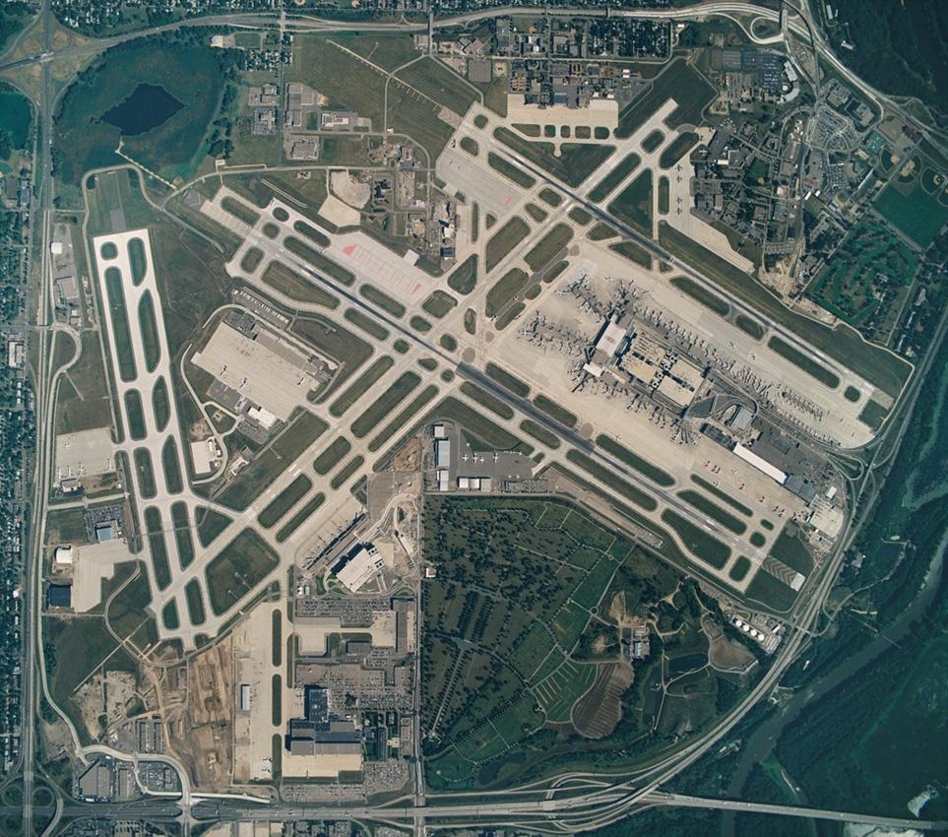
Can you identify all the major parts of your local airport?

Slide 11
Students model actual airports using Minecraft
Organized lesson plans build on one another
Knowledge check assignments verify student learning and involvement
Collaborative communication between students, teachers, parents, and FAA staff
STEM based applied knowledge in math, engineering, and aerospace career development
Check out this video on the Airport Design Challenge!
Apprx 3:30 minutes

Slide 12
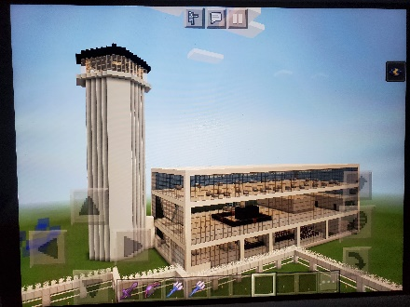
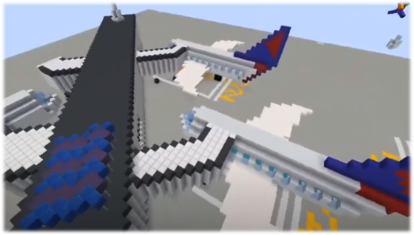
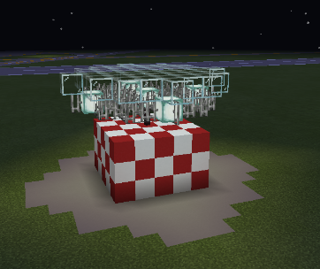
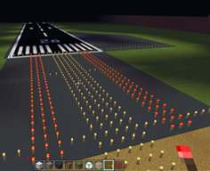
STEM AVSED
Enroll Today!

