Slide 1
Safe Machine Learning-Based Aerospace Autonomy
Kerianne Hobbs, Ph.D.
Safe Autonomy and Space Lead, ACT3

Slide 2
How do you know an autonomous system will do what you want?
How do you know an autonomous system won’t do what you don’t want?
What if the autonomous system is based on machine learning?

Slide 3
Types of Machine Learning
Supervised
Unsupervised
Reinforcement Learning
Learning by known examples
Data is labeled
Examples: classification, regression
Learning hidden structure in data
Data is unlabeled
Examples: clustering, anomaly detection
Learning to take actions.
Learning to map situations to actions to maximize reward
Learner discovers actions by trial and error.
State
S_{t}
or
Observation
O_{t}
Agent
Reward
R_{t}
Action
A_{t}
Environment

Slide 4
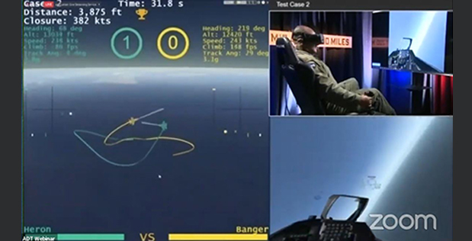
Significant Achievements of Reinforcement Learning
RL has already shown superhuman performance in several big “human versus machine” competitions​ - high dimensional state spaces, partial observability, complex strategy
AlphaGo - Deepmind trained agents to play GO​ (2016)
OpenAI 5 - OpenAI trained agents to play DOTA 2​ (2019)
AlphaStar - Deepmind trained agents to play StarCraft 2​ (2019)
Alpha Dog Fight Trials - Heron Systems trained agents to aerial dogfight​ (2020)
GPT-4 passes Bar Exam, US Medical Licensing Exam, college course exams (2023)
Photo Courtesy of DARPA

Slide 5
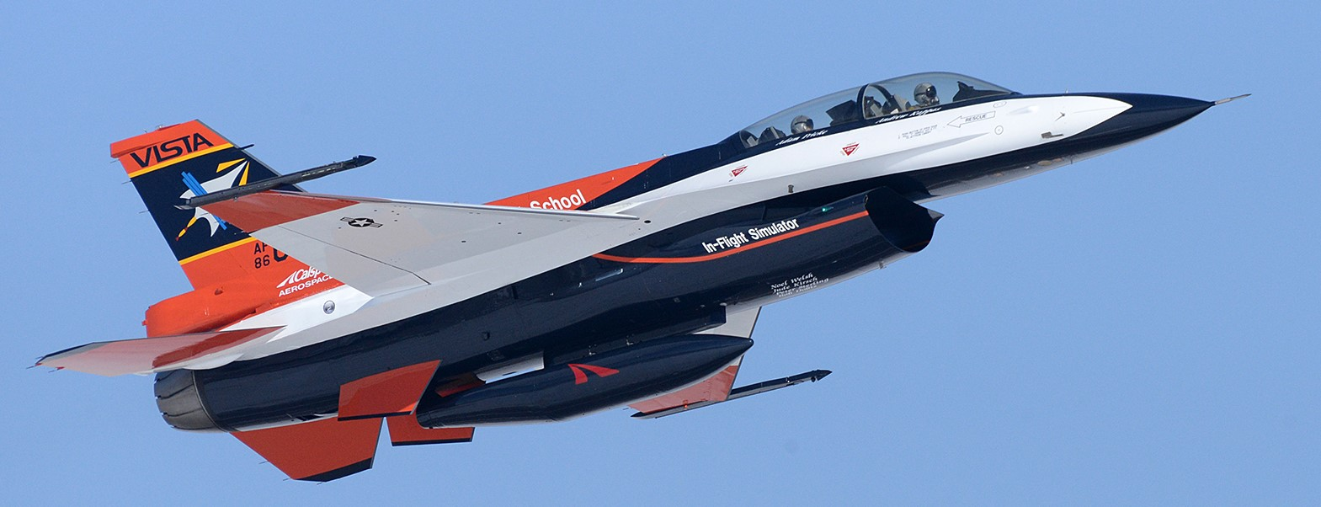
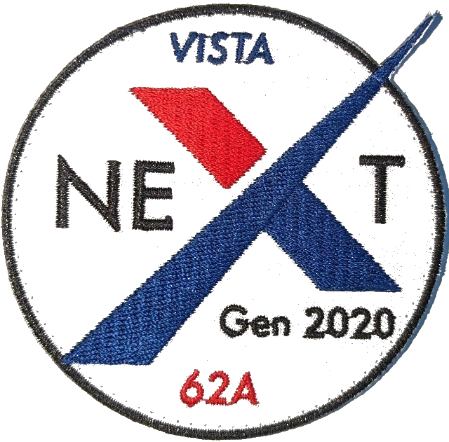
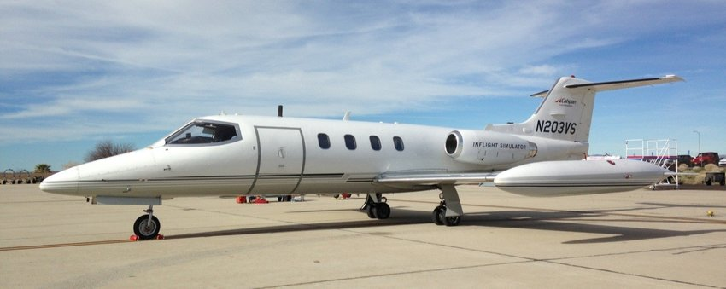
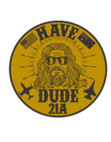
AFRL Autonomous Air Combat Operations
Vision Statement: AFRL ACT3 Autonomous Air Combat Operation (AACO) was formed to Demonstrate AI Tactical Autopilot engaging in multi-ship / multi-role Beyond Visual Range (BVR) operations with tactical proficiency
X62 VISTA (F16)
8 sorties
Aviate, Navigate, BVR, LVC
AACO Formed
FY21/FY22
FY23Q4
FY19Q2
FY23Q1
Learjet
25+ sorties
Aviate, Navigate, BVR, LVC
XQ-58 Valkyrie
Aviate, Navigate, BVR, LVC
Multi ship

Slide 6
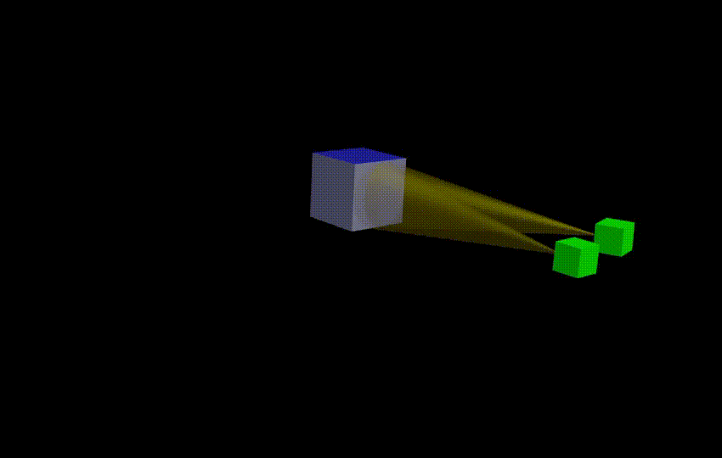
Safe, Trusted Autonomy for Responsible Spacecraft (STARS)
AFRL Seedling for Disruptive Capabilities Program (SDCP) Applied Research
What would it take to put a neural network control system on a spacecraft?
Develop flexible human-autonomy interfaces
Develop reinforcement learning-based neural network multi-agent controllers
Develop run time assurance approaches that mitigate hazards and allow the autonomy to stay on mission for longer
Kyle Dunlap, David Van Wijk, and Kerianne Hobbs, "Run Time Assurance for Autonomous Spacecraft Inspection" 2023 AAS/AIAA Astrodynamics Specialist Conference, Big Sky, MT, August 13-17, 2023 Preprint: https://arxiv.org/pdf/2302.02885
David Van Wijk, Kyle Dunlap, and Kerianne Hobbs, "Deep Reinforcement Learning for Autonomous Spacecraft Inspection Using Illumination" 2023 AAS/AIAA Astrodynamics Specialist Conference, Big Sky, MT, August 13-17, 2023 Preprint: https://arxiv.org/pdf/2308.02743.pdf
Michael Hibbard, Ufuk Topcu, and Kerianne Hobbs, “Guaranteeing Safety via Active Set Invariance Filters for Multi-agent Space Systems with Coupled Dynamics,” IEEE American Control Conference, June 8-10, 2022

Slide 7
Safe Autonomy Research Priorities
Run Time Assurance
Trusted Autonomy
Safe Reinforcement Learning, with Rigor
Neural Network Verification
Hazard Analysis
Assurance Cases

Slide 8
Run Time Assurance
Our Team’s Biggest Investment
Kerianne L. Hobbs, Mark L. Mote, Matthew C.L. Abate, Samuel D. Coogan, and Eric M. Feron “Run Time Assurance for Safety Critical Systems: An Introduction to Safety Filtering Approaches for Complex Control Systems,” IEEE Control Systems Magazine, April 2023 Preprint: https://arxiv.org/pdf/2110.03506.pdf
Kerianne L. Hobbs, Jennifer Davis, Lucas Wagner, and Eric M Feron, “Formal Specification and Analysis of Spacecraft Collision Avoidance Run Time Assurance Requirements.” IEEE Aerospace, Big Sky, MT, 6-13 Mar 2021, Best Paper Award of 35 papers in track

Slide 9
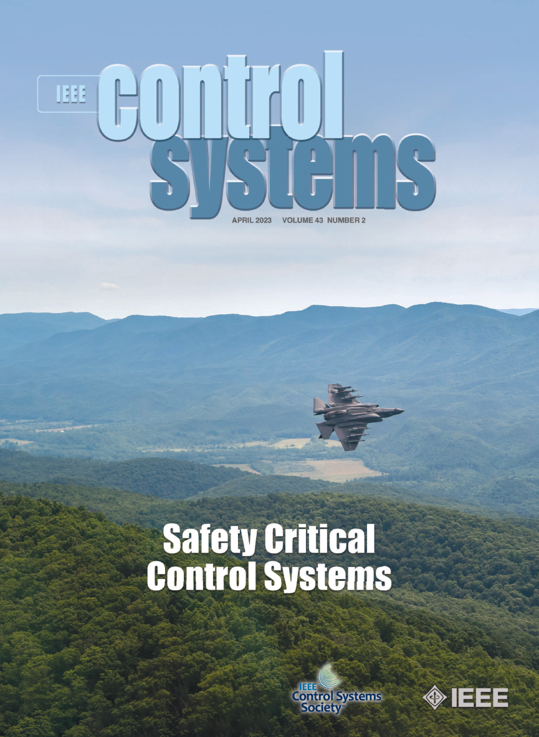
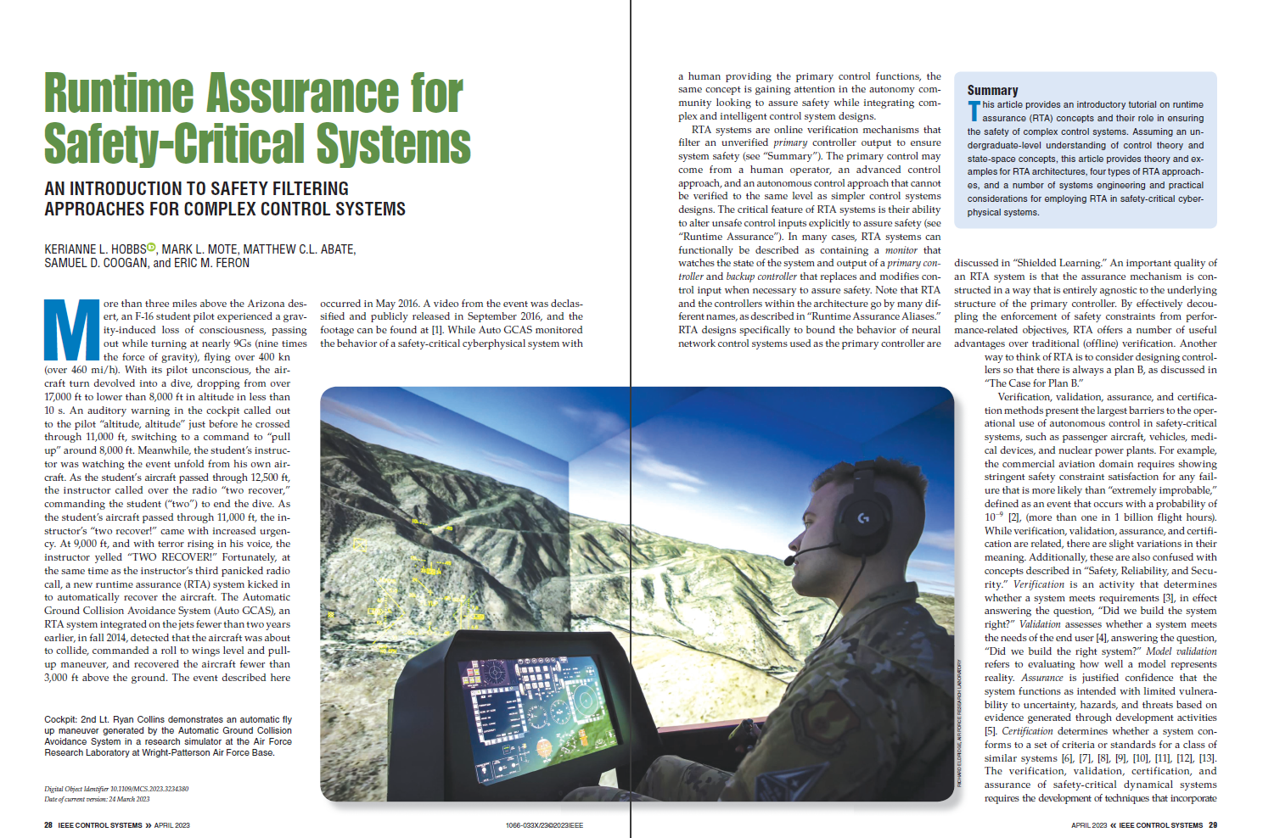
Run Time Assurance: Leading an Emerging Field
Kerianne L. Hobbs, Mark L. Mote, Matthew C.L. Abate, Samuel D. Coogan, and Eric M. Feron “Run Time Assurance for Safety Critical Systems: An Introduction to Safety Filtering Approaches for Complex Control Systems,” IEEE Control Systems Magazine. April 2023. Preprint: https://arxiv.org/pdf/2110.03506.pdf

Slide 10
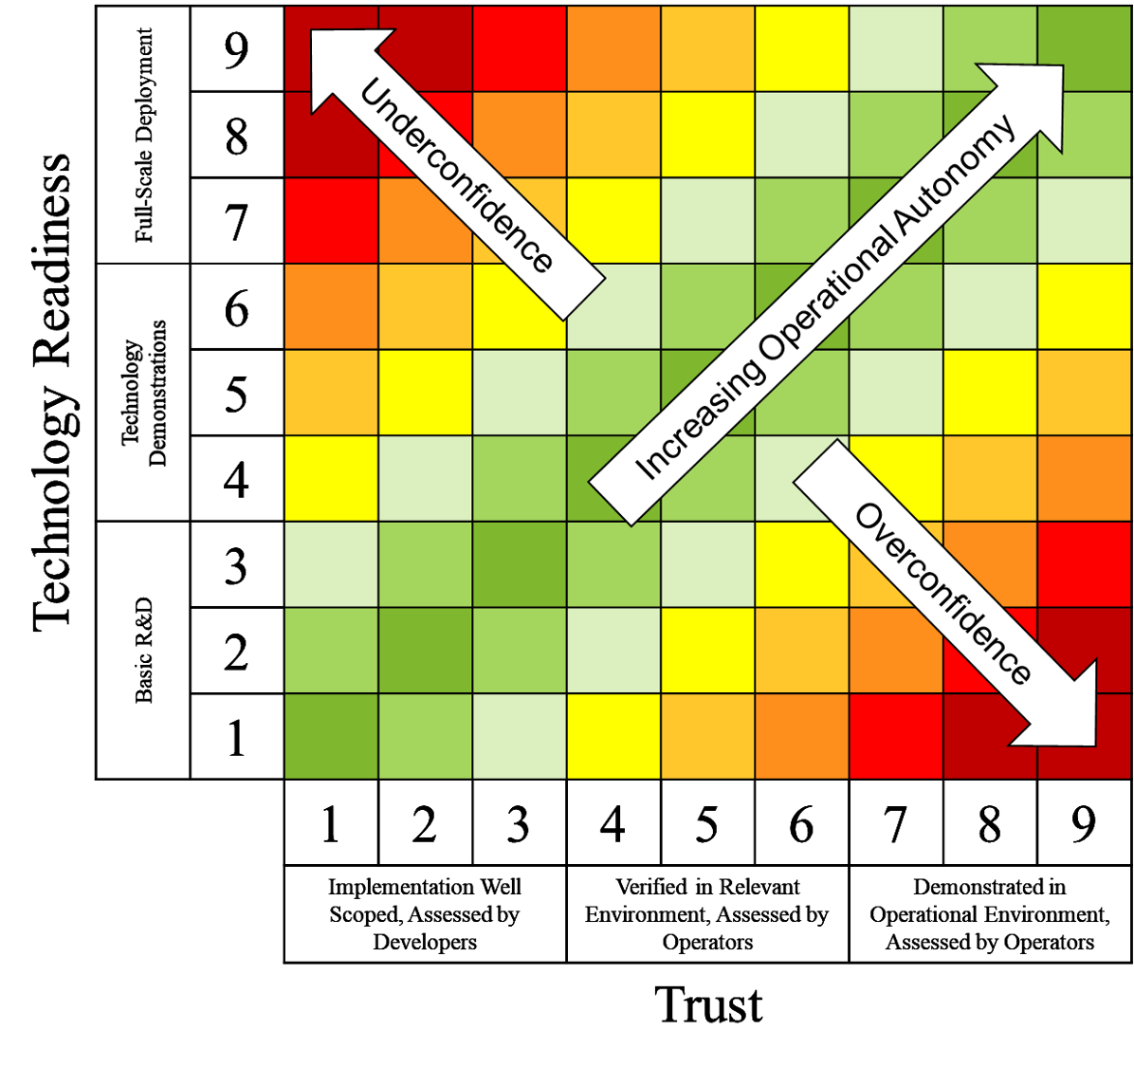
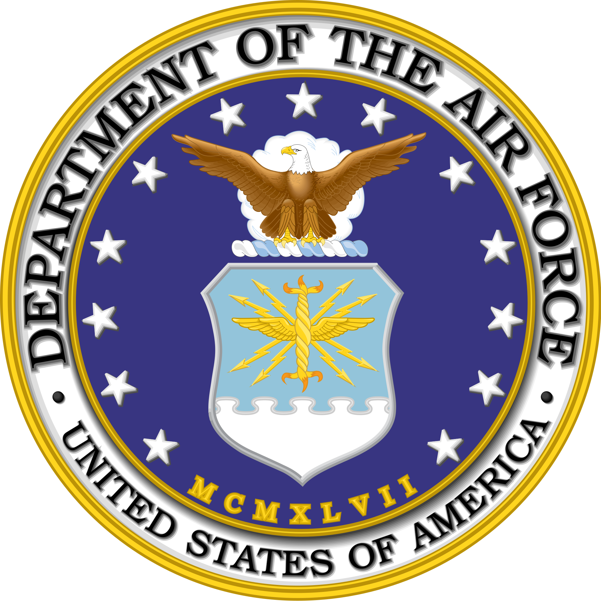
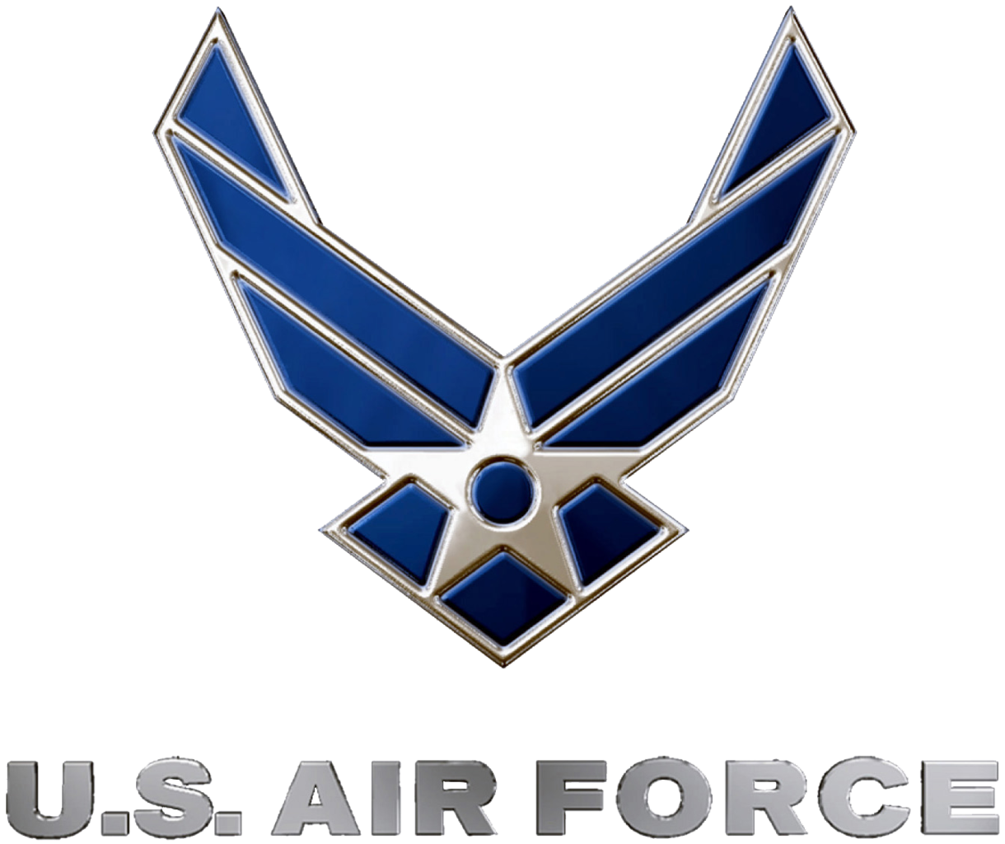
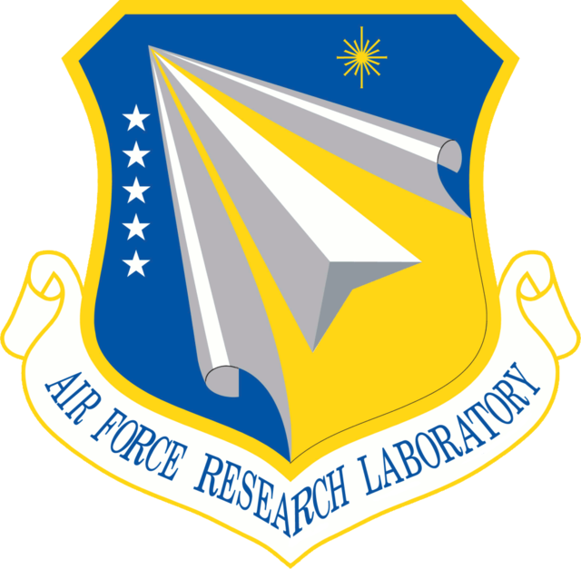
Trusted Autonomy Readiness Levels
Active Partner in the NRO/NASA/DAF Space Trusted Autonomy group under the Space Science and Technology Partnership forum
Defined Space Trusted Autonomy Readiness (STAR) Levels
Defines capability and trust levels
Includes background on trust in automation research
Consistent with other forms of readiness levels: original TRLs, algorithm RLs, manufacturing RL, commercialization RL, data RL, machine learning RL, etc.
[Accepted] Kerianne Hobbs, Bernard Li, “Safety, Trust, and Ethics Considerations for Human-AI Teaming in Aerospace Control,” AIAA SciTech, 8–12 January 2024, Orlando, FL.
Kerianne L. Hobbs, Joseph B. Lyons, Martin S. Feather, Benjamin P Bycroft, Sean Phillips, Michelle Simon, Mark Harter, Kenneth Costello, Yuri Gawdiak, Stephen Paine, “Space Trusted Autonomy Readiness Levels,” IEEE Aerospace, Big Sky, MT, March 4-11, 2023. Preprint: https://arxiv.org/pdf/2210.09059
[Submitted] Joseph B. Lyons, Kerianne Hobbs, Steve Rogers, Scott H. Clouse, “Responsible (Use of) AI,” in Understanding the Role of Humanity in Responsible Deployment of Intelligent Technologies in Socio-technical Ecosystems, Special Issue of Frontiers in Neuroergonomics, 2023.

Slide 11
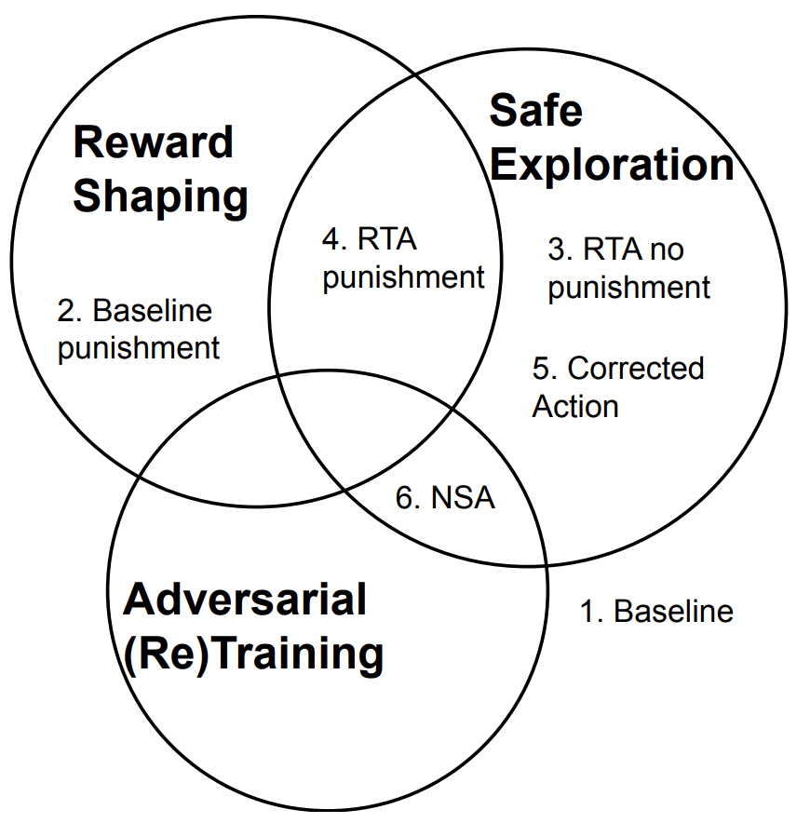
Safe Reinforcement Learning with Rigor
Repeatability: Analyze results over multiple (10+) random seeds, with representative metric (interquartile mean)
To RTA or not to RTA?
Do agents learn to become dependent on RTA?
Which RTA configuration is most effective?
Which RTA approach is most effective?
Which RL Algorithm works better with RTA, off-policy (SAC) or on-policy (PPO)?
Which is more important, Reward Shaping or Safe Exploration?
Nathaniel Hamilton, Kyle Dunlap, Taylor T Johnson, Kerianne Hobbs, “Ablation Study of How Run Time Assurance Impacts the Training and Performance of Reinforcement Learning Agents,” IEEE Space Mission Challenges for Information Technology, Caltech, Pasadena, CA, USA - 18-21 July 2023. Preprint: https://arxiv.org/pdf/2207.04117 Best Paper Award

Slide 12
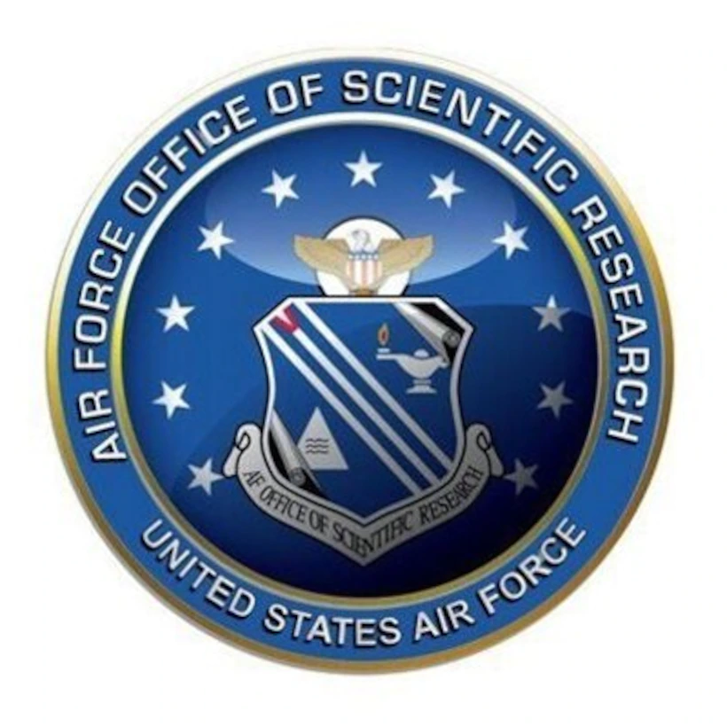
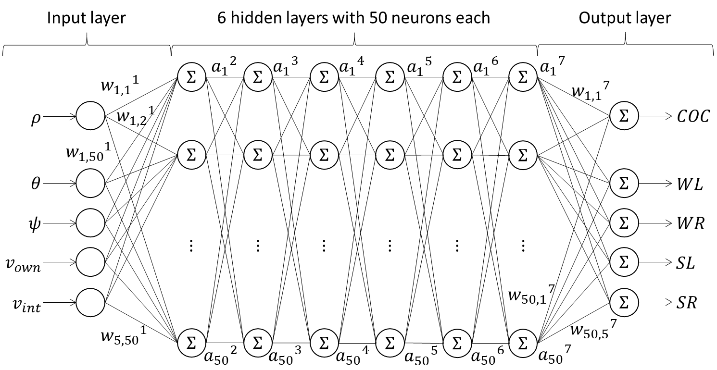
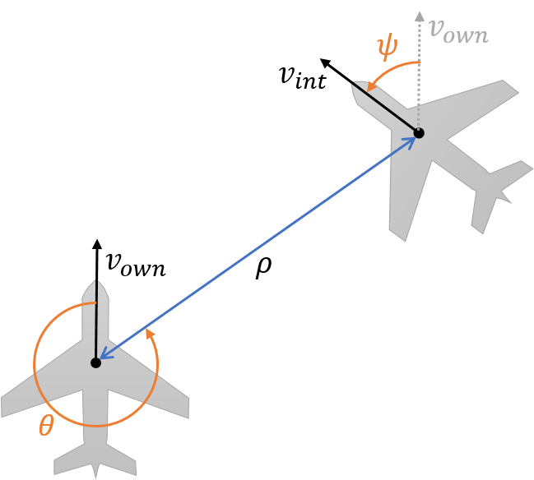
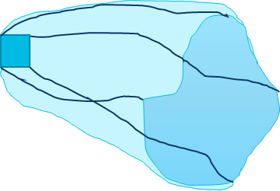
Neural Network Control System Verification
Safety: nothing bad ever happens
Liveness: something good eventually happens
Manzanas Lopez, D., Johnson, T., Tran, H. D., Bak, S., Chen, X., & Hobbs, K. L., “Evaluation of Neural Network Verification Methods for Air to Air Collision Avoidance,” AIAA Journal of Air Transportation Systems, January–March 2023. https://arc.aiaa.org/doi/pdf/10.2514/1.D0255?download=true

Slide 13
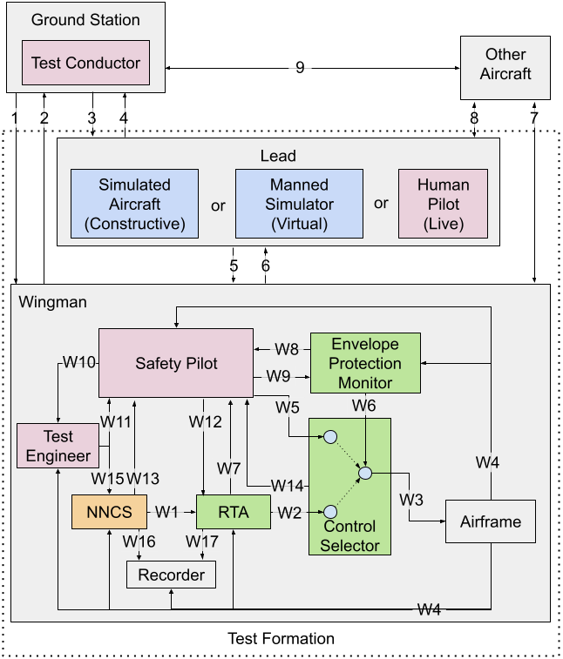
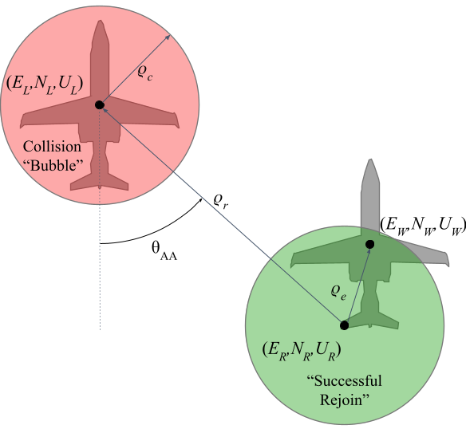
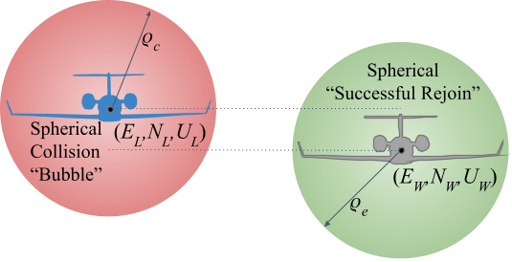
Hazard Analysis: Run Time Assured Neural Network Control (Systems Theoretic Process Analysis)
Flight Test Control Structure Block Diagram
(NNCS = Neural Network Control System, RTA = Run Time Assurance, CS = Control Selector, EPM = Envelope Protection Monitor, VSS = CS+EPM = Variable Stability System)
Kerianne L. Hobbs, Benjamin K. Heiner, Lillian Busse, Kyle Dunlap, Jonathan Rowanhill, Ashlie B. Hocking, and Aditya Zutshi, “Systems Theoretic Process Analysis of a Run Time Assured Neural Network Control System” AIAA SciTech 2023, National Harbor, MD. Preprint: https://arxiv.org/pdf/2209.00552

Slide 14
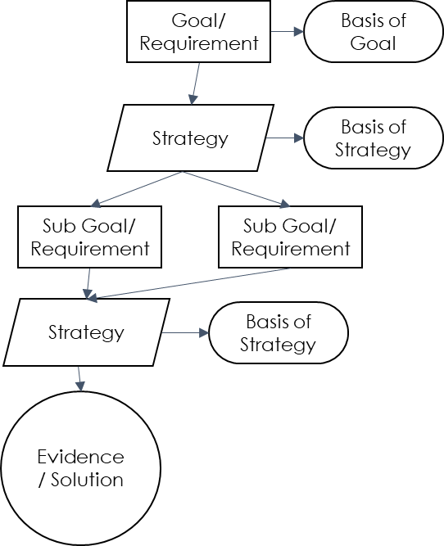
Assurance Case
Structured assurance arguments
Defense: Argue system is safe using goal structured notation, inductive reasoning
Prosecution: Apply defeasible logic to argue system is unsafe
Juror: Does the certification authority agree with the defense in light of the prosecution?
In process, discover necessary design elements and verification evidence to assure safety
Jonathan Rowanhill, Ashlie B. Hocking, Aditya Zutshi, Kerianne L. Hobbs “Bridging the Gap: Applying Assurance Arguments to MIL-HDBK-516C Certification of a Neural Network Control System with ASIF Run Time Assurance Architecture” Digital Avionics Systems Conference, Barcelona, Span, October, 2023. Preprint: https://arxiv.org/pdf/2303.15568.pdf

Slide 15
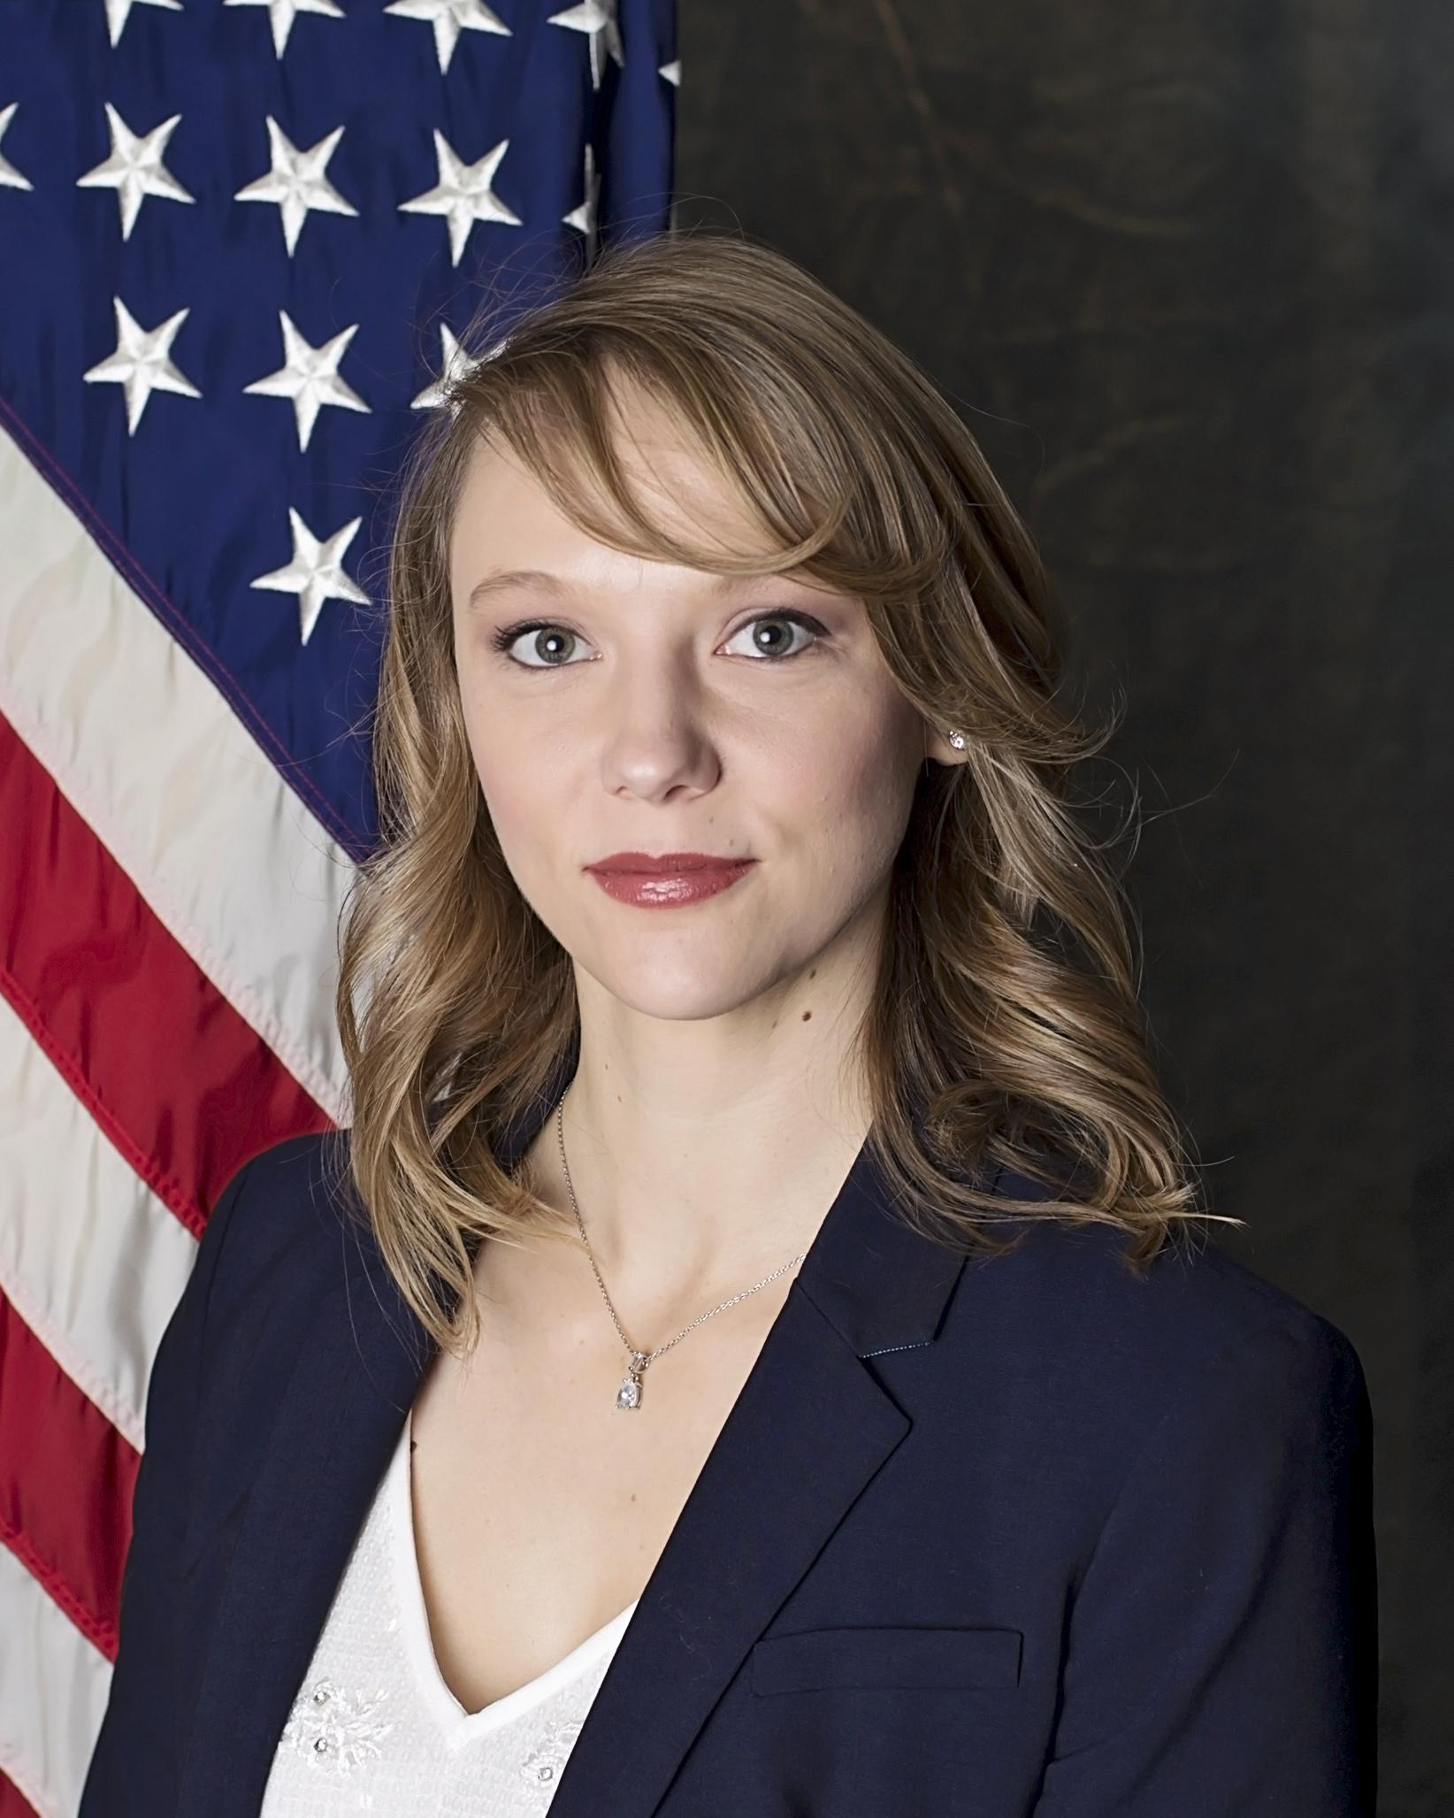
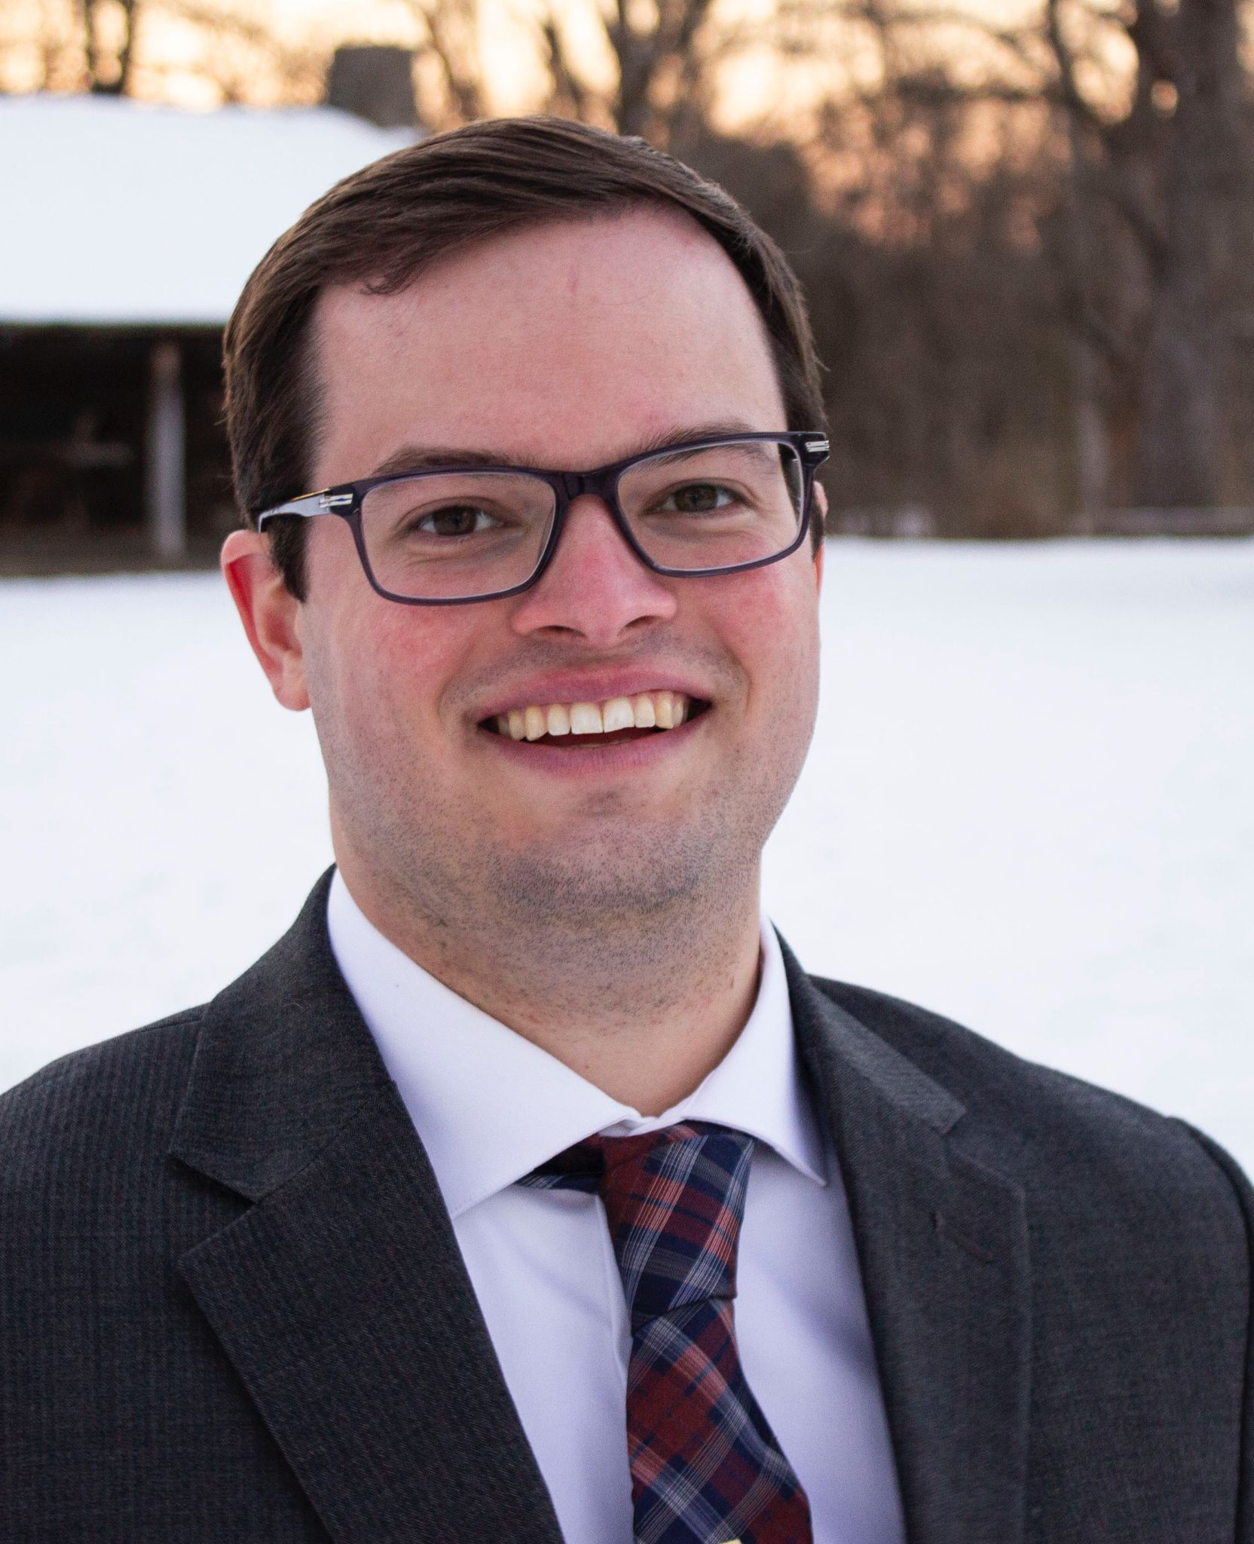
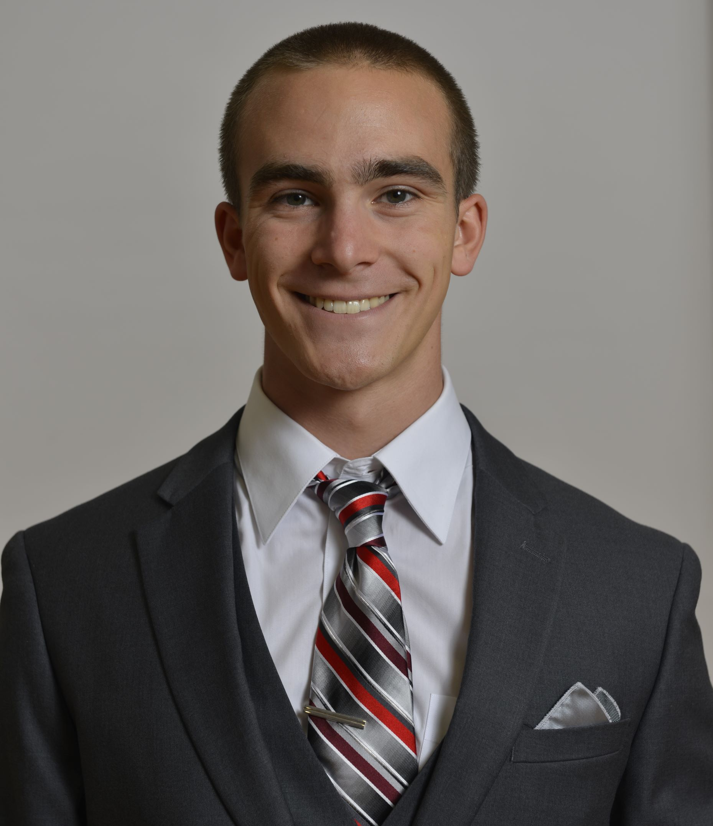
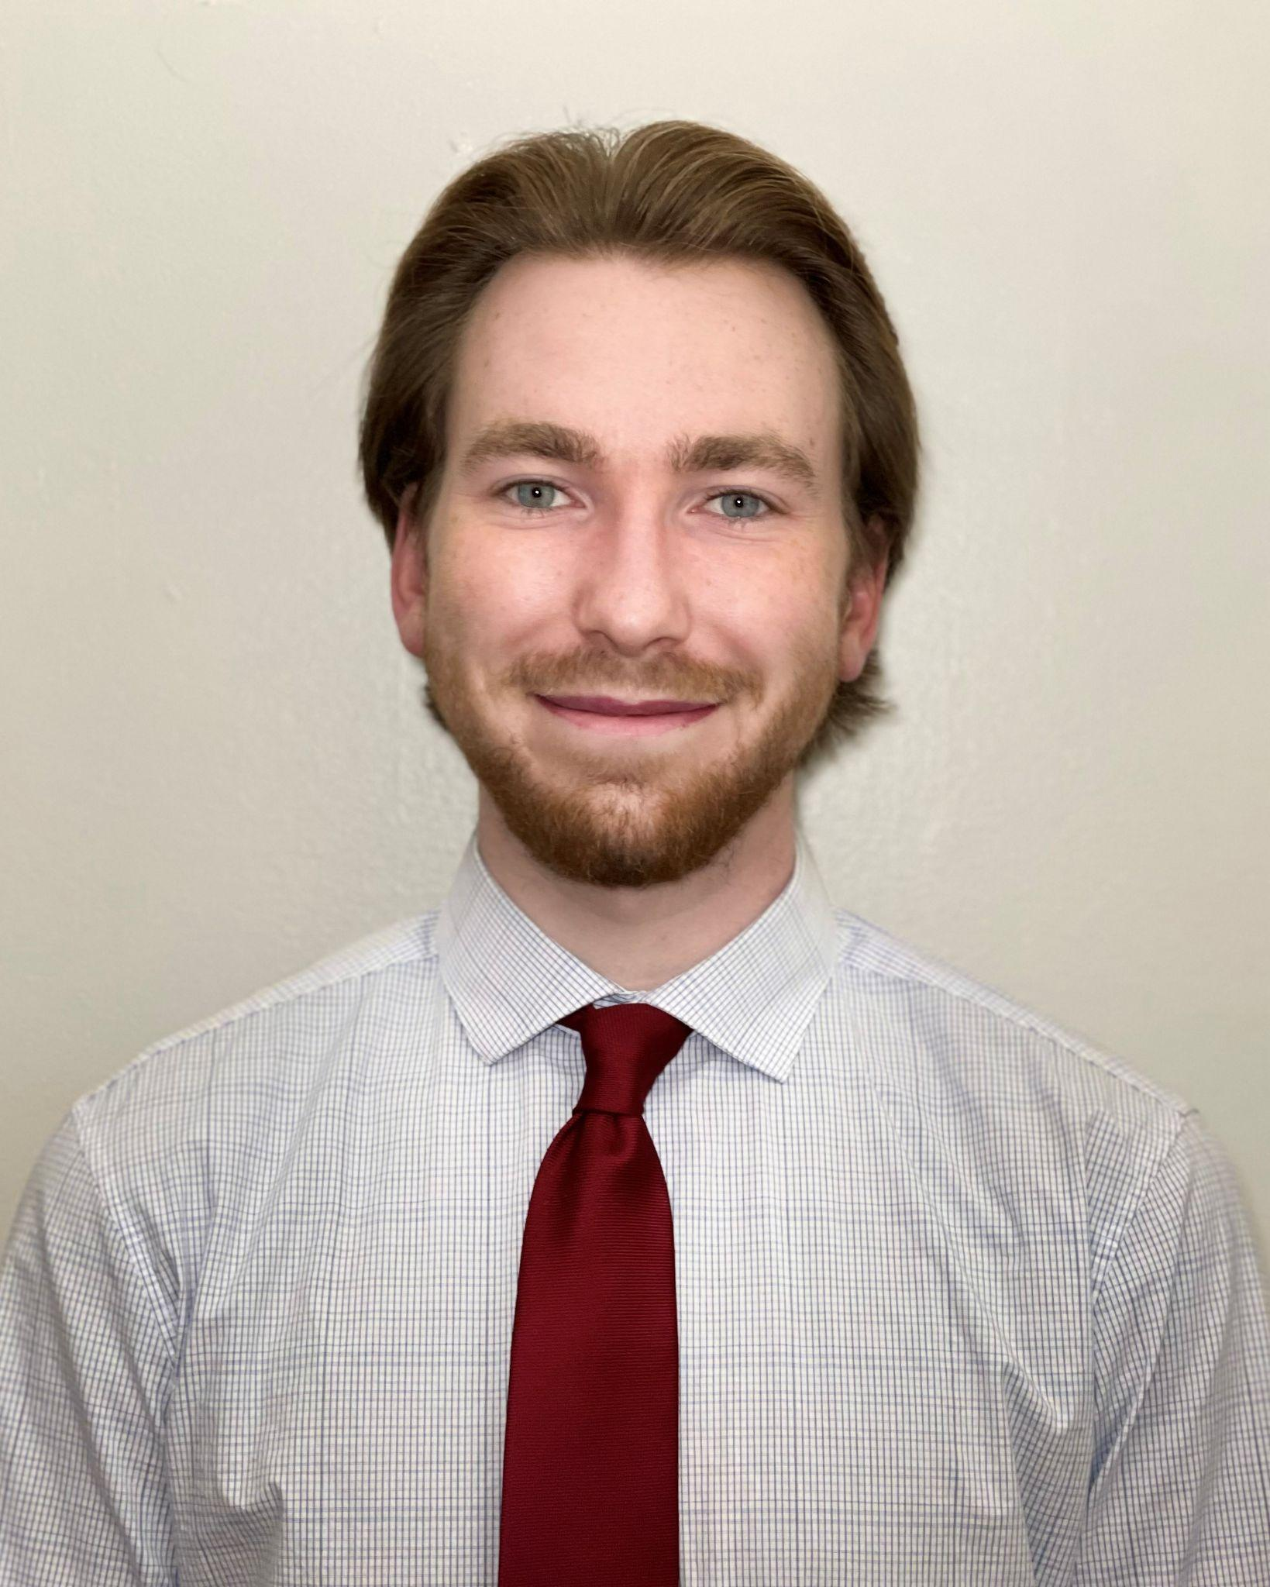
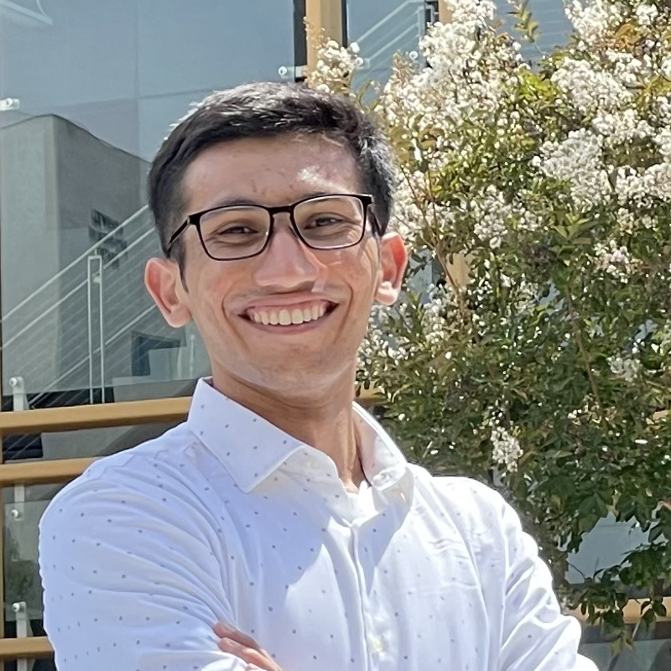
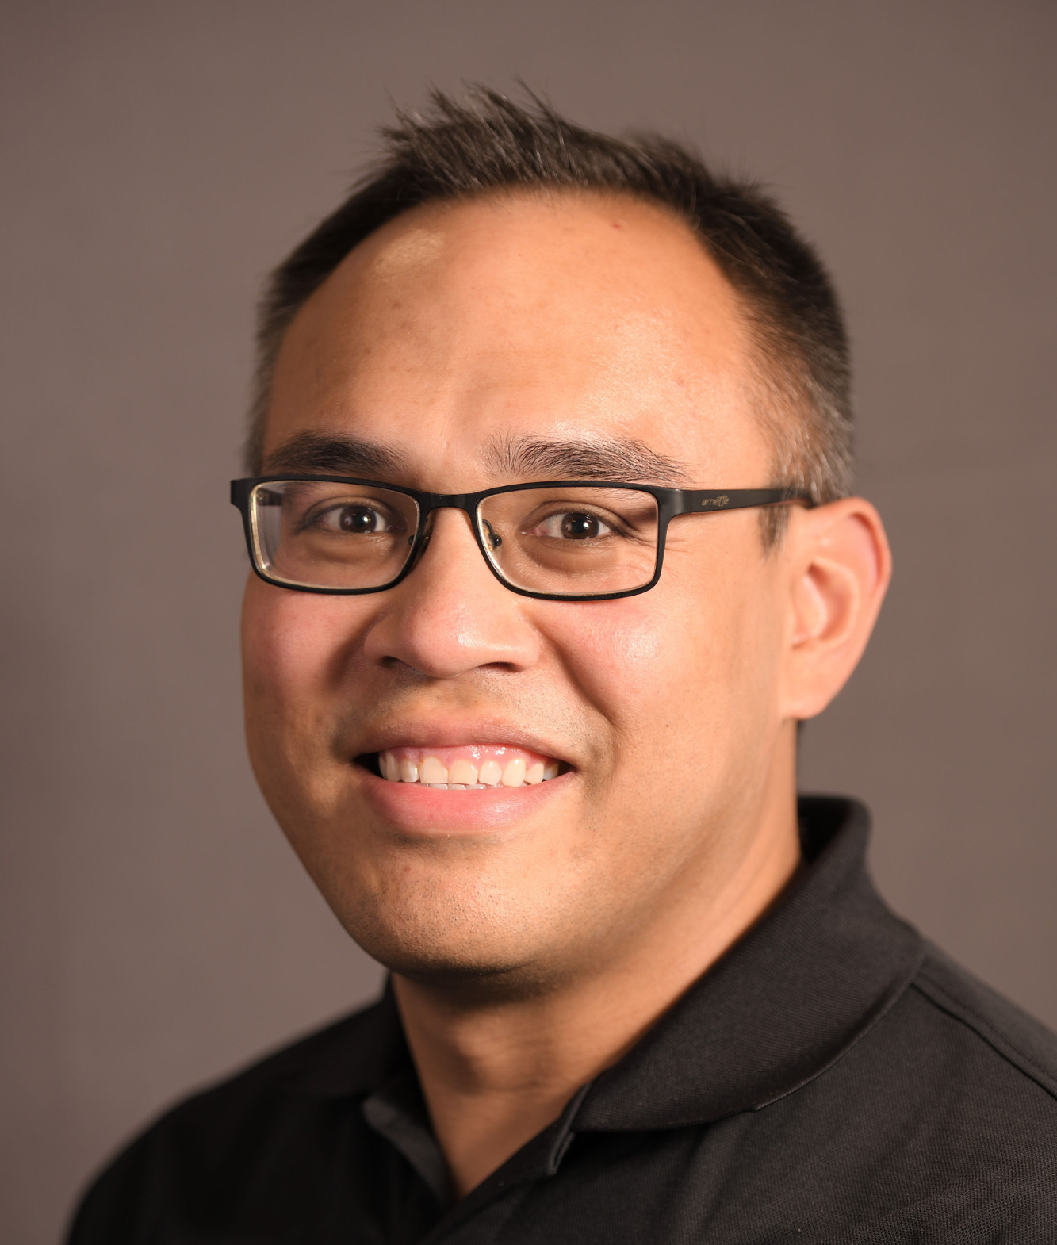
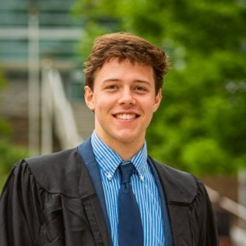
AFRL Safe Autonomy Team
Questions?
KERIANNE HOBBS, PhD
AFRL (ACT3/RYZA)
JOHN MCCARROLL
Matrix Research
CHARLES KEATING
University of Dayton Research Institute
NATE HAMILTON, PhD
Parallax Advanced Research
KYLE DUNLAP
Parallax Advanced Research
JAMIE CUNNINGHAM
Parallax Advanced Research
KOCHISE BENNETT, PhD
Toyon Research Corporation
ADITESH KUMAR
Toyon Research Corporation
Kerianne L. Hobbs, Ph.D.
Safe Autonomy Lead
Air Force Research Laboratory
Wright-Patterson AFB, OH kerianne.hobbs@us.af.mil
DAVID VAN WIJK
Texas A&M
Intern

Slide 16
Journal Publications Since 2020
[Submitted] Joseph B. Lyons, Kerianne Hobbs, Steve Rogers, Scott H. Clouse, “Responsible (Use of) AI,” in Understanding the Role of Humanity in Responsible Deployment of Intelligent Technologies in Socio-technical Ecosystems, Special Issue of Frontiers in Neuroergonomics, 2023.
Kerianne L. Hobbs, Mark L. Mote, Matthew C.L. Abate, Samuel D. Coogan, and Eric M. Feron “Run Time Assurance for Safety Critical Systems: An Introduction to Safety Filtering Approaches for Complex Control Systems,” IEEE Control Systems Magazine, April 2023. Preprint https://arxiv.org/pdf/2110.03506.pdf 2023 Impact Factor: 5.972
Manzanas Lopez, D., Johnson, T., Tran, H. D., Bak, S., Chen, X., & Hobbs, K. L., “Evaluation of Neural Network Verification Methods for Air to Air Collision Avoidance,” AIAA Journal of Air Transportation Systems, January–March 2023. https://arc.aiaa.org/doi/pdf/10.2514/1.D0255?download=true
Kyle Dunlap, Mark Mote, Kaiden Delsing, Christopher W. Hays, Kerianne L. Hobbs, “Safe Satellite Docking via Run Time Assured Reinforcement Learning” AIAA Journal of Aerospace Information Systems. 31 Oct 2022. 2023 Impact Factor: 1.444
Kyle Dunlap, Michael Hibbard, Mark Mote, and Kerianne Hobbs “Comparing Run Time Assurance Approaches for Safe Spacecraft Docking,” IEEE Control Systems Letters (L-CSS), 2021. Preprint: https://arxiv.org/pdf/2110.00447

Slide 17
Conference Publications Since 2020 (1 of 2)
[Submitted] Kerianne Hobbs, Bernard Li, “Safety, Trust, and Ethics Considerations for Human-AI Teaming in Aerospace Control,” AIAA SciTech, 8–12 January 2024, Orlando, FL.
[submitted] Kristina Miller, Christopher K. Zeitler, William Shen, Kerianne Hobbs, Sayan Mitra, John Schierman and Mahesh Viswanathan, “Optimal Runtime Safety Assurance via Reinforcement Learning” 21st International Symposium on Automated Technology for Verification and Analysis (ATVA 2023), Singapore, October 24 – October 27, 2023.
Jonathan Rowanhill, Ashlie B. Hocking, Aditya Zutshi, Kerianne L. Hobbs “Bridging the Gap: Applying Assurance Arguments to MIL-HDBK-516C Certification of a Neural Network Control System with ASIF Run Time Assurance Architecture” Digital Avionics Systems Conference, Barcelona, Span, October 1 5, 2023. Preprint: https://arxiv.org/pdf/2303.15568.pdf
[Draft] Veena Krish, Andrew Mata, Kerianne Hobbs, Amir Rahmati, Stanley Bak, “Provable Observation Noise Robustness for Neural Network Control Systems” Conference TBD
Kyle Dunlap, David Van Wijk, and Kerianne Hobbs, "Run Time Assurance for Autonomous Spacecraft Inspection" 2023 AAS/AIAA Astrodynamics Specialist Conference, Big Sky, MT, August 13-17, 2023 Preprint: https://arxiv.org/pdf/2302.02885
David Van Wijk, Kyle Dunlap, and Kerianne Hobbs, "Deep Reinforcement Learning for Autonomous Spacecraft Inspection Using Illumination" 2023 AAS/AIAA Astrodynamics Specialist Conference, Big Sky, MT, August 13-17, 2023, Preprint: https://arxiv.org/pdf/2308.02743.pdf
Nathaniel Hamilton, Kyle Dunlap, Taylor T Johnson, Kerianne Hobbs, “Ablation Study of How Run Time Assurance Impacts the Training and Performance of Reinforcement Learning Agents,” IEEE Space Mission Challenges for Information Technology - IEEE Space Computing Conference, Caltech, Pasadena, CA, USA - 18-21 July 2023. Preprint: https://arxiv.org/pdf/2207.04117 BEST PAPER
Umberto Ravaioli, Kyle Dunlap, and Kerianne Hobbs “A Universal Framework for Generalized Run Time Assurance with JAX Automatic Differentiation” American Control Conference, May 31-June 2, 2023, San Diego, CA. Preprint: https://arxiv.org/pdf/2209.01120
Kerianne L. Hobbs, Joseph B. Lyons, Martin S. Feather, Benjamin P Bycroft, Sean Phillips, Michelle Simon, Mark Harter, Kenneth Costello, Philip C. Slingerland, Yuri Gawdiak, Stephen Paine, “Space Trusted Autonomy Readiness Levels,” IEEE Aerospace, Big Sky, MT, March 4-11, 2023. Preprint: https://arxiv.org/pdf/2210.09059
Hobbs, K., Heiner, B., Busse, L., Rowanhill, J., Hocking, A. B., Zutshi, A., “Systems Theoretic Process Analysis of a Run Time Assured Neural Network Control System,” AIAA SciTech, National Harbor, MD, Jan. 2023. Preprint: https://arxiv.org/pdf/2209.00552
Michael Hibbard, Ufuk Topcu, and Kerianne Hobbs, “Guaranteeing Safety via Active Set Invariance Filters for Multi-agent Space Systems with Coupled Dynamics,” IEEE American Control Conference, June 8-10, 2022
Kyle Dunlap, Michael Hibbard, Mark Mote, and Kerianne Hobbs “Comparing Run Time Assurance Approaches for Safe Spacecraft Docking,” IEEE American Control Conference, June 8-10, 2022. Preprint: https://arxiv.org/pdf/2110.00447

Slide 18
Conference Publications Since 2020 (2 of 2)
Umberto Ravaioli, James Cunningham, John McCarroll, Vardaan Gangal, Kyle Dunlap, and Kerianne Hobbs, “Safe Reinforcement Learning Benchmark Environments for Aerospace Control Systems” IEEE Aerospace Conference, March 2022, Big Sky, MT.
Preston K. Robinette, Benjamin K. Heiner, Umberto Ravaioli, Nathaniel Hamilton, Taylor Johnson, and Kerianne L. Hobbs, “Reinforcement Learning Heuristics for Aerospace Control Systems” IEEE Aerospace Conference, March 2022, Big Sky, MT.
Kyle Dunlap, Mark Mote, Kaiden Delsing, Kerianne L. Hobbs, “Safe Satellite Docking via Run Time Assured Reinforcement Learning” AIAA SciTech, San Diego, CA 2022.
Kyle Dunlap, Kelly Cohen, and Kerianne Hobbs, “Comparing the Explainability and Performance of Reinforcement Learning and Genetic Fuzzy Systems for Safe Satellite Docking,” North American Fuzzy Information processing Society NAFIPS’2021, Virtual, June 7-9, 2021. Outstanding Paper Award
Christopher D. Petersen, Sean Phillips, Kerianne L. Hobbs, and Kendra Lang, “Challenge Problem: Assured Satellite Proximity Operations” 1st AAS/AIAA Space Flight Mechanics Meeting, Virtual, February 1-4, 2021.
Mark Mote, Chris W. Hays, Alexander R. Collins, Eric M. Feron, Kerianne L. Hobbs “Natural Motion-based Trajectories for Automatic Spacecraft Collision Avoidance During Proximity Operations,” IEEE Aerospace, Big Sky, MT, 6-13 Mar 2021.
Kerianne L. Hobbs, Jennifer Davis, Lucas Wagner, and Eric M Feron, “Formal Specification and Analysis of Spacecraft Collision Avoidance Run Time Assurance Requirements.” IEEE Aerospace, Big Sky, MT, 6-13 Mar 2021, Best Paper Award of 35 papers in track
Diego Manzanas Lopez, Hoang-Dung Tran, Taylor T. Johnson, Stanley Bak, Xin Chen, Kerianne L. Hobbs, “Neural Network Verification Methods for Closed-Loop ACAS Xu Properties” AIAA SciTech, 11-15 Jan 2021, Nashville, TN.
Kerianne L. Hobbs, Alexander R. Collins, and Eric Feron, “Risk-Based Formal Requirement Elicitation for Automatic Spacecraft Maneuvering,” AIAA SciTech, 11-15 Jan 2021, Nashville, TN.
Kerianne L. Hobbs, Alexander R. Collins, and Eric Feron, “Towards a Taxonomy for Automatic and Autonomous Cooperative Spacecraft Maneuvering in a Space Traffic Management Framework,” AIAA ASCEND, Nov 16-18 2020.
Bak, S., Tran, H. D., Hobbs, K., & Johnson, T. T. (2020, July). “Improved geometric path enumeration for verifying ReLU neural networks,” in the International Conference on Computer Aided Verification (pp. 66-96). Springer, Cham.
Hobbs, K. L., Feron, E. M., “A Taxonomy for Aerospace Collision Avoidance with Implications for Automation in Space Traffic Management,” AIAA Science and Technology Forum and Exposition (AIAA SciTech 2020) Orlando, FL, 6-10 January 2020.

Slide 19
Ethics, Safety and Trust in AI
Autonomy: delegated, bounded authority given to the agent to make decisions on the human’s behalf
There is no such thing as Ethical AI, only Ethical use of AI
Trust is defined as a willingness to accept vulnerability in situations characterized by uncertainty.
Safety is freedom from harm during operations.
Ethics are rules created by societies and cultures governing moral and just usage of a technology.
Ethical considerations begin at design time and continue through operational use
Potential to use Model Cards or Datasheets for Datasets as communication of ethics from design to use
[Submitted] Joseph B. Lyons, Kerianne Hobbs, Steve “Cap” Rogers, Scott H. Clouse, “Responsible (Use of) AI,” in Understanding the Role of Humanity in Responsible Deployment of Intelligent Technologies in Socio-technical Ecosystems, Special Issue of Frontiers in Neuroergonomics, 2023.
[Accepted] Kerianne Hobbs, Bernard Li, “Safety, Trust, and Ethics Considerations for Human-AI Teaming in Aerospace Control,” AIAA SciTech, 8–12 January 2024, Orlando, FL.

Slide 20
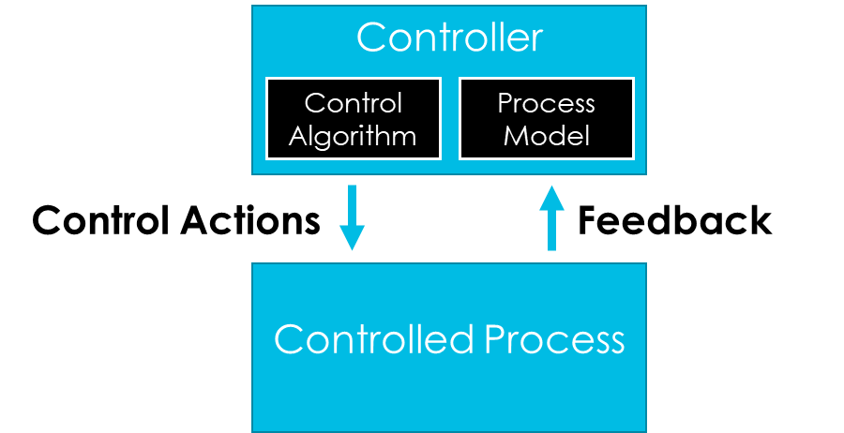
Systems Theoretic Process Analysis
(Controller) (provides) (Control Action) to (Controlled Process) when (Context)
(does not provide)
(provides too early)
(provides too late)
(provides too long)
(provides too short)
Kerianne L. Hobbs, Benjamin K. Heiner, Lillian Busse, Kyle Dunlap, Jonathan Rowanhill, Ashlie B. Hocking, and Aditya Zutshi “Systems Theoretic Process Analysis of a Run Time Assured Neural Network Control System” AIAA SciTech 2023, National Harbor, MD.
Kerianne L. Hobbs, Alexander R. Collins, and Eric Feron, “Risk-Based Formal Requirement Elicitation for Automatic Spacecraft Maneuvering,” AIAA SciTech, 11-15 Jan 2021, Nashville, TN
Kerianne L. Hobbs, Jennifer Davis, Lucas Wagner, and Eric M Feron, “Formal Specification and Analysis of Spacecraft Collision Avoidance Run Time Assurance Requirements.” IEEE Aerospace, Big Sky, MT, 6-13 Mar 2021. (Best paper award of 35)
Hobbs, K.L., Cargal, C., Feron, E., Burns, R.S., “Early Safety Analysis of Manned-Unmanned Team System,” 2018 AIAA Information Systems-AIAA Infotech @ Aerospace, Kissimmee, Florida, 8-12 January, 2018.

