Slide 1
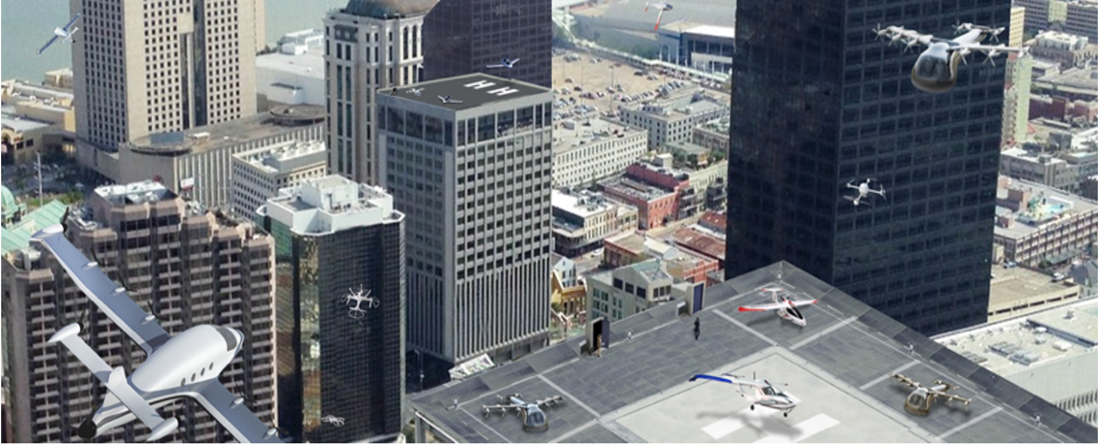

Approaches for engaging stakeholders for UAM Airspace Research
FAA V&V Summit 2023 -- September 27th, 2023

Slide 2
Outline
UAM Airspace Background
Challenges to Stakeholder Convergence
Approaches we have taken
Q&A

Slide 3
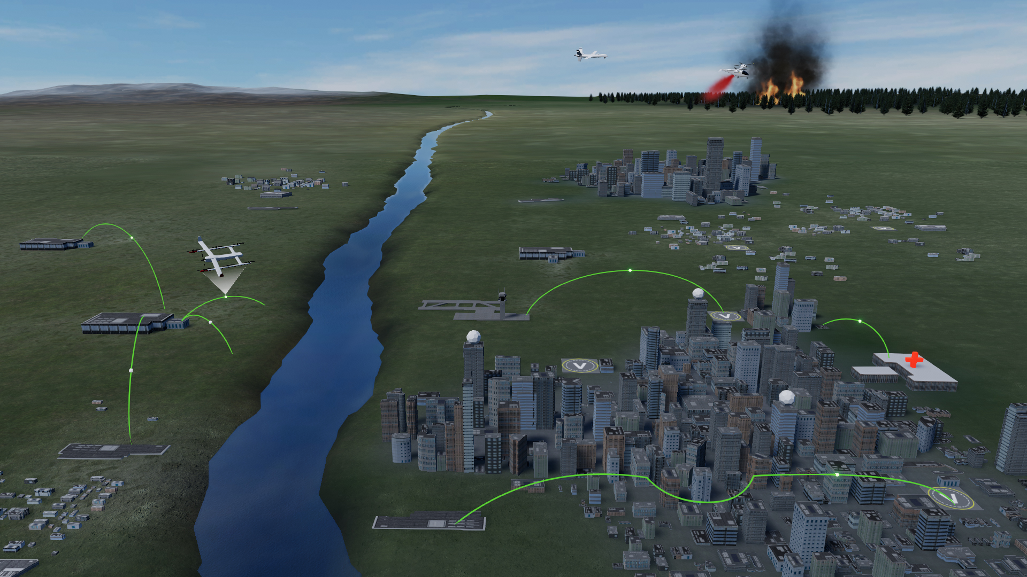
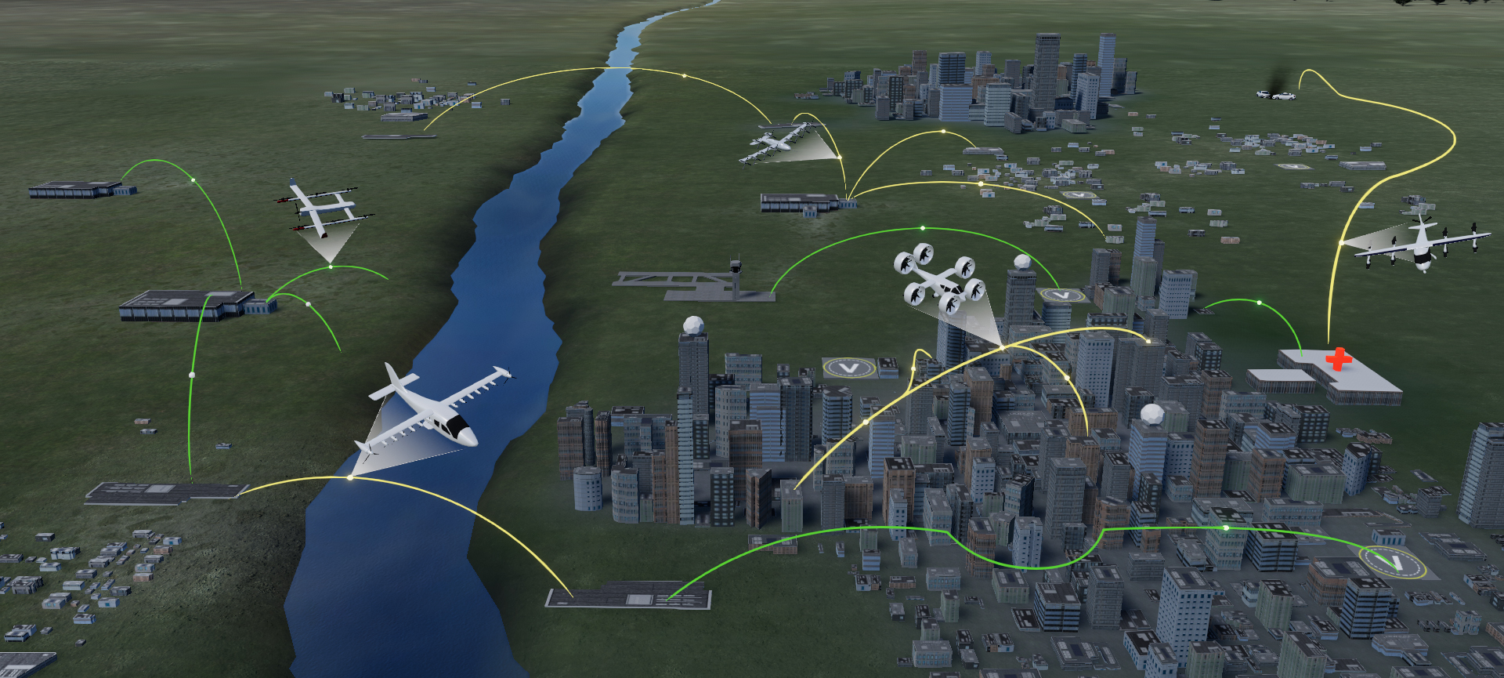
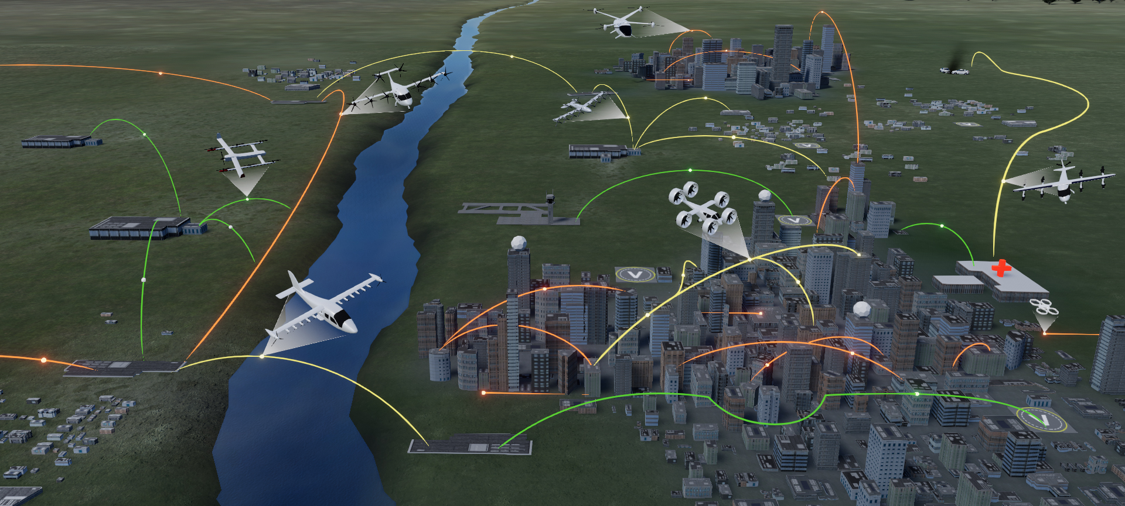


On Demand Airport Transfer
Cargo Delivery
Cross Metro Transfer
Regional Network
Air Ambulance
Fleet Operations
Urban Air Mobility (UAM) Missions
Regional
Network
Cargo
Delivery
On Demand
Airport
Transfer
Air
Ambulance
Fleet
Operations
Cross Metro
Transfer
3
Image credit: FAA/NASA

Slide 4
UAM Airspace Background
UAM Airspace Subproject, under NASA's Air Traffic Management eXploration (ATM-X) Project, was established in 2017.
  Conduct research to enable scalable operations and integration of UAM into the National Airspace System (NAS)
  “Airspace system should be ready when vehicles are ready”
2024+:
Validated Research
2020-2023: Phase 2
Applied Research
2017-2019: Phase 1
Exploratory Research
UAM gaining wider acceptance;
Stakeholders are many but more defined
Convergence
UAM gaining initial acceptance;
Stakeholders are many
UAM as an emerging idea; lots of unknowns, key stakeholders are vehicle manufacturers
Time

Slide 5
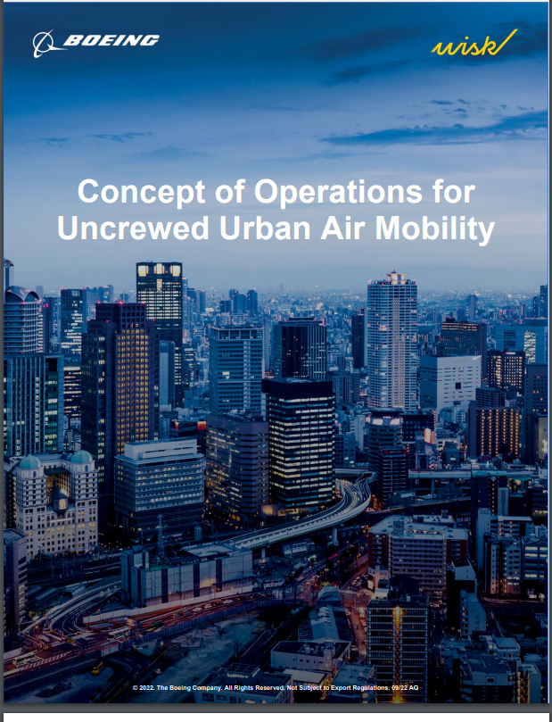
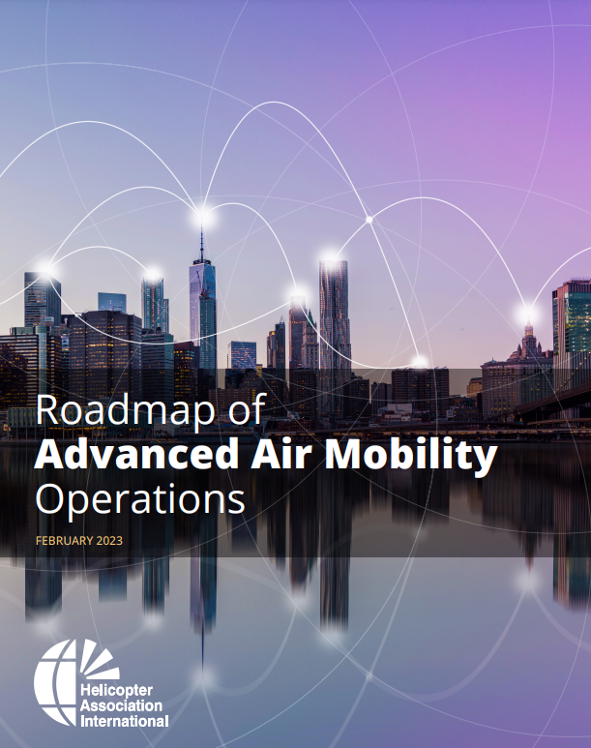
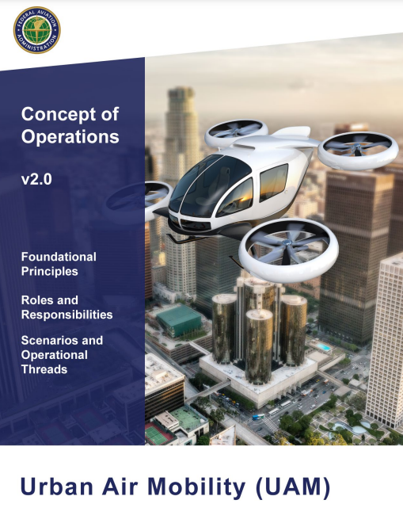
Relevant Stakeholders for UAM Airspace... Many!
Airspace Mgmt
Fleet Mgmt
Vertiport Mgmt
Vehicle
Stake-holders
Local Govts
Infra-structure
Current NAS Users
Govt Agencies
Many stakeholders, each with their unique perspectives and concept of operations
Source: Wisk
Source: Helicopter Association
International
Source: FAA

Slide 6

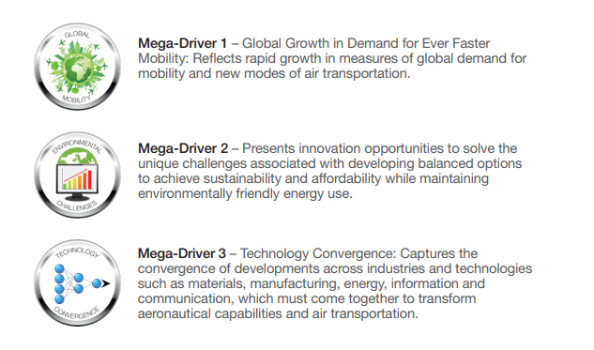
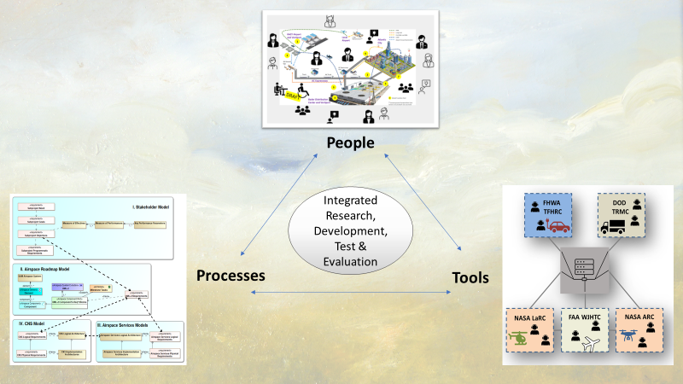
Relevance of Stakeholder Convergence to NASA Strategic Implementation Plan (SIP)
NASA SIP includes three mega-drivers, one of them is technology convergence
Stakeholder engagement is about people convergence
People convergence need to come before processes and technology can converge
Images credit: NASA
Reference: NASA Aeronautics Strategic Implementation Plan https://www.nasa.gov/aeroresearch/strategy

Slide 7
Challenges for Convergence
Priorities
Concept of Operations
Terms
Common Reference Framework
Different timelines and priorities; Industry wants to move faster than regulatory bodies
Stakeholders are looking at the problem differently from their own perspective
Even definition of UAM was not clear
Research organization like NASA can help bring stakeholders together

Slide 8
Approaches we have taken (2020-2023)
Common Reference Framework
Workshops
Integrated Testing with Industry Prototypes
Human-In-The-Loop Sims
Integrated Testing with FAA Automation
Apply V&V with agility with two key elements:
Common reference framework
Learn, update, repeat – Rather do quickly, smaller efforts, more times. Could be asynchronous learning, bring the learnings back to the framework
learn
learn
learn
learn

Slide 9
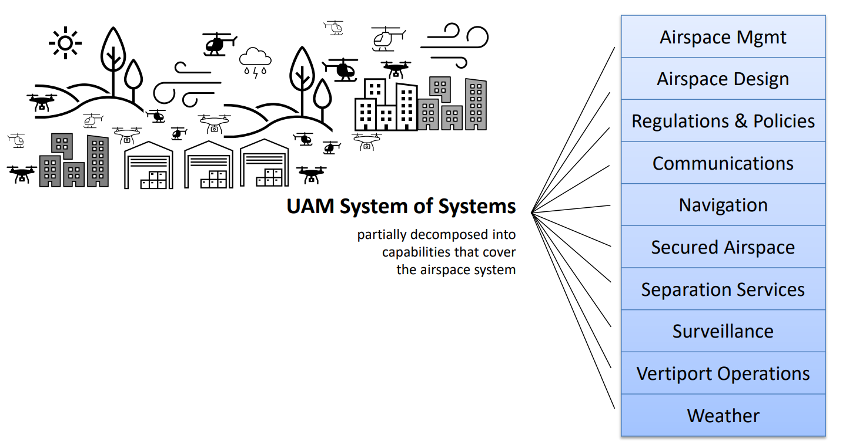
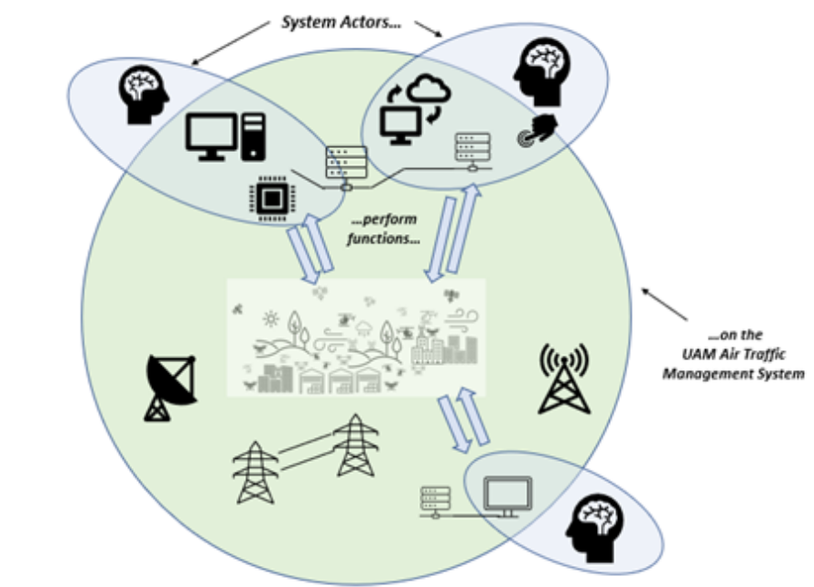
Common Reference Framework
A maintainable framework that describes:
  the progression
  the roles of stakeholders
  the system and its components
A living document
  used by NASA, to describe how research informs progression of UAM capabilities
  ultimate, it is for all (public and private) stakeholders
  synchronizes information for different validation activities (left of the V)
  as we learn from activities, assimilate new information into the framework (right of the V)
A tool for interfacing with many different stakeholders
  starting point for discussions and workshops
  digital engineering allows for information sharing

Slide 10
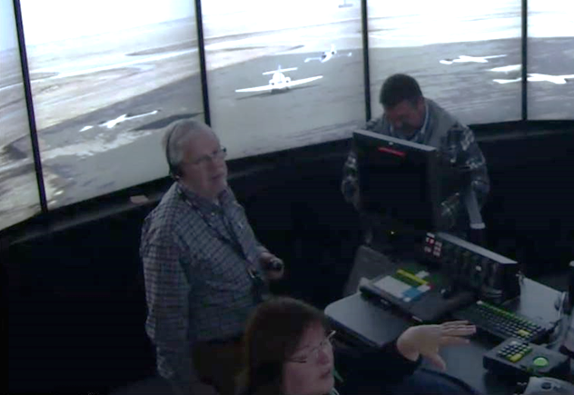
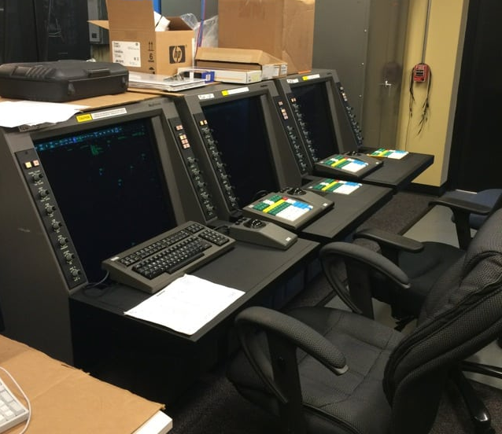
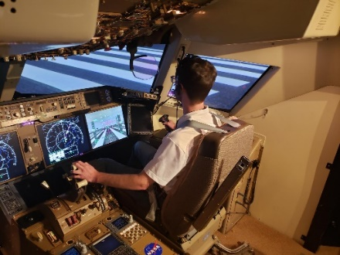
Integrated Testing with FAA Automation
Why is there a need for this?
  Scaling to the limit without fundamentally changing the NAS
  Fundamental shift for FAA and industry
How does this bring stakeholders together?
  NASA can work with both FAA and industry
  NASA brings early prototypes to the operational systems, can identify weak or erroneous assumptions sooner
  Industry benefits from those lessons to develop their prototypes and see how they interact with FAA existing automation
  NASA has decades of experience, research on AAM concepts bringing those languages with those of FAA's. Increasing FAA's readiness/awareness of technologies
FAA Tower Lab
FAA Automation
Fleet Managers
UAM Pilots
Images credit: FAA/NASA
Notes:
Picture taken from Microsoft Office Stock Images.
Talking Notes:
-Just like levels of automation is impossible, and there are really 3-4 different and dependent variables…the NAS is another order of magnitude complex in its behavior and multi-variate dependencies
-Endpoint might be “pilot is removed from the cockpit carrying human passengers”. Consider the event “pilot is removed from cockpit carrying cargo” as well. Both come before the existing endpoint.
-NASA has a 5-year head-start on reality. In 2028, OEMs and Operators expect the eVTOL market to have opened. We’re looking at 2028 today, and in 5 years we can push pretty far into the future.

Slide 11


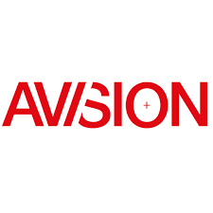








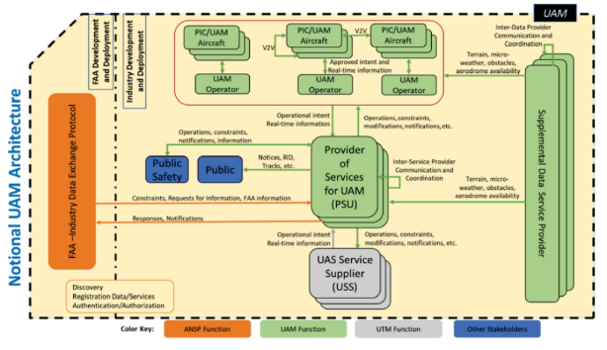
Integrated Testing with Industry Prototypes
Why is there a need for this?
  Relatively new industry
  Key players have mixed level of experiences with traditional Air Traffic Management (ATM)
  Building this cooperative traffic management network requires industry to integrate with each other
  If each company build their own prototypes, unlikely they would interoperate
How does this help bring stakeholders together?
  NASA fills in that knowledge space in ATM, wherever needed, when working with industry to develop common requirements
  NASA provides the catalyst to jump start industry (e.g., initial prototypes, draft community-based rules)
  Industry prototypes are validated against a set of common, interoperable requirements
UAM Notional Architecture
Source: FAA NextGen UAM ConOps v1.0

Slide 12

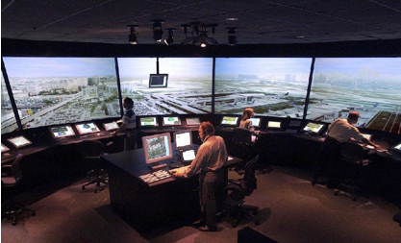


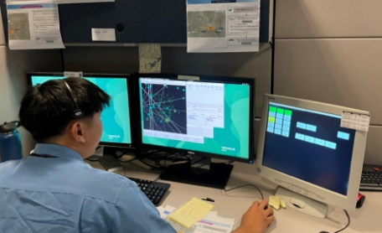

Human-In-The-Loop (HITL) Simulations
Why is there a need for this?
  Humans still play key roles in this progression
How does this help bring stakeholders together?
  Invites Air Traffic Controllers (ATCs) to participate and be part of the early engineering process
  Allows ATCs to see themselves in a familiar environment and get their head wrapped around the procedures
  Early buy-in, share with their peers, more convergence
  Helps other stakeholders understand scalability possibilities without additional FAA automation
Pseudo-ATC Positions
Pseudo Pilot Positions
Images credit: FAA/NASA

Slide 13
Q&A

