Slide 1
Accelerating Technology, Innovation and Partnerships
Allen Walker
Senior Advisor
FAA Verification and Validation Summit
September 28, 2023

Slide 2
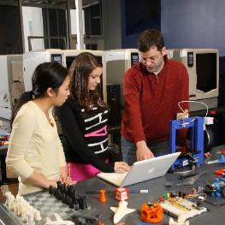
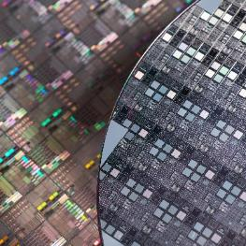
Seven Decades of NSF-Powered Innovations
FOUNDATION FOR
THE INTERNET
3-D PRINTING
BREAKTHROUGH
FIRST IMAGE OF
A BLACK HOLE
RAPID COVID-19 TESTING
CLIMATE
FORECASTING
LIGO
GRAVITATIONAL
WAVES
COMPUTER CHIP
FABRICATION
ARTIFICIAL
INTELLIGENCE
(AI)
EARLY WEB
SEARCH
MAGIC
SCHOOL BUS
Notes:
The internet, 3-D printing, the first image of a black hole, rapid COVID testing, climate forecasting,
Confirming Einstein’s theory of relativity by detecting ripples in time-space,
Computer chip fabrication, Artificial Intelligence like speech recognition software, search engines, the and the Magic School Bus.
These are just a few examples of the NSF impact.
That's because the largest economic driver in the last half century are science and technology advancements.
Those start with basic research, and the largest investor in basic research is the Federal Government.
NSF is unique. It is the only Federal agency that invests in research across every field of science and technology.
After nearly 75 years of investments, NSF results are everywhere.

Slide 3
NSF’s Mission
Promote the progress of science
Advance the
national health,
prosperity and
welfare
Secure
the national
defense
Notes:
After government leadership helped translate knowledge to innovation during WWII, the U.S. decided to continue that progress during peacetime.
That's why Congress established NSF in 1950 with a big mission.
To promote science progress for:
Economic prosperity;
National security;
Global leadership.
NSF investments in research and education have led to breakthroughs that created new technology, industries, and fueled one of the most successful economies in history.
But research and development spending peaked in 1964. At the same time, other countries created their own models.
Today, global competition has never been so fierce. In certain measures, the U.S. is falling behind. For example, China now leads the world in both scientific publications and patents.
To keep our competitive edge, we must invest on a bigger scale. We have an opportunity with the landmark CHIPS and Science Act.
Passed with bipartisan support and enacted in 2022, it unlocks investments in U.S. science and engineering by authorizing Congress to more than double the NSF budget over the next five years.

Slide 4
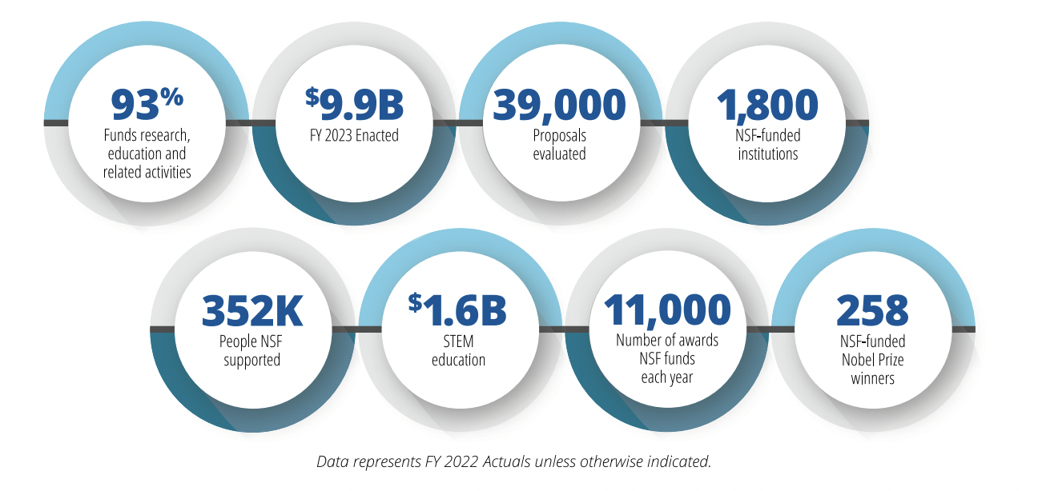
NSF by the Numbers
From https://www.nsf.gov/about/congress/factsheets.jsp
4
Notes:
• NSF allocates 94% of its approximately $8.5 billion budget for grants and awards to support research projects, facilities and STEM education.
• NSF funds research in all 50 states and U.S. territories.
• NSF fosters international scientific collaboration on all 7 continents around the globe.
• About 2,000 academic and other private and public institutions across the U.S. conduct NSF-funded research.
• NSF supports 24% of all federally funded academic fundamental research at U.S. colleges and universities.
• In 2020, NSF received approximately 43,000 research proposals from scientists and engineers and funded about 12,000.
• NSF-funded researchers have received 248 Nobel Prizes.

Slide 5
NSF’s Three Strategic Priorities
STRENGTHENING ESTABLISHED NSF
INSPIRING THE MISSING MILLIONS
ACCELERATING TECHNOLOGY AND INNOVATION
With investments that expand
the frontiers of knowledge
and technology.
Using interventions and capacity building that enhance and broaden participation.
Through innovative, cross-cutting partnerships and programs.
Notes:
To accomplish all of this and more, we are pursuing three main priorities.
We will continue to strengthen the established NSF by investing in fundamental research, infrastructure, and STEM education.
We are inspiring the Missing Millions not currently participating in our nation’s STEM enterprise.
We are accelerating technology development and innovation at speed and scale through our new directorate.
Let me give you an example of each:

Slide 6
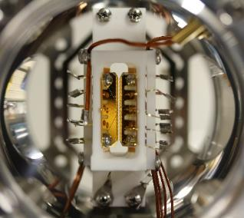
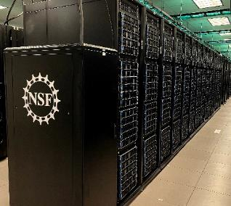
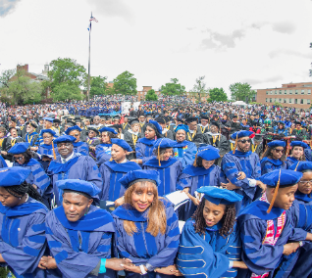
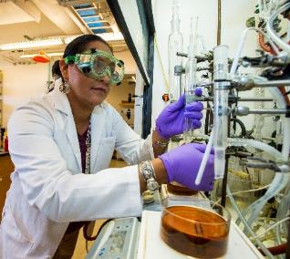
NSF Supports All Areas of Science and Engineering
ENGINEERING
GEOSCIENCE & POLAR PROGRAMS
BIOLOGICAL
SCIENCES
COMPUTER & INFORMATION SCIENCE & ENGINEERING
SOCIAL, BEHAVIORAL & ECONOMIC SCIENCES
MATHEMATICAL & PHYSICAL SCIENCES
STEM
EDUCATION
Integrative Activities
International Science & Engineering
Notes:
NSF has been investing in fundamental research in all fields of science and engineering, delivering foundational and use-inspired outcomes, for seven decades.
For example, NSF is the largest non-defense funder of artificial intelligence research, has funded more than 240 Nobel Prize winners, and has directly contributed to seminal advances like 3D printing, bar codes, the Internet and the first images of a black hole in the Milky Way.
In the fight against COVID-19, the results of NSF investments have proven critical: the nation's capacity to test rapidly and at large scale is directly attributable to polymerase chain reaction, or PCR, testing capabilities, which were made possible by NSF-funded research.

Slide 7
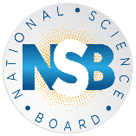
A Changing Landscape
Global Competition
Defining Moment
Socioeconomic
Challenges
Vision 2030
Missing Millions
Notes:
NSF invests in the full spectrum of fundamental research, from exploratory, curiosity-driven research to use-inspired, solution-oriented research. Across this spectrum, NSF’s investments deliver incredible benefits for the American people.​
​The challenges of our time demand that we rapidly scale these investments and build even stronger bridges between discovery, innovation, and commercialization. ​

Slide 8
A Pivotal Moment for the Nation and Society
Climate
change
Equitable access to education, health care
Critical and resilient infrastructure
Notes:
From addressing the impacts of climate change, to providing equitable access to education, healthcare, and broadband connectivity, to improving U.S. infrastructure, the Nation faces momentous challenges. ​

Slide 9
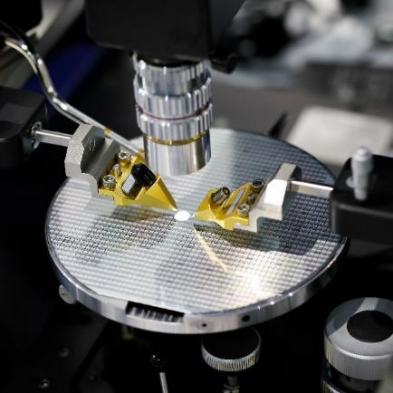
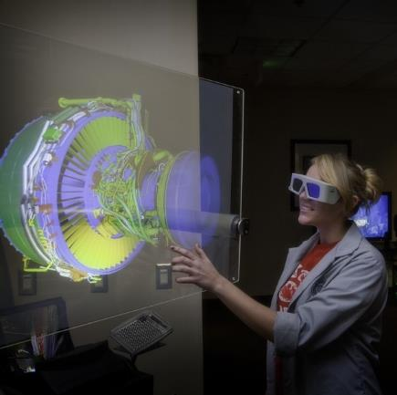
A Changing Science and Engineering Enterprise Can Meet This Moment
Pace of discovery accelerated by data, emerging technologies
Demand for societal and economic impact
Opportunity to
leverage
partnerships
Notes:
At the same time, America’s research and innovation enterprise is undergoing historic changes – the pace of discovery has accelerated; STEM researchers and students are increasingly passionate about channeling their work to address the problems that we face in our communities; and STEM talent is highly distributed prompting the need for unique new partnerships that blend expertise and resources. ​

Slide 10
A New “Horizontal”: Strengthen, Scale Use-Inspired and Translational Research
ENGINEERING
GEOSCIENCE & POLAR PROGRAMS
BIOLOGICAL
SCIENCES
COMPUTER & INFORMATION SCIENCE & ENGINEERING
SOCIAL, BEHAVIORAL & ECONOMIC SCIENCES
MATHEMATICAL & PHYSICAL SCIENCES
STEM
EDUCATION
DIRECTORATE FOR TECHNOLOGY, INNOVATION AND PARTNERSHIP
Integrative Activities
International Science & Engineering
Notes:
NSF has been investing in fundamental research in all fields of science and engineering, delivering foundational and use-inspired outcomes, for seven decades.
For example, NSF is the largest non-defense funder of artificial intelligence research, has funded more than 240 Nobel Prize winners, and has directly contributed to seminal advances like 3D printing, bar codes, the Internet and the first images of a black hole in the Milky Way.
In the fight against COVID-19, the results of NSF investments have proven critical: the nation's capacity to test rapidly and at large scale is directly attributable to polymerase chain reaction, or PCR, testing capabilities, which were made possible by NSF-funded research.

Slide 11
TIP Directorate Mission
TIP harnesses the nation's vast and diverse talent pool to advance critical and emerging technologies, address pressing societal and economic challenges, and accelerate the translation of research results from lab to market and society. TIP improves U.S. competitiveness, growing the U.S. economy and training a diverse workforce for future, high-wage jobs.
11
Notes:
TIP is seizing a generational opportunity to focus on these pivotal challenges, enhancing the fundamental research that powers future technologies and solutions. And by tapping into the full breadth of the nation's demography and geography, TIP shapes the nation's competitiveness as well as infuses diverse thinking and expertise into the development of new technologies and solutions — ensuring U.S. leadership and security for decades to come.​
​TIP addresses a critical need to advance the geography of innovation, engaging communities throughout the country that for too long have been unserved or underserved in the nation’s research and innovation enterprise. ​

Slide 12
TIP Programs Power Technology Breakthroughs
TIP bridges the gap
Public Funds
Private Funds
RAMP OF OPPORTUNITY
Valley of Death
LAB
SOCIETY
Foundational Research | Use-Inspired Research | Proofs-of-Concept | Prototype Development |  | Product/Solution Development | National and Societal Impact, Commercialization
12
12

Slide 13
Catalyzing a Paradigm Expansion
Today
Tomorrow
Largely investigator-driven
Primarily academic research teams
Stream of discoveries improve prosperity, resilience, quality of life
“Technology / supply push”
Users / beneficiaries engaged in shaping, conducting research
Multi-sector teams – academia, industry, government, civil society, communities of practice
Important societal and/or economic problems drive research pursuits
“Market / demand pull”
+

Slide 14
TIP’s Core Message
TIP advances U.S. competitiveness​ and societal impact by nurturing partnerships that​ drive and accelerate:
Diverse Innovation Ecosystems
Technology Translation and Development
Workforce Development
14
14
Notes:
TIP integrates with NSF's existing directorates and fosters partnerships—with government, industry, nonprofits, civil society and communities of practice—to leverage, energize and rapidly bring to society use-inspired research and innovation.
TIP has three primary pillars:
First, cultivating innovation ecosystems throughout the U.S. to drive use-inspired research in key technology and societal challenge areas that will create jobs, improve local or regional economies and make the US more competitive.
Second, enhancing the translation research into the market and to society. We are giving researchers, entrepreneurs and startups opportunities or pathways to develop their research into a product, service or open-source solution with impact.
Third, we are creating new programs and opportunities for people to get jobs emerging technology areas. They can pivot to new careers, get training in STEM fields, or upskilled to attain high-paying, good jobs. TIP is leveraging partnerships to help make these opportunities a reality.

Slide 15
DIVERSE INNOVATION ECOSYSTEMS
NSF Convergence Accelerator funds transdisciplinary teams through convergence research and innovation processes to stimulate innovative idea sharing and development of sustainable solutions to solve societal challenges.
Opportunity available to:
Academia
Two Phases:
PHASE I (PLANNING)
9 months Up to $750,000
PHASE II (IMPLEMENTATION)
24 months Up to $5 Million
Business & Industry
Governments
Nonprofits

Slide 16
NSF Convergence Accelerator Portfolio
Track A | Track B | Track C | Track D | Track E | Track F
Open Knowledge Networks | AI and the Future of Work | Quantum Technology | AI-Innovation Data Sharing & Modeling | Networked Blue Economy | Trust & Authenticity in Communication Systems
2019 COHORT
2020 COHORT
2021 COHORT
Complete
Phase 2
Phase 2
Track G | Track H | Track I | Track J | Track K | Track L | Track M
Securely Operating Through 5G Infrastructure | Enhancing Opportunities for Persons with Disabilities | Sustainable Materials for Global Challenges | Food & Nutrition Security | Equitable Water Solutions | Real-World Chemical Sensing Applications | Bio-Inspired Design Innovations
2022 COHORT
2023 COHORT
Phase 1
Phase 1
16

Slide 17
DIVERSE INNOVATION ECOSYSTEMS
DIVERSE INNOVATION ECOSYSTEMS
NSF Regional Innovation Engines (NSF Engines) program supports the development of diverse, regional coalitions to engage in use-inspired research, drive research results to the market and society, promote workforce development, and ultimately stimulate the economy and create new jobs.
Opportunity available to:
Academia
NSF Engines are funded up to $160 million
for up to 10 years
NSF Engine Development Awards -
up to $1 million for up to 2 years to plan for an Engine.
Business & Industry
Governments
Nonprofits

Slide 18
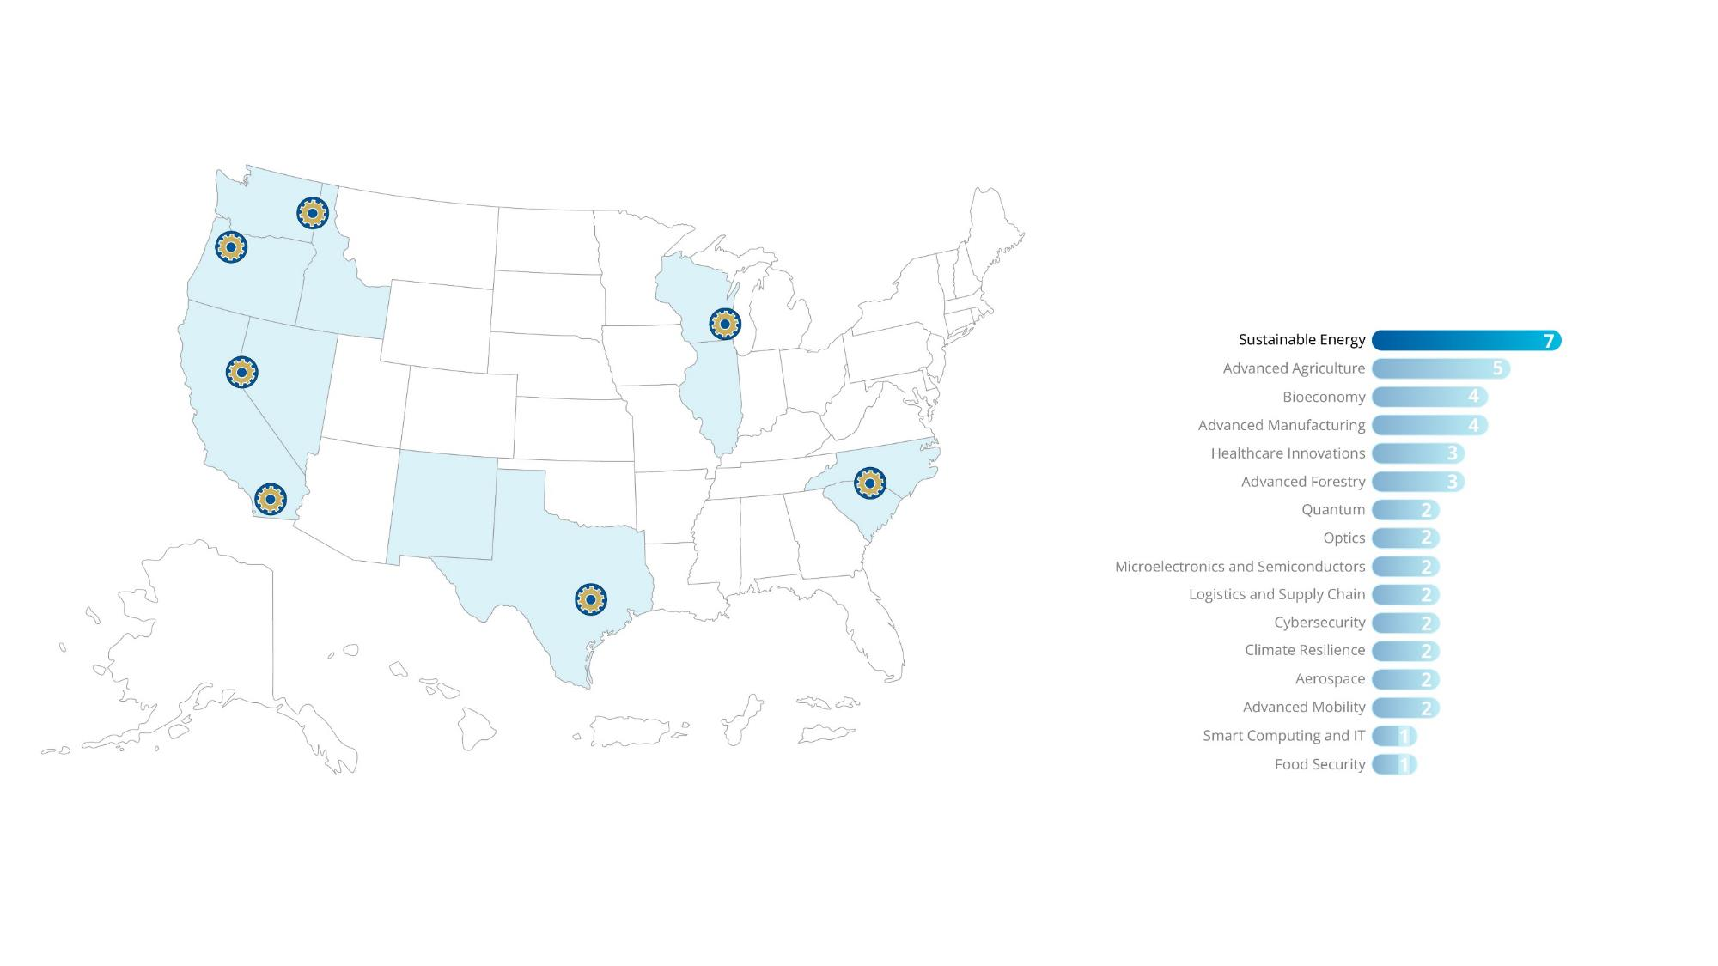
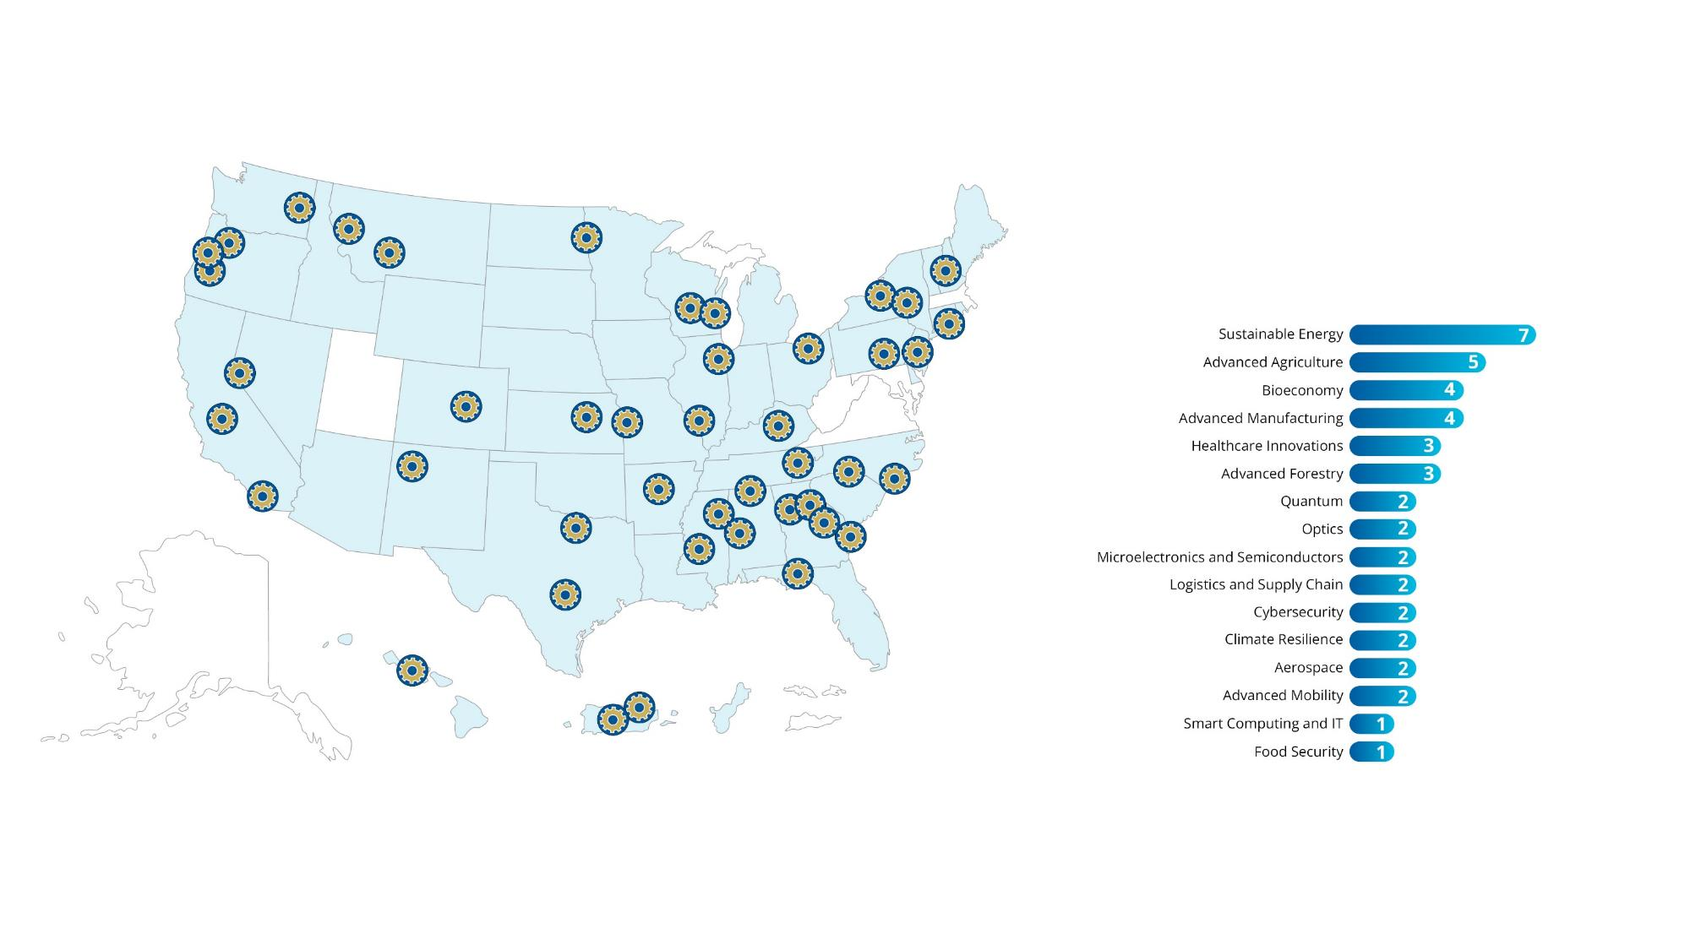
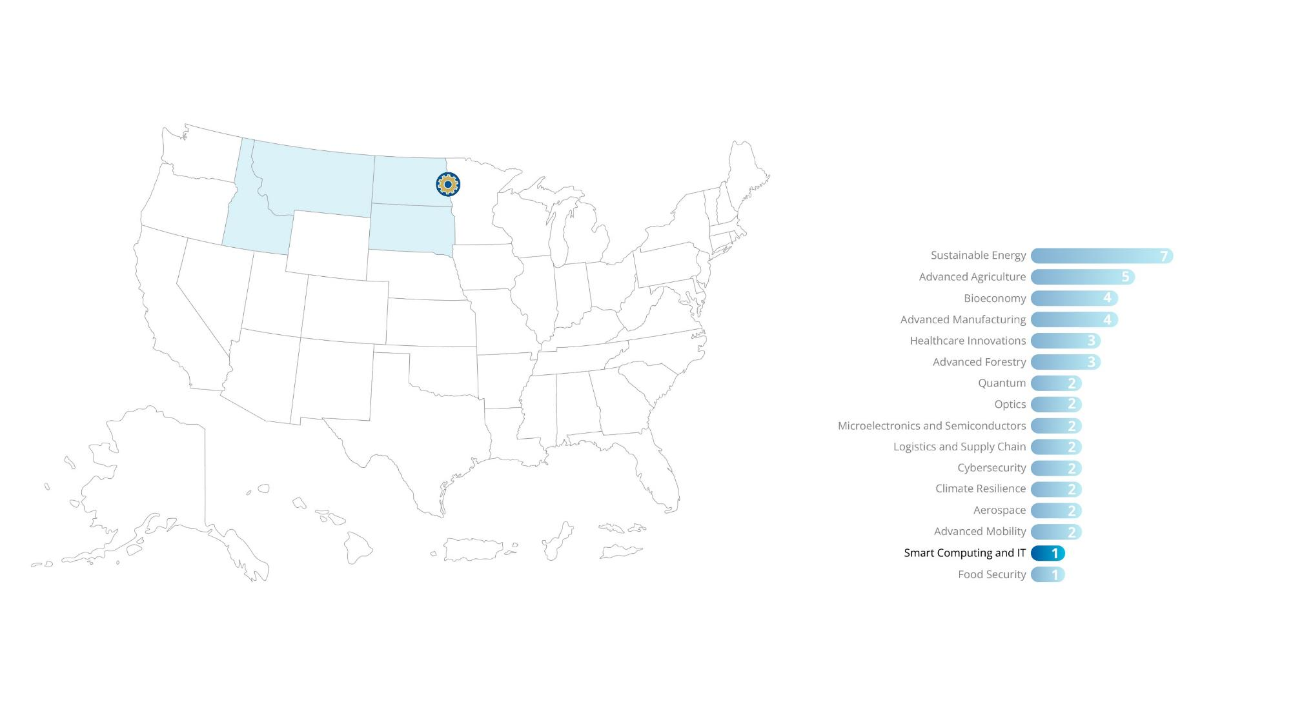
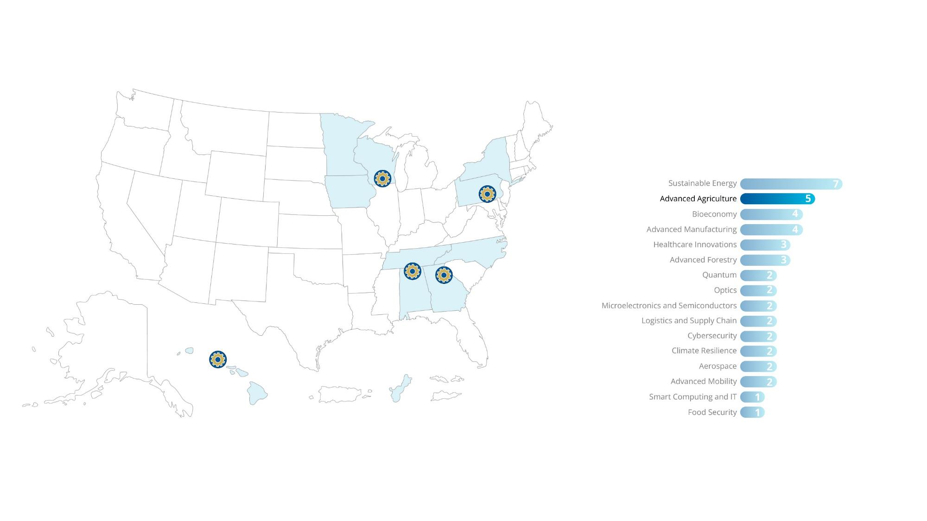
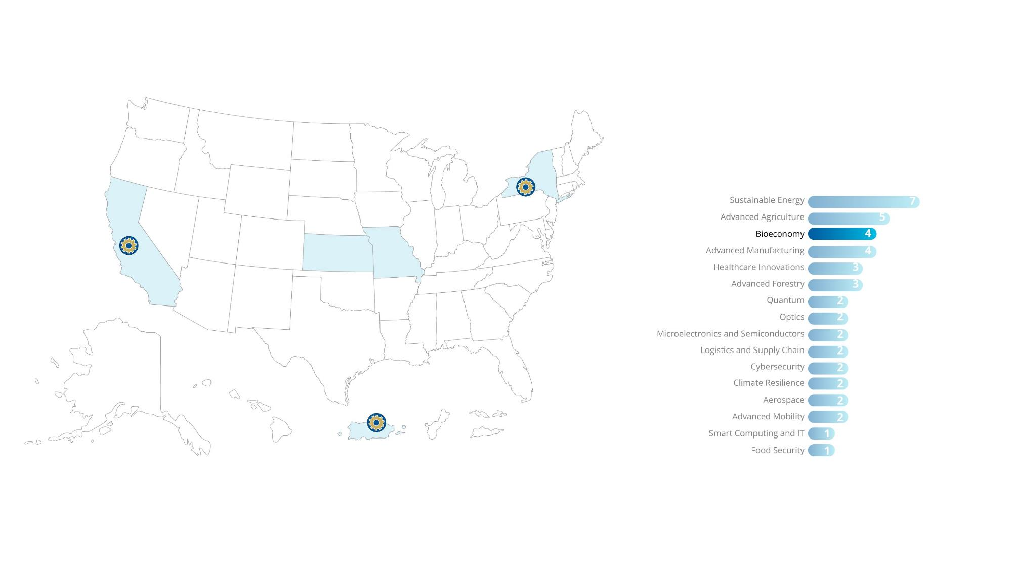
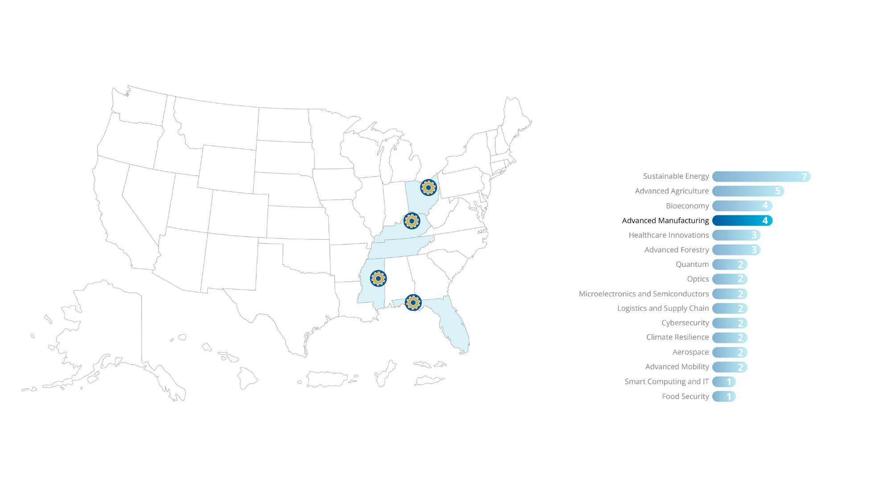
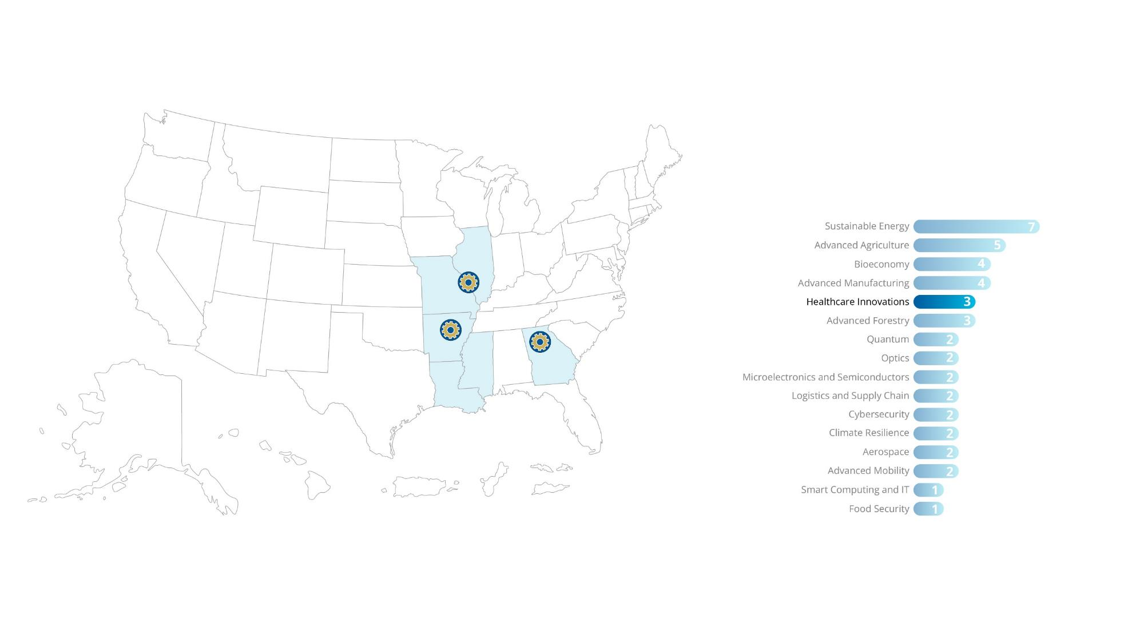
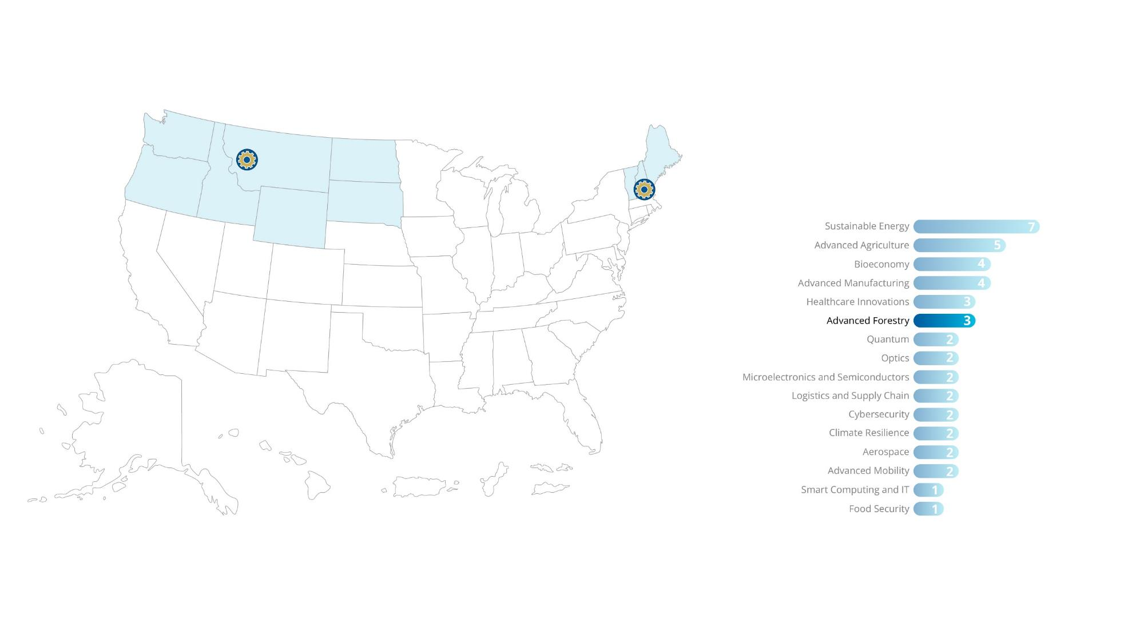
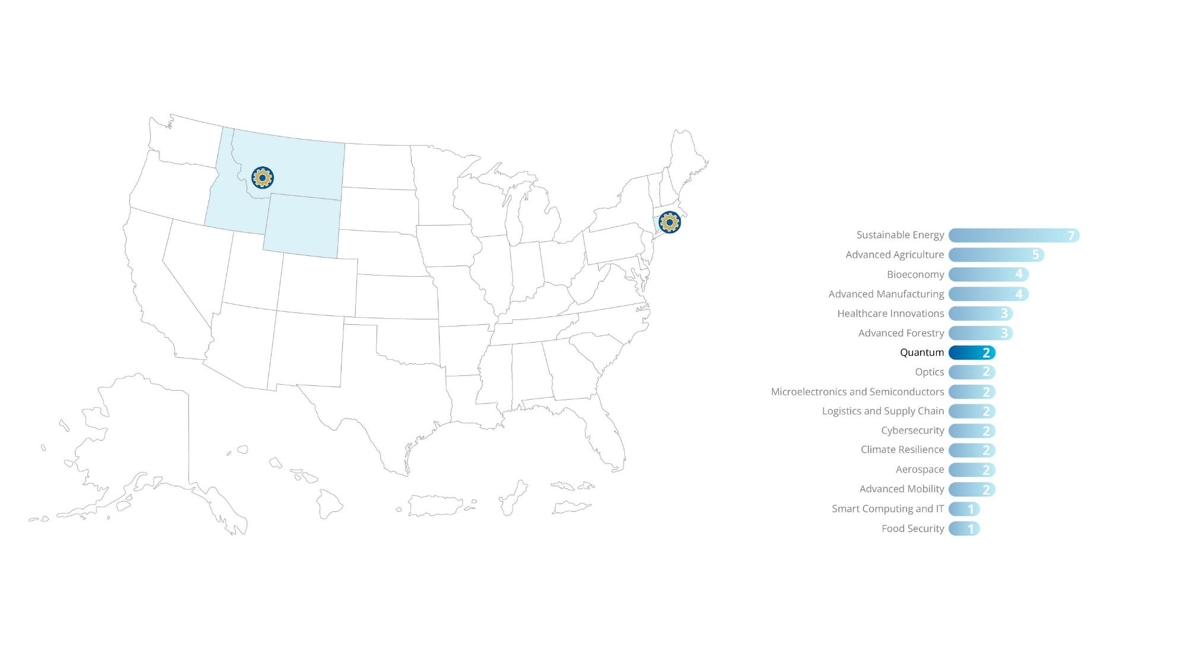
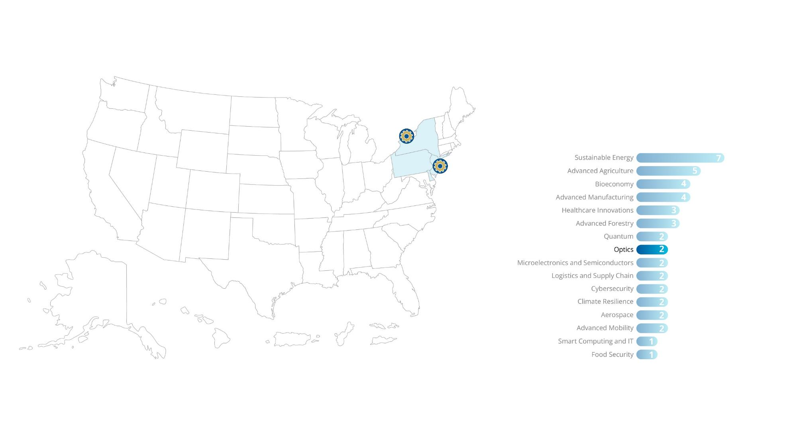
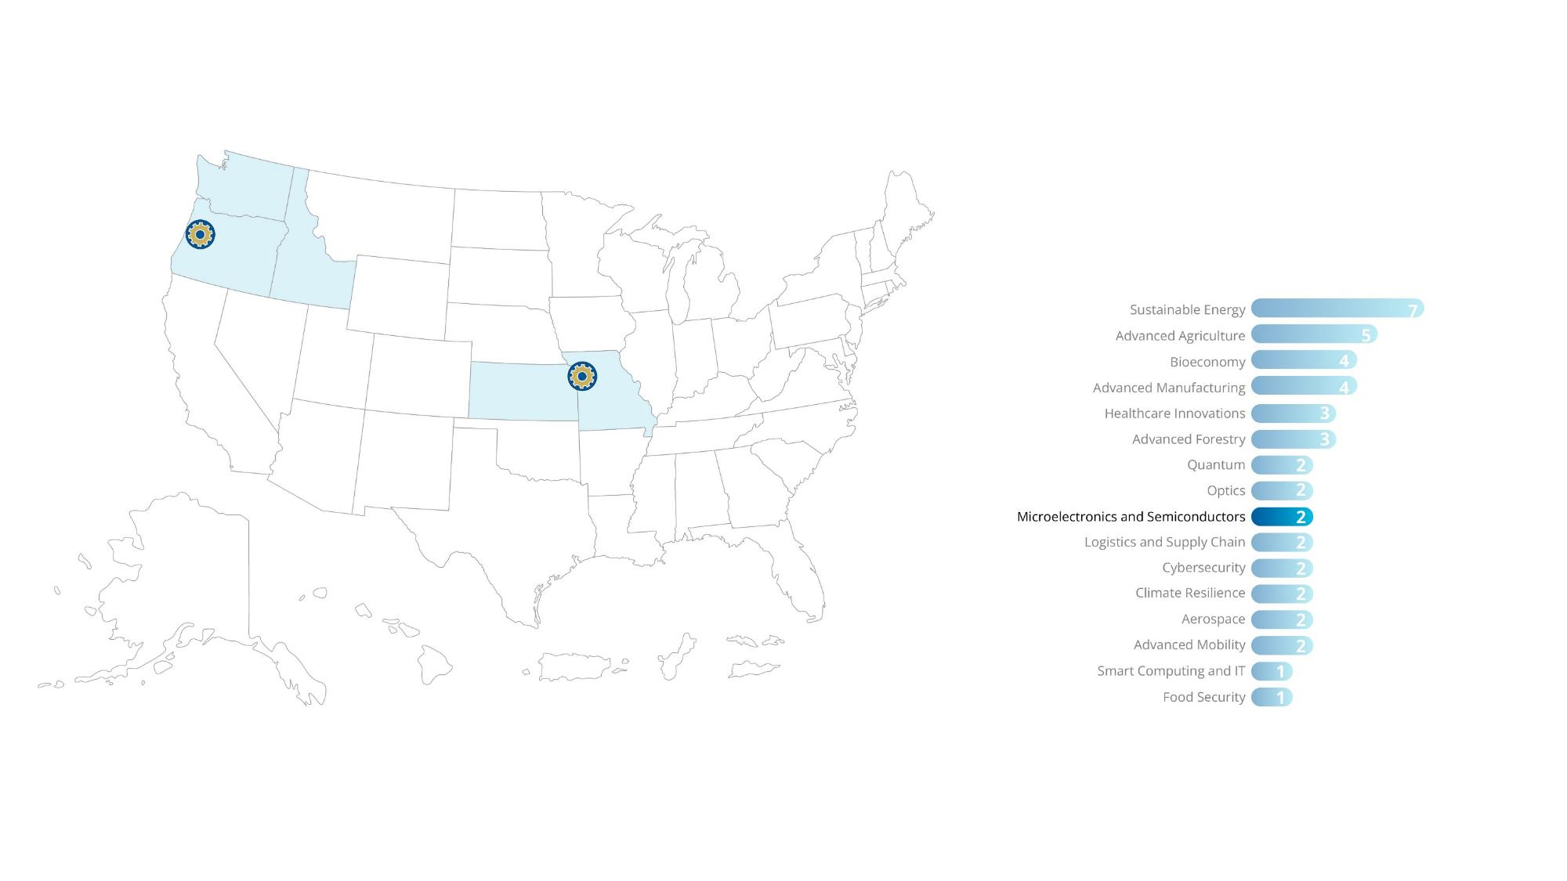
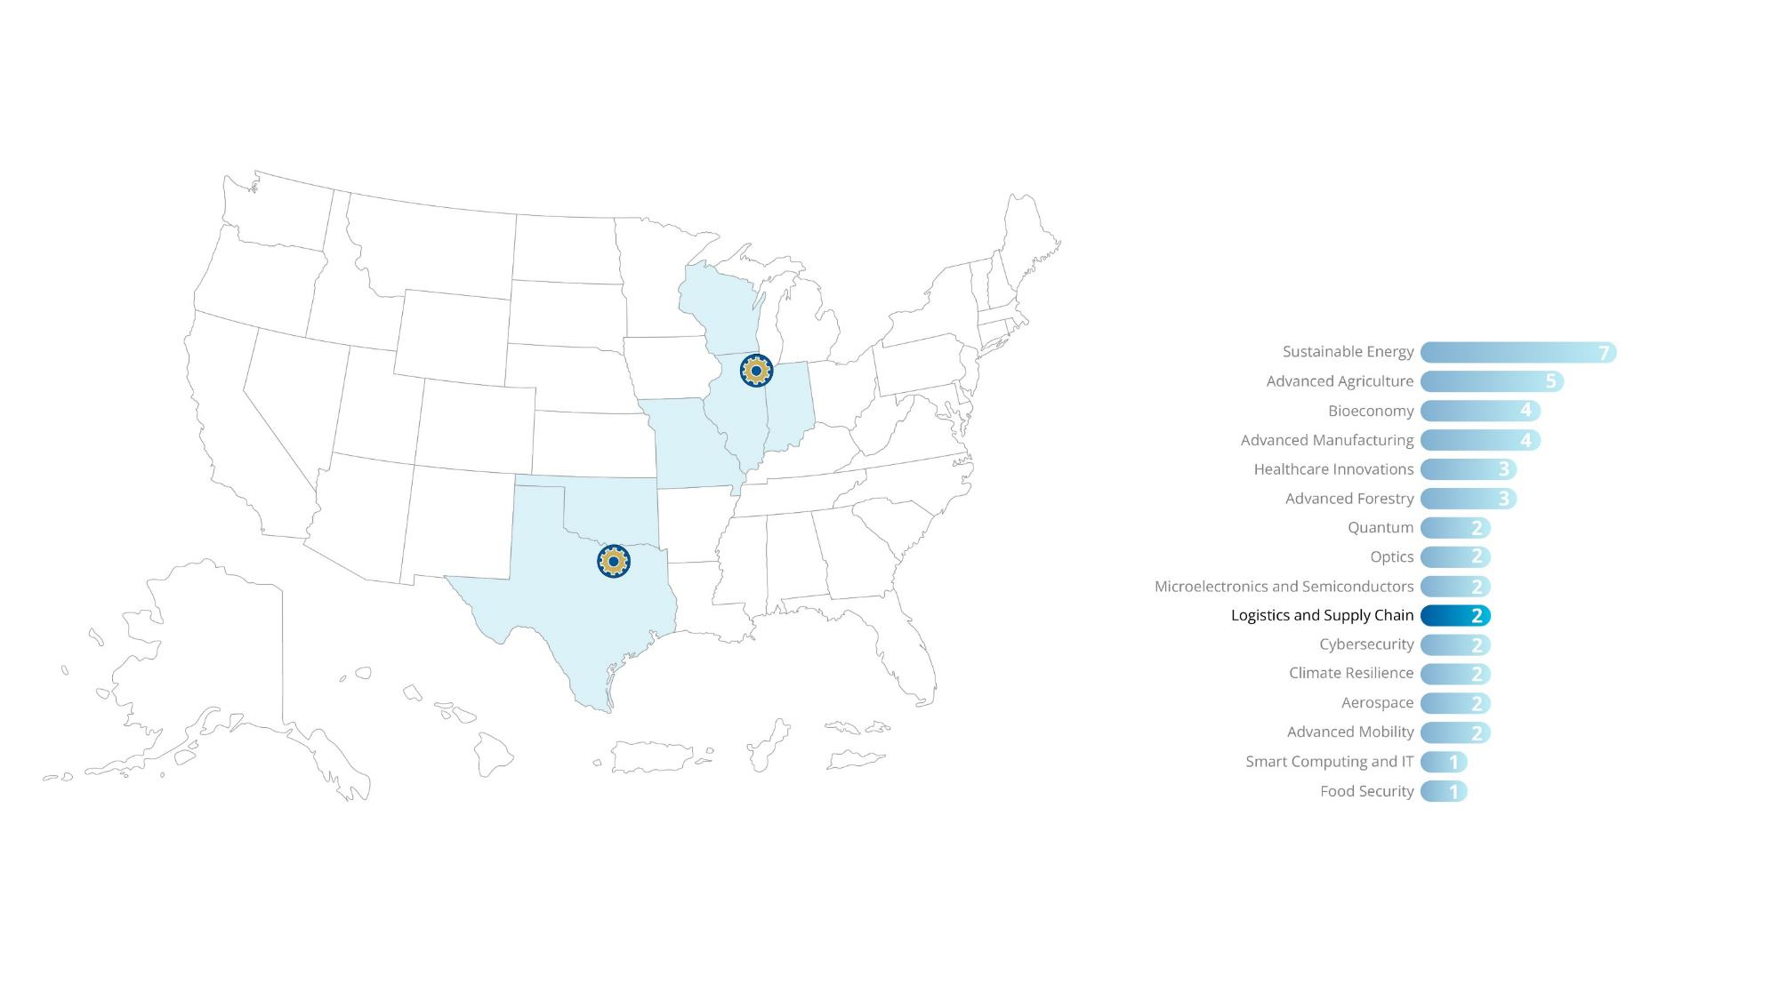
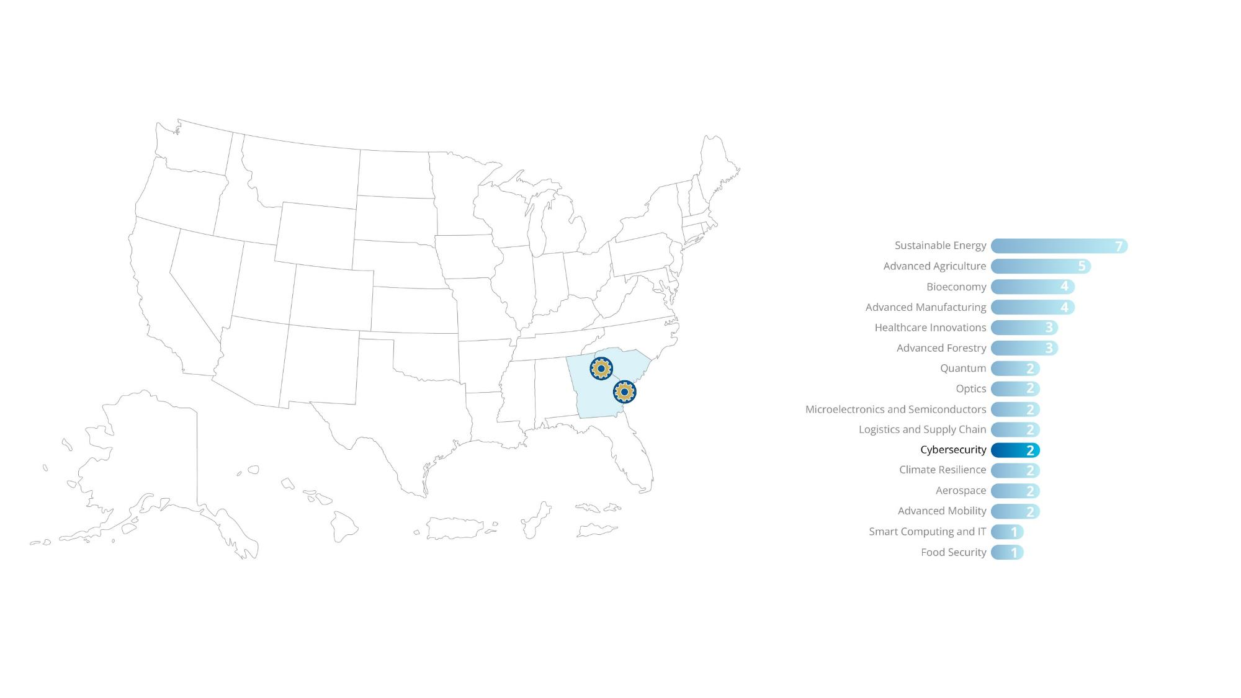
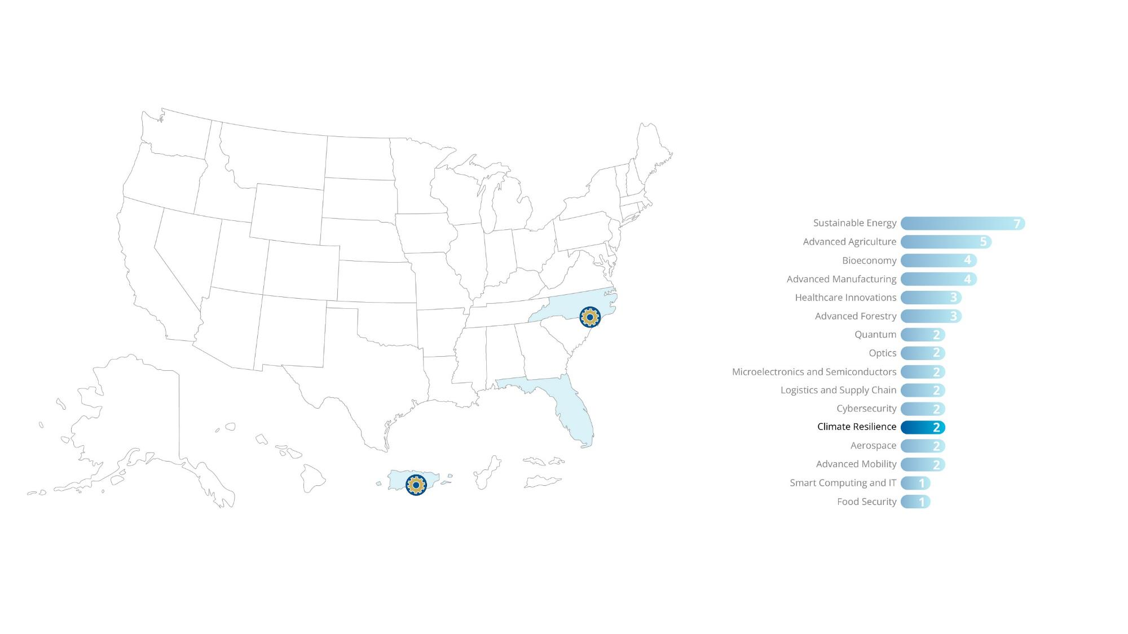
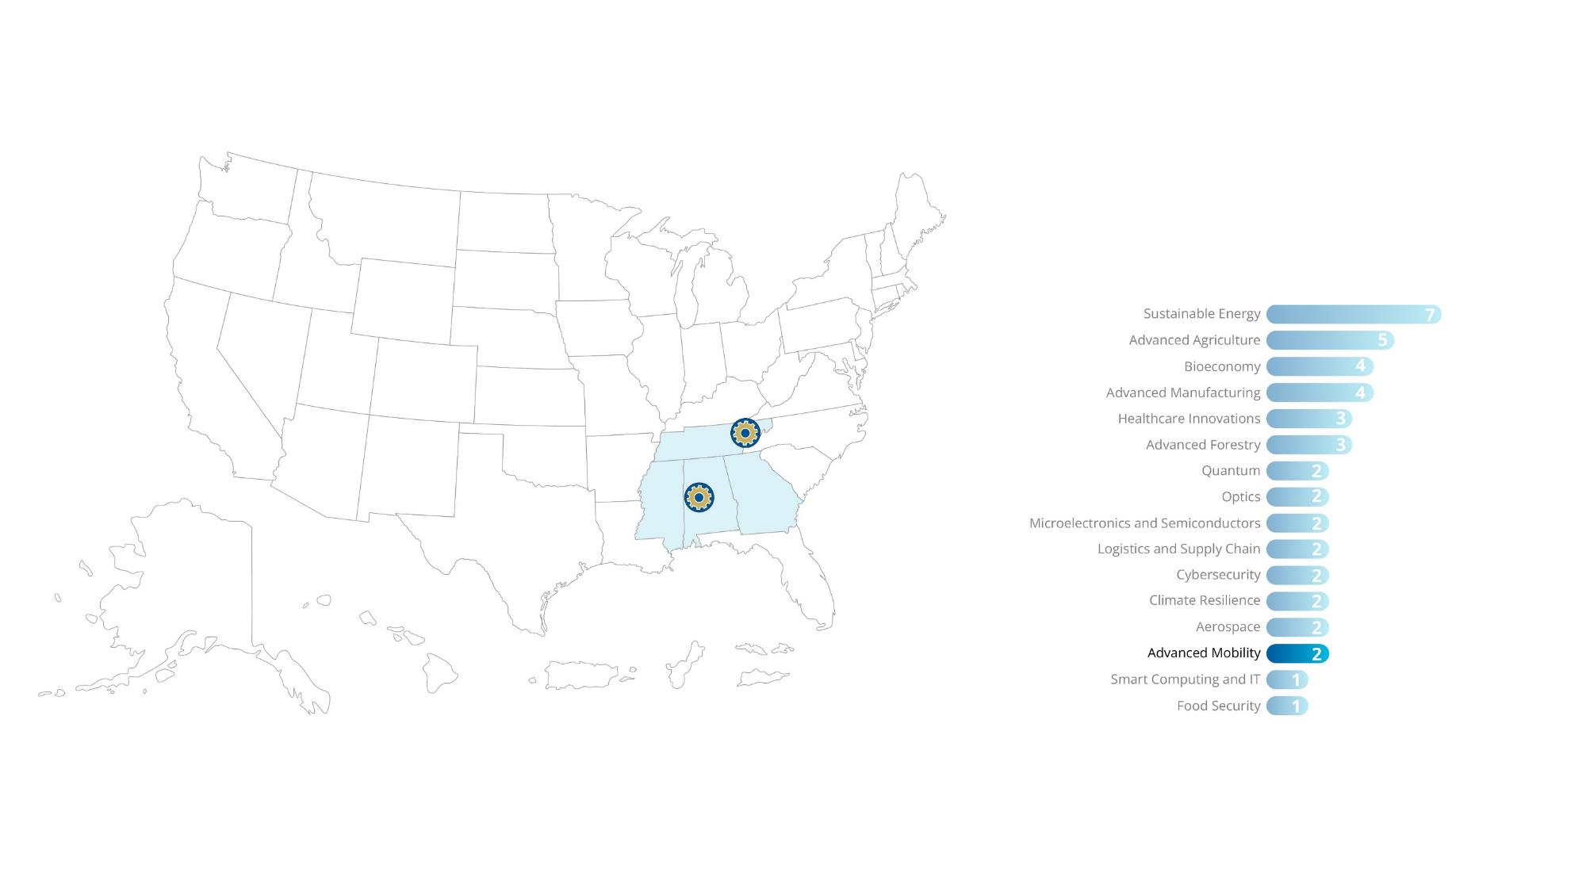
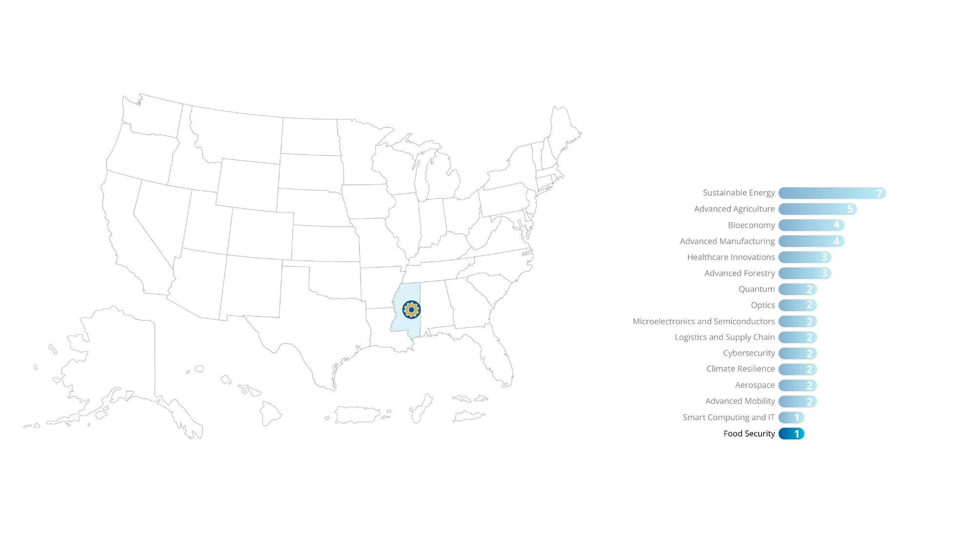
44 NSF Engines State Development Awards
The first-ever NSF Engines Development Awards will help regional partners collaborate to advance key technologies, address societal challenges, and create economic opportunities. The awards to 44 unique teams span universities, nonprofits, business and other organizations across U.S. states and territories.
^{Topics} Each Award is aligned with one of the following topics.
States and territories covered by at least one award
18
18
18

Slide 19
NSF Engines: Scaffolding for Success
DIVERSE INNOVATION ECOSYSTEMS
DIVERSE INNOVATION ECOSYSTEMS
Regional
Innovation Ecosystem
Issued Dec. 8, 2022:
Enabling Partnerships to Increase Innovation Capacity (EPIIC)
NSF Engine
Later:
NSF Regional Innovation Engines Venture Platform
Issued April 25, 2023:
NSF Regional Innovation Engines Builder Platform

Slide 20
TIP’s Core Message
TIP advances U.S. competitiveness​ and societal impact by nurturing partnerships that​ drive and accelerate:
Diverse Innovation Ecosystems
Technology Translation and Development
Workforce Development
20
20
Notes:
TIP charge and landscape (chips, climate, semiconductors, global competition, missing millions)
- Accelerating Technology
- Workforce
- Partnerships
TIP integrates with NSF's existing directorates and fosters partnerships—with government, industry, nonprofits, civil society and communities of practice—to leverage, energize and rapidly bring to society use-inspired research and innovation.
TIP programming has three primary foci:
First, cultivating innovation ecosystems throughout the U.S. that allow us to be able to advance use inspired research with a particular focus on the breakthrough technologies and societal and economic challenges that we face, and how those technologies can help to address those societal and economic challenges.
Second, enhancing the translation of emerging technologies to the market and to society more generally, and I’ll say a little bit more about that in the context of POSE in just a moment.
Third, leveraging partnerships that bring researchers and practitioners together, to be able to really pursue those efforts that I just described.

Slide 21
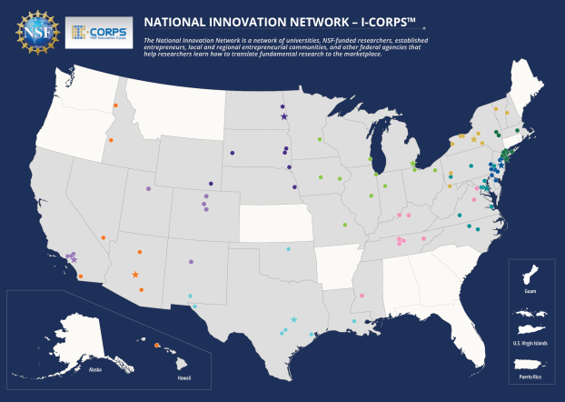
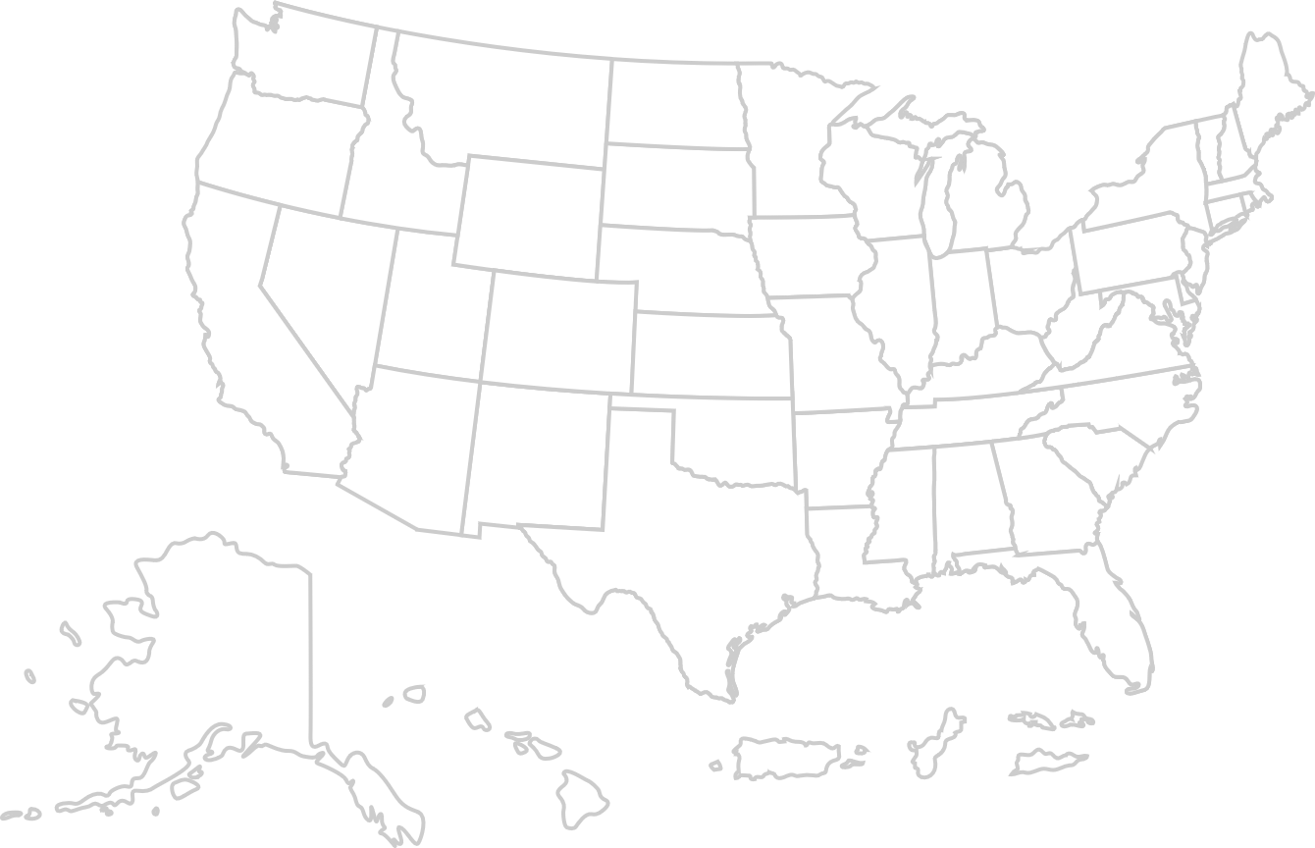
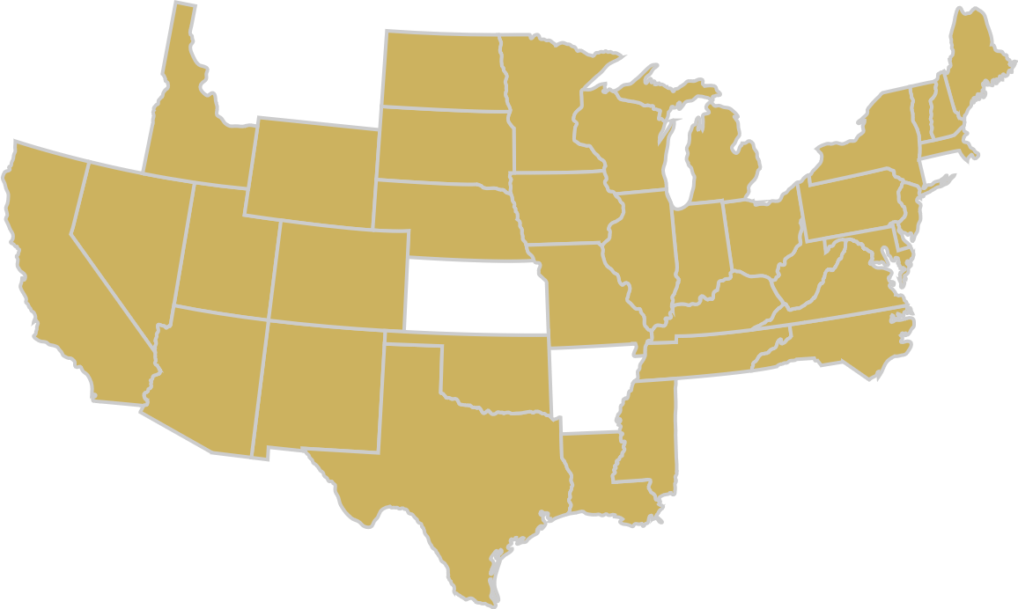
TECHNOLOGY TRANSLATION AND DEVELOPMENT
Innovation Corps (I-Corps™) provides experiential entrepreneurial education to further the nation's innovation ecosystem. Hubs implement the I-Corps program by creating a network of universities that help researchers learn how to test the market through customer discovery.
All Hubs
I-Corps Hubs Funding for up to $3 million
per year for 5 years
10 I-Corps Hubs involving nearly 100 universities
Opportunity available to:
Academia
I-Corps Teams Funding for $50,000 for 7 weeks

Slide 22
TECHNOLOGY TRANSLATION AND DEVELOPMENT
Partnerships for Innovation (PFI) program offers researchers a technology testbed to gain market insights, launch a commercial application or facilitate industry adoption. PFI helps researchers translate basic research into technologies and spurs university spinoff companies.
Two Phases:
TECHNOLOGY TRANSLATION
2 years Up to $550,000
RESEARCH
PARTNERSHIPS
3 years Up to $1 million
Opportunity available to:
Academia
Nonprofits

Slide 23
TECHNOLOGY TRANSLATION AND DEVELOPMENT
America's Seed Fund powered by NSF (the Small Business Innovation Research and Small Business Technology Transfer program) provides up to $2 million in research and development funding for deep-tech startups, transforming scientific and engineering discoveries into products and services with commercial and societal impact.
Submit a Project Pitch to get started!
PHASE I
6-12 months
Up to $275,000
PHASE II
2 years
Up to $1 million
PHASE IIB
Up to $500,000
Opportunity available to:
Academia
Business & Industry

Slide 24
TECHNOLOGY TRANSLATION AND DEVELOPMENT
Pathways to Enable Open-Source Ecosystems (POSE) supports sustainable high-impact open-source ecosystems to ensure more secure open-source products, increase coordination of developer contributions and a more focused route to impactful technologies.
Pathways to Enable
Open-Source Ecosystems
Two Phases:
Opportunity available to:
PHASE I 1 year Up to
$300,000
PHASE II 2 years Up to
$1.5 million
Academia
Business & Industry
Nonprofits

Slide 25
TIP’s Core Message
TIP advances U.S. competitiveness​ and societal impact by nurturing partnerships that​ drive and accelerate:
Diverse Innovation Ecosystems
Technology Translation and Development
Workforce Development
25
25
Notes:
TIP charge and landscape (chips, climate, semiconductors, global competition, missing millions)
- Accelerating Technology
- Workforce
- Partnerships
TIP integrates with NSF's existing directorates and fosters partnerships—with government, industry, nonprofits, civil society and communities of practice—to leverage, energize and rapidly bring to society use-inspired research and innovation.
TIP programming has three primary foci:
First, cultivating innovation ecosystems throughout the U.S. that allow us to be able to advance use inspired research with a particular focus on the breakthrough technologies and societal and economic challenges that we face, and how those technologies can help to address those societal and economic challenges.
Second, enhancing the translation of emerging technologies to the market and to society more generally, and I’ll say a little bit more about that in the context of POSE in just a moment.
Third, leveraging partnerships that bring researchers and practitioners together, to be able to really pursue those efforts that I just described.

Slide 26
WORKFORCE DEVELOPMENT
Experiential Learning for Emerging and Novel Technologies (ExLENT) program promotes partnerships between organizations in emerging technology fields and those with expertise in workforce development to expand practical learning opportunities for individuals interested in entering or gaining more experience in emerging and novel technology.
Opportunity available to:
Academia
Funding up to $6 million over 4 years
Business & Industry
Governments
Nonprofits

Slide 27
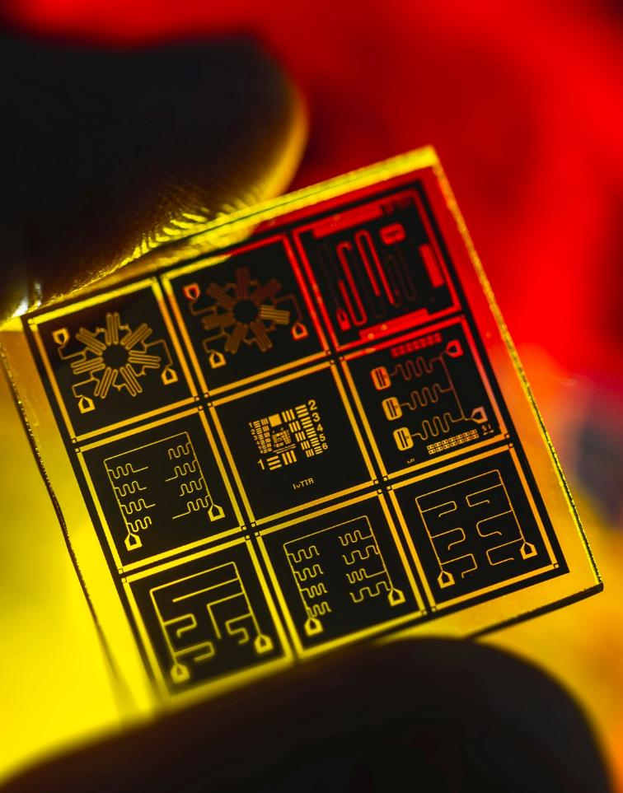
WORKFORCE DEVELOPMENT
Through a $20 million cooperative agreement, the Entrepreneurial Fellowships run by the non-profit, Activate.org, support researchers from a variety of backgrounds and geographies to move technologies from lab to market.
2 years of training At least $350,000 in direct support, plus specialized research facilities and equipment
Opportunity available to:
Individual Researchers

Slide 28
Partnerships as the Foundation
“To help develop and attract a pipeline of skilled talent from within the region, Intel plans to invest approximately $100 million over the next decade in partnership with … the U.S. National Science Foundation [ranging] from collaborative research projects to building semiconductor-specific curricula for associate and undergraduate degree programs.”
“[NSF] announced a cross-sector partnership with Micron Technology, Inc. to develop bold, potentially transformative solutions to address semiconductor manufacturing challenges and workforce shortages. NSF and Micron will each invest $5 million in support of research, education, infrastructure capacity building, and workforce development...”
JANUARY 2022
NOVEMBER 2022
Notes:
TIP is a crosscutting platform that collaboratively integrates with NSF's existing directorates and fosters partnerships — with government, industry, nonprofits, civil society and communities of practice — to leverage, energize and rapidly bring to society use-inspired research and innovation to societal impact.
Visit
https://beta.nsf.gov/tip/about-tip

Slide 29
TIP: Accelerating Research To Impact
TIP
Notes:
TIP charge and landscape (chips, climate, semiconductors, global competition, missing millions)
- Accelerating Technology
- Workforce
- Partnerships
TIP integrates with NSF's existing directorates and fosters partnerships—with government, industry, nonprofits, civil society and communities of practice—to leverage, energize and rapidly bring to society use-inspired research and innovation.
TIP programming has three primary foci:
First, cultivating innovation ecosystems throughout the U.S. that allow us to be able to advance use inspired research with a particular focus on the breakthrough technologies and societal and economic challenges that we face, and how those technologies can help to address those societal and economic challenges.
Second, enhancing the translation of emerging technologies to the market and to society more generally, and I’ll say a little bit more about that in the context of POSE in just a moment.
Third, leveraging partnerships that bring researchers and practitioners together, to be able to really pursue those efforts that I just described.

Slide 30
TIP: Accelerating Research to Impact
Diverse Innovation
Ecosystems
Nurtures regional and national innovation and technology ecosystems to support researchers and innovators.
Technology Translation
and Development
Supports researchers, startups, and entrepreneurs to create technologies and innovations with impact.
Workforce Development
Supports people from all demographics and geographies to get the training and expertise for the jobs of the future.
Notes:
TIP is a crosscutting platform that collaboratively integrates with NSF's existing directorates and fosters partnerships — with government, industry, nonprofits, civil society and communities of practice — to leverage, energize and rapidly bring to society use-inspired research and innovation to societal impact.
Visit
https://beta.nsf.gov/tip/about-tip

Slide 31
LEARN ABOUT TIP
Funding opportunities
Sign up for our newsletter
Resources and upcoming events
new.nsf.gov/tip/latest

Slide 32
Find Your Opportunities
Academia
Business & Industry
Government
Nonprofits
America's Seed Fund powered by NSF
Accelerating Research Translation
Convergence Accelerator
Enabling Partnerships to Increase Innovation Capacity
Experiential Learning for Emerging and Novel Technologies
NSF Entrepreneurial Fellowships
NSF Innovation Corps (I-Corps™)
Partnerships for Innovation
Pathways to Enable Open-Source Ecosystems
Privacy-Enhancing Technologies Prize Challenge
Prototype Open Knowledge Network
NSF Regional Innovation Engines
America's Seed Fund powered by NSF
Convergence Accelerator
Experiential Learning for Emerging and Novel Technologies
Pathways to Enable Open-Source Ecosystems
Pathways to Enable Open-Source Ecosystems
Privacy-Enhancing Technologies Prize Challenge
Prototype Open Knowledge Network
NSF Regional Innovation Engines
Convergence Accelerator
Experiential Learning for Emerging and Novel Technologies
NSF Regional Innovation Engines
Visionary interdisciplinary Teams Advancing Learning Prize Challenge
Convergence Accelerator
Experiential Learning for Emerging and Novel Technologies
Partnerships for Innovation
Pathways to Enable Open-Source Ecosystems
Prototype Open Knowledge Network
NSF Regional Innovation Engines
Visionary interdisciplinary Teams Advancing Learning Prize Challenge

Slide 33
Questions?
Email tip@nsf.gov or alwalker@nsf.gov
Visit https://new.nsf.gov/tip/

Slide 34
Ramping up TIP
Apr 27: NSF hosts first- ever industry partnership summit
Oct. 27: NSF + Micron announce $10M semi. workforce partnership
Jan. 26: NSF announce cross-sector partnership with Ericsson, Intel, IBM, and Samsung on its FuSe program
March 16: TIP is established
Nov. 10: NSF announce winners in first phase of NSF, NIST, OSTP, UK privacy prize challenges
Jan. 10: NSF + NobleReach Emerge announce biotechnology investment
Apr 25: NSF launches new $9.5 million opportunity to support NSF Engines
July 20: NSF, NIST, OSTP, UK announce privacy prize challenges
Apr. 3: NSF announce 100 teams advancing to Vital Prize Challenge
Oct. 19: NSF launches ExLENT program
MAR 2022
JUL
2022
OCT 2022
NOV 2022
JAN 2023
APR 2023
MAY 2022
SEP
2022
DEC 2022
FEB 2023
MAR 2023
MAY 2023
Feb. 15, 2022 Pathways to
enable Open-Source Ecosystems launches
Sept. 7: NSF, DOD partner to advance 5G security
Dec 8: NSF launches EPIIC program
Feb 8: NSF launches ART program
Dec 9: NSF invests $12M on solutions for persons with disabilities
May 11: NSF announces the first-ever NSF Engines, program awards to 44 unique teams
May 3: NSF Engines program launches
I-Corps™
Mar 15: NSF launches Proto-OKN program
Dec 12: NSF announce Builder Platform for NSF Engines
Jan. 21, 2022 NSF + Intel announce $100M semi. workforce partnership
Sept. 8: NSF awards five new I-Corps™ Hubs
Dec 13: NSF invests $11M to address food/nutrition security
Sept. 19: Entrepreneurial Fellows program launches
Dec 19: NSF invests $12M on advance circular economy

Slide 35
CHIPS and Science Act: TIP Authorization
Sec. 10381. Establishment.
Sec. 10382. Purposes.
Sec. 10383. Activities.
Sec. 10384. Requirements.
Sec. 10385. Assistant Director.
Sec. 10386. Advisory committee.
Sec. 10387. Challenges and focus areas.
Sec. 10388. Regional Innovation Engines.
Sec. 10389. Translation accelerator. | Pending approps
Sec. 10390. Test beds. | Pending approps
Sec. 10391. Planning and capacity building awards.
Sec. 10392. Entrepreneurial fellowships.
Sec. 10393. Scholarships and fellowships. | Pending approps
Sec. 10394. Research and development awards.
Sec. 10395. Scaling innovations in PreK–12 STEM education. | Pending approps
Sec. 10396. Authorities.
Sec. 10397. Coordination of activities.
Sec. 10398. Ethical, legal, and societal considerations.
Sec. 10399. Reports and roadmaps.
Sec. 10399A. NASEM Evaluation. | (After 6 years)
Completed
Ongoing
Scaling
Notes:
Speaker
Insert the directorate/office org chart

Slide 36
TECHNOLOGY TRANSLATION AND DEVELOPMENT
Prototype Open Knowledge Network (Proto-OKN) program funds projects to prototype scalable, cloud-based technical infrastructure to address challenges across healthcare, space, criminal justice, climate change and many other fields. This program was born from NSF Convergence Accelerator’s Track A and an innovation sprint.
Opportunity available to:
Three Themes:
Academia
THEME I 3 years Up to $1.5 million
THEME II 2 years Up to $1.5 million
THEME III
3 years
Up to $1.5 million
Business & Industry
Nonprofits

Slide 37
TECHNOLOGY TRANSLATION AND DEVELOPMENT
The U.S. National Science Foundation today announced a cross-sector partnership with Ericsson, IBM, Intel, and Samsung to support the design of the next generation of semiconductors as part of its Future of Semiconductors (FuSe) initiative.
Opportunity available to:
$50 million partnership
Academia
Business & Industry
Nonprofits

