Slide 1
Where Modes Connect
Automation fueling the convergence of air and surface transportation
Taylor Lochrane, Ph.D., P.E.
Deputy Director and Chief Scientist
USDOT Highly Automated Systems Safety Center of Excellence
Presented September 27, 2023

Slide 2
Agenda
01
About HASS COE
02
A coordinated approach
03
Advancing multimodal integration
04
Distributed testing
05
Questions

Slide 3
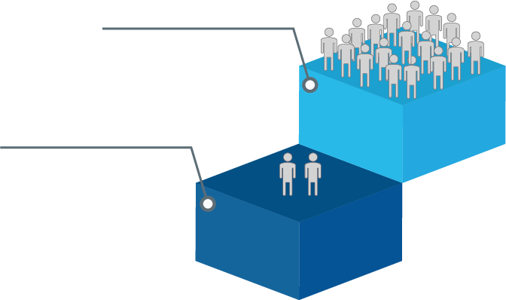
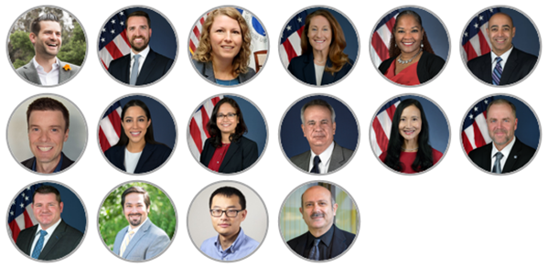
About HASS COE
Identifying, and advising U.S. DOT on, national automation safety opportunities and risks across the entire transportation ecosystem
Congressional Intent*
Provide support and partnership to U.S. DOT Operating Administrations (OAs) and industry for reviewing, assessing, and validating the safety of highly automated systems
Serve as a central expert resource within U.S. DOT for multimodal automation and human factors, computer science, data analytics, machine learning, sensors, and other technologies
* H.R.1865 - Further Consolidated Appropriations Act, 2020 (paraphrased)
DIVERSE AND BALANCED EXPERTISE
17 HASS staff
94%
JUNE 2023
of positions filled (17 out of 18)
78%
2 HASS staff
of staff from outside U.S. DOT
JUNE 2022
~25
years average experience
89%
have post-grad education

Slide 4
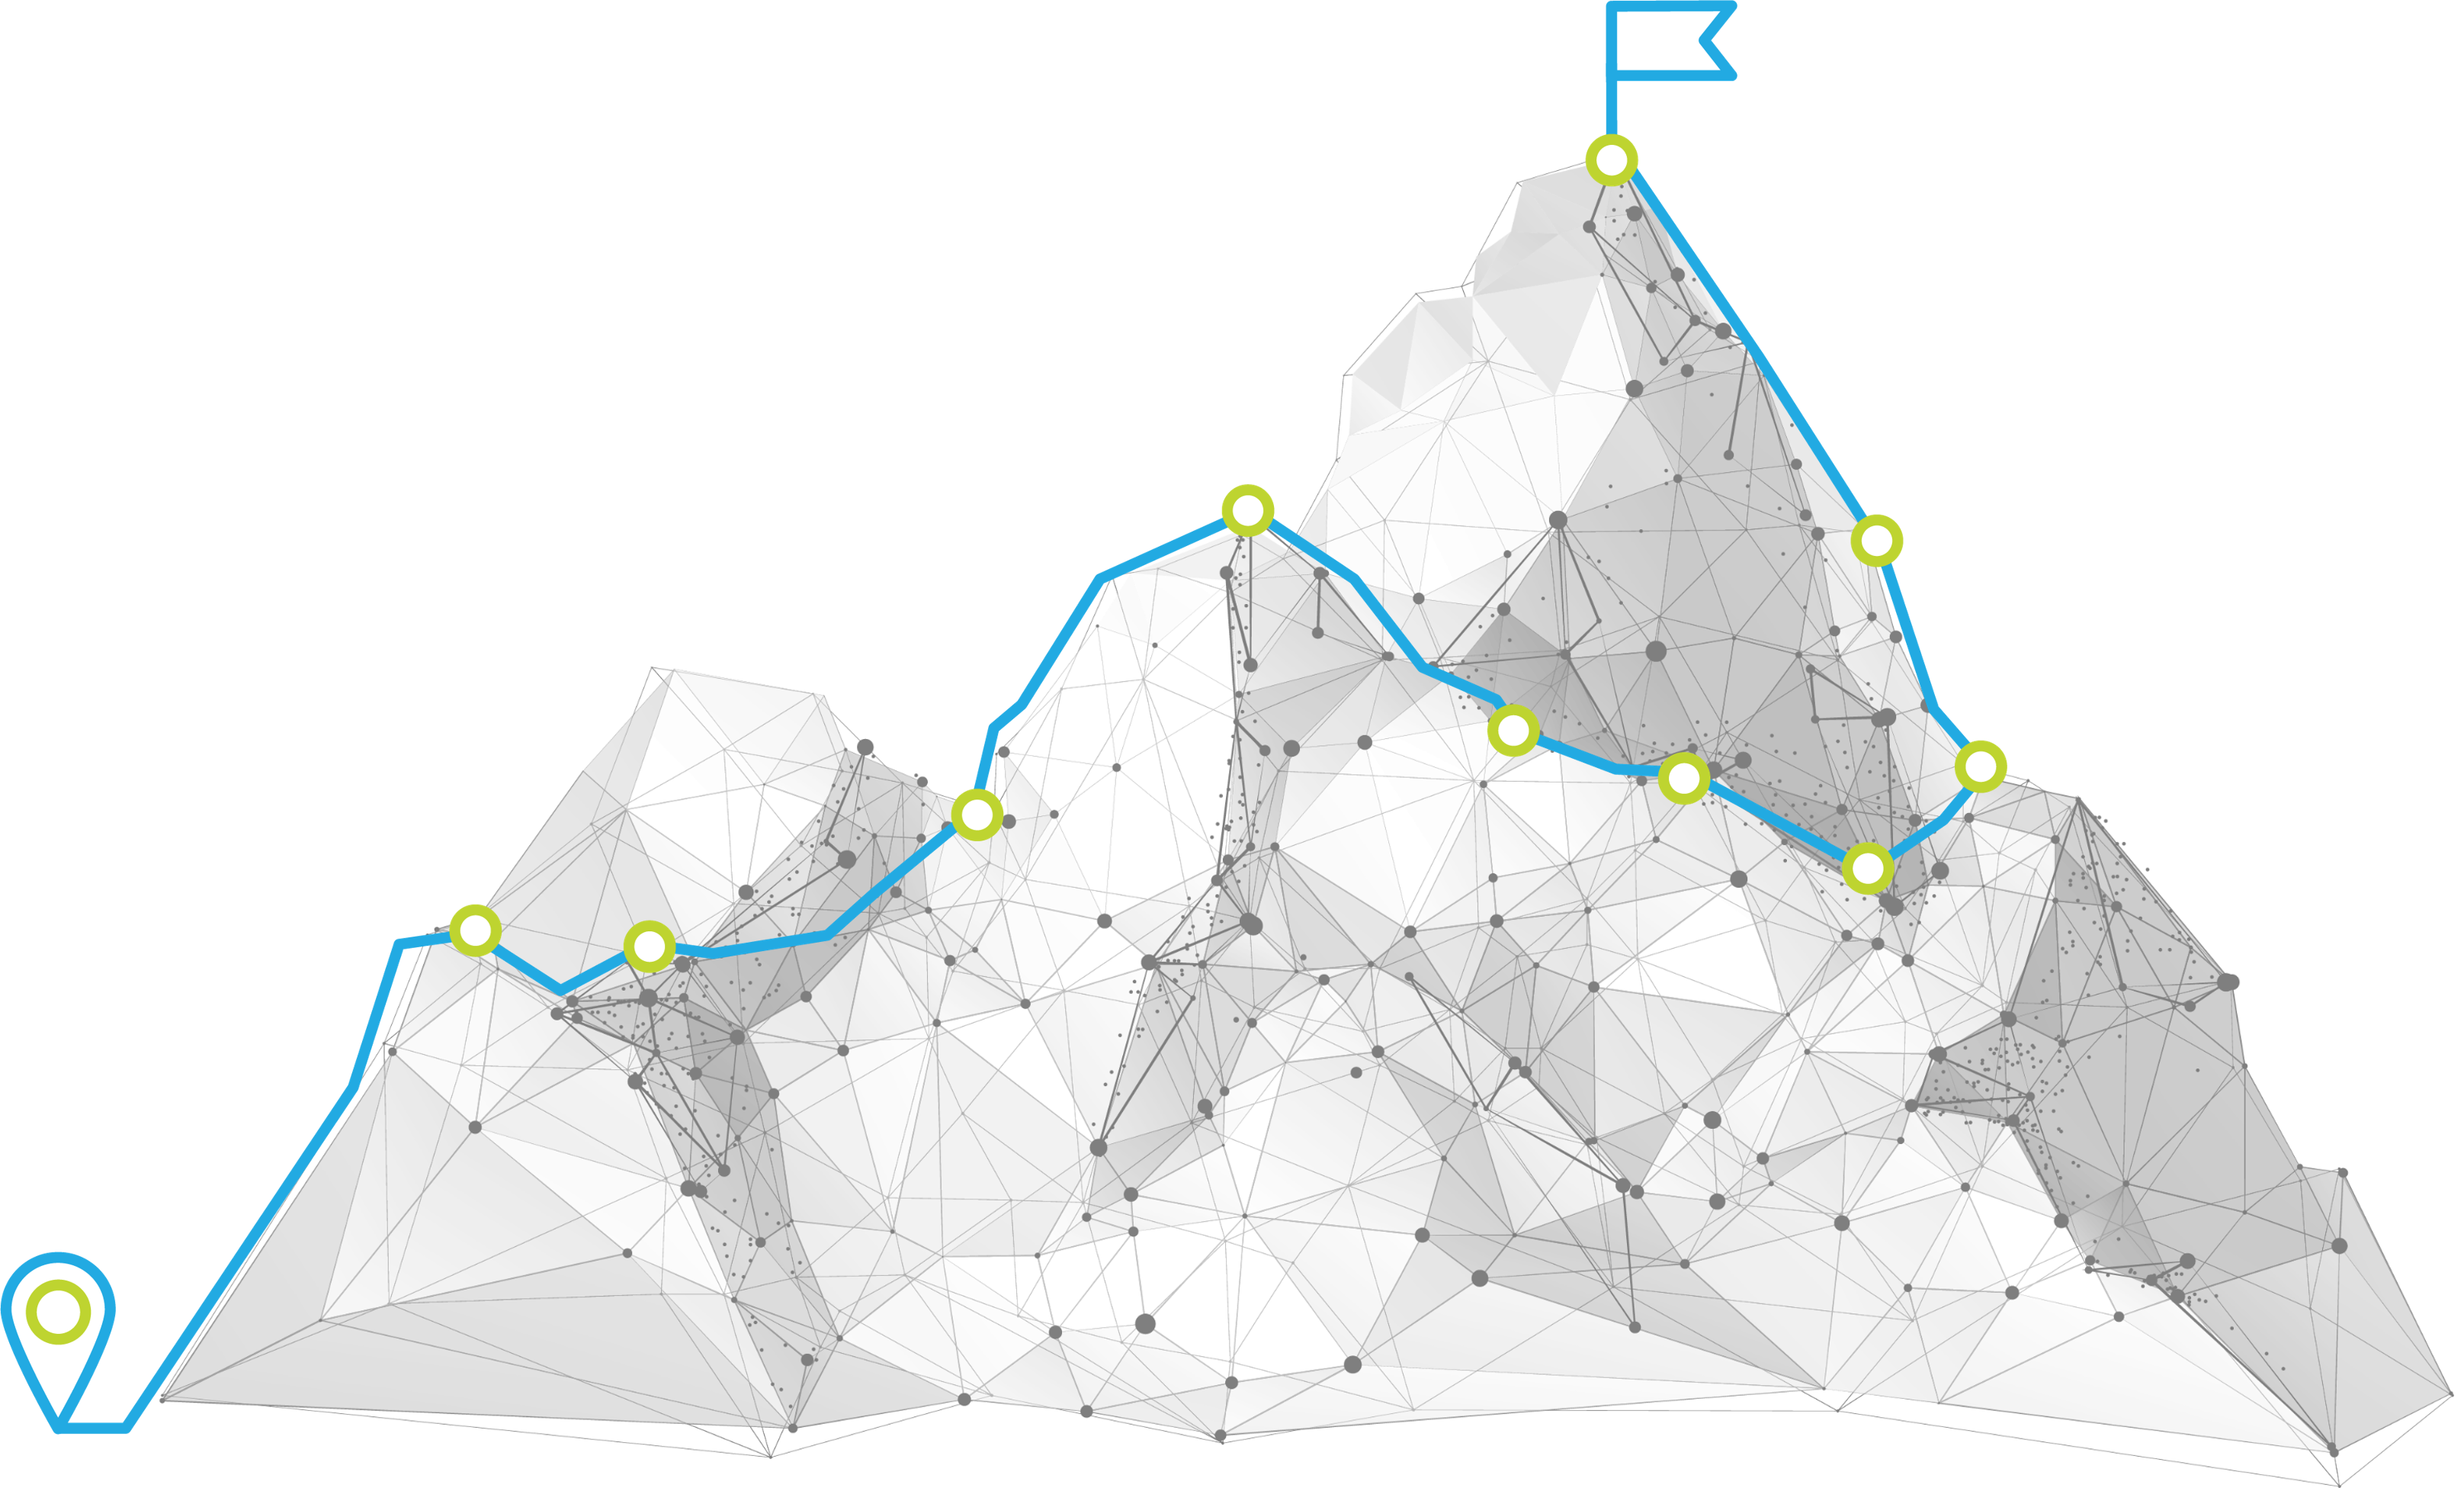
About HASS COE
Vision
Advance the safe and responsible integration of automation across the transportation ecosystem
Mission
Ensure federal capacity to review, assess, and validate the safety of automated technologies comprehensively across modes while enabling cross-sector collaboration for a holistic approach to the safe integration of automation in transportation

Slide 5
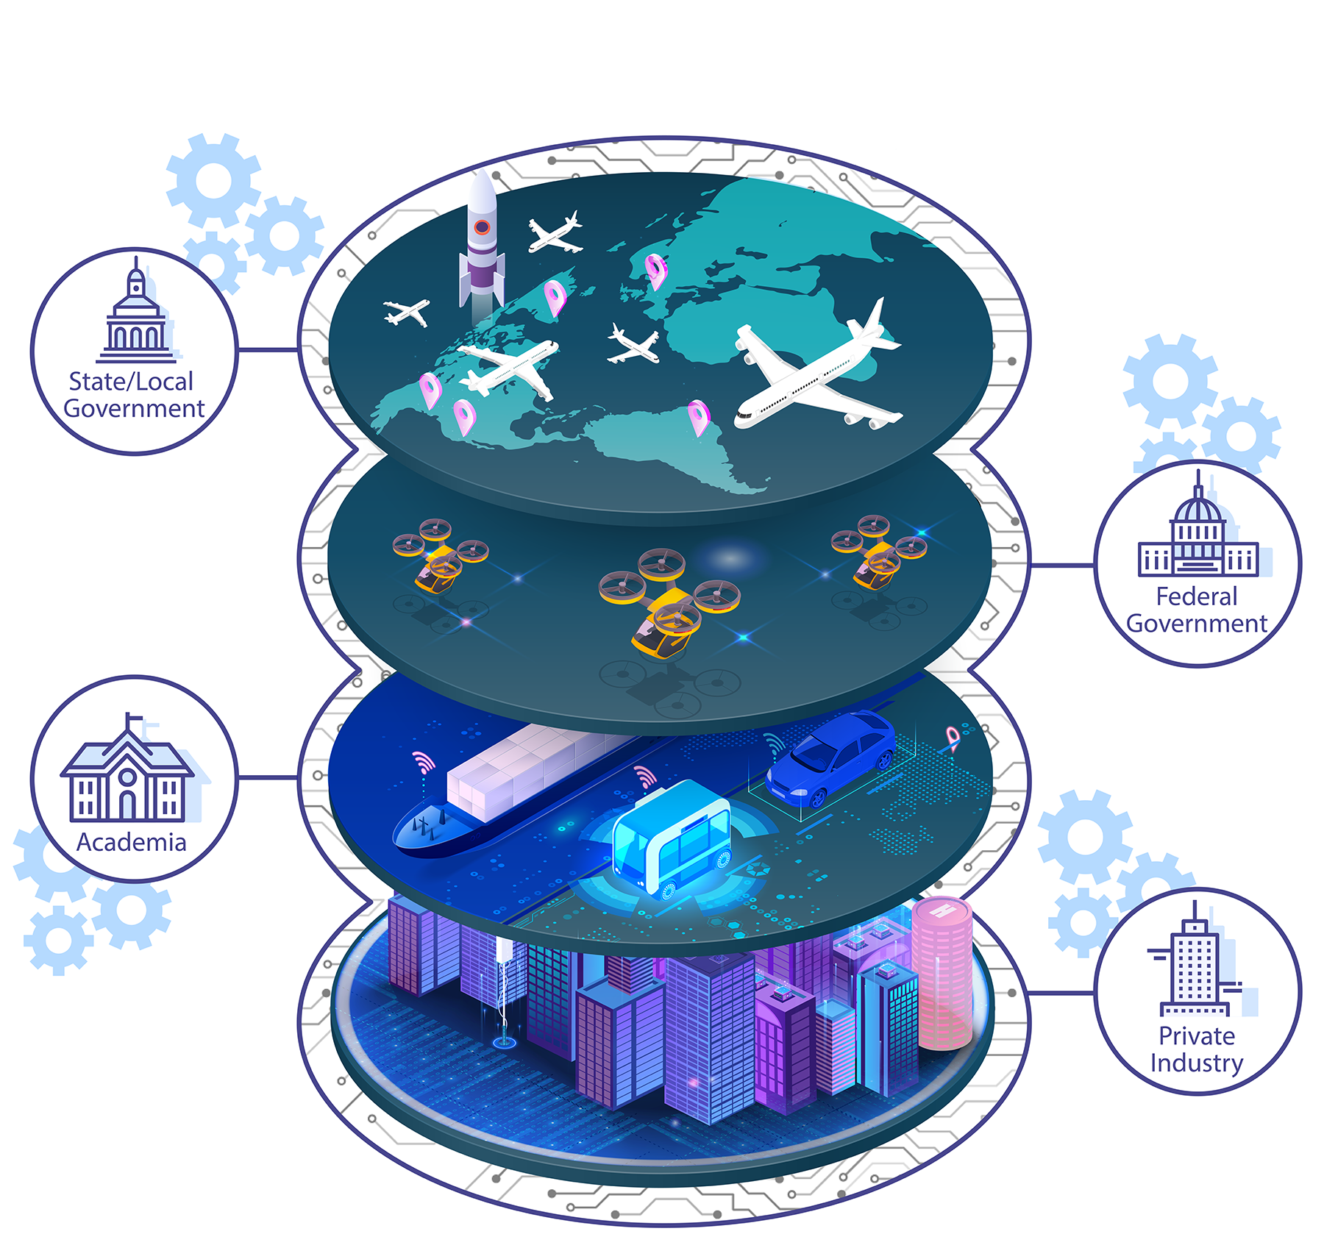
Fulfilling the need for a coordinated approach
Spearheading cross-sector and multimodal collaboration to advance the safe and responsible integration of automation across the transportation ecosystem
HASS engages transportation automation safety stakeholders to:
Support a holistic, proactive, and nimble approach to highly automated systems
Foster dialogue among policymakers, technology experts, and the transportation community
Identify and develop pivotal points of interoperability and integration over the long term
Facilitate technical assessment and validation activities

Slide 6
The nation must prepare for new automation technologies and vehicles in our overall transportation system
Drones, Advanced Air Mobility (AAM), and disruptive technologies (autonomy, automation, AI) developing at a rapid pace
Future Transportation System = Multimodal System of Systems
Lack of certification standards and regulatory framework
Limited data that is public domain or provided to government
Federated new systems for traffic management and guidance will be needed
Projected traffic densities for automated surface and flight profiles are far greater than anything that is currently managed with today’s systems
New AAM vehicles are not door-to-door / gate-to-gate modes
Relies on other modes of transportation to complete trips (first mile / last mile)
Seamless information sharing across modes and among users essential for efficient and safe functionality across complex system of systems
Radiofrequency spectrum needs across air and surface users will require further examination
Notes:
Highly automated, light, short-haul passenger aircraft (air taxis) are not certified
Low-altitude transport in FAA-approved corridors have not been approved
12 global city consortiums addressing problem (Tokyo, Paris, LA, etc)
Competitive and complementary to existing and future surface modes
Advances total mobility concept: multimodal integration

Slide 7
A whole-of-community approach
One of America’s greatest strengths is close collaboration among the government, industry, and academia, but has suffered in the new millennium*
Partnerships Large and Small
The United States must make a concerted effort to restore the level of collaboration between the government, industry, and academia, and to accelerate the adoption of commercial technology by the DoD.
Special Competitive Studies Project, Interim Panel Report Oct 2022
Academia
Entrepreneurs
Users
Operators
Government
Corporate
Transportation Community
*Adapted from the Special Competitive Studies Project, Interim Panel Report Oct 2022
Notes:
Implement a New Public-Private Partnering Model Between the U.S. Government, Industry, Academia, Investors, and Civil Society. One of America’s greatest defense strengths has been the close collaboration among the government, industry, and academia. That collaboration has, for various reasons, suffered over the past 20 years. At the same time, the CCP has been focusing on comprehensive national military-civilian fusion. China continues its inexorable march toward reducing dependencies on the United States and advancing the development of Chinese technology companies.

Slide 8
The need for distributed testing to advance our global competitiveness
Recently on March 2023, the White House Office of Science, Technology and Policy published the National Aeronautics Priorities, on page 12 under Advancing Global Competitiveness section:
“One avenue for academic, private sector, and government cooperation is ensuring infrastructure and testbeds are available to the community, consistent with airspace safety and national security considerations. The U.S. Government will provide a safe, timely, responsive regulatory environment, consistent with national security and foreign policy considerations, that supports the infusion and agility needed for new technologies. The U.S. Government will work with ICAO and other international organizations to develop cost-effective, cooperative international standards and regulatory approaches, while promoting safety and sustainability.”

Slide 9
What is distributed testing?
Non-destructive open testing platform that encourages a Public Private Partnership model to more rapidly mature requirements and provide necessary data for regulatory solutions
Safer – Does not involve risk to public or property.
Any company can test the capabilities of its technology without risk to people, property, or the physical prototype; reducing cost and risk barriers of certification and operational approvals by providing validated, predictive data toward higher assurance of success in live testing.
Cost Effective: Condenses cost of testing and research, and removes unnecessary rebuilds.
Opens opportunities to smaller companies that cannot afford test space of time-intensive exemption processes.
Uses proven technologies and techniques from the U.S. Department of Defense (DoD), NASA, and U.S Department of Transportation (USDOT).
Collaborative and unconstrained, yet secure
Connections to a central network can be placed anywhere in the country for ease of access.
Open to researchers, academia, government at all levels, and industry simultaneously or in sectors.
Virtual environments can predictively test multimodal concepts of operations for airspace requirements, topography, CNS, infrastructure needs, obstacles, aircraft performance, and other considerations such as winds and weather.
Addresses performance, flight profiles/operating standards, and equipage of all new vehicles (surface and air).
Protects intellectual property for industry while providing needed data for risk assessment, standards, and enabling regulations.
Notes:
The Department of Transportation would further benefit from observations of industry operations in the system to establish minimum safety criteria aimed at advancing regulations and guidance that will ensure the safe integration of new technologies into the airspace, but also the wider transportation and smart infrastructure networks of the future.
This proposal would require the Secretary to establish a multimodal integrated research and development test environment to enable the integration of new technologies into existing and future transportation networks.
The proposal would make use of and expand upon the as established by the Further Consolidated Appropriations Act, 2020 (section 105, title I, division H, of Pub. L 116-94); and the Federal Aviation Administration’s William J. Hughes Technical Center.

Slide 10
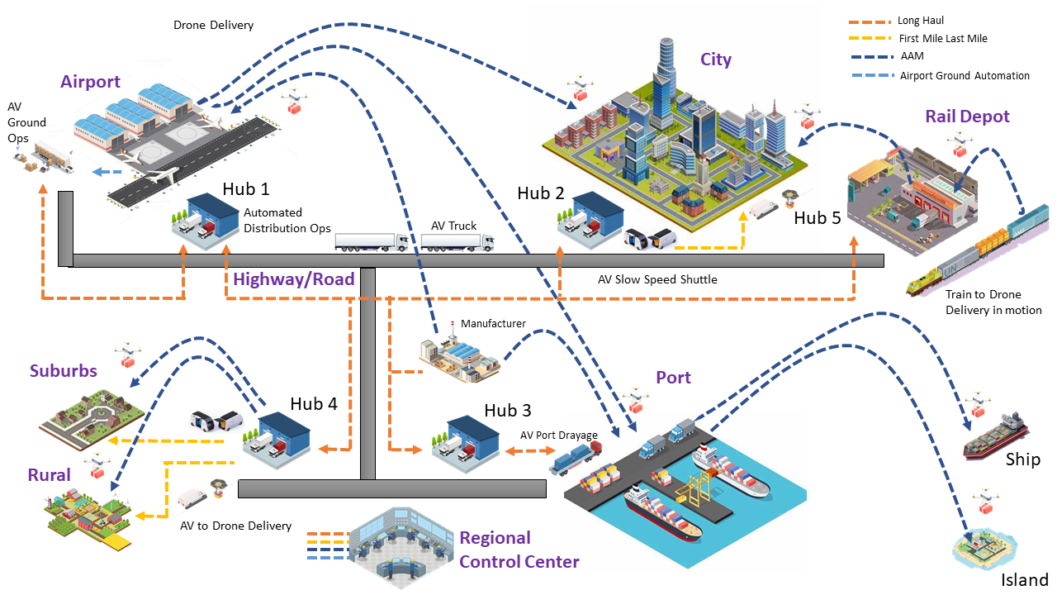
Creating the transportation system of the future
Working across agencies to make it all happen
Seeing the whole picture

Slide 11
Contact
Taylor Lochrane, Ph.D., P.E.
Deputy Director and Chief Scientist, HASS COE taylor.lochrane@dot.gov
transportation.gov/hasscoe
linkedin.com/company/hasscoe

