Slide 1

V&V Summit Forum 2024
John Frederick: FAA Verification and Validation Branch Manager (ANG-E5A)
Taylor Lochrane: DOT Deputy Director for Science and Technology
Highly Automated Systems Safety (HAAS) Center of Excellence
Operationalizing Advanced Concepts:
Making it Happen
Date: May 8th, 2024
Place: National Aerospace Research and Technology Park (NARTP)

Slide 2
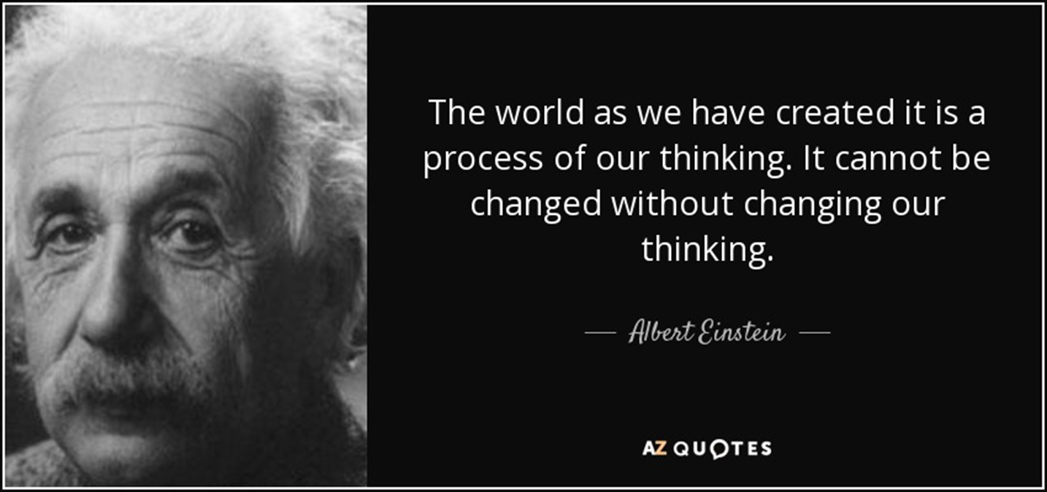
The Challenge: Evolving the Transportation System into the Future

Slide 3
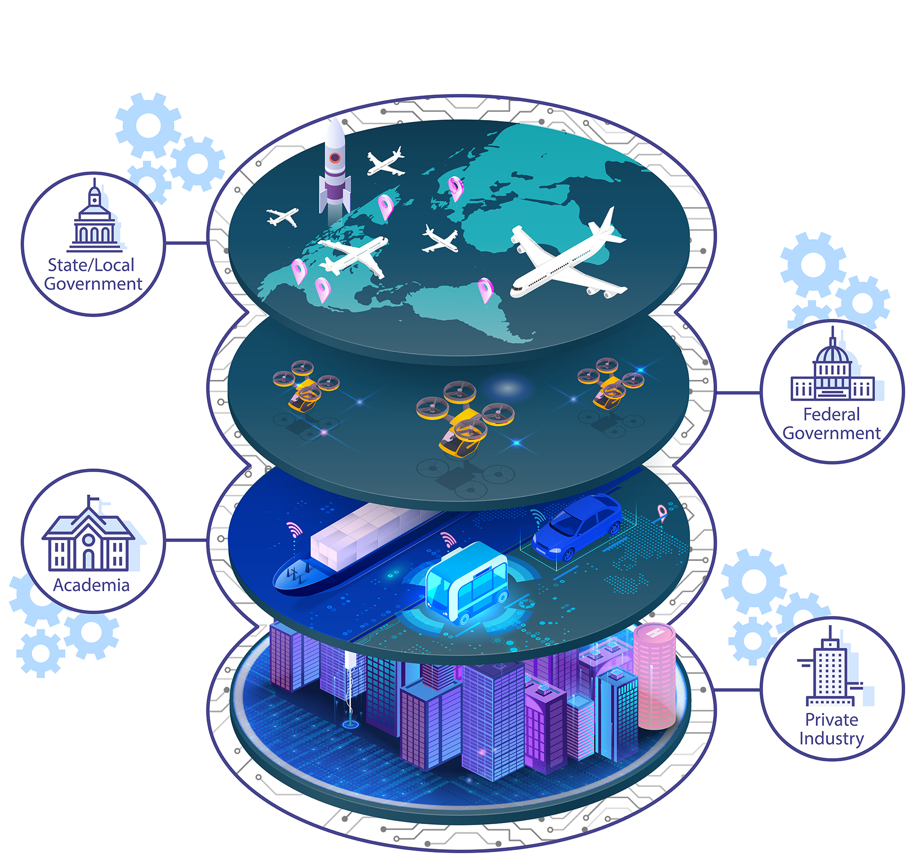
Spearheading cross-sector and multimodal collaboration to advance the safe and responsible integration of automation across the transportation ecosystem
Fulfilling the Need for a Coordinated Approach
HASS engages transportation automation safety stakeholders to:
Support a holistic, proactive, and nimble
approach to highly automated systems
Foster dialogue among policymakers, technology experts, and the transportation community
Identify and develop pivotal points of
interoperability and integration over
the long term
Facilitate technical assessment
and validation activities

Slide 4
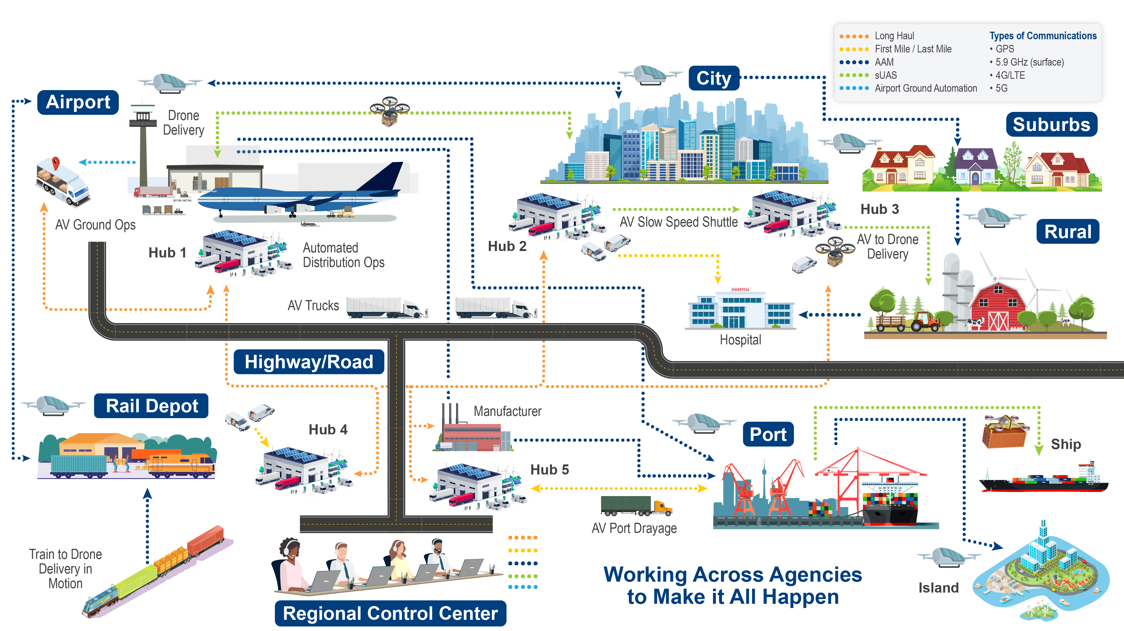
Seeing the Whole Picture
Creating the Transportation System of the Future

Slide 5


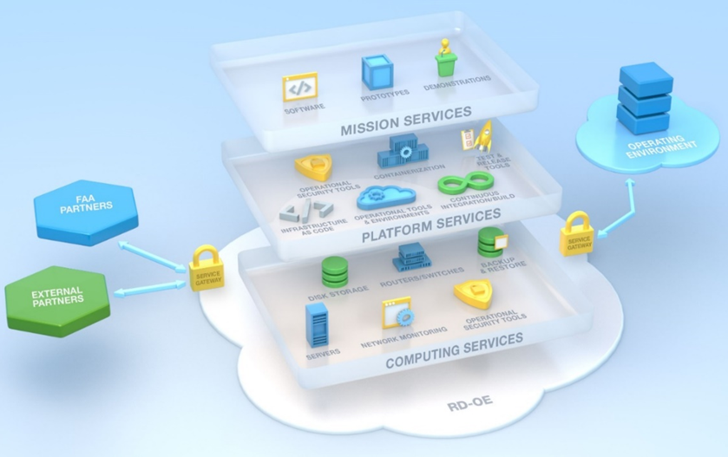
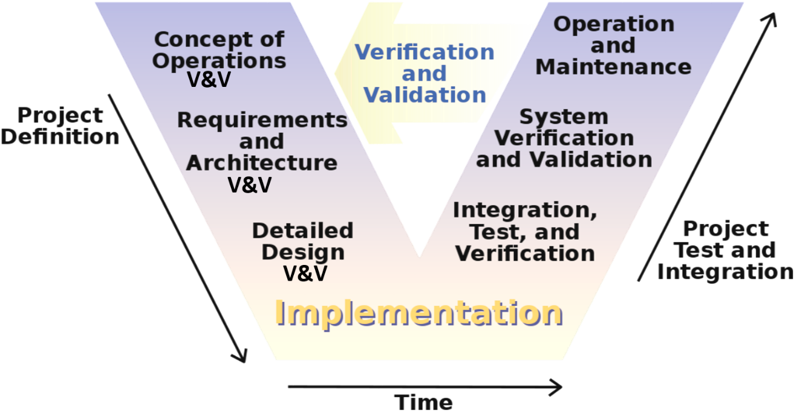
Systematic V&V is Critical to the Implementation of Complex Concepts

Slide 6


Slide 7
V&V Summit Forum 2024
Operationalizing Advanced Concepts:
Making it Happen

