Slide 1

17th Annual V&V Summit
Opening Remarks
Enabling Dynamic
Innovation with Rigor
John Frederick, Manager
V&V Strategies and Practices Branch (ANG-E5A)
September 21-22, 2022

Slide 2

V&V Summit Agenda — Day 1

Slide 3
V&V Summit Agenda — Day 2

Slide 4
17th Annual Verification & Validation Summit Information
Visit the V&V Summit Website for 2022:
  Agenda and Speaker Biographies
  Presentations — Available after the V&V Summit
  Summit Feedback
  https://www.faa.gov/about/office_org/headquarters_offices/ang/library/events/v_vsummits/
Q&A: Live for in-person and in Zoom Q&A area for online participants during the Summit
Chat area (read only) — Used for communications from the host or speakers
Interactive polling — Participants may use their mobile devices or Chrome browser; instructions when the activity begins
eLMS training credit available for FAA Federal Employees (faa.gov email) — Must attend both days
Google Chrome is the preferred browser

Slide 5

Agility Driver: Speed of Technology & Velocity of Obsolescence
Computer processing speed doubles approximately every 18 months
(Source: Moore’s Law)
The largest transistor count in a commercially available microprocessor in 2022 is 114 billion transistors
  In 2017, about 10 billion
  In 1971, it was under 10,000
Digital innovation spurred by COVID-19 has put AI and analytics at the center of business operations (Source: Harvard Business Review)
97% of enterprises reported: Having mature processes to deploy and operationalize machine learning at speed and scale is essential to success (Source: Forrester Research)

Slide 6
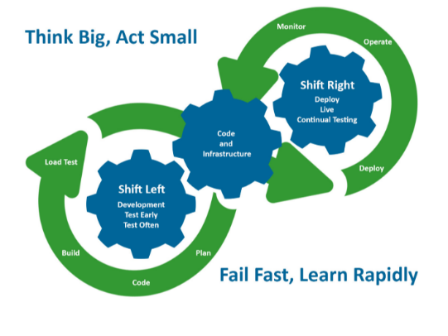
Combining Agile & Shift-Left Principles

Slide 7
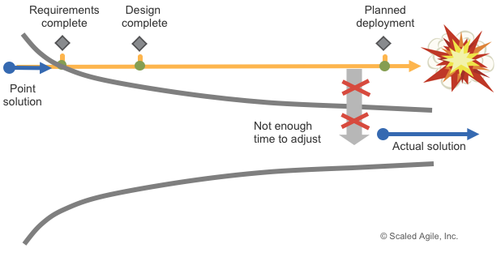
Agile Acquisition — Stay on Target and on Time

Slide 8
Putting the Squeeze on the Cone of Uncertainty

Slide 9
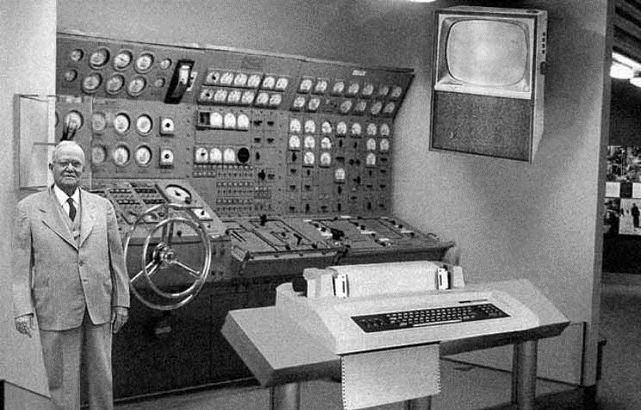
Knowledge-based Innovation
All the necessary knowledge was available by 1918, but the first operational digital computer did not appear until 1946
Convergence among different kinds of knowledge is essential
Innovation is both conceptual and perceptual
Would-be innovators must also go out and look, ask, and listen (Source: Harvard Business Review)
V&V Summits are all about knowledge convergence with a focus on new concepts and improved perceptions

